Slide 1
Monday, January 9, 2023
CS 107
Lecture 1: Welcome
#include<stdio.h>
#include<stdlib.h>
int main() {
printf("Hello, World!\n");
return 0;
}
(gdb) disassemble main
Dump of assembler code for function main:
0x000000000040052d <+0>: push %rbp
0x000000000040052e <+1>: mov %rsp,%rbp
0x0000000000400531 <+4>: mov $0x4005d4,%edi
0x0000000000400536 <+9>: callq 0x400410 <puts@plt>
0x000000000040053b <+14>: mov $0x0,%eax
0x0000000000400540 <+19>: pop %rbp
0x0000000000400541 <+20>: retq
End of assembler dump.
(gdb)
Computer Systems
Winter 2023
Stanford University
Computer Science Department
Lecturer: Chris Gregg
Reading: Course reader: Introduction, Number Formats used in CS 107, Bits and Bytes

Slide 2
Today's Topics
What is CS107?
Who We Are
Course Components and Overview
The C Language
Logistics
  Exams
  Labs
  Assignment 0
  Lab Signup
Bits and Bytes
0b10100 Questions

Slide 3
What is CS107?
▪ The CS106 series teaches you how to solve problems as a programmer
▪ Many times CS106 instructors had to say “just don’t worry about that” or “it probably doesn’t make sense why that happens, but ignore it for now” or “just type this to fix it”
▪ CS107 finally takes you behind the scenes ▪ How do things really work in there?
› It’s not quite down to hardware or physics/electromagnetism (those will have to stay even further behind the scenes for now!)
› It’s how things work inside Python/C++ (we will explore from C), and how your programs map onto the components of computer systems

Slide 4
CS107 Learning Goals
▪ The goals for CS107 are for students to gain mastery of
› writing C programs with complex use of memory and pointers
› an accurate model of the address space and compile/runtime behavior of C programs
▪ to achieve competence in
› translating C to/from assembly
› writing programs that respect the limitations of computer arithmetic
› identifying bottlenecks and improving runtime performance
› writing code that correctly ports to other architectures
› working effectively in UNIX development environment
▪ and have exposure to
    › a working understanding of the basics of computer architecture

Slide 5

Who We Are: Chris
Chris Gregg
cgregg@stanford.edu

Slide 6

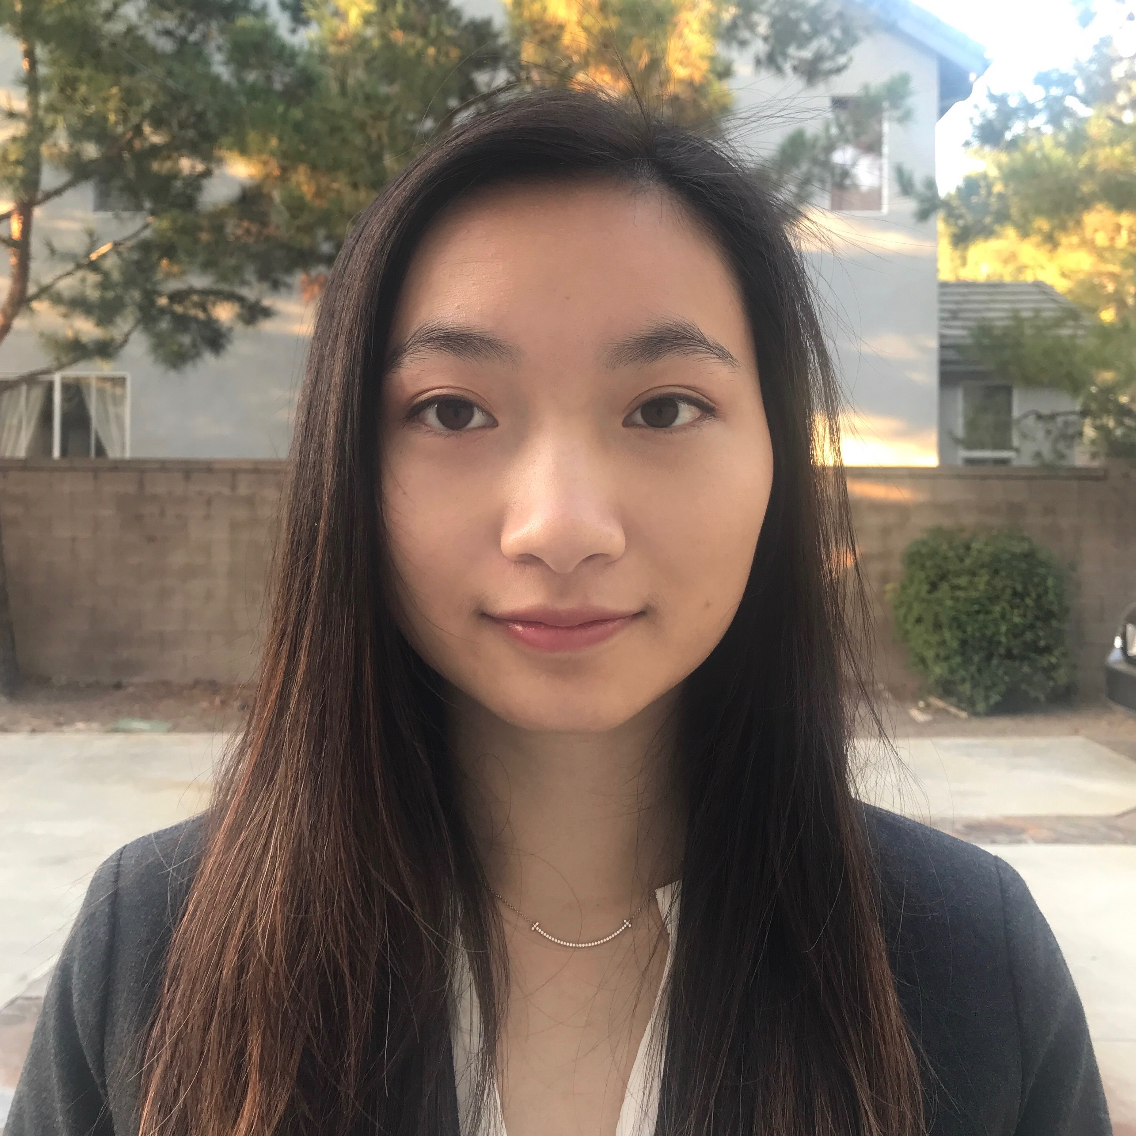
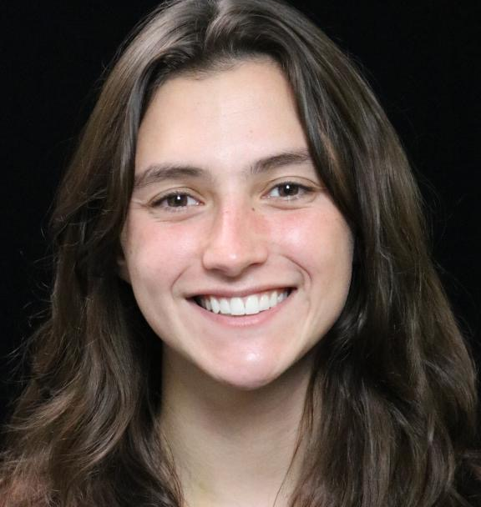



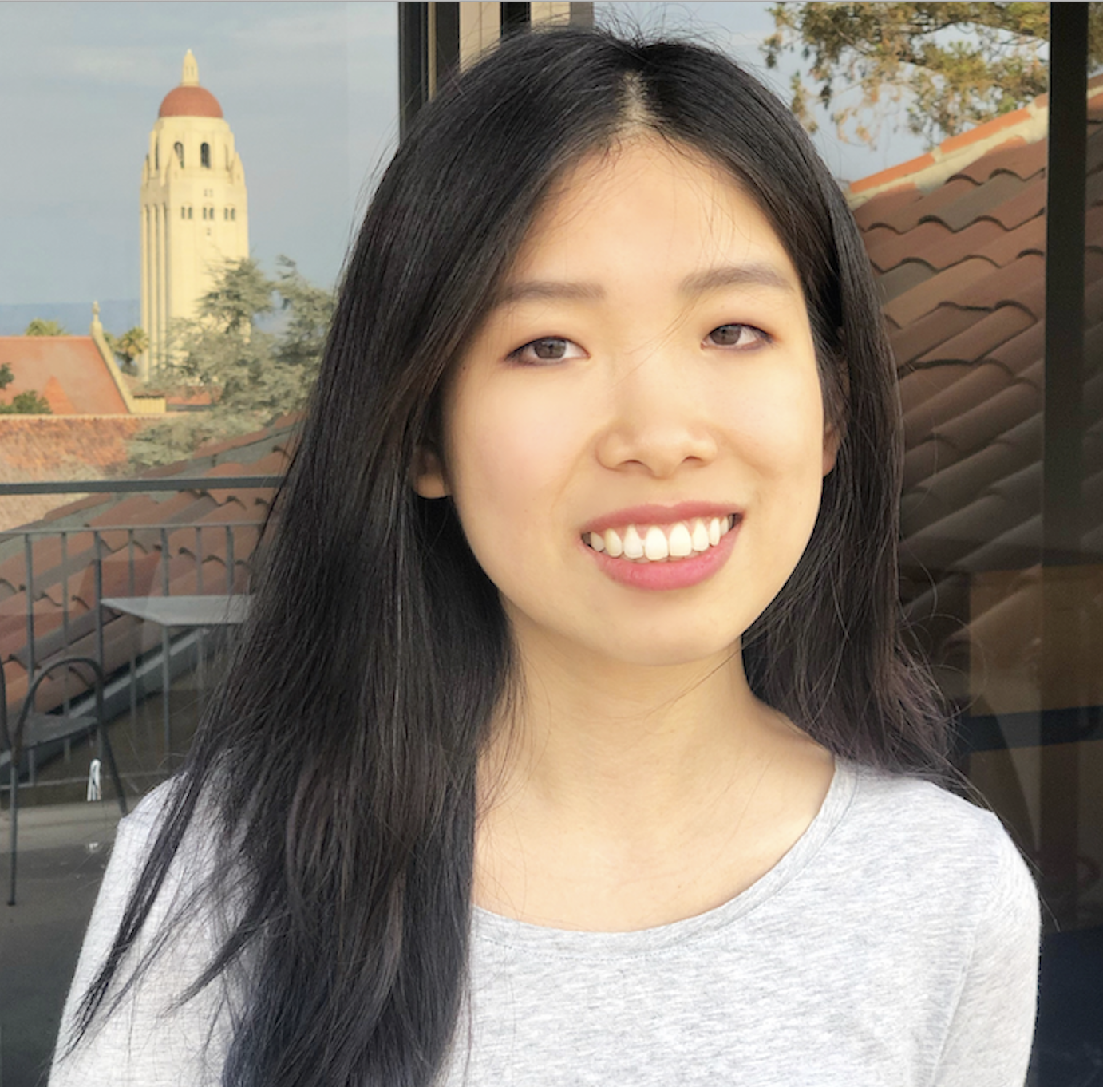




Who We Are: CAs
Daniel Rebelsky
Christine Cheng
Eva Betelaan
Alex Bradfield
Megan Worrel
Frankie Cerkvenik
(CS107A)
Tori Qiu
Jerry Chen
Aman Kansal
Derek Chung
Jagriti Dixit

Slide 7
Course Components and Overview
Textbook: Bryant and O’Hallaron, 3rd Edition
You must get the 3rd Edition, as things have significantly changed since the previous editions.
▪ The suggested C reference is just one suggestion
› You could do just as well with a different C book
› You could do just as well with Google or websites like http://www.cplusplus.com/reference/clibrary/
› Just need somewhere to turn when you have a question about C

Slide 8

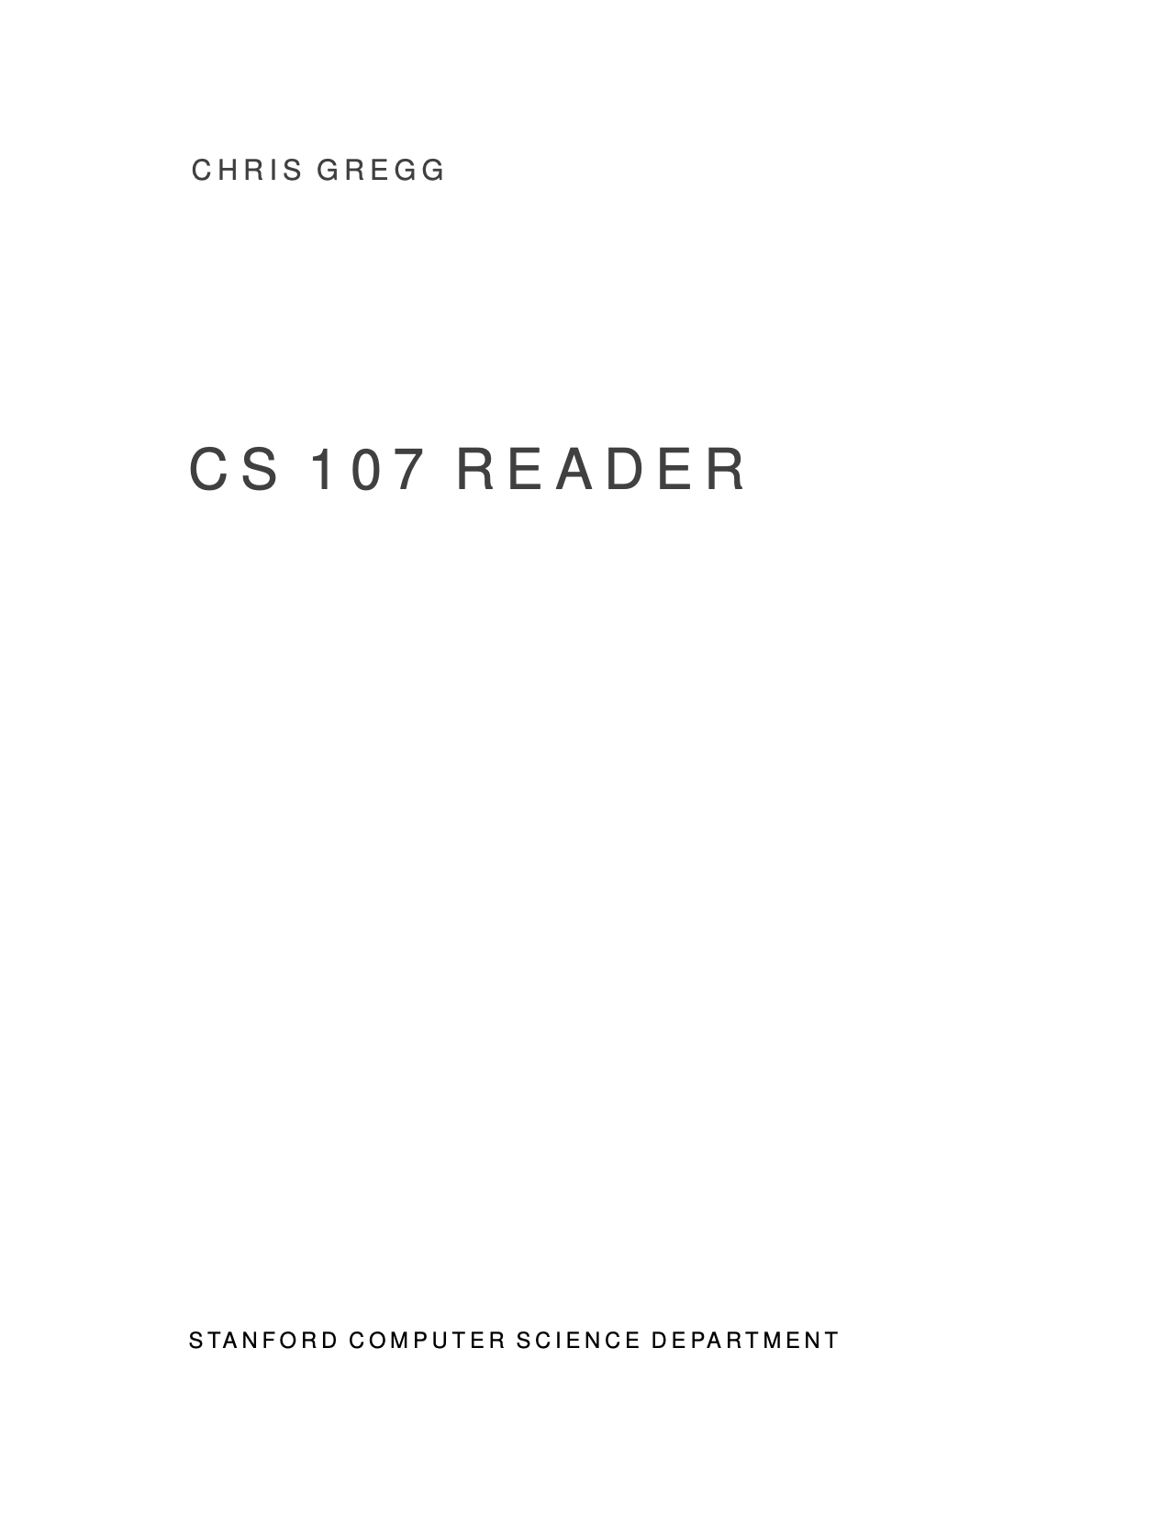
Course Components and Overview
There is a course reader, which condenses much of the material for the course:
https://stanford.edu/~cgregg/cgi-bin/107-reader
If you find typos, let me know!

Slide 9
Course Components and Overview
Week | Topics
1 | Admin, UNIX environment, Integer representation
2 | Bits/bitwise ops, computer arithmetic, C pointers/arrays
3 | C-strings, C stdlib, dynamic allocation
4 | C generics, void *, function pointers
5 | Floating point representation, intro to assembly
6 | x86-64: addressing, ALU ops Midterm: Wed Feb 15th, Evening
7 | x86-64: control, function calls, runtime stack
8 | Address space, dynamic memory management
9 | Performance / Optimization
10 | Advanced topics, wrap/review
11 | Final: Friday Mar 24th 8:30AM-11:30AM

Slide 10
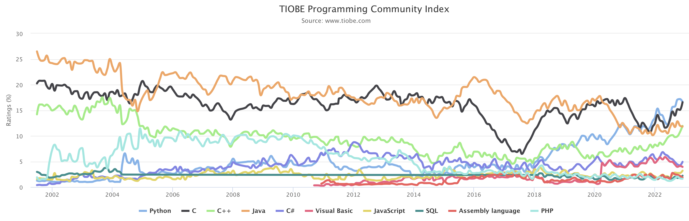
The C Language

Slide 11
The C Language: History and Background
▪ Birthdate around 1970
▪ Created to make writing Unix (the OS itself) and tools for Unix easier
▪ Part of the C/C++/Java family of languages
        › (with C++ and Java coming later)
▪ Design principles:
        › Small,simple abstractions of hardware
        › Minimalist aesthetic
        › C is much more concerned with efficiency and minimalism than safety (Java/Python) or convenient high-level services and abstractions (Java, Python, C++)

Slide 12
The C Language: Comparison of C and C++
▪ Some things will be very familiar:
  › Syntax
      › Basic data types
  › Arithmetic, relational, and logical operators
▪ You may be sad about what’s missing:
  › No power features of C++ (overloading operators, default arguments, pass by reference, classes/objects, fancy ADTs)
  › Thin standard libraries (no graphics, networking, etc)
  › Weak compiler checks, almost no runtime checks
▪ Benefits:
      › Small language footprint (not much to learn)
▪ Philosophical difference:
  › Procedural (C)
  › Procedural + Objects (C++)

Slide 13
The C Language: Hello, World! Compiling, gdb
Also: command line arguments and boolean values

Slide 14
Logistics
See the Course Handout for details (link)
Web site: https://cs107.stanford.edu
Class time: 11:30AM-1PM, M/F, Online (first two weeks), Bishop Auditorium (weeks 3-10, hopefully)
Labs: Various Times Tu/We/Th
Exams: Midterm, Wednesday, February 15th, Time TBD (evening)
  Final Exam: Friday, March 24th, 8:30am-11:30am
(Note: there are no alternate final exam times)

Slide 15
Assignment 0: Unix!
Assignment page: https://web.stanford.edu/class/cs107/assign0/
Six parts:
Read / View Unix Overview Documents / Videos
"Clone" Assignment 0 starter code
Answer Questions in readme.txt
Honor Code Quiz
Run make to compile a program, and make minor modifications
Submit the assignment
Assignment already released, due Monday, 1/16

Slide 16
Lab Signup
Online:
https://cs107.stanford.edu/labs
The signup will be available Tuesday, January 10, 10:00am.
Labs will be weekly, starting during week 2.
Lab signup will not be first-come, first-served (you'll put in preferences), and the labs are held on Wednesdays, Thursdays

Slide 17
Bits and Bytes Introduction
0

Slide 18
Bits and Bytes Introduction
1

Slide 19
Computers are good at detecting "off" or "on"
We have lots of ways to tell the difference between two different states:
Clockwise / Counterclockwise
Lightbulb off / on
Punchcard hole / no hole

Slide 20
Computers are good at detecting "off" or "on"
Electronic computers are built using transistors
A transistor can be set up to either be "off" or "on" -- this gives us our 0 and 1!

Slide 21
One bit doesn't do much for us!
We call a single on/off representation a 'bit'.
But having one bit isn't particularly helpful!
We only have two states we can represent with one bit!
If we want more states, we simply combine bits together, much like we do with base 10 representation.
If we want to combine more than ten states with base 10, we add another digit.
Base 10 has ten digits: 0 1 2 3 4 5 6 7 8 9
We can represent up to ten numbers with one digit in base 10
If we want to represent more numbers, we add more digits: 10 11 12 13 14 ...
Base 2 is the same. We can represent two numbers with one digit: 0 or 1
To represent more numbers, we add more digits! 10 11 100 101 110 ...

Slide 22
Combinations of bits can represent everything
We can encode anything we want with bits. E.g., the ASCII character set.

Slide 23
CS107: Three Number Representations
Unsigned Integers: positive integers and zero only
Ex. 0, 1, 2, ..., 74629, 99999999
Signed Integers: negative, positive, and zero integers only
Ex. 0, 1, 2, ..., 74629, 99999999
(represented in "two's complement")
Floating Point Numbers: a base-2 representation of scientific notation, for real numbers
Ex. 0.0, 0.1, -12.2, 4.87563 x 10³, -1.00005 x 10⁻¹²

Slide 24
Computers use a limited number of bits for numbers
Let's write a little program...

Slide 25
Computers use a limited number of bits for numbers
#include<stdio.h>
#include<stdlib.h>
int main() {
int a = 200;
int b = 300;
int c = 400;
int d = 500;
int answer = a * b * c * d;
printf("%d\n",answer);
return 0;
}
$ gcc -g -O0 mult-test.c -o mult-test
$ ./mult-test
-884901888
$

Slide 26
Computers use a limited number of bits for numbers
#include<stdio.h>
#include<stdlib.h>
int main() {
int a = 200;
int b = 300;
int c = 400;
int d = 500;
int answer = a * b * c * d;
printf("%d\n",answer);
return 0;
}
Recall that in base 10, you can represent: 10 numbers with one digit (0 - 9),
100 numbers with two digits (00 - 99),
1000 numbers with three digits (000 - 999)
I.e., with n digits, you can represent up to 10^{n} numbers.
In base 2, you can represent:
2 numbers with one digit (0 - 1)
4 numbers with two digits (00 - 11)
8 numbers with three digits (000 - 111)
I.e., with n digits, you can represent up to 2^{n} numbers
The C int type is a "32-bit" number, meaning it uses 32 digits. That means we can represent up to 2³² numbers.

Slide 27
Computers use a limited number of bits for numbers
#include<stdio.h>
#include<stdlib.h>
int main() {
int a = 200;
int b = 300;
int c = 400;
int d = 500;
int answer = a * b * c * d;
printf("%d\n",answer);
return 0;
}
2³² = 4,294,967,296
200 * 300 * 400 * 500 = 12,000,000,000
Turns out it is worse -- ints are signed, meaning that the largest positive number is
(2³² / 2) - 1 =
2³¹ - 1 = 2,147,483,647
$ gcc -g -O0 mult-test.c -o mult-test
$ ./mult-test
-884901888
$

Slide 28
Computers use a limited number of bits for numbers
#include<stdio.h>
#include<stdlib.h>
int main() {
int a = 200;
int b = 300;
int c = 400;
int d = 500;
int answer = a * b * c * d;
printf("%d\n",answer);
return 0;
}
The good news: all of the following produce the same (wrong) answer:
(500 * 400) * (300 * 200)
((500 * 400) * 300) * 200
((200 * 500) * 300) * 400
400 * (200 * (300 * 500))
$ gcc -g -O0 mult-test.c -o mult-test
$ ./mult-test
-884901888
$

Slide 29
Let's look at a different program
#include<stdio.h>
#include<stdlib.h>
int main() {
float a = 3.14;
float b = 1e20;
printf("(3.14 + 1e20) - 1e20 = %f\n", (a + b) - b);
printf("3.14 + (1e20 - 1e20) = %f\n", a + (b - b));
return 0;
}
$ gcc -g -Og -std=gnu99 float-mult-test.c -o float-mult-test
$ ./float-mult-test.c
(3.14 + 1e20) - 1e20 = 0.000000
3.14 + (1e20 - 1e20) = 3.140000
$
bigger problem!

Slide 30
Let's look at a different program
$ gcc -g -O0 mult-test.c -o mult-test
$ ./mult-test
-884901888
$
Both C and C++ have specific representations of numbers that allow for these kinds of bugs.
$ gcc -g -Og -std=gnu99 float-mult-test.c -o float-mult-test
$ ./float-mult-test.c
(3.14 + 1e20) - 1e20 = 0.000000
3.14 + (1e20 - 1e20) = 3.140000
$

Slide 31
Information Storage

Slide 32
Information Storage
In C, everything can be thought of as a block of 8 bits

Slide 33
Information Storage
In C, everything can be thought of as a block of 8 bits
called a "byte"

Slide 34
Information Storage
We will discuss manipulating bytes on a bit-by-bit level, but we won't be able to consider an individual bit on its own.
In a computer, the memory system is simply a large array of bytes (sound familiar, from CS106B?)
values (ints):
address (decimal):
address (hex):
7 | 2 | 8 | 3 | 14 | 99 | -6 | 3 | 45 | 11
200d | 204d | 208d | 212d | 216d | 220d | 224d | 228d | 232d | 236d
0xc8 | 0xcc | 0xd0 | 0xd4 | 0xd8 | 0xdc | 0xe0 | 0xe4 | 0xe8 | 0xec
Each address (a pointer!) represents the next byte in memory.
E.g., address 0 is a byte, then address 1 is the next full byte, etc.
Again: you can't address a bit. You must address at the byte level.

Slide 35
Byte Range
Because a byte is made up of 8 bits, we can represent the range of a byte as follows:
00000000 to 11111111
This range is 0 to 255 in decimal.
But, neither binary nor decimal is particularly convenient to write out bytes (binary is too long, and decimal isn't numerically friendly for byte representation)
So, we use "hexadecimal," (base 16).

Slide 36
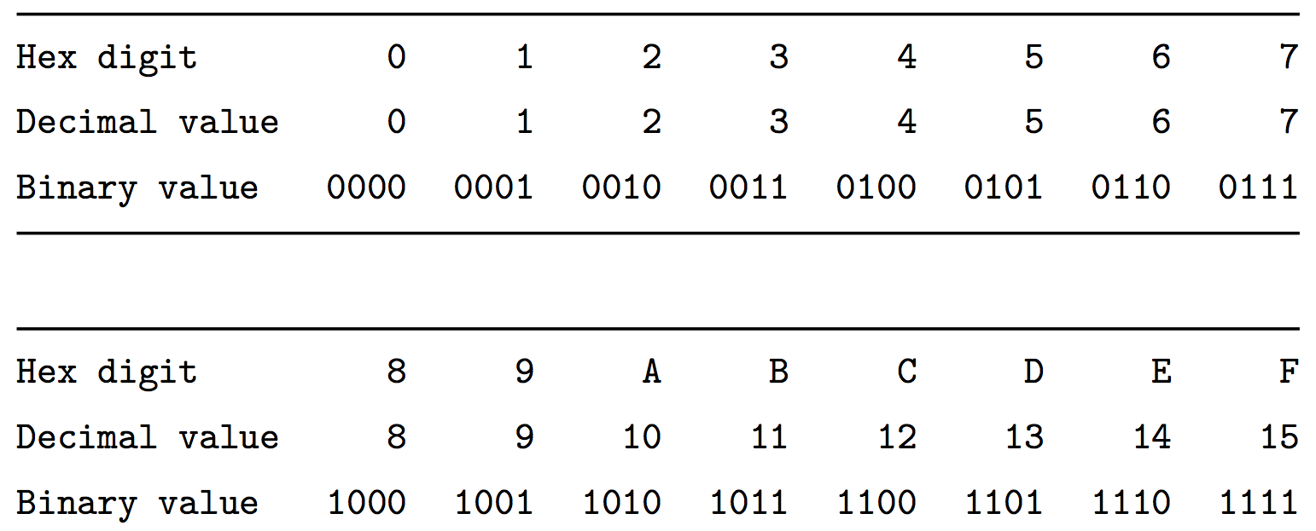
Hexadecimal
Hexadecimal has 16 digits, so we augment our normal 0-9 digits with six more digits: A, B, C, D, E, and F.
Figure 2.2 in the textbook shows the hex digits and their binary and decimal values:

Slide 37
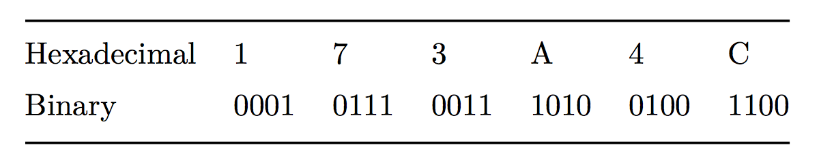
Hexadecimal
In C, we write a hexadecimal with a starting 0x. So, you will see numbers such as 0xfa1d37b, which means that it is a hex number.
You should memorize the binary representations for each hex digit. One trick is to memorize A (1010), C (1100), and F (1111), and the others are easy to figure out.
Let's practice some hex to binary and binary to hex conversions:
Convert: 0x173A4C to binary.
0x173A4C is binary
0b000101110011101001001100

Slide 38
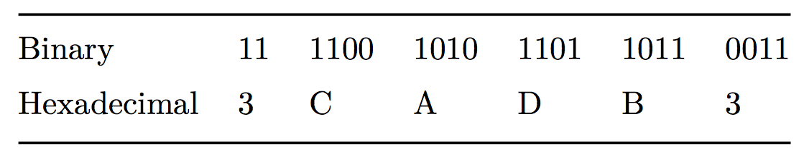
Hexadecimal
Convert: 0b1111001010110110110011 to hexadecimal.
(start from the right)
0b1111001010110110110011
is hexadecimal 3CADB3

Slide 39
Hexadecimal
Convert: 0b1111001010110110110011 to hexadecimal.
(start from the right)
0b1111001010110110110011
is hexadecimal 3CADB3

Slide 40
Hexadecimal
Convert: 0b1111001010110110110011 to hexadecimal.
(start from the right)
0b1111001010110110110011
is hexadecimal 3CADB3

Slide 41
Hexadecimal
Convert: 0b1111001010110110110011 to hexadecimal.
(start from the right)
0b1111001010110110110011
is hexadecimal 3CADB3

Slide 42
Hexadecimal
Convert: 0b1111001010110110110011 to hexadecimal.
(start from the right)
0b1111001010110110110011
is hexadecimal 3CADB3

Slide 43
Hexadecimal
Convert: 0b1111001010110110110011 to hexadecimal.
(start from the right)
0b1111001010110110110011
is hexadecimal 3CADB3

Slide 44
Hexadecimal
Convert: 0b1111001010110110110011 to hexadecimal.
(start from the right)
0b1111001010110110110011
is hexadecimal 3CADB3

Slide 45
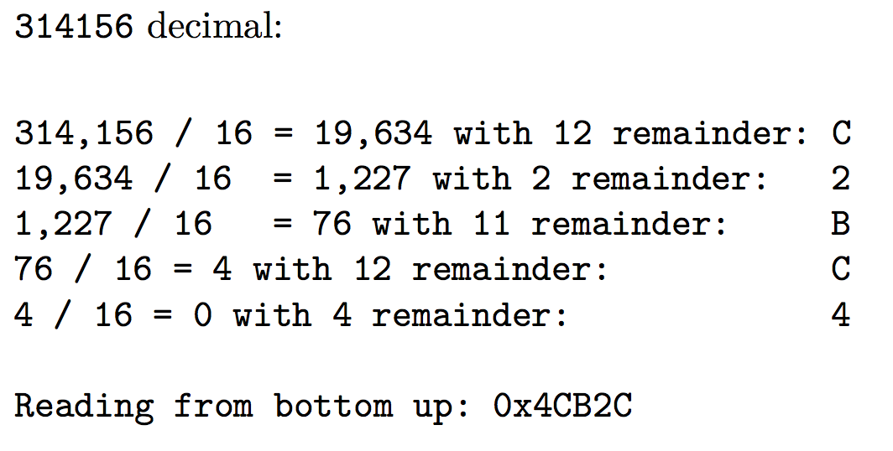
Decimal to Hexadecimal
To convert from decimal to hexadecimal, you need to repeatedly divide
the number in question by 16, and the remainders make up the digits of
the hex number:

Slide 46
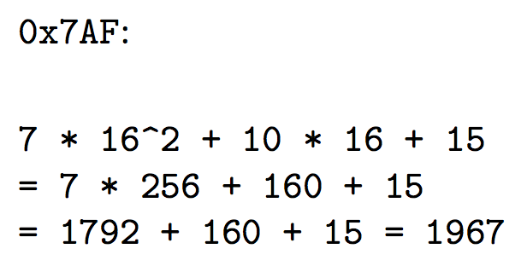
Hexidecimal to Decimal
To convert from hexadecimal to decimal, multiply each of the hexadecimal
digits by the appropriate power of 16:

Slide 47
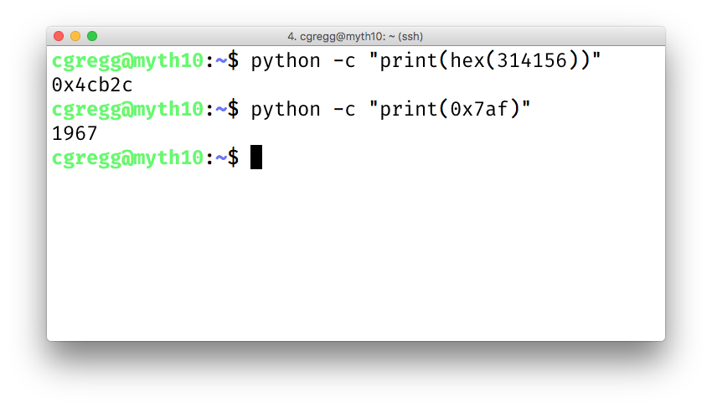
Let the computer do it!
Honestly, hex to decimal and vice versa are easy to let the computer handle. You can either use a search engine (Google does this automatically), or you can use a python one-liner:

Slide 48
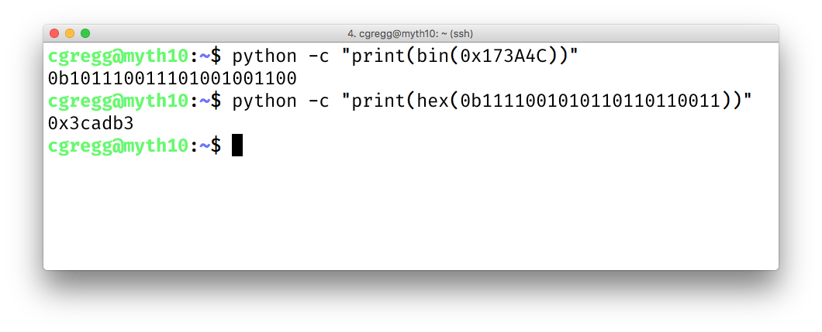
Let the computer do it!
You can also use Python to convert to and from binary:
(but you should memorize this as it is easy and you will use it frequently)

Slide 49
20 Questions for Chris
In the last few minutes of class, you get to ask me 20 questions
The questions can be about the class, about me, about computing, about philosophy, etc.
I do reserve the right to not answer something too personal. :)
Code:

Slide 50
References and Advanced Reading
References:
  Tiobe Programming Index: https://www.tiobe.com/tiobe-index/
  The C Language: https://en.wikipedia.org/wiki/C_(programming_language)
  Kernighan and Ritchie (K&R) C: https://www.youtube.com/watch?v=de2Hsvxaf8M
  C Standard Library: http://www.cplusplus.com/reference/clibrary/
Advanced Reading:
  After All These Years, the World is Still Powered by C Programming
  Is C Still Relevant in the 21st Century?
  Why Every Programmer Should Learn C

