Slide 1
Friday, January 13, 2023
CS 107
Lecture 2: Integer Representations and Bits / Bytes
Computer Systems
Winter 2023
Stanford University
Computer Science Department
Reading: Reader: Bits and Bytes, Textbook: Chapter 2.2
Lecturer: Chris Gregg

Slide 2
Today's Topics
Logistics
  Assign0 — Due Monday
  Labs start Wednesday
  Office hours in full coverage
Reading: Reader: Bits and Bytes, Textbook: Chapter 2.2 (very mathy…)
Integer Representations
  Unsigned numbers
  Signed numbers
    two's complement
  Signed vs Unsigned numbers
  Casting in C
  Signed and unsigned comparisons
  The sizeof operator
  Min and Max integer values
  Truncating integers
  two's complement overflow

Slide 3
Today's Topics
More on extending the bit representation of numbers
Truncating numbers
Data Sizes
Addressing and Byte Ordering
Boolean Algebra

Slide 4
Integer Representations

Slide 5
Integer Representations
The C language has two different ways to represent numbers, unsigned and signed:
unsigned: can only represent non-negative numbers
signed: can represent negative, zero, and positive numbers
We are going to talk about these representations, and also about what happens when we expand or shrink an encoded integer to fit into a different type (e.g., int to long)

Slide 6
Unsigned Integers
For positive (unsigned) integers, there is a 1-to-1 relationship between the decimal representation of a number and its binary representation. If you have a 4-bit number, there are 16 possible combinations, and the unsigned numbers go from 0 to 15:
0b0000 = 0 0b0001 = 1 0b0010 = 2 0b0011 = 3
0b0100 = 4 0b0101 = 5 0b0110 = 6 0b0111 = 7
0b1000 = 8 0b1001 = 9 0b1010 = 10 0b1011 = 11
0b1100 = 12 0b1101 = 13 0b1110 = 14 0b1111 = 15
The range of an unsigned number is 0 → 2^{w} - 1, where w is the number of bits in our integer. For example, a 32-bit int can represent numbers from 0 to 2³² - 1, or 0 to 4,294,967,295.

Slide 7
Signed Integers: How do we represent them?
What if we want to represent negative numbers? We have choices!
One way we could encode a negative number is simply to designate some bit as a "sign" bit, and then interpret the rest of the number as a regular binary number and then apply the sign. For instance, for a four-bit number:
0 001 = 1
0 010 = 2
0 011 = 3
0 100 = 4
0 101 = 5
0 110 = 6
0 111 = 7
1 001 = -1
1 010 = -2
1 011 = -3
1 100 = -4
1 101 = -5
1 110 = -6
1 111 = -7
This might be okay...but we've only represented 14 of our 16 available numbers...

Slide 8
Signed Integers: How do we represent them?
What about 0 000 and 1 000? What should they represent?
Well...this is a bit tricky!
0 001 = 1
0 010 = 2
0 011 = 3
0 100 = 4
0 101 = 5
0 110 = 6
0 111 = 7
1 001 = -1
1 010 = -2
1 011 = -3
1 100 = -4
1 101 = -5
1 110 = -6
1 111 = -7

Slide 9
Signed Integers: How do we represent them?
What about 0 000 and 1 000? What should they represent?
Well...this is a bit tricky!
0 001 = 1
0 010 = 2
0 011 = 3
0 100 = 4
0 101 = 5
0 110 = 6
0 111 = 7
1 001 = -1
1 010 = -2
1 011 = -3
1 100 = -4
1 101 = -5
1 110 = -6
1 111 = -7
Let's look at the bit patterns:
0 000 1 000
Should we make the 0 000 just represent decimal 0? What about 1 000? We could make it 0 as well, or maybe -8, or maybe even 8, but none of the choices are nice.

Slide 10
Signed Integers: How do we represent them?
What about 0 000 and 1 000? What should they represent?
Well...this is a bit tricky!
0 001 = 1
0 010 = 2
0 011 = 3
0 100 = 4
0 101 = 5
0 110 = 6
0 111 = 7
1 001 = -1
1 010 = -2
1 011 = -3
1 100 = -4
1 101 = -5
1 110 = -6
1 111 = -7
Let's look at the bit patterns:
0 000 1 000
Should we make the 0 000 just represent decimal 0? What about 1 000? We could make it 0 as well, or maybe -8, or maybe even 8, but none of the choices are nice.
Fine. Let's just make 0 000 to be equal to decimal 0. How does arithmetic work?
Well…to add two numbers, you need to know the sign, then you might have to subtract (borrow and carry, etc.), and the sign might change…this is going to get ugly!

Slide 11
Signed Integers: How do we represent them?
There is a better way!

Slide 12
Signed Integers: How do we represent them?
Behold: the "two's complement" circle:
In the early days of computing*, two's complement was determined to be an excellent way to store binary numbers.
In two's complement notation, positive numbers are represented as themselves (phew), and negative numbers are represented as the two's complement of themselves (definition to follow).
This leads to some amazing arithmetic properties!
*John von Neumann suggested it in 1945, for the EDVAC computer.

Slide 13
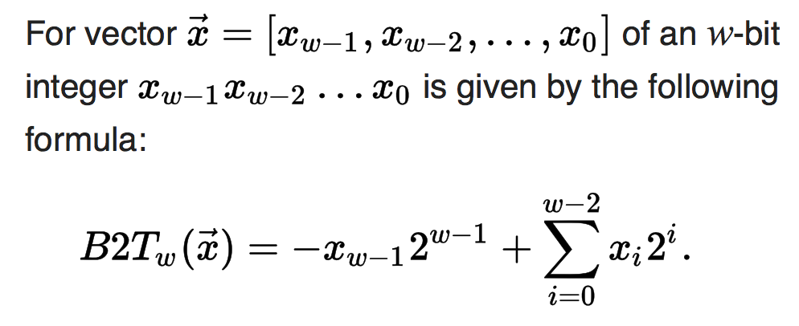
Two's Complement
A two's-complement number system encodes positive and negative numbers in a binary number representation. The weight of each bit is a power of two, except for the most significant bit, whose weight is the negative of the corresponding power of two.
Definition:
B2Tw means "Binary to Two's complement function"
In practice, a negative number in two's complement is obtained by inverting all the bits of its positive counterpart*, and then adding 1.
*Inverting all the bits of a number is its "one's complement"

Slide 14
Two's Complement
In practice, a negative number in two's complement is obtained by inverting all the bits of its positive counterpart*, and then adding 1, or: x = ~x + 1
Example: The number 2 is represented as normal in binary: 0010
-2 is represented by inverting the bits, and adding 1:
0010 ☞ 1101
1101
+ 1
1110
*Inverting all the bits of a number is its "one's complement"

Slide 15
Two's Complement
Trick: to convert a positive number to its negative in two's complement, start from the right of the number, and write down all the digits until you get to a 1. Then invert the rest of the digits:
Example: The number 2 is represented as normal in binary: 0010
Going from the right, write down numbers until you get to a 1:
10
Then invert the rest of the digits:
1110
*Inverting all the bits of a number is its "one's complement"

Slide 16
Two's Complement
To convert a negative number to a positive number, perform the same steps!
Example: The number -5 is represented in two's complements as: 1011
5 is represented by inverting the bits, and adding 1:
1011 ☞ 0100
0100
+ 1
0101
Shortcut: start from the right, and write down numbers until you get to a 1:
1
Now invert all the rest of the digits:
0101

Slide 17
Two's Complement: Neat Properties
There are a number of useful properties associated with two's complement numbers:
There is only one zero (yay!)
The highest order bit (left-most) is 1 for negative, 0 for positive (so it is easy to tell if a number is negative)
Adding two numbers is just…adding!
Example:
2 + -5 = -3
0010 ☞ 2
+1011 ☞ -5
1101 ☞ -3 decimal (wow!)

Slide 18
Two's Complement: Neat Properties
More useful properties:
Subtracting two numbers is simply performing the two's complement on one of them and then adding.
Example:
4 - 5 = -1
0100 ☞ 4, 0101 ☞ 5
Find the two's complement of 5: 1011
add:
0100 ☞ 4
+1011 ☞ -5
1111 ☞ -1 decimal

Slide 19
Two's Complement: Neat Properties
More useful properties:
Multiplication of two's complement works just by multiplying (throw away overflow digits).
Example: -2 * -3 = 6
1110 ☞ -2
x1101 ☞ -3
1110
0000
1110
+1110
10110110 ☞ 6

Slide 20
Two's Complement: Powers of two remain!
From the definition of a two's complement number, we can see that we are still dealing with bits being equal to their powers-of-two place: there isn't anything magical about the placement of the bits:
-5 = 1 0 1 1
(1 * -2³) + (0 * 2²) + (1 * 2¹) + (1 * 2⁰)

Slide 21
Practice
Convert the following 4-bit numbers from positive to negative, or from negative to positive using two's complement notation:
-4 (1100) ☞
7 (0111) ☞
3 (0011) ☞
-8 (1000) ☞

Slide 22
Practice
Convert the following 4-bit numbers from positive to negative, or from negative to positive using two's complement notation:
-4 (1100) ☞
7 (0111) ☞
3 (0011) ☞
-8 (1000) ☞
0100
1001
1101
1000 (?! If you look at the chart, +8 cannot be represented in two's complement with 4 bits!)

Slide 23
Practice
Convert the following 8-bit numbers from positive to negative, or from negative to positive using two's complement notation:
-4 (11111100) ☞
27 (00011011) ☞
-127 (10000001) ☞
1 (00000001) ☞
00000100
11100101
01111111
11111111

Slide 24
Casting Between Signed and Unsigned
Converting between two numbers in C can happen explicitly (using a parenthesized cast), or implicitly (without a cast):
explicit
implicit
1 2 3 4 5
int tx, ty;
unsigned ux, uy;
…
tx = (int) ux;
uy = (unsigned) ty;
1 2 3 4 5
int tx, ty;
unsigned ux, uy;
…
tx = ux; // cast to signed
uy = ty; // cast to unsigned
When casting: the underlying bits do not change, so there isn't any conversion going on, except that the variable is treated as the type that it is. You cannot convert a signed number to its unsigned counterpart using a cast!

Slide 25
Casting Between Signed and Unsigned
When casting: the underlying bits do not change, so there isn't any conversion going on, except that the variable is treated as the type that it is. You cannot convert a signed number to its unsigned counterpart using a cast!
1 2 3 4 5
6
7
8
9
10
11
12
// test_cast.c
#include<stdio.h>
#include<stdlib.h>
int main() {
int v = -12345;
unsigned int uv = (unsigned int) v;
printf("v = %d, uv = %u\n",v,uv);
return 0;
}
$ ./test_cast
v = -12345, uv = 4294954951

Slide 26
Casting Between Signed and Unsigned
printf has three 32-bit integer representations:
%d : signed 32-bit int
%u : unsigned 32-bit int
%x : hex 32-bit int
As long as the value is a 32-bit type, printf will treat it according to the formatter it is applying:
1 2 3 4 5
6
7
8
9
10
11
12
int x = -1;
unsigned u = 3000000000; // 3 billion
printf("x = %u = %d\n", x, x);
printf("u = %u = %d\n", u, u);
$ ./test_printf
x = 4294967295 = -1
u = 3000000000 = -1294967296

Slide 27
Signed vs Unsigned Number Wheels

Slide 28
Comparison between signed and unsigned integers
When a C expression has combinations of signed and unsigned variables, you need to be careful!
If an operation is performed that has both a signed and an unsigned value, C implicitly casts the signed argument to unsigned and performs the operation assuming both numbers are non-negative. Let's take a look…
Expression | Type | Evaluation
0 == 0U
-1 < 0
-1 < 0U
2147483647 > -2147483647 - 1
2147483647U > -2147483647 - 1
2147483647 > (int)2147483648U
-1 > -2
(unsigned)-1 > -2

Slide 29
Comparison between signed and unsigned integers
When a C expression has combinations of signed and unsigned variables, you need to be careful!
If an operation is performed that has both a signed and an unsigned value, C implicitly casts the signed argument to unsigned and performs the operation assuming both numbers are non-negative. Let's take a look…
Expression | Type | Evaluation
0 == 0U | Unsigned | 1
-1 < 0 | Signed | 1
-1 < 0U | Unsigned | 0
2147483647 > -2147483647 - 1 | Signed | 1
2147483647U > -2147483647 - 1 | Unsigned | 0
2147483647 > (int)2147483648U | Signed | 1
-1 > -2 | Signed | 1
(unsigned)-1 > -2 | Unsigned | 1
Note: In C, 0 is false and everything else is true. When C produces a boolean value, it allways chooses 1 to represent true.

Slide 30
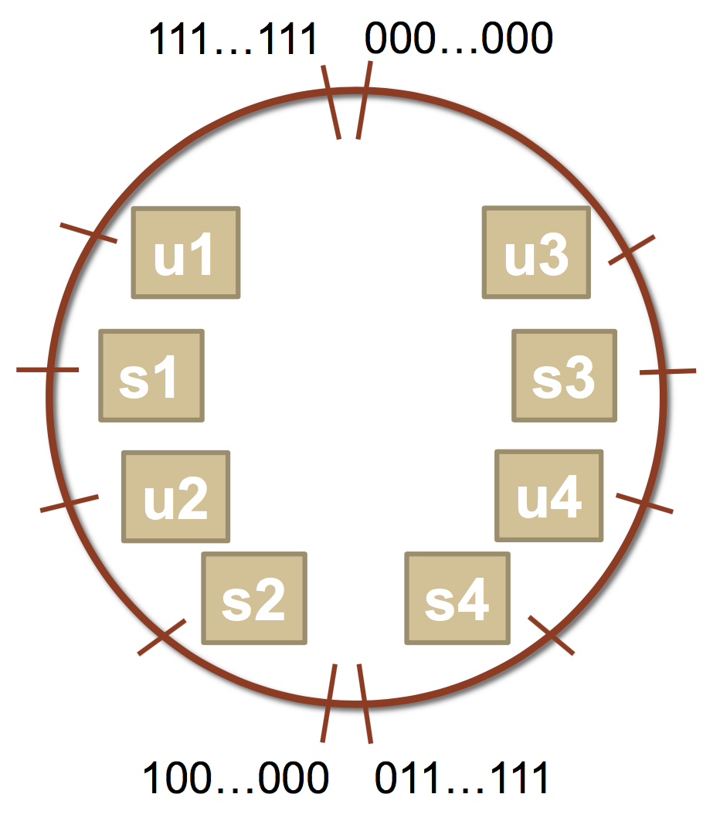
Comparison between signed and unsigned integers
Let's try some more…a bit more abstractly.
int s1, s2, s3, s4;
unsigned int u1, u2, u3, u4;
Which many of the following statements are true? (assume that
variables are set to values that place them in the spots shown)
s3 > u3
u2 > u4
s2 > s4
s1 > s2
u1 > u2
s1 > u3

Slide 31
Comparison between signed and unsigned integers
Let's try some more…a bit more abstractly.
int s1, s2, s3, s4;
unsigned int u1, u2, u3, u4;
Which many of the following statements are true? (assume that
variables are set to values that place them in the spots shown)
s3 > u3 : true
u2 > u4 : true
s2 > s4 : false
s1 > s2 : true
u1 > u2 : true
s1 > u3 : true

Slide 32
The sizeof Operator
As we have seen, integer types are limited by the number of bits they hold. On the 64-bit myth machines, we can use the sizeof operator to find how many bytes each type uses:
int main() {
printf("sizeof(char): %d\n", (int) sizeof(char));
printf("sizeof(short): %d\n", (int) sizeof(short));
printf("sizeof(int): %d\n", (int) sizeof(int));
printf("sizeof(unsigned int): %d\n", (int) sizeof(unsigned int));
printf("sizeof(long): %d\n", (int) sizeof(long));
printf("sizeof(long long): %d\n", (int) sizeof(long long));
printf("sizeof(size_t): %d\n", (int) sizeof(size_t));
printf("sizeof(void *): %d\n", (int) sizeof(void *));
return 0;
}
$ ./sizeof
sizeof(char): 1
sizeof(short): 2
sizeof(int): 4
sizeof(unsigned int): 4
sizeof(long): 8
sizeof(long long): 8
sizeof(size_t): 8
sizeof(void *): 8
Type | Width in bytes | Width in bits
char | 1 | 8
short | 2 | 16
int | 4 | 32
long | 8 | 64
void * | 8 | 64

Slide 33
MIN and MAX values for integers
Because we now know how bit patterns for integers works, we can figure out the maximum and minimum values, designated by INT_MAX, UINT_MAX, INT_MIN, (etc.), which are defined in limits.h
Type | Width (bytes) | Width (bits) | Min in hex (name) | Max in hex (name)
char | 1 | 8 | 80 (CHAR_MIN) | 7F (CHAR_MAX)
unsigned char | 1 | 8 | 0 | FF (UCHAR_MAX)
short | 2 | 16 | 8000 (SHRT_MIN) | 7FFF (SHRT_MAX)
unsigned short | 2 | 16 | 0 | FFFF (USHRT_MAX)
int | 4 | 32 | 80000000 (INT_MIN) | 7FFFFFFF (INT_MAX)
unsigned int | 4 | 32 | 0 | FFFFFFFF (UINT_MAX)
long | 8 | 64 | 8000000000000000 (LONG_MIN) | 7FFFFFFFFFFFFFFF (LONG_MAX)
unsigned long | 8 | 64 | 0 | FFFFFFFFFFFFFFFF (ULONG_MAX)

Slide 34
Expanding the bit representation of a number
Sometimes we want to convert between two integers having different sizes. E.g., a short to an int, or an int to a long.
We might not be able to convert from a bigger data type to a smaller data type, but we do want to always be able to convert from a smaller data type to a bigger data type.
This is easy for unsigned values: simply add leading zeros to the representation (called "zero extension").
unsigned short s = 4;
// short is a 16-bit format, so s = 0000 0000 0000 0100b
unsigned int i = s;
// conversion to 32-bit int, so i = 0000 0000 0000 0000 0000 0000 0000 0100b

Slide 35
Expanding the bit representation of a number
For signed values, we want the number to remain the same, just with more bits. In this case, we perform a "sign extension" by repeating the sign of the value for the new digits. E.g.,
short s = 4;
// short is a 16-bit format, so s = 0000 0000 0000 0100b
int i = s;
// conversion to 32-bit int, so i = 0000 0000 0000 0000 0000 0000 0000 0100b
— or —
short s = -4;
// short is a 16-bit format, so s = 1111 1111 1111 1100b
int i = s;
// conversion to 32-bit int, so i = 1111 1111 1111 1111 1111 1111 1111 1100b

Slide 36
Sign-extension Example
// show_bytes() defined on pg. 45, Bryant and O'Halloran
int main() {
short sx = -12345; // -12345
unsigned short usx = sx; // 53191
int x = sx; // -12345
unsigned ux = usx; // 53191
printf("sx = %d:\t", sx);
show_bytes((byte_pointer) &sx, sizeof(short));
printf("usx = %u:\t", usx);
show_bytes((byte_pointer) &usx, sizeof(unsigned short));
printf("x = %d:\t", x);
show_bytes((byte_pointer) &x, sizeof(int));
printf("ux = %u:\t", ux);
show_bytes((byte_pointer) &ux, sizeof(unsigned));
return 0;
}
$ ./sign_extension
sx = -12345: c7 cf
usx = 53191: c7 cf
x = -12345: c7 cf ff ff
ux = 53191: c7 cf 00 00
(careful: this was printed on the little-endian myth machines!)

Slide 37
Truncating Numbers: Signed
What if we want to reduce the number of bits that a number holds? E.g.
int x = 53191;
short sx = (short) x;
int y = sx;
What happens here? Let's look at the bits in x (a 32-bit int), 53191:
0000 0000 0000 0000 1100 1111 1100 0111
When we cast x to a short, it only has 16-bits, and C truncates the number:
1100 1111 1100 0111
What is this number in decimal? Well, it must be negative (b/c of the initial 1), and it is -12345.

Slide 38
Truncating Numbers: Signed
What if we want to reduce the number of bits that a number holds? E.g.
int x = 53191; // 53191
short sx = (short) x; // -12345
int y = sx;
This is a form of overflow! We have altered the value of the number.
Be careful!
We don't have enough bits to store the int in the short for the value we have in the int, so the strange values occur.
What is y above? We are converting a short to an int, so we sign-extend, and we get -12345!
1100 1111 1100 0111 becomes
1111 1111 1111 1111 1100 1111 1100 0111
Play around here: http://www.convertforfree.com/twos-complement-calculator/

Slide 39
Truncating Numbers: Signed
If the number does fit into the smaller representation in the current form, it will convert just fine.
int x = -3; // -3
short sx = (short) -3; // -3
int y = sx; // -3
x: 1111 1111 1111 1111 1111 1111 1111 1101 becomes
sx: 1111 1111 1111 1101
Play around here: http://www.convertforfree.com/twos-complement-calculator/

Slide 40
Truncating Numbers: Unsigned
We can also lose information with unsigned numbers:
unsigned int x = 128000;
unsigned short sx = (short) x;
unsigned int y = sx;
Bit representation for x = 128000 (32-bit unsigned int):
0000 0000 0000 0001 1111 0100 0000 0000
Truncated unsigned short sx:
1111 0100 0000 0000
which equals 62464 decimal.
Converting back to an unsigned int, y = 62464

Slide 41
Overflow in Unsigned Addition
When integer operations overflow in C, the runtime does not produce an error:
#include<stdio.h>
#include<stdlib.h>
#include<limits.h> // for UINT_MAX
int main() {
unsigned int a = UINT_MAX;
unsigned int b = 1;
unsigned int c = a + b;
printf("a = %u\n",a);
printf("b = %u\n",b);
printf("a + b = %u\n",c);
return 0;
}
$ ./unsigned_overflow
a = 4294967295
b = 1
a + b = 0
Technically, unsigned integers in C don't overflow, they just wrap. You need to be aware of the size of your numbers. Here is one way to test if an addition will fail:
// for addition
#include <limits.h>
unsigned int a = <something>;
unsigned int x = <something>;
if (a > UINT_MAX - x) /* `a + x` would overflow */;

Slide 42
Overflow in Signed Addition
Signed overflow wraps around to the negative numbers:
YouTube fell into this trap — their view counter was a signed, 32-bit int. They fixed it after it was noticed, but for a while, the view count for Gangnam Style (the first video with over INT_MAX number of views) was negative.

Slide 43
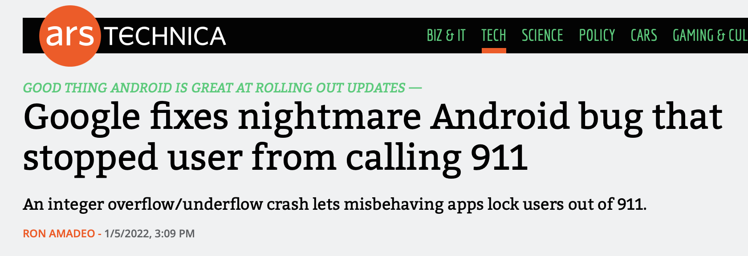
Overflow in Signed Addition
In the news on January 5, 2022 (!):
https://arstechnica.com/gadgets/2022/01/google-fixes-nightmare-android-bug-that-stopped-user-from-calling-911/

Slide 44
Overflow in Signed Addition
Signed overflow wraps around to the negative numbers.
#include<stdio.h>
#include<stdlib.h>
#include<limits.h> // for INT_MAX
int main() {
int a = INT_MAX;
int b = 1;
int c = a + b;
printf("a = %d\n",a);
printf("b = %d\n",b);
printf("a + b = %d\n",c);
return 0;
}
$ ./signed_overflow
a = 2147483647
b = 1
a + b = -2147483648
Technically, signed integers in C produce undefined behavior when they overflow. On two's complement machines (virtually all machines these days), it does overflow predictably. You can test to see if your addition will be correct:
// for addition
#include <limits.h>
int a = <something>;
int x = <something>;
if ((x > 0) && (a > INT_MAX - x)) /* `a + x` would overflow */;
if ((x < 0) && (a < INT_MIN - x)) /* `a + x` would underflow */;

Slide 45

3 Minute Break
WHEN CS107 GOES TOO FAST
take a break

Slide 46
Data Sizes

Slide 47
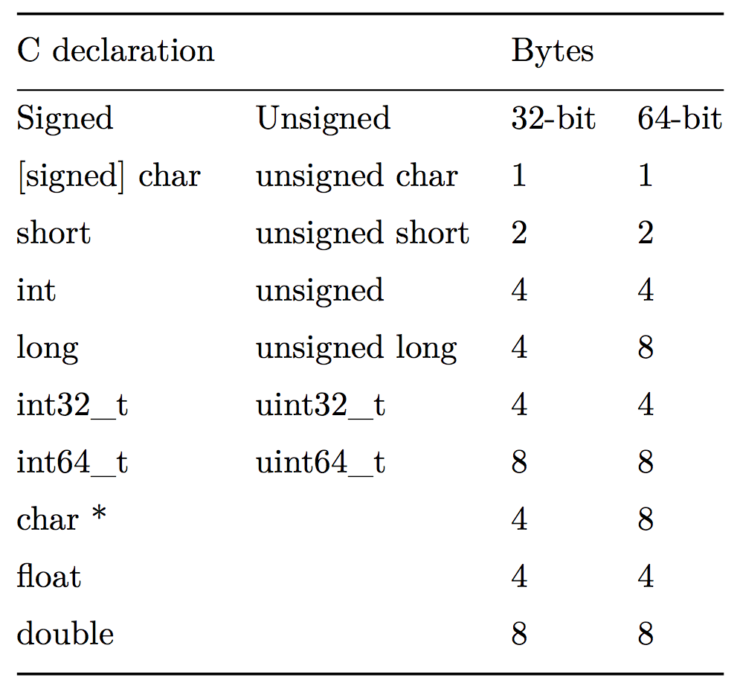
Data Sizes
On the myth computers (and most 64-bit computers today), the int representation is comprised of 32-bits, or four 8-bit bytes. but the C language does not mandate this. To the right is Figure 2.3 from your textbook:

Slide 48
Data Sizes
There are guarantees on the lower-bounds for type sizes, but you should expect that the myth machines will have the numbers in the 64-bit column.

Slide 49
Data Sizes
You can be guaranteed the sizes for int32_t (4 bytes) and int64_t (8 bytes)

Slide 50
Data Sizes
C allows a variety of ways to order keywords to define a type. The following all have the same meaning:
unsigned long
unsigned long int
long unsigned
long unsigned int

Slide 51
Addressing and Byte Ordering
On the myth machines, pointers are 64-bits long, meaning that a program can "address" up to 2⁶⁴ bytes of memory, because each byte is individually addressable.
This is a lot of memory! It is 16 exabytes, or 1.84 x 10¹⁹ bytes. Older, 32-bit machines could only address 2³² bytes, or 4 Gigabytes.
64-bit machines can address 4 billion times more memory than 32-bit machines...
Machines will not need to address more than 2⁶⁴ bytes of memory for a long, long time.

Slide 52
Addressing and Byte Ordering
We've already talked about the fact that a memory address (pointer) points to a particular byte. But, what if we want to store a data type that has more than one byte?
The int type on our machines is 4 bytes long. So, how is a byte stored in memory?
We have choices!
First, let's talk about the ordering of the bytes in a 4-byte hex number. We can represent an ints as 8-digit hex numbers:
0x01234567
We can separate out the bytes:
0x 01 23 45 67

Slide 53
Addressing and Byte Ordering
01 23 45 67
0000 0001 0010 0011 0100 0101 0110 0111
--------- --------- --------- ---------
most significant least significant
• Some machines choose to store the bytes ordered from least significant byte to most significant byte, called “little endian” (because the “little end” comes first).
• Other machines choose to store the bytes ordered from most significant byte to least significant byte, called “big endian” (because the “big end” comes first).

Slide 54
Addressing and Byte Ordering
Our 0x01234567 number would look like this in memory for a little endian computer (which, by the way, is the way the myth computers store ints):
byte: | 67 | 45 | 23 | 01
address: | 0x100 | 0x101 | 0x102 | 0x103
A big-endian representation would look like this:
byte: | 01 | 23 | 45 | 67
address: | 0x100 | 0x101 | 0x102 | 0x103
Many times we don’t care how our integers are stored, but in cs107 we will! Let’s look at a sample program and dig under the hood to see how little-endian works.

Slide 55
Addressing and Byte Ordering
Our 0x01234567 number would look like this in memory for a little endian computer (which, by the way, is the way the myth computers store ints):
address: 0x100 0x101 0x102 0x103
value: 67 45 23 01
A big-endian representation would look like this:
address: 0x100 0x101 0x102 0x103
value: 01 23 45 67
Many times we don’t care how our integers are stored, but in cs107 we will! Let’s look at a sample program and dig under the hood to see how little-endian works.

Slide 56
Addressing and Byte Ordering
1
2
3
4
5
6
7
8
9
10
11
#include<stdio.h>
#include<stdlib.h>
int main() {
// a variable
int a = 0x01234567;
// print the variable in big endian format
printf("a's value: 0x%.8x\n",a);
return 0;
}

Slide 57
Addressing and Byte Ordering
$ gcc -g -O0 -std=gnu99 big_endian.c -o big_endian
$ ./big_endian
a's value: 0x01234567
$ gdb big_endian
GNU gdb (Ubuntu 7.7.1-0ubuntu5~14.04.3) 7.7.1
...
(gdb) break main
Breakpoint 1 at 0x400535: file big_endian.c, line 6.
(gdb) run
Starting program: /afs/.ir.stanford.edu/users/c/g/cgregg/107/lectures/lecture2_bits_bytes_continued/big_endian
Breakpoint 1, main () at big_endian.c:6
6 int a = 0x01234567;
(gdb) n
9 printf("a's value: 0x%08x\n",a);
(gdb) p/x a
$1 = 0x1234567
(gdb) p &a
$2 = (int *) 0x7fffffffe98c
(gdb) x/16bx &a
0x7fffffffe98c: 0x67 0x45 0x23 0x01 0x00 0x00 0x00 0x00
0x7fffffffe994: 0x00 0x00 0x00 0x00 0x45 0x2f 0xa3 0xf7
(gdb)
Note the ordering: 0x01234567 is stored as Little Endian!

Slide 58
Boolean Algebra

Slide 59
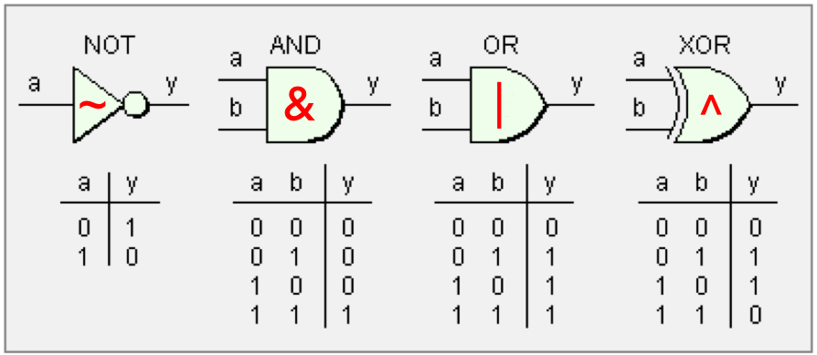
Boolean Algebra
Because computers store values in binary, we need to learn about boolean algebra. Most of you have already studied this in some form in math classes before, but we are going to quantify it and discuss it in the context of computing and programming.
We can define Boolean algebra over a 2-element set, 0 and 1, where 0 represents false and 1 represents true.
The symbols are: ~ for NOT, & for AND, | for OR, and ^ for "exclusive or," which means that if one and only one of the values is true, the expression is true.

Slide 60
Boolean Algebra
Be careful! There are logical analogs to some of these that you have used in C++ and other programming languages: ! (logical NOT), && (logical AND), and || (logical OR), but we are now talking about bit operations that result in 0 or 1 for each bit in a number.
The bitwise operators use single character representations for AND and OR, not double-characters.

Slide 61
Boolean Algebra
When a boolean operator is applied to two numbers (or, in the case of ~, a single number), the operator is applied to the corresponding bits in each number. For example:
0110
& 1100
----
0100
0110
| 1100
----
1110
0110
^ 1100
----
1010
~ 1100
----
0011

Slide 62
Boolean Algebra: Mystery Function
Let's look at a mystery function!
1
2
3
4
5
6
7
8
9
10
11
12
13
14
15
16
17
18
19
20
21
22
23
// mystery1.c
#include<stdlib.h>
#include<stdio.h>
void mystery(int *x, int *y) {
if (x != y) {
*y = *x ^ *y;
*x = *x ^ *y;
*y = *x ^ *y;
}
}
int main(int argc, char *argv[]) {
int x = atoi(argv[1]);
int y = atoi(argv[2]);
printf("x:%d, y:%d\n",x,y);
mystery(&x,&y);
printf("x:%d, y:%d\n",x,y);
return 0;
}
$ ./mystery 4 5

Slide 63
Boolean Algebra: Mystery Function
Let's look at a mystery function!
1
2
3
4
5
6
7
8
9
10
11
12
13
14
15
16
17
18
19
20
21
22
23
// mystery1.c
#include<stdlib.h>
#include<stdio.h>
void mystery(int *x, int *y) {
if (x != y) {
*y = *x ^ *y;
*x = *x ^ *y;
*y = *x ^ *y;
}
}
int main(int argc, char *argv[]) {
int x = atoi(argv[1]);
int y = atoi(argv[2]);
printf("x:%d, y:%d\n",x,y);
mystery(&x,&y);
printf("x:%d, y:%d\n",x,y);
return 0;
}
$ ./mystery 4 5
x:4, y:5
x:5, y:4
https://en.wikipedia.org/wiki/XOR_swap_algorithm
This relies on the fact that x^x == 0, and the associativity and commutativity of the exclusive or function.
Incidentally, if you XOR a number with all 1s, you get the complement!

Slide 64
Boolean Algebra: Operations on bit flags
We can represent finite sets with bit vectors, where we can perform set functions such as union, intersection, and complement. For example:
bit vector a = [01101001] encodes the set A = {0,3,5,6} (reading the 1 positions from right to left, with #0 being the right-most, #7 being the left-most)
bit vector b = [01010101] encodes the set B = {0,2,4,6}
The | operator produces a set union:
a | b → [01111101], or A ∪ B = {0,2,3,4,5,6}
The & operator produces a set intersection:
a & b → [01000001], or A ∩ B = {0,6}

Slide 65
Boolean Algebra: Bit Masking
A common use of bit-level operations is to implement masking operations, where a mask is a bit pattern that will be used to choose a selected set of bits in a word. For example, the mask of 0xFF means the lowest byte in an integer. To get the low-order byte out of an integer, we simply use the bitwise AND operator with the mask:
int j = 0x89ABCDEF;
int k = j & 0xFF; // k now holds the value 0xEF,
// which is the low-order byte of j
A useful expression is ~0, which makes an integer with all 1s, regardless of the size of the integer.

Slide 66
Boolean Algebra: Bit Masking
Challenge 1: write an expression that sets the least significant byte to all ones, and all other bytes of the number (assume it is the variable j) left unchanged E.g.
0x87654321 → 0x876543FF
Possible answer: j | 0xFF
Challenge 2: write an expression that complements all but the least significant byte of j, with the least significant byte unchanged. E.g.
0x87654321 → 0x789ABC21
Possible answer: j ^ ~0xFF

Slide 67
Boolean Algebra: Shift Operations
C provides operations to shift bit patterns to the left and to the right.
The << operator moves the bits to the left, replacing the lower order bits with zeros and dropping any values that would be bigger than the type can hold:
x << k will shift x to the left by k number of bits.
Examples for an 8-bit binary number:
00110111 << 2 returns 11011100
01100011 << 4 returns 00110000
10010101 << 4 returns 01010000

Slide 68
Boolean Algebra: Shift Operations
There are actually two flavors of right shift, which work differently depending on the value and type of the number you are shifting.
A logical right shift moves the values to the right, replacing the upper bits with 0s.
An arithmetic right shift moves the values to the right, replacing the upper bits with a copy of the most significant bit. This may seem weird! But, we will see why this is useful soon!
Examples for an 8-bit binary number:
Logical right shift:
00110111 >> 2 returns 00001101
10110111 >> 2 returns 00101101
01100011 >> 4 returns 00000110
10010101 >> 4 returns 00001001
Examples for an 8-bit binary number:
Artithmetic right shift:
00110111 >> 2 returns 00001101
10110111 >> 2 returns 11101101
01100011 >> 4 returns 00000110
10010101 >> 4 returns 11111001

Slide 69
Right shift: arithmetic -vs- logical
The right-shift (>>) operator behaves differently for unsigned and signed numbers:
Unsigned numbers are logically-right shifted (by shifting in 0s, always)
Signed numbers are arithmetically-right shifted (by shifting in the sign bit)
// show_bytes() defined on pg. 45, Bryant and O'Halloran
int main() {
int a = 1048576;
int a_rs8 = a >> 8;
int b = -1048576;
int b_rs8 = b >> 8;
printf("a = %d:\t", a);
show_bytes((byte_pointer) &a, sizeof(int));
printf("a >> 8 = %d:\t", a_rs8);
show_bytes((byte_pointer) &a_rs8, sizeof(int));
printf("b = %d:\t", b);
show_bytes((byte_pointer) &b, sizeof(int));
printf("b >> 8 = %d:\t", b_rs8);
show_bytes((byte_pointer) &b_rs8, sizeof(int));
return 0;
}
$ ./right_shift
a = 1048576: 00 00 10 00
a >> 8 = 4096: 00 10 00 00
b = -1048576: 00 00 f0 ff
b >> 8 = -4096: 00 f0 ff ff
(run on a little-endian machine)

Slide 70
Shift Operation Pitfalls
There are two important things you need to consider when using the shift operators:
The C standard does not precisely define whether a right shift for signed integers is logical or arithmetic. Almost all compilers / machines use arithmetic shifts for signed integers, and you can most likely assume this. Don't be surprised if some Internet pedant yells at you about it some day. :) All unsigned integers will always use a logical right shift (more on this later!)
Operator precedence can be tricky! Example:
1<<2 + 3<<4 means this: 1 << (2 + 3) << 4, because addition and subtraction have a higher precedence than shifts!
Always parenthesize to be sure:
(1<<2) + (3<<4)

Slide 71
Practice!
Let's take a look at lots of examples:
If you want to try the examples out yourself. On myth:
$ cd CS107
$ cp -r /afs/ir/class/cs107/lecture-code/lect2 .
cd lect2
make
ls # to see the files

Slide 72
References and Advanced Reading
References:
  Two's complement calculator: http://www.convertforfree.com/twos-complement-calculator/
  Wikipedia on Two's complement: https://en.wikipedia.org/wiki/Two%27s_complement
  The sizeof operator: http://www.geeksforgeeks.org/sizeof-operator-c/
Advanced Reading:
  Signed overflow: https://stackoverflow.com/questions/16056758/c-c-unsigned-integer-overflow
  Integer overflow in C: https://www.gnu.org/software/autoconf/manual/autoconf-2.62/html_node/Integer-Overflow.html
  https://stackoverflow.com/questions/34885966/when-an-int-is-cast-to-a-short-and-truncated-how-is-the-new-value-determined

Slide 73
References and Advanced Reading
References:
  argc and argv: http://crasseux.com/books/ctutorial/argc-and-argv.html
  The C Language: https://en.wikipedia.org/wiki/C_(programming_language)
  Kernighan and Ritchie (K&R) C: https://www.youtube.com/watch?v=de2Hsvxaf8M
  C Standard Library: http://www.cplusplus.com/reference/clibrary/
  https://en.wikipedia.org/wiki/Bitwise_operations_in_C
  http://en.cppreference.com/w/c/language/operator_precedence
Advanced Reading:
  After All These Years, the World is Still Powered by C Programming
  Is C Still Relevant in the 21st Century?
  Why Every Programmer Should Learn C

Slide 74
0
1
-1
0000
2
1111
0001
-2
1110
0010
3
1101
-3
0011
4-bit
two's complement signed integer representation
1100
0100
4
-4
1011
0101
-8
7
1010
-7
0110
1001
1000
0111
6
-6
5
-5

Slide 75
0
15
1
0000
14
1111
0001
2
1110
0010
13
3
1101
0011
1100
12
4
4-bit
unsigned integer representation
0100
1011
0101
8
7
9
1010
0110
6
10
1001
1000
0111
5
11

