Slide 1
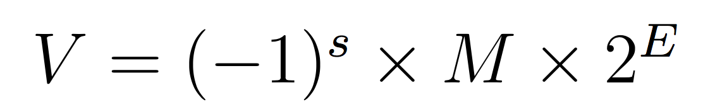
Monday, February 6, 2023
CS 107
Lecture 8: Floating Point Numbers
Single precision (float)
31 | 30 | 23 | 22 | 0
s | exp |  | frac
Computer Systems
Winter 2023
Stanford University
Computer Science Department
Reading: Reader: Floating Point, Textbook: Chapter 2.4
Lecturer: Chris Gregg

Slide 2
Today's Topics
Logistics
  Midterm next Wednesday, in person — we will post information about the midterm early this week.
Reading: Reader: Floating Point, Textbook: Chapter 2.4
Programs from class: /afs/ir/class/cs107/samples/lect8
Floating Point Numbers
  Real Numbers
  Fixed Point
  IEEE 754 Floating Point
    Normalized values
    Denormalized values
    Exceptional values
    Arithmetic

Slide 3
Real Numbers
⅕

Slide 4
Real Numbers
⅕
= 0.2

Slide 5
Real Numbers
⅓

Slide 6
Real Numbers
⅓
= 0.33333…

Slide 7
Real Numbers
⅓
= 0.33333…
When I was in 6th grade, this was a mind blowing concept.

Slide 8
Fractions
⅓
= 0.33333…
Especially this

Slide 9
Real Numbers
π
= 3.14159…
And don't get me started on this

Slide 10
Real Numbers
Once we leave the realm of integers, real numbers become … tricky.
Some rational numbers, e.g., ⅕, can be represented exactly, by a fixed number of decimal digits (0.2 in this case)
Some rational numbers, e.g., ⅓, can not be represented exactly, and we have this idea of "repeating indefinitely," which we represent with "…" (0.33333…)
Irrational numbers can never be represented by a fixed number of decimal digits, and the meaning of "…" means "indefinitely" but loses the "repeating" part. Irrational numbers can never be represented exactly using a digit notation.
The big question: how do we represent real numbers in a computer?

Slide 11
Real Numbers in a Computer
The big question: how do we represent real numbers in a computer?
As always, we have choices. Here are some constraints:
We want to represent real numbers in a fixed number of bits. This means that we aren't going to be able to represent all real numbers exactly, nor even all rational numbers exactly. Furthermore, we can't even represent all rational numbers in a range exactly (there are infinitely many rational numbers in any fixed range).
We want to represent a large range of numbers.
We want to be able to perform calculations on the numbers.

Slide 12
Real Numbers in a Computer
One idea: Fixed Point
When we represented integers, we implicitly placed the decimal point (or binary point, in base 2) after the least significant digit, and we limited ourselves to positive powers of our base. E.g., 1234 is really 1234.0000…
We could just move the decimal place, and use that as our system for representing real numbers:
In decimal:
e.g., 123.45

Slide 13
Fixed Point
e.g., 123.45
What range of numbers can we represent now?

Slide 14
Fixed Point
e.g., 123.45
What range of numbers can we represent now?
0 to 999.99

Slide 15
Fixed Point
e.g., 123.45
What range of numbers can we represent now?
0 to 999.99
What is the "precision" we can represent (i.e., how precise?)

Slide 16
Fixed Point
e.g., 123.45
What range of numbers can we represent now?
0 to 999.99
What is the "precision" we can represent (i.e., how precise?)
we can represent five decimal digits of precision, to the 100th place

Slide 17
Fixed Point
e.g., 123.45
We can't represent some rational numbers exactly:
123.456
123.333…
1000 (overflow? Also, 999.991, or 999.9901, or 999.99001, or …)
0.001 (underflow?)
We would have to round or truncate, or over/under-flow.

Slide 18
Fixed Point
e.g., 123.45
Fixed-point arithmetic is pretty easy:
123.45
+678.90
802.35

Slide 19
Fixed Point
e.g., 123.45
Fixed-point arithmetic is pretty easy:
123.45
+678.90
802.35
100.22
* 1.08
80176
000000
1002200
1082376 = 108.2376
= 108.24
(rounded)

Slide 20
Fixed Point
Fixed point has its uses, but it is somewhat limiting. We can do regular arithmetic, and we know how many decimal places of precision we get.
However, the range is set by where we fix the decimal place, and we had hoped for a large range. If we set the decimal place to be to the left of the most significant digit for a five-digit number, our range would only be 0 to 0.99999.

Slide 21
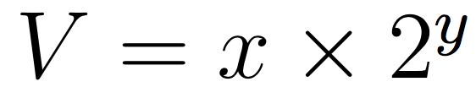
Floating Point
A different idea is to represent numbers in the form
In this form, we will break our number into two parts (actually, three, including a sign bit), with an exponent (y) and a fractional value (x).
Before we get into the details, let's investigate what fractional values in binary look like. Recall, in decimal:
Digits after the decimal point are represented by negative powers of 10.

Slide 22
Fractional Values in Binary
In binary, digits after the binary point are represented by negative powers of two:
Online binary to decimal converter:
http://web.stanford.edu/class/cs107/float/

Slide 23
Fractional Values in Binary
Example: 101.11 in binary:
What happens to your number if you shift the binary point to the left by one?

Slide 24
Fractional Values in Binary
Example: 101.11 in binary:
What happens to your number if you shift the binary point to the left by one?
The number is divided by two.

Slide 25
Fractional Values in Binary
Example: 101.11 in binary:
What happens to your number if you shift the binary point to the left by one?
The number is divided by two.
What happens to your number if you shift the binary point to the right by one?

Slide 26
Fractional Values in Binary
Example: 101.11 in binary:
What happens to your number if you shift the binary point to the left by one?
The number is divided by two.
What happens to your number if you shift the binary point to the right by one?
The number is multiplied by two.

Slide 27
Fractional Values in Binary
Example: 101.11 in binary:
What happens to your number if you shift the binary point to the left by one?
The number is divided by two.
What happens to your number if you shift the binary point to the right by one?
The number is multiplied by two.
What is represented by 0.111111…1?

Slide 28
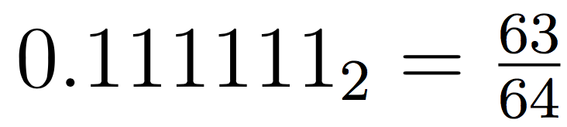
Fractional Values in Binary
Example: 101.11 in binary:
What happens to your number if you shift the binary point to the left by one?
The number is divided by two.
What happens to your number if you shift the binary point to the right by one?
The number is multiplied by two.
What is represented by 0.111111…1?
Numbers just below 1, e.g.:
Shorthand: 1-𝜖

Slide 29
Fractional Values in Binary
Just like decimal with numbers like ⅓ and ⅙, binary cannot represent exactly any numbers like ⅓ and ⅕, nor even ⅒:
// testTenth.c
#include<stdio.h>
#include<stdlib.h>
int main()
{
float f = 0.1;
// print with 27 decimal places
printf("%.27f\n",f);
return 0;
}
$ ./testTenth
0.100000001490116119384765625
Fractional binary notation can only exactly represent numbers that can be written in the form:

Slide 30
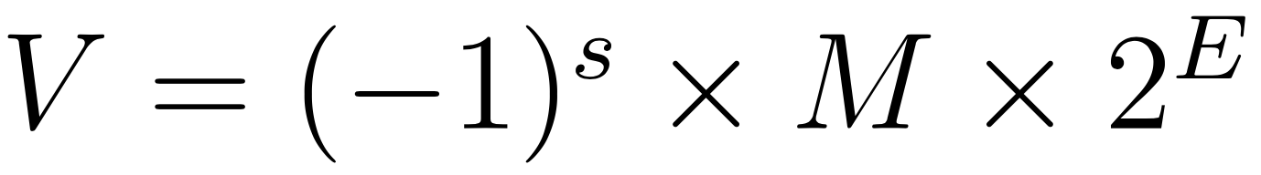
IEEE Floating Point
When designing a number format, choices need to be made about the format specification. In the late 1970s, Intel sponsored William Kahan (from Berkeley…) to design a floating point standard, which formed the basis for the "IEEE Standard 754," or IEEE Floating Point, which almost all computers use today. The standard defines the bit pattern (32-bit, 64-bit, etc.) as a number in the form:
Where:
The sign s is negative (s == 1) or positive (s == 0), with the sign for numerical value 0 as a special case.
The significand M (sometimes called the Mantissa), is a fractional binary number that ranges either between 1 and 2-𝜖 or between 0 and 1-𝜖.
The exponent E weights the value by a (possibly negative) power of 2.

Slide 31
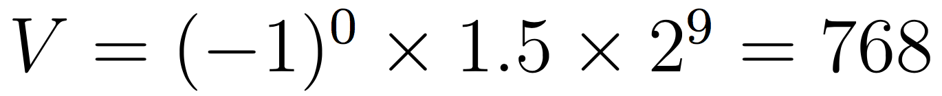
IEEE Floating Point Examples
Example: For s=0, M=1.5, E=9:

Slide 32
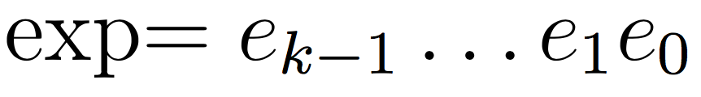
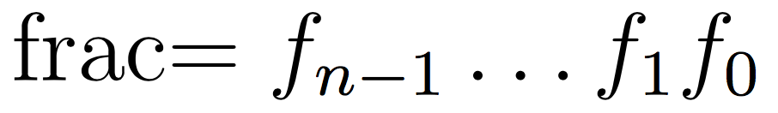
IEEE Floating Point
The bit representation of a floating point number is divided into three fields to encode these values:
The single sign bit s directly encodes the sign s.
The k-bit exponent field, encodes the exponent E.
The n-bit fraction field encodes the significand M, but the value encoded also depends on whether or not the exponent field equals 0.
31 | 30 | 23 | 22 | 0
s | exp |  | frac
Single precision (float)

Slide 33
Before We Continue
31 | 30 | 23 | 22 | 0
s | exp |  | frac
Single precision (float)
Right now, you're saying to yourself, "Uhh…this is going to be complicated."

Slide 34
Before We Continue
31 | 30 | 23 | 22 | 0
s | exp |  | frac
Single precision (float)
Right now, you're saying to yourself, "Uhh…this is going to be complicated."
Yes, it does take some time to learn. We want you to appreciate a few things about the IEEE floating point format:
It is based on decisions and choices that were made, with good reason (we will discuss those reasons).
It is efficient, and attempts to eek out as much as it can from those 32 or 64 bits — computing is often about efficiency, and the people who came up with the standard really thought hard about it.
We don't want you to think "I could never come up with that!" — rather, we want you to appreciate it for what it is.

Slide 35
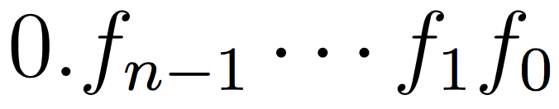
Normalized Floats
31 | 30 | 23 | 22 | 0
s | exp |  | frac
Single precision (float)
A float is considered to have a "normalized" value if the exponent is not all 0s and it is not all 1s, and is the most common case (e.g., bits 23-30 are not the value 0 or the value 255).
The exponent is a signed integer in biased form. The exponent has a value exp - bias, where the "bias" is 2^{k-1} - 1, and where k is the number of bits in the exponent (k=8 for floats, meaning that the bias is 2⁷ - 1 = 127). For floats, the exponent range is -126 to +127.
The fraction is interpreted as having a fractional value f, where 0 ≤ f < 1, and having a binary representation of , with the binary point to the left of the most significant bit.
The significand is defined to be M = 1 + f. This is an implied leading 1 representation, and a trick for getting an additional digit for free!

Slide 36
An extra bit of precision for free?
31 | 30 | 23 | 22 | 0
s | exponent (8 bits) |  | fraction (23 bits)
Single precision (float)
Yes! We can always adjust the exponent so that the significand is in the range 1 ≤ M < 2 (assuming no overflow), so we don't need to explicitly represent the leading bit, because it is always 1 (very cool!)
Remember, the designers of IEEE Floating Point wanted the best system, and this is a cool idea.
Example:
31 | 30 | 23 | 22 | 0
0 | 01111110 |  | 00000000000000000000000
Sign: 0 (positive)
Exponent: 01111110 = 126 (biased), so exponent of 2 will be 126 - 127 = -1
Fraction: 0, which is assumed to be 1.0 (binary), which is 1.0 decimal
Therefore, this number represents +1.0 x 2⁻¹ = 0.5 (to the converter!)

Slide 37
Let's try some more…
31 | 30 | 23 | 22 | 0
s | exponent (8 bits) |  | fraction (23 bits)
Single precision (float)
Example:
31 | 30 | 23 | 22 | 0
0 | 10000100 |  | 01010000000000000000000
Sign: 0 (positive)
Exponent: 10000100 = 132 (biased), so exponent of 2 will be 132 - 127 = 5
Fraction: 0101, which is assumed to be 1.0101 (binary), which is:
Therefore, this number represents +1.3125 x 2⁵ = 42.0 (to the converter!)
https://www.h-schmidt.net/FloatConverter/IEEE754.html

Slide 38
Let's try some more…
31 | 30 | 23 | 22 | 0
s | exponent (8 bits) |  | fraction (23 bits)
Single precision (float)
Example:
31 | 30 | 23 | 22 | 0
0 | 10000100 |  | 01011000000000000000000
Sign: 0 (positive)
Exponent: 10000100 = 132 (biased), so exponent of 2 will be 132 - 127 = 5
Fraction: 01011, which is assumed to be 1.01011 (binary), which is:
Therefore, this number represents +1.34375 x 2⁵ = 43.0 (to the converter!)

Slide 39
Let's try some more…
31 | 30 | 23 | 22 | 0
s | exponent (8 bits) |  | fraction (23 bits)
Single precision (float)
Example:
31 | 30 | 23 | 22 | 0
1 | 10000101 |  | 10010000000000000000000
Sign: 1 (negative)
Exponent: 10000101 = 133 (biased), so exponent of 2 will be 133 - 127 = 6
Fraction: 1001, which is assumed to be 1.1001 (binary), which is:
Therefore, this number represents -1.5625 x 2⁶ = -100.0 (to the converter!)

Slide 40
Let's try some more…
31 | 30 | 23 | 22 | 0
s | exponent (8 bits) |  | fraction (23 bits)
Single precision (float)
Example:
31 | 30 | 23 | 22 | 0
0 | 01111010 |  | 10010000000000000000000
Sign: 0 (positive)
Exponent: 01111010 = 122 (biased), so exponent of 2 will be 122 - 127 = -5
Fraction: 1001, which is assumed to be 1.1001 (binary), which is:
Therefore, this number represents +1.5625 x 2⁻⁵ = 0.048828125
(to the converter!)

Slide 41
3 minute break

Slide 42
When is a floating point value an integer?
31 | 30 | 23 | 22 | 0
s | exponent (8 bits) |  | fraction (23 bits)
Single precision (float)
Before we tackle that question, let's ask another: what is the exponent really doing to the significand?
Remember:
We are multiplying the significand (M) by a power of two…in other words, we are shifting it.
So…if the un-biased exponent shifts the significand enough bits so that none of the fractional bits are still fractions, then we have an integer.

Slide 43
When is a floating point value an integer?
31 | 30 | 23 | 22 | 0
s | exponent (8 bits) |  | fraction (23 bits)
Single precision (float)
Example: Let's convert 1234567 decimal to floating point
We need to divide by a power of two such that we get a fraction that is between 1 and 2.
First, let's convert 1234567 to binary for the significand:
        100101101011010000111 (use this website for the conversion)
Remove the leading 1 (it's free!), and add zeros at the end to get to 23 bits:
Now determine the amount we need to shift left to get the binary representation in the form of 1.xxxx (in this case, 20), and add the bias: 20 + 127 = 147, and convert to binary (also, add the sign bit, 0):
31 | 30 | 23 | 22 | 0
 |  |  | 00101101011010000111000
31 | 30 | 23 | 22 | 0
0 | 10010011 |  | 00101101011010000111000

Slide 44
Denormalized Floats
31 | 30 | 23 | 22 | 0
s | 00000000 |  | fraction (23 bits)
Single precision (float)
When the exponent is all zeros, this is called "denormalized" form. We interpret the exponent differently: the exponent is now 1-Bias (or, you can think of the bias now being 1 less, or 126 instead of 127 in the case of 32-bit floats). The significand value is simply the fraction, without a leading 1.
Why do we do this?
  We now have a way to represent zero (all 0s). Technically, all 0s is +0.0, and a 1 followed by all 0s is -0.0.
  There is "gradual underflow," meaning that it allows us to extend the lower range of representable numbers, and to limit the amount of error with very small numbers. See here for more information than you may ever want: https://docs.oracle.com/cd/E19957-01/816-2464/ncg_math.html

Slide 45
Exceptional Floating Point Values
31 | 30 | 23 | 22 | 0
s | 11111111 |  | fraction (23 bits)
Single precision (float)
When the exponent is all ones, this is called "exceptional" form. These numbers are not real numbers in the sense that we can calculate with them (except in very certain circumstances).
Exceptional numbers can denote the infinities:
  0 11111111 00000000000000000000000 is +infinity
  1 11111111 00000000000000000000000 is -infinity
Exceptional numbers also define the "NaN" (Not a Number) numbers, which can have special purposes, but are largely ignored (and there are millions of them!)
You can generate exceptional numbers in various ways:
  The divisions 0/0 and ±∞/±∞
  The multiplications 0×±∞ and ±∞×0.
  The additions ∞ + (−∞), (−∞) + ∞ and equivalent subtractions.
  The square root of a negative number.
See https://en.wikipedia.org/wiki/NaN#Operations_generating_NaN for more details.

Slide 46
Arithmetic with Floating Point Numbers
On the first day of class, we looked at the following program:
#include<stdio.h>
#include<stdlib.h>
int main() {
float a = 3.14;
float b = 1e20;
printf("(3.14 + 1e20) - 1e20 = %g\n", (a + b) - b);
printf("3.14 + (1e20 - 1e20) = %g\n", a + (b - b));
return 0;
}
$ ./floatMultTest
(3.14 + 1e20) - 1e20 = 0.000000
3.14 + (1e20 - 1e20) = 3.140000
we now have the tools to see why this happens!

Slide 47
Arithmetic with Floating Point Numbers
You might be thinking: oh, this is just overflowing. But it is more subtle than that.
float a = 3.14;
float b = 1e20;
printf("(3.14 + 1e20) - 1e20 = %f\n", (a + b) - b);
printf("3.14 + (1e20 - 1e20) = %f\n", a + (b - b));
Let's look at the binary representations for 3.14 and 1e20:
31 | 30 | 23 | 22 | 0
0 | 10000000 |  | 10010001111010111000011
3.14:
31 | 30 | 23 | 22 | 0
0 | 11000001 |  | 01011010111100011101100
1e20:
How are we going to add these numbers?

Slide 48
Arithmetic with Floating Point Numbers
31 | 30 | 23 | 22 | 0
0 | 10000000 |  | 10010001111010111000011
3.14:
31 | 30 | 23 | 22 | 0
0 | 11000001 |  | 01011010111100011101100
1e20:
You cannot simply add the two significands together, you have to align their
binary points. If we wanted to add the decimal values, it would look like this:
3.14
+ 100000000000000000000.00
100000000000000000003.14
Let's see what this looks like in 32-bit IEEE format…

Slide 49
Arithmetic with Floating Point Numbers
Let's see what this looks like in 32-bit IEEE format…
100000000000000000003.14
First: Convert to proper binary (http://web.stanford.edu/class/cs107/float/convert.html):
1010110101111000111010111100010110101100011000100000000000000000011.001000111101011100001010001111010111…
Second: Find the most significant 1 and take the next 23 digits after the 1 (we get the 1 for free!). We round up if the rest of the number contributes more than half (0.1b is 1/2): 1 01011010111100011101011 1100. (we round up to: 01011010111100011101100. This is the significand.
Third: Count how many places we need to shift left to put the number in 1.xxx format. In this case it is 66. We add 127 to this number, which gives us 127 + 66 = 193, which is our exponent (binary: 11000001)
Fourth: if the sign is positive, the sign bit will be 0, otherwise 1.

Slide 50
Arithmetic with Floating Point Numbers
So, we are left with the following for 100000000000000000003.14 decimal:
31 | 30 | 23 | 22 | 0
0 | 11000001 |  | 01011010111100011101100
Let's compare this to 1e20 that we had before:
31 | 30 | 23 | 22 | 0
0 | 11000001 |  | 01011010111100011101100
Identical! We didn't have enough bits to differentiate between 1e20 and 100000000000000000003.14

Slide 51
Arithmetic with Floating Point Numbers
Back to our original example:
float a = 3.14;
float b = 1e20;
printf("(3.14 + 1e20) - 1e20 = %f\n", (a + b) - b);
printf("3.14 + (1e20 - 1e20) = %f\n", a + (b - b));
$ ./floatMultTest
(3.14 + 1e20) - 1e20 = 0.000000
3.14 + (1e20 - 1e20) = 3.140000
Clearly, 1e20 - 1e20 will produce 0 (no need to shift the binary points). What this really means is that floating point arithmetic is not associative. In other words, the order of operations matters.

Slide 52
Arithmetic with Floating Point Numbers
Here is another example:
  int main()
  {
  double a = 0.1;
  double b = 0.2;
  double c = 0.3;
  double d = a + b;
  printf("0.1 + 0.2 == 0.3 ? %s\n", a + b == c ? "true" : "false");
  return 0;
  }
$ ./floatEquality
0.1 + 0.2 == 0.3 ? false
The rounding that happens during the calculation of 0.1 + 0.2 produces a different number than 0.3!

Slide 53
Arithmetic with Floating Point Numbers
  int main()
  {
  double a = 0.1;
  double b = 0.2;
  double c = 0.3;
  double d = a + b;
  printf("0.1 + 0.2 == 0.3 ? %s\n", a + b == c ? "true" : "false");
  printf("0.1:\t%.50g\n",a);
  printf("0.2:\t%.50g\n",b);
  printf("0.3:\t%.50g\n",c);
  printf("a + b:\t%.50g\n",d);
  return 0;
  }
$ ./floatEquality
0.1 + 0.2 == 0.3 ? false
0.1: 0.1000000000000000055511151231257827021181583404541
0.2: 0.2000000000000000111022302462515654042363166809082
0.3: 0.2999999999999999888977697537484345957636833190918
a + b: 0.30000000000000004440892098500626161694526672363281
See extra slide for gdb run.

Slide 54
Arithmetic with Floating Point Numbers
Here is another example:
  #include<stdio.h>
  #include<stdlib.h>
  int main()
  {
  printf("16777224.0f == 16777225.0f ? %s\n",
  16777224.0f == 16777225.0f ? "true" : "false");
  return 0;
  }

Slide 55
Arithmetic with Floating Point Numbers
Here is another example:
  #include<stdio.h>
  #include<stdlib.h>
  int main()
  {
  printf("16777224.0f == 16777225.0f ? %s\n",
  16777224.0f == 16777225.0f ? "true" : "false");
  return 0;
  }
$ ./floatEquality2
16777224.0f == 16777225.0f ? true
It turns out that 16777225 is an integer that you cannot represent as a 32-bit float.

Slide 56
Floating Point Takeaways
The IEEE Floating Point Standard was a carefully thought-out way to get the most out of a discrete set of bits. It may not be simple, but it is a great study in good engineering design.
Floating point numbers represent a very large range, in a limited number of bits. A 32-bit float can only hold a bit over 4 billion numbers and has a range of -3.4E+38 to +3.4E+38. Not only is this literally an infinite number of reals that the format must try and represent, but that is a phenomenal range of numbers. The 64-bit double range is -1.7E+308 to +1.7E+308 (!)
Most numbers are, therefore, only represented approximately in float format, including many integers. Example:
  1 trillion = 1,000,000,000,000, and in 32-bit floating point, it is actually represented by the value 999,999,995,904, off by 4096!
  You almost certainly don't want to use floats for currency!

Slide 57
Floating Point Takeaways
You have to be very careful with your arithmetic when you are dealing with floats:
  Associativity does not hold for numbers far apart in the range.
  Many numbers are not exact (e.g., 0.1, 0.4, etc.)
  Equality comparison operations are often unwise.

Slide 58
References and Advanced Reading
References:
  IEEE 754: https://en.wikipedia.org/wiki/IEEE_754
  IEEE Floating point: http://steve.hollasch.net/cgindex/coding/ieeefloat.html
  Floating point arithmetic: https://en.wikipedia.org/wiki/Floating-point_arithmetic#Dealing_with_exceptional_cases
Advanced Reading:
  Comparing floats using equality: https://stackoverflow.com/questions/1088216/whats-wrong-with-using-to-compare-floats-in-java
  Floating point converter: https://www.h-schmidt.net/FloatConverter/IEEE754.html
  What Every Computer Scientist Should Know About Floating-Point Arithmetic
  Floating point rounding errors: https://softwareengineering.stackexchange.com/questions/101163/what-causes-floating-point-rounding-errors
  Why do we have a bias in floating point exponents?

Slide 59
Extra Slides
Extra Slides

Slide 60
gdb run for 0.1 + 0.2 != 0.3
$ gdb floatEquality
The target architecture is assumed to be i386:x86-64
Reading symbols from floatEquality...done.
(gdb) break main
Breakpoint 1 at 0x400535: file floatEquality.c, line 5.
(gdb) run
Starting program: /afs/ir.stanford.edu/class/cs107/samples/lect10/floatEquality
Breakpoint 1, main () at floatEquality.c:5
5 double a = 0.1;
(gdb) n
6 double b = 0.2;
(gdb)
7 double c = 0.3;
(gdb)
8 double d = a + b;
(gdb)
9 printf("0.1 + 0.2 == 0.3 ? %s\n", a + b == c ? "true" : "false");
(gdb) x/gt &c
0x7fffffffe9e0: 0011111111010011001100110011001100110011001100110011001100110011
(gdb) x/gt &d
0x7fffffffe9e8: 0011111111010011001100110011001100110011001100110011001100110100
(gdb)

