Slide 1
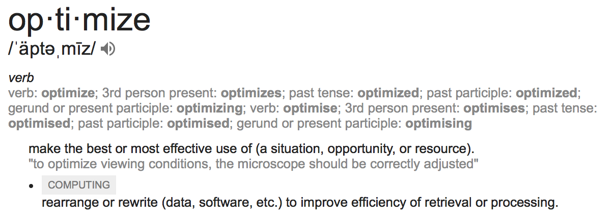
Monday, March 6, 2023
CS 107
Lecture 16: Optimization
Computer Systems
Winter 2023
Stanford University
Computer Science Department
Reading: Chapter 5, textbook
Lecturer: Chris Gregg

Slide 2
Today's Topics
Programs from class: /afs/ir/class/cs107/samples/lect15
Optimization:
  What optimizing compilers do and don't do
  GCC explorer: https://godbolt.org/g/3p91t2
Memory Performance
  How memory is organized
  Caching
  Impact of temporal and spatial locality
Profiling tools
  Measuring runtime and memory performance

Slide 3

A few quotes on optimization
“We should forget about small efficiencies, say about 97% of the time: premature optimization is the root of all evil. ”
— Donald Knuth
“More computing sins are committed in the name of efficiency (without necessarily achieving it) than for any other single reason - including blind stupidity.”
— W.A. Wulf (University of Virginia)
“Bottlenecks occur in surprising places, so don't try to second guess and put in a speed hack until you have proven that's where the bottleneck is.”
— Rob Pike (Google, created UTF-8, the Go programming language)

Slide 4
Optimization Considerations
Measure, measure, measure! Time your code to see if there is even an issue. We optimize code to make it faster (or smaller) — if there isn't a problem already, don't optimize. In other words, if it works okay at the scale you care about, don't try and optimize.
For example, if the code scales well already, it probably doesn't need to be optimized further.
Use the correct algorithm and design — optimization won't change Big O or fix a bad design, and your biggest win will be because you've chosen the correct algorithms to begin with.

Slide 5
Optimization Considerations
Keep it simple! — Simple code that is easy to understand and debug is generally best. In this case you are optimizing the programmer's time. This is especially true for the parts of your code that aren't providing the bottleneck.
Let gcc do its optimizations — don't pre-optimize, and after you compile with a high optimization in gcc, look at the assembly code and analyze it to see where you may be able to optimize.
Optimize explicitly as a last resort — measure again, and attack the bottlenecks first.

Slide 6
Optimization Blockers
Programmers need to be careful to write code that can be optimized!
Although this isn't always possible, it is a good goal to have.
Let's look at two functions:
void twiddle1(long *xp,
long *yp)
{
*xp += *yp;
*xp += *yp;
}
void twiddle2(long *xp,
long *yp)
{
*xp += 2 * *yp;
}
The functions perform the same thing, right?

Slide 7
Optimization Blockers
void twiddle1(long *xp,
long *yp)
{
*xp += *yp;
*xp += *yp;
}
$ ./twiddle 2 3
a: 2, b: 3
after twiddle1(&a, &b), a = 8
a: 2, b:3
after twiddle2(&a, &b), a = 8
a: 2
after twiddle1(&a, &a), a = 8
a: 2
after twiddle2(&a, &a), a = 6
void twiddle2(long *xp,
long *yp)
{
*xp += 2 * *yp;
}
Oops — if the pointer is the same, we have a problem! Pointers can be optimization blockers. gcc won't optimize twiddle1 to twiddle2, because it could lead to incorrect code.

Slide 8
Optimization Examples: Constant Folding
GCC explorer: https://gcc.godbolt.org/z/vbfTjehPa
unsigned long CF(unsigned long val)
{
unsigned long ones = ~0U/UCHAR_MAX;
unsigned long highs = ones << (CHAR_BIT - 1);
return (val - ones) & highs;
}
-O0
-O2
pushq %rbp
movq %rsp, %rbp
movq %rdi, -24(%rbp)
movq $16843009, -8(%rbp)
movq -8(%rbp), %rax
salq $7, %rax
movq %rax, -16(%rbp)
movq -24(%rbp), %rax
subq -8(%rbp), %rax
andq -16(%rbp), %rax
popq %rbp
ret
leaq -16843009(%rdi), %rax
andl $2155905152, %eax
ret
The compiler doesn't need to do as many real-time calculations, and folds the constants into two calculations.

Slide 9
Optimization Ex: Common Subexpression Elimination
GCC explorer: https://gcc.godbolt.org/z/5oK5PxY5s
int CSE(int num, int val)
{
int a = (val + 50);
int b = num * a - (50 + val);
return (val + (100 / 2)) + b;
}
-O0
pushq %rbp
movq %rsp, %rbp
movl %edi, -20(%rbp)
movl %esi, -24(%rbp)
movl -24(%rbp), %eax
addl $50, %eax
movl %eax, -4(%rbp)
movl -20(%rbp), %eax
imull -4(%rbp), %eax
movl -24(%rbp), %edx
addl $50, %edx
subl %edx, %eax
movl %eax, -8(%rbp)
movl -24(%rbp), %eax
leal 50(%rax), %edx
movl -8(%rbp), %eax
addl %edx, %eax
popq %rbp
ret
-O2
leal 50(%rsi), %eax
imull %edi, %eax
ret
The complier is able to eliminate subexpressions by determining that they are the same.

Slide 10
Optimization Ex: Strength Reduction
GCC explorer: https://gcc.godbolt.org/z/cW7n4G3hT
int SR(int a, int val)
{
unsigned int b = 5*val;
int c = b / (1 << val);
return (b + c) % 2;
}
-O0
pushq %rbp
movq %rsp, %rbp
movl %edi, -20(%rbp)
movl -20(%rbp), %edx
movl %edx, %eax
sall $2, %eax
addl %edx, %eax
movl %eax, -4(%rbp)
movl -20(%rbp), %eax
movl -4(%rbp), %edx
movl %eax, %ecx
shrl %cl, %edx
movl %edx, %eax
movl %eax, -8(%rbp)
movl -8(%rbp), %edx
movl -4(%rbp), %eax
addl %edx, %eax
andl $1, %eax
popq %rbp
ret
-O2
leal (%rdi,%rdi,4), %eax
movl %edi, %ecx
movl %eax, %edx
shrl %cl, %edx
addl %edx, %eax
andl $1, %eax
ret
The complier replaces expensive (strong) operations (e.g., divides) with equivalent expressions that are less strong.

Slide 11
Optimization Ex: Code Motion
GCC explorer: https://gcc.godbolt.org/z/zh6YMjjb8
int CM(int val)
{
int sum = 0;
do {
sum += 6 + 14 * val;
} while (sum < (9 / val));
return sum;
}
-O0
pushq %rbp
movq %rsp, %rbp
movl %edi, -20(%rbp)
movl $0, -4(%rbp)
.L2:
movl -20(%rbp), %eax
addl %eax, %eax
leal 0(,%rax,8), %edx
subl %eax, %edx
movl %edx, %eax
addl $6, %eax
addl %eax, -4(%rbp)
movl $9, %eax
cltd
idivl -20(%rbp)
cmpl -4(%rbp), %eax
jg .L2
movl -4(%rbp), %eax
popq %rbp
ret
-O2
The compiler moves code out of loops if it can: it only needs to perform the operation once, so it does.
movl $9, %eax
xorl %ecx, %ecx
cltd
idivl %edi
imull $14, %edi, %esi
addl $6, %esi
.L2:
addl %esi, %ecx
cmpl %eax, %ecx
jl .L2
movl %ecx, %eax
ret

Slide 12
Optimization Ex: Dead Code Elimination
GCC explorer:
https://gcc.godbolt.org/z/r1eeWEarG
int DC(int param1, int param2)
{
if (param1 < param2 && param1 > param2) // can this test ever be true?
printf("The end of the world is near!\n");
int result;
for (int i = 0; i < 1000; i++)
result *= i;
if (param1 == param2) // if/else obviously same on both paths
param1++;
else
param1++;
if (param1 == 0) // if/else no-so-obviously same on both paths
return 0;
else
return param1;
}
-O0
.LC0:
.string "The end of the world is near!"
DC:
    pushq %rbp
    movq %rsp, %rbp
    subq $32, %rsp
    movl %edi, -20(%rbp)
    movl %esi, -24(%rbp)
    movl -20(%rbp), %eax
    cmpl -24(%rbp), %eax
    jge .L2
    movl -20(%rbp), %eax
    cmpl -24(%rbp), %eax
    jle .L2
    movl $.LC0, %edi
    call puts
.L2:
    movl $0, -8(%rbp)
    jmp .L3
.L4:
    movl -4(%rbp), %eax
    imull -8(%rbp), %eax
    movl %eax, -4(%rbp)
    addl $1, -8(%rbp)
.L3:
    cmpl $999, -8(%rbp)
    jle .L4
    movl -20(%rbp), %eax
    cmpl -24(%rbp), %eax
    jne .L5
    addl $1, -20(%rbp)
    jmp .L6
.L5:
    addl $1, -20(%rbp)
.L6:
    cmpl $0, -20(%rbp)
    jne .L7
    movl $0, %eax
    jmp .L8
.L7:
    movl -20(%rbp), %eax
.L8:
    leave
    ret
-O2
The compiler realizes that most of the code does not perform useful work, so it just removes it!
DC:
leal 1(%rdi), %eax
ret

Slide 13
gcc and optimization
-O0 // faithful, literal match to C, and the best for debugging (but everything goes
on the stack)
-Og // streamlined, but debug-friendly (we used this for most assignments and
bank vault)
-O2 // apply all acceptable optimizations
-O3 // even more optimizations, but relies strongly on exact C specification (e.g., if you assume, for instance that signed numbers wrap, your code might break with this optimization level)
-Os // optimize for code size; performs the -O2 optimizations that don't increase the code size (e.g., no function alignment)
You can see all optimizations that will be run by compiling with the following flags:
      gcc -O3 prog.c -o prog -Q --help=optimizers

Slide 14
gcc and optimization
gcc knows the hardware you are running on, including:
  Register allocation
  Instruction choice
  Alignment
All transformations made by gcc during optimization should be legal and equivalent to your original C program.
  The compiler knows about compile time, not run time.
  The optimizations are conservative (e.g., it rarely tries to perform too much optimization with pointers, and it rarely removes a function unless it knows enough about it to do so).

Slide 15
gcc and optimization
How do we measure performance?
  Timers! There are a number of different ways to do it. One timer, rtdsc, is only available in assembly, although we can write a C program to access it by using "inline assembly" or linking to an assembly function.
  We can also use valgrind --tool=callgrind
You should time unoptimized vs. optimized
  mult.c
  sorts.c
  fact.c
  array.c

Slide 16
What gcc cannot do
gcc cannot fix algorithmic weaknesses, or big-O!
If you optimize too early yourself, gcc may not be able to figure out any further optimizations
gcc generally cannot remove function calls, nor can it "see through" pointers to determine if aliasing has occurred.

Slide 17
What gcc can do
Example: summing the char values in a string
int charsum(char *s)
{
int sum = 0;
for (size_t i = 0; i < strlen(s); i++) {
sum += s[i];
}
return sum;
}
What is going to cause the bottleneck for this function?

Slide 18
What gcc can do
Example: summing the char values in a string
int charsum(char *s)
{
int sum = 0;
for (size_t i = 0; i < strlen(s); i++) {
sum += s[i];
}
return sum;
}
What is going to cause the bottleneck for this function?
strlen(s) -- it must search one character at a time!

Slide 19
What gcc can do
Example: summing the char values in a string
int charsum(char *s)
{
int sum = 0;
for (size_t i = 0; i < strlen(s); i++) {
sum += s[i];
}
return sum;
}
What is going to cause the bottleneck for this function?
What is going to cause the bottleneck for this function?
strlen(s) -- it must search one character at a time!
What can the compiler do about it?

Slide 20
What gcc can do
Example: summing the char values in a string
int charsum(char *s)
{
int sum = 0;
for (size_t i = 0; i < strlen(s); i++) {
sum += s[i];
}
return sum;
}
What is going to cause the bottleneck for this function?
What is going to cause the bottleneck for this function?
strlen(s) -- it must search one character at a time!
int charsum2(char *s)
{
int sum = 0;
size_t len = strlen(s);
for (size_t i = 0; i < len; i++) {
sum += s[i];
}
return sum;
}
What can the compiler do about it?

Slide 21
What gcc cannot do
Example: converting a string to lowercase
void lower1(char *s)
{
for (size_t i = 0; i < strlen(s); i++) {
if (s[i] >= 'A' && s[i] <= 'Z') {
s[i] -= ('A' - 'a');
}
}
}
What is going to cause the bottleneck for this function?

Slide 22
What gcc cannot do
Example: converting a string to lowercase
void lower1(char *s)
{
for (size_t i = 0; i < strlen(s); i++) {
if (s[i] >= 'A' && s[i] <= 'Z') {
s[i] -= ('A' - 'a');
}
}
}
What is going to cause the bottleneck for this function?
strlen(s) -- it must search one character at at time!

Slide 23
What gcc cannot do
Example: converting a string to lowercase
void lower1(char *s)
{
for (size_t i = 0; i < strlen(s); i++) {
if (s[i] >= 'A' && s[i] <= 'Z') {
s[i] -= ('A' - 'a');
}
}
}
What is going to cause the bottleneck for this function?
strlen(s) -- it must search one character at at time!
Can the compiler move this out of the loop?

Slide 24
What gcc cannot do
Example: converting a string to lowercase
void lower1(char *s)
{
for (size_t i = 0; i < strlen(s); i++) {
if (s[i] >= 'A' && s[i] <= 'Z') {
s[i] -= ('A' - 'a');
}
}
}
What is going to cause the bottleneck for this function?
strlen(s) -- it must search one character at at time!
Can the compiler move this out of the loop?
It cannot! Because s is changing, the compiler won't risk moving strlen() outside the loop. It can't figure out that a zero won't ever be put into the string (changing the string's length).

Slide 25
Hand-optimization
Let's look at some code for a vector -- this is the textbook example in chapter 5 handout: /afs/ir/class/cs107/lect15/vector_handout.pdf
Let's look at the combine functions (there are four versions). The first version is this:
void combine1(vec_ptr v, data_t *dest)
{
*dest = IDENT; // 0
for (long i = 0; i < vec_length(v); i++) {
data_t val;
get_vec_element(v, i, &val);
*dest = *dest OP val; // OP is +
}
}
Original clock-ticks per call to combine1:
    -O1: 11.3
    -O2: 9.3
What might we do to improve this function?

Slide 26
Hand-optimization
Let's look at some code for a vector -- this is the textbook example in chapter 5 handout: /afs/ir/class/cs107/samples/lect16/vector_handout.pdf
Let's look at the combine functions (there are four versions). The first version is this:
void combine1(vec_ptr v, data_t *dest)
{
*dest = IDENT;
for (long i = 0; i < vec_length(v); i++) {
data_t val;
get_vec_element(v, i, &val);
*dest = *dest OP val;
}
}
Original clock-ticks per call to combine1:
    -O1: 11.3
    -O2: 9.3
What might we do to improve this function?
Let's move the call to vec_length out of the function.

Slide 27
Hand-optimization
Here is combine2:
// move call to vec_length out of loop
void combine2(vec_ptr v, data_t *dest)
{
long length = vec_length(v);
*dest = IDENT;
for (long i = 0; i < length; i++) {
data_t val;
get_vec_element(v, i, &val);
*dest = *dest OP val;
}
}
Clock-ticks for combine1 and combine2:
    comb1 comb2
    -O1: 11.3 5.8
    -O2: 9.3 5.8
Better! Both optimizations ended up about the same for combine2. Can we do better?

Slide 28
Hand-optimization
Here is combine2:
// move call to vec_length out of loop
void combine2(vec_ptr v, data_t *dest)
{
long length = vec_length(v);
*dest = IDENT;
for (long i = 0; i < length; i++) {
data_t val;
get_vec_element(v, i, &val);
*dest = *dest OP val;
}
}
Clock-ticks for combine1 and combine2:
    comb1 comb2
    -O1: 11.3 5.8
    -O2: 9.3 5.8
Better! Both optimizations ended up about the same for combine2. Can we do better?
Maybe the call to get_vec_element seems like it may be causing a bottleneck. Let's look at that function.

Slide 29
Hand-optimization
// move call to vec_length out of loop
void combine2(vec_ptr v, data_t *dest)
{
long length = vec_length(v);
*dest = IDENT;
for (long i = 0; i < length; i++) {
data_t val;
get_vec_element(v, i, &val);
*dest = *dest OP val;
}
}
Clock-ticks for combine1 and combine2:
    comb1 comb2
    -O1: 11.3 5.8
    -O2: 9.3 5.8
/*
* Retrieve vector element and store at dest.
* Return 0 (out of bounds) or 1 (successful)
*/
int get_vec_element(vec_ptr v, long index, data_t *dest)
{
if (index < 0 || index >= v->len)
return 0;
*dest = v->data[index];
return 1;
}
Here is the get_vec_element function:
Hmm...maybe the bounds checking is the issue. Let's just get rid of the function altogether and directly access the data.
This does break some abstraction, but it is in the name of speed!

Slide 30
Hand-optimization
Here is combine3:
// direct access to vector data
void combine3(vec_ptr v, data_t *dest)
{
long length = vec_length(v);
data_t *data = get_vec_start(v);
*dest = IDENT;
for (long i = 0; i < length; i++) {
*dest = *dest OP data[i];
}
}
Clock-ticks for combine1 and combine2:
    comb1 comb2 comb3
    -O1: 11.3 5.8 6.02
    -O2: 9.3 5.8 1.9
It looks like the -O1 actually got worse! It probably is about the same, actually, but our timing isn't perfect. The -O2 did get much better, and we should look at the assembly code to see why.
Is there anything else we can do to make this faster?

Slide 31
Hand-optimization
Here is combine3:
// direct access to vector data
void combine3(vec_ptr v, data_t *dest)
{
long length = vec_length(v);
data_t *data = get_vec_start(v);
*dest = IDENT;
for (long i = 0; i < length; i++) {
*dest = *dest OP data[i];
}
}
Clock-ticks for combine1 and combine2:
    comb1 comb2 comb3
    -O1: 11.3 5.8 6.02
    -O2: 9.3 5.8 1.9
There are three memory references in the following line:
*dest = *dest OP data[i];
We really only need to update memory at the end of the function, so let's do it.

Slide 32
Hand-optimization
Here is combine4:
// accumulate result in local variable
void combine4(vec_ptr v, data_t *dest)
{
long length = vec_length(v);
data_t *data = get_vec_start(v);
data_t acc = IDENT;
for (long i = 0; i < length; i++) {
acc = acc OP data[i];
}
*dest = acc;
}
Clock-ticks for combine1 and combine2:
    comb1 comb2 comb3 comb4
    -O1: 11.3 5.8 6.02 2.3
    -O2: 9.3 5.8 1.9 1.5
This is much better! We were able to save 5x time in the -O1 version, and 6x time in the -O2 version. From the comb1 -O1 version to the comb4 -O2 version, we have a 7.5x improvement in time.

Slide 33
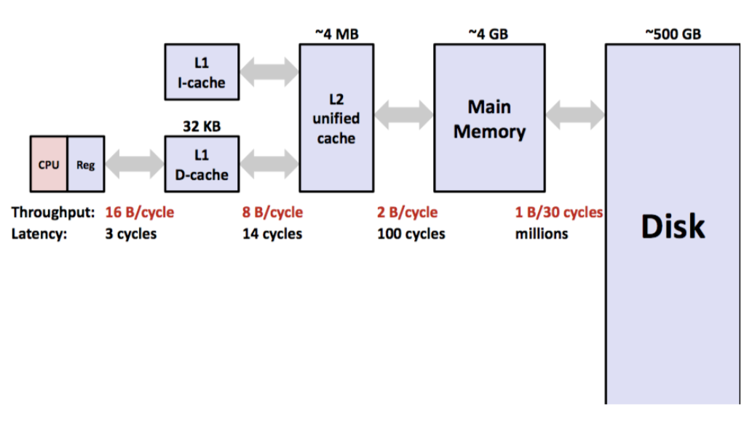
Caching
Computers these days have many levels of memory, from registers, to cache, to main memory, to disk memory. The myth machines, with a Core i7 CPU have the following memory structure (find out by typing lscpu)
256KB
8MB
32GB
1TB
L2
cache
L3
cache
4 B/cycle
40 cycles
Memory goes from really fast (registers) to really slow (disk), and as data is more frequently used, it ends up in faster and faster memory.

Slide 34
Caching and Locality
All caching depends on locality.
Temporal locality
Repeat access to same data tends to be co-located in TIME
Things I have used recently, I am likely to use again soon
Spatial locality
Related data tends to be co-located in SPACE
Data that is near a used item is more likely to also be accessed
Realistic scenario:
97% cache hit rate
Cache hit costs 1 cycle
Cache miss costs 100 cycles
How much of your memory access time spent on 3% of accesses that are cache misses?
array.c

Slide 35
Using Callgrind
Run program under callgrind, creates file callgrind.out.pid
valgrind --tool=callgrind ./array_opt
Process file to see source annotated with count per line
callgrind_annotate --auto=yes callgrind.out.<pid>

