Slide 1
CS107, Lecture 26
Wrap-Up / What’s Next?

Slide 2
We’ve covered a lot in just 10 weeks! Let’s take a look back.

Slide 3
Our CS107 Journey
Bits and Bytes
Heap Allocators
C Strings
Arrays and Pointers
Stack and Heap
Generics
Assembly

Slide 4
Course Overview
Bits and Bytes - How can a computer represent integer numbers?
Characters and C Strings - How can a computer represent and manipulate more complex data types like text?
Pointers, Stack Memory and Heap Memory – How can we effectively manage all forms of memory in our programs?
Generics - How can we tap our knowledge of computer memory and data representation to write code that works with any data type?
Assembly - How does a computer compile, interpret, and execute C programs? And what does assembly code look like?
Heap Allocators - How do core memory-allocation operations like malloc and free work? Are the built-in versions always good enough?

Slide 5
First Day
/*
* hello.c
* This program prints a welcome message
* to the user.
*/
#include <stdio.h> // for printf
int main(int argc, char *argv[]) {
printf("Hello, world!\n");
return 0;
}

Slide 6
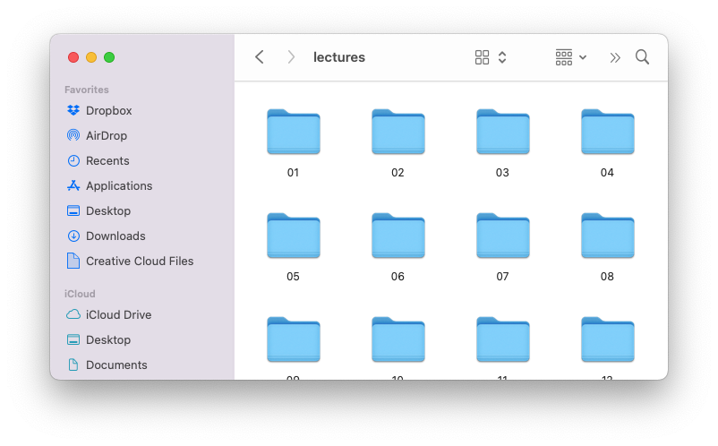
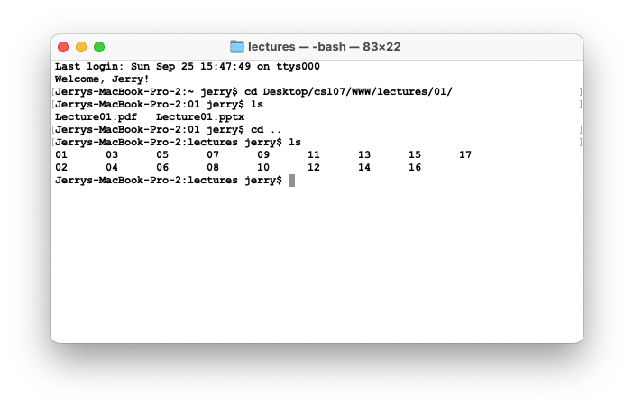
First Day
The command-line is a text-based interface to navigate a computer, instead of a Graphical User Interface (GUI).
Graphical User Interface
Text-based interface

Slide 7
Bits And Bytes
Key Question: How can a computer represent integer numbers?

Slide 8
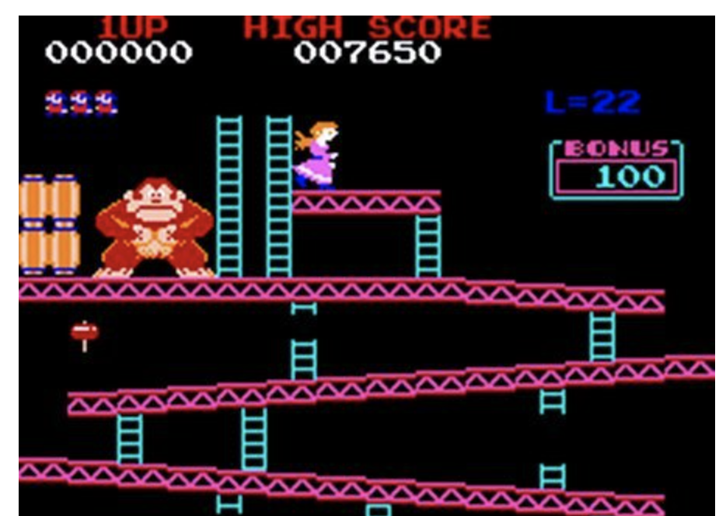

Bits And Bytes
Why does this matter?
Limitations of representation and arithmetic impact programs!
We can also efficiently manipulate data using bits.

Slide 9
C Strings
Key Question: How can a computer represent and manipulate more complex data like text?
Strings in C are arrays of characters ending with a null terminator!
We can manipulate them using pointers and C library functions (many of which you could probably implement).
index | 0 | 1 | 2 | 3 | 4 | 5 | 6 | 7 | 8 | 9 | 10 | 11 | 12 | 13
value | 'H' | 'e' | 'l' | 'l' | 'o' | ',' | ' ' | 'w' | 'o' | 'r' | 'l' | 'd' | '!' | '\0'

Slide 10
C Strings
Why does this matter?
Understanding this representation is key to efficient string manipulation.
This is how strings are represented in both low- and high-level languages!
  C++: https://www.quora.com/How-does-C++-implement-a-string
  Python: https://www.laurentluce.com/posts/python-string-objects-implementation/

Slide 11
Pointers, Stack and Heap
Key Question: How can we effectively manage all types of memory in our programs?
Arrays let us store ordered lists of information.
Pointers let us pass addresses of data instead of the data itself.
We can use the stack, which cleans up memory for us, or the heap, which we must manually manage.
STACK
Address | Value
 | …
0x1f0 | 2
 | …
0x10 | 0x1f0
 | …
x
main()
myFunc()
intPtr

Slide 12

Stack And Heap
Why does this matter?
The stack and heap allow for two ways to store data in our programs, each with their own tradeoffs, and it’s crucial to understand the nuances of managing memory in any program you write!
Pointers let us pass around references to data efficiency

Slide 13
Generics
Key Question: How can we use our knowledge of memory and data representation to write code that works with any data type?
We can use void * to circumvent the type system, memcpy, etc. to copy generic data, and function pointers to pass logic around.
Why does this matter?
Working with any data type lets us write more generic, reusable code.
Using generics helps us better understand the type system in C and other languages, and where it can help and hinder our program.

Slide 14
Assembly Language
Key Question: How does a computer interpret and execute C programs?
GCC compiles our code into machine code instructions executable by our processor.
Our processor uses registers and instructions like mov to manipulate data.

Slide 15

Assembly Language
Why does this matter?
We write C code because it is higher level and transferrable across machines. But it is not the representation executed by the computer!
Understanding how programs are compiled and executed, as well as computer architecture, is key to writing performant programs (e.g. fewer lines of code is not necessarily better).
We can reverse engineer and exploit programs at the assembly level!

Slide 16
Heap Allocators
Key Question: How do core memory-allocation operations like malloc and free work?
A heap allocator manages a block of memory for the heap and completes requests to use or give up memory space.
We can manage the data in a heap allocator using headers, pointers to free blocks, or other designs
Why does this matter?
Designing a heap allocator requires making many design decisions to optimize it as much as possible. There is no perfect design!
All languages have a "heap" but manipulate it in different ways.

Slide 17
Ethics, Privacy, Partiality and Trust
Key Question: How do we act responsibly in maintaining security, protecting privacy, and ensuring warranted trust in the systems we build and maintain?
Why does this matter?
Responsible programming involves documentation—including informative error messages!—that allows others to evaluate the reliability of your code.
Responsible system and program design requires choosing a trust model and considering data privacy. This might also require deciding to whom to be partial.

Slide 18
Our CS107 Journey
Bits and Bytes
Heap Allocators
C Strings
Arrays and Pointers
Stack and Heap
Generics
Assembly

Slide 19
CS107 Learning Goals
The goals for CS107 are for students
to acquire a fluency with
  pointers and memory and how to make use of them when writing C code
  an executable’s address space and runtime behavior
to acquire competency with
  the translation of C to and from assembly code
  the implementation of programs that respect the limits of computer arithmetic
  the ability to identify bottlenecks and improve runtime performance
  the ability to navigate your own Unix development environment
  the ethical frameworks you need to better design and implement software
and to have some exposure to
  the basics of computer architecture

Slide 20

The C Coding Experience
https://www.youtube.com/watch?v=G7LJC9vJluU

Slide 21
Tools and Techniques
Unix and the command line
Coding Style
Debugging (gdb)
Testing (sanitycheck)
Memory Checking (valgrind)
Profiling (callgrind)

Slide 22
Unix And The Command Line
Unix and command line tools are extremely popular tools outside of CS107 for:
Running programs (web servers, python programs, remote programs…)
Accessing remote servers (Amazon Web Services, Microsoft Azure, Heroku…)
Programming embedded devices (Raspberry Pi, etc.)
Our goal for CS107 was to help you become proficient in navigating Unix

Slide 23
Coding Style
Writing clean, readable code is crucial for any computer science project
Unfortunately, a fair amount of existing code is poorly-designed/documented
Our goal for CS107 was to help you write with good coding style and read/understand/comment provided code.

Slide 24
Debugging (GDB)
Debugging is a crucial skill for any computer scientist
Our goal for CS107 was to help you become a better debugger
  narrow in on bugs
  diagnose the issue
  implement a fix
Practically every project you work on will have debugging facilities
  Python: pdb
  IDEs: built-in debuggers (e.g., QT Creator, Eclipse, XCode, Visual Studio)
  Web development: in-browser debugger

Slide 25
Testing (sanitycheck)
Testing is a crucial skill for any computer scientist
Our goal for CS107 was to help you become a better tester
  Writing targeted tests to validate correctness
  Use tests to prevent regressions
  Use tests to develop incrementally

Slide 26
Memory Validation and Profiling
Memory checking and profiling are crucial for any computer scientist to analyze program performance and increase efficiency.
Many projects you work on will have profiling and memory analysis facilities:
  Mobile development: integrated tools (XCode Instruments, Android Profiler, etc.)
  Web development: in-browser tools

Slide 27

Tools
You’ll see manifestations of these tools throughout projects you work on. We hope you can use your CS107 knowledge to take advantage of them!
Notes:
Leaks + profiling time + zombies (accessing freed memory)

Slide 28
Concepts
C Language
Bit-Level Representations
Arrays and Pointers
Memory Management
Generics
Assembly
Allocators

Slide 29
Systems
How can we write programs that execute multiple tasks simultaneously? (take CS111!)
Threads of execution
Locks to prevent simultaneous access
How is a compiler implemented? (take CS143!)
Lexical analysis
Parsing
Semantic Analysis
Code Generation
How can applications communicate over a network? (take CS144!)
How can we weigh different tradeoffs of network architecture design?
How can we effectively transmit bits across a network?

Slide 30
Systems
How is an operating system implemented? (take CS111/CS112/CS212!)
Threads
User Programs
Virtual Memory
Filesystem

Slide 31
Machine Learning
Can we speed up machine learning training with reduced precision computation?
https://www.top500.org/news/ibm-takes-aim-at-reduced-precision-for-new-generation-of-ai-chips/
https://devblogs.nvidia.com/mixed-precision-training-deep-neural-networks/
How can we implement performant machine learning libraries?
Popular tools such as TensorFlow and PyTorch are implemented using C!
https://pytorch.org/blog/a-tour-of-pytorch-internals-1/
https://www.tensorflow.org/guide/extend/architecture

Slide 32
Web Development
How can we efficiently translate JavaScript code to machine code?
The Chrome V8 JavaScript engine converts JavaScript into machine code for computers to execute: https://medium.freecodecamp.org/understanding-the-core-of-nodejs-the-powerful-chrome-v8-engine-79e7eb8af964
The popular nodejs web server tool is built on Chrome V8
How can we compile programs into an efficient binary instruction format that runs in a web browser?
WebAssembly is an emerging standard instruction format that runs in browsers: https://webassembly.org
You can compile C/C++/other languages into WebAssembly for web execution

Slide 33
Programming Languages / Runtimes
How can programming languages and runtimes efficiently manage memory?
Manual memory management (C/C++)
Reference Counting (Swift)
Garbage Collection (Java)
How can we design programming languages to reduce the potential for programmer error? (take CS242!)
Haskell/Swift 'optionals'
How can we design portable programming languages?
Java Bytecode: https://en.wikipedia.org/wiki/Java_bytecode

Slide 34
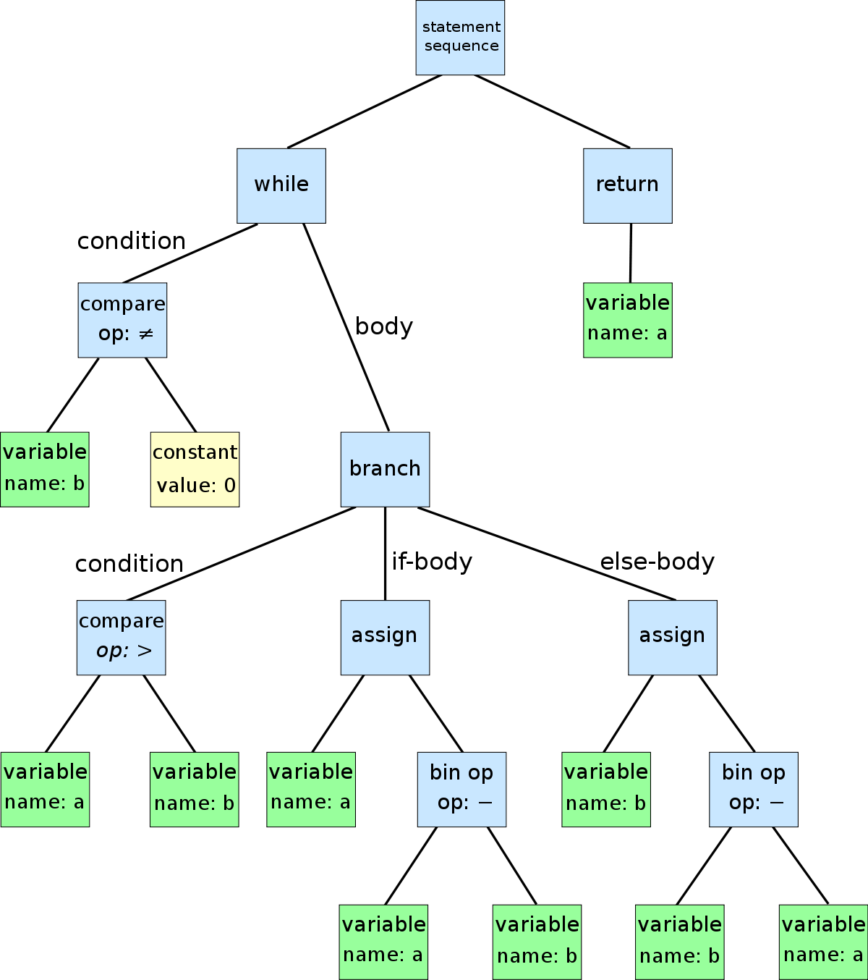
Theory
How can compilers output efficient machine code instructions for programs? (take CS143!)
Languages can be represented as regular expressions and context-free grammars, and programs can be represented as tree structures.
We can model programs as control-flow graphs for additional optimization

Slide 35
Security
How can we find / fix vulnerabilities at various levels in our programs? (take CS155!)
Understand machine-level representation and data manipulation
Understand how a computer executes programs
macOS High Sierra Root Login Bug: https://objective-see.com/blog/blog_0x24.html
How can we ensure that our systems and networks are secure? (take CS155!)
How can we design internet services worthy of our trust? (take CS152!)

Slide 36
Ethics, Privacy, Partiality and Trust
How can we recognize ethically important decisions as they arise? What policies ought we to adopt to address these issues? (take CS 181!)
Why is privacy important? What technical and policy standards should we strive for to protect privacy? (take CS 182!)

Slide 37
After CS107, you are prepared to take a variety of classes in various areas. What are some options?

Slide 38

Where Are We?
CS 106B/X
CS 103
Programming
Abstractions
Mathematical
Foundations of
Computing
We are here
CS 107/E
CS 109
Systems
Theory
Computer
Organization and
Systems
Intro to Probability
for Computer
Scientists
CS 111
CS 161
Operating Systems
Principles
Design and Analysis
of Algorithms

Slide 39




CS 111
How can programs perform multiple tasks concurrently and share resources between those tasks?
How does every program think it has access to all memory addresses if it needs them?
How can we implement a filesystem to store persistent data?
Jerry Cain
David Mazieres
Nick Troccoli
John Ousterhout
https://en.wikipedia.org/wiki/Multithreading_(computer_architecture)#/media/File:Multithreaded_process.svg

Slide 40
Other Courses
CS112: Operating Systems Project
CS140/CS212: Operating Systems
CS143: Compilers
CS144: Networking
CS145: Databases
CS152: Trust and Safety Engineering
CS155: Computer and Network Security
CS166: Data Structures
CS181: Computers, Ethics, and Public Policy
CS182: Ethics, Public Policy, and Technological Change
CS221: Artificial Intelligence
CS246: Mining Massive Datasets
EE108: Digital Systems Design
EE180: Digital Systems Architecture

Slide 41
Thank you!
Notes:
CS107 is a challenging class
We strive to help you learn the most per unit time
We hope you learned a lot, enjoyed the class, and that we were able to exceed your expectations
Visit anytime!

