Slide 1
CS107 Lecture 3
Byte Ordering & Bitwise Operators
reading:
Bryant & O’Hallaron, Ch. 2.1
This document is copyright (C) Stanford Computer Science, Lisa Yan, and Nick Troccoli, licensed under Creative Commons Attribution 2.5 License. All rights reserved.
Based on slides created by Marty Stepp, Cynthia Lee, Chris Gregg, Jerry Cain and others.

Slide 2
Where we left off

Slide 3
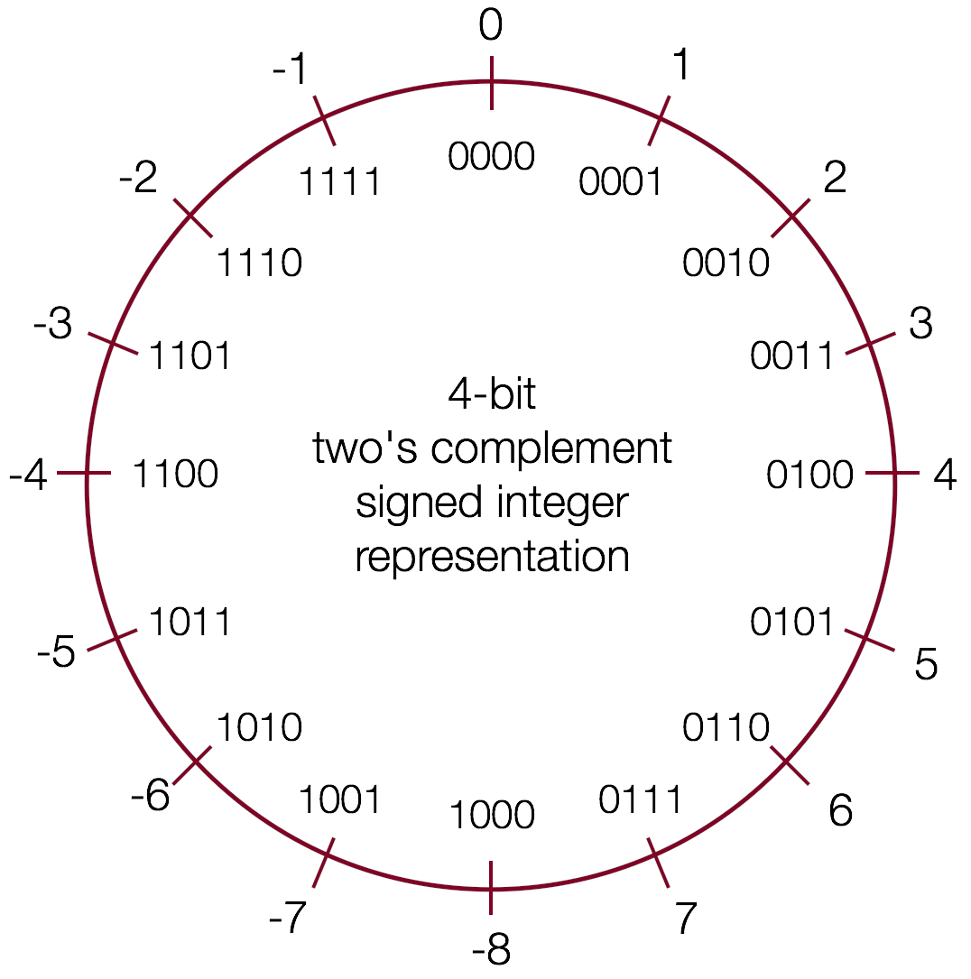
Comparison between signed and unsigned integers
When a C expression has combinations of signed and unsigned variables, you need to be careful!
If an operation is performed that has both a signed and an unsigned value, C implicitly casts the signed argument to unsigned and performs the operation assuming both numbers are non-negative. Let's take a look…
Expression | Type | Evaluation
0 == 0U | Unsigned | 1
-1 < 0 | Signed | 1
-1 < 0U | Unsigned | 0
2147483647 > -2147483647 - 1 | Signed | 1
2147483647U > -2147483647 - 1 | Unsigned | 0
2147483647 > (int)2147483648U | Signed | 1
-1 > -2 | Signed | 1
(unsigned)-1 > -2 | Unsigned | 1
Note: In C, 0 is false and everything else is true. When C produces a boolean value, it allways chooses 1 to represent true.

Slide 4
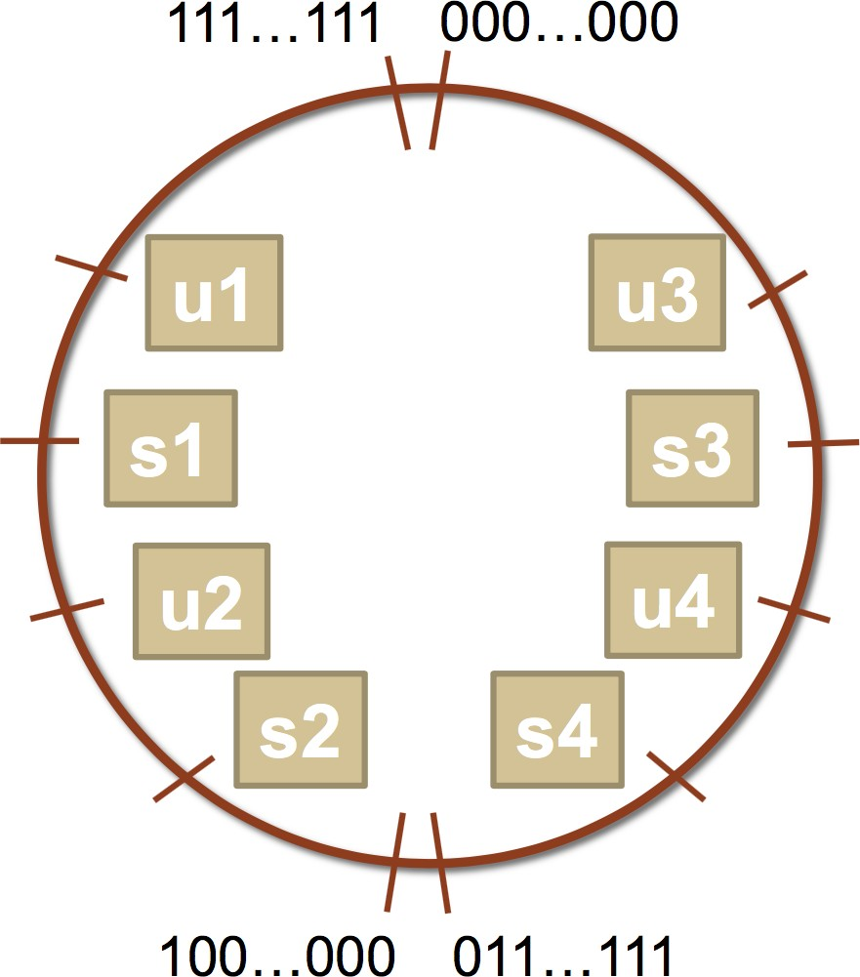
Comparison between signed and unsigned integers
Let's try some more…a bit more abstractly.
int s1, s2, s3, s4;
unsigned int u1, u2, u3, u4;
What is the value of this expression?
u1 | > s3
Go to
https://pollev.com/cs107summer

Slide 5
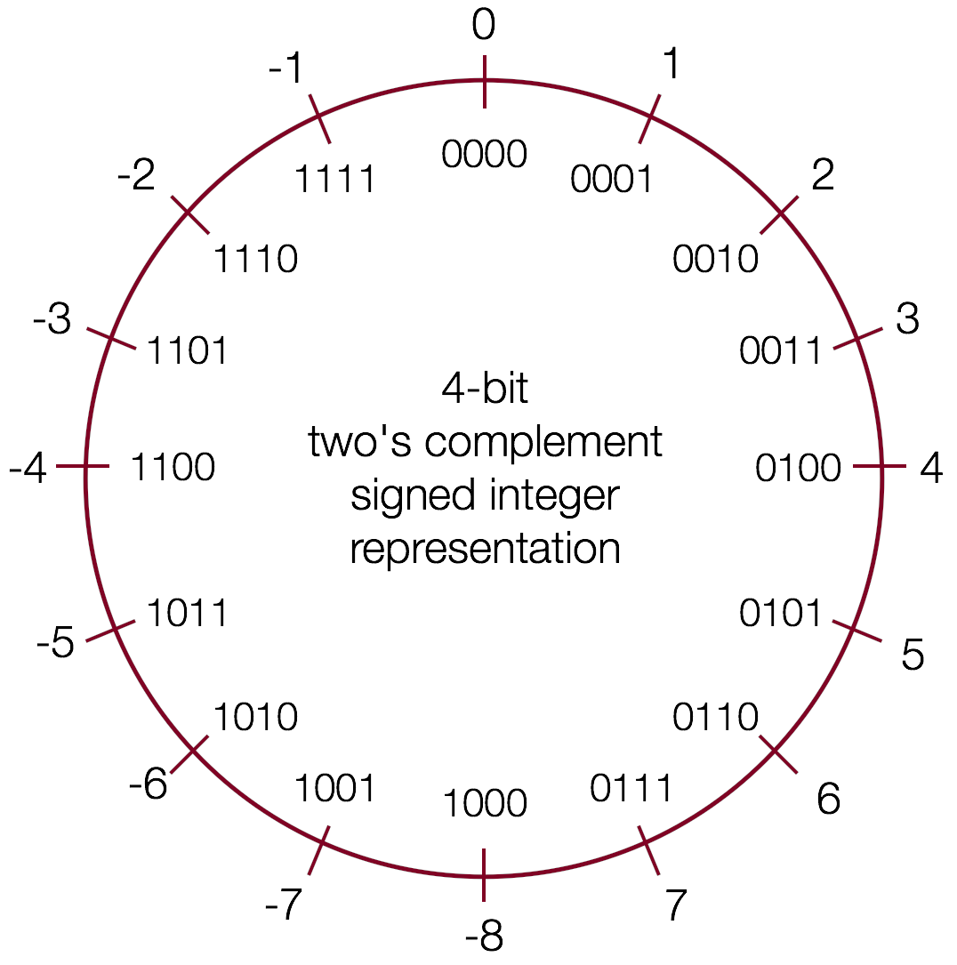



Overflow
What is happening here? Assume 4-bit numbers.
0b1101
+ 0b0100
15
14
0
1
2
13
3
12
4
11
5
10
9
6
8
7

Slide 6
Overflow
What is happening here? Assume 4-bit numbers.
0b1101
+ 0b0100
15
14
0
1
2
13
3
12
4
Signed
-3 + 4 = 1
No overflow
Unsigned
13 + 4 = 1
Overflow
11
5
10
6
9
8
7

Slide 7
Limits and Comparisons
1. What is
the…
Largest unsigned?
Largest signed?
Smallest signed?
char
₂8
- 1 = 255
₂7
– 1 = 127
-2⁷ = -128
₂32
₂31
₋₂31
=
int
- 1 =
- 1 =
4294967296
2147483647
-2147483648
These are available as UCHAR_MAX, INT_MIN,
INT_MAX, etc. in the
<limits.h> header.

Slide 8
Limits and Comparisons
2. Will the following char comparisons evaluate to true or false?
i. -7 < 4
iii. (char) 130 > 4
ii. -7 < 4U
iv. (char) -132 > 2
By default, numeric constants in C are signed ints, unless they are suffixed with u (unsigned) or L (long).

Slide 9
The sizeof Operator
long sizeof(type);
// Example
long int_size_bytes = sizeof(int); // 4
long short_size_bytes = sizeof(short); // 2 long char_size_bytes = sizeof(char); // 1
sizeof takes a variable type as a parameter and returns the size of that type, in bytes.

Slide 10
MIN and MAX values for integers
Because we now know how bit patterns for integers works, we can figure out the maximum and minimum values, designated by INT_MAX, UINT_MAX, INT_MIN, (etc.), which are defined in limits.h
Type | Width (bytes) | Width (bits) | Min in hex (name) | Max in hex (name)
char | 1 | 8 | 80 (CHAR_MIN) | 7F (CHAR_MAX)
unsigned char | 1 | 8 | 0 | FF (UCHAR_MAX)
short | 2 | 16 | 8000 (SHRT_MIN) | 7FFF (SHRT_MAX)
unsigned short | 2 | 16 | 0 | FFFF (USHRT_MAX)
int | 4 | 32 | 80000000 (INT_MIN) | 7FFFFFFF (INT_MAX)
unsigned int | 4 | 32 | 0 | FFFFFFFF (UINT_MAX)
long | 8 | 64 | 8000000000000000 (LONG_MIN) | 7FFFFFFFFFFFFFFF (LONG_MAX)
unsigned long | 8 | 64 | 0 | FFFFFFFFFFFFFFFF (ULONG_MAX)

Slide 11
Min and Max Integer Values
You can also find constants in the standard library that define the max and min for each type on that machine(architecture)
Visit <limits.h> or <cstdint.h> and look for variables like:
INT_MIN
INT_MAX
UINT_MAX
LONG_MIN
LONG_MAX
ULONG_MAX
…

Slide 12
Expanding Bit Representations
Sometimes, we want to convert between two integers of different sizes (e.g.
short to int, or int to long).
We might not be able to convert from a bigger data type to a smaller data type, but we do want to always be able to convert from a smaller data type to a bigger data type.
For unsigned values, we can add leading zeros to the representation (“zero extension”)
For signed values, we can repeat the sign of the value for new digits (“sign extension”
Note: when doing <, >, <=, >= comparison between different size types, it will
promote to the larger type.

Slide 13
Expanding the bit representation of a number
For signed values, we want the number to remain the same, just with more bits. In this case, we perform a "sign extension" by repeating the sign of the value for the new digits. E.g.,
short s = 4;
// short is
int i = s;
a 16-bit format, so
s = 0000 0000 0000 0100b
// conversion | to 32-bit int, | so | i | = | 0000 | 0000 | 0000 | 0000 | 0000 | 0000 | 0000 | 0100b
— or —
short s = -4; // short is a | 16-bit format, | so |  |  |  |  |  | s = | 1111 | 1111 | 1111 | 1100b
int i = s; // conversion | to 32-bit int, | so | i | = | 1111 | 1111 | 1111 | 1111 | 1111 | 1111 | 1111 | 1100b
Converting from a smaller type to a larger type is also often called promotion
I.E. the number was promoted from short to int

Slide 14
Sign-extension Example
// show_bytes() defined on pg. 45, Bryant and O'Halloran
int main() {
short sx = -12345; // -12345
unsigned short usx = sx; // 53191
int x = sx; // -12345
unsigned ux = usx; // 53191
printf("sx = %d:\t", sx);
show_bytes((byte_pointer) &sx, sizeof(short));
printf("usx = %u:\t", usx);
show_bytes((byte_pointer) &usx, sizeof(unsigned short));
printf("x = %d:\t", x);
show_bytes((byte_pointer) &x, sizeof(int));
printf("ux = %u:\t", ux);
show_bytes((byte_pointer) &ux, sizeof(unsigned));
return 0;
}
$ ./sign_extension
sx = -12345: c7 cf
usx = 53191: c7 cf
x = -12345: c7 cf ff ff
ux = 53191: c7 cf 00 00
(careful: this was printed on the little-endian myth machines!)

Slide 15
Truncating Numbers: Signed
What if we want to reduce the number of bits that a number holds? E.g.
int x short int y
= 53191;
sx = (short)
= sx;
// 53191
x; // -12345
This is a form of overflow! We have altered the value of the number. Be careful!
We don't have enough bits to store the int in the short for the value we have in the int, so the strange values occur.
What is y above? We are converting a short to an int, so we sign-extend, and we get -12345!
 |  |  |  | 1100 | 1111 | 1100 | 0111 becomes
1111 | 1111 | 1111 | 1111 | 1100 | 1111 | 1100 | 0111
Play around here: http://www.convertforfree.com/twos-complement-calculator/

Slide 16
Truncating Numbers: Signed
If the number does fit into the smaller representation in the current form, it will convert just fine.
int x short int y
= -3;
sx = (short)
= sx; // -3
// -3
-3; // -3
x: | 1111 | 1111 | 1111 | 1111 | 1111 | 1111 | 1111 | 1101 becomes
sx: |  |  |  |  | 1111 | 1111 | 1111 | 1101
Play around here: http://www.convertforfree.com/twos-complement-calculator/

Slide 17
Truncating Numbers: Unsigned
We can also lose information with unsigned numbers:
unsigned unsigned unsigned
int x short int y
= 128000;
sx = (short) x;
= sx;
Bit representation for x = 128000 (32-bit unsigned int):
0000 0000 0000 0001 1111 0100 0000 0000
Truncated unsigned short sx:
1111 0100 0000 0000
which equals 62464 decimal.
Converting back to an unsigned int, y = 62464

Slide 18
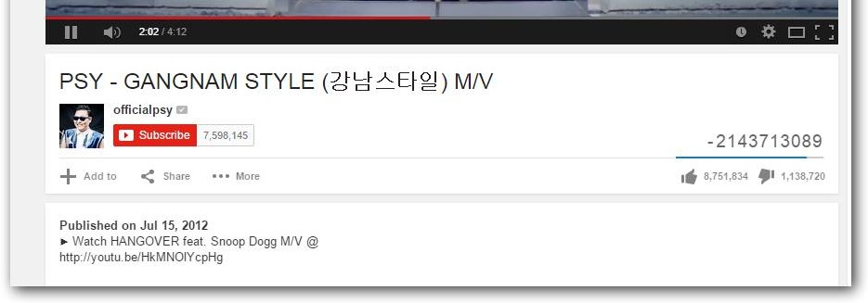
Overflow in Signed Addition
Signed overflow wraps around to the negative numbers:
YouTube fell into this trap — their view counter was a signed, 32-bit int. They fixed it after it was noticed, but for a while, the view count for Gangnam Style (the first video with over INT_MAX number of views) was negative.

Slide 19
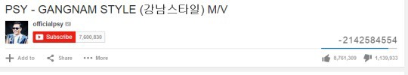
Overflow In Practice: PSY
YouTube: “We never thought a video would be watched in numbers greater than a 32-bit integer (=2,147,483,647 views), but that was before we met PSY. "Gangnam Style" has been viewed so many times we had to upgrade to a 64-bit integer (9,223,372,036,854,775,808)!”

Slide 20
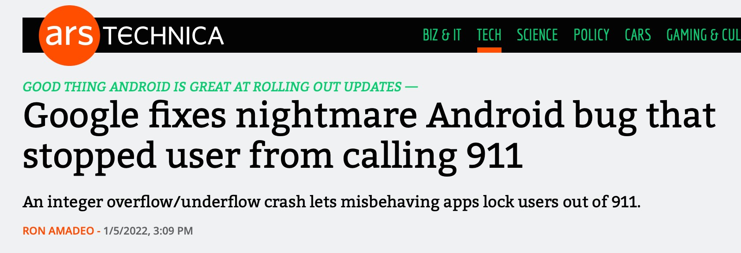
Overflow in Signed Addition
In the news on January 5, 2022 (!):
https://arstechnica.com/gadgets/2022/01/google-fixes-nightmare-android-bug- that-stopped-user-from-calling-911/

Slide 21
Overflow in Signed Addition
Signed overflow wraps around to the negative numbers.
#include<stdio.h>
#include<stdlib.h>
#include<limits.h> // for INT_MAX
int main() {
int a = INT_MAX;
int b = 1;
int c = a + b;
printf("a = %d\n",a);
printf("b = %d\n",b);
printf("a + b = %d\n",c);
return 0;
}
$ ./signed_overflow
a = 2147483647
b = 1
a + b = -2147483648
Technically, signed integers in C produce undefined behavior when they overflow. On two's complement machines (virtually all machines these days), it does overflow predictably. You can test to see if your addition will be correct:
// for addition
#include <limits.h>
int a = <something>;
int x = <something>;
if ((x > 0) && (a > INT_MAX - x)) /* `a + x` would overflow */;
if ((x < 0) && (a < INT_MIN - x)) /* `a + x` would underflow */;

Slide 22
Overflow
At which points can overflow occur for signed and unsigned int? (assume binary values shown are all 32 bits)
Signed and unsigned can both overflow at points X and Y
Signed can overflow only at X, unsigned only at Y
Signed can overflow only at Y, unsigned only at X
Signed can overflow at X and Y, unsigned only at X
Neither.
111…111
111…110
000…000
000…001
111…101
111…100
000…010
000…011
X
…
…
Y
100…010
100…001
100…000
011…101
011…110
011…111
Go to
https://pollev.com/cs107summer

Slide 23
Overflow In Practice: Timestamps
Many systems store timestamps as the number of seconds since Jan. 1, 1970
in a signed 32-bit integer.
Problem: the latest timestamp that can be represented this way is 3:14:07 UTC on Jan. 13 2038!

Slide 24
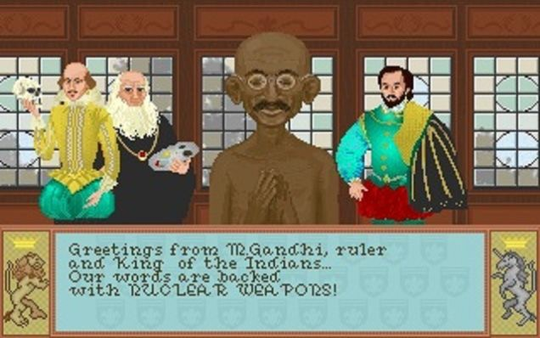
Overflow In Practice: Gandhi
In the game “Civilization”, each civilization leader had an “aggression” rating. Gandhi was meant to be peaceful, and had a score of 1.
If you adopted “democracy”, all players’ aggression reduced by 2. Gandhi’s went from 1 to 255!
Gandhi then became a big fan of nuclear weapons.
https://kotaku.com/why-gandhi-is-such-an-asshole-in-civilization-1653818245

Slide 25
Overflow in Practice:
Pacman Level 256
Make sure to reboot Boeing Dreamliners every 248 days
Comair/Delta airline had to cancel thousands of flights days before Christmas
Reported vulnerability CVE-2019-3857 in libssh2 may allow a hacker to remotely execute code
Donkey Kong Kill Screen

Slide 26
printf and Integers
There are 3 placeholders for 32-bit integers that we can use:
  %d: signed 32-bit int
  %u: unsigned 32-bit int
  %x: hex 32-bit int
The placeholder—not the expression filling in the placeholder—dictates what gets printed!

Slide 27
Casting
What happens at the byte level when we cast between variable types? The bytes remain the same! This means they may be interpreted differently depending on the type.
int v = -12345; unsigned int uv = v;
printf("v = %d, uv = %u\n", v, uv);
This prints out: "v = -12345, uv = 4294954951". Why?

Slide 28
Casting
What happens at the byte level when we cast between variable types? The bytes remain the same! This means they may be interpreted differently depending on the type.
int v = -12345; unsigned int uv = v;
printf("v = %d, uv = %u\n", v, uv);
The bit representation for -12345 is 0b11111111111111111100111111000111.
If we treat this binary representation as a positive number, it’s huge!

Slide 29
Practice: Two’s Complement
Fill in the below table:
It’s easier to compute base-10 for positive numbers, so use two’s complement first if negative.
char x = ;
decimal binary
char y = -x;
decimal binary
1.
2.
3.
4.
0b1111 1100
0b0001 1000
0b0010 0100
0b1101 1111

Slide 30
Practice: Two’s Complement
Fill in the below table:
It’s easier to compute base-10 for positive numbers, so use two’s complement first if negative.
char | x = ; | char y = -x;
decimal | binary | decimal | binary
1. -4 | 0b1111 1100 | 4 | 0b0000 | 0100
2. | 0b0001 1000
3. | 0b0010 0100
4. | 0b1101 1111

Slide 31
Practice: Two’s Complement
Fill in the below table:
It’s easier to compute base-10 for positive numbers, so use two’s complement first if negative.
char x = ;
decimal binary
-4 0b1111 1100
24 0b0001 1000
36 0b0010 0100
-33 0b1101 1111
char y = -x;
decimal binary
1.
2.
3.
4.
4
0b0000 0100
-24
0b1110 1000
-36
0b1101 1100
33
0b0010 0001

Slide 32
Addressing and Byte Ordering
Every variable holds a value stored in memory.
A non-pointer variable (quietly) stores the address to that location in memory.
This means that when we use that variable it gives us the value at that location
A pointer (quietly) stores a location in memory, however the value at the location is another address.
Regardless of whether we are storing a value or an address, it is quite common for us to need more than one byte.

Slide 33
Addressing and Byte Ordering
The int type on our machines is 4 bytes long. So, how do we store 4 bytes, if memory is only byte-addressable?
We store it contiguously (back-to-back)!
That still leaves us with an important question, which way to go?
Right -> Left or Left -> Right?
We call this question the Endianness of the number
Lets begin by representing an int as an 8-digit hex numbers:
0x01234567
We can then separate out the bytes (remember 2 hex digits is 8 bits or 1 byte):
0x 01 23 45 67

Slide 34
Addressing and Byte Ordering
01 23 45 67
0000 0001 0010 0011 0100 0101 0110 0111
most significant least significant
Some machines choose to store the bytes ordered from least significant byte to most significant byte, called “little endian” (because the “little end” comes first).
Other machines choose to store the bytes ordered from most significant byte to least significant byte, called “big endian” (because the “big end” comes first).

Slide 35
Addressing and Byte Ordering
•
Our 0x 01 23 45 67 number would look like this in memory for a little endian computer (which, by the way, is the way the myth computers store ints):
byte: address:
67 | 45 | 23 | 01
0x100 | 0x101 | 0x102 | 0x103
•
A big-endian representation would look like this:
byte:
address:
Many times we don’t care how our integers are stored, but in cs107 we will! Let’s look at a sample program and dig under the hood to see how little-endian works.
01 | 23 | 45 | 67
0x100 | 0x101 | 0x102 | 0x103

Slide 36
Addressing and Byte Ordering
#include<stdio.h>
#include<stdlib.h>
3
4 int 5 | main() { // a variable
6 | int a = 0x01234567;
7
8 | // print the variable in big endian | format
9 | printf("a's value: 0x%.8x\n",a);
10 | return 0;
11 }

Slide 37
GDB as an Interpreter
gdb live_session run gdb on live_session executable
p print variable (p varname) or evaluated expression (p 3L << 10)
p/t, p/x
p/d, p/u, p/c
<enter>
q
binary and hex formats.
Execute last command again
Quit gdb
Important When first launching gdb:
Gdb is not running any program and therefore can’t print variables
It can still process operators on constants

Slide 38
gdb on a program
gdb live_session
b
run gdb on executable Set breakpoint on a function (e.g., b main)
or line (b 42)
Run with provided args control forward execution (next, step into, continue)
r 82
n, s, continue
p print variable (p varname) or evaluated expression (p 3L << 10)
p/t, p/x
p/d, p/u, p/c
info
binary and hex formats.
args, locals
Important: gdb does not run the current line until you hit “next”

Slide 39
gdb: highly recommended
At this point, setting breakpoints/stepping in gdb may seem like overkill for what could otherwise be achieved by copious printf statements.
However, gdb is incredibly useful for assign1 (and all assignments):
A fast “C interpreter”: p + <expression>
  Sandbox/try out ideas around bitshift operators, signed/unsigned types, etc.
  Can print values out in binary!
  Once you’re happy, then make changes to your C file
Tip: Open two terminal windows and SSH into myth in both
  Keep one for emacs, the other for gdb/command-line
  Easily reference C file line numbers and variables while accessing gdb
Tip: Every time you update your C file, make and then rerun gdb. Gdb takes practice! But the payoff is tremendous! ©

Slide 40
gdb step, next, finish
I've seen a few students who have been frustrated with stepping through functions in gdb. Sometimes, they will accidentally step into a function like strlen or printf and get stuck.
There are three important gdb commands about stepping through a program:
step (abbreviation: s) : executes the next line and goes into function calls.
next (abbreviation: n) : executes the next line, and does not go into function calls. I.e., if you want to run a line with strlen or printf but don't want to attempt to go into that function, use next.
display (abbreviation: disp) : displays a variable (or other item) after each step.
finish (abbreviation: fin) : completes a function and returns to the calling function. This is the command you want if you accidentally go into a function like strlen or printf! This continues the program until the end of the function, putting you back into the calling function3 .

Slide 41
Bitwise Operations

Slide 42
Bitwise Operators
You’re already familiar with many operators in C:
  Arithmetic operators: +, -, *, /, %
  Comparison operators: ==, !=, <, >, <=, >=
  Logical Operators: &&, ||, !
Today, we’re introducing a new category of operators: bitwise operators:
  &, |, ~, ^, <<, >>

Slide 43
And (&)
AND is a binary operator. The AND of 2 bits is 1 if both bits are 1, and 0 otherwise.
output = a & b;
a | b | output
0 | 0 | 0
0 | 1 | 0
1 | 0 | 0
1 | 1 | 1
& with 1 to let a bit through, & with 0 to zero out a bit

Slide 44
Or (|)
OR is a binary operator. The OR of 2 bits is 1 if either (or both) bits is 1.
output = a | b;
a | b | output
0 | 0 | 0
0 | 1 | 1
1 | 0 | 1
1 | 1 | 1
| with 1 to turn on a bit, | with 0 to let a bit go through

Slide 45
Not (~)
NOT is a unary operator. The NOT of a bit is 1 if the bit is 0, or 1 otherwise.
output = ~a;
a | output
0 | 1
1 | 0

Slide 46
Exclusive Or (^)
Exclusive Or (XOR) is a binary operator. The XOR of 2 bits is 1 if exactly one of the bits is 1, or 0 otherwise.
output = a ^ b;
a | b | output
0 | 0 | 0
0 | 1 | 1
1 | 0 | 1
1 | 1 | 0
^ with 1 to flip a bit, ^ with 0 to let a bit go through

Slide 47

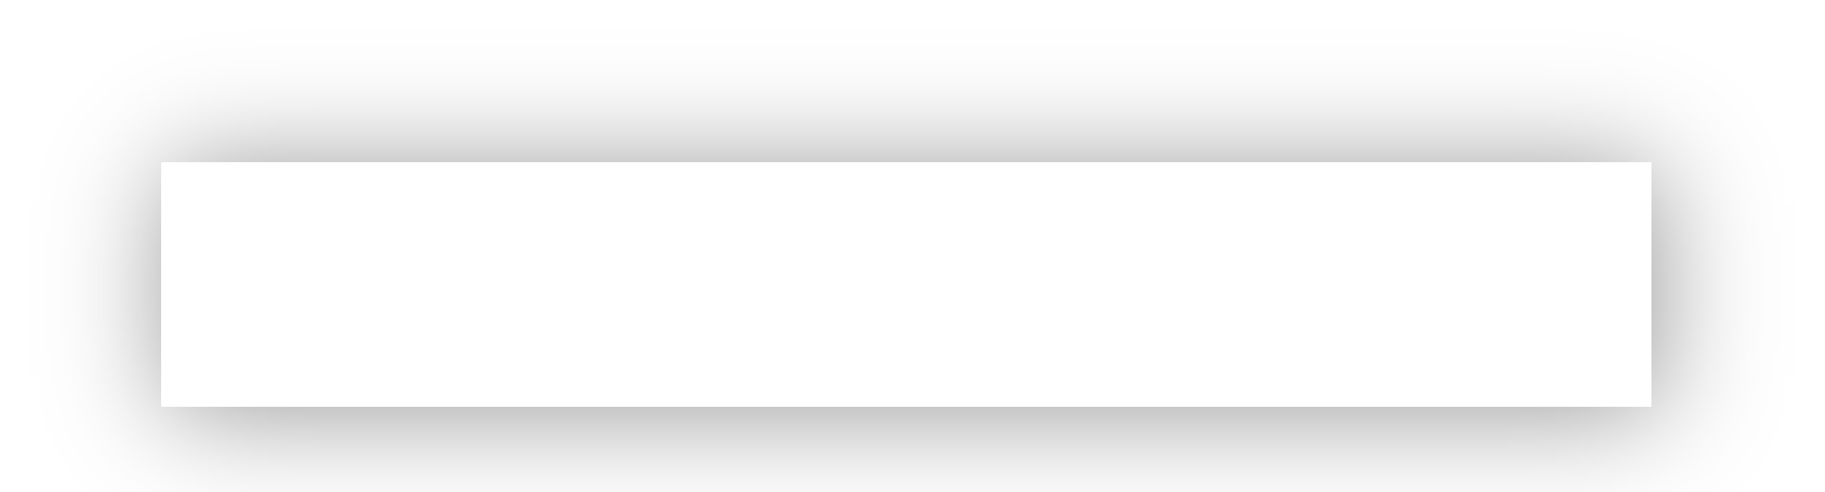
Operators on Multiple Bits
When these operators are applied to numbers (multiple bits), the operator is applied to the corresponding bits in each number. For example:
 | AND |  |  | OR |  |  | XOR |  |  | NOT
 | 0110 |  |  | 0110 |  |  | 0110
& | 1100 |  | | | 1100 |  | ^ | 1100 |  | ~ | 1100
 | 0100 |  |  | 1110 |  |  | 1010 |  |  | 0011
Note: these are different from the logical operators AND (&&), OR (||) and NOT (!).

Slide 48
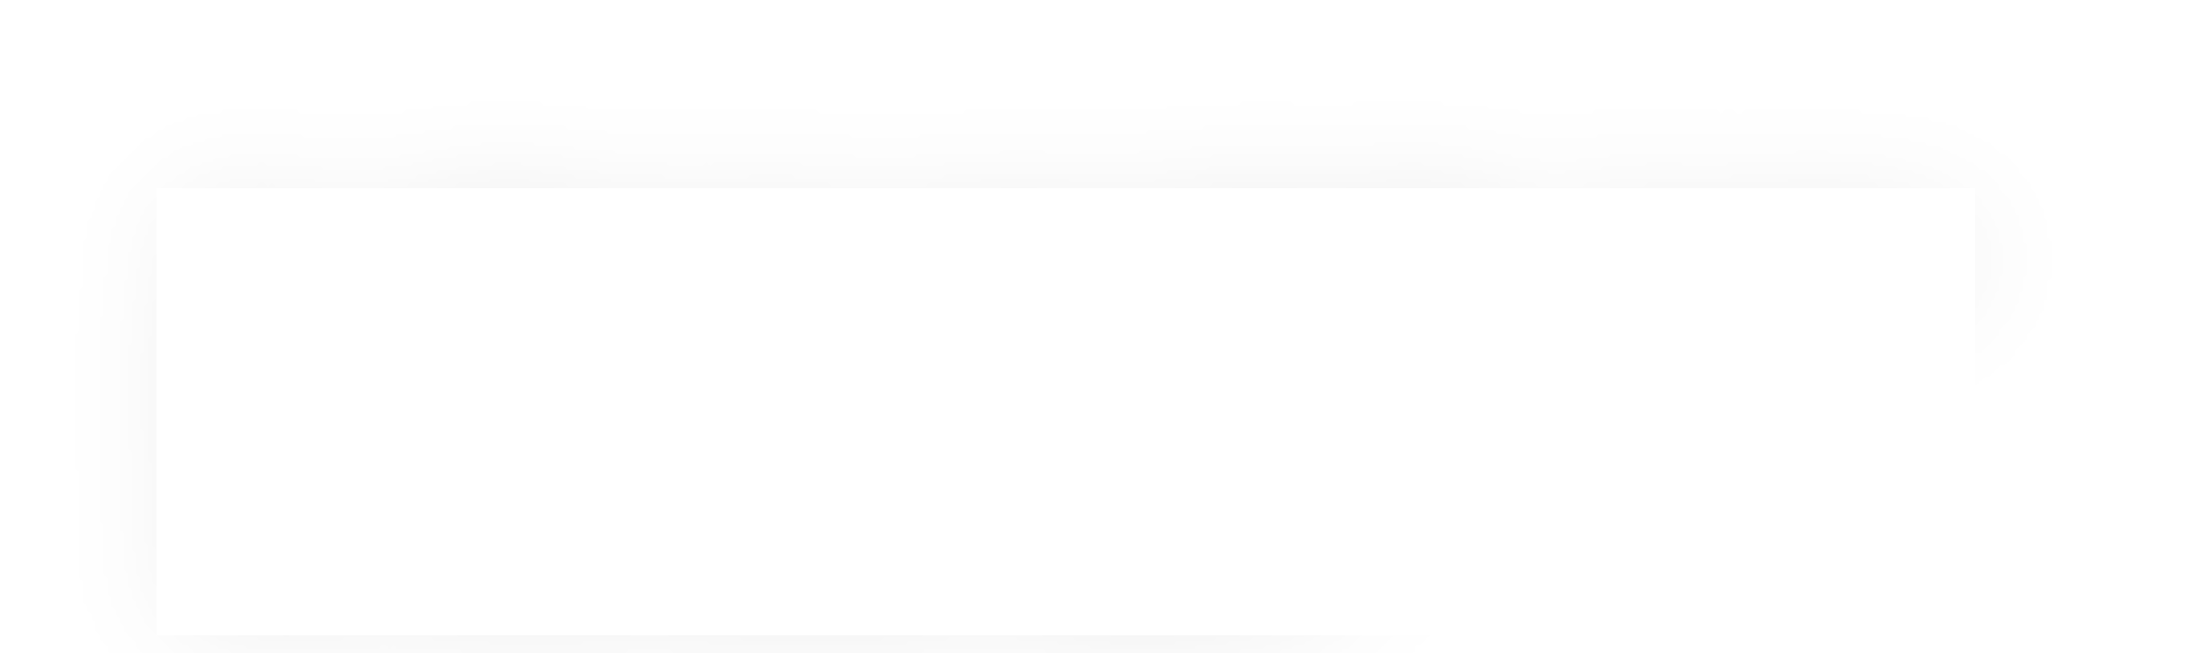
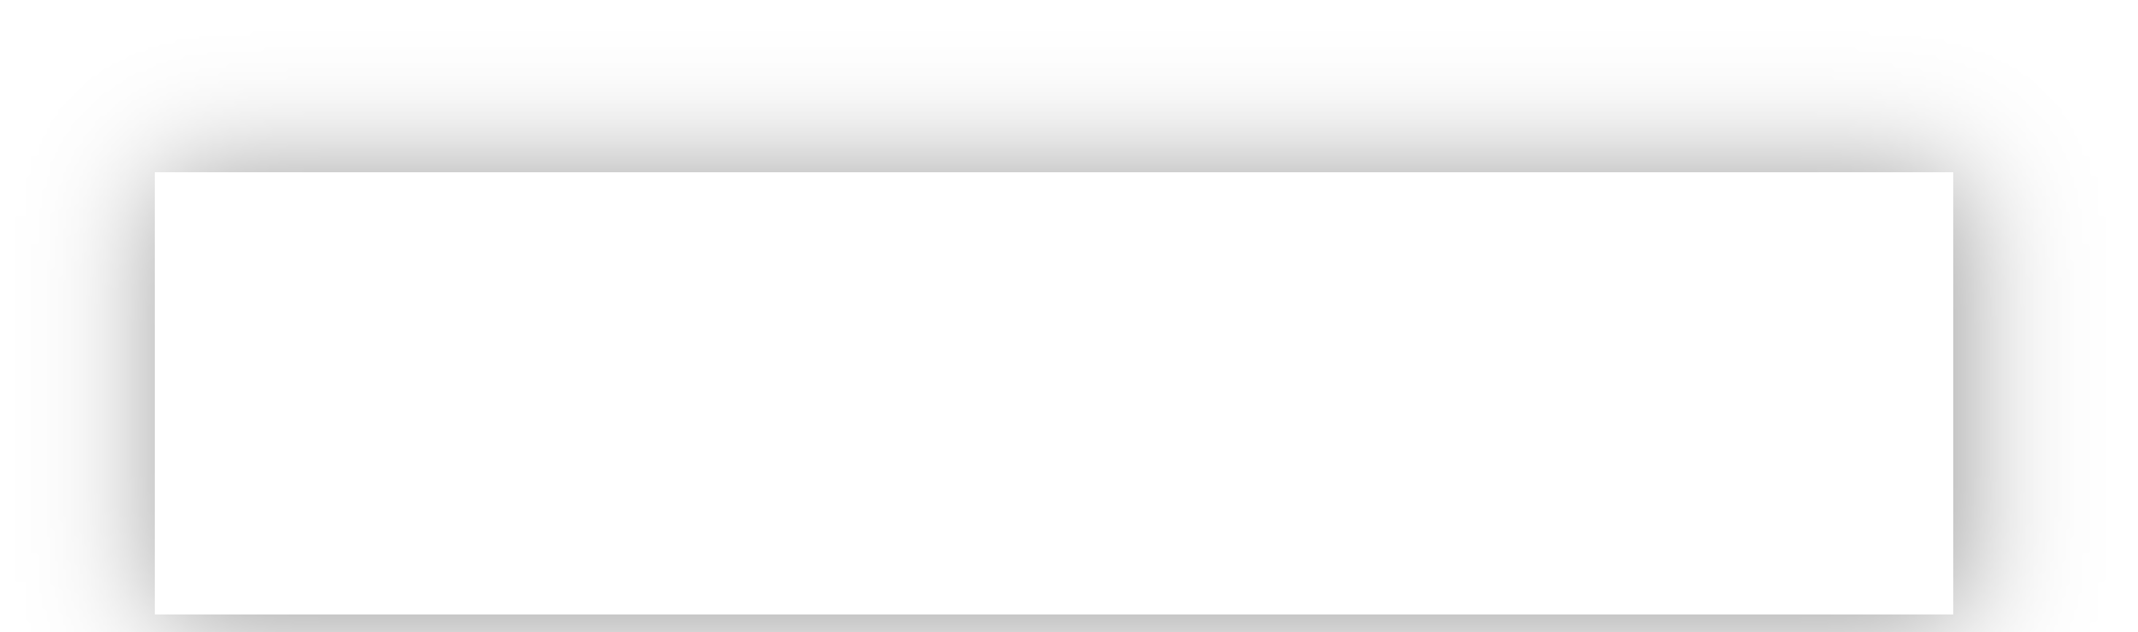
Operators on Multiple Bits
When these operators are applied to numbers (multiple bits), the operator is applied to the corresponding bits in each number. For example:
 | AND |  |  | OR |  |  | XOR |  |  | NOT
 | 0110 |  |  | 0110 |  |  | 0110
& | 1100 |  | | | 1100 |  | ^ | 1100 |  | ~ | 1100
 | 0100 |  |  | 1110 |  |  | 1010 |  |  | 0011
This is different from logical AND (&&). The logical AND returns true if both are nonzero, or false otherwise. With &&, this would be 6 && 12, which would evaluate to true (1).
13

Slide 49
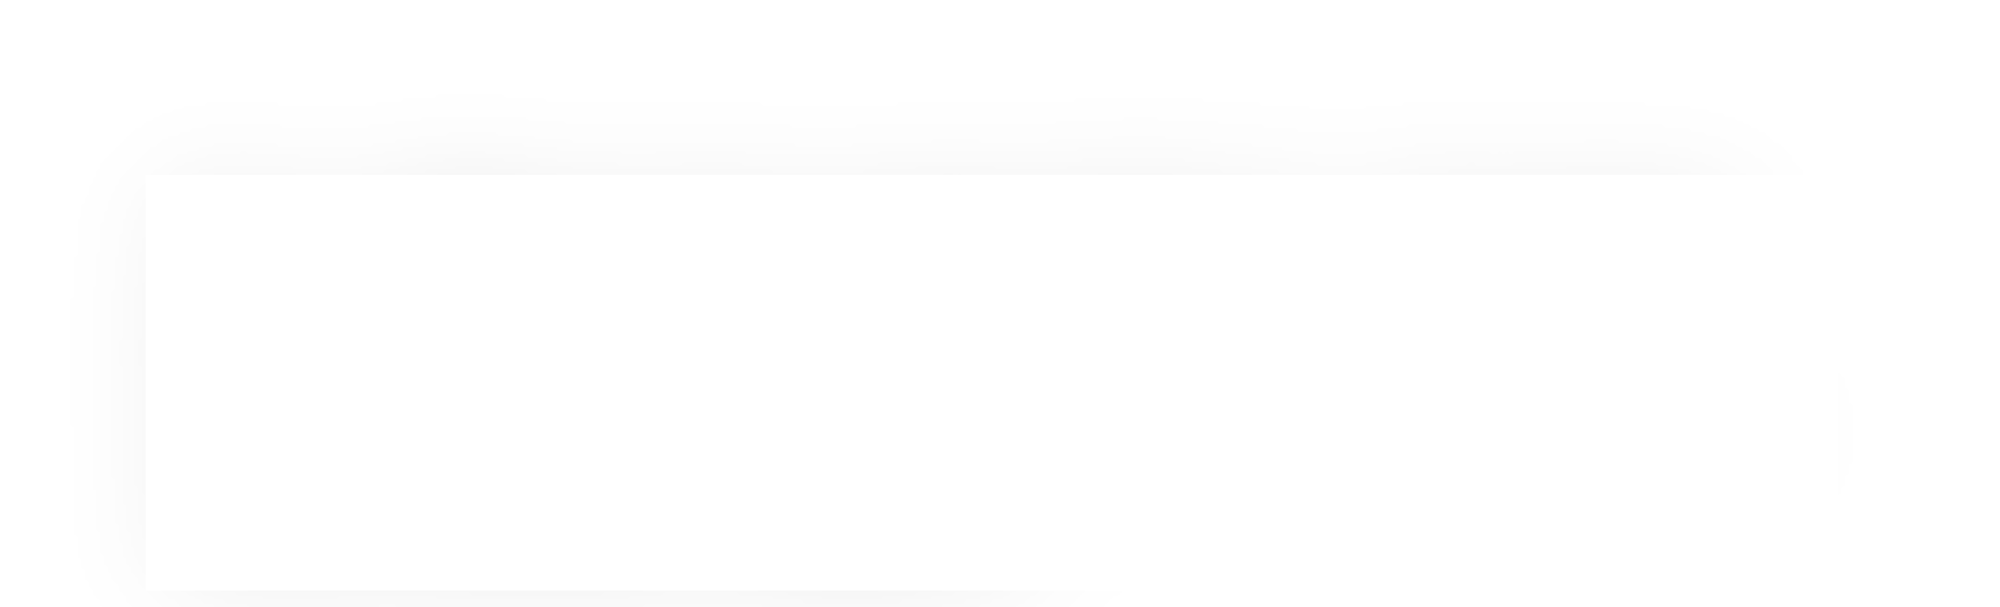
Operators on Multiple Bits
When these operators are applied to numbers (multiple bits), the operator is applied to the corresponding bits in each number. For example:
 | AND |  |  | OR |  |  | XOR |  |  | NOT
 | 0110 |  |  | 0110 |  |  | 0110
& | 1100 |  | | | 1100 |  | ^ | 1100 |  | ~ | 1100
 | 0100 |  |  | 1110 |  |  | 1010 |  |  | 0011
This is different from logical OR (||). The logical OR returns true if either are nonzero, or false otherwise. With ||, this would be 6 || 12, which would evaluate to true (1).
14

Slide 50

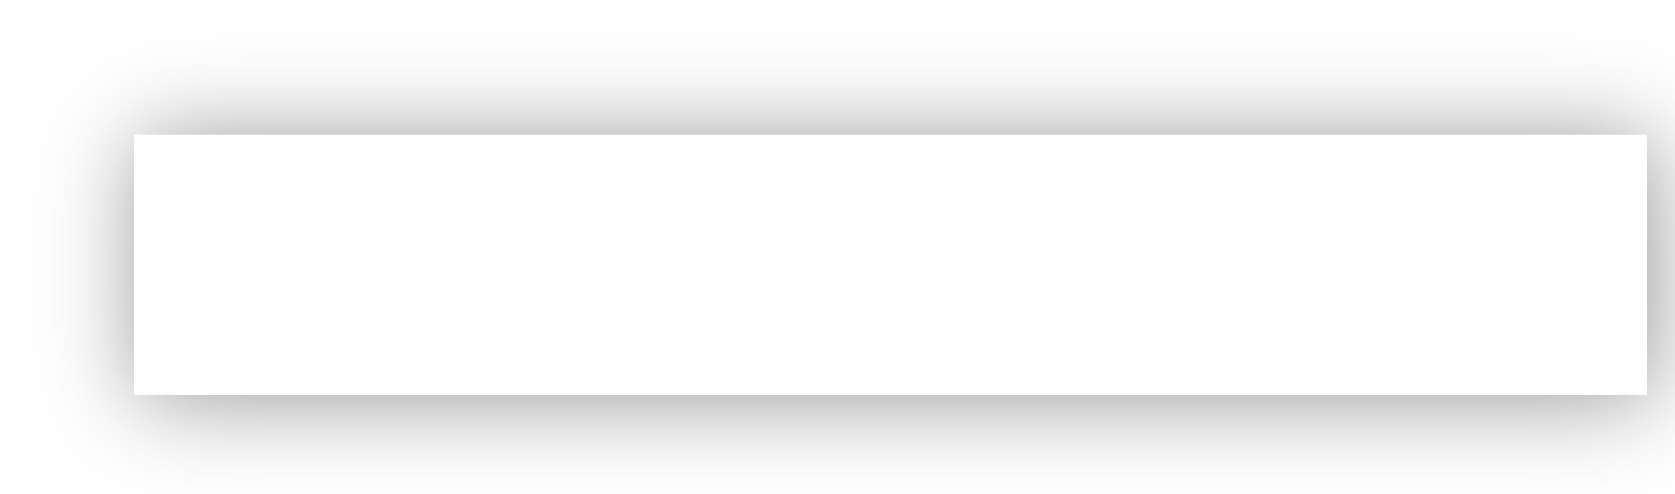
Operators on Multiple Bits
When these operators are applied to numbers (multiple bits), the operator is applied to the corresponding bits in each number. For example:
 | AND |  |  | OR |  |  | XOR |  |  | NOT
 | 0110 |  |  | 0110 |  |  | 0110
& | 1100 |  | | | 1100 |  | ^ | 1100 |  | ~ | 1100
 | 0100 |  |  | 1110 |  |  | 1010 |  |  | 0011
This is different from logical NOT (!). The logical NOT returns true if this is zero, and false otherwise. With !, this would be !12, which would evaluate to false (0).

Slide 51
Bit Vectors and Sets
We can use bit vectors (ordered collections of bits) to represent finite sets, and perform functions such as union, intersection, and complement.
Example: we can represent current courses taken using a char.
0 | 0 | 1 | 0 | 0 | 0 | 1 | 1
CS161
CS109
CS103
CS110
CS107
CS106X
CS106B
CS106A

Slide 52
Bit Vectors and Sets
0 | 0 | 1 | 0 | 0 | 0 | 1 | 1
CS161
CS109
CS103
CS110
CS107
CS106X
CS106B
CS106A
How do we find the union of two sets of courses taken? Use OR:
00100011
| 01100001
01100011

Slide 53
Bit Vectors and Sets
0 | 0 | 1 | 0 | 0 | 0 | 1 | 1
CS161
CS109
CS103
CS110
CS107
CS106X
CS106B
CS106A
How do we find the intersection of two sets of courses taken? Use AND:
00100011
& 01100001
00100001

Slide 54
Bit Masking
We will frequently want to manipulate or isolate out specific bits in a larger collection of bits. A bitmask is a constructed bit pattern that we can use, along with bit operators, to do this.
Example: how do we update our bit vector to indicate we’ve taken CS107?
0 | 0 | 1 | 0 | 0 | 0 | 1 | 1
CS161
CS109
CS103
CS110
CS107
CS106X
CS106B
CS106A
00100011
| 00001000
00101011

Slide 55
Bit Masking
#define | CS106A | 0x1 | /* | 0000 | 0001 | */
#define | CS106B | 0x2 | /* | 0000 | 0010 | */
#define | CS106X | 0x4 | /* | 0000 | 0100 | */
#define | CS107 | 0x8 | /* | 0000 | 1000 | */
#define | CS110 | 0x10 | /* | 0001 | 0000 | */
#define | CS103 | 0x20 | /* | 0010 | 0000 | */
#define | CS109 | 0x40 | /* | 0100 | 0000 | */
#define | CS161 | 0x80 | /* | 1000 | 0000 | */
char myClasses = ...; myClasses = myClasses | CS107;
// Add CS107

Slide 56
Bit Masking
#define | CS106A | 0x1 | /* | 0000 | 0001 | */
#define | CS106B | 0x2 | /* | 0000 | 0010 | */
#define | CS106X | 0x4 | /* | 0000 | 0100 | */
#define | CS107 | 0x8 | /* | 0000 | 1000 | */
#define | CS110 | 0x10 | /* | 0001 | 0000 | */
#define | CS103 | 0x20 | /* | 0010 | 0000 | */
#define | CS109 | 0x40 | /* | 0100 | 0000 | */
#define | CS161 | 0x80 | /* | 1000 | 0000 | */
char myClasses = ...; myClasses |= CS107;
// Add CS107

Slide 57
Bit Masking
Example: how do we update our bit vector to indicate we’ve not taken CS103?
0 | 0 | 1 | 0 | 0 | 0 | 1 | 1
CS161
CS109
CS103
CS110
CS107
CS106X
CS106B
CS106A
00100011
& 11011111
00000011
char myClasses = ...;
myClasses = myClasses & ~CS103;
// Remove CS103
23

Slide 58
Bit Masking
Example: how do we update our bit vector to indicate we’ve not taken CS103?
0 | 0 | 1 | 0 | 0 | 0 | 1 | 1
CS161
CS109
CS103
CS110
CS107
CS106X
CS106B
CS106A
00100011
& 11011111
00000011
char myClasses = ...; myClasses &= ~CS103;
// Remove CS103
24

Slide 59
Bit Masking
Example: how do we check if we’ve taken CS106B?
0 | 0 | 1 | 0 | 0 | 0 | 1 | 1
CS161
CS109
CS103
CS110
CS107
CS106X
CS106B
CS106A
00100011
& 00000010
00000010
char myClasses = ...;
if (myClasses & CS106B) {...
// taken CS106B!
25

Slide 60
Bit Masking
Example: how do we check if we’ve not taken CS107?
0 | 0 | 1 | 0 | 0 | 0 | 1 | 1
CS161
CS109
CS103
CS110
CS107
CS106X
CS106B
CS106A
00100011
& 00001000
00000000
char myClasses = ...;
if (!(myClasses & CS107)) {...
//
not
taken
CS107!

Slide 61
Bit Masking
Example: how do we check if we’ve not taken CS107?
0 | 0 | 1 | 0 | 0 | 0 | 1 | 1
CS161
CS109
CS103
CS110
CS107
CS106X
CS106B
CS106A
 | 00100011 |  | 00000000
& | 00001000 | ^ | 00001000
 | 00000000 |  | 00001000
char myClasses = ...;
if ((myClasses & CS107) ^ CS107) {...
//
not
taken
CS107!

Slide 62
Left Shift (<<)
The LEFT SHIFT operator shifts a bit pattern a certain number of positions to the left. New lower order bits are filled in with 0s, and bits shifted off the end are lost.
x << k; x <<= k;
// evaluates to x shifted to the left by k bits
// shifts x to the left by k bits
8-bit examples:
00110111 | << | 2 | results | in | 11011100
01100011 | << | 4 | results | in | 00110000
10010101 | << | 4 | results | in | 01010000

Slide 63
Right Shift (>>)
The RIGHT SHIFT operator shifts a bit pattern a certain number of positions to the right. Bits shifted off the end are lost.
x >> k; x >>= k;
// evaluates to x shifted to the right by k bits
// shifts x to the right by k bits
Question: how should we fill in new higher-order bits?
Idea: let’s follow left-shift and fill with 0s.
short x = 2; x >>= 1;
// 0000 0000 0000 0010
// 0000 0000 0000 0001
printf("%d\n", x); // 1

Slide 64
Right Shift (>>)
The RIGHT SHIFT operator shifts a bit pattern a certain number of positions to the right. Bits shifted off the end are lost.
x >> k; x >>= k;
// evaluates to x shifted to the right by k bit
// shifts x to the right by k bits
Question: how should we fill in new higher-order bits?
Idea: let’s follow left-shift and fill with 0s.
short x = -2; // 1111 1111 1111 1110
x >>= 1; // 0111 1111 1111 1111
printf("%d\n", x); // 32767!

Slide 65
Right Shift (>>)
The RIGHT SHIFT operator shifts a bit pattern a certain number of positions to the right. Bits shifted off the end are lost.
x >> k; x >>= k;
// evaluates to x shifted to the right by k bit
// shifts x to the right by k bits
Question: how should we fill in new higher-order bits?
Problem: always filling with zeros means we may change the sign bit.
Solution: let’s fill with the sign bit!

Slide 66
Right Shift (>>)
The RIGHT SHIFT operator shifts a bit pattern a certain number of positions to the right. Bits shifted off the end are lost.
x >> k; x >>= k;
// evaluates to x shifted to the right by k bit
// shifts x to the right by k bits
Question: how should we fill in new higher-order bits?
Solution: let’s fill with the sign bit!
short x = 2; x >>= 1;
// 0000 0000 0000 0010
// 0000 0000 0000 0001
printf("%d\n", x); // 1

Slide 67
Right Shift (>>)
The RIGHT SHIFT operator shifts a bit pattern a certain number of positions to the right. Bits shifted off the end are lost.
x >> k; x >>= k;
// evaluates to x shifted to the right by k bit
// shifts x to the right by k bits
Question: how should we fill in new higher-order bits?
Solution: let’s fill with the sign bit!
short x = -2; // 1111 1111 1111 1110
x >>= 1; // 1111 1111 1111 1111
printf("%d\n", x); // -1!

Slide 68
Right Shift (>>)
There are two kinds of right shifts, depending on the value and type you are shifting:
Logical Right Shift: fill new high-order bits with 0s.
Arithmetic Right Shift: fill new high-order bits with the most-significant bit.
Unsigned numbers are right-shifted using Logical Right Shift.
Signed numbers are right-shifted using Arithmetic Right Shift.
This way, the sign of the number (if applicable) is preserved!

Slide 69
Shift Operation Pitfalls
Technically, the C standard does not precisely define whether a right shift for signed integers is logical or arithmetic. However, almost all compilers/machines use arithmetic, and you can most likely assume this.
Operator precedence can be tricky! For example:
1<<2 + 3<<4 means 1 << (2+3) << 4 because addition and subtraction have higher precedence than shifts! Always use parentheses to be sure:
(1<<2) + (3<<4)

Slide 70
Bit Operator Pitfalls
The default type of a number literal in your code is an int.
Let’s say you want a long with the index-32 bit as 1:
long num = 1 << 32;
This doesn’t work! 1 is by default an int, and you can’t shift an int by 32 because it only has 32 bits. You must specify that you want 1 to be a long.
long num = 1L << 32;

Slide 71
Bitwise Warmup
How can we use bitmasks + bitwise operators to…
0b00001101
1. …turn on a particular set of bits?
2. …turn off a particular set of bits?
3. …flip a particular set of bits?
0b00001101
0b00001101
0b00001101
0b00001111
0b00001001
0b00001011

Slide 72
Bitwise Warmup
How can we use bitmasks + bitwise operators to…
0b00001101
1. …turn on a particular
2. …turn off a particular
3. …flip a particular set of bits? _{XOR}
set of bits?
OR
set of bits?
AND
0b00001101 |  | 0b00001101 |  | 0b00001101
0b00000010 | | | 0b11111011 | & | 0b00000110 | ^
0b00001111
0b00001001
0b00001011

Slide 73
More Exercises
Suppose we have a 64-bit number.
long x = 0b1010010;
How can we use bit operators, and the constant 1L or -1L to…
…design a mask that turns on the i-th bit of a number for any i (0, 1, 2, …, 63)?
…design a mask that zeros out (i.e., turns off) the bottom i bits (and keeps the rest of the bits the same)?

Slide 74
More Exercises
Suppose we have a 64-bit number.
long x = 0b1010010;
How can we use bit operators, and the constant 1L or -1L to…
…design a mask that turns on the i-th bit of a number for any i (0, 1, 2, …, 63)?
x | (1L << i)
…design a mask that zeros out (i.e., turns off) the bottom i bits (and keeps the rest of the bits the same)?
x & (-1L << i)

Slide 75
On your own
Print a variable
Print (in binary, then in hex) result of left-shifting 14 and 32 by 4 bits.
Print (in binary, then in hex) result of subtracting 1 from 128
1 << 32
Why is this zero? Compare with 1 << 31.
Print in hex to make it easier to count zeros.

Slide 76
References and Advanced Reading
References:
  Two's complement calculator: http://www.convertforfree.com/twos-complement- calculator/
  Wikipedia on Two's complement: https://en.wikipedia.org/wiki/ Two%27s_complement
  The sizeof operator: http://www.geeksforgeeks.org/sizeof-operator-c/
Advanced Reading:
  Signed overflow: https://stackoverflow.com/questions/16056758/c-c-unsigned- integer-overflow
  Integer overflow in C: https://www.gnu.org/software/autoconf/manual/ autoconf-2.62/html_node/Integer-Overflow.html
  https://stackoverflow.com/questions/34885966/when-an-int-is-cast-to-a-short-and- truncated-how-is-the-new-value-determined

Slide 77
References and Advanced Reading
References:
  argc and argv: http://crasseux.com/books/ctutorial/argc-and-argv.html
  The C Language: https://en.wikipedia.org/wiki/C_(programming_language)
  Kernighan and Ritchie (K&R) C: https://www.youtube.com/watch?v=de2Hsvxaf8M
  C Standard Library: http://www.cplusplus.com/reference/clibrary/
  https://en.wikipedia.org/wiki/Bitwise_operations_in_C
  http://en.cppreference.com/w/c/language/operator_precedence
Advanced Reading:
  After All These Years, the World is Still Powered by C Programming
  Is C Still Relevant in the 21st Century?
  Why Every Programmer Should Learn C

