Slide 1
CS107, Lecture 5
More C Strings
Reading: K&R (1.6, 5.5, Appendix B3) or Essential C section 3

Slide 2
CS107 Topic 2
How can a computer represent and manipulate more complex data like text?
Why is answering this question important?
Shows us how strings are represented in C and other languages (last time)
Helps us better understand buffer overflows, a common bug (last time)
Introduces us to pointers, because strings can be pointers (this time)
assign2: implement 2 functions a 1 program using those functions to find the location of different built-in commands in the filesystem. You’ll write functions to extract a list of possible locations and tokenize that list of locations.

Slide 3
Learning Goals
Understand how to use the built-in string functions for common string tasks
Learn more about the risks of buffer overflows and how to mitigate them
Understand how strings are represented as pointers and how that helps us better understand their behavior

Slide 4
Lecture Plan
Recap: Strings so far
Searching in Strings
Practice: Password Verification
Buffer Overflows, Security and Valgrind
Pointers
cp -r /afs/ir/class/cs107/lecture-code/lect5 .

Slide 5
Lecture Plan
Recap: Strings so far
Searching in Strings
Practice: Password Verification
Buffer Overflows, Security and Valgrind
Pointers
cp -r /afs/ir/class/cs107/lecture-code/lect5 .

Slide 6
C Strings
C strings are arrays of characters ending with a null-terminating character '\0'.
String operations such as strlen use the null-terminating character to find the end of the string.
Side note: use strlen to get the length of a string. Don’t use sizeof!
index | 0 | 1 | 2 | 3 | 4 | 5 | 6 | 7 | 8 | 9 | 10 | 11 | 12 | 13
value | 'H' | 'e' | 'l' | 'l' | 'o' | ',' | ' ' | 'w' | 'o' | 'r' | 'l' | 'd' | '!' | '\0'

Slide 7
Common string.h Functions
Function | Description
strlen(str) | returns the # of chars in a C string (before null-terminating character).
strcmp(str1, str2), strncmp(str1, str2, n) | compares two strings; returns 0 if identical, <0 if str1 comes before str2 in alphabet, >0 if str1 comes after str2 in alphabet. strncmp stops comparing after at most n characters.
strchr(str, ch) strrchr(str, ch) | character search: returns a pointer to the first occurrence of ch in str, or NULL if ch was not found in str. strrchr find the last occurrence.
strstr(haystack, needle) | string search: returns a pointer to the start of the first occurrence of needle in haystack, or NULL if needle was not found in haystack.
strcpy(dst, src), strncpy(dst, src, n) | copies characters in src to dst, including null-terminating character. Assumes enough space in dst. Strings must not overlap. strncpy stops after at most n chars, and does not add null-terminating char.
strcat(dst, src), strncat(dst, src, n) | concatenate src onto the end of dst. strncat stops concatenating after at most n characters. Always adds a null-terminating character.
strspn(str, accept), strcspn(str, reject) | strspn returns the length of the initial part of str which contains only characters in accept. strcspn returns the length of the initial part of str which does not contain any characters in reject.

Slide 8
Substrings
Since C strings are pointers to characters, we can adjust the pointer to omit characters at the beginning.
// Want just "car"
char chars[8];
strcpy(chars, "racecar");
char *str1 = chars;
char *str2 = chars + 4;
0xf1 | 0xf2 | 0xf3 | 0xf4 | 0xf5 | 0xf6 | 0xf7 | 0xf8
'r' | 'a' | 'c' | 'e' | 'c' | 'a' | 'r' | '\0'
chars
0xee
0xf1
0xd2
0xf5
str1
str2

Slide 9
Substrings
To omit characters at the end, make a new string that is a partial copy of the original.
// Want just "race"
char str1[8];
strcpy(str1, "racecar");
char str2[5];
strncpy(str2, str1, 4);
str2[4] = '\0';
printf("%s\n", str1); // racecar
printf("%s\n", str2); // race

Slide 10
Substrings
We can combine pointer arithmetic and copying to make any substrings we’d like.
// Want just "ace"
char str1[8];
strcpy(str1, "racecar");
char str2[4];
strncpy(str2, str1 + 1, 3);
str2[3] = '\0';
printf("%s\n", str1); // racecar
printf("%s\n", str2); // ace

Slide 11
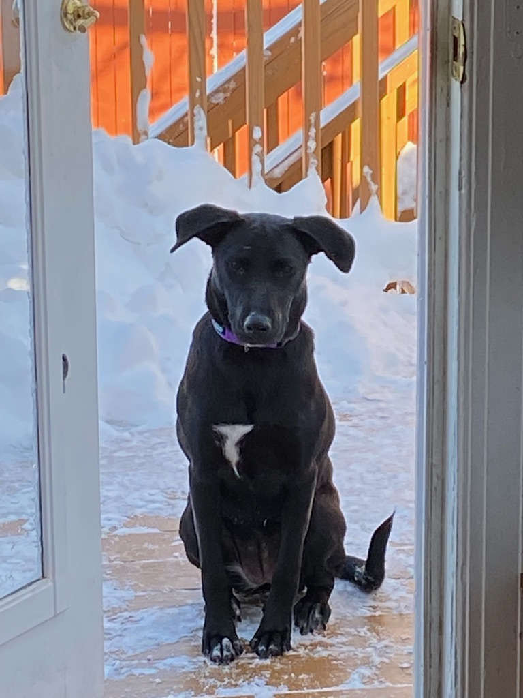
String Diamond
Write a function diamond that accepts a string parameter and prints its letters in a "diamond" format as shown below.
For example, diamond("BAILEY") should print:
  B
  BA
  BAI
  BAIL
  BAILE
  BAILEY
  AILEY
  ILEY
  LEY
  EY
  Y

Slide 12
Practice: String Diamond
string_diamond.c
Notes:
stdbool

Slide 13
Lecture Plan
Recap: Strings so far
Searching in Strings
Practice: Password Verification
Buffer Overflows, Security and and Valgrind
Pointers
cp -r /afs/ir/class/cs107/lecture-code/lect5 .

Slide 14
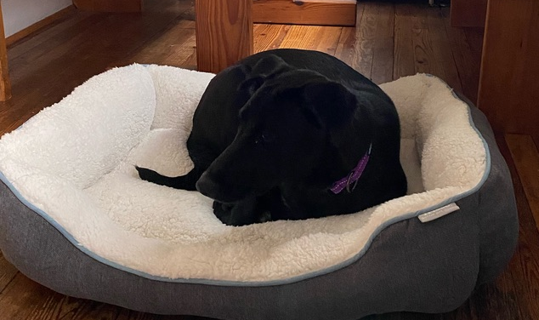
Searching For Letters
strchr returns a pointer to the first occurrence of a character in a string, or NULL if the character is not in the string.
char bailey[7];
strcpy(bailey, "Bailey");
char *letterI = strchr(bailey, 'i');
printf("%s\n", bailey); // Bailey
printf("%s\n", letterI); // iley
If there are multiple occurrences of the letter, strchr returns a pointer to the first one. Use strrchr to obtain a pointer to the last occurrence.

Slide 15
Searching For Strings
strstr returns a pointer to the first occurrence of the second string in the first, or NULL if it cannot be found.
char bailey[11];
strcpy(bailey, "Bailey Dog");
char *substr = strstr(bailey, "Dog");
printf("%s\n", bailey); // Bailey Dog
printf("%s\n", substr); // Dog
If there are multiple occurrences of the string, strstr returns a pointer to the first one.

Slide 16
String Spans
strspn returns the length of the initial part of the first string which contains only characters in the second string.
char bailey[10];
strcpy(bailey, "Bailey Dog");
int spanLength = strspn(bailey, "aBeoi"); // 3
“How many places can we go in the first string before I encounter a character not in the second string?”

Slide 17
String Spans
strcspn (c = “complement”) returns the length of the initial part of the first string which contains only characters not in the second string.
char bailey[10];
strcpy(bailey, "Bailey Dog");
int spanLength = strcspn(bailey, "driso"); // 2
“How many places can we go in the first string before I encounter a character in the second string?”

Slide 18
C Strings As Parameters
When we pass a string as a parameter, it is passed as a char *. We can still operate on the string the same way as with a char[]. (We’ll see why today!).
int doSomething(char *str) {
char secondChar = str[1];
...
}
// can also write this, but it is really a pointer
int doSomething(char str[]) { ...

Slide 19
Arrays of Strings
We can make an array of strings to group multiple strings together:
char *stringArray[5]; // space to store 5 char *s
We can also use the following shorthand to initialize a string array:
char *stringArray[] = {
"Hello",
"Hi",
"Hey there"
};

Slide 20
Arrays of Strings
We can access each string using bracket syntax:
printf("%s\n", stringArray[0]); // print out first string
When an array is passed as a parameter in C, C passes a pointer to the first element of the array. This is what argv is in main! This means we write the parameter type as:
void myFunction(char **stringArray) {
// equivalent to this, but it is really a double pointer
void myFunction(char *stringArray[]) {

Slide 21
Practice: Password Verification
Write a function verifyPassword that accepts a candidate password and certain password criteria and returns whether the password is valid.
bool verifyPassword(char *password, char *validChars, char *badSubstrings[], int numBadSubstrings);
password is valid if it contains only letters in validChars, and does not contain any substrings in badSubstrings.

Slide 22
Practice: Password Verification
bool verifyPassword(char *password, char *validChars, char *badSubstrings[], int numBadSubstrings);
Example:
char *invalidSubstrings[] = { "1234" };
bool valid1 = verifyPassword("1572", "0123456789",
invalidSubstrings, 1); // true
bool valid2 = verifyPassword("141234", "0123456789",
invalidSubstrings, 1); // false

Slide 23
Practice: Password Verification
verify_password.c
Notes:
stdbool

Slide 24
Lecture Plan
Recap: Strings so far
Searching in Strings
Practice: Password Verification
Buffer Overflows, Security and Valgrind
Pointers
cp -r /afs/ir/class/cs107/lecture-code/lect5 .

Slide 25
Recall: Buffer Overflows
We must make sure there is enough space in the destination to hold the entire copy, including the null-terminating character.
char str2[6]; // not enough space!
strcpy(str2, "hello, world!"); // overwrites other memory!
Writing past memory bounds is called a “buffer overflow”. It can allow for security vulnerabilities!

Slide 26
Recall: Buffer Overflows
char str1[14];
strcpy(str1, "hello, world!");
char str2[6];
strcpy(str2, str1); // not enough space - overwrites other memory!
0 | 1 | 2 | 3 | 4 | 5 | 6 | 7 | 8 | 9 | 10 | 11 | 12 | 13
'h' | 'e' | 'l' | 'l' | 'o' | ',' | ' ' | 'w' | 'o' | 'r' | 'l' | 'd' | '!' | '\0'
str1
0 | 1 | 2 | 3 | 4 | 5
'h' | 'e' | 'l' | 'l' | 'o' | ','
' ' | 'w' | 'o' | 'r' | 'l' | 'd' | '!' | '\0'
str2
- other program memory -

Slide 27
Buffer Overflow Impacts
Buffer overflows are not merely functionality bugs; they can cause a range of unintended behavior:
Access memory you shouldn’t be able to access
Modify memory you shouldn’t be able to access
  Change a value that is used later in the program
  Change the program to execute your instructions instead of its own
And more…
It’s our job as programmers to find and fix buffer overflows and other bugs not just for the functional correctness of our programs, but to protect people who use and interact with my code.

Slide 28
Buffer Overflow Impacts
AOL instant messenger buffer overflow: allowed remote attackers to execute code: https://www.cvedetails.com/cve/CVE-2002-0362/
Morris Worm: first internet worm to gain widespread attention; exploited buffer overflow in Unix command called ”finger”: https://en.wikipedia.org/wiki/Morris_worm

Slide 29
How can we fix buffer overflows?
There’s no single solution to fix all buffer overflows; instead, it’s a combination of techniques to avoid them as much as possible:
Constant vigilance while programming (checking arrays and where they are modified)
Carefully reading documentation
Thorough testing to uncover issues before release
Thorough documentation to document assumptions in your code
(Where possible) use of tools that reduce the possibility for buffer overflows

Slide 30
How can we fix buffer overflows?
There’s no single solution to fix all buffer overflows; instead, it’s a combination of techniques to avoid them as much as possible:
Constant vigilance while programming (checking arrays and where they are modified)
Carefully reading documentation
Thorough testing to uncover issues before release
Thorough documentation to document assumptions in your code
(Where possible) use of tools that reduce the possibility for buffer overflows

Slide 31
How can we fix buffer overflows?
  MAN page for gets():
  “Never use gets(). Because it is impossible to tell without knowing the data in advance how many characters gets() will read, and because gets() will continue to store characters past the end of the buffer, it is extremely dangerous to use. It has been used to break computer security. Use fgets() instead.”

Slide 32
How can we fix buffer overflows?
There’s no single solution to fix all buffer overflows; instead, it’s a combination of techniques to avoid them as much as possible:
Constant vigilance while programming (checking arrays and where they are modified)
Carefully reading documentation
Thorough testing to uncover issues before release
Thorough documentation to document assumptions in your code
(Where possible) use of tools that reduce the possibility for buffer overflows

Slide 33
How Can We Fix Overflows?
Valgrind: Your Greatest Ally
Write your own tests
Consider writing tests before writing the main program
✨ cs107.stanford.edu/testing.html ✨

Slide 34
How can we fix buffer overflows?
There’s no single solution to fix all buffer overflows; instead, it’s a combination of techniques to avoid them as much as possible:
Constant vigilance while programming (checking arrays and where they are modified)
Carefully reading documentation
Thorough testing to uncover issues before release
Thorough documentation to document assumptions in your code
(Where possible) use of tools that reduce the possibility for buffer overflows

Slide 35
How Can We Fix Overflows?
Documentation & MAN Pages (Written by Others)
  “The strcpy() function copies the string pointed to by src, including the terminating null byte (‘\0’), to the buffer pointed to by dest. The strings may not overlap, and the destination string dest must be large enough to receive the copy. Beware of buffer overruns! (See BUGS.) …
  BUGS
  If the destination string of a strcpy() is not large enough, then anything might happen. Overflowing fixed-length string buffers is a favorite cracker technique for taking complete control of the machine. Any time a program reads or copies data into a buffer, the program first needs to check that there’s enough space. This may be unnecessary if you can show that overflow is impossible, but be careful: programs can get changed over time, in ways that may make the impossible possible.”

Slide 36
How can we fix buffer overflows?
There’s no single solution to fix all buffer overflows; instead, it’s a combination of techniques to avoid them as much as possible:
Constant vigilance while programming (checking arrays and where they are modified)
Carefully reading documentation
Thorough testing to uncover issues before release
Thorough documentation to document assumptions in your code
(Where possible) use of tools that reduce the possibility for buffer overflows

Slide 37
Memory Safe Systems Programming
Idea 5: Choose your Tools & Languages Carefully
Existing code bases or requirements for a project may dictate what tools you use. Knowing C is crucial – it is and will remain widely used.
When you you are choosing tools for systems programming, consider languages that can help guard against programmer error.
Rust (Mozilla)
Go (Google)
Project Verona (Microsoft)

Slide 38
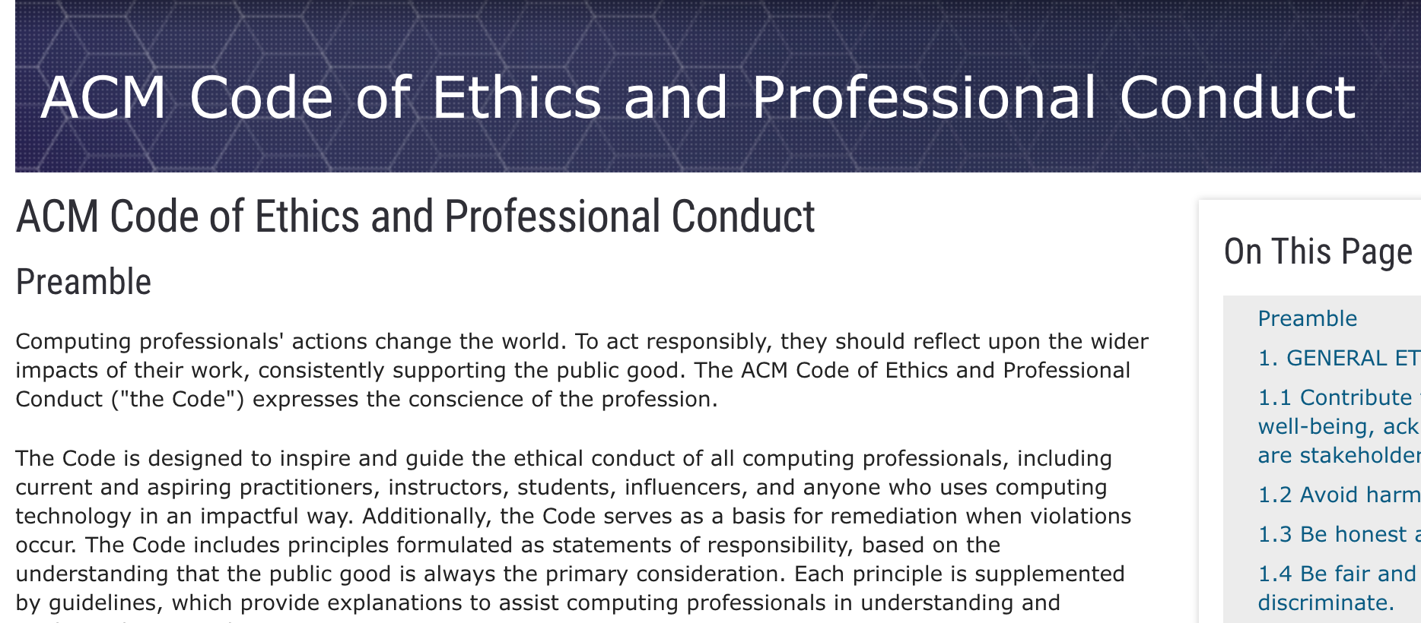
Association for Computing Machinery (ACM) Code of Ethics

Slide 39
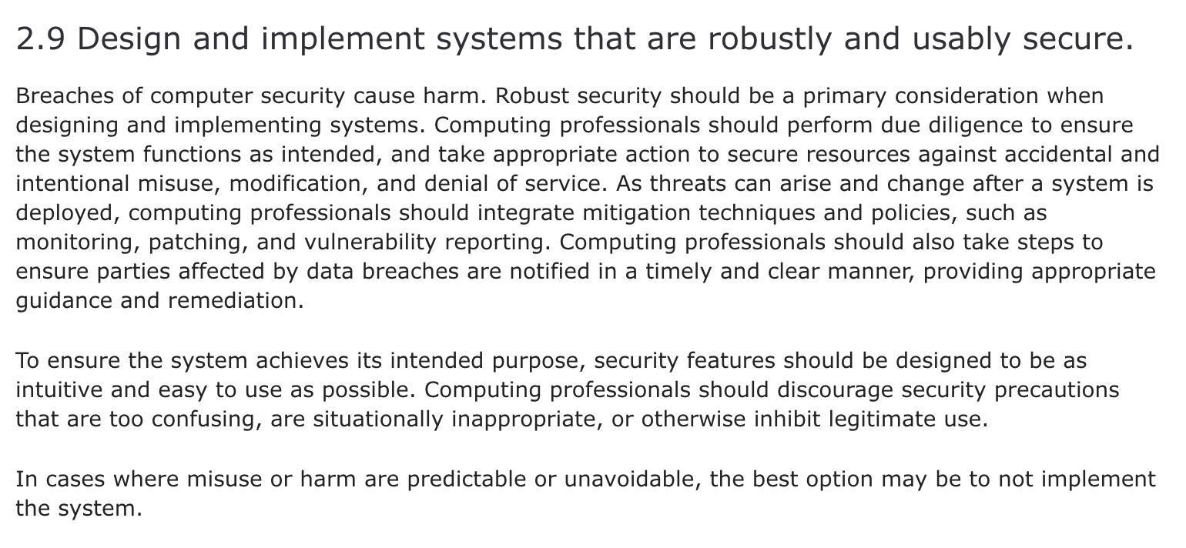
ACM Code of Ethics on Security

Slide 40
How can we fix buffer overflows?
There’s no single solution to fix all buffer overflows; instead, it’s a combination of techniques to avoid them as much as possible:
Constant vigilance while programming (checking arrays and where they are modified)
Carefully reading documentation
Thorough testing to uncover issues before release
Thorough documentation to document assumptions in your code
(Where possible) use of tools that reduce the possibility for buffer overflows

Slide 41
Buffer Overflows
We must always ensure that memory operations we perform don’t improperly read or write memory.
  E.g. don’t copy a string into a space that is too small!
  E.g. don’t ask for the string length of an uninitialized string!
The Valgrind tool may be able to help track down memory-related issues.
  See cs107.stanford.edu/resources/valgrind
  We’ll talk about Valgrind more when we talk about dynamically-allocated memory.

Slide 42
Demo: Memory Errors
memory_errors.c

Slide 43
Lecture Plan
Recap: Strings so far
Searching in Strings
Practice: Password Verification
Buffer Overflows, Security and Valgrind
Pointers
cp -r /afs/ir/class/cs107/lecture-code/lect5 .

Slide 44
Pointers
A pointer is a variable that stores a memory address.
Because there is no pass-by-reference in C like in C++, pointers let us pass around the address of one instance of memory, instead of making many copies.
One (8 byte) pointer can refer to any size memory location!
Pointers are also essential for allocating memory on the heap, which we will cover later.
Pointers also let us refer to memory generically, which we will cover later.

Slide 45
Memory
Memory is a big array of bytes.
Each byte has a unique numeric index that is commonly written in hexadecimal.
A pointer stores one of these memory addresses.
Address | Value
 | …
0x105 | '\0'
0x104 | 'e'
0x103 | 'l'
0x102 | 'p'
0x101 | 'p'
0x100 | 'a'
 | …

Slide 46
Memory
Memory is a big array of bytes.
Each byte has a unique numeric index that is commonly written in hexadecimal.
A pointer stores one of these memory addresses.
Address | Value
 | …
261 | '\0'
260 | 'e'
259 | 'l'
258 | 'p'
257 | 'p'
256 | 'a'
 | …

Slide 47
Looking Back at C++
How would we write a program with a function that takes in an int and modifies it? We might use pass by reference.
void myFunc(int& num) {
num = 3;
}
int main(int argc, char *argv[]) {
int x = 2;
myFunc(x);
printf("%d", x); // 3!
...
}

Slide 48
Looking Ahead to C
All parameters in C are “pass by value.” For efficiency purposes, arrays (and strings, by extension) passed in as parameters are converted to pointers.
This means whenever we pass something as a parameter, we pass a copy.
If we want to modify a parameter value in the function we call and have the changes persist afterwards, we can pass the location of the value instead of the value itself. This way we make a copy of the address instead of a copy of the value.

Slide 49
Pointers
int x = 2;
// Make a pointer that stores the address of x.
// (& means "address of")
int *xPtr = &x;
// Dereference the pointer to go to that address.
// (* means "dereference")
printf("%d", *xPtr); // prints 2

Slide 50
Recap
Recap: Strings so far
Searching in Strings
Practice: Password Verification
Buffer Overflows, Security and Valgrind
Pointers
Strings in Memory
Lecture 5 takeaway: C strings are pointers and arrays. C strings are error-prone, and issues like buffer overflows can arise!
cp -r /afs/ir/class/cs107/lecture-code/lect5 .

Slide 51
Extra Practice

Slide 52
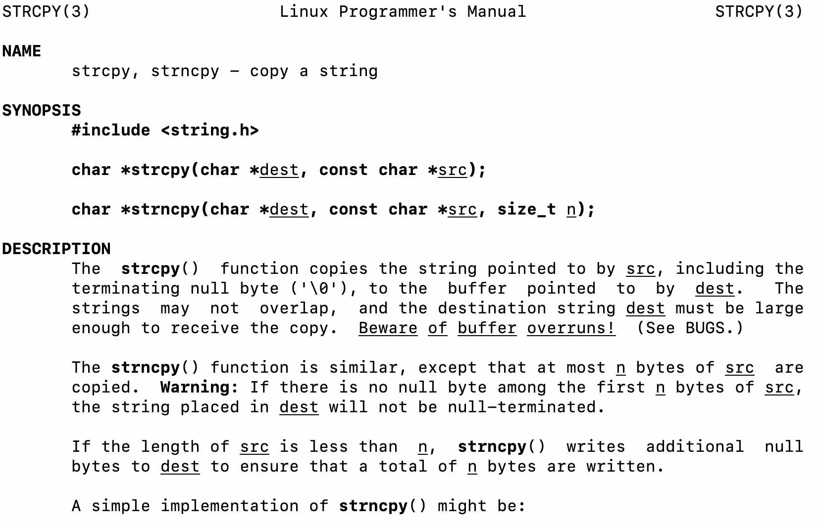
2. Code study: strncpy
0x60 | 0x61 | 0x62 | 0x63 | 0x64 | 0x65 | 0x66
'M' | 'o' | 'n' | 'd' | 'a' | 'y' | '\0'
buf
0x58 | 0x59 | 0x5a | 0x5b
'F' | 'r' | 'i' | '\0'
str
1
2
3
4
5
6
7
8
char *strncpy(char *dest, const char *src, size_t n) {
size_t i;
for (i = 0; i < n && src[i] != '\0'; i++)
dest[i] = src[i];
for ( ; i < n; i++)
dest[i] = '\0';
return dest;
}
🤔
What happens if we call strncpy(buf, str, 5);?

Slide 53
2. Code study: strncpy
0x60 | 0x61 | 0x62 | 0x63 | 0x64 | 0x65 | 0x66
'M' | 'o' | 'n' | 'd' | 'a' | 'y' | '\0'
buf
0x58 | 0x59 | 0x5a | 0x5b
'F' | 'r' | 'i' | '\0'
str
1
2
3
4
5
6
7
8
char *strncpy(char *dest, const char *src, size_t n) {
size_t i;
for (i = 0; i < n && src[i] != '\0'; i++)
dest[i] = src[i];
for ( ; i < n; i++)
dest[i] = '\0';
return dest;
}
dest
src
n
5
i
What happens if we call strncpy(buf, str, 5);?

