Slide 1
CS107, Lecture 1
Welcome to CS107!
reading:
Course Syllabus
Bryant & O’Hallaron, Ch. 1 (skim)
Honor Code and Collaboration Page
😷 masks recommended

Slide 2
Plan For Today
Introduction
CS107 Course Topics
CS107 Course Policies
Unix and the Command Line

Slide 3

Asking Questions
Feel free to raise your hand at any time with a question
If you are more comfortable, you can post a question in the Ed forum thread for each day’s lecture (optionally anonymously)
We will monitor the thread throughout the lecture for questions
Visit Ed (or access via Canvas):
https://edstem.org/us/courses/38542/discussion/
Today’s thread:
https://edstem.org/us/courses/38542/discussion/2880579

Slide 4
Guiding Principles For In-Person Class
We are likely not fully recovered or restored from the stresses of the past 36+ months and now facing new uncertainties, responsibilities, and emotions.
We will do everything we can to support you. We have designed the course to the best of our ability to provide flexibility.
We will constantly evaluate and listen to ensure the class is going as smoothly as possible for everyone.
Please communicate with us if any personal circumstances or issues arise! We are here to support you.

Slide 5
Guiding Principles For In-Person Class
Stanford University is currently strongly recommending the use of masks in classrooms and instructional spaces. We strongly encourage you to wear a mask in lecture, section and helper hours.
Some of us have health conditions precluding our ability to wear masks. Students in this situation should work with the Office of Accessible Education.
Some of us might feel more comfortable wearing masks/social distancing even when not required. All of our preferences are reasonable, and it is important that we treat each others’ preferences with respect and care.

Slide 6
Plan For Today
Introduction
CS107 Course Topics
CS107 Course Policies
Unix and the Command Line

Slide 7
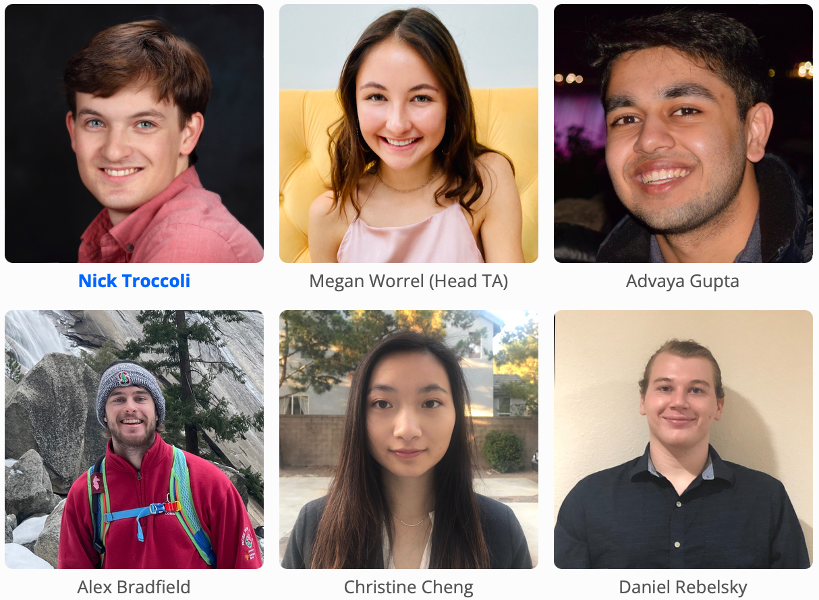
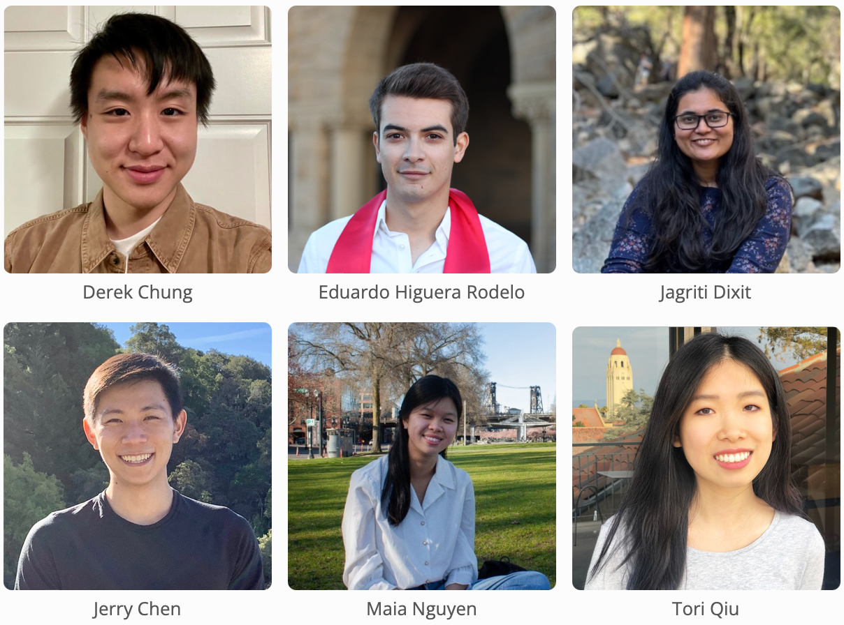
Teaching Team
About Nick Troccoli (troccoli@stanford.edu):
Lecturer in CS, taught CS106X, CS107, CS110, CS111
Stanford BS/MS (coterm) in CS
Systems track undergrad, AI track grad

Slide 8

Companion Class: CS107A
CS107A is an extra 1-unit “Pathfinders” or “ACE” section with additional course support, practice and instruction.
Meets for additional weekly sections and has additional review sessions
Entry by application – see the course website for details: cs107a.stanford.edu

Slide 9
Course Website
cs107.stanford.edu
*lecture videos / lecture participation grades on Canvas
Notes:
Go there for quick tour

Slide 10
Plan For Today
Introduction
CS107 Course Topics
CS107 Course Policies
Unix and the Command Line

Slide 11
What is CS107?
The CS106 courses (or equivalent) provided you with a solid foundation in programming methodology and abstractions (variables, functions, data structures, pointers, recursion, classes, algorithms).
CS107 follows on this to build up and expand your breadth and depth of programming experience and techniques to show you how machines really work.
CS107 key question: how / why?

Slide 12
CS107: How/Why?
The CS106 series taught you how to solve problems as a programmer. CS107 goes a level deeper to understand the how and why:
How is data in our program really represented?
How does heap memory work?
How does a computer know how to run the code we write?
How does a program map onto the components of computer systems?
Why is my program doing X when I expected it to do Y?
Understanding computing at this level demystifies how these seemingly-complex systems work and can aid future projects you work on.

Slide 13
Course Overview
Bits and Bytes - How can a computer represent integer numbers?
Chars and C-Strings - How can a computer represent and manipulate more complex data like text?
Pointers, Stack and Heap – How can we effectively manage all types of memory in our programs?
Generics - How can we use our knowledge of memory and data representation to write code that works with any data type?
Assembly - How does a computer interpret and execute C programs?
Heap Allocators - How do core memory-allocation operations like malloc and free work?
Ethics, Privacy, Partiality and Trust - How do we act responsibly in maintaining security, protecting privacy, and ensuring warranted trust in the systems we build and maintain?
Notes:
Don’t list everything, just pick a few

Slide 14
CS107 Learning Goals
The goals for CS107 are for students to gain mastery of
- writing C programs with complex use of memory and pointers
- an accurate model of the address space and compile/runtime behavior of C programs
to achieve competence in
- translating C to/from assembly
- writing programs that respect the limitations of computer arithmetic
- identifying bottlenecks and improving runtime performance
- working effectively in a Unix development environment
- using ethical frameworks and case studies to inform decision-making
and have exposure to
- a working understanding of the basics of computer architecture

Slide 15
CS107 and Programming Experience
We hope that CS107 can help further develop your programming experience and comfort with programming.
CS107 focuses heavily on debugging and getting to the root of why something is happening.
Across assignments, we will be emphasizing how to become a better debugger, how to write better code, and how to further your software development skills.

Slide 16
Plan For Today
Introduction
CS107 Course Topics
CS107 Course Policies
Unix and the Command Line

Slide 17
Course Syllabus and Schedule
cs107.stanford.edu/syllabus
cs107.stanford.edu/schedule
Notes:
Go there for quick tour

Slide 18
SCPD Students
cs107.stanford.edu/scpd

Slide 19
Getting Started Guide
cs107.stanford.edu/getting-started.html
(on course website under ”handouts”)
Notes:
Go there for quick tour

Slide 20
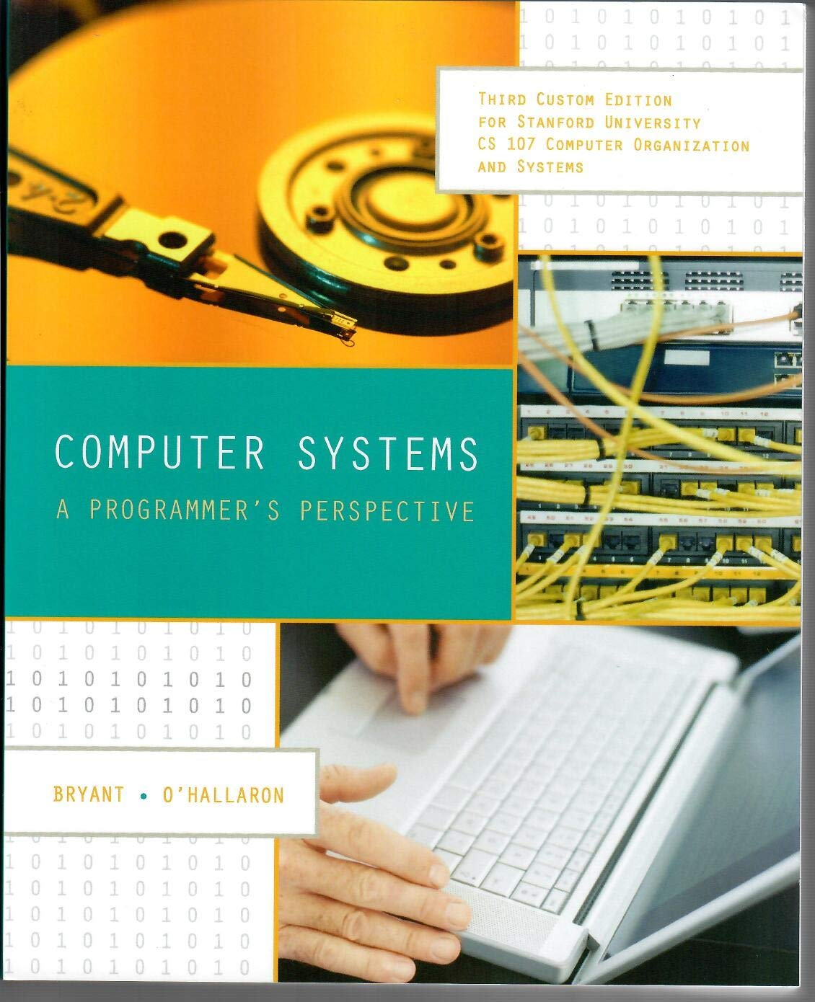

Textbook(s)
Computer Systems: A Programmer’s Perspective by Bryant & O’Hallaron, 3rd Edition
  3rd edition matters – important updates to content
  Stanford Library has generously scanned all readings for CS107 under “fair use” (private study, scholarship, research). [Canvas -> Files]. Please do not distribute.
  If you want more context, you may want to purchase a full copy
A C programming reference of your choice
  The C Programming Language by Kernighan and Ritchie (free link on course website Resources page)
  Other C programming books, websites, or reference sheets
Full textbook
CS107 full chapters
CS107-specific readings
The textbook (and C programming references) are very good resources in this course, especially post-midterm!
Notes:
t’s also good to give a reminder to the students that the PDF shouldn’t be distributed/reuploaded anywhere beyond their personal computers.

Slide 21
Course Structure
Lectures: understand concepts, see demos
Labs: learn tools, study code, discuss with peers
Assignments: build programming skills, synthesize lecture/lab content
  assign0: due next Monday (covers today and part of Wednesday’s lecture)
Great preview of homework!

Slide 22
Grading
  ****** 52% Assignments
  * 8% Lab Participation
  * 5% Lecture Participation
  ** 15% Midterm Exam
  ** 20% Final Exam
Read our full course policies document:
https://cs107.stanford.edu/syllabus.html

Slide 23
Grading
  ****** 52% Assignments
  * 8% Lab Participation
  * 5% Lecture Participation
  ** 15% Midterm Exam
  ** 20% Final Exam
Read our full course policies document:
https://cs107.stanford.edu/syllabus.html

Slide 24
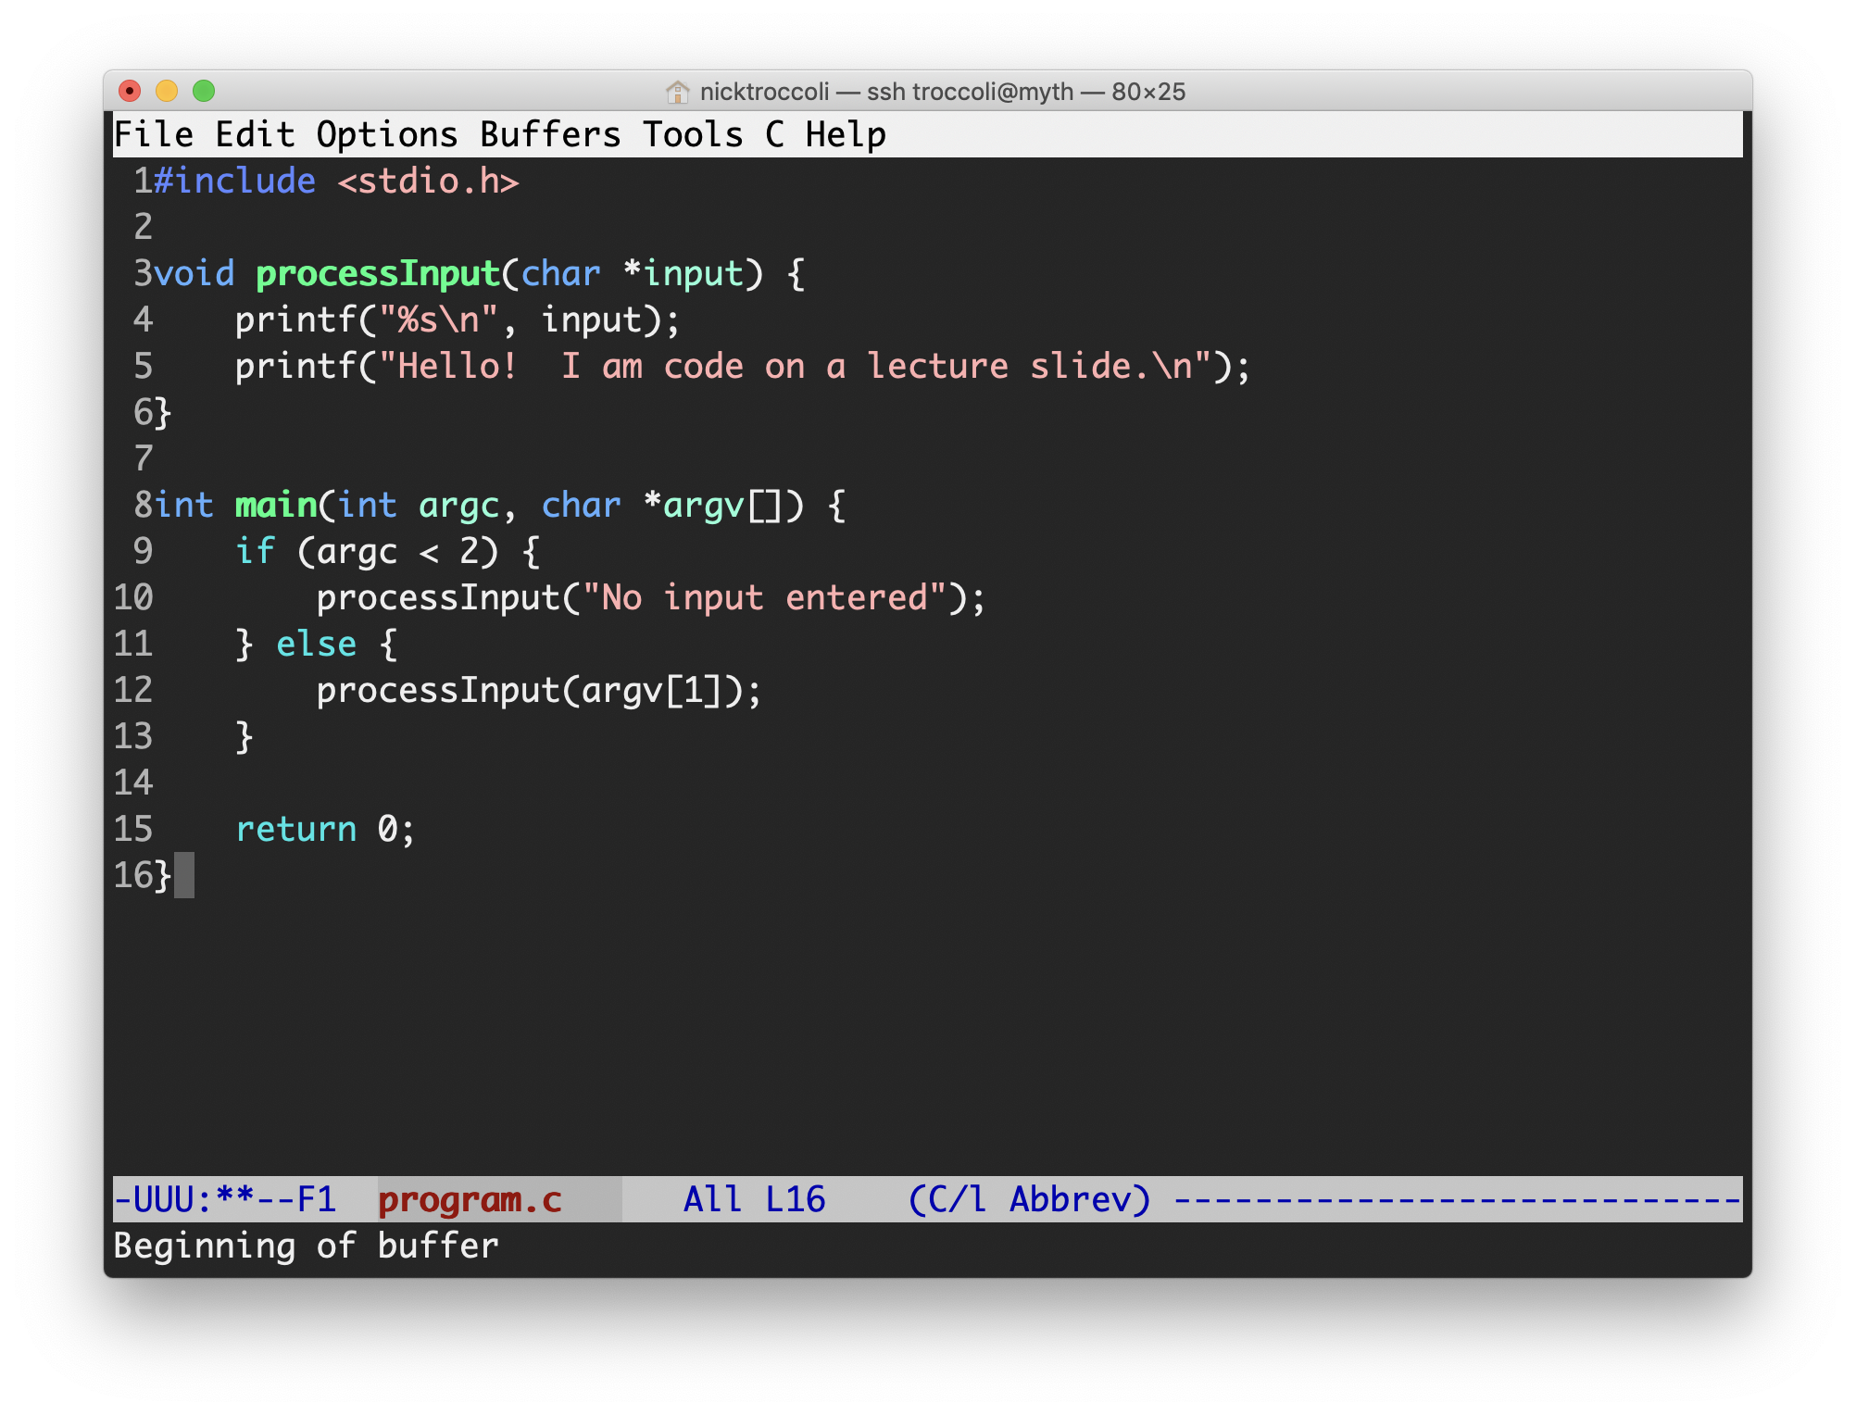
Assignments
7 programming assignments completed individually using Unix command line tools
  Free software, pre-installed on Myth machines / available on course website
  We will give out starter projects for each assignment
Graded on functionality (behavior) and style (elegance)
  Functionality graded using automated tools, given as point score – no TA review
  Style graded via automated tests and TA code review, given as bucket score
  Grades returned via course website
Notes:
AUTOMATED functionality grading

Slide 25
The Style Bucket System
+ | An outstanding job; could be used as course example code for good style.
ok | A good job; solid effort, but also opportunities for improvement.
- | Shows some effort and understanding but has larger problems that should be focused on.
- - | Shows many significant issues and does not represent passing work.
0 | No work submitted, or barely any changes from the starter assignment.
Notes:
Mostly ok

Slide 26
Assignment Late Policy
Start out with 5 “free late days”: each late day allows you to submit an assignment up to 24 additional hours late without penalty. (No late days permitted for the first or last assignments)
Hard deadline 48 hours after original due date
Penalty per day after late days are exhausted (1 day: 80% cap; 2 days: 60% cap)
Late days are “pre-granted extensions” – additional extensions for exceptional circumstances must be approved by the Head TA. Please communicate with us! We are here to accommodate you as much as possible.

Slide 27
Question Break!
What questions do you have about the overall course goals, textbook or assignments?

Slide 28
Grading
  ****** 52% Assignments
  * 8% Lab Participation
  * 5% Lecture Participation
  ** 15% Midterm Exam
  ** 20% Final Exam
Read our full course policies document:
https://cs107.stanford.edu/syllabus.html

Slide 29
Lab Sections
Weekly 1-hour 30-minute in-person labs led by a CA, starting next week, offered Wednesdays through Fridays.
Hands-on practice in small groups with lecture material and course concepts.
Graded on attendance + participation
SCPD students have the option to attend a remote section or complete lab work remotely (more info in SCPD Handout)
Lab preference submissions open Tuesday 4/4 at 5PM PST and are not first-come first-serve. You may submit your preferences anytime until Saturday 4/8 at 5PM PST. Sign up on the course website.

Slide 30
Grading
  ****** 52% Assignments
  * 8% Lab Participation
  * 5% Lecture Participation
  ** 15% Midterm Exam
  ** 20% Final Exam
Read our full course policies document:
https://cs107.stanford.edu/syllabus.html

Slide 31
Lecture Recordings
Because CS107 is on SCPD (for professional development students) this quarter, the course lectures are recorded and available for later viewing.
See the calendar page (or lecture dropdown) on the course website for slides and lecture code

Slide 32
Lecture Participation
At the same time, lecture is an important part of the course and we’ve found it most effective when students participate in person.
In each lecture (starting Fri – test run on Wed), we’ll use Poll Everywhere to take polls and do practice questions. If you answer all questions in a lecture (regardless of correctness), you get credit for that lecture.
We will provide 5 pre-excused absences for when you are ill, in COVID-19 isolation, or have other extenuating circumstances. They are intended only for these scenarios!
Further excused absences are granted by the Head TA only in cases where you have already used your 5 excused absences for extenuating circumstances and further extenuating circumstances necessitate additional accommodations.
SCPD students have substitute grade component (more details soon)
Notes:
Wed trial, Fri start
Not just to keep up to date with course material, but allows us to tailor lectures to you and what is most helpful

Slide 33
Grading
  ****** 52% Assignments
  * 8% Lab Participation
  * 5% Lecture Participation
  ** 15% Midterm Exam
  ** 20% Final Exam
Read our full course policies document:
https://cs107.stanford.edu/syllabus.html

Slide 34
Exams
Midterm exam – Tuesday, May 9, 7-9PM outside of class
  Contact the Head TA by 11:59PM on Friday, April 21 if you have an academic or University conflict with this time, and absolutely cannot make the regularly scheduled midterm
Final exam – Monday, June 12, 3:30PM-6:30PM
  No alternate final! You MUST be able to take the final exam at the scheduled time (except for university athletics or OAE accommodations)
Both exams are paper exams and are closed-book and closed-notes, but you may bring in 1 double-sided page of notes. You will also be provided with a syntax reference sheet.
SCPD students have 24hr window during which to take the exams

Slide 35
Grading
  ****** 52% Assignments
  * 8% Lab Participation
  * 5% Lecture Participation
  ** 15% Midterm Exam
  ** 20% Final Exam
Read our full course policies document:
https://cs107.stanford.edu/syllabus.html

Slide 36
Getting Help
Post on the Discussion Forum
  Online discussion forum for students; post questions, answer other students’ questions
  Best for course material discussions, course policy questions, short debugging questions or general assignment questions (DON’T PUBLICLY POST ASSIGNMENT CODE!)
Visit Helper Hours
  Chat about course topics or just hang out
  Sign up in a queue for 1:1 TA help; schedule will be posted on course website tomorrow.
  Mix of in-person and online helper hours
  Best for group work, coding/debugging questions (with TAs only!) or longer course material discussions
Email the Course Staff
  Email instructor/Head TA for private matters (e.g. OAE accommodations, extension requests, other personal matters).
  Email your grader for grading questions about a particular assignment

Slide 37
OAE Accommodations
Please email the Head TA as soon as possible with any accommodations you may need for the course.
We are eager to do everything we can to support you and make you successful in CS107!

Slide 38
Course Flexibility
If you are ever sick or encounter an emergency or other exceptional circumstance, we have a variety of accommodation mechanisms, including:
  Assignment late days
  Makeup labs or excused absences
  Lecture excused absences
  Exam accommodations for emergencies/illness
  Ability to attend all helper hours remotely with Head TA permission
If you feel ill or are sick, please stay home and take care of yourself. We never want you to feel that you must attend class or helper hours if you are not feeling well. And if you are ill or have another emergency or exceptional circumstance, please reach out to us so that we can help!

Slide 39
Question Break!
What questions do you have about labs, lecture or exams?

Slide 40
Stanford Honor Code
The Honor Code is an undertaking of the students, individually and collectively:
  that they will not give or receive aid in examinations; that they will not give or receive unpermitted aid in class work, in the preparation of reports, or in any other work that is to be used by the instructor as the basis of grading;
  that they will do their share and take an active part in seeing to it that others as well as themselves uphold the spirit and letter of the Honor Code.
The faculty on its part manifests its confidence in the honor of its students by refraining from proctoring examinations and from taking unusual and unreasonable precautions to prevent the forms of dishonesty mentioned above. The faculty will also avoid, as far as practicable, academic procedures that create temptations to violate the Honor Code.
While the faculty alone has the right and obligation to set academic requirements, the students and faculty will work together to establish optimal conditions for honorable academic work.
see also: http://honorcode.stanford.edu/
It is your responsibility to ensure you have read and are familiar with the honor code guidelines posted on the main page of the CS107 course website. Please read them and come talk to us if you have any questions or concerns.
Notes:
Environment for all to do best work

Slide 41
Honor Code and CS107
Please help us ensure academic integrity:
  Indicate any assistance received on HW (books, friends, etc.).
  Do not look at other people's solution code or answers
  Do not give your solutions to others or post them on the web or our Ed forum.
  Report any inappropriate activity you see performed by others.
Assignments are checked regularly for similarity with help of software tools.
If you need help, please contact us and we will help you.
  We do not want you to feel any pressure to violate the Honor Code in order to succeed in this course.
  If you realize that you have made a mistake, you may retract your submission to any assignment at any time, no questions asked, up to the start of the final exam.
https://cs107.stanford.edu/collaboration

Slide 42
Plan For Today
Introduction
CS107 Course Topics
CS107 Course Policies
Unix and the Command Line

Slide 43
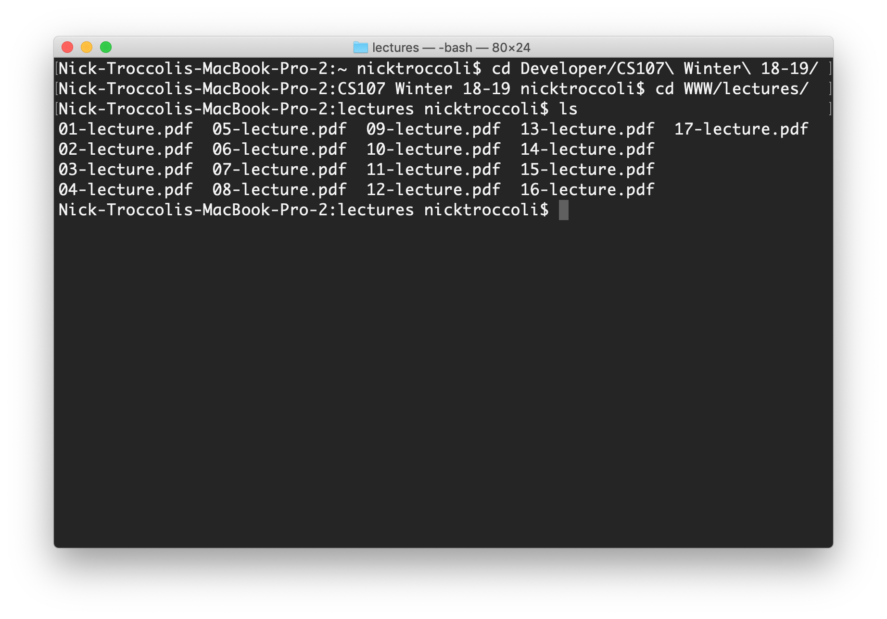
What is Unix?
Unix: a set of standards and tools commonly used in software development.
  macOS and Linux are operating systems built on top of Unix
You can navigate a Unix system using the command line (“terminal”)
Every Unix system works with the same tools and commands

Slide 44
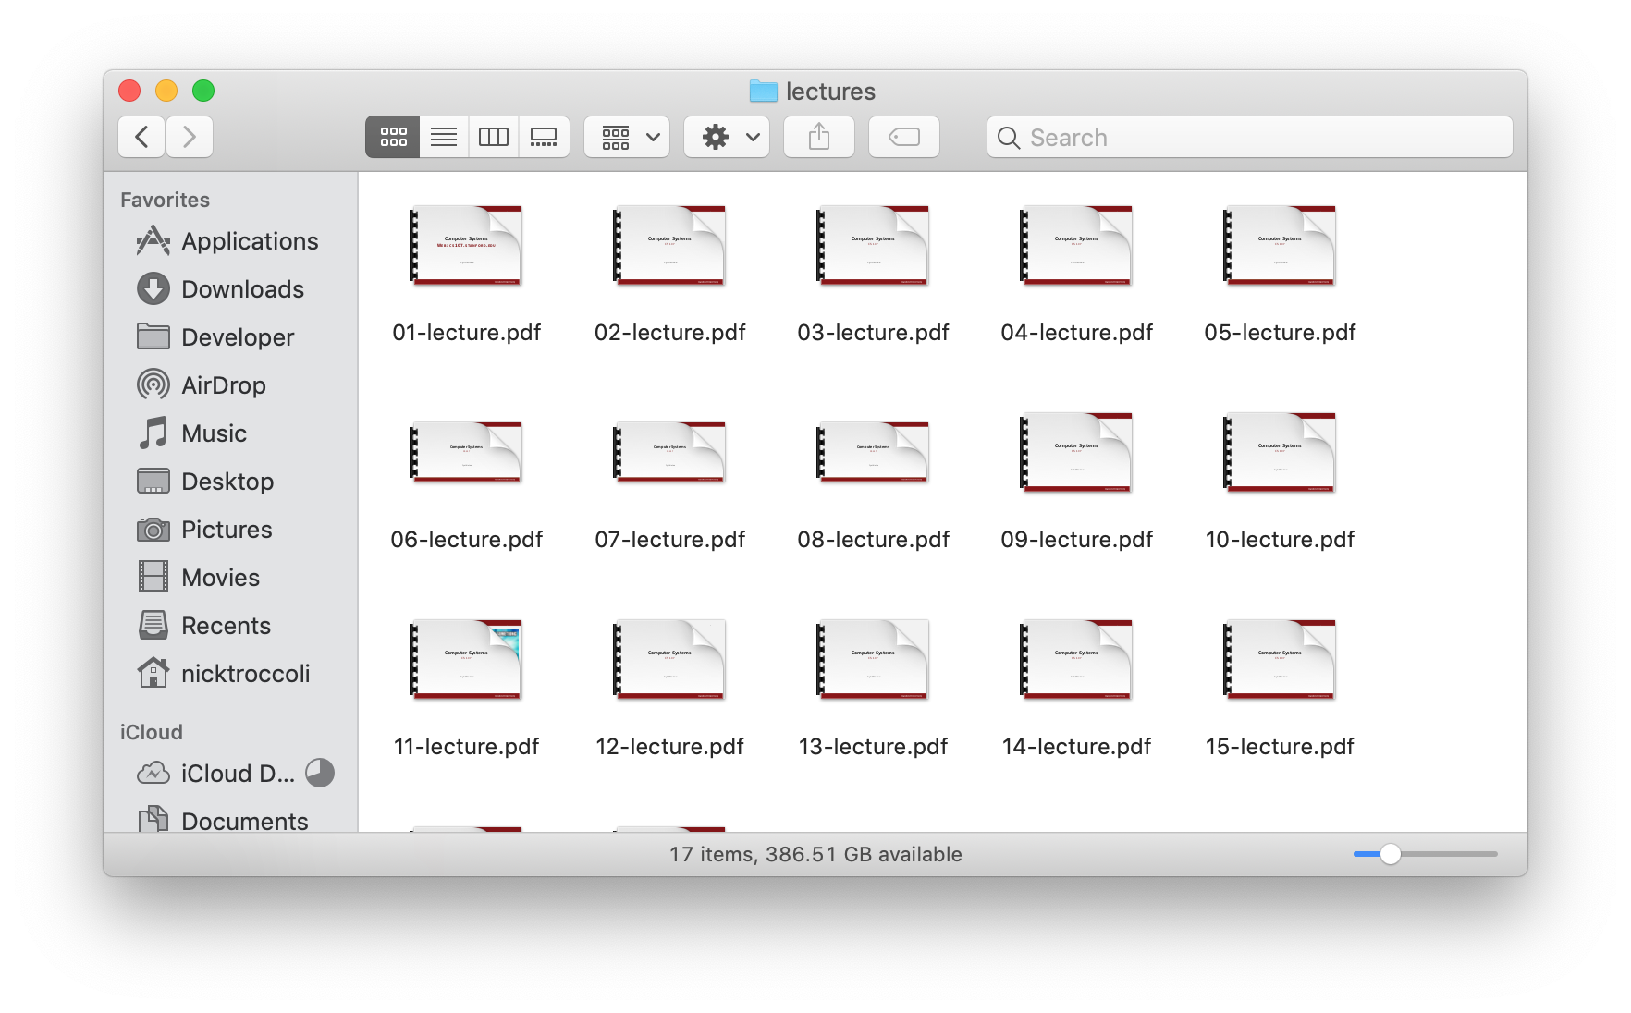
What is the Command Line?
The command-line is a text-based interface (i.e., terminal interface) to navigate a computer, instead of a Graphical User Interface (GUI).
Graphical User Interface
Text-based interface

Slide 45
Command Line Vs. GUI
Just like a GUI file explorer interface, a terminal interface:
shows you a specific place on your computer at any given time.
lets you go into folders and out of folders.
lets you create new files and edit files.
lets you execute programs.
Graphical User Interface
Command-line interface

Slide 46
Why Use Unix / the Command Line?
You can navigate almost any device using the same tools and commands:
  Servers
  Laptops and desktops
  Embedded devices (Raspberry Pi, etc.)
  Mobile Devices (Android, etc.)
Used frequently by software engineers:
  Web development: running servers and web tools on servers
  Machine learning: processing data on servers, running algorithms
  Systems: writing operating systems, networking code and embedded software
  Mobile Development: running tools, managing libraries
  And more…
We’ll use Unix and the command line to implement and execute our programs.
Notes:
Remote access is easy

Slide 47
Learning Unix and the Command Line
Using Unix and the command line can be intimidating at first:
  It looks retro!
  How do I know what to type?
It’s like learning a new language:
  At first, you may have to constantly look things up (resources on course website!)
  It’s important to spend as much time as possible (during labs and assignments) building muscle memory with the tools
Notes:
Ask questions!

Slide 48
Recap
CS107 is a programming class in C that teaches you about what goes on under the hood of programming languages and software.
We’ll use Unix and command line tools to write, debug and run our programs.
Please visit the course website, cs107.stanford.edu, where you can read the General Information page, information about the Honor Code in CS107, and more about CS107 course policies and logistics.
We’re looking forward to an awesome quarter!

