Slide 1
CS107, Lecture 12
Control Flow: When in doubt just JMP!
Reading: B&O 3.1-3.4
This document is copyright (C) Stanford Computer Science, Lisa Yan, and Nick Troccoli, licensed under Creative Commons Attribution 2.5 License. All rights reserved.
Based on slides created by Marty Stepp, Cynthia Lee, Chris Gregg, and others.

Slide 2
Learning Goals
Learn about how assembly stores comparison and operation results in condition codes
Understand how assembly implements loops and control flow

Slide 3
Lecture Plan
Assembly Execution and %rip
Control Flow Mechanics
  Condition Codes
  Assembly Instructions
If statements
Loops
  While loops
  For loops
Other Instructions That Depend On Condition Codes
Live Session Slides
5
27
46
54
67
73
81

Slide 4
Lecture Plan
Assembly Execution and %rip
Control Flow Mechanics
  Condition Codes
  Assembly Instructions
If statements
Loops
  While loops
  For loops
Other Instructions That Depend On Condition Codes
Live Session Slides
5
27
46
54
67
73
81

Slide 5
Executing Instructions
What does it mean for a program to execute?

Slide 6
Executing Instructions
4004fd 4004fc
fa
eb
01
fc
45
83
00
00
00
00
fc
45
c7
e5
89
48
55
So far:
Program values can be stored in memory or registers.
Assembly instructions read/write values back and forth between registers (on the CPU) and memory.
Assembly instructions are also stored in memory.
4004fb 4004fa 4004f9
4004f8
4004f7
4004f6
4004f5
4004f4
4004f3
4004f2
4004f1
4004f0
4004ef 4004ee 4004ed
Today:
Who controls the instructions?
How do we know what to do now or next?
Answer:
The program counter (PC), %rip.

Slide 7
Register Responsibilities
Some registers take on special responsibilities during program execution.
%rax stores the return value
%rdi stores the first parameter to a function
%rsi stores the second parameter to a function
%rdx stores the third parameter to a function
%rip stores the address of the next instruction to execute
%rsp stores the address of the current top of the stack
See the x86-64 Guide and Reference Sheet on the Resources webpage for more!

Slide 8
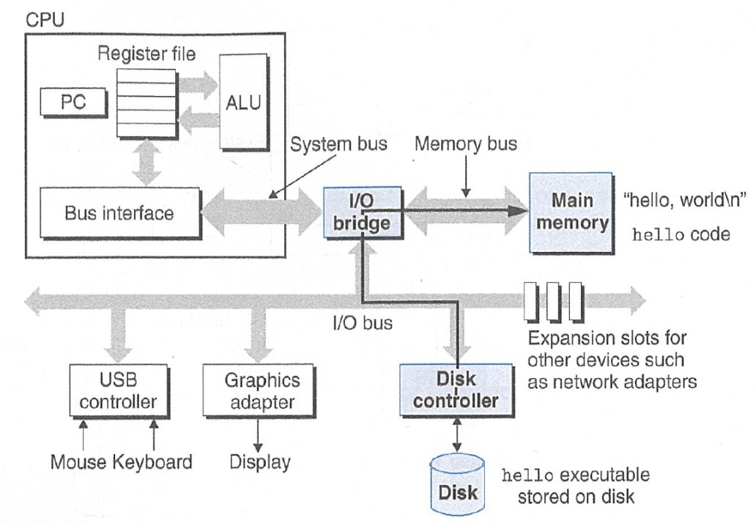
Instructions Are Just Bytes!

Slide 9
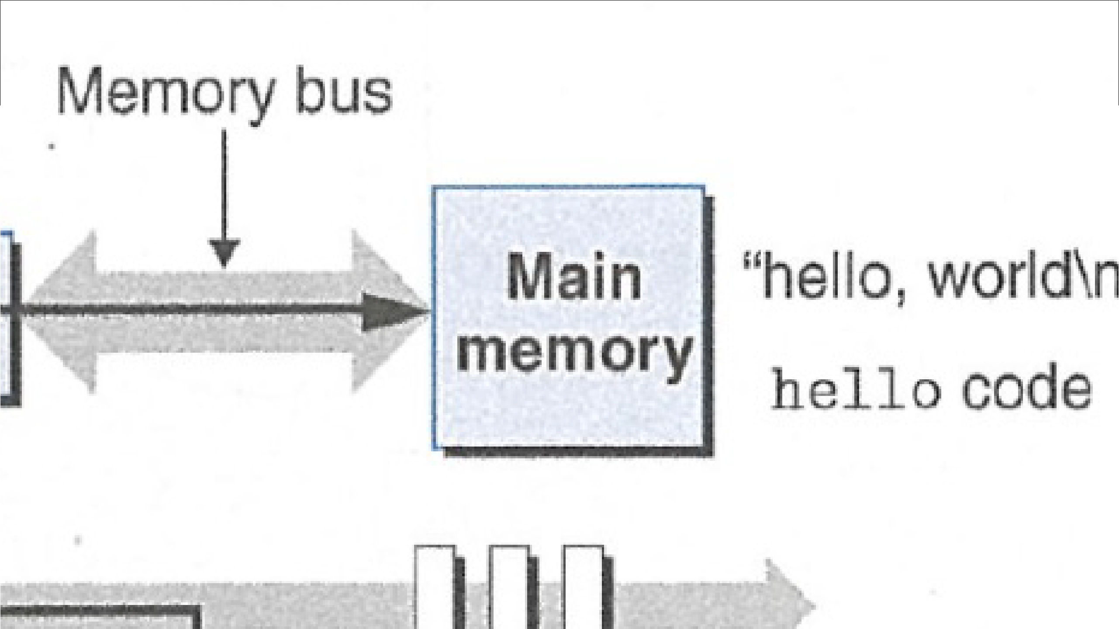
Instructions Are Just Bytes!

Slide 10




Instructions Are Just Bytes!
Main Memory
Stack
Heap
Data
Text (code)
Machine code instructions
0x0

Slide 11



_{%rip} 4004fd
p
 | fa
4004fc | eb
4004fb | 01
4004fa | fc
4004f9 | 45
4004f8 | 83
4004f7 | 00
4004f6 | 00
4004f5 | 00
4004f4 | 00
4004f3 | fc
4004f2 | 45
4004f1 | c7
4004f0 | e5
4004ef | 89
4004ee | 48
4004ed | 55
00000000004004ed <loop>:
4004ed: | 55 |  |  |  |  |  |  | push | %rbp
4004ee: | 48 | 89 | e5 |  |  |  |  | mov | %rsp,%rbp
4004f1: | c7 | 45 | fc | 00 | 00 | 00 | 00 | movl | $0x0,-0x4(%rbp)
4004f8: 4004fc: | 83 eb | 45 fa | fc | 01 |  |  |  | addl jmp | $0x1,-0x4(%rbp) 4004f8 <loop+0xb>
Main Memory
Stack
Heap
Data
Text (code)

Slide 12
%rip
4004fd | fa
4004fc | eb
4004fb | 01
4004fa | fc
4004f9 | 45
4004f8 | 83
4004f7 | 00
4004f6 | 00
4004f5 | 00
4004f4 | 00
4004f3 | fc
4004f2 | 45
4004f1 | c7
4004f0 | e5
4004ef | 89
4004ee | 48
4004ed | 55
00000000004004ed <loop>:
4004ed: | 55 |  |  |  |  |  |  | push | %rbp
4004ee: | 48 | 89 | e5 |  |  |  |  | mov | %rsp,%rbp
4004f1: | c7 | 45 | fc | 00 | 00 | 00 | 00 | movl | $0x0,-0x4(%rbp)
4004f8: | 83 | 45 | fc | 01 |  |  |  | addl | $0x1,-0x4(%rbp)
4004fc: | eb | fa |  |  |  |  |  | jmp | 4004f8 <loop+0xb>
The program counter (PC), known as %rip in x86-64, stores the address in memory of the next instruction to be executed.
0x4004ed
%rip

Slide 13
%rip
4004fd | fa
4004fc | eb
4004fb | 01
4004fa | fc
4004f9 | 45
4004f8 | 83
4004f7 | 00
4004f6 | 00
4004f5 | 00
4004f4 | 00
4004f3 | fc
4004f2 | 45
4004f1 | c7
4004f0 | e5
4004ef | 89
4004ee | 48
4004ed | 55
00000000004004ed <loop>:
4004ed: | 55 |  |  |  |  |  |  | push | %rbp
4004ee: | 48 | 89 | e5 |  |  |  |  | mov | %rsp,%rbp
4004f1: | c7 | 45 | fc | 00 | 00 | 00 | 00 | movl | $0x0,-0x4(%rbp)
4004f8: | 83 | 45 | fc | 01 |  |  |  | addl | $0x1,-0x4(%rbp)
4004fc: | eb | fa |  |  |  |  |  | jmp | 4004f8 <loop+0xb>
The program counter (PC), known as %rip in x86-64, stores the address in memory of the next instruction to be executed.
0x4004ee
%rip

Slide 14
%rip
4004fd | fa
4004fc | eb
4004fb | 01
4004fa | fc
4004f9 | 45
4004f8 | 83
4004f7 | 00
4004f6 | 00
4004f5 | 00
4004f4 | 00
4004f3 | fc
4004f2 | 45
4004f1 | c7
4004f0 | e5
4004ef | 89
4004ee | 48
4004ed | 55
00000000004004ed <loop>:
4004ed: | 55 |  |  |  |  |  |  | push | %rbp
4004ee: | 48 | 89 | e5 |  |  |  |  | mov | %rsp,%rbp
4004f1: | c7 | 45 | fc | 00 | 00 | 00 | 00 | movl | $0x0,-0x4(%rbp)
4004f8: | 83 | 45 | fc | 01 |  |  |  | addl | $0x1,-0x4(%rbp)
4004fc: | eb | fa |  |  |  |  |  | jmp | 4004f8 <loop+0xb>
The program counter (PC), known as %rip in x86-64, stores the address in memory of the next instruction to be executed.
0x4004f1
%rip
15

Slide 15
%rip
4004fd | fa
4004fc | eb
4004fb | 01
4004fa | fc
4004f9 | 45
4004f8 | 83
4004f7 | 00
4004f6 | 00
4004f5 | 00
4004f4 | 00
4004f3 | fc
4004f2 | 45
4004f1 | c7
4004f0 | e5
4004ef | 89
4004ee | 48
4004ed | 55
00000000004004ed <loop>:
4004ed: | 55 |  |  |  |  |  |  | push | %rbp
4004ee: | 48 | 89 | e5 |  |  |  |  | mov | %rsp,%rbp
4004f1: | c7 | 45 | fc | 00 | 00 | 00 | 00 | movl | $0x0,-0x4(%rbp)
4004f8: | 83 | 45 | fc | 01 |  |  |  | addl | $0x1,-0x4(%rbp)
4004fc: | eb | fa |  |  |  |  |  | jmp | 4004f8 <loop+0xb>
The program counter (PC), known as %rip in x86-64, stores the address in memory of the next instruction to be executed.
0x4004f8
%rip
16

Slide 16
%rip
4004fd | fa
4004fc | eb
4004fb | 01
4004fa | fc
4004f9 | 45
4004f8 | 83
4004f7 | 00
4004f6 | 00
4004f5 | 00
4004f4 | 00
4004f3 | fc
4004f2 | 45
4004f1 | c7
4004f0 | e5
4004ef | 89
4004ee | 48
4004ed | 55
00000000004004ed <loop>:
4004ed: | 55 |  |  |  |  |  |  | push | %rbp
4004ee: | 48 | 89 | e5 |  |  |  |  | mov | %rsp,%rbp
4004f1: | c7 | 45 | fc | 00 | 00 | 00 | 00 | movl | $0x0,-0x4(%rbp)
4004f8: | 83 | 45 | fc | 01 |  |  |  | addl | $0x1,-0x4(%rbp)
4004fc: | eb | fa |  |  |  |  |  | jmp | 4004f8 <loop+0xb>
The program counter (PC), known as %rip in x86-64, stores the address in memory of the next instruction to be executed.
0x4004fc
%rip
17

Slide 17
%rip
4004fd | fa
4004fc | eb
4004fb | 01
4004fa | fc
4004f9 | 45
4004f8 | 83
4004f7 | 00
4004f6 | 00
4004f5 | 00
4004f4 | 00
4004f3 | fc
4004f2 | 45
4004f1 | c7
4004f0 | e5
4004ef | 89
4004ee | 48
4004ed | 55
00000000004004ed <loop>:
4004ed: | 55 |  |  |  |  |  |  | push | %rbp
4004ee: | 48 | 89 | e5 |  |  |  |  | mov | %rsp,%rbp
4004f1: | c7 | 45 | fc | 00 | 00 | 00 | 00 | movl | $0x0,-0x4(%rbp)
4004f8: | 83 | 45 | fc | 01 |  |  |  | addl | $0x1,-0x4(%rbp)
4004fc: | eb | fa |  |  |  |  |  | jmp | 4004f8 <loop+0xb>
Special hardware sets the program counter to the next instruction:
%rip += size of bytes of current instruction
0x4004fc
%rip
18

Slide 18
Going In Circles
How can we use this representation of execution to represent e.g. a loop?
Key Idea: we can ”interfere” with %rip and set it back to an earlier instruction!
19

Slide 19
Jump!
4004fd | fa
4004fc | eb
4004fb | 01
4004fa | fc
4004f9 | 45
4004f8 | 83
4004f7 | 00
4004f6 | 00
4004f5 | 00
4004f4 | 00
4004f3 | fc
4004f2 | 45
4004f1 | c7
4004f0 | e5
4004ef | 89
4004ee | 48
4004ed | 55
00000000004004ed <loop>:
4004ed: | 55 |  |  |  |  |  |  | push | %rbp
4004ee: | 48 | 89 | e5 |  |  |  |  | mov | %rsp,%rbp
4004f1: | c7 | 45 | fc | 00 | 00 | 00 | 00 | movl | $0x0,-0x4(%rbp)
4004f8: | 83 | 45 | fc | 01 |  |  |  | addl | $0x1,-0x4(%rbp)
4004fc: | eb | fa |  |  |  |  |  | jmp | 4004f8 <loop+0xb>
The jmp instruction is an unconditional jump that sets the program counter to the jump target (the operand).
0x4004fc
%rip

Slide 20
Jump!
4004fd | fa
4004fc | eb
4004fb | 01
4004fa | fc
4004f9 | 45
4004f8 | 83
4004f7 | 00
4004f6 | 00
4004f5 | 00
4004f4 | 00
4004f3 | fc
4004f2 | 45
4004f1 | c7
4004f0 | e5
4004ef | 89
4004ee | 48
4004ed | 55
00000000004004ed <loop>:
4004ed: | 55 |  |  |  |  |  |  | push | %rbp
4004ee: | 48 | 89 | e5 |  |  |  |  | mov | %rsp,%rbp
4004f1: | c7 | 45 | fc | 00 | 00 | 00 | 00 | movl | $0x0,-0x4(%rbp)
4004f8: | 83 | 45 | fc | 01 |  |  |  | addl | $0x1,-0x4(%rbp)
4004fc: | eb | fa |  |  |  |  |  | jmp | 4004f8 <loop+0xb>
The jmp instruction is an unconditional jump that sets the program counter to the jump target (the operand).
0x4004fc
%rip

Slide 21
Jump!
4004fd | fa
4004fc | eb
4004fb | 01
4004fa | fc
4004f9 | 45
4004f8 | 83
4004f7 | 00
4004f6 | 00
4004f5 | 00
4004f4 | 00
4004f3 | fc
4004f2 | 45
4004f1 | c7
4004f0 | e5
4004ef | 89
4004ee | 48
4004ed | 55
00000000004004ed <loop>:
4004ed: | 55 |  |  |  |  |  |  | push | %rbp
4004ee: | 48 | 89 | e5 |  |  |  |  | mov | %rsp,%rbp
4004f1: | c7 | 45 | fc | 00 | 00 | 00 | 00 | movl | $0x0,-0x4(%rbp)
4004f8: | 83 | 45 | fc | 01 |  |  |  | addl | $0x1,-0x4(%rbp)
4004fc: | eb | fa |  |  |  |  |  | jmp | 4004f8 <loop+0xb>
The jmp instruction is an unconditional jump that sets the program counter to the jump target (the operand).
0x4004fc
%rip

Slide 22
Jump!
4004fd | fa
4004fc | eb
4004fb | 01
4004fa | fc
4004f9 | 45
4004f8 | 83
4004f7 | 00
4004f6 | 00
4004f5 | 00
4004f4 | 00
4004f3 | fc
4004f2 | 45
4004f1 | c7
4004f0 | e5
4004ef | 89
4004ee | 48
4004ed | 55
00000000004004ed <loop>:
4004ed: | 55 |  |  |  |  |  |  | push | %rbp
4004ee: | 48 | 89 | e5 |  |  |  |  | mov | %rsp,%rbp
4004f1: | c7 | 45 | fc | 00 | 00 | 00 | 00 | movl | $0x0,-0x4(%rbp)
4004f8: | 83 | 45 | fc | 01 |  |  |  | addl | $0x1,-0x4(%rbp)
4004fc: | eb | fa |  |  |  |  |  | jmp | 4004f8 <loop+0xb>
The jmp instruction is an unconditional jump that sets the program counter to the jump target (the operand).
0x4004fc
%rip

Slide 23
Jump!
4004fd | fa
4004fc | eb
4004fb | 01
4004fa | fc
4004f9 | 45
4004f8 | 83
4004f7 | 00
4004f6 | 00
4004f5 | 00
4004f4 | 00
4004f3 | fc
4004f2 | 45
4004f1 | c7
4004f0 | e5
4004ef | 89
4004ee | 48
4004ed | 55
00000000004004ed <loop>:
4004ed: | 55 |  |  |  |  |  |  | push | %rbp
4004ee: | 48 | 89 | e5 |  |  |  |  | mov | %rsp,%rbp
4004f1: | c7 | 45 | fc | 00 | 00 | 00 | 00 | movl | $0x0,-0x4(%rbp)
4004f8: | 83 | 45 | fc | 01 |  |  |  | addl | $0x1,-0x4(%rbp)
4004fc: | eb | fa |  |  |  |  |  | jmp | 4004f8 <loop+0xb>
This assembly represents an infinite loop in C!
0x4004fc
while
(true)
{…}
%rip

Slide 24
jmp
The jmp instruction jumps to another instruction in the assembly code (“Unconditional Jump”).
jmp Label jmp *Operand
(Direct Jump) (Indirect Jump)
The destination can be hardcoded into the instruction (direct jump):
jmp 404f8 <loop+0xb> # jump to instruction at 0x404f8
The destination can also be one of the usual operand forms (indirect jump):
jmp *%rax # jump to instruction at address in %rax

Slide 25
“Interfering” with %rip
How do we repeat instructions in a loop?
jmp [target]
  A 1-step unconditional jump (always jump when we execute this instruction)
What if we want a conditional jump?

Slide 26
Lecture Plan
Assembly Execution and %rip
Control Flow Mechanics
  Condition Codes
  Assembly Instructions
If statements
Loops
  While loops
  For loops
Other Instructions That Depend On Condition Codes
Live Session Slides
5
27
46
54
67
73
81

Slide 27
Control
In C, we have control flow statements like if, else, while, for, etc. to write programs that are more expressive than just one instruction following another.
This is conditional execution of statements: executing statements if one condition is true, executing other statements if one condition is false, etc.
How is this represented in assembly?

Slide 28
Control
In Assembly:
Calculate the condition result
Based on the result, go to a or b
if | (x | > | y) | {
} } | // else // | a { b

Slide 29
Control
In assembly, it takes more than one instruction to do these two steps.
Most often: 1 instruction to calculate the condition, 1 to conditionally jump
Common Pattern:
cmp S1, S2 // compare two values
je [target] or jne [target] or jl [target] or ...
// conditionally jump
“jump if equal”
“jump if not equal”
“jump if less than”

Slide 30
Conditional Jumps
There are also variants of jmp that jump only if certain conditions are true (“Conditional Jump”). The jump location for these must be hardcoded into the instruction.
Instruction |  | Synonym | Set Condition
je | Label | jz | Equal / zero
jne | Label | jnz | Not equal / not zero
js | Label |  | Negative
jns | Label |  | Nonnegative
jg | Label | jnle | Greater (signed >)
jge | Label | jnl | Greater or equal (signed >=)
jl | Label | jnge | Less (signed <)
jle | Label | jng | Less or equal (signed <=)
ja | Label | jnbe | Above (unsigned >)
jae | Label | jnb | Above or equal (unsigned >=)
jb | Label | jnae | Below (unsigned <)
jbe | Label | jna | Below or equal (unsigned <=)

Slide 31
Control
Read cmp S1,S2 as “compare S2 to S1”:
// Jump if %edi > 2 cmp $2, %edi
jg [target]
// Jump if %edi != 3 cmp $3, %edi
jne [target]
// Jump if %edi == 4 cmp $4, %edi
je [target]
// Jump if %edi <= 1 cmp $1, %edi
jle [target]

Slide 32


Control
Read cmp S1,S2 as “compare S2 to S1”:
// Jump if %edi > 2 cmp $2, %edi
jg [target]
// Jump if %edi == 4 cmp $4, %edi
je [target]
// Jump if %edi ! cmp $3, %edi
jne [target]
edi <= 1
= 3 // Jump if %
cmp $1, %edi jle [target]
Wait a minute – how does the jump instruction know anything about the compared values in the earlier instruction?

Slide 33
Control
The CPU has special registers called condition codes that are like “global variables”. They automatically keep track of information about the most recent arithmetic or logical operation.
  cmp compares via calculation (subtraction) and info is stored in the condition codes
  conditional jump instructions look at these condition codes to know whether to jump
What exactly are the condition codes? How do they store this information?

Slide 34
Condition Codes
Alongside normal registers, the CPU also has single-bit condition code registers. They store the results of the most recent arithmetic or logical operation.
Most common condition codes:
CF: Carry flag. The most recent operation generated a carry out of the most significant bit. Used to detect overflow for unsigned operations.
ZF: Zero flag. The most recent operation yielded zero.
SF: Sign flag. The most recent operation yielded a negative value.
OF: Overflow flag. The most recent operation caused a two’s-complement overflow-either negative or positive.

Slide 35
Condition Codes
Alongside normal registers, the CPU also has single-bit condition code registers. They store the results of the most recent arithmetic or logical operation.
Example: if we calculate t = a + b, condition codes are set according to:
CF: Carry flag (Unsigned Overflow).
ZF: Zero flag (Zero).
SF: Sign flag (Negative).
(unsigned) t < (unsigned) a (t == 0)
(t < 0)
OF: Overflow flag (Signed Overflow). (a<0 == b<0) && (t<0 != a<0)

Slide 36
Setting Condition Codes
The cmp instruction is like the subtraction instruction, but it does not store the result anywhere. It just sets condition codes. (Note the operand order!)
CMP S1, S2 S2 – S1
Instruction | Description
cmpb | Compare byte
cmpw | Compare word
cmpl | Compare double word
cmpq | Compare quad word

Slide 37
Control
Read cmp S1,S2 as “compare S2 to S1”. It calculates S2 – S1 and updates the condition codes with the result.
// Jump if %edi > 2
// calculates %edi – 2 cmp $2, %edi
jg [target]
// Jump if %edi == 4
// calculates %edi – 4 cmp $4, %edi
je [target]
// Jump if %edi != 3
// calculates %edi – 3 cmp $3, %edi
jne [target]
// Jump if %edi <= 1
// calculates %edi – 1 cmp $1, %edi
jle [target]

Slide 38
Conditional Jumps
Conditional jumps can look at subsets of the condition codes in order to check their condition of interest.
Instruction |  | Synonym | Set Condition
je | Label | jz | Equal / zero (ZF = 1)
jne | Label | jnz | Not equal / not zero (ZF = 0)
js | Label |  | Negative (SF = 1)
jns | Label |  | Nonnegative (SF = 0)
jg | Label | jnle | Greater (signed >) (ZF = 0 and SF = OF)
jge | Label | jnl | Greater or equal (signed >=) (SF = OF)
jl | Label | jnge | Less (signed <) (SF != OF)
jle | Label | jng | Less or equal (signed <=) (ZF = 1 or SF! = OF)
ja | Label | jnbe | Above (unsigned >) (CF = 0 and ZF = 0)
jae | Label | jnb | Above or equal (unsigned >=) (CF = 0)
jb | Label | jnae | Below (unsigned <) (CF = 1)
jbe | Label | jna | Below or equal (unsigned <=) (CF = 1 or ZF = 1)

Slide 39
Setting Condition Codes
The test instruction is like cmp, but for AND. It does not store the & result anywhere. It just sets condition codes.
TEST S1, S2 S2 & S1
Instruction | Description
testb | Test byte
testw | Test word
testl | Test double word
testq | Test quad word
Cool trick: if we pass the same value for both operands, we can check the sign of that value using the Sign Flag and Zero Flag condition codes!

Slide 40
Condition Codes
Previously-discussed arithmetic and logical instructions update these flags. lea
does not (it was intended only for address computations).
Logical operations (xor, etc.) set carry and overflow flags to zero.
Shift operations set the carry flag to the last bit shifted out and set the overflow flag to zero.
For more complicated reasons, inc and dec set the overflow and zero flags, but leave the carry flag unchanged.

Slide 41

Exercise 1: Conditional jump
je target jump if ZF is 1
Let %edi store 0x10. Will we jump in the following cases?
%edi
0x10
cmp $0x10,%edi je 40056f add $0x1,%edi
test $0x10,%edi je 40056f add $0x1,%edi

Slide 42
Exercise 1: Conditional jump
je target jump if ZF is 1
Let %edi store 0x10. Will we jump in the following cases?
Assume they are run in order.
%edi
0x10
1. cmp $0x10,%edi
je 40056f add $0x1,%edi
S2 - S1 == 0, so jump
2. test $0x10,%edi
je
add
40056f
$0x1,%edi
S2 & S1 != 0, so don’t jump

Slide 43
Exercise 2: Conditional jump
00000000004004d6 |  |  | <if_then>:
4004d6: | 83 | ff | 06 | cmp | $0x6,%edi
4004d9: | 75 | 03 |  | jne | 4004de <if_then+0x8>
400rdb: | 83 | c7 | 01 | add | $0x1,%edi
4004de: | 8d | 04 | 3f | lea | (%rdi,%rdi,1),%eax
4004e1: | c3 |  |  | retq
%edi
0x5
1. What is the value of %rip after executing the jne instruction?
2. What is the value of %eax
when we hit the retq instruction?
4004d9
4004db
4004de
Other
4004e1
0x2
0xa
0xc
E.
Other

Slide 44
Exercise 2: Conditional jump
00000000004004d6 |  |  | <if_then>:
4004d6: | 83 | ff | 06 | cmp | $0x6,%edi
4004d9: | 75 | 03 |  | jne | 4004de <if_then+0x8>
400rdb: | 83 | c7 | 01 | add | $0x1,%edi
4004de: | 8d | 04 | 3f | lea | (%rdi,%rdi,1),%eax
4004e1: | c3 |  |  | retq
%edi
0x5
1. What is the value of %rip after executing the jne instruction?
2. What is the value of %eax
when we hit the retq instruction?
4004d9
4004db
4004e1
0x2
C. 4004de
C. 0xa
D. Other
D. 0xc
E.
Other

Slide 45
Lecture Plan
Assembly Execution and %rip
Control Flow Mechanics
  Condition Codes
  Assembly Instructions
If statements
Loops
  While loops
  For loops
Other Instructions That Depend On Condition Codes
Live Session Slides
5
27
46
54
67
73
81

Slide 46
If Statements
How can we use instructions like cmp and conditional jumps to implement if statements in assembly?

Slide 47
Practice: Fill In The Blank
int if_then(int param1) { if ( ) {
;
}
return ;
}
0000000000401126 <if_then>:
401126: cmp
401129: je
40112b: lea
40112e: retq
40112f: add
401132: jmp
$0x6,%edi 40112f
(%rdi,%rdi,1),%eax
$0x1,%edi 40112b

Slide 48
Practice: Fill In The Blank
int if_then(int param1) { if ( param1 == 6 ) {
param1++;
}
return param1 * 2;
}
0000000000401126 <if_then>:
__________
401126: cmp
401129: je
40112b: lea
40112e: retq
40112f: add
401132: jmp
$0x6,%edi 40112f
(%rdi,%rdi,1),%eax
_________
$0x1,%edi 40112b
__________

Slide 49
Common If-Else Construction
If-Else In C
long absdiff(long x, long y) { long result;
if (x < y) {
result = y – x;
} else {
result = x – y;
}
return result;
}
If-Else In Assembly pseudocode
Test
Jump to else-body if test passes If-body
Jump to past else-body Else-body
Past else body

Slide 50
Practice: Fill in the Blank
If-Else In C
long absdiff(long x, long y) { long result;
if ( ) {
;
} else {
;
}
return result;
}
401134 <+0>: mov
401137 <+3>: cmp
40113a <+6>: jge
40113c <+8>: sub
%rsi,%rax
%rsi,%rdi
0x401140 <absdiff+12>
%rdi,%rax
40113f <+11>: retq
401140 <+12>: sub
401143 <+15>: mov
401146 <+18>: retq
%rsi,%rdi
%rdi,%rax
If-Else In Assembly pseudocode
Test
Jump to else-body if test passes If-body
Jump to past else-body Else-body
Past else body

Slide 51
Practice: Fill in the Blank
If-Else In C
401134 <+0>: mov
401137 <+3>: cmp
40113a <+6>: jge
40113c <+8>: sub
%rsi,%rax
%rsi,%rdi
0x401140 <absdiff+12>
%rdi,%rax
long absdiff(long x, long y) { long result;
if (
x < y _{) {}
40113f <+11>: retq
401140 <+12>: sub
401143 <+15>: mov
401146 <+18>: retq
result = y - x ;
} else {
result = x - y ;
}
return result;
}
%rsi,%rdi
%rdi,%rax
If-Else In Assembly pseudocode
Test
Jump to else-body if test passes If-body
Jump to past else-body Else-body
Past else body

Slide 52
If-Else Construction Variations
C Code
Assembly
int | test(int arg) |  | { | 401134 | <+0>: | cmp | $0x3,%edi
 | int ret; |  |  | 401137 | <+3>: | jle | 0x401142 | <test+14>
 | if (arg > 3) ret = 10; | { |  | 401139 40113e | <+5>: <+10>: | mov add | $0xa,%eax $0x1,%eax
 | } else { |  |  | 401141 | <+13>: | retq
 | ret = 0; |  |  | 401142 | <+14>: | mov | $0x0,%eax
 | } |  |  | 401147 | <+19>: | jmp | 0x40113e | <test+10>
 | ret++;
 | return ret;
}

Slide 53
Lecture Plan
Assembly Execution and %rip
Control Flow Mechanics
  Condition Codes
  Assembly Instructions
If statements
Loops
  While loops
  For loops
Other Instructions That Depend On Condition Codes
Live Session Slides
5
27
46
54
67
73
81

Slide 54
Loops and Control Flow
void loop() {
int i = 0;
while (i < 100) { i++;
}
}
0x000000000040115c | <+0>: | mov | $0x0,%eax
0x0000000000401161 | <+5>: | cmp | $0x63,%eax
0x0000000000401164 | <+8>: | jg | 0x40116b <loop+15>
0x0000000000401166 | <+10>: | add | $0x1,%eax
0x0000000000401169 0x000000000040116b | <+13>: <+15>: | jmp retq | 0x401161 <loop+5>

Slide 55


Loops and Control Flow
void loop() {
int i = 0;
while (i < 100) { i++;
}
}
0x000000000040115c <+0>: mov
0x0000000000401161 <+5>: cmp
0x0000000000401164 <+8>: jg
0x0000000000401166 <+10>: add
0x0000000000401169 <+13>: jmp
0x000000000040116b <+15>: retq
$0x0,%eax
$0x63,%eax 0x40116b <loop+15>
$0x1,%eax
0x401161 <loop+5>
Set %eax (i) to 0.

Slide 56
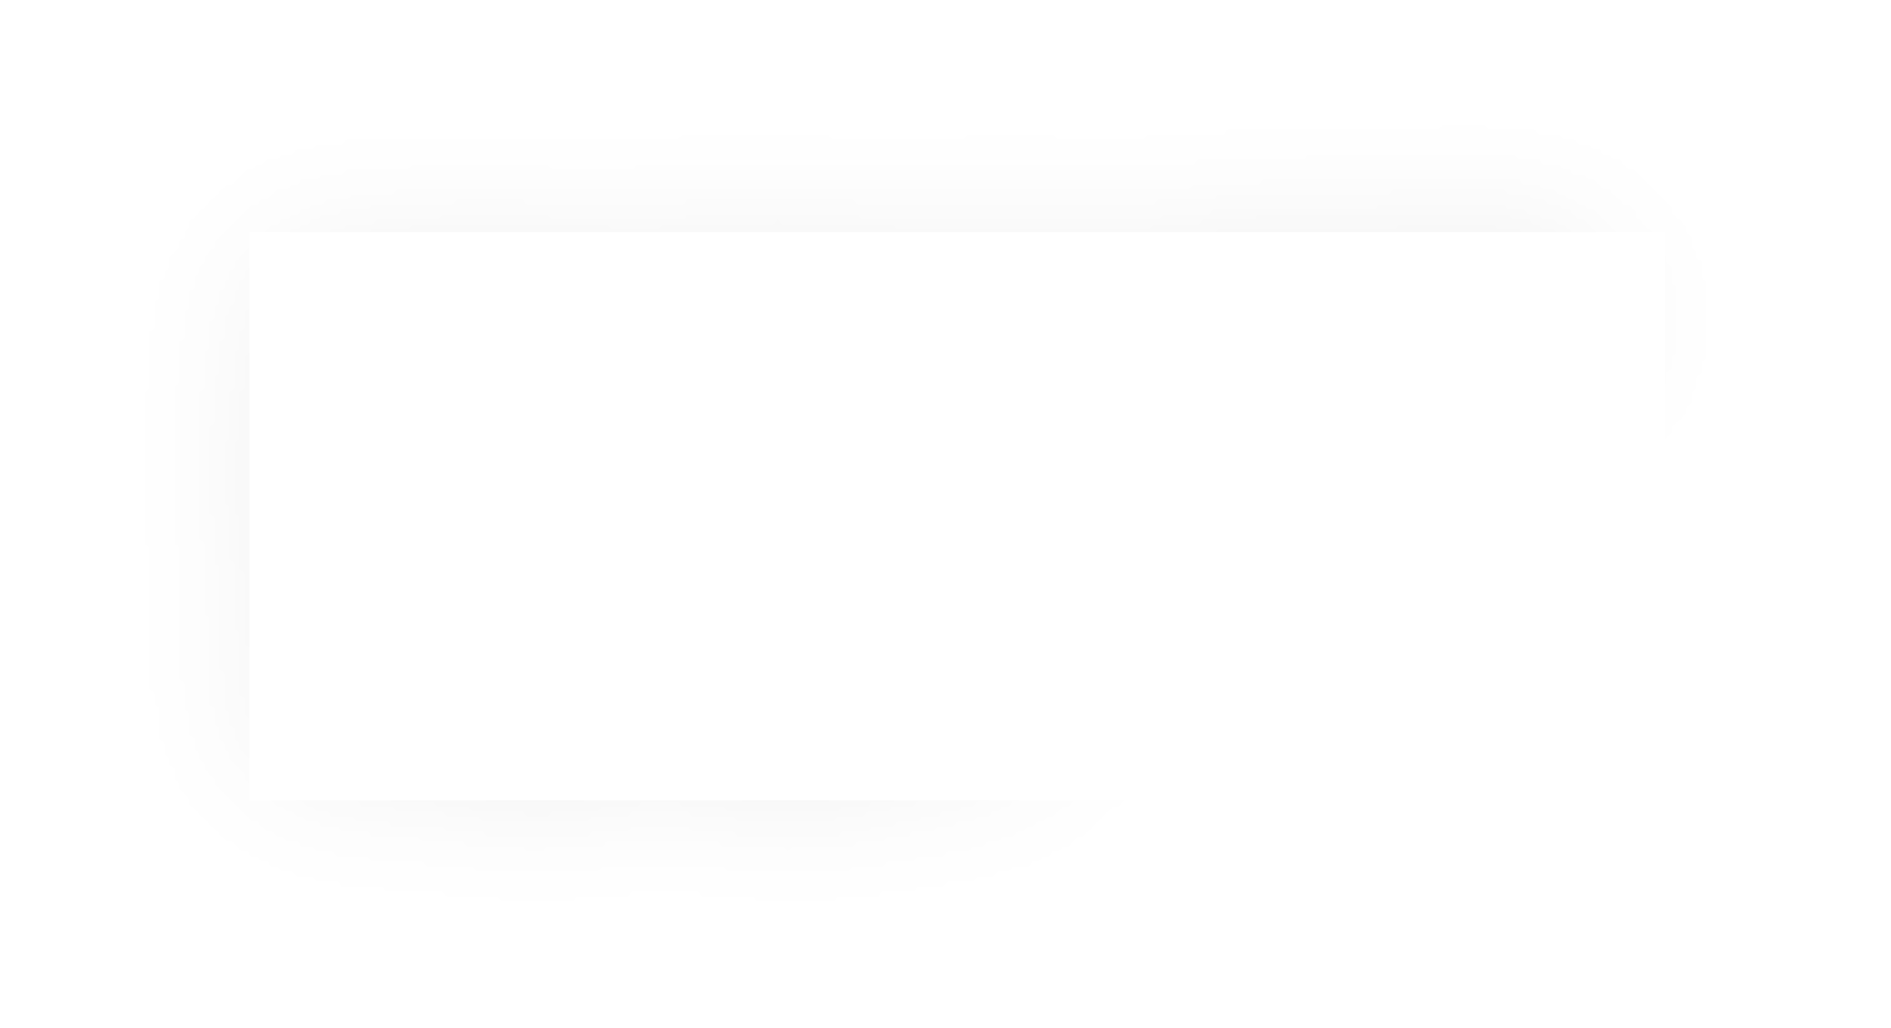

Loops and Control Flow
void loop() {
int i = 0;
while (i < 100) { i++;
}
}
0x000000000040115c <+0>: mov
0x0000000000401161 <+5>: cmp
0x0000000000401164 <+8>: jg
0x0000000000401166 <+10>: add
0x0000000000401169 <+13>: jmp
0x000000000040116b <+15>: retq
$0x0,%eax
$0x63,%eax 0x40116b <loop+15>
$0x1,%eax
0x401161 <loop+5>
Compare %eax (i) to 0x63 (99) by calculating %eax – 0x63.
This is 0 – 99 = -99, so it sets the Sign Flag to 1.

Slide 57


Loops and Control Flow
void loop() {
int i = 0;
while (i < 100) { i++;
}
}
0x000000000040115c <+0>: mov
0x0000000000401161 <+5>: cmp
0x0000000000401164 <+8>: jg
0x0000000000401166 <+10>: add
0x0000000000401169 <+13>: jmp
0x000000000040116b <+15>: retq
$0x0,%eax
$0x63,%eax 0x40116b <loop+15>
$0x1,%eax
0x401161 <loop+5>
jg means “jump if greater than”. This jumps if %eax > 0x63. The flags indicate this is false, so we do not jump.

Slide 58


Loops and Control Flow
void loop() {
int i = 0;
while (i < 100) { i++;
}
}
0x000000000040115c <+0>: mov
0x0000000000401161 <+5>: cmp
0x0000000000401164 <+8>: jg
0x0000000000401166 <+10>: add
0x0000000000401169 <+13>: jmp
0x000000000040116b <+15>: retq
$0x0,%eax
$0x63,%eax 0x40116b <loop+15>
$0x1,%eax
0x401161 <loop+5>
Add 1 to %eax (i).

Slide 59


Loops and Control Flow
void loop() {
int i = 0;
while (i < 100) { i++;
}
}
0x000000000040115c <+0>: mov
0x0000000000401161 <+5>: cmp
0x0000000000401164 <+8>: jg
0x0000000000401166 <+10>: add
0x0000000000401169 <+13>: jmp
0x000000000040116b <+15>: retq
$0x0,%eax
$0x63,%eax 0x40116b <loop+15>
$0x1,%eax
0x401161 <loop+5>
Jump to another instruction.

Slide 60
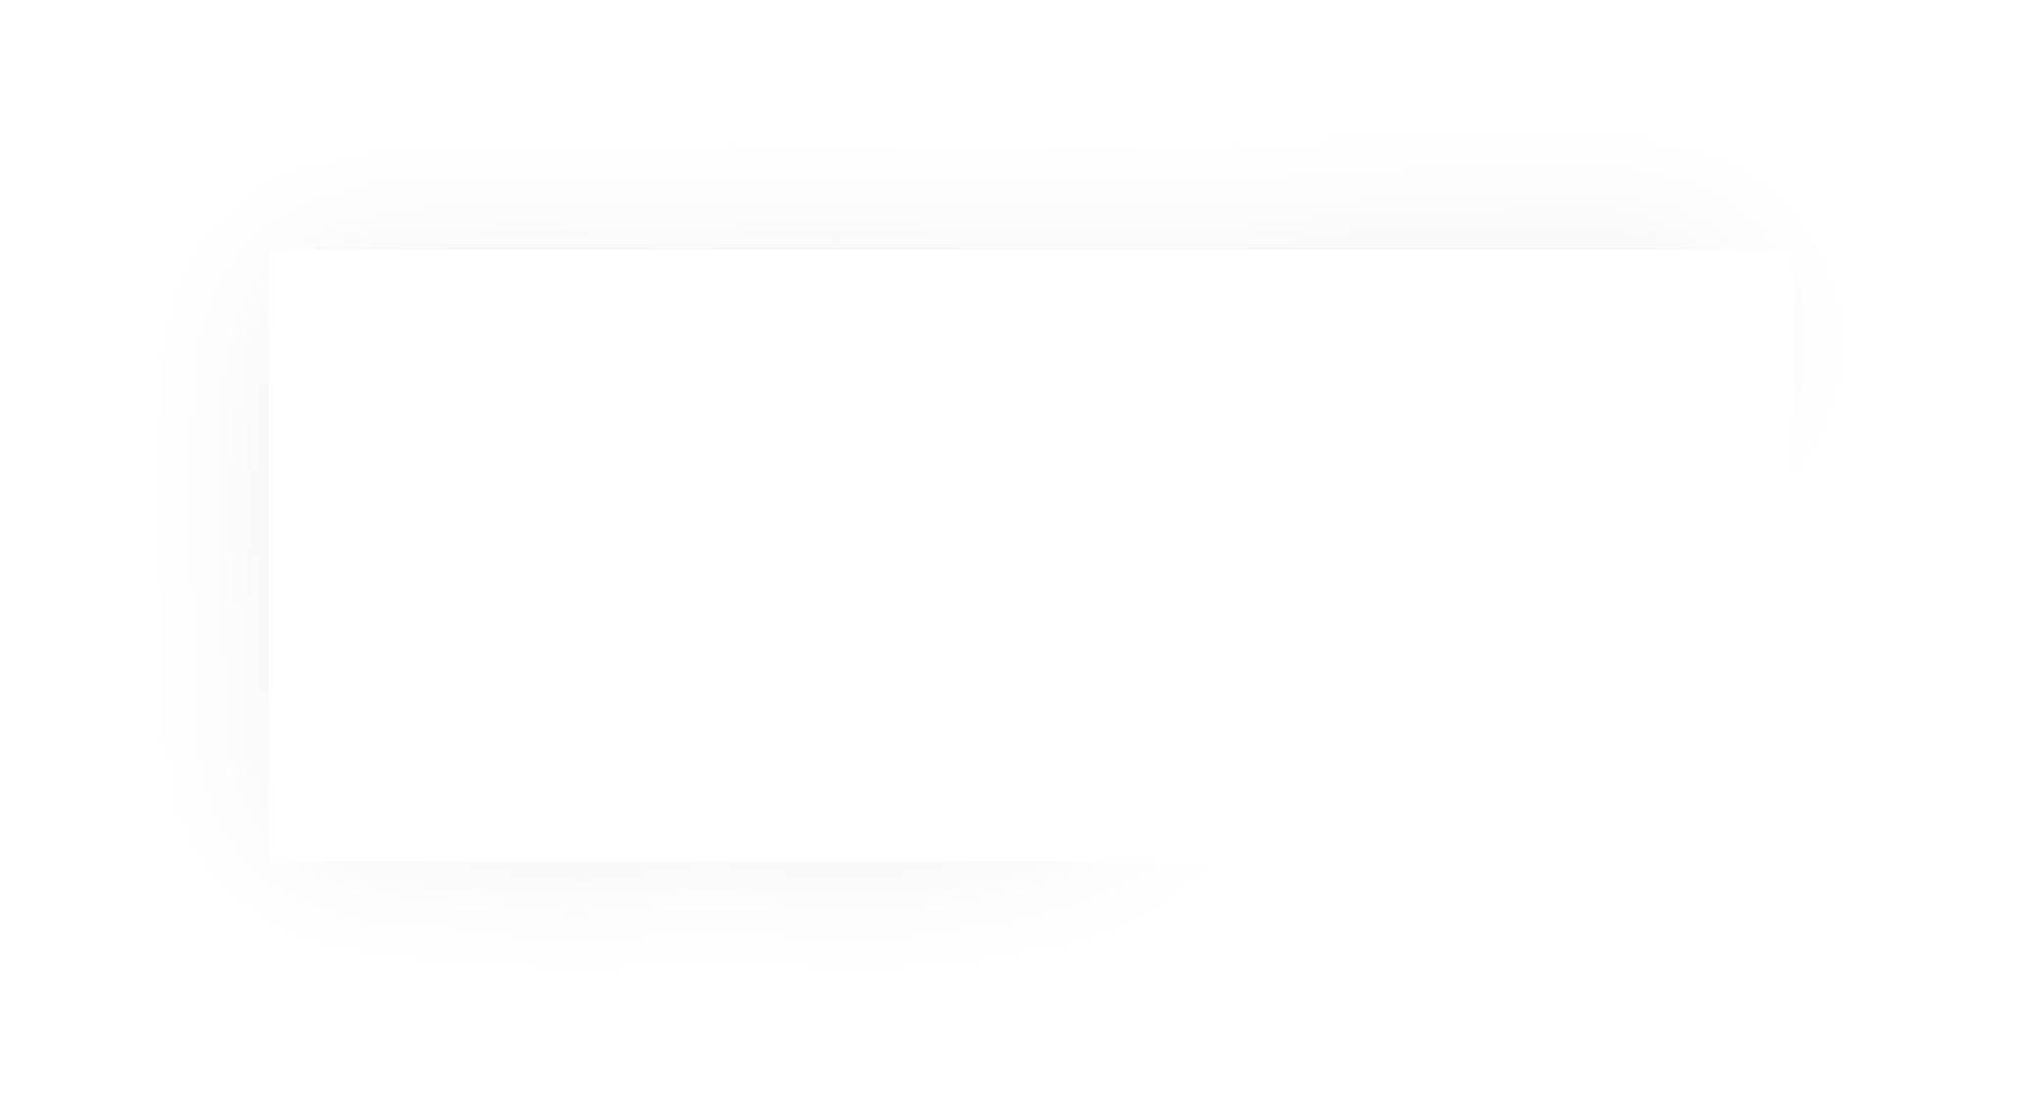
Loops and Control Flow
void loop() {
int i = 0;
while (i < 100) { i++;
}
}
0x000000000040115c <+0>: mov
0x0000000000401161 <+5>: cmp
0x0000000000401164 <+8>: jg
0x0000000000401166 <+10>: add
0x0000000000401169 <+13>: jmp
0x000000000040116b <+15>: retq
$0x0,%eax
$0x63,%eax 0x40116b <loop+15>
$0x1,%eax
0x401161 <loop+5>
Compare %eax (i) to 0x63 (99) by calculating %eax – 0x63.
This is 1 – 99 = -98, so it sets the Sign Flag to 1.

Slide 61


Loops and Control Flow
void loop() {
int i = 0;
while (i < 100) { i++;
}
}
0x000000000040115c <+0>: mov
0x0000000000401161 <+5>: cmp
0x0000000000401164 <+8>: jg
0x0000000000401166 <+10>: add
0x0000000000401169 <+13>: jmp
0x000000000040116b <+15>: retq
$0x0,%eax
$0x63,%eax 0x40116b <loop+15>
$0x1,%eax
0x401161 <loop+5>
We continue in this pattern until we make this conditional jump.
When will that be?

Slide 62


Loops and Control Flow
void loop() {
int i = 0;
while (i < 100) { i++;
}
}
0x000000000040115c <+0>: mov
0x0000000000401161 <+5>: cmp
0x0000000000401164 <+8>: jg
0x0000000000401166 <+10>: add
0x0000000000401169 <+13>: jmp
0x000000000040116b <+15>: retq
$0x0,%eax
$0x63,%eax 0x40116b <loop+15>
$0x1,%eax
0x401161 <loop+5>
We will stop looping when this comparison says that %eax – 0x63 > 0!

Slide 63


Loops and Control Flow
void loop() {
int i = 0;
while (i < 100) { i++;
}
}
0x000000000040115c <+0>: mov
0x0000000000401161 <+5>: cmp
0x0000000000401164 <+8>: jg
0x0000000000401166 <+10>: add
0x0000000000401169 <+13>: jmp
0x000000000040116b <+15>: retq
$0x0,%eax
$0x63,%eax 0x40116b <loop+15>
$0x1,%eax
0x401161 <loop+5>
Then, we return from the function.

Slide 64
GCC Common While Loop Construction
C
while (test) {
body
}
Assembly
Test
Skip | loop | if | test | passes
Body Jump | back | to | test
From Previous Slide:
0x000000000040115c | <+0>: | mov | $0x0,%eax
0x0000000000401161 | <+5>: | cmp | $0x63,%eax
0x0000000000401164 | <+8>: | jg | 0x40116b <loop+15>
0x0000000000401166 | <+10>: | add | $0x1,%eax
0x0000000000401169 | <+13>: | jmp | 0x401161 <loop+5>
0x000000000040116b | <+15>: | retq

Slide 65
GCC Other While Loop Construction
C
while (test) {
body
}
Assembly
Jump Body | to | test
Test Jump | to | body if test passes
From Previous Slide:
0x0000000000400570 | <+0>: | mov | $0x0,%eax
0x0000000000400575 | <+5>: | jmp | 0x40057a <loop+10>
0x0000000000400577 | <+7>: | add | $0x1,%eax
0x000000000040057a | <+10>: | cmp | $0x63,%eax
0x000000000040057d | <+13>: | jle | 0x400577 <loop+7>
0x000000000040057f | <+15>: | repz | retq

Slide 66
Lecture Plan
Assembly Execution and %rip
Control Flow Mechanics
  Condition Codes
  Assembly Instructions
If statements
Loops
  While loops
  For loops
Other Instructions That Depend On Condition Codes
Live Session Slides
5
27
46
54
67
73
81

Slide 67


Common For Loop Construction
C For loop
for (init; test; update) {
body
}
Assembly pseudocode
Init Test
Skip loop if test passes
Body
Update
Jump back to test
C Equivalent While Loop
init
while(test) {
body
update
}
For loops and while loops are treated (essentially) the same when compiled down to assembly.

Slide 68
Back to Our First Assembly
int sum_array(int arr[], int nelems) { int sum = 0;
for (int i = 0; i < nelems; i++) { sum += arr[i];
}
return sum;
}
Which register is C code’s sum?
Which register is C code’s i?
Which assembly instruction is C code’s sum += arr[i]?
What are the cmp and jge
instructions doing?
(jge: signed jump greater than/equal)
0000000000401136 <sum_array>:
401136 <+0>: mov
40113b <+5>: mov
$0x0,%eax
$0x0,%edx
%esi,%eax
401140 <+10>: cmp
401142 <+12>: jge
0x40114f <sum_array+25>
401144 <+14>: movslq %eax,%rcx
401147 <+17>: add
40114a <+20>: add
40114d <+23>: jmp
40114f <+25>: mov
401151 <+27>: retq
(%rdi,%rcx,4),%edx
$0x1,%eax
0x401140 <sum_array+10>
%edx,%eax
69

Slide 69

Demo: GDB and Assembly
sum_array.c
70

Slide 70

gdb tips
layout split
(ctrl-x a: exit, ctrl-l: resize)
View C, assembly, and gdb (lab5)
info reg |  |  |  |  | Print all registers
p $eax |  |  |  |  | Print register value
p $eflags |  |  |  |  | Print all condition codes currently set
b *0x400546 |  |  |  |  | Set breakpoint at assembly instruction
b *0x400550 | if | $eax | > | 98 | Set conditional breakpoint
ni |  |  |  |  | Next assembly instruction
si |  |  |  |  | Step into assembly instruction (will step into function calls)
71

Slide 71
gdb tips
p/x $rdi p/t $rsi
Print register value in hex Print register value in binary
x $rdi x/4bx $rdi x/4wx $rdi
Examine the byte stored at this address Examine 4 bytes starting at this address Examine 4 ints starting at this address

Slide 72
Lecture Plan
Assembly Execution and %rip
Control Flow Mechanics
  Condition Codes
  Assembly Instructions
If statements
Loops
  While loops
  For loops
Other Instructions That Depend On Condition Codes
Live Session Slides
5
27
46
54
67
73
81

Slide 73
Condition Code-Dependent Instructions
There are three common instruction types that use condition codes:
jmp instructions conditionally jump to a different next instruction
set instructions conditionally set a byte to 0 or 1
new versions of mov instructions conditionally move data

Slide 74
set: Read condition codes
set instructions condinonally set a byte to 0 or 1.
Reads current state of ﬂags
operand is a single-byte register (e.g., %al) or single-byte memory locanon
Does not perturb other bytes of register
Typically followed by movzbl to zero those bytes
cmp $0xf,%edi
setle %al
movzbl %al, %eax retq
int small(int x) { return x < 16;
}

Slide 75
set: Read condition codes
Instruction Synonym Set Condition (1 if true, 0 if false)
sete | D |  | setz | Equal / zero
setne |  | D | setnz | Not equal / not zero
sets | D |  |  | Negative
setns |  | D |  | Nonnegative
setg | D |  | setnle | Greater (signed >)
setge |  | D | setnl | Greater or equal (signed >=)
setl | D |  | setnge | Less (signed <)
setle |  | D | setng | Less or equal (signed <=)
seta | D |  | setnbe | Above (unsigned >)
setae |  | D | setnb | Above or equal (unsigned >=)
setb | D |  | setnae | Below (unsigned <)
setbe |  | D | setna | Below or equal (unsigned <=)

Slide 76
cmov: Conditional move
cmovx src,dst conditionally moves data in src to data in dst.
Mov src to dst if condition x holds; no change otherwise
src is memory address/register, dst is register
May be more efficient than branch (i.e., jump)
Often seen with C ternary operator: result = test ? then: else;
cmp mov
%edi,%esi
%edi, %eax
int max(int x, int y) { return x > y ? x : y;
cmovge %esi, %eax retq
}

Slide 77
cmov: Conditional move
Instruction |  | Synonym | Move Condition
cmove | S,R | cmovz | Equal / zero (ZF = 1)
cmovne | S,R | cmovnz | Not equal / not zero (ZF = 0)
cmovs | S,R |  | Negative (SF = 1)
cmovns | S,R |  | NonnegaOve (SF = 0)
cmovg | S,R | cmovnle | Greater (signed >) (SF = 0 and SF = OF)
cmovge | S,R | cmovnl | Greater or equal (signed >=) (SF = OF)
cmovl | S,R | cmovnge | Less (signed <) (SF != OF)
cmovle | S,R | cmovng | Less or equal (signed <=) (ZF = 1 or SF! = OF)
cmova | S,R | cmovnbe | Above (unsigned >) (CF = 0 and ZF = 0)
cmovae | S,R | cmovnb | Above or equal (unsigned >=) (CF = 0)
cmovb | S,R | cmovnae | Below (unsigned <) (CF = 1)
cmovbe | S,R | cmovna | Below or equal (unsigned <=) (CF = 1 or ZF = 1)

Slide 78
Recap
Assembly Execution and %rip
Control Flow Mechanics
  Condition Codes
  Assembly Instructions
If statements
Loops
  While loops
  For loops
Other Instructions That Depend On Condition Codes
Next time: Function calls in assembly

Slide 79

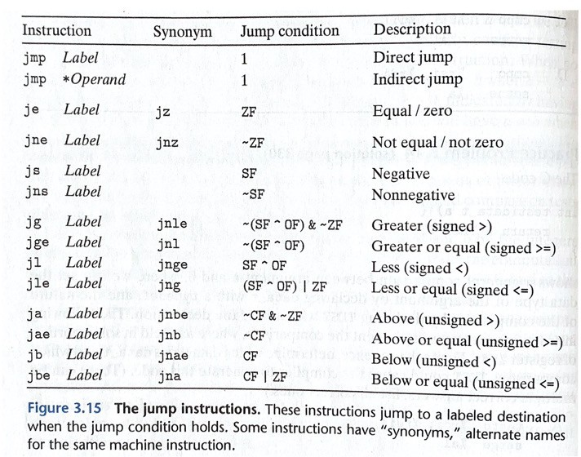
How to remember cmp/jmp
CMP S1, S2 is S2 – S1 (just sets condition codes). But generally:
cmp S1, S2
jg …
S2 S1
>
S2 - S1 0
>
Much less important to remember exact condition codes
  Yes, they fully explain conditional jmp…
  …but more important to know how to translate assembly back into C
  If you’re interested, B&O p. 206 has details
8
3

Slide 80
Remember test exists
TEST S1, S2 is S2 & S1
test %edi, %edi jns …
%edi & %edi is nonnegative
%edi is nonnegative

Slide 81
Practice: Fill in the blanks
long loop(long a, long b) { long result = (1) ; while ( (2) ) {
result = (3) ; a = (4) ;
}
return result;
}
<+0>: | mov | $0x1,%eax
<+5>: | cmp | %rsi,%rdi
<+8>: | jge | 0x1151 | <loop+24>
<+10>: | lea | (%rdi,%rsi,1),%rdx
<+14>: | imul | %rdx,%rax
<+18>: | add | $0x1,%rdi
<+22>: | jmp | 0x113e <loop+5>
<+24>: | retq
GCC common while loop construction:
Test
Jump past loop if fails
Body
Jump to test
https://godbolt.org/z/zrW6c5MGa
86

Slide 82
Practice: Fill in the blanks
long loop(long a, long b) { long result = (1) ; while ( (2) ) {
result = (3) ; a = (4) ;
}
return result;
}
<+0>: | mov | $0x1,%eax
<+5>: | cmp | %rsi,%rdi
<+8>: | jge | 0x1151 | <loop+24>
<+10>: | lea | (%rdi,%rsi,1),%rdx
<+14>: | imul | %rdx,%rax
<+18>: | add | $0x1,%rdi
<+22>: | jmp | 0x113e <loop+5>
<+24>: | retq
GCC common while loop construction:
Test
Jump past loop if fails
Body
Jump to test

Slide 83
Practice: Fill in the blanks
long loop(long a, long b) { long result = ; while ( ) {
result = ; a = ;
}
return result;
}
<+0>: | mov | $0x1,%eax
<+5>: | cmp | %rsi,%rdi
<+8>: jge 0x1151 <loop+24>
<+10>: | lea | (%rdi,%rsi,1),%rdx
<+14>: | imul | %rdx,%rax
<+18>: | add | $0x1,%rdi
<+22>: jmp
0x113e <loop+5>
<+24>:
retq

Slide 84
Practice: Fill in the blanks
long loop(long a, long b) { long result = 1 ; while ( a < b ) {
result = result*(a+b) ;
a = a + 1 ;
}
return result;
}
<+0>: | mov | $0x1,%eax
<+5>: | cmp | %rsi,%rdi
<+8>: jge 0x1151 <loop+24>
<+10>: | lea | (%rdi,%rsi,1),%rdx
<+14>: | imul | %rdx,%rax
<+18>: | add | $0x1,%rdi
<+22>: jmp
0x113e <loop+5>
<+24>:
retq

Slide 85
test practice: What’s the C code?
0x400546 0x400548 | <test_func> <test_func+2> | test jns | %edi,%edi 0x400550 | <test_func+10>
0x40054a 0x40054f 0x400550 0x400555 | <test_func+4> <test_func+9> <test_func+10> <test_func+15> | mov retq mov retq | $0xfeed,%eax $0xaabbccdd,%eax

Slide 86
test practice: What’s the C code?
0x400546 0x400548 | <test_func> <test_func+2> | test jns | %edi,%edi 0x400550 | <test_func+10>
0x40054a 0x40054f 0x400550 0x400555 | <test_func+4> <test_func+9> <test_func+10> <test_func+15> | mov retq mov retq | $0xfeed,%eax $0xaabbccdd,%eax
int test_func(int x) { if (x < 0) {
return 0xfeed;
}
return 0xaabbccdd;
}
(or anything like this)

Slide 87
Practice: “Escape Room”
<escape_room+0> | lea | (%rdi,%rdi,1),%eax
<escape_room+3> | cmp | $0x5,%eax
<escape_room+6> | jg | 0x114c <escape_room+19>
<escape_room+8> | cmp | $0x1,%edi
<escape_room+11> | je | 0x1152 <escape_room+25>
<escape_room+13> | mov | $0x0,%eax
<escape_room+18> | retq
<escape_room+19> | mov | $0x1,%eax
<escape_room+24> | retq
<escape_room+25> | mov | $0x1,%eax
<escape_room+30> | retq
What must be passed to the escapeRoom function such that it
You don’t have to reverse-engineer C code exactly!
returns true (1) and not false (0)?
Just figure out the big picture!

Slide 88
Practice: “Escape Room”
<escape_room+0> | lea | (%rdi,%rdi,1),%eax
<escape_room+3> | cmp | $0x5,%eax
<escape_room+6> | jg | 0x114c <escape_room+19>
<escape_room+8> | cmp | $0x1,%edi
<escape_room+11> | je | 0x1152 <escape_room+25>
<escape_room+13> | mov | $0x0,%eax
<escape_room+18> | retq
<escape_room+19> | mov | $0x1,%eax
<escape_room+24> | retq
<escape_room+25> | mov | $0x1,%eax
<escape_room+30> | retq
What must be passed to the escapeRoom function such that it
First param > 2 or == 1.
returns true (1) and not false (0)?

Slide 89
Lecture Plan
Revisiting %rip
Calling Functions
  The Stack
  Passing Control
  Passing Data
  Local Storage
Register Restrictions
Pulling it all together: recursion example
Optimizations
Live session slides
5
19
22
36
44
65
69
78
81
93
cp -r /afs/ir/class/cs107/lecture-code/lect13 .

