Slide 1
CS107, Lecture 15
Introduction to Assembly
Reading: B&O 3.1-3.4
😷 masks recommended

Slide 2
CS107 Topic 5
How does a computer interpret and execute C programs?
Why is answering this question important?
Learning how our code is really translated and executed helps us write better code
We can learn how to reverse engineer and exploit programs at the assembly level
assign5: find and exploit vulnerabilities in an ATM program, reverse engineer a program without seeing its code, and de-anonymize users given a data leak.

Slide 3
Learning Goals
Learn what assembly language is and why it is important
Become familiar with the format of human-readable assembly and x86
Learn the mov instruction and how data moves around at the assembly level

Slide 4
Lecture Plan
Overview: GCC and Assembly
Demo: Looking at an executable
Registers and The Assembly Level of Abstraction
The mov Instruction
cp -r /afs/ir/class/cs107/lecture-code/lect15 .

Slide 5
Lecture Plan
Overview: GCC and Assembly
Demo: Looking at an executable
Registers and The Assembly Level of Abstraction
The mov Instruction
cp -r /afs/ir/class/cs107/lecture-code/lect15 .

Slide 6
GCC
GCC is the compiler that converts your human-readable code into machine-readable instructions.
C, and other languages, are high-level abstractions we use to write code efficiently. But computers don’t really understand things like data structures, variable types, etc. Compilers are the translator!
Pure machine code is 1s and 0s – everything is bits, even your programs! But we can read it in a human-readable form called assembly. (Engineers used to write code in assembly before C).
There may be multiple assembly instructions needed to encode a single C instruction.
We’re going to go behind the curtain to see what the assembly code for our programs looks like.

Slide 7
Why are we reading assembly?
idea
C code
Assembly code
Machine code
Programmer-
generated
gcc (compiler+assembler) generated
Main goal: Information retrieval
We will not be writing assembly! (that’s the compiler’s job)
Rather, we want to translate the assembly back into our C code.
Knowing how our C code is converted into machine instructions gives us insight into how to write more efficient, cleaner code.

Slide 8
Lecture Plan
Overview: GCC and Assembly
Demo: Looking at an executable
Registers and The Assembly Level of Abstraction
The mov Instruction
cp -r /afs/ir/class/cs107/lecture-code/lect15 .

Slide 9
Demo: Looking at an Executable (objdump -d)

Slide 10
Our First Assembly
int sum_array(int arr[], int nelems) {
int sum = 0;
for (int i = 0; i < nelems; i++) {
sum += arr[i];
}
return sum;
}
What does this look like in assembly?

Slide 11
Our First Assembly
int sum_array(int arr[], int nelems) {
int sum = 0;
for (int i = 0; i < nelems; i++) {
sum += arr[i];
}
return sum;
}
0000000000401136 <sum_array>:
401136: b8 00 00 00 00 mov $0x0,%eax
40113b: ba 00 00 00 00 mov $0x0,%edx
401140: 39 f0 cmp %esi,%eax
401142: 7d 0b jge 40114f <sum_array+0x19>
401144: 48 63 c8 movslq %eax,%rcx
401147: 03 14 8f add (%rdi,%rcx,4),%edx
40114a: 83 c0 01 add $0x1,%eax
40114d: eb f1 jmp 401140 <sum_array+0xa>
40114f: 89 d0 mov %edx,%eax
401151: c3 retq
make
objdump -d sum

Slide 12
Our First Assembly
0000000000401136 <sum_array>:
401136: b8 00 00 00 00 mov $0x0,%eax
40113b: ba 00 00 00 00 mov $0x0,%edx
401140: 39 f0 cmp %esi,%eax
401142: 7d 0b jge 40114f <sum_array+0x19>
401144: 48 63 c8 movslq %eax,%rcx
401147: 03 14 8f add (%rdi,%rcx,4),%edx
40114a: 83 c0 01 add $0x1,%eax
40114d: eb f1 jmp 401140 <sum_array+0xa>
40114f: 89 d0 mov %edx,%eax
401151: c3 retq
Notes:
Read top to bottom

Slide 13
Our First Assembly
0000000000401136 <sum_array>:
401136: b8 00 00 00 00 mov $0x0,%eax
40113b: ba 00 00 00 00 mov $0x0,%edx
401140: 39 f0 cmp %esi,%eax
401142: 7d 0b jge 40114f <sum_array+0x19>
401144: 48 63 c8 movslq %eax,%rcx
401147: 03 14 8f add (%rdi,%rcx,4),%edx
40114a: 83 c0 01 add $0x1,%eax
40114d: eb f1 jmp 401140 <sum_array+0xa>
40114f: 89 d0 mov %edx,%eax
401151: c3 retq
This is the name of the function (same as C) and the memory address where the code for this function starts.

Slide 14
Our First Assembly
0000000000401136 <sum_array>:
401136: b8 00 00 00 00 mov $0x0,%eax
40113b: ba 00 00 00 00 mov $0x0,%edx
401140: 39 f0 cmp %esi,%eax
401142: 7d 0b jge 40114f <sum_array+0x19>
401144: 48 63 c8 movslq %eax,%rcx
401147: 03 14 8f add (%rdi,%rcx,4),%edx
40114a: 83 c0 01 add $0x1,%eax
40114d: eb f1 jmp 401140 <sum_array+0xa>
40114f: 89 d0 mov %edx,%eax
401151: c3 retq
These are the memory addresses where each of the instructions live. Sequential instructions are sequential in memory.

Slide 15
Our First Assembly
0000000000401136 <sum_array>:
401136: b8 00 00 00 00 mov $0x0,%eax
40113b: ba 00 00 00 00 mov $0x0,%edx
401140: 39 f0 cmp %esi,%eax
401142: 7d 0b jge 40114f <sum_array+0x19>
401144: 48 63 c8 movslq %eax,%rcx
401147: 03 14 8f add (%rdi,%rcx,4),%edx
40114a: 83 c0 01 add $0x1,%eax
40114d: eb f1 jmp 401140 <sum_array+0xa>
40114f: 89 d0 mov %edx,%eax
401151: c3 retq
This is the assembly code: “human-readable” versions of each machine code instruction.

Slide 16
Our First Assembly
0000000000401136 <sum_array>:
401136: b8 00 00 00 00 mov $0x0,%eax
40113b: ba 00 00 00 00 mov $0x0,%edx
401140: 39 f0 cmp %esi,%eax
401142: 7d 0b jge 40114f <sum_array+0x19>
401144: 48 63 c8 movslq %eax,%rcx
401147: 03 14 8f add (%rdi,%rcx,4),%edx
40114a: 83 c0 01 add $0x1,%eax
40114d: eb f1 jmp 401140 <sum_array+0xa>
40114f: 89 d0 mov %edx,%eax
401151: c3 retq
This is the machine code: raw hexadecimal instructions, representing binary as read by the computer. Different instructions may be different byte lengths.

Slide 17
Our First Assembly
0000000000401136 <sum_array>:
401136: b8 00 00 00 00 mov $0x0,%eax
40113b: ba 00 00 00 00 mov $0x0,%edx
401140: 39 f0 cmp %esi,%eax
401142: 7d 0b jge 40114f <sum_array+0x19>
401144: 48 63 c8 movslq %eax,%rcx
401147: 03 14 8f add (%rdi,%rcx,4),%edx
40114a: 83 c0 01 add $0x1,%eax
40114d: eb f1 jmp 401140 <sum_array+0xa>
40114f: 89 d0 mov %edx,%eax
401151: c3 retq

Slide 18
Our First Assembly
0000000000401136 <sum_array>:
401136: b8 00 00 00 00 mov $0x0,%eax
40113b: ba 00 00 00 00 mov $0x0,%edx
401140: 39 f0 cmp %esi,%eax
401142: 7d 0b jge 40114f <sum_array+0x19>
401144: 48 63 c8 movslq %eax,%rcx
401147: 03 14 8f add (%rdi,%rcx,4),%edx
40114a: 83 c0 01 add $0x1,%eax
40114d: eb f1 jmp 401140 <sum_array+0xa>
40114f: 89 d0 mov %edx,%eax
401151: c3 retq
Each instruction has an operation name (“opcode”).

Slide 19
Our First Assembly
0000000000401136 <sum_array>:
401136: b8 00 00 00 00 mov $0x0,%eax
40113b: ba 00 00 00 00 mov $0x0,%edx
401140: 39 f0 cmp %esi,%eax
401142: 7d 0b jge 40114f <sum_array+0x19>
401144: 48 63 c8 movslq %eax,%rcx
401147: 03 14 8f add (%rdi,%rcx,4),%edx
40114a: 83 c0 01 add $0x1,%eax
40114d: eb f1 jmp 401140 <sum_array+0xa>
40114f: 89 d0 mov %edx,%eax
401151: c3 retq
Each instruction can also have arguments (“operands”).

Slide 20
Our First Assembly
0000000000401136 <sum_array>:
401136: b8 00 00 00 00 mov $0x0,%eax
40113b: ba 00 00 00 00 mov $0x0,%edx
401140: 39 f0 cmp %esi,%eax
401142: 7d 0b jge 40114f <sum_array+0x19>
401144: 48 63 c8 movslq %eax,%rcx
401147: 03 14 8f add (%rdi,%rcx,4),%edx
40114a: 83 c0 01 add $0x1,%eax
40114d: eb f1 jmp 401140 <sum_array+0xa>
40114f: 89 d0 mov %edx,%eax
401151: c3 retq
$[number] means a constant value, or “immediate” (e.g. 1 here).

Slide 21
Our First Assembly
0000000000401136 <sum_array>:
401136: b8 00 00 00 00 mov $0x0,%eax
40113b: ba 00 00 00 00 mov $0x0,%edx
401140: 39 f0 cmp %esi,%eax
401142: 7d 0b jge 40114f <sum_array+0x19>
401144: 48 63 c8 movslq %eax,%rcx
401147: 03 14 8f add (%rdi,%rcx,4),%edx
40114a: 83 c0 01 add $0x1,%eax
40114d: eb f1 jmp 401140 <sum_array+0xa>
40114f: 89 d0 mov %edx,%eax
401151: c3 retq
%[name] means a register, a storage location on the CPU (e.g. edx here).

Slide 22
🌟 Keep a resource guide handy 🌟
https://web.stanford.edu/class/cs107/resources/x86-64-reference.pdf
CS107 x86 Guide: https://cs107.stanford.edu/guide/x86-64.html
B&O book:
  Canvas -> Files
  -> Bryant_OHallaron_ch3.1-3.8.pdf
It’s like learning how to read (not speak) a new language! (again!)

Slide 23
Lecture Plan
Overview: GCC and Assembly
Demo: Looking at an executable
Registers and The Assembly Level of Abstraction
The mov instruction
cp -r /afs/ir/class/cs107/lecture-code/lect15 .

Slide 24
Assembly Abstraction
C abstracts away the low-level details of machine code. It lets us work using variables, variable types, and other higher-level abstractions.
C and other languages let us write code that works on most machines.
Assembly code is just bytes! No variable types, no type checking, etc.
Assembly/machine code is processor-specific.
What is the level of abstraction for assembly code?
Notes:
C code works on computer and phone, but needs to be recompiled!

Slide 25
Registers
%rax

Slide 26
Registers
%rax
%rsi
%r8
%r12
%rbx
%rdi
%r9
%r13
%rcx
%rbp
%r10
%r14
%rdx
%rsp
%r11
%r15

Slide 27
Registers
What is a register?
A register is a fast read/write memory slot right on the CPU that can hold variable values.
Registers are located in the CPU; they are separate from main memory.

Slide 28
Registers
A register is a 64-bit space inside the processor.
There are 16 registers available, each with a unique name.
Registers are like “scratch paper” for the processor. Data being calculated or manipulated is moved to registers first. Operations are performed on registers.
Registers also hold parameters and return values for functions.
Registers are extremely fast memory!
Processor instructions consist mostly of moving data into/out of registers and performing arithmetic on them. This is the level of logic your program must be in to execute!

Slide 29
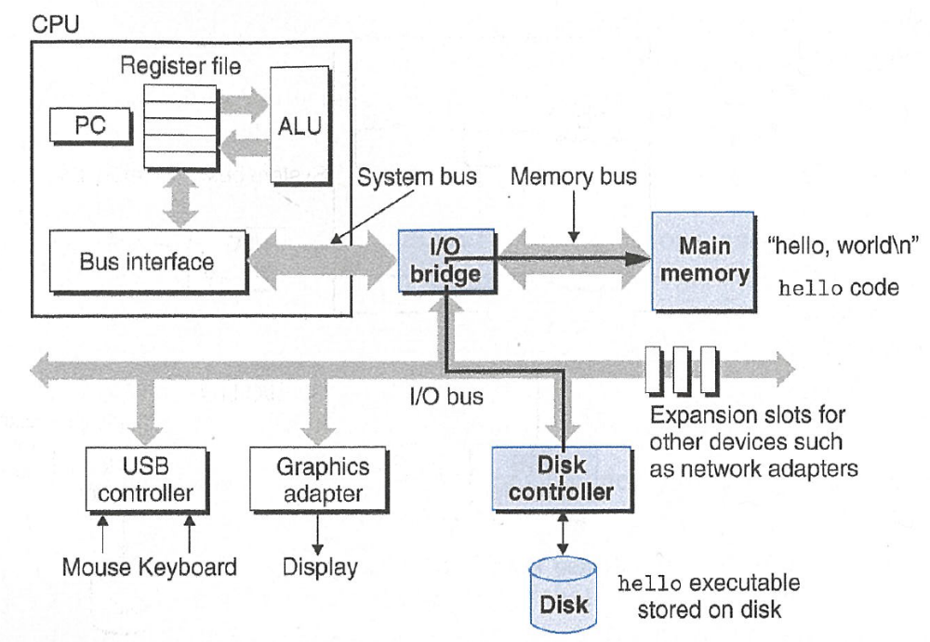
Computer architecture
registers accessed by name
ALU is main workhorse of CPU
memory needed
for program
execution
(stack, heap, etc.)
accessed by address
disk/server stores program
when not executing

Slide 30
Machine-Level Code
Assembly instructions manipulate these registers. For example:
One instruction adds two numbers in registers
One instruction transfers data from a register to memory
One instruction transfers data from memory to a register

Slide 31
GCC And Assembly
GCC compiles your program – it lays out memory on the stack and heap and generates assembly instructions to access and do calculations on those memory locations.
Here’s what the “assembly-level abstraction” of C code might look like:
C | Assembly Abstraction
int sum = x + y; | Copy x into register 1 Copy y into register 2 Add register 2 to register 1 Write register 1 to memory for sum

Slide 32
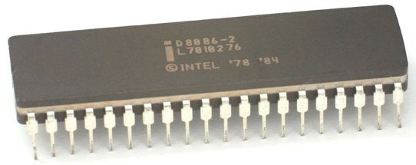
Instruction set architecture (ISA)
We are going to learn the x86-64 instruction set architecture (used by Intel and AMD processors).
  There are many other instruction sets: ARM, MIPS, etc.
An ISA is a contract between program/compiler and hardware:
  Defines operations that the processor (CPU) can execute
  Data read/write/transfer operations
  Control mechanisms
Intel originally designed their instruction set in 1978.
  Legacy support is a huge issue for x86-64
  Originally 16-bit processor, then 32 bit, now 64 bit.
  These design choices dictated the register sizes
  (and even register/instruction names).
Application program
Compiler
OS
ISA
CPU design
Circuit design
Chip layout
Notes:
legacy and backwards compatibility!!

Slide 33
Aside: 32-to-64-bit Transition
Early 2000s: most computers were 32-bit. This means that pointers were 4 bytes (32 bits).
32-bit pointers store a memory address from 0 to 2³²-1, equaling 2³² bytes of addressable memory. This equals 4 Gigabytes, meaning that 32-bit computers could have at most 4GB of memory (RAM)!
Because of this, computers transitioned to 64-bit. This means that datatypes were enlarged; pointers in programs were now 64 bits.
64-bit pointers store a memory address from 0 to 2⁶⁴-1, equaling 2⁶⁴ bytes of addressable memory. This equals 16 Exabytes, meaning that 64-bit computers could have at most 1024*1024*1024*16 GB of memory (RAM)!
Notes:
Fun fact: mobile devices still transitioning

Slide 34
Lecture Plan
Overview: GCC and Assembly
Demo: Looking at an executable
Registers and The Assembly Level of Abstraction
The mov Instruction
cp -r /afs/ir/class/cs107/lecture-code/lect15 .

Slide 35
mov
The mov instruction copies bytes from one place to another;
it is like the assignment operator (=) in C.
mov src,dst
The src and dst can each be one of:
Immediate (constant value, like a number) (only src)
Register
Memory Location
(at most one of src, dst)
$0x104
%rbx
0x6005c0
Direct address

Slide 36
Operand Forms: Immediate
mov $0x104,_____
Copy the value 0x104 into some destination.

Slide 37
Operand Forms: Registers
Copy the value in register %rbx into some destination.
mov %rbx,____
mov ____,%rbx
Copy the value from some source into register %rbx.

Slide 38
Operand Forms: Absolute Addresses
Copy the value at address 0x104 into some destination.
mov 0x104,_____
mov _____,0x104
Copy the value from some source into the memory at address 0x104.

Slide 39
Practice #1: Operand Forms
What are the results of the following move instructions (executed separately)? For this problem, assume the value 5 is stored at address 0x42, and the value 8 is stored in %rbx.
mov $0x42,%rax
mov 0x42,%rax
mov %rbx,0x55
Notes:
Move 0x42 into %rax
Move 5 into %rax
Move 8 to address 0x55

Slide 40
Operand Forms: Indirect
Copy the value at the address stored in register %rbx into some destination.
mov (%rbx),_____
mov _____,(%rbx)
Copy the value from some source into the memory at the address stored in register %rbx.

Slide 41
Operand Forms: Base + Displacement
Copy the value at the address (0x10 plus what is stored in register %rax) into some destination.
mov 0x10(%rax),_________
mov __________,0x10(%rax)
Copy the value from some source into the memory at the address (0x10 plus what is stored in register %rax).

Slide 42
Operand Forms: Indexed
Copy the value at the address which is (the sum of the values in registers %rax and %rdx) into some destination.
mov (%rax,%rdx),__________
mov ___________,(%rax,%rdx)
Copy the value from some source into the memory at the address which is (the sum of the values in registers %rax and %rdx).

Slide 43
Operand Forms: Indexed
Copy the value at the address which is (the sum of 0x10 plus the values in registers %rax and %rdx) into some destination.
mov 0x10(%rax,%rdx),______
mov _______,0x10(%rax,%rdx)
Copy the value from some source into the memory at the address which is (the sum of 0x10 plus the values in registers %rax and %rdx).

Slide 44
Practice #2: Operand Forms
What are the results of the following move instructions (executed separately)? For this problem, assume the value 0x11 is stored at address 0x10C, 0xAB is stored at address 0x104, 0x100 is stored in register %rax and 0x3 is stored in %rdx.
mov $0x42,(%rax)
mov 4(%rax),%rcx
mov 9(%rax,%rdx),%rcx
For #3, respond with your thoughts on PollEv: pollev.com/cs107 or text CS107 to 22333 once to join.
Imm(r_{b}, r_{i}) is equivalent to address Imm + R[r_{b}] + R[r_{i}]
Displacement: positive or negative constant (if missing, = 0)
Base: register (if missing, = 0)
Index: register (if missing, = 0)
Notes:
Move 0x42 to memory address 0x100
Move 0xAB into %rcx
Move 0x11 into %rcx

Slide 45
Recap
Overview: GCC and Assembly
Demo: Looking at an executable
Registers and The Assembly Level of Abstraction
The mov instruction
Next time: diving deeper into assembly
Lecture 15 takeaway: Assembly is the human-readable version of the form our programs are ultimately executed in by the processor. The compiler translates source code to machine code. The most common assembly instruction is mov to move data around.

Slide 46
Extra Practice

Slide 47
1. Extra Practice
Fill in the blank to complete the C code that 1. generates this assembly
2. has this register layout
int x = ...
int *ptr = malloc(…);
...
___???___ = _???_;
mov %ecx,(%rax)
<val of x>
<val of ptr>
(Pedantic: You should sub in <x> and <ptr> with actual values, like 4 and 0x7fff80)
🤔
%ecx
%rax

Slide 48
1. Extra Practice
Fill in the blank to complete the C code that 1. generates this assembly
2. has this register layout
int x = ...
int *ptr = malloc(…);
...
___???___ = _???_;
mov %ecx,(%rax)
*ptr = x;
<val of x>
<val of ptr>
%ecx
%rax

