Slide 1
CS107 Lecture 2
Unix and C
😷 masks recommended

Slide 2
Announcements
Remember to input your section preferences through 5PM Sat! Link is on the course website (under “Sections”).
Helper Hours scheduled and starting this week!
assign0 released, due Mon 11:59PM PDT
Please email Megan (Head TA) about OAE accommodations and midterm conflicts as soon as you can

Slide 3
CS 106L: Standard C++ Programming
1 unit, TTh 4:30-5:50, Thornton 110
Course Info: cs106l.stanford.edu
Vector<T> → std::vector<T>
std::binary_search
std::iostream
[&]() { return val; }
T operator+(T& rhs);
T(const T& copy);
int&& a = 5 + 2;
T(T&& tempval);
std::make_unique<Type>(args…);
Containers
Algorithms
Streams
Lambdas
Operator Overloading
Special Member Functions
rvalues
Move Semantics
RAII

Slide 4
Learning Goals
Learn how to navigate a computer and edit/run programs using the terminal
Understand the differences between C and other languages and how to write C programs

Slide 5
Lecture Plan
Unix and the Command Line
Getting Started With C

Slide 6
Lecture Plan
Unix and the Command Line
Getting Started With C

Slide 7


What is the Command Line?
The command-line is a text-based interface (i.e., terminal interface) to navigate a computer, instead of a Graphical User Interface (GUI).
Graphical User Interface
Text-based interface

Slide 8
Unix Commands To Try
cd – change directories (..)
ls – list directory contents
mkdir – make directory
emacs – open text editor
rm – remove file or folder
man – view manual pages
See the course website for more commands and a complete reference.

Slide 9
Demo: Using Unix and the Command Line
Get up and running with our guide:
http://cs107.stanford.edu/resources/getting-started.html
Notes:
Everything documented in next slide!

Slide 10
Lecture Plan
Unix and the Command Line
Getting Started With C
Integer Representations
Bits and Bytes
Unsigned Integers

Slide 11
The C Language
C was created around 1970 to make writing Unix and Unix tools easier.
Part of the C/C++/Java family of languages (C++ and Java were created later)
Design principles:
  Small, simple abstractions of hardware
  Minimalist aesthetic
  Prioritizes efficiency and minimalism over safety and high-level abstractions
Procedural (you write functions, no classes or methods) – vs. C++ or Python where you can write functions but also classes with methods
Doesn’t have all features you may know from other languages (e.g., no pass by reference, no classes and objects, no ADTs, no extensive libraries, weak compiler and almost no runtime checks – which can cause security vulnerabilities!)

Slide 12
Why C?
Many tools (and even other languages, like Python!) are built with C.
C is the language of choice for fast, highly efficient programs.
C is popular for systems programming (operating systems, networking, etc.)
C lets you work at a lower level to manipulate and understand the underlying system.
Notes:
Manipulations that are easy in C, harder elsewhere

Slide 13
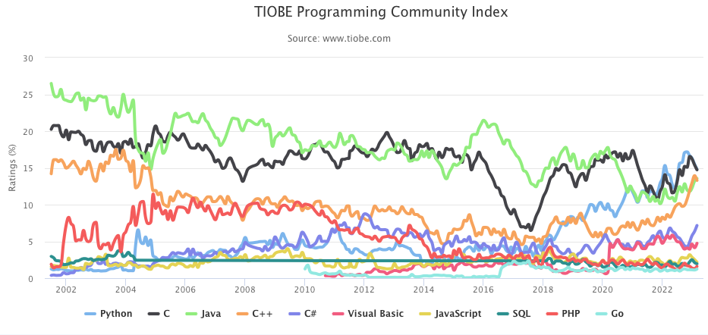
Programming Language Popularity
https://www.tiobe.com/tiobe-index/

Slide 14
Our First C Program
/*
* hello.c
* This program prints a welcome message
* to the user.
*/
#include <stdio.h> // for printf
int main(int argc, char *argv[]) {
printf("Hello, world!\n");
return 0;
}

Slide 15
Our First C Program
/*
* hello.c
* This program prints a welcome message
* to the user.
*/
#include <stdio.h> // for printf
int main(int argc, char *argv[]) {
printf("Hello, world!\n");
return 0;
}
Program comments
You can write block or inline comments.

Slide 16
Our First C Program
/*
* hello.c
* This program prints a welcome message
* to the user.
*/
#include <stdio.h> // for printf
int main(int argc, char *argv[]) {
printf("Hello, world!\n");
return 0;
}
Import statements
C libraries are written with angle brackets.
Local libraries have quotes:
#include "lib.h"

Slide 17
Our First C Program
/*
* hello.c
* This program prints a welcome message
* to the user.
*/
#include <stdio.h> // for printf
int main(int argc, char *argv[]) {
printf("Hello, world!\n");
return 0;
}
Main function – entry point for the program
Should always return an integer (0 = success)

Slide 18
Our First C Program
/*
* hello.c
* This program prints a welcome message
* to the user.
*/
#include <stdio.h> // for printf
int main(int argc, char *argv[]) {
printf("Hello, world!\n");
return 0;
}
Main parameters – main takes two parameters, both relating to the command line arguments used to execute the program.
argc is the number of arguments in argv
argv is an array of arguments (char * is C string)
Notes:
What are provided to the program when it is run on command line

Slide 19
Our First C Program
/*
* hello.c
* This program prints a welcome message
* to the user.
*/
#include <stdio.h> // for printf
int main(int argc, char *argv[]) {
printf("Hello, world!\n");
return 0;
}
printf – prints output to the screen
Notes:
\n
stdio

Slide 20
Console Output: printf
printf(text, arg1, arg2, arg3,...);
printf makes it easy to print out the values of variables or expressions.
If you include placeholders in your printed text, printf will replace each placeholder in order with the values of the parameters passed after the text.
%s (string) %d (integer) %f (double)
// Example
    char *classPrefix = "CS";
    int classNumber = 107;
    printf("You are in %s%d", classPrefix, classNumber); // You are in CS107
Notes:
TODO: motivate more by showing multiline print

Slide 21
Familiar Syntax
int x = 42 + 7 * -5; // variables, types
double pi = 3.14159;
char c = 'Q'; /* two comment styles */
for (int i = 0; i < 10; i++) { // for loops
if (i % 2 == 0) { // if statements
x += i;
}
}
while (x > 0 && c == 'Q' || b) { // while loops, logic
x = x / 2;
if (x == 42) {
return 0;
}
}
binky(x, 17, c); // function call

Slide 22
Boolean Variables
To declare Booleans, (e.g. bool b = ____), you must include stdbool.h:
#include <stdio.h> // for printf
#include <stdbool.h> // for bool
int main(int argc, char *argv[]) {
bool x = 5 > 2 && binky(argc) > 0;
if (x) {
printf("Hello, world!\n");
} else {
printf("Howdy, world!\n");
}
return 0;
}

Slide 23
Boolean Expressions
C treats a nonzero value as true, and a zero value as false:
#include <stdio.h>
int main(int argc, char *argv[]) {
int x = 5;
if (x) { // true
printf("Hello, world!\n");
} else {
printf("Howdy, world!\n");
}
return 0;
}

Slide 24
Writing, Debugging and Compiling
We will use:
the emacs text editor to write our C programs
the make tool to compile our C programs
the gdb debugger to debug our programs
the valgrind tools to debug memory errors and measure program efficiency
Now
Next week

Slide 25
Working On C Programs
ssh – remotely log in to Myth computers
Emacs – text editor to write and edit C programs
  Use the mouse to position cursor, scroll, and highlight text
  Ctl-x Ctl-s to save, Ctl-x Ctl-c to quit
make – compile program using provided Makefile
./myprogram – run executable program (optionally with arguments)
make clean – remove executables and other compiler files
Lecture code is accessible at /afs/ir/class/cs107/lecture-code/lect[N]
  Make your own copy: cp -r /afs/ir/class/cs107/lecture-code/lect[N] lect[N]
  See the website for even more commands, and a complete reference.

Slide 26
Demo: Compiling And Running A C Program
Get up and running with our guide:
http://cs107.stanford.edu/resources/getting-started.html

Slide 27
Assign0
Assignment 0 (Intro to Unix and C) is due on Mon. 4/10 at 11:59PM PDT.
There are 5 parts to the assignment, which is meant to get you comfortable using the command line, and editing/compiling/running C programs:
Visit the website resources to become familiar with different Unix commands
Clone the assign0 starter project
Answer several questions in readme.txt
Compile a provided C program and modify it
Submit the assignment

Slide 28
Preview: Next Time
Make sure to reboot Boeing Dreamliners every 248 days
Comair/Delta airline had to cancel thousands of flights days before Christmas
Many operating systems may have issues storing timestamp values beginning on Jan 19, 2038
Reported vulnerability CVE-2019-3857 in libssh2 may allow a hacker to remotely execute code
Next time: How can a computer represent integer numbers? What are the limitations?

