Slide 1
CS107, Lecture 20: Sockets Programming
Slides by Daniel Rebelsky, modeled in part off of slides from Nick Troccoli and Jerry Cain, and content in part from ChatGPT and Beej’s Guide to Network Programming Using Internet Sockets

Slide 2
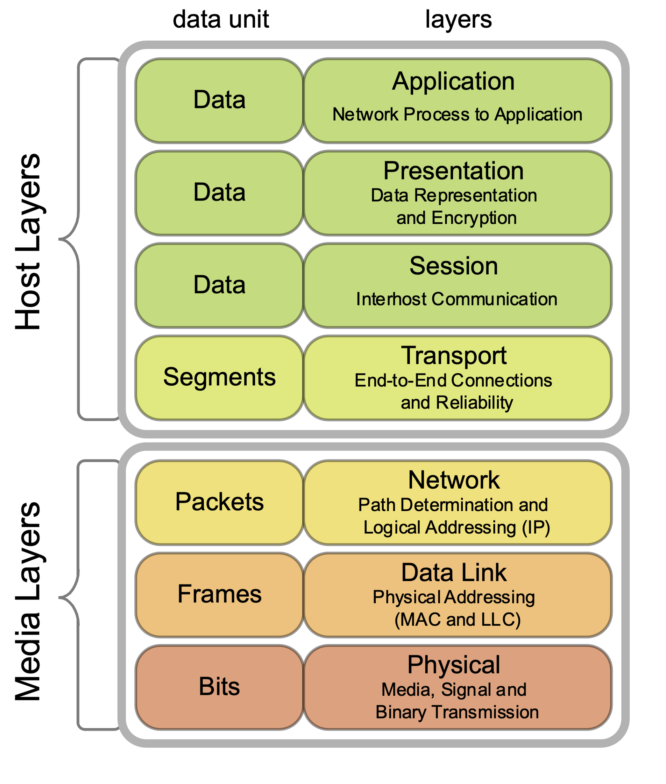
Quick Overview
CultureDuQ, CC BY-SA 4.0 https://creativecommons.org/licenses/by-sa/4.0, via Wikimedia Commons

Slide 3
TCP and UDP
Both run on top of IP
Both have a port number (16 bits)
  Official port usage is assigned by IANA
  Ports under 1024 are typically reserved (i.e., on the myth machines, you need special permission to bind to them)
  Common ports include: 22 (SSH), 53 (DNS), 80 (HTTP), 443 (HTTPS)—see also https://www.iana.org/assignments/service-names-port-numbers/service-names-port-numbers.xhtml or /etc/services

Slide 4
TCP and UDP (continued)
So, to connect to a remote server, we need both an IP address and a port number
  Quick aside on IP addresses: IPv4 addresses are only 32 bits long, which only makes for about 4 billion total IPs, which we’ve fully allocated; IPv6 addresses, by contrast, are 128 bits long
    IPv4 addresses are often written in dotted quad format of 192.168.1.1
    IPv6 addresses are a little more complicated, but can be written as 2607:f6d0:0:0:0:0:0:0 (which can also be written as 2607:f6d0::)
    Either way, IP addresses can be a little cumbersome to write, so we use DNS (domain name service) to map from domain names (e.g., web.stanford.edu) to IP addresses (e.g., 171.67.215.200)

Slide 5
TCP and UDP (continued)
Quick aside on client server model: for the rest of the lecture, we’ll be implicitly referencing this model—the rough idea is that we have a server (imagine, e.g., Google) which serves data to one or more clients (imagine, e.g., people Googling)
TCP and UDP both allow us to send arbitrary bytes over the network
It is important that we send bytes in a way that both the client and server will understand
  A protocol specifies how the bytes will be interpreted
  IP and TCP/UDP level details specify that the network byte order should be big-endian (myth machines are little-endian)

Slide 6
TCP and UDP (continued)
TCP provides a “reliable bytestream” abstraction (except in exceptional cases, the data will arrive correctly on the other side)
  Useful for non-time critical applications (e.g., web servers (HTTP prior to HTTP/3 runs over TCP), ssh, etc…)
UDP provides an unreliable datagram abstraction (it’s effectively just a userspace wrapper around IP, hence “User Datagram Protocol”)
  Useful for time critical applications, or applications that can deal with some data loss (e.g., video conferencing, online gaming, etc…)

Slide 7
Socket Programming Basics

Slide 8
socket()
int socket(int domain, int type, int protocol);
The domain specifies what type of socket we want—for this lecture, it will be one of PF_INET or PF_INET6
The type for this lecture will always be SOCK_STREAM (meaning TCP, it could also be SOCK_DGRAM for UDP)
The protocol is the protocol number (e.g., one of IPPROTO_TCP or IPPROTO_UDP, but we can use 0 since SOCK_STREAM means TCP, and it will figure it out)
Returns a “file descriptor” on success and <0 on error (setting errno as appropriate)

Slide 9
Detour: file descriptors
You may encounter the phrase “everything is a file” when working in a Unix/Linux context
File descriptors are one incarnation of this—a FILE * is a convenient wrapper around a file descriptor
  A file descriptor is an integer that the OS hands to our process that we can use syscalls on to read/write data (e.g., read, write) or otherwise modify (e.g., fcntl)
  We’ll have the following file descriptors always by default: 0 (stdin), 1 (stdout), 2 (stderr)
Note that we use file descriptors for both real files and for sockets (among other things)

Slide 10
Detour: error handling
At Adam’s request
Many system calls (and wrapping C functions) can fail
In C, we’ll often see failure represented as a negative value, with errno (see man errno) set appropriately (perror will print the corresponding error message)
  Basically every function today can fail in this manner
In 107, we’ve mostly ignored this up until this point, but there are a few ways to handle this in C
  Explicitly check every return value that might fail, write out the failure condition
  Wrap functions in safe forms (e.g., the textbook creates Write from write)
  Use macros to help simplify
  gotos are often used for clean up, but given their potential for misuse, we won’t cover them to closely here
  On the (optional) sockets assignment, we’ll provide a few options for error handling (which you should be doing)

Slide 11
Detour: man pages
While, in general, we like to tell you to read the manpage for the functions, the man pages for sockets programming tend to be comparatively more difficult to actually find and understand
I would recommend using the fake man pages from https://beej.us/guide/bgnet/ and then consulting the real man pages later, as appropriate (and if necessary)

Slide 12
bind()
“bind”s a socket to a particular address/port combo
int bind(int sockfd, struct sockaddr *my_addr, int addrlen);
Note, we tend to only use bind as a server (as a client, we tend not to actually care what our port is)

Slide 13
struct sockaddr
struct sockaddr is the generic type for a socket address, but we’ll use struct sockaddr_in or struct sockaddr_in6 and cast to a struct sockaddr
struct sockaddr {
unsigned short sa_family; // address family, AF_xxx
char sa_data[14]; // 14 bytes of protocol address
};
struct sockaddr_in {
short int sin_family; // Address family, AF_INET
unsigned short int sin_port; // Port number
struct in_addr sin_addr; // Internet address
unsigned char sin_zero[8]; // Same size as struct sockaddr
};
struct in_addr {
uint32_t s_addr; // that's a 32-bit int (4 bytes)
};
struct sockaddr_in6 {
u_int16_t sin6_family; // address family, AF_INET6
u_int16_t sin6_port; // port number, Network Byte Order
u_int32_t sin6_flowinfo; // IPv6 flow information
struct in6_addr sin6_addr; // IPv6 address
u_int32_t sin6_scope_id; // Scope ID
};
struct in6_addr {
unsigned char s6_addr[16]; // IPv6 address
};

Slide 14
inet_pton(), inet_addr(), and inet_aton()
aton and addr only work for IPv4 addresses
int inet_aton(const char *cp, struct in_addr *inp);
in_addr_t inet_addr(const char *cp);
cp is a string of a dotted quad IP address
int inet_pton(int af, const char *src, void *dst);

Slide 15
getaddrinfo()
int getaddrinfo(const char *node, // e.g. "www.example.com" or IP
const char *service, // e.g. "http" or port number
const struct addrinfo *hints,
struct addrinfo **res);
Gives us a linked list of struct addrinfos
struct addrinfo {
int ai_flags; // AI_PASSIVE, AI_CANONNAME, etc.
int ai_family; // AF_INET, AF_INET6, AF_UNSPEC
int ai_socktype; // SOCK_STREAM, SOCK_DGRAM
int ai_protocol; // use 0 for "any"
size_t ai_addrlen; // size of ai_addr in bytes
struct sockaddr *ai_addr; // struct sockaddr_in or _in6
char *ai_canonname; // full canonical hostname
struct addrinfo *ai_next; // linked list, next node
};

Slide 16
bind()
int bind(int sockfd, struct sockaddr *my_addr, int addrlen);
Binds our socket to the address and port specified by my_addr
We will often use INADDR_ANY to indicate that we want to accept any IPv4 connection (slightly different for IPv6, see “Jumping from IPv4 to IPv6” on Beej’s guide)

Slide 17
listen()
int listen(int sockfd, int backlog);
Starts our socket “listening” (what a server would do)
backlog is how many outstanding requests can be queued until we accept them

Slide 18
accept()
int accept(int sockfd, struct sockaddr *addr, socklen_t *addrlen);
Returns a file descriptor for a remote connection
We’ll use a struct sockaddr_storage (guaranteed large enough to store any address) for the address
struct sockaddr_storage {
sa_family_t ss_family; // address family
// all this is padding, implementation specific, ignore it:
char __ss_pad1[_SS_PAD1SIZE];
int64_t __ss_align;
char __ss_pad2[_SS_PAD2SIZE];
};

Slide 19
connect()
int connect(int sockfd, struct sockaddr *serv_addr, int addrlen);
Useful for the client, connects our local socket to the remote address

Slide 20
send()
int send(int sockfd, const void *msg, int len, int flags);
Returns how many bytes were actually sent (may be less than we requested, which we’ll have to handle)
flags can be 0 by default
Note that while we could use write, we tend to use send instead since it lets us to more specific socket things (see the man page for flags)

Slide 21
recv()
int recv(int sockfd, void *buf, int len, int flags);
Returns how many bytes were received (no more than len)
Returns <0 on error, 0 when remote side has closed

Slide 22
close()
close(sockfd);
Prevents any further reads or writes to the socket, the remote peer will receive an error on trying to read or write
Also, marks the fd as usable again (no longer counts toward our per-process limit)

Slide 23
shutdown()
int shutdown(int sockfd, int how);
Note that you will still have to close eventually
how | Effect
0 | Further receives are disallowed
1 | Further sends are disallowed
2 | Further sends and receives are disallowed (like close())

Slide 24
Code demo

Slide 25
Handling multiple clients
We may not get to this in lecture, but you should investigate using select() and/or poll() (or epoll if you want to get really fancy) for the assignment

