Slide 1
CS107, Lecture 5
From C Strings to Pointers
Reading: Essential C section 3
This document is copyright (C) Stanford Computer Science, Lisa Yan, Nick Troccoli and Katie Creel, licensed under Creative Commons Attribution 2.5 License. All rights reserved.
Based on slides created by Marty Stepp, Cynthia Lee, Chris Gregg, Lisa Yan, Jerry Cain and others.
1

Slide 2
C Strings As Parameters
When we pass a string as a parameter, it is passed as a char *. We can still operate on the string the same way as with a char[]. (We’ll see why today!).
int doSomething(char *str) { char secondChar = str[1];
...
}
// can also write this, but it is really a pointer
int
doSomething(char
str[])
{
...

Slide 3
Arrays of Strings
We can make an array of strings to group multiple strings together:
char *stringArray[5]; // space to store 5 char *s
We can also use the following shorthand to initialize a string array:
char *stringArray[] = { "Hello",
"Hi",
"Hey there"
};
11

Slide 4
Arrays of Strings
We can access each string using bracket syntax:
printf("%s\n", stringArray[0]); // print out first string
When an array is passed as a parameter in C, C passes a pointer to the first element of the array. This is what argv is in main! This means we write the parameter type as:
void myFunction(char **stringArray) {
// equivalent to this, but it is really a double pointer void myFunction(char *stringArray[]) {

Slide 5
Practice: Password Verification
Write a function verifyPassword that accepts a candidate password and certain password criteria and returns whether the password is valid.
bool verifyPassword(char *password, char *validChars, char
*badSubstrings[], int numBadSubstrings);
password is valid if it contains only letters in validChars, and does not contain any substrings in badSubstrings.

Slide 6
Practice: Password Verification
bool verifyPassword(char *password, char *validChars, char
*badSubstrings[], int numBadSubstrings);
Example:
char *invalidSubstrings[] = { "1234" };
bool valid1 = verifyPassword("1572", "0123456789", invalidSubstrings, 1); // true
bool valid2 = verifyPassword("141234", "0123456789", invalidSubstrings, 1); // false
14

Slide 7
Common string.h Functions
Function | Description
strlen(str) | returns the # of chars in a C string (before null-terminating character).
strcmp(str1, str2), strncmp(str1, str2, n) | compares two strings; returns 0 if identical, <0 if str1 comes before str2 in alphabet, >0 if str1 comes after str2 in alphabet. strncmp stops comparing after at most n characters.
strchr(str, ch) strrchr(str, ch) | character search: returns a pointer to the first occurrence of ch in str, or NULL if ch was not found in str. strrchr find the last occurrence.
strstr(haystack, needle) | string search: returns a pointer to the start of the first occurrence of needle in haystack, or NULL if needle was not found in haystack.
strcpy(dst, src), strncpy(dst, src, n) | copies characters in src to dst, including null-terminating character. Assumes enough space in dst. Strings must not overlap. strncpy stops after at most n chars, and does not add null-terminating char.
strcat(dst, src), strncat(dst, src, n) | concatenate src onto the end of dst. strncat stops concatenating after at most n characters. Always adds a null-terminating character.
strspn(str, accept), strcspn(str, reject) | strspn returns the length of the initial part of str which contains only characters in accept. strcspn returns the length of the initial part of str which does not contain any characters in reject. ₁₇

Slide 8

Practice: Password Verification
verify_password.c
15

Slide 9
Lecture Plan
Searching in Strings
Practice: Password Verification
Demo: Buffer Overflow and Valgrind
Pointers
Strings in Memory
Security and Overflows
Live Session
6
13
16
19
50
88
110
cp -r /afs/ir/class/cs107/lecture-code/lect5 .
16

Slide 10
Buffer Overflows
We must always ensure that memory operations we perform don’t improperly read or write memory.
  E.g. don’t copy a string into a space that is too small!
  E.g. don’t ask for the string length of an uninitialized string!
The Valgrind tool may be able to help track down memory-related issues.
  See cs107.stanford.edu/resources/valgrind
  We’ll talk about Valgrind more when we talk about dynamically-allocated memory.
17

Slide 11
Demo: Memory Errors
memory_errors.c
18

Slide 12
Lecture Plan
Searching in Strings
Practice: Password Verification
Demo: Buffer Overflow and Valgrind
Pointers
Strings in Memory
Security and Overflows
Live Session
6
13
16
19
50
88
110
cp -r /afs/ir/class/cs107/lecture-code/lect5 .
19

Slide 13
Pointers
A pointer is a variable that stores a memory address.
Because there is no pass-by-reference in C like in C++, pointers let us pass around the address of one instance of memory, instead of making many copies.
One (8 byte) pointer can refer to any size memory location!
Pointers are also essential for allocating memory on the heap, which we will cover later.
Pointers also let us refer to memory generically, which we will cover later.

Slide 14
Memory
Memory is a big array of bytes.
Each byte has a unique numeric index that is commonly written in hexadecimal.
A pointer stores one of these memory addresses.
Address
Value
0x105 0x104 0x103 0x102 0x101 0x100 | …
 | '\0'
 | 'e'
 | 'l'
 | 'p'
 | 'p'
 | 'a'
 | …

Slide 15
Memory
Memory is a big array of bytes.
Each byte has a unique numeric index that is commonly written in hexadecimal.
A pointer stores one of these memory addresses.
Address
Value
261 260 259 258 257 256 | …
 | '\0'
 | 'e'
 | 'l'
 | 'p'
 | 'p'
 | 'a'
 | …

Slide 16
Looking Back at C++
How would we write a program with a function that takes in an int and modifies it? We might use pass by reference.
void myFunc(int& num) { num = 3;
}
int main(int argc, char *argv[]) { int x = 2;
myFunc(x);
printf("%d", x); // 3!
...
}

Slide 17
Looking Ahead to C
All parameters in C are “pass by value.” For efficiency purposes, arrays (and strings, by extension) passed in as parameters are converted to pointers.
This means whenever we pass something as a parameter, we pass a copy.
If we want to modify a parameter value in the function we call and have the changes persist afterwards, we can pass the location of the value instead of the value itself. This way we make a copy of the address instead of a copy of the value.

Slide 18
Pointers
int x = 2;
// Make a pointer that stores the address of x.
// (& means "address of") int *xPtr = &x;
// Dereference the pointer to go to that address.
// (* means "dereference") printf("%d", *xPtr); // prints 2

Slide 19
Pointers
A pointer is a variable that stores a memory address.
void myFunc(int *intPtr) {
*intPtr = 3;
}
int main(int argc, char *argv[]) {
int x = 2;
myFunc(&x);
printf("%d", x); // 3!
...
}

Slide 20
Pointers
A pointer is a variable that stores a memory address.
STACK
main
void myFunc(int *intPtr) {
*intPtr = 3;
}
int main(int argc, char *argv[]) { int x = 2;
myFunc(&x);
printf("%d", x); // 3!
...
}

Slide 21
Pointers
A pointer is a variable that stores a memory address.
STACK
main
x 2
void myFunc(int *intPtr) {
*intPtr = 3;
}
int main(int argc, char *argv[]) { int x = 2;
myFunc(&x);
printf("%d", x); // 3!
...
}

Slide 22
Pointers
A pointer is a variable that stores a memory address.
STACK
main
x 2
void myFunc(int *intPtr) {
*intPtr = 3;
}
int main(int argc, char *argv[]) { int x = 2;
myFunc(&x);
printf("%d", x); // 3!
...
}

Slide 23
Pointers
A pointer is a variable that stores a memory address.
STACK
main
x 2
void myFunc(int *intPtr) {
*intPtr = 3;
}
myFunc
int main(int argc, char *argv[]) { int x = 2;
myFunc(&x);
intPtr
printf("%d", x); // 3!
...
}

Slide 24
Pointers
A pointer is a variable that stores a memory address.
STACK
main
x 2
void myFunc(int *intPtr) {
*intPtr = 3;
}
myFunc
int main(int argc, char *argv[]) { int x = 2;
myFunc(&x);
intPtr
printf("%d", x); // 3!
...
}

Slide 25
Pointers
A pointer is a variable that stores a memory address.
STACK
main
x 3
void myFunc(int *intPtr) {
*intPtr = 3;
}
myFunc
int main(int argc, char *argv[]) { int x = 2;
myFunc(&x);
intPtr
printf("%d", x); // 3!
...
}

Slide 26
Pointers
A pointer is a variable that stores a memory address.
STACK
main
x 3
void myFunc(int *intPtr) {
*intPtr = 3;
}
int main(int argc, char *argv[]) { int x = 2;
myFunc(&x);
printf("%d", x); // 3!
...
}

Slide 27
Pointers
A pointer is a variable that stores a memory address.
STACK
main
x 3
void myFunc(int *intPtr) {
*intPtr = 3;
}
int main(int argc, char *argv[]) { int x = 2;
myFunc(&x);
printf("%d", x); // 3!
...
}

Slide 28
Pointers
A pointer is a variable that stores a memory address.
STACK
Address Value
x 0x1f0 | …
 | 2
 | …
void myFunc(int *intPtr) {
*intPtr = 3;
}
main()
int main(int argc, char *argv[]) { int x = 2;
myFunc(&x);
printf("%d", x); // 3!
...
}

Slide 29
Pointers
A pointer is a variable that stores a memory address.
STACK
Address Value
…
2
x
0x1f0
void myFunc(int *intPtr) {
*intPtr = 3;
}
main()
…
int main(int argc, char *argv[]) { int x = 2;
myFunc(&x);
printf("%d", x); // 3!
...
}

Slide 30
Pointers
A pointer is a variable that stores a memory address.
STACK
Address Value
…
x
0x1f0
2
void myFunc(int *intPtr) {
*intPtr = 3;
}
main()
…
myFunc()
intPtr
0x10
0x1f0
…
int main(int argc, char *argv[]) { int x = 2;
myFunc(&x);
printf("%d", x); // 3!
...
}

Slide 31
Pointers
A pointer is a variable that stores a memory address.
STACK
Address Value
…
x
0x1f0
2
void myFunc(int *intPtr) {
*intPtr = 3;
}
main()
…
myFunc()
intPtr
0x10
0x1f0
…
int main(int argc, char *argv[]) { int x = 2;
myFunc(&x);
printf("%d", x); // 3!
...
}

Slide 32
Pointers
A pointer is a variable that stores a memory address.
STACK
Address Value
…
x
0x1f0
3
void myFunc(int *intPtr) {
*intPtr = 3;
}
main()
…
myFunc()
intPtr
0x10
0x1f0
…
int main(int argc, char *argv[]) { int x = 2;
myFunc(&x);
printf("%d", x); // 3!
...
}

Slide 33
Pointers
A pointer is a variable that stores a memory address.
STACK
Address Value
x 0x1f0 | …
 | 3
 | …
void myFunc(int *intPtr) {
*intPtr = 3;
}
main()
int main(int argc, char *argv[]) { int x = 2;
myFunc(&x);
printf("%d", x); // 3!
...
}

Slide 34
Pointers
A pointer is a variable that stores a memory address.
STACK
Address Value
…
3
x
0x1f0
void myFunc(int *intPtr) {
*intPtr = 3;
}
main()
…
int main(int argc, char *argv[]) { int x = 2;
myFunc(&x);
printf("%d", x); // 3!
...
}

Slide 35
Pointers Summary
If you are performing an operation with some input and do not care about any changes to the input, pass the data type itself. This makes a copy of the data.
If you are modifying a specific instance of some value, pass the location of what you would like to modify. This makes a copy of the data’s location.
If a function takes an address (pointer) as a parameter, it can go to that address if it needs the actual value.

Slide 36
Pointers
Without pointers, we would make copies.
STACK
Address Value
x 0x1f0 | …
 | 2
 | …
void myFunc(int val) { val = 3;
}
main()
int main(int argc, char *argv[]) { int x = 2;
myFunc(x);
printf("%d", x); // 2!
...
}

Slide 37
Pointers
Without pointers, we would make copies.
STACK
Address Value
…
void myFunc(int val) { val = 3;
}
2
x
0x1f0
main()
…
int main(int argc, char *argv[]) { int x = 2;
myFunc(x);
printf("%d", x); // 2!
...
}

Slide 38
Pointers
Without pointers, we would make copies.
STACK
Address Value
…
void myFunc(int val) { val = 3;
}
2
x
0x1f0
main()
…
myFunc()
2
val
0x10
int main(int argc, char *argv[]) { int x = 2;
myFunc(x);
…
printf("%d", x); // 2!
...
}

Slide 39
Pointers
Without pointers, we would make copies.
STACK
Address Value
…
void myFunc(int val) { val = 3;
}
2
x
0x1f0
main()
…
myFunc()
2
val
0x10
int main(int argc, char *argv[]) { int x = 2;
myFunc(x);
…
printf("%d", x); // 2!
...
}

Slide 40
Pointers
Without pointers, we would make copies.
STACK
Address Value
…
void myFunc(int val) { val = 3;
}
2
x
0x1f0
main()
…
myFunc()
3
val
0x10
int main(int argc, char *argv[]) { int x = 2;
myFunc(x);
…
printf("%d", x); // 2!
...
}

Slide 41
Pointers
Without pointers, we would make copies.
STACK
Address Value
x 0x1f0 | …
 | 2
 | …
void myFunc(int val) { val = 3;
}
main()
int main(int argc, char *argv[]) { int x = 2;
myFunc(x);
printf("%d", x); // 2!
...
}

Slide 42
Pointers
Without pointers, we would make copies.
STACK
Address Value
…
void myFunc(int val) { val = 3;
}
2
x
0x1f0
main()
…
int main(int argc, char *argv[]) { int x = 2;
myFunc(x);
printf("%d", x); // 2!
...
}

Slide 43
Lecture Plan
Searching in Strings
Practice: Password Verification
Demo: Buffer Overflow and Valgrind
Pointers
Strings in Memory
Security and Overflows
Live Session
6
13
16
19
50
88
110
cp -r /afs/ir/class/cs107/lecture-code/lect5 .
50

Slide 44
Strings In Memory
If we create a string as a char[], we can modify its characters because its memory lives in our stack space.
We cannot set a char[] equal to another value, because it is not a pointer; it refers to the block of memory reserved for the original array.
If we pass a char[] as a parameter, set something equal to it, or perform arithmetic with it, it’s automatically converted to a char *.
If we create a new string with new characters as a char *, we cannot modify its characters because its memory lives in the data segment.
We can set a char * equal to another value, because it is a reassign-able pointer.
Adding an offset to a C string gives us a substring that many places past the first character.
If we change characters in a string parameter, these changes will persist outside of the function.

Slide 45
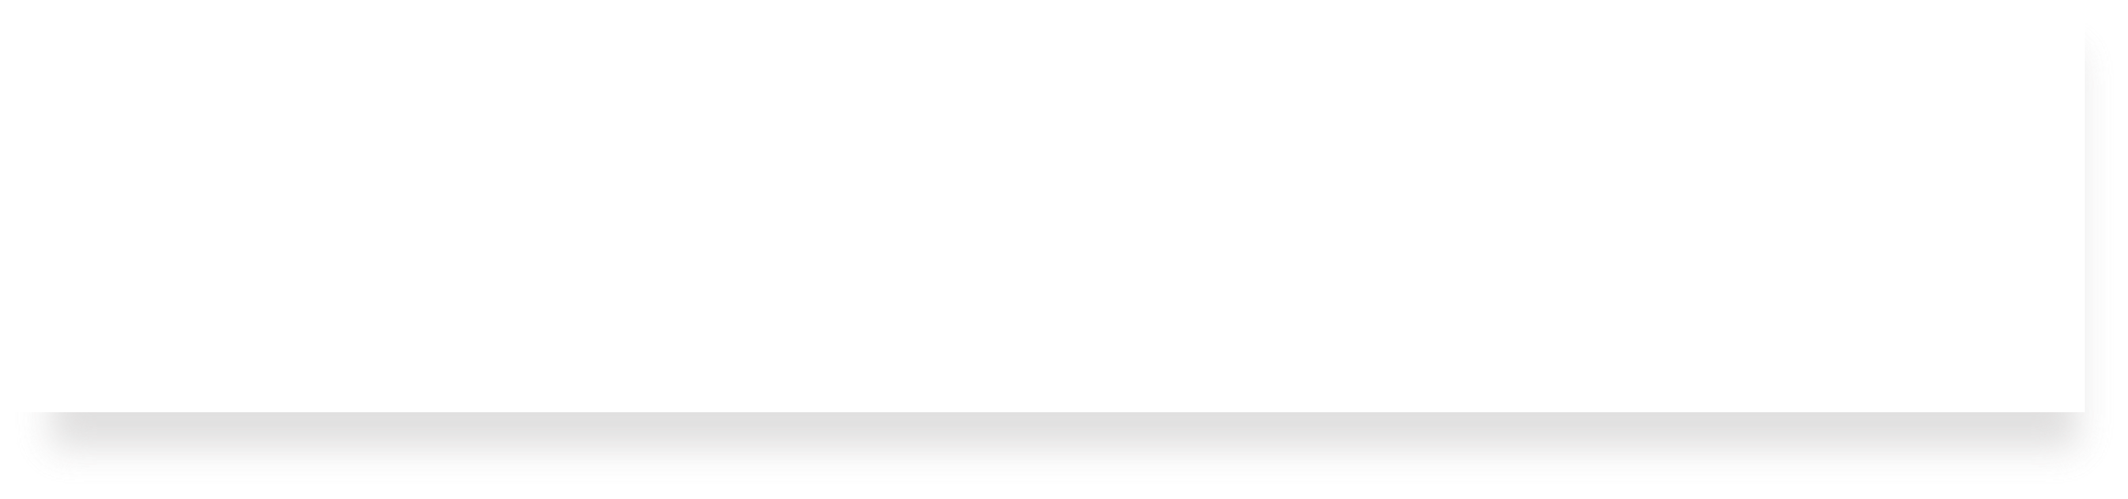
String Behavior #1: If we create a string as a char[], we can modify its characters because its memory lives in our stack space.

Slide 46
Character Arrays
When we declare an array of characters, contiguous memory is allocated on the stack to store the contents of the entire array. We can modify what is on the stack.
STACK
Address Value
 | …
 | '\0'
 | 'e'
 | 'l'
 | 'p'
 | 'p'
 | 'a'
 | …
0x105
char str[6]; strcpy(str, "apple");
0x104
0x103
0x102
0x101
str
0x100

Slide 47
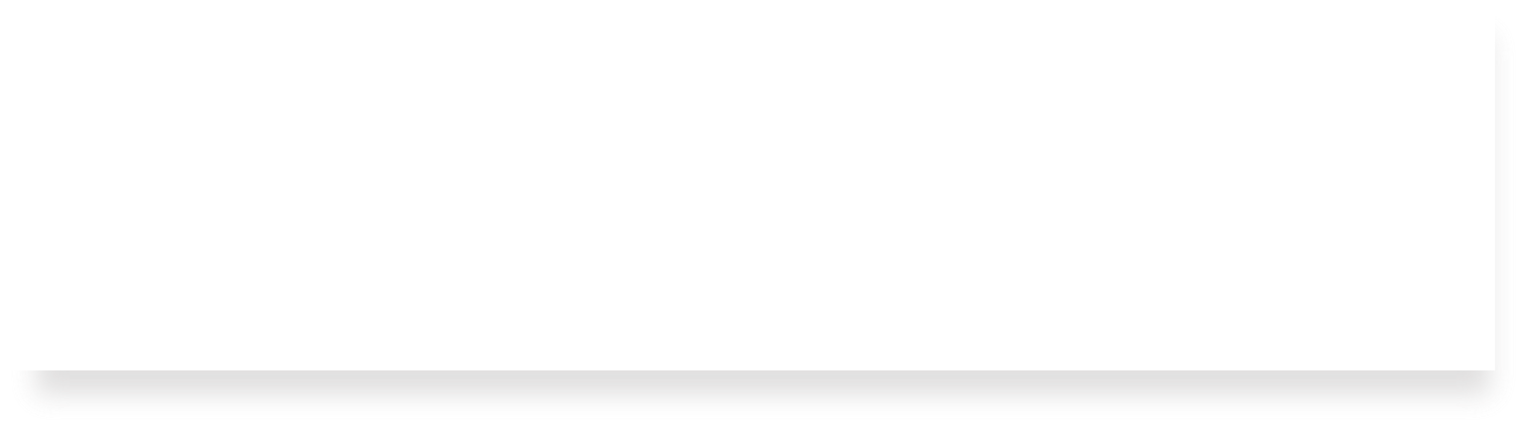
String Behavior #2: We cannot set a char[] equal to another value, because it is not a pointer; it refers to the block of memory reserved for the original array.

Slide 48
Character Arrays
An array variable refers to an entire block of memory. We cannot reassign an existing array to be equal to a new array.
char str[6]; strcpy(str, "apple"); char str2[8]; strcpy(str2, "apple 2");
str = str2; // not allowed!
An array’s size cannot be changed once we create it; we must create another new array instead.

Slide 49
String Behavior #3: If we pass a char[] as a parameter, set something equal to it, or perform arithmetic with it, it’s automatically converted to a char *.

Slide 50

String Parameters
How do you think the parameter str is being represented?
?
void fun_times(char *str) {
...
}
str
0xa0
0xa1
0xa2
0xa3
0xa4
int main(int argc, char *argv[]) { char local_str[5]; strcpy(local_str, "rice"); fun_times(local_str);
return 0;
}
'r' | 'i' | 'c' | 'e' | '\0'
local_str
A copy of the array local_str
A pointer containing an address to the first element in local_str

Slide 51
String Parameters
How do you think the parameter str is being represented?
void fun_times(char *str) {
...
}
str
0xa0
0xa0
0xa1
0xa2
0xa3
0xa4
int main(int argc, char *argv[]) { char local_str[5]; strcpy(local_str, "rice"); fun_times(local_str);
return 0;
}
'r' | 'i' | 'c' | 'e' | '\0'
local_str
A. A copy of the array local_str
B.
A pointer containing an address to the first element in local_str

Slide 52
char * Variables
How do you think the local variable str is being represented?
int main(int argc, char *argv[]) { char local_str[5]; strcpy(local_str, "rice"); char *str = local_str;
...
return 0;
}
?
str
0xa0
0xa1
0xa2
0xa3
0xa4
local_str
'r' | 'i' | 'c' | 'e' | '\0'
A.
B.
A copy of the array local_str A pointer containing an address to the first element in local_str

Slide 53
char * Variables
How do you think the local variable str is being represented?
int main(int argc, char *argv[]) { char local_str[5]; strcpy(local_str, "rice"); char *str = local_str;
...
return 0;
}
str
0xa0
0xa0
0xa1
0xa2
0xa3
0xa4
local_str
'r' | 'i' | 'c' | 'e' | '\0'
A.
B.
A copy of the array local_str A pointer containing an address to the first element in local_str

Slide 54
char * Variables
How do you think the local variable str is being represented?
int main(int argc, char *argv[]) { char local_str[5]; strcpy(local_str, "rice"); char *str = local_str + 2;
...
return 0;
}
?
str
0xa0
0xa1
0xa2
0xa3
0xa4
local_str
'r' | 'i' | 'c' | 'e' | '\0'
A.
B.
A copy of part of the array local_str
A pointer containing an address to the third element in local_str

Slide 55
char * Variables
How do you think the local variable str is being represented?
int main(int argc, char *argv[]) { char local_str[5]; strcpy(local_str, "rice"); char *str = local_str + 2;
...
return 0;
}
str
0xa2
0xa0
0xa1
0xa2
0xa3
0xa4
local_str
'r' | 'i' | 'c' | 'e' | '\0'
A.
B.
A copy of part of the array local_str
A pointer containing an address to the third element in local_str

Slide 56
String Parameters
All string functions take char * parameters – they accept char[], but they are implicitly converted to char * before being passed.
strlen(char *str)
strcmp(char *str1, char *str2)
…
char * is still a string in all the core ways a char[] is
  Access/modify characters using bracket notation
  Print it out
  Use string functions
  But under the hood they are represented differently!
Takeaway: We create strings as char[], pass them around as char *

Slide 57
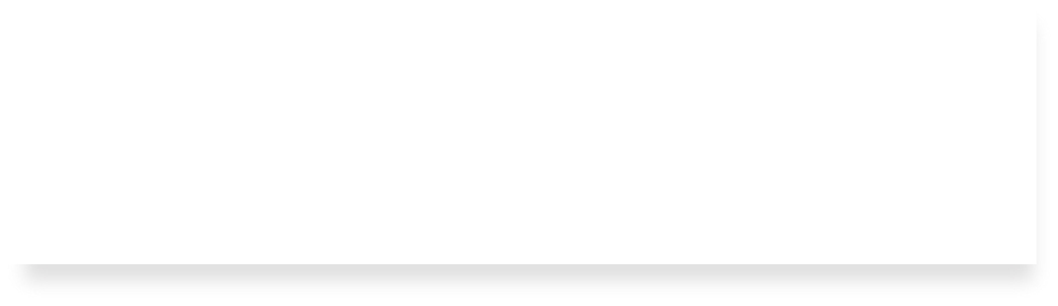
String Behavior #4: If we create a new string with new characters as a char *, we cannot modify its characters because its memory lives in the data segment.

Slide 58
char *
There is another convenient way to create a string if we do not need to modify it later. We can create a char * and set it directly equal to a string literal.
char *myString = "Hello, world!"; char *empty = "";
myString[0] = 'h';
// crashes!
// Hello, world!
printf("%s", myString);

Slide 59
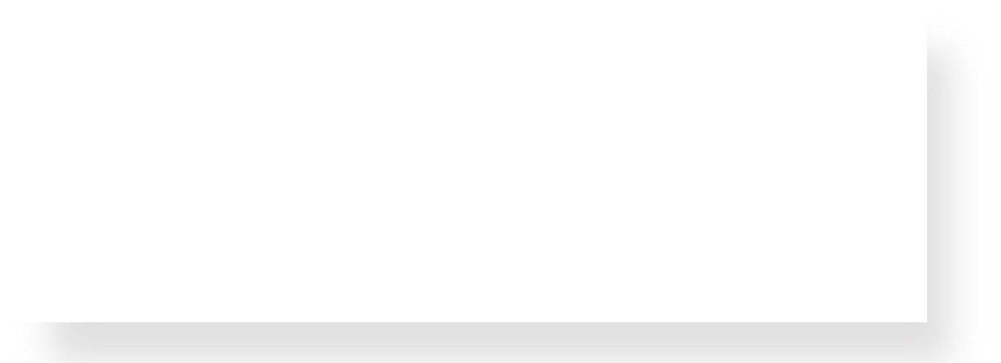
char *
When we declare a char pointer equal to a string literal, the characters are not stored on the stack. Instead, they are stored in a special area of memory called the “data segment”. We cannot modify memory in this segment.
char *str = "hi";
The pointer variable (e.g. str) refers to the address
Address
str 0xff0
Value
…
STACK
0x10
…
…
0x12
0x11 'i'
0x10 'h'
'\0'
of the first character of the string in the data
segment.
DATA SEGMENT
This applies only to creating new strings with char *. This does not apply for making a char * that points to an existing stack string.
…

Slide 60
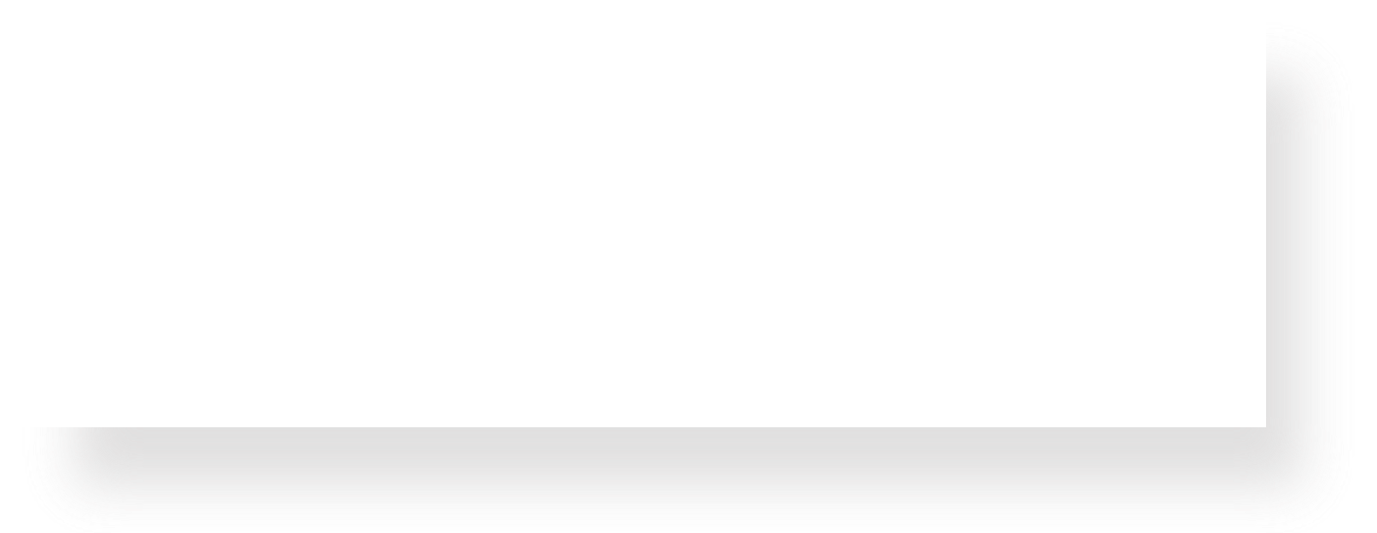
Memory Locations
For each code snippet below, can we modify the characters in myStr?
char myStr[6];
Key Question: where do its
characters live?
Do they live in
memory we own?
Or the read-
only data segment?

Slide 61
Memory Locations
For each code snippet below, can we modify the characters in myStr?
char *myStr = "Hi";
Key Question: where do its
characters live?
Do they live in
memory we own?
Or the read-
only data segment?

Slide 62
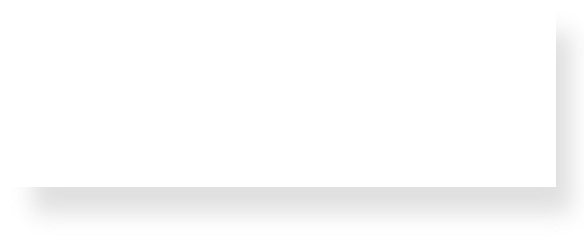
Memory Locations
For each code snippet below, can we modify the characters in myStr?
Key Question: where do its characters live? Do they live in memory we own? Or the read- only data segment?
char buf[6]; strcpy(buf, "Hi"); char *myStr = buf;

Slide 63
Memory Locations
For each code snippet below, can we modify the characters in myStr?
char *otherStr = "Hi"; char *myStr = otherStr;
Key Question: where do its characters live? Do they live in memory we own? Or the read- only data segment?

Slide 64
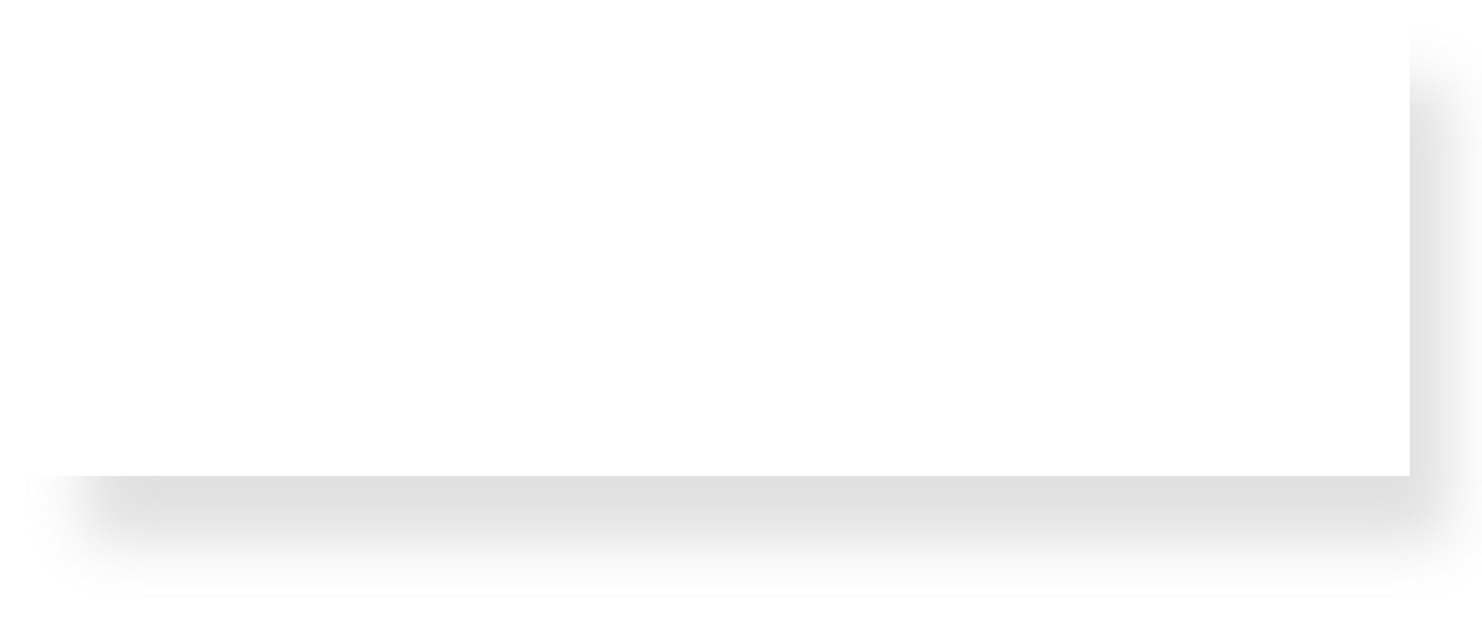
Memory Locations
For each code snippet below, can we modify the characters in myStr?
void myFunc(char *myStr) {
...
}
Key Question: where do its characters live? Do they live in memory we own? Or the read- only data segment?
int main(int argc, char *argv[]) { char buf[6];
strcpy(buf, "Hi");
myFunc(buf); return 0;
}

Slide 65
Memory Locations
Q: Is there a way to check in code whether a string’s characters are modifiable?
A: No. This is something you can only tell by looking at the code itself and how the string was created.
Q: So then if I am writing a string function that modifies a string, how can I tell if the string passed in is modifiable?
A: You can’t! This is something you instead state as an assumption in your function documentation. If someone calls your function with a read-only string, it will crash, but that’s not your function’s fault :-)

Slide 66
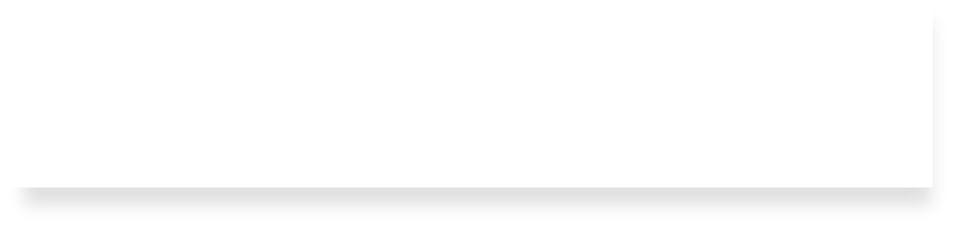
String Behavior #5: We can set a char
* equal to another value, because it is a reassign-able pointer.

Slide 67
char *
A char * variable refers to a single character. We can reassign an existing char *
pointer to be equal to another char * pointer.
char *str = "apple"; char *str2 = "apple 2";
// e.g. 0xfff0
// e.g. 0xfe0
str = str2; // ok! Both store address 0xfe0

Slide 68
Arrays and Pointers
We can also make a pointer equal to an array; it will point to the first element in that array.
STACK
Address Value
…
0x105
0x104
0x103
0x102
0x101
0x100 'a'
ptr 0xf8
'\0'
int main(int argc, char *argv[]) { char str[6];
strcpy(str, "apple"); char *ptr = str;
...
}
'e'
'l'
main()
'p'
'p'
str
0x100
…

Slide 69
Arrays and Pointers
We can also make a pointer equal to an array; it will point to the first element in that array.
STACK
Address Value
…
0x105
0x104
0x103
0x102
0x101
0x100 'a'
ptr 0xf8
'\0'
int main(int argc, char *argv[]) { char str[6];
strcpy(str, "apple"); char *ptr = str;
'e'
'l'
main()
'p'
'p'
// equivalent
char *ptr = &str[0];
str
0x100
// confusingly equivalent, avoid char *ptr = &str;
...
…
}
76

Slide 70
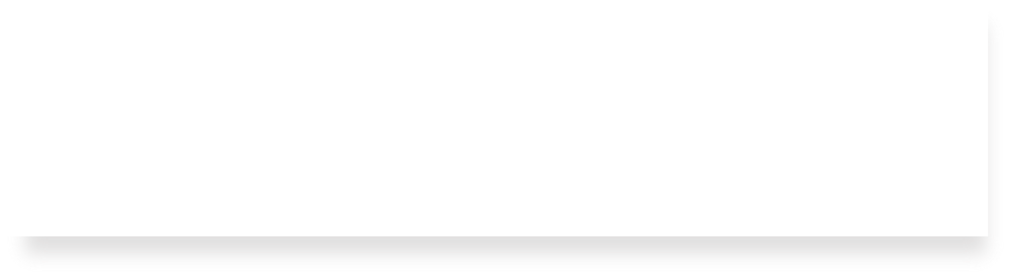
String Behavior #6: Adding an offset to a C string gives us a substring that many places past the first character.

Slide 71
Pointer Arithmetic
When we do pointer arithmetic, we are adjusting the pointer by a certain number of places (e.g. characters).
TEXT SEGMENT
Address Value
0xff5 0xff4 0xff3 0xff2 0xff1 0xff0 | …
 | '\0'
 | 'e'
 | 'l'
 | 'p'
 | 'p'
 | 'a'
 | …
char char char | *str *str2 *str3 | = | "apple"; = str + 1; = str + 3; |  | // // // | e.g. e.g. e.g. | 0xff0 0xff1 0xff3
printf("%s", |  |  |  | str); | // | apple
printf("%s", |  |  |  | str2); | // | pple
printf("%s", |  |  |  | str3); | // | le

Slide 72
char *
When we use bracket notation with a pointer, we are performing pointer arithmetic and dereferencing:
char *str = "apple"; // e.g. 0xff0
// both of these add three places to str,
// and then dereference to get the char there.
// E.g. get memory at 0xff3.
TEXT SEGMENT
Address Value
0xff5 0xff4 0xff3 0xff2 0xff1 0xff0 | …
 | '\0'
 | 'e'
 | 'l'
 | 'p'
 | 'p'
 | 'a'
 | …
char thirdLetter = str[3]; char thirdLetter = *(str + 3);
// 'l'
// 'l'

Slide 73
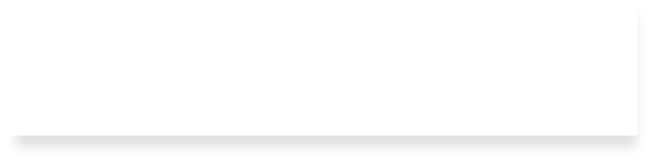
String Behavior #7: If we change characters in a string parameter, these changes will persist outside of the function.

Slide 74
Strings as Parameters
When we pass a char * string as a parameter, C makes a copy of the address stored in the char * and passes it to the function. This means they both refer to the same memory location.
STACK
Address Value
 | …
 | 0x10
 | …
 | …
 | 0x10
 | …
main()
str 0xfff0
void myFunc(char *myStr) {
...
}
myFunc()
myStr
0xff0
int main(int argc, char *argv[]) { char *str = "apple"; myFunc(str);
...
}
81

Slide 75
Strings as Parameters
When we pass a char array as a parameter, C makes a copy of the address of the first array element and passes it (as a char *) to the function.
STACK
Address Value
…
0x105
0x104
0x103
0x102
0x101
0x100 'a'
'\0'
'e'
void myFunc(char *myStr) {
...
}
'l'
main()
'p'
'p'
int main(int argc, char *argv[]) { char str[6];
strcpy(str, "apple"); myFunc(str);
...
}
str
…
…
myFunc()
myStr
0xf 0x100
…
8
2

Slide 76
Strings as Parameters
When we pass a char array as a parameter, C makes a copy of the address of the first array element and passes it (as a char *) to the function.
STACK
Address Value
…
0x105
0x104
0x103
0x102
0x101
0x100 'a'
'\0'
'e'
void myFunc(char *myStr) {
...
}
'l'
main()
'p'
'p'
int main(int argc, char *argv[]) { char str[6];
strcpy(str, "apple");
// equivalent
char *strAlt = str; myFunc(strAlt);
...
str
…
…
myFunc()
myStr
0xf 0x100
…
8
3

Slide 77
Strings as Parameters
This means if we modify characters in myFunc, the changes will persist back in main!
STACK
Address Value
…
0x105
0x104
0x103
0x102
0x101
0x100 'a'
'\0'
void myFunc(char *myStr) { myStr[4] = 'y';
}
'e'
'l'
main()
'p'
int main(int argc, char *argv[]) { char str[6];
strcpy(str, "apple");
myFunc(str);
printf("%s", str); // apply
...
'p'
str
…
…
myFunc()
myStr
0xf 0x100
}
…
8

Slide 78
Strings as Parameters
This means if we modify characters in myFunc, the changes will persist back in main!
STACK
Address Value
…
0x105
0x104
0x103
0x102
0x101
0x100 'a'
'\0'
void myFunc(char *myStr) { myStr[4] = 'y';
}
'y'
'l'
main()
'p'
int main(int argc, char *argv[]) { char str[6];
strcpy(str, "apple");
myFunc(str);
printf("%s", str); // apply
...
'p'
str
…
…
myFunc()
myStr
0xf 0x100
}
…
8

Slide 79
Strings In Memory
If we create a string as a char[], we can modify its characters because its memory lives in our stack space.
We cannot set a char[] equal to another value, because it is not a pointer; it refers to the block of memory reserved for the original array.
If we pass a char[] as a parameter, set something equal to it, or perform arithmetic with it, it’s automatically converted to a char *.
If we create a new string with new characters as a char *, we cannot modify its characters because its memory lives in the data segment.
We can set a char * equal to another value, because it is a reassign-able pointer.
Adding an offset to a C string gives us a substring that many places past the first character.
If we change characters in a string parameter, these changes will persist outside of the function.
86

Slide 80
Lecture Plan
Searching in Strings
Practice: Password Verification
Demo: Buffer Overflow and Valgrind
Pointers
Strings in Memory
Security and Overflows
Live Session
6
13
16
19
50
88
110
cp -r /afs/ir/class/cs107/lecture-code/lect5 .
87

Slide 81
Recall: Integer Overflow in Practice
PSY – Gangnam Style
The End of 32-bit Time aka January 13, 2038
Gandhi in “Civilization”
Pacman Level 256
Make sure to reboot Boeing Dreamliners every 248 days
Comair/Delta airline had to cancel thousands of flights days before Christmas
Reported vulnerability CVE-2019-3857 in libssh2 may allow a hacker to remotely execute code
Donkey Kong Kill Screen

Slide 82

Assignment 1: Ariane-5 Case Study

Slide 83
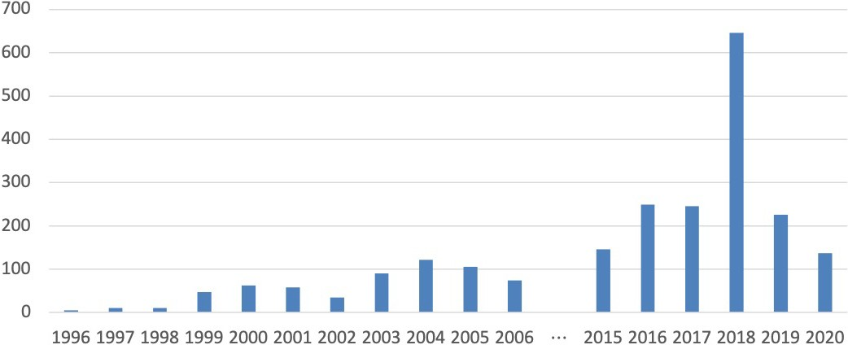
Integer Overflow in the National Vulnerability Database

Slide 84
Recall: Buffer Overflows
char str1[14];
strcpy(str1, "hello, world!"); char str2[6];
strcpy(str2, str1); // not enough space - overwrites other memory!
0
1
2
3
4
5
6
7
8
9
10 11 12 13
str1
'h' | 'e' | 'l' | 'l' | 'o' | ',' | ' ' | 'w' | 'o' | 'r' | 'l' | 'd' | '!' | '\0'
0
1
2
3
4
5
str2
'h' | 'e' | 'l' | 'l' | 'o' | ','
' ' 'w' 'o-'other'prr'ogram'lm'emo'ryd-' '!' '\0'

Slide 85
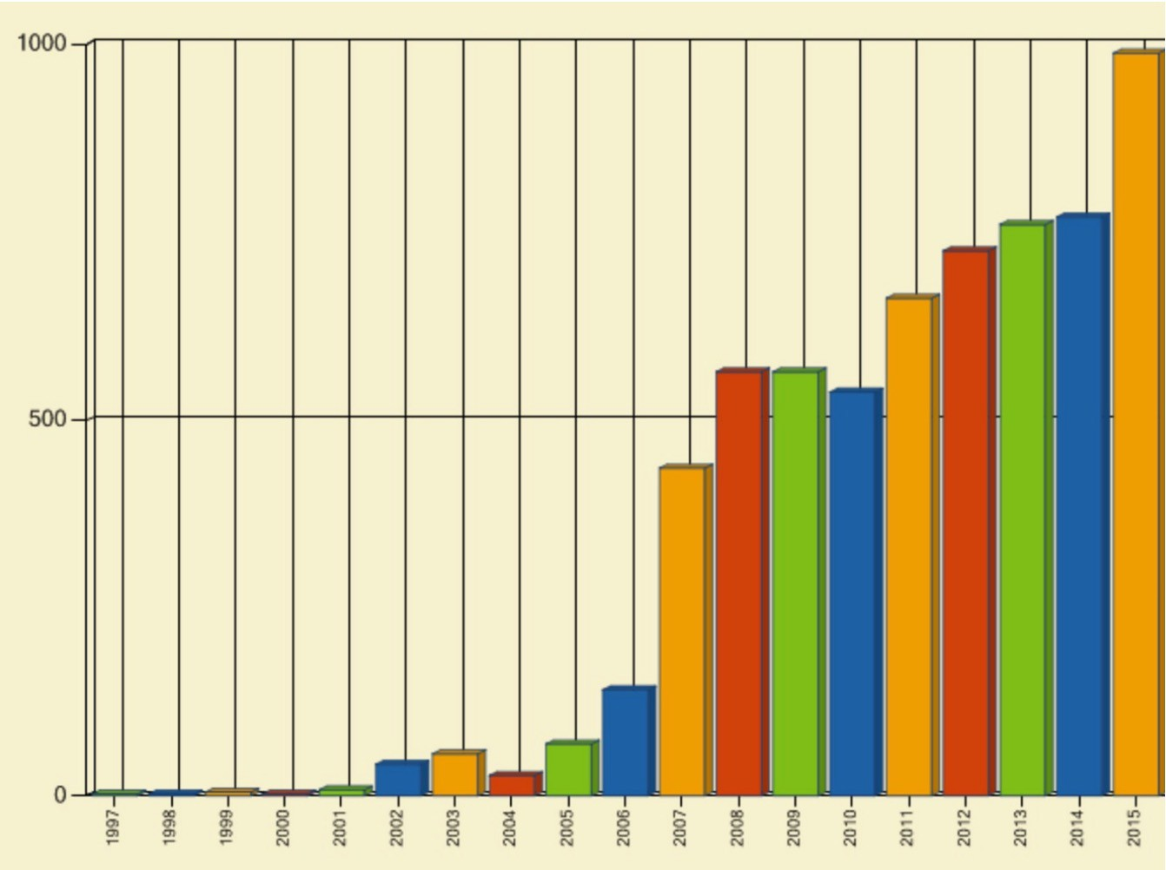
Buffer Overflow Vulnerabilities are Very Common

Slide 86
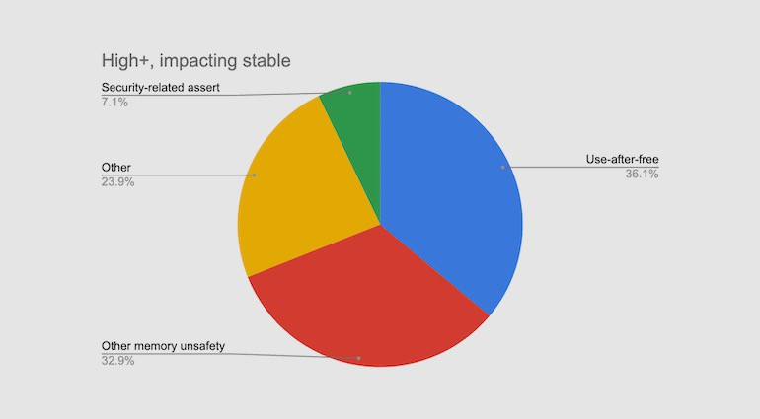
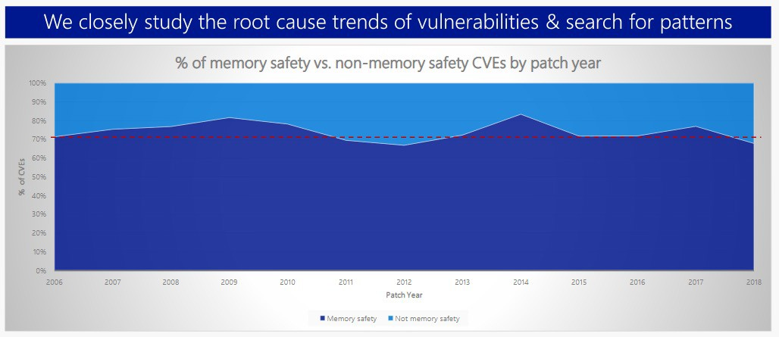
~70% of serious bugs for Chrome and Microsoft are related to memory safety
Memory
safety
issues
include
buffer
overflows
...

Slide 87
How can we fix buffer overflows?
Idea 1: Constant Vigilance (While Programming)
Check all buffers and trace their possible modifications
void printCapitalized(char *str1) {
// make a copy first char buf[BUF_SIZE]; strcpy(buf, str1);
...
}

Slide 88
How can we fix buffer overflows?
Idea 1: Constant Vigilance (While Programming)
Check all buffers and trace their possible modifications
Scrutinize functions that do not include bounds checking
  common offenders include strcpy, printf, sprintf
int sprintf(char *str, const char *format, ...)

Slide 89
How can we fix buffer overflows?
Idea 1: Constant Vigilance (While Programming)
Check all buffers and trace their possible modifications
Scrutinize functions that do not include bounds checking
  Some library functions later deprecated for this reason
MAN page for gets():
“Never use gets(). Because it is impossible to tell without knowing the data in advance how many characters gets() will read, and because gets() will continue to store characters past the end of the buffer, it is extremely dangerous to use. It has been used to break computer security. Use fgets() instead.”

Slide 90
How can we fix buffer overflows?
Idea 1: Constant Vigilance (While Programming)
Check all buffers and trace their possible modifications
Scrutinize functions that do not include bounds checking
Consider use of strn- functions like strncpy
  These functions will not write more than the size you specify
  However, they do not ensure that strings are null- terminated
  Use them, but use with care

Slide 91
How can we fix buffer overflows?
Idea 1: Constant Vigilance (While Programming)
Check all buffers and trace their possible modifications
Scrutinize functions that do not include bounds checking
Consider use of strn- functions like strncopy
Conclusion: Constant vigilance is necessary but not sufficient in the struggle to identify & fix buffer overflows

Slide 92

How Can We Fix Overflows?
Idea 2: Testing
Valgrind: Your Greatest Ally
Write your own tests
Consider writing tests before writing the main program
cs107.stanford.edu/testing.html

Slide 93
How Can We Fix Overflows?
Idea 3: Documentation (Written by You)
Document your assumptions about what will be stored in the buffer
This will allow others (including your future self) to write better tests

Slide 94
How Can We Fix Overflows?
Idea 4: Documentation & MAN Pages (Written by Others)
“The strcpy() function copies the string pointed to by src, including the terminating null byte (‘\0’), to the buffer pointed to by dest. The strings may not overlap, and the destination string must be large enough to receive the copy.
Beware of buffer overruns! (See BUGS.) …
BUGS
If the destination string of a strcpy() is not large enough, then anything might happen. Overflowing fixed-length string buffers is a favorite cracker technique for taking complete control of the machine. Any time a program reads or copies data into a buffer, the program first needs to check that there’s enough space. This may be unnecessary if you can show that overflow is impossible, but be careful: programs can get changed over time, in ways that may make the impossible possible.”

Slide 95
Memory Safe Systems Programming
Idea 5: Choose your Tools & Languages Carefully
Existing code bases or requirements for a project may dictate what tools you use. Knowing C is crucial – it is and will remain widely used.
When you you are choosing tools for systems programming, consider languages that can help guard against programmer error.
Rust (Mozilla)
Go (Google)
Project Verona (Microsoft)

Slide 96
Why Should We Fix Overflows?
Why should I fix overflows?
  So that my program doesn’t crash

Slide 97
Why Should We Fix Overflows?
Why should I fix overflows?
  So that my program doesn’t crash
  So that my program works and accomplishes its goal

Slide 98
Why Should We Fix Overflows?
Why should So that So that | I my my | fix overflows? program doesn’t crash program works and accomplishes | its | goal
So my | that code | I | can | protect |  |  | others |  | who | use | and | interact | with
So | that | I | can | be | a | good |  | computer |  | scientist

Slide 99
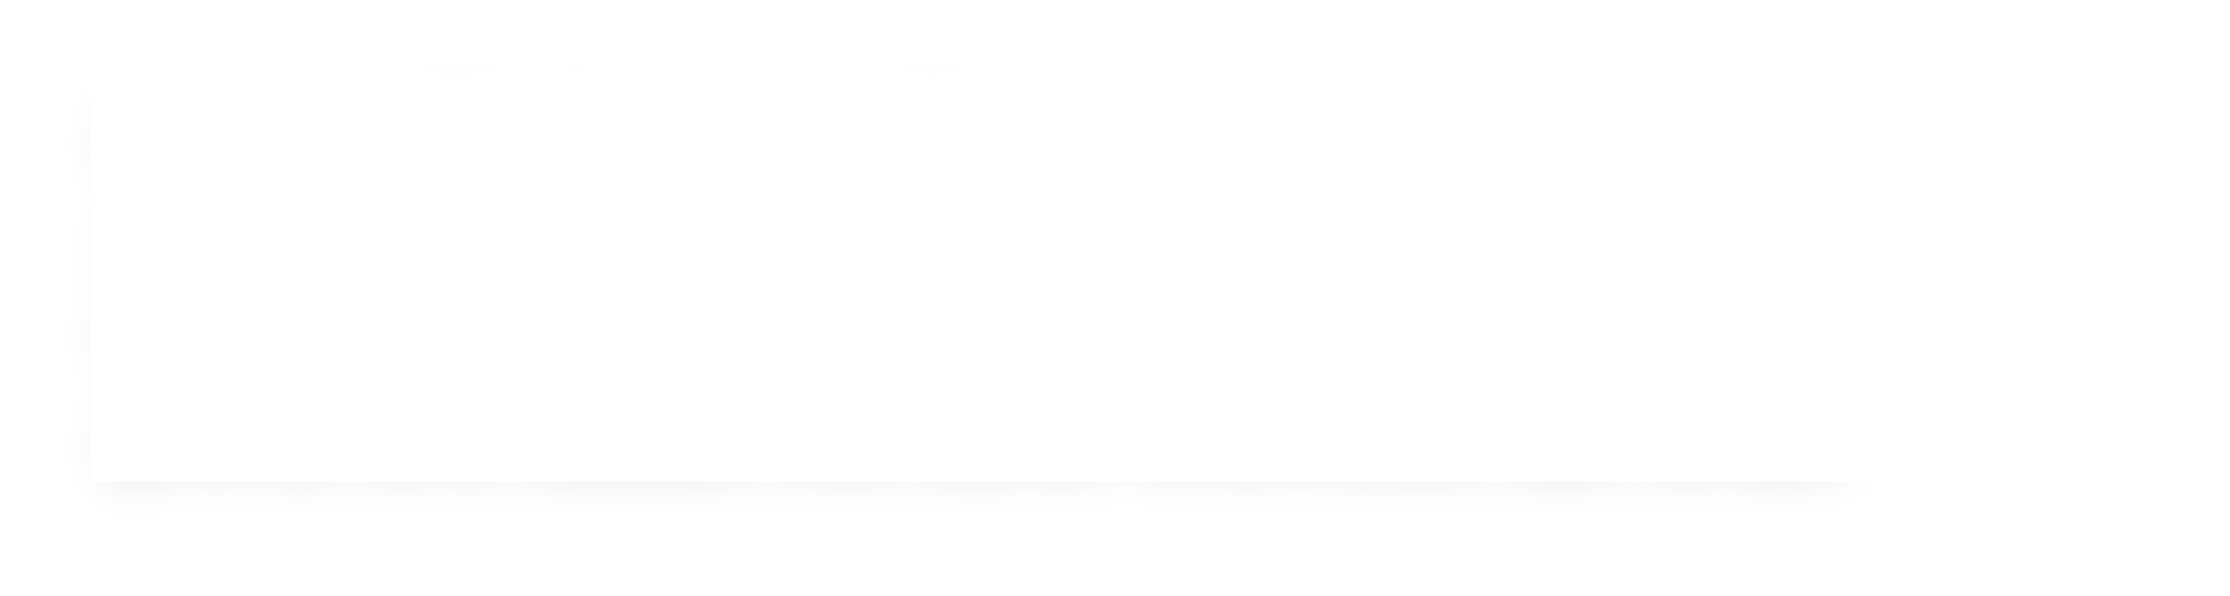
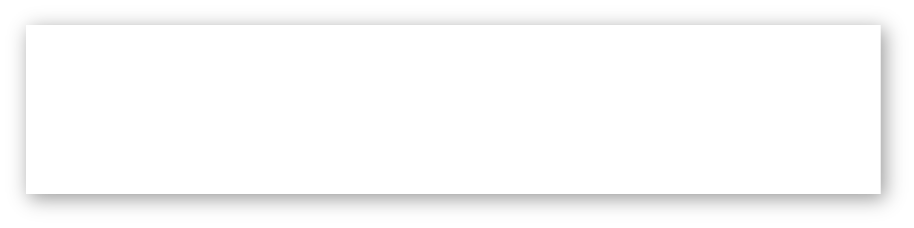
Plan For Today
Lecture 5 takeaway: C strings are pointers and arrays; understanding how pointers and arrays work help us better understand C string behavior. C strings are error- prone, and issues like buffer overflows can arise!

Slide 100
Review
Parameters in C are passed by value; if we pass something as a parameter, we pass a copy of it
Therefore, if a function tries to change the value of a parameter itself, this will always change its local copy, not the original:
void myFunc(SOME_TYPE param) {
param = ... // changes local copy
...
}
int main(int argc, char *argv[]) { SOME_TYPE x = ...
myFunc(x);
// x will always be the same here
...
}

Slide 101
Review
If we wish to have another function modify some local variable, we must pass
its location (address). Thus, we pass a copy of its address, not the value.
The function can then dereference that address and modify what’s there, and the changes will persist.
void myFunc(SOME_TYPE *param) {
*param = ... // changes original copy
...
}
int main(int argc, char *argv[]) { SOME_TYPE x = ...
myFunc(&x);
// x will be changed here
...
}

Slide 102
Arrays vs. Pointers
When you create an array, you are making space for each element in the array.
When you create a pointer, you are making space for an 8 byte address.
Arrays ”decay to pointers” when you perform arithmetic or pass as parameters.
You cannot set an array equal to something after initialization, but you can set a pointer equal to something at any time.
&arr does nothing on arrays, but &ptr on pointers gets its address
sizeof(arr) gets the size of an array in bytes, but sizeof(ptr) is always 8

Slide 103
1. Pointer arithmetic
1
2
3
4
5
6
7
8
9
10
11
12
13
void func(char *str) { str[0] = 'S';
str++;
*str = 'u';
str = str + 3; str[-2] = 'm';
}
Will there be a compile error/segfault?
If no errors, what is printed?
int main(int argc, const char *argv[]) { char buf[] = "Monday";
printf("before func: %s\n", buf); func(buf);
printf("after func: %s\n", buf); return 0;
14
}
• Draw memory diagrams!
• Pointers store addresses! Make up addresses if it helps your mental model.

Slide 104
1. Pointer arithmetic
1
2
3
4
5
6
7
8
9
10
11
12
13
void func(char *str) { str[0] = 'S';
str++;
*str = 'u';
str = str + 3; str[-2] = 'm';
}
func
str
int main(int argc, const char *argv[]) { char buf[] = "Monday";
printf("before func: %s\n", buf);
func(buf);
printf("after func: %s\n", buf); return 0;
main |  | 0x60 | 0x61 | 0x62 | 0x63 | 0x64 | 0x65 | 0x66
buf
14
}
• Draw memory diagrams!
• Pointers store addresses! Make up addresses if it helps your mental model.

Slide 105
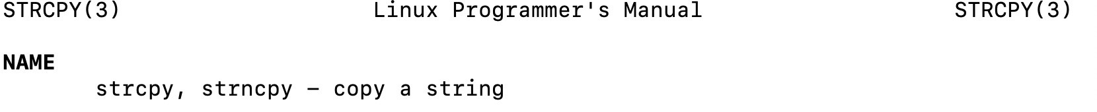
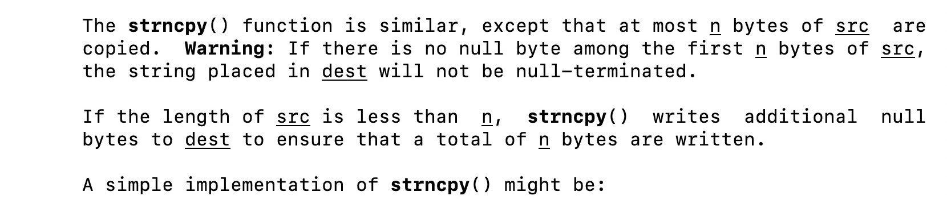
2. Code study: strncpy
0x60
0x61
0x62
0x63
0x64
0x65
0x66
buf
'M' | 'o' | 'n' | 'd' | 'a' | 'y' | '\0'
0x58
0x59
0x5a
0x5b
'F' | 'r' | 'i' | '\0'
str
e_t n) {
char *strncpy(char *dest, const size_t i; |  | char *src, siz
3 | for (i = 0; i < n && src[i] | != '\0'; i++)
4 | dest[i] = src[i];
5 | for ( ; i < n; i++)
6 | dest[i] = '\0';
7 | return dest;
8 }
What happens if we call strncpy(buf,
str, 5);?

Slide 106
2. Code study: strncpy
0x60
0x61
0x62
0x63
0x64
0x65
0x66
buf
'M' | 'o' | 'n' | 'd' | 'a' | 'y' | '\0'
0x58
0x59
0x5a
0x5b
str
'F' | 'r' | 'i' | '\0'
1
2
3
4
5
6
7
8
char *strncpy(char *dest, const char *src, size_t n) { size_t i;
for (i = 0; i < n && src[i] != '\0'; i++) dest[i] = src[i];
for ( ; i < n; i++)
dest[i] = '\0'; return dest;
}
dest
src
n
5
i
What happens if we call strncpy(buf,
str, 5);?

Slide 107
3. char* vs char[] exercises
Suppose we use a variable str
as follows:
// initialize as below
str = str + 1;
str[1] = 'u’;
printf("%s", str)
For each of the following initializations:
Will there be a compile error/segfault?
If no errors, what is printed?
1. char str[7]; strcpy(str, "Hello1");
2. char *str = "Hello2";
3. char arr[7]; strcpy(arr, "Hello3"); char *str = arr;
4. char *ptr = "Hello4"; char *str = ptr;
120

Slide 108
3. char* vs char[] exercises
Suppose we use a variable str
as follows:
// initialize as below
str = str + 1;
str[1] = 'u’;
printf("%s", str)
For each of the following initializations:
Will there be a compile error/segfault?
If no errors, what is printed?
1. char str[7]; strcpy(str, "Hello1");
Line A: Compile error (cannot reassign array)
3. char arr[7]; strcpy(arr, "Hello3"); char *str = arr;
Prints eulo3
2. char *str = "Hello2";
Line B: Segmentation fault (string literal)
4. char *ptr = "Hello4"; char *str = ptr;
Line B: Segmentation fault (string literal)
121

Slide 109
4. Bonus: Tricky addresses
1
2
3
4
5
6
7
8
9
10
11
12
void tricky_addresses() { char buf[] = "Local"; char *ptr1 = buf;
char **double_ptr = &ptr1;
What is stored in each variable? (We cover double pointers more in Lecture 6)
printf("ptr1's value: printf("ptr1’s deref
printf(" address:
%p\n", ptr1);
: %c\n", *ptr1);
%p\n", &ptr1);
printf("double_ptr value: %p\n", double_ptr); printf("buf's address: %p\n", &buf);
char *ptr2 = &buf; printf("ptr2's value:
%s\n", ptr2);
}

Slide 110

4. Bonus: Tricky addresses
1
2
3
4
5
6
7
8
9
10
11
12
void tricky_addresses() {
0x28
0x29
0x2a
0x2b
0x2c
0x2d
char buf[] = "Local"; char *ptr1 = buf;
char **double_ptr = &ptr1;
buf
'L' | 'o' | 'c' | 'a' | 'l' | '\0'
printf("ptr1's value: printf("ptr1’s deref
printf(" address:
%p\n", ptr1);
: %c\n", *ptr1);
%p\n", &ptr1);
0x10
printf("double_ptr value: %p\n", double_ptr); printf("buf's address: %p\n", &buf);
ptr1
0x18
char *ptr2 = &buf; printf("ptr2's value:
double
_ptr
%s\n", ptr2);
}
0x20
While Line 10 raises a compiler warning, functionally it will still work— because pointers are addresses.
ptr2

