Slide 1
CS107, Lecture 6
More Pointers and Arrays
Reading: K&R (5.2-5.5) or Essential C section 6
This document is copyright (C) Stanford Computer Science, Lisa Yan, and Nick Troccoli, licensed under Creative Commons Attribution 2.5 License. All rights reserved.
Based on slides created by Marty Stepp, Cynthia Lee, Chris Gregg, Lisa Yan, Jerry Cain and others.

Slide 2
CS107 Topic 3: How can we effectively manage all types of memory in our programs?

Slide 3
Lecture Plan
Pointers and Parameters
Double Pointers
Arrays in Memory
Arrays of Pointers
Pointer Arithmetic
Other topics: const, struct and ternary
4
42
57
66
64
72
cp -r /afs/ir/class/cs107/lecture-code/lect06 .

Slide 4
Lecture Plan
Pointers and Parameters
Double Pointers
Arrays in Memory
Arrays of Pointers
Pointer Arithmetic
Other topics: const, struct and ternary
4
42
57
66
64
72
cp -r /afs/ir/class/cs107/lecture-code/lect06 .

Slide 5
Pointers
A pointer is a variable that stores a memory address.
Because there is no pass-by-reference in C like in C++, pointers let us pass around the address of one instance of memory, instead of making many copies.
One (8 byte) pointer can represent any size memory location!
Pointers are also essential for allocating memory on the heap, which we will cover later.
Pointers also let us refer to memory generically, which we will cover later.

Slide 6
Memory
Memory is a big array of bytes.
Each byte has a unique numeric index that is commonly written in hexadecimal.
A pointer stores one of these memory addresses.
Address
Value
0x105 0x104 0x103 0x102 0x101 0x100 | …
 | '\0'
 | 'e'
 | 'l'
 | 'p'
 | 'p'
 | 'a'
 | …

Slide 7
Memory
Memory is a big array of bytes.
Each byte has a unique numeric index that is commonly written in hexadecimal.
A pointer stores one of these memory addresses.
Address
Value
261 260 259 258 257 256 | …
 | '\0'
 | 'e'
 | 'l'
 | 'p'
 | 'p'
 | 'a'
 | …

Slide 8
Pointers
int x = 2;
// Make a pointer that stores the address of x.
// (& means "address of") int *xPtr = &x;
// Dereference the pointer to go to that address.
// (* means "dereference") printf("%d", *xPtr); // prints 2

Slide 9
Pointers
A pointer is a variable that stores a memory address.
STACK
Address Value
_{X} 0x1f0 | …
 | 2
 | …
void myFunc(int *intPtr) {
*intPtr = 3;
}
main()
int main(int argc, char *argv[]) {
int x = 2;
myFunc(&x);
printf("%d", x); // 3!
...
}

Slide 10
Pointers
A pointer is a variable that stores a memory address.
STACK
Address Value
…
2
x
0x1f0
void myFunc(int *intPtr) {
*intPtr = 3;
}
main()
…
int main(int argc, char *argv[]) {
int x = 2;
myFunc(&x);
printf("%d", x); // 3!
...
}

Slide 11
Pointers
A pointer is a variable that stores a memory address.
STACK
Address Value
…
x
0x1f0
2
void myFunc(int *intPtr) {
*intPtr = 3;
}
main()
…
myFunc()
intPtr
0x10
0x1f0
…
int main(int argc, char *argv[]) {
int x = 2;
myFunc(&x);
printf("%d", x); // 3!
...
}

Slide 12
Pointers
A pointer is a variable that stores a memory address.
STACK
Address Value
…
x
0x1f0
2
void myFunc(int *intPtr) {
*intPtr = 3;
}
main()
…
myFunc()
intPtr
0x10
0x1f0
…
int main(int argc, char *argv[]) { int x = 2;
myFunc(&x);
printf("%d", x); // 3!
...
}

Slide 13
Pointers
A pointer is a variable that stores a memory address.
STACK
Address Value
…
x
0x1f0
3
void myFunc(int *intPtr) {
*intPtr = 3;
}
main()
…
myFunc()
intPtr
0x10
0x1f0
…
int main(int argc, char *argv[]) {
int x = 2;
myFunc(&x);
printf("%d", x); // 3!
...
}

Slide 14
Pointers
A pointer is a variable that stores a memory address.
STACK
Address Value
 | …
 | 3
 | …
x
0x1f0
void myFunc(int *intPtr) {
*intPtr = 3;
}
main()
int main(int argc, char *argv[]) { int x = 2;
myFunc(&x);
printf("%d", x); // 3!
...
}

Slide 15
Pointers
A pointer is a variable that stores a memory address.
STACK
Address Value
…
3
x
0x1f0
void myFunc(int *intPtr) {
*intPtr = 3;
}
main()
…
int main(int argc, char *argv[]) { int x = 2;
myFunc(&x);
printf("%d", x); // 3!
...
}

Slide 16
C Parameters
When you pass a value as a parameter, C passes a copy of that value.
void myFunction(int x) {
…
}
int main(int argc, char *argv[]) { int num = 4;
myFunction(num); // passes copy of 4
}

Slide 17
C Parameters
When you pass a value as a parameter, C passes a copy of that value.
void myFunction(int *x) {
…
}
int main(int argc, char *argv[]) { int num = 4;
myFunction(&num); // passes copy of e.g. 0xffed63
}

Slide 18
C Parameters
When you pass a value as a parameter, C passes a copy of that value.
void myFunction(char … |  | ch) | {
}
int | main(int argc, char *argv[]) |  |  | {
} | char *myStr = "Hello!"; myFunction(myStr[1]); |  |  | // passes copy of 'e'

Slide 19
C Parameters
If you are performing an operation with some input and do not care about any changes to the input, pass the data type itself.
If you are modifying a specific instance of some value, pass the location of what you would like to modify and dereference that location to access what’s there.
Do I care about modifying this instance of my data? If so, I need to pass where that instance lives, as a parameter, so it can be modified.

Slide 20
C Parameters
If you are performing an operation with some input and do not care about any changes to the input, pass the data type itself.
void myFunction(char ch) { printf("%c", ch);
}
int main(int argc, char *argv[]) { char *myStr = "Hello!";
myFunction(myStr[1]); // prints 'e'
}

Slide 21
C Parameters
If you are performing an operation with some input and do not care about any changes to the input, pass the data type itself.
int } | myFunction(int return num1 + | num1, num2; | int num2) {
int | main(int argc, | char | *argv[]) {
int | x | = | 5;
int | y | = | 6;
// returns 11
int sum = myFunction(x, y);
}

Slide 22
C Parameters
If you are modifying a specific instance of some value, pass the location of what you would like to modify.
Do I care about modifying this instance of my data? If so, I need to pass where that instance lives, as a parameter, so it can be modified.

Slide 23
char[]
STACK
When we declare an array of characters, contiguous memory is allocated on the stack to store the contents of the entire array.
int main(int argc, char *argv[]) {
char str[6];
strcpy(str, "apple");
...
Address | Value
 | …
0x105 | '\0'
0x104 | 'e'
0x103 | 'l'
0x102 | 'p'
0x101 | 'p'
0x100 | 'a'
 | …
main()
str

Slide 24
char *
STACK
When we declare a char *, we allocate space on the stack to store an address, not actual characters. But we can still generally use char * the same as char[].
int main(int argc, char *argv[]) {
char str[6];
strcpy(str, "apple");
char *strAlt = str;
...
Address | Value
 | …
0x105 | '\0'
0x104 | 'e'
0x103 | 'l'
0x102 | 'p'
0x101 | 'p'
0x100 | 'a'
 | …
0xf | 0x100
 | …
main()
str
strAlt

Slide 25
Strings as Parameters
STACK
When we pass a char array as a parameter, C makes a copy of the address of the first array element and passes it (as a char *) to the function.
void myFunc(char *myStr) {
...
}
int main(int argc, char *argv[]) {
char str[6];
strcpy(str, "apple");
myFunc(str);
...
}
Address | Value
 | …
0x105 | '\0'
0x104 | 'e'
0x103 | 'l'
0x102 | 'p'
0x101 | 'p'
0x100 | 'a'
 | …
 | …
0xf | 0x100
 | …
main()
str
myFunc()
myStr

Slide 26
Strings as Parameters
STACK
This means if we modify characters in myFunc, the changes will persist back in main!
void myFunc(char *myStr) {
myStr[4] = 'y';
}
int main(int argc, char *argv[]) {
char str[6];
strcpy(str, "apple");
myFunc(str);
printf("%s", str); // apply
...
}
Address | Value
 | …
0x105 | '\0'
0x104 | 'y'
0x103 | 'l'
0x102 | 'p'
0x101 | 'p'
0x100 | 'a'
 | …
 | …
0xf | 0x100
 | …
main()
str
myFunc()
myStr

Slide 27
char *
A char * variable refers to a single character. We can reassign an existing char * pointer to be equal to another char * pointer.
char *str = "apple"; // e.g. 0xfff0
char *str2 = "apple 2"; // e.g. 0xfe0
str = str2; // ok! Both store address 0xfe0

Slide 28
Arrays and Pointers
STACK
We can also make a pointer equal to an array; it will point to the first element in that array.
int main(int argc, char *argv[]) {
char str[6];
strcpy(str, "apple");
char *ptr = str;
...
}
Address | Value
 | …
0x105 | '\0'
0x104 | 'e'
0x103 | 'l'
0x102 | 'p'
0x101 | 'p'
0x100 | 'a'
0xf8 | 0x100
 | …
main()
str
ptr

Slide 29
Arrays and Pointers
STACK
We can also make a pointer equal to an array; it will point to the first element in that array.
int main(int argc, char *argv[]) {
char str[6];
strcpy(str, "apple");
char *ptr = str;
// equivalent
char *ptr = &str[0];
// confusingly equivalent, avoid
char *ptr = &str;
...
}
Address | Value
 | …
0x105 | '\0'
0x104 | 'e'
0x103 | 'l'
0x102 | 'p'
0x101 | 'p'
0x100 | 'a'
0xf8 | 0x100
 | …
main()
str
ptr

Slide 30
Read-only Strings
There is another convenient way to create a string if we do not need to modify it later. We can create a char * and set it directly equal to a string literal.
char *myString = "Hello, world!";
...
printf("%s", myString); // Hello, world!

Slide 31
Read-only Strings
When we declare a char pointer equal to a string literal, the characters are not stored on the stack. Instead, they are stored in a special area of memory called the “data segment”. We cannot modify memory in this segment.
char *str = "hi";
The pointer variable (e.g. str) refers to the address of the first character of the string in the data segment.
Address | Value
 | …
0xff0 | 0x10
 | …
 | …
0x12 | '\0'
0x11 | 'i'
0x10 | 'h'
 | …
STACK
str
DATA SEGMENT
NOTE: not all char * strings are read-only. Only ones that point to characters in the data segment are read-only.
Notes:
Text segment stores string literals to potentially reduce duplicate memory

Slide 32
Read-only Strings
Read-only strings are convenient to use, but make sure to not use a read-only string in code that tries to modify its characters – it will crash!
char *myString = "Hello, world!";
myString[0] = 'h'; // crashes!
There’s no way in code to check if a string is read-only; it’s up to the programmer to properly use strings to avoid these crashes.
E.g. don’t pass in a read-only string as the src to strcpy
strcpy(myString, "Hi"); // crashes!

Slide 33
Read-only Strings
A string is read-only if it points to characters that live in the data segment, rather than memory we can modify.
char *readOnly = "Hi";
char modifiable[6];
strcpy(modifiable, "Hi");
// is ptr read-only?
char *ptr = modifiable;
// no, because it points to characters on the stack
ptr[0] = 'h'; // ok!

Slide 34
Strings In Memory
If we create a string as a char[], we can modify its characters because its memory lives in our stack space.
We cannot set a char[] equal to another value, because it is not a pointer; it refers to the block of memory reserved for the original array.
If we pass a char[] as a parameter, set something equal to it, or perform arithmetic with it, it’s automatically converted to a char *.
We can set a char * equal to another value, because it is a reassign-able pointer.
If we create a new string with new characters as a char *, we cannot modify its characters because its memory lives in the data segment.
Adding an offset to a C string gives us a substring that many places past the first character.
If we change characters in a string parameter, these changes will persist outside of the function.

Slide 35
Lecture Plan
Pointers and Parameters
Double Pointers
Arrays in Memory
Arrays of Pointers
Pointer Arithmetic
Other topics: const, struct and ternary
Live Session
4
42
57
66
64
72
99
cp -r /afs/ir/class/cs107/lecture-code/lect06 .
42

Slide 36
Exercise 1
We want to write a function that prints out the square of a number. What should go in each of the blanks?
void printSquare(__?__) {
int square = __?__ * __?__;
printf("%d", square);
}
int main(int argc, char *argv[]) {
int num = 3;
printSquare(__?__); // should print 9
}

Slide 37
Exercise 1
We want to write a function that prints out the square of a number. What should go in each of the blanks?
void printSquare(int x) {
x = x * x;
printf("%d", x);
}
int main(int argc, char *argv[]) {
int num = 3;
printSquare(num); // should print 9
}
We are performing a calculation with some input and do not care about any changes to the input, so we pass the data type itself.

Slide 38
Exercise 2
We want to write a function that flips the case of a letter. What should go in each of the blanks?
void flipCase(__?__) {
if (isupper(__?__)) {
__?__ = __?__;
} else if (islower(__?__)) {
__?__ = __?__;
}
}
int main(int argc, char *argv[]) {
char ch = 'g';
flipCase(__?__);
printf("%c", ch); // want this to print ‘G’
}

Slide 39
Exercise 2
We want to write a function that flips the case of a letter. What should go in each of the blanks?
void flipCase(char *letter) {
if (isupper(*letter)) {
*letter = tolower(*letter);
} else if (islower(*letter)) {
*letter = toupper(*letter);
}
}
int main(int argc, char *argv[]) {
char ch = 'g';
flipCase(&ch);
printf("%c", ch); // want this to print ‘G’
}
We are modifying a specific instance of the letter, so we pass the location of the letter we would like to modify.

Slide 40
Exercise 3
Sometimes, we would like to modify a string’s pointer itself, rather than just the characters it points to. E.g. we want to write a function skipSpaces that modifies a string pointer to skip past any initial spaces. What should go in each of the blanks?
void skipSpaces(__1__) {
...
}
int main(int argc, char *argv[]) {
char *str = " hello";
skipSpaces(__2__);
printf("%s", str); // should print "hello"
}
🤔

Slide 41
Exercise 3
Sometimes, we would like to modify a string’s pointer itself, rather than just the characters it points to. E.g. we want to write a function skipSpaces that modifies a string pointer to skip past any initial spaces. What should go in each of the blanks?
void skipSpaces(char **strPtr) {
...
}
int main(int argc, char *argv[]) {
char *str = " hello";
skipSpaces(&str);
printf("%s", str); // should print "hello"
}
We are modifying a specific instance of the string pointer, so we pass the location of the string pointer we would like to modify.

Slide 42
Pointers to Strings
Address | Value
 | …
 | …
void skipSpaces(char **strPtr) {
int numSpaces = strspn(*strPtr, " ");
*strPtr += numSpaces;
}
int main(int argc, char *argv[]) {
char *myStr = " hi";
skipSpaces(&myStr);
printf("%s\n", myStr); // hi
return 0;
}
STACK
main()

Slide 43
Pointers to Strings
Address | Value
 | …
0x105 | 0xf
 | …
 | …
0x13 | '\0'
0x12 | 'i'
0x11 | 'h'
0x10 | ' '
0xf | ' '
 | …
void skipSpaces(char **strPtr) {
int numSpaces = strspn(*strPtr, " ");
*strPtr += numSpaces;
}
int main(int argc, char *argv[]) {
char *myStr = " hi";
skipSpaces(&myStr);
printf("%s\n", myStr); // hi
return 0;
}
STACK
main()
myStr
DATA SEGMENT

Slide 44
Pointers to Strings
Address | Value
 | …
0x105 | 0xf
 | …
 | …
0x13 | '\0'
0x12 | 'i'
0x11 | 'h'
0x10 | ' '
0xf | ' '
 | …
void skipSpaces(char **strPtr) {
int numSpaces = strspn(*strPtr, " ");
*strPtr += numSpaces;
}
int main(int argc, char *argv[]) {
char *myStr = " hi";
skipSpaces(&myStr);
printf("%s\n", myStr); // hi
return 0;
}
STACK
main()
myStr
DATA SEGMENT

Slide 45
Pointers to Strings
Address | Value
 | …
0x105 | 0xf
 | …
 | …
0xf0 | 0x105
 | …
 | …
0x13 | '\0'
0x12 | 'i'
0x11 | 'h'
0x10 | ' '
0xf | ' '
 | …
void skipSpaces(char **strPtr) {
int numSpaces = strspn(*strPtr, " ");
*strPtr += numSpaces;
}
int main(int argc, char *argv[]) {
char *myStr = " hi";
skipSpaces(&myStr);
printf("%s\n", myStr); // hi
return 0;
}
main()
myStr
STACK
skipSpaces()
strPtr
DATA SEGMENT

Slide 46
Pointers to Strings
Address | Value
 | …
0x105 | 0xf
 | …
 | …
0xf0 | 0x105
0xe8 | 2
 | …
 | …
0x13 | '\0'
0x12 | 'i'
0x11 | 'h'
0x10 | ' '
0xf | ' '
 | …
void skipSpaces(char **strPtr) {
int numSpaces = strspn(*strPtr, " ");
*strPtr += numSpaces;
}
int main(int argc, char *argv[]) {
char *myStr = " hi";
skipSpaces(&myStr);
printf("%s\n", myStr); // hi
return 0;
}
main()
myStr
STACK
strPtr
skipSpaces()
numSpaces
DATA SEGMENT

Slide 47
Pointers to Strings
Address | Value
 | …
0x105 | 0xf
 | …
 | …
0xf0 | 0x105
0xe8 | 2
 | …
 | …
0x13 | '\0'
0x12 | 'i'
0x11 | 'h'
0x10 | ' '
0xf | ' '
 | …
void skipSpaces(char **strPtr) {
int numSpaces = strspn(*strPtr, " ");
*strPtr += numSpaces;
}
int main(int argc, char *argv[]) {
char *myStr = " hi";
skipSpaces(&myStr);
printf("%s\n", myStr); // hi
return 0;
}
main()
myStr
STACK
strPtr
skipSpaces()
numSpaces
DATA SEGMENT

Slide 48
Pointers to Strings
Address | Value
 | …
0x105 | 0x11
 | …
 | …
0x13 | '\0'
0x12 | 'i'
0x11 | 'h'
0x10 | ' '
0xf | ' '
 | …
void skipSpaces(char **strPtr) {
int numSpaces = strspn(*strPtr, " ");
*strPtr += numSpaces;
}
int main(int argc, char *argv[]) {
char *myStr = " hi";
skipSpaces(&myStr);
printf("%s\n", myStr); // hi
return 0;
}
STACK
main()
myStr
DATA SEGMENT

Slide 49
Pointers to Strings
Address | Value
 | …
0x105 | 0x11
 | …
 | …
0x13 | '\0'
0x12 | 'i'
0x11 | 'h'
0x10 | ' '
0xf | ' '
 | …
void skipSpaces(char **strPtr) {
int numSpaces = strspn(*strPtr, " ");
*strPtr += numSpaces;
}
int main(int argc, char *argv[]) {
char *myStr = " hi";
skipSpaces(&myStr);
printf("%s\n", myStr); // hi
return 0;
}
STACK
main()
myStr
DATA SEGMENT

Slide 50
Making Copies
Address | Value
 | …
0x105 | 0xf
 | …
 | …
0xf0 | 0xf
 | …
 | …
0x13 | '\0'
0x12 | 'i'
0x11 | 'h'
0x10 | ' '
0xf | ' '
 | …
void skipSpaces(char *strPtr) {
int numSpaces = strspn(strPtr, " ");
strPtr += numSpaces;
}
int main(int argc, char *argv[]) {
char *myStr = " hi";
skipSpaces(myStr);
printf("%s\n", myStr); // hi
return 0;
}
main()
myStr
STACK
skipSpaces()
strPtr
This advances skipSpace’s own copy of the string pointer, not the instance in main.
DATA SEGMENT

Slide 51
Recap
Finishing up: Strings and Pointers
Now onto: Double Pointers
Lecture 6 takeaway: pointers let us store the addresses of data and pass them as parameters. We can use double pointers if we want to change the value of a pointer in another function.
Notes:
20min
25min
10min
10min
15min

Slide 52
Lecture Plan
Pointers and Parameters
Double Pointers
Arrays in Memory
Arrays of Pointers
Pointer Arithmetic
Other topics: const, struct and ternary
4
42
57
66
64
72
cp -r /afs/ir/class/cs107/lecture-code/lect06 .
57

Slide 53
Arrays
When you declare an array, contiguous memory is allocated on the stack to store the contents of the entire array.
char str[6];
strcpy(str, "apple");
The array variable (e.g. str) is not a pointer; it refers to the entire array contents. In fact, sizeof returns the size of the entire array!
int arrayBytes = sizeof(str); // 6
STACK
Address | Value
 | …
0x105 | '\0'
0x104 | 'e'
0x103 | 'l'
0x102 | 'p'
0x101 | 'p'
0x100 | 'a'
 | …
str

Slide 54
Arrays
An array variable refers to an entire block of memory. You cannot reassign an existing array to be equal to a new array.
int nums[] = {1, 2, 3};
int nums2[] = {4, 5, 6, 7};
nums = nums2; // not allowed!
An array’s size cannot be changed once you create it; you must create another new array instead.

Slide 55
Arrays as Parameters
STACK
When you pass an array as a parameter, C makes a copy of the address of the first array element, and passes it (a pointer) to the function.
void myFunc(char *myStr) {
...
}
int main(int argc, char *argv[]) {
char str[3];
strcpy(str, "hi");
myFunc(str);
...
}
Address | Value
0x1f2 | '\0'
0x1f1 | 'i'
0x1f0 | 'h'
 | ...
0xff
0xfe
0xfd
0xfc
0xfb
0xfa
0xf9
0xf8
 | ...
main()
str
0x1f0
myFunc()
mystr

Slide 56
Arrays as Parameters
STACK
When you pass an array as a parameter, C makes a copy of the address of the first array element and passes it (a pointer) to the function.
void myFunc(char *myStr) {
…
}
int main(int argc, char *argv[]) {
char str[3];
strcpy(str, "hi");
// equivalent
char *arrPtr = str;
myFunc(arrPtr);
...
}
Address | Value
0x1f2 | '\0'
0x1f1 | 'i'
0x1f0 | 'h'
0x1e8 | 0x1f0
 | …
0x10 | 0x1f0
 | …
str
main()
arrPtr
myStr
myFunc()

Slide 57
Arrays as Parameters
STACK
This also means we can no longer get the full size of the array using sizeof, because now it is just a pointer.
void myFunc(char *myStr) {
int size = sizeof(myStr); // 8
}
int main(int argc, char *argv[]) {
char str[3];
strcpy(str, "hi");
int size = sizeof(str); // 3
myFunc(str);
...
}
Address | Value
0x1f2 | '\0'
0x1f1 | 'i'
0x1f0 | 'h'
 | ...
0xff
0xfe
0xfd
0xfc
0xfb
0xfa
0xf9
0xf8
main()
str
0x1f0
myFunc()
mystr

Slide 58
sizeof returns the size of an array, or 8 for a pointer. Therefore, when we pass an array as a parameter, we can no longer use sizeof to get its full size.

Slide 59
Arrays vs. Pointers
When you create an array, you are making space for each element in the array.
When you create a pointer, you are making space for an 8 byte address.
Arrays ”decay to pointers” when you perform arithmetic or pass as parameters.
You can set a pointer equal to an array; that pointer will point to the array’s first element
&arr does nothing on arrays, but &ptr on pointers gets its address
sizeof(arr) gets the size of an array in bytes, but sizeof(ptr) is always 8

Slide 60
Lecture Plan
Pointers and Parameters
Double Pointers
Arrays in Memory
Arrays of Pointers
Pointer Arithmetic
Other topics: const, struct and ternary
4
42
57
66
64
72
cp -r /afs/ir/class/cs107/lecture-code/lect06 .
66

Slide 61
Arrays Of Pointers
You can make an array of pointers to e.g. group multiple strings together:
char *stringArray[5]; // space to store 5 char *s
This stores 5 char *s, not all of the characters for 5 strings!
char *str0 = stringArray[0]; // first char *

Slide 62
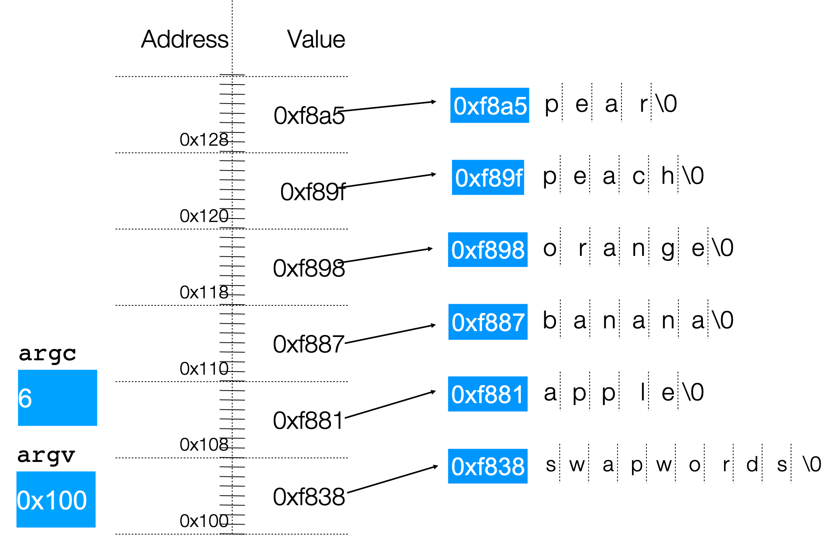
Arrays Of Pointers

Slide 63
Arrays Of Pointers
Question:
What’s the value of argv[0]?

Slide 64
Lecture Plan
Pointers and Parameters
Double Pointers
Arrays in Memory
Arrays of Pointers
Pointer Arithmetic
Other topics: const, struct and ternary
4
42
57
66
64
72
cp -r /afs/ir/class/cs107/lecture-code/lect06 .

Slide 65
Pointer Arithmetic
When you do pointer arithmetic, you are adjusting the pointer by a certain number of places (e.g. characters).
char *str = "apple"; // e.g. 0xff0
char *str1 = str + 1; // e.g. 0xff1
char *str3 = str + 3; // e.g. 0xff3
printf("%s", str); // apple
printf("%s", str1); // pple
printf("%s", str3); // le
DATA SEGMENT
Address | Value
 | …
0xff5 | '\0'
0xff4 | 'e'
0xff3 | 'l'
0xff2 | 'p'
0xff1 | 'p'
0xff0 | 'a'
 | …

Slide 66
Pointer Arithmetic
Pointer arithmetic does not work in bytes. Instead, it works in the size of the type it points to.
// nums points to an int array
int *nums = … // e.g. 0xff0
int *nums1 = nums + 1; // e.g. 0xff4
int *nums3 = nums + 3; // e.g. 0xffc
printf("%d", *nums); // 52
printf("%d", *nums1); // 23
printf("%d", *nums3); // 34
STACK
Address | Value
 | …
0x1004 | 1
0x1000 | 16
0xffc | 34
0xff8 | 12
0xff4 | 23
0xff0 | 52
 | …

Slide 67
Pointer Arithmetic
Pointer arithmetic does not work in bytes. Instead, it works in the size of the type it points to.
// nums points to an int array
int *nums = … // e.g. 0xff0
int *nums3 = nums + 3; // e.g. 0xffc
int *nums2 = nums3 - 1; // e.g. 0xff8
printf("%d", *nums); // 52
printf("%d", *nums2); // 12
printf("%d", *nums3); // 34
STACK
Address | Value
 | …
0x1004 | 1
0x1000 | 16
0xffc | 34
0xff8 | 12
0xff4 | 23
0xff0 | 52
 | …

Slide 68
Pointer Arithmetic
When you use bracket notation with a pointer, you are actually performing pointer arithmetic and dereferencing:
char *str = "apple"; // e.g. 0xff0
// both of these add two places to str,
// and then dereference to get the char there.
// E.g. get memory at 0xff2.
char thirdLetter = str[2]; // 'p'
char thirdLetter = *(str + 2); // 'p'
DATA SEGMENT
Address | Value
 | …
0xff5 | '\0'
0xff4 | 'e'
0xff3 | 'l'
0xff2 | 'p'
0xff1 | 'p'
0xff0 | 'a'
 | …

Slide 69
Pointer Arithmetic
Pointer arithmetic with two pointers does not give the byte difference. Instead, it gives the number of places they differ by.
// nums points to an int array
int *nums = … // e.g. 0xff0
int *nums3 = nums + 3; // e.g. 0xffc
int diff = nums3 - nums; // 3
STACK
Address | Value
 | …
0x1004 | 1
0x1000 | 16
0xffc | 34
0xff8 | 12
0xff4 | 23
0xff0 | 52
 | …

Slide 70
Pointer Arithmetic
How does the code know how many bytes it should look at once it visits an address? At compile time, C can figure out the sizes of different data types, and the sizes of what they point to.
int x = 2;
int *xPtr = &x; // e.g. 0xff0
// C knows to print out just the 4 bytes at xPtr
printf("%d", *xPtr); // 2

Slide 71
Pointer Arithmetic
How does the code know how many bytes it should add when performing pointer arithmetic? At compile time, C can figure out the sizes of different data types, and the sizes of what they point to.
int nums[] = {1, 2, 3};
// C knows to add 4 bytes here
int *intPtr = nums + 1;
char str[6];
strcpy(str, "CS107");
// C knows to add 1 byte here
char *charPtr = str + 1;

Slide 72
Lecture Plan
Pointers and Parameters
Double Pointers
Arrays in Memory
Arrays of Pointers
Pointer Arithmetic
Other topics: const, struct and ternary
4
42
57
66
64
72
cp -r /afs/ir/class/cs107/lecture-code/lect06 .

Slide 73
Const
Use const to declare global constants in your program. This indicates the variable cannot change after being created.
const double PI = 3.1415;
const int DAYS_IN_WEEK = 7;
int main(int argc, char *argv[]) {
…
if (x == DAYS_IN_WEEK) {
…
}
…
}

Slide 74
Const
Use const with pointers to indicate that the data that is pointed to cannot change.
char str[6];
strcpy(str, "Hello"); const char *s = str;
// Cannot use s to change characters it points to s[0] = 'h';

Slide 75
Const
Sometimes we use const with pointer parameters to indicate that the function will not / should not change what it points to. The actual pointer can be changed, however.
// This function promises to not change str’s characters int countUppercase(const char *str) {
int count = 0;
for (int i = 0; i < strlen(str); i++) { if (isupper(str[i])) {
count++;
}
}
return count;
}

Slide 76
Const
By definition, C gets upset when you set a non-const pointer equal to a const
pointer. You need to be consistent with const to reflect what you cannot modify.
// This function promises to not change str’s characters int countUppercase(const char *str) {
// compiler warning and error char *strToModify = str;
strToModify[0] = …
}

Slide 77
Const
By definition, C gets upset when you set a non-const pointer equal to a const pointer. You need to be consistent with const to reflect what you cannot modify. Think of const as part of the variable type.
// This function promises to not change str’s characters int countUppercase(const char *str) {
const char *strToModify = str;
strToModify[0] = …
}

Slide 78
Const
const can be confusing to interpret in some variable types.
// cannot modify this char const char c = 'h';
// cannot modify chars pointed to by str const char *str = …
// cannot modify chars pointed to by *strPtr const char **strPtr = …

Slide 79
Structs
A struct is a way to define a new variable type that is a group of other variables.
struct date {
int month; int day;
};
…
// declaring a struct type
// members of each date structure
struct date today; today.month = 1;
today.day = 28;
// construct structure instances
struct date new_years_eve = {12, 31};
// shorter initializer syntax

Slide 80
Structs
Wrap the struct definition in a typedef to avoid having to include the word
struct every time you make a new variable of that type.
typedef | struct | date | {
int | month;
int | day;
} date;
…
date today; today.month = 1;
today.day = 28;
date new_years_eve = {12, 31};

Slide 81
Structs
If you pass a struct as a parameter, like for other parameters, C passes a copy of the entire struct.
void advance_day(date d) { d.day++;
}
int main(int argc, char *argv[]) { date my_date = {1, 28}; advance_day(my_date); printf("%d", my_date.day); // 28 return 0;
}

Slide 82
Structs
If you pass a struct as a parameter, like for other parameters, C passes a copy of the entire struct. Use a pointer to modify a specific instance.
void advance_day(date *d) { (*d).day++;
}
int main(int argc, char *argv[]) { date my_date = {1, 28}; advance_day(&my_date); printf("%d", my_date.day); // 29 return 0;
}

Slide 83
Structs
The arrow operator lets you access the field of a struct pointed to by a pointer.
void advance_day(date *d) {
d->day++; // equivalent to (*d).day++;
}
int main(int argc, char *argv[]) { date my_date = {1, 28}; advance_day(&my_date); printf("%d", my_date.day); // 29 return 0;
}

Slide 84
Structs
C allows you to return structs from functions as well. It returns whatever is contained within the struct.
date create_new_years_date() { date d = {1, 1};
return d; // or return (date){1, 1};
}
int main(int argc, char *argv[]) {
date my_date = create_new_years_date(); printf("%d", my_date.day); // 1
return 0;
}

Slide 85
Structs
sizeof gives you the entire size of a struct, which is the sum of the sizes of all its contents.
typedef struct date {
 | int | month;
 | int | day;
} | date;
int main(int argc, char *argv[]) { int size = sizeof(date); // 8 return 0;
}

Slide 86
Arrays of Structs
You can create arrays of structs just like any other variable type.
typedef struct my_struct { int x;
char c;
} my_struct;
…
my_struct array_of_structs[5];

Slide 87
Arrays of Structs
To initialize an entry of the array, you must use this special syntax to confirm the type to C.
typedef struct my_struct { int x;
char c;
} my_struct;
…
my_struct array_of_structs[5]; array_of_structs[0] = (my_struct){0, 'A'};

Slide 88
Arrays of Structs
You can also set each field individually.
typedef struct my_struct { int x;
char c;
} my_struct;
…
my_struct array_of_structs[5]; array_of_structs[0].x = 2; array_of_structs[0].c = 'A';

Slide 89
Ternary Operator
The ternary operator is a shorthand for using if/else to evaluate to a value.
condition ? expressionIfTrue : expressionIfFalse
int x;
if( argc > 1){
x = 50;
} else {
x = 0;
}
// equivalent to
int x = argc > 1 ? 50 : 0;
97

Slide 90
Recap
Pointers and Parameters
Double Pointers
Arrays in Memory
Arrays of Pointers
Pointer Arithmetic
Other topics: const, struct and ternary

Slide 91
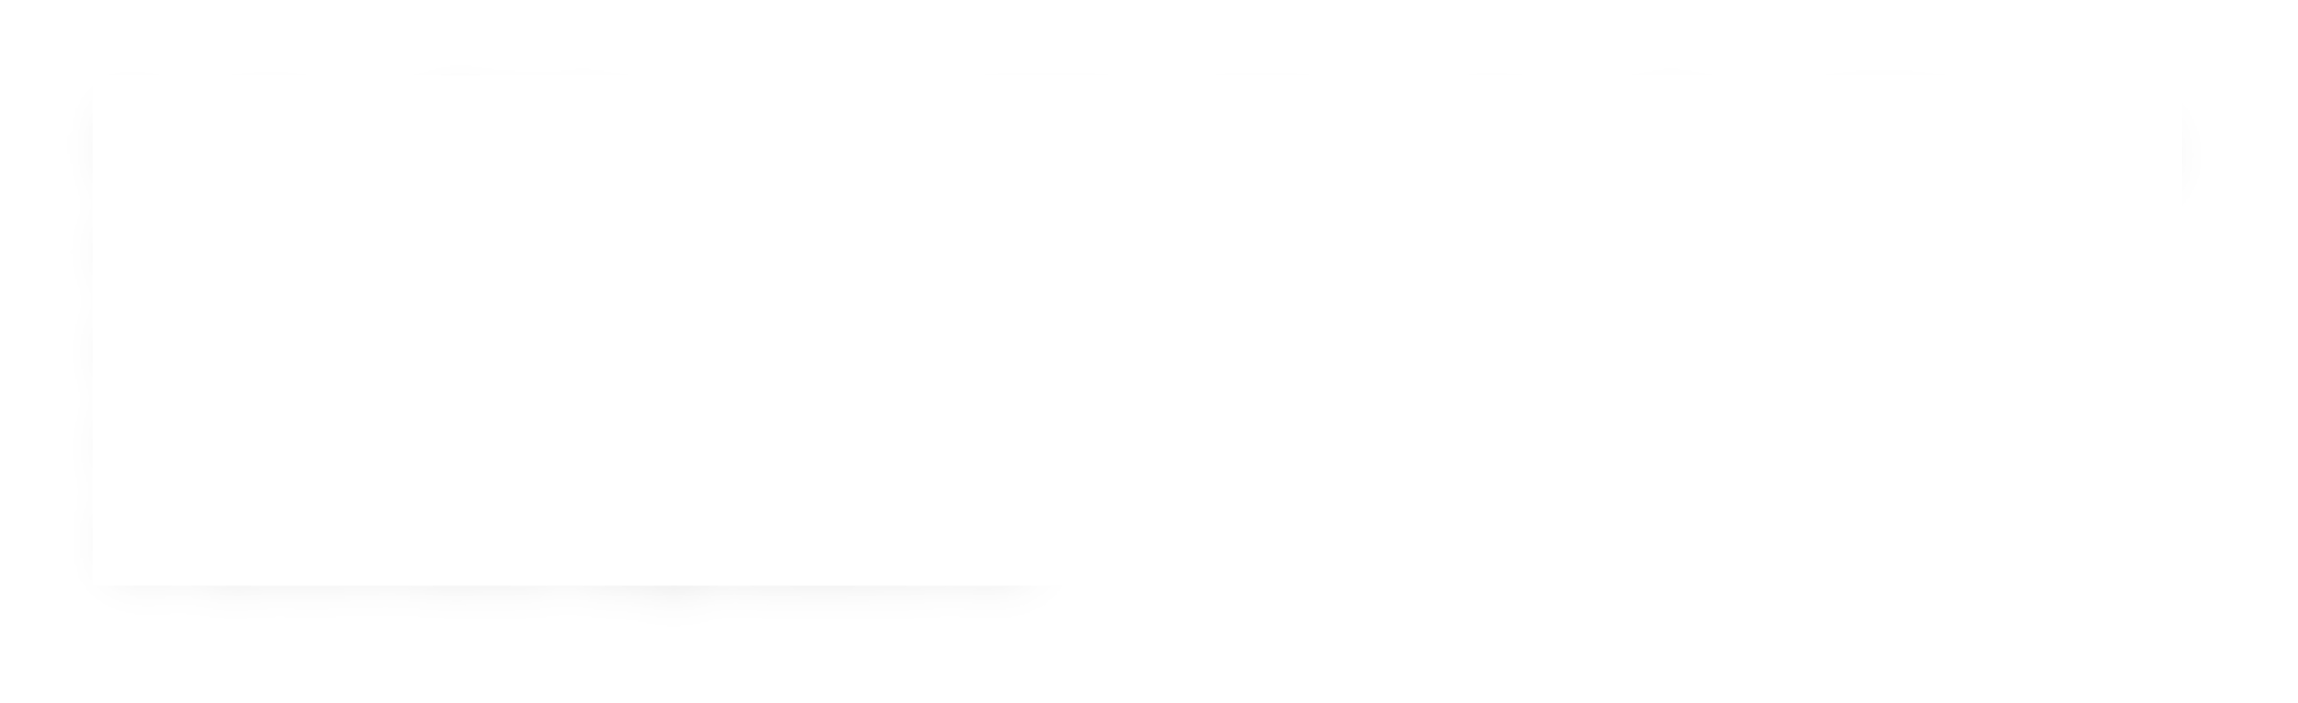
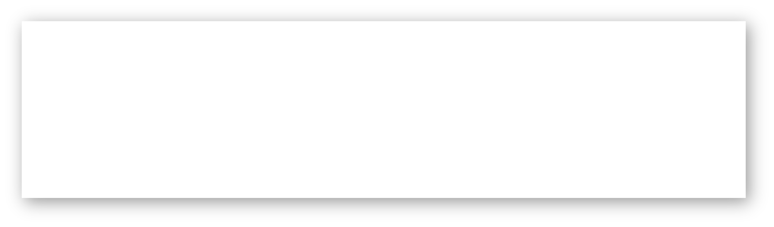
Plan For Today
10 minutes: general review
5 minutes: post questions or comments on Ed for what we should discuss
Lecture 6 takeaway: pointers let us store the addresses of data and pass them as parameters. We can perform arithmetic with pointers to change where they point to.
Arrays in C also “decay to pointers” as parameters and in arithmetic expressions.

Slide 92
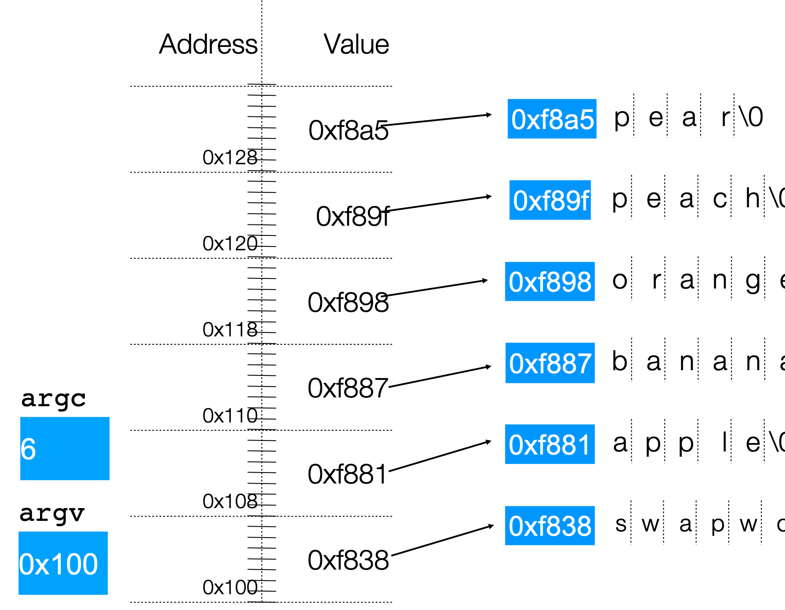
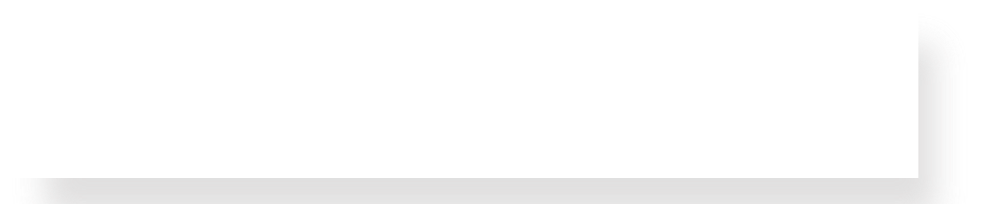
How to draw memory diagrams?
STACK
Address Value
STACK
Address Value
…
0x1f2 0x1f1 0x1f0
'\0'
0x105
0x104 'y'
0x103 'l'
0x102 'p'
0x101 'p'
0x100 'a'
'i'
'\0'
main()
str
'h'
0xff 0xfe 0xfd
...
main()
str
^{0xfc}0x1f0
…
myFunc()
0xfb 0xfa 0xf9
^{mystr} 0xf8
…
myFunc()
myStr
0xf 0x100
…
Slide 34
Choose whatever style is convenient for you, keeping in mind that (1) memory is contiguous, and (2) C types are different sizes.

Slide 93
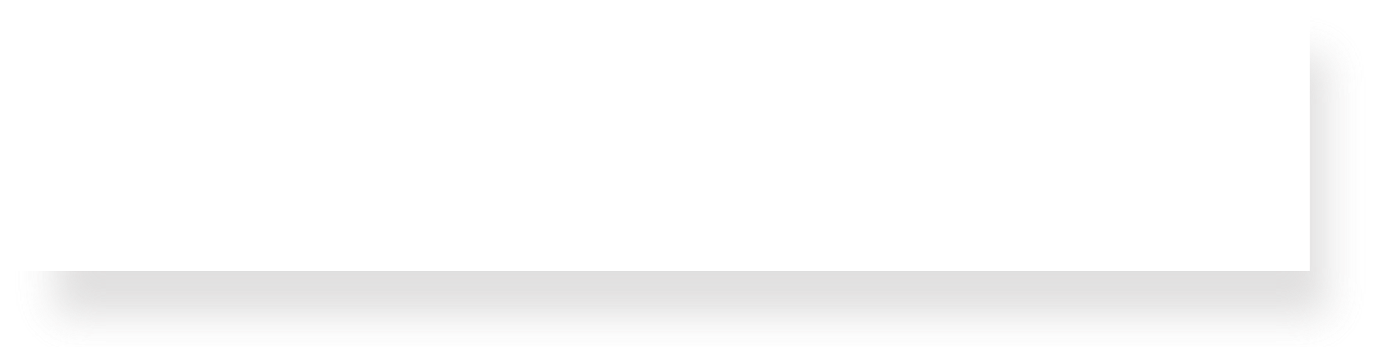
Is there a difference?
size_t get_total_strlen(char *strs[], size_t num) {
…
Intent: strs is an array of strings
}
void *skip_spaces(char **p_str) {
…
}
Intent: p_str is a pointer to a string
No difference to the compiler—it’s char**! But it clarifies the intent of a function/a parameter for the programmer.

Slide 94

Pointer arithmetic
Array indexing is “syntactic sugar” for pointer arithmetic:
ptr + i
*(ptr + i)
&ptr[i] ptr[i]
Pointer arithmeec does not work in bytes; it works on the type it points to.
On int* addresses scale by sizeof(int), on char* scale by sizeof(char) .
This means too-large/negative subscripts will compile ©
arr[99] arr[-1]
You can use either syntax on either pointer or array.

Slide 95
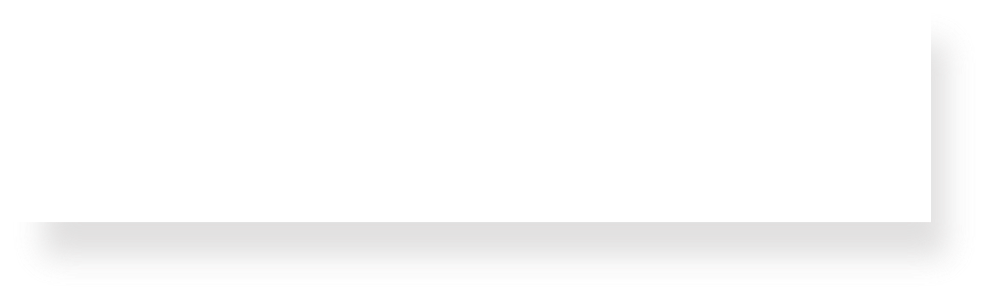





Translating C into English
If declaration: “pointer”
ex: int * is "pointer to an int”
* If operation: "dereference/the value at address”
ex: *num is "the value at address num"
&
“address of”
<ptr name>
address
<arr name>
address
(except sizeof)
int arr[] = {3, 4, -1, 2};
int *ptr0 = arr;
int *elt0 = *arr;
int elt = *(arr + 3);
int **ptr1=. &ptr;
// initializes stack array
// with 4 ints
Type check with a diagram!

Slide 96
Translating C into English
If declaration: “pointer”
ex: int * is "pointer to an int”
* If operation: "dereference/the value at address”
ex: *num is "the value at address num"
&
“address of”
<ptr name>
address
<arr name>
address
(except sizeof)
int arr[] = {3, 4, -1, 2};
int *ptr0 = arr;
int *elt0 = *arr;
int elt = *(arr + 3);
int **ptr1=. &ptr;
// initializes stack array
// with 4 ints
Address arr
Value at address arr
The value at address 3 ints after address arr
address of ptr
Type check with a diagram!

Slide 97
Plan For Today
10 minutes: general review
5 minutes: Any questions?
Lecture 6 takeaway: pointers let us store the addresses of data and pass them as parameters. We can perform arithmetic with pointers to change where they point to.
Arrays in C also “decay to pointers” as parameters and in arithmetic expressions.

Slide 98
Extra Practice

Slide 99
2. char* vs char[] exercises
// initialize as below
A str = str + 1;
B str[1] = 'u’;
C printf("%s", str)
For each of the following initializations:
Will there be a compile error/segfault?
If no errors, what is printed?
Suppose we use a
variable str
as follows:
char str[7];
strcpy(str, "Hello1");
char *str = "Hello2";
char arr[7];
strcpy(arr, "Hello3");
char *str = arr;
char *ptr = "Hello4";
char *str = ptr;
🤔
Notes:
Let’s do some exercises related to the difference between char* and char[]. Suppose we’ve instantiated char as below, which I’ll show you, and then I update its address, with str = str + 1, and I modify its contents, with str[1] = ‘u’. Then I print it out, which is a read-only operation anyway.
For each of the four following instantiations, try to figure out whether there will be a compile error, a segmentation fault, or no error. A segmentation fault, or segfault here, is when you try to modify memory in a not okay way. Okay, pause here.
So to answer these questions, let’s just run each of these to see what they do, and we’ll try to interpret why this happens.

Slide 100
2. char* vs char[] exercises
// initialize as below
A str = str + 1;
B str[1] = 'u’;
C printf("%s", str)
For each of the following initializations:
Will there be a compile error/segfault?
If no errors, what is printed?
Suppose we use a
variable str
as follows:
char str[7];
strcpy(str, "Hello1");
char *str = "Hello2";
Line A: Compile error
(cannot reassign array)
Line B: Segmentation fault
(string literal)
char arr[7];
strcpy(arr, "Hello3");
char *str = arr;
char *ptr = "Hello4";
char *str = ptr;
Line B: Segmentation fault
(string literal)
Prints eulo3
Notes:
Let’s do some exercises related to the difference between char* and char[]. Suppose we’ve instantiated char as below, which I’ll show you, and then I update its address, with str = str + 1, and I modify its contents, with str[1] = ‘u’. Then I print it out, which is a read-only operation anyway.
For each of the four following instantiations, try to figure out whether there will be a compile error, a segmentation fault, or no error. A segmentation fault, or segfault here, is when you try to modify memory in a not okay way. Okay, pause here.
So to answer these questions, let’s just run each of these to see what they do, and we’ll try to interpret why this happens.

Slide 101
3. Bonus: Tricky addresses
1
2
3
4
5
6
7
8
9
10
11
12
void tricky_addresses() {
char buf[] = "Local";
char *ptr1 = buf;
char **double_ptr = &ptr1;
printf("ptr1's value: %p\n", ptr1);
printf("ptr1’s deref : %c\n", *ptr1);
printf(" address: %p\n", &ptr1);
printf("double_ptr value: %p\n", double_ptr);
printf("buf's address: %p\n", &buf);
char *ptr2 = &buf;
printf("ptr2's value: %s\n", ptr2);
}
What is stored in each variable?
🤔

Slide 102
3. Bonus: Tricky addresses
1
2
3
4
5
6
7
8
9
10
11
12
void tricky_addresses() {
char buf[] = "Local";
char *ptr1 = buf;
char **double_ptr = &ptr1;
printf("ptr1's value: %p\n", ptr1);
printf("ptr1’s deref : %c\n", *ptr1);
printf(" address: %p\n", &ptr1);
printf("double_ptr value: %p\n", double_ptr);
printf("buf's address: %p\n", &buf);
char *ptr2 = &buf;
printf("ptr2's value: %s\n", ptr2);
}
0x28 | 0x29 | 0x2a | 0x2b | 0x2c | 0x2d
'L' | 'o' | 'c' | 'a' | 'l' | '\0'
buf
0x10
ptr1
0x18
double_ptr
0x20
While Line 10 raises a compiler warning, functionally it will still work—because pointers are addresses.
ptr2

Slide 103
Pen and paper: A * Wars Story
1
2
3
4
5
6
7
8
9
void binky() {
int a = 10;
int b = 20;
int *p = &a;
int *q = &b;
*p = *q;
p = q;
}
Lines 2-5: Draw a diagram.
Line 7: Update your diagram.
Line 8: Update your diagram.
0xffe800
10
0xffe808
0xffe800
a
p
0xffe804
20
0xffe810
0xffe804
b
q
🤔

Slide 104
Pen and paper: A * Wars Story
1
2
3
4
5
6
7
8
9
void binky() {
int a = 10;
int b = 20;
int *p = &a;
int *q = &b;
*p = *q;
p = q;
}
Lines 2-5: Draw a diagram.
Line 7: Update your diagram.
Line 8: Update your diagram.
0xffe800
10
0xffe808
0xffe800
a
20
p
0xffe804
20
0xffe810
0xffe804
b
q

Slide 105
Pen and paper: A * Wars Story
1
2
3
4
5
6
7
8
9
void binky() {
int a = 10;
int b = 20;
int *p = &a;
int *q = &b;
*p = *q;
p = q;
}
Lines 2-5: Draw a diagram.
Line 7: Update your diagram.
Line 8: Update your diagram.
0xffe800
20
0xffe808
0xffe800
a
p
0xffe804
0xffe804
20
0xffe810
0xffe804
b
q
Notes:
If you want to play around with this code in gdb, I encourage you to! It’s located in this arrptr.c.

Slide 106
* Wars: Episode I (of 2)
In variable declaration, * creates a pointer.
0xf0
'r'
char ch = 'r';
ch stores a char
ch
0xe8
0xf0
char *cptr = &ch;
cptr stores an address of a char
(points to a char)
cptr
char **strptr = &cptr;
strptr stores an address of a char *
(points to a char *)
0xe0
0xe8
strptr
Notes:
I’ve always found pointers difficult because there are really two use cases for the star operator. One of them happens when you are creating the variable, and the other one is when you actually access the variable. Let’s talk about the first one.

Slide 107
* Wars: Episode II (of 2)
In reading values from/storing values, * dereferences a pointer.
0xf0
'r'
char ch = 'r';
ch = ch + 1;
Increment value stored in ch
ch
's'
0xe8
0xf0
char *cptr = &ch;
cptr
char **strptr = &cptr;
0xe0
0xe8
strptr
Notes:
Okay, so that was variable declaration. When you first make the metaphorical box that has the metaphorical arrow pointing to a metaphorical other box.
The second case to use the star (asterisk) is when you are reading/writing values. This is called dereferencing.

Slide 108
* Wars: Episode II (of 2)
In reading values from/storing values, * dereferences a pointer.
0xf0
's'
char ch = 'r';
ch = ch + 1;
Increment value stored in ch
ch
't'
0xe8
0xf0
char *cptr = &ch;
*cptr = *cptr + 1;
Increment value stored at memory address in cptr
(increment char pointed to)
cptr
char **strptr = &cptr;
0xe0
0xe8
strptr
Notes:
First line here, declare the pointer variable. Okay. Now, the second line dereferences to read and also dereferences to write.
Read the value. From where? From the address that cptr points to. ‘s’. + 1. ‘t’.
Store the value. To where? To the address that cptr points to.

Slide 109
* Wars: Episode II (of 2)
In reading values from/storing values, * dereferences a pointer.
0xf0
't'
0xf1
?
char ch = 'r';
ch = ch + 1;
Increment value stored in ch
ch
0xe8
0xf0
0xe8
0xf1
char *cptr = &ch;
*cptr = *cptr + 1;
Increment value stored at memory address in cptr
(increment char pointed to)
cptr
char **strptr = &cptr;
*strptr = *strptr + 1;
Increment value stored at memory address in cptr
(increment address pointed to)
0xe0
0xe8
strptr
Notes:
The exact same thing happens with double pointers.

Slide 110
Skip spaces
1
2
3
4
5
6
7
8
9
10
  void skip_spaces(char **p_str) {
  int num = strspn(*p_str, " ");
  *p_str = *p_str + num;
  }
  int main(int argc, char *argv[]){
  char *str = " Hi!";
  skip_spaces(&str);
  printf("%s", str); // "Hi!"
  return 0;
  }
' ' | ' ' | 'H' | 'i' | '!' | '\0'
str
p_str
' ' | ' ' | 'H' | 'i' | '!' | '\0'
str
p_str
What diagram most accurately depicts program state at Line 4 (before skip_spaces returns to main)?
' ' | ' ' | 'H' | 'i' | '!' | '\0'
🤔
str
p_str

Slide 111
Skip spaces
1
2
3
4
5
6
7
8
9
10
  void skip_spaces(char **p_str) {
  int num = strspn(*p_str, " ");
  *p_str = *p_str + num;
  }
  int main(int argc, char *argv[]){
  char *str = " Hi!";
  skip_spaces(&str);
  printf("%s", str); // "Hi!"
  return 0;
  }
' ' | ' ' | 'H' | 'i' | '!' | '\0'
str
p_str
' ' | ' ' | 'H' | 'i' | '!' | '\0'
str
p_str
What diagram most accurately depicts program state at Line 4 (before skip_spaces returns to main)?
' ' | ' ' | 'H' | 'i' | '!' | '\0'
str
p_str

Slide 112

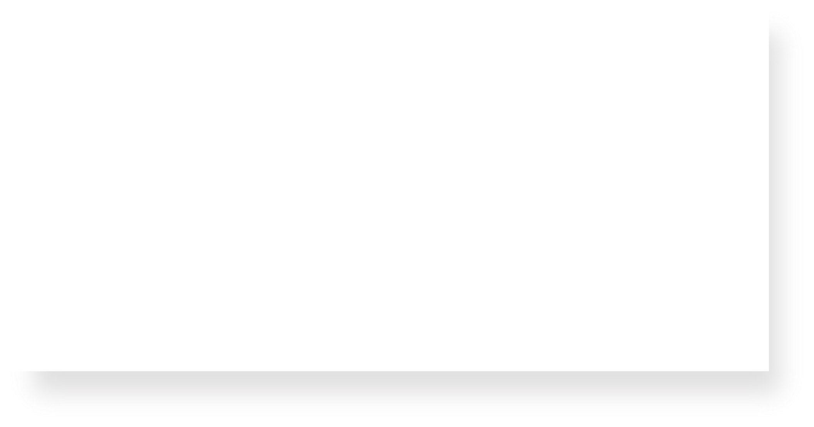
const vs #define
#define THIRD_BIT 1 << 3
#define is a hard-coded substitution that gcc will make when compiling your code.
// cannot modify this char
const char c = 'h';
Const signals that this variable (in this scope) should not be modified.
In CS107, you often won’t have to declare const variables, but you will be provided parameters or use functions that have it
Const directly modifies the adjacent keyword
// cannot modify chars pointed to by str const char *str = …
// cannot modify chars pointed to by *strPtr const char **strPtr = …
(Slide 86)
120

Slide 113
const
1
2
3
4
5
6
char buf[6]; strcpy(buf, "Hello");
const char *str = buf; str[0] = 'M';
str = "Mello"; buf[0] = 'M';
Which lines (if any) above will cause an error due to violating const? Remember that const char * means that the characters at the location it stores cannot be changed.

Slide 114


const
1
2
3
4
5
6
char buf[6]; strcpy(buf, "Hello");
const char *str = buf; str[0] = 'M';
str = "Mello"; buf[0] = 'M';
Line 1 makes a typical modifiable character array of 6 characters.
Which lines (if any) above will cause an error due to violating const? Remember that const char * means that the characters at the location it stores cannot be changed.

Slide 115

const
1
2
3
4
5
6
char buf[6]; strcpy(buf, "Hello");
const char *str = buf; str[0] = 'M';
str = "Mello"; buf[0] = 'M';
Line 2 copies characters into this modifiable character array.
Which lines (if any) above will cause an error due to violating const? Remember that const char * means that the characters at the location it stores cannot be changed.

Slide 116
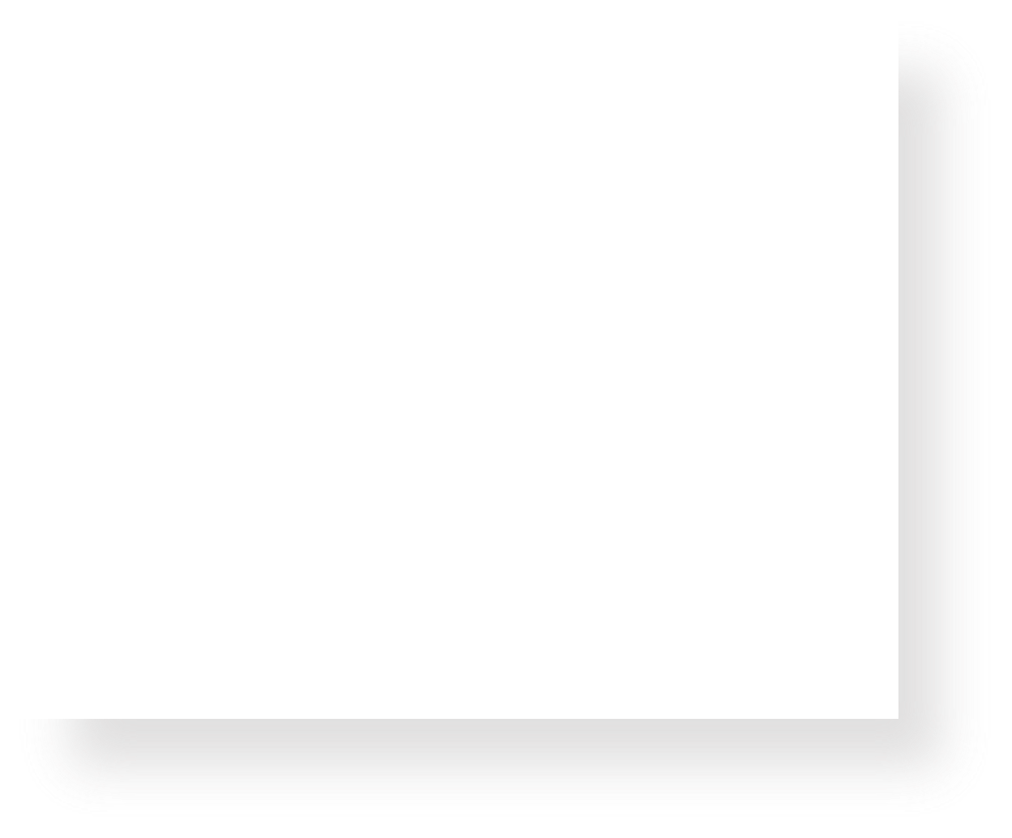
const
1
2
3
4
5
6
char buf[6]; strcpy(buf, "Hello");
const char *str = buf; str[0] = 'M';
str = "Mello"; buf[0] = 'M';
Line 3 makes a const pointer that points to the first element of buf. We cannot use str to change the characters it points to because it is const.
Which lines (if any) above will cause an error due to violating const? Remember that const char * means that the characters at the location it stores cannot be changed.

Slide 117
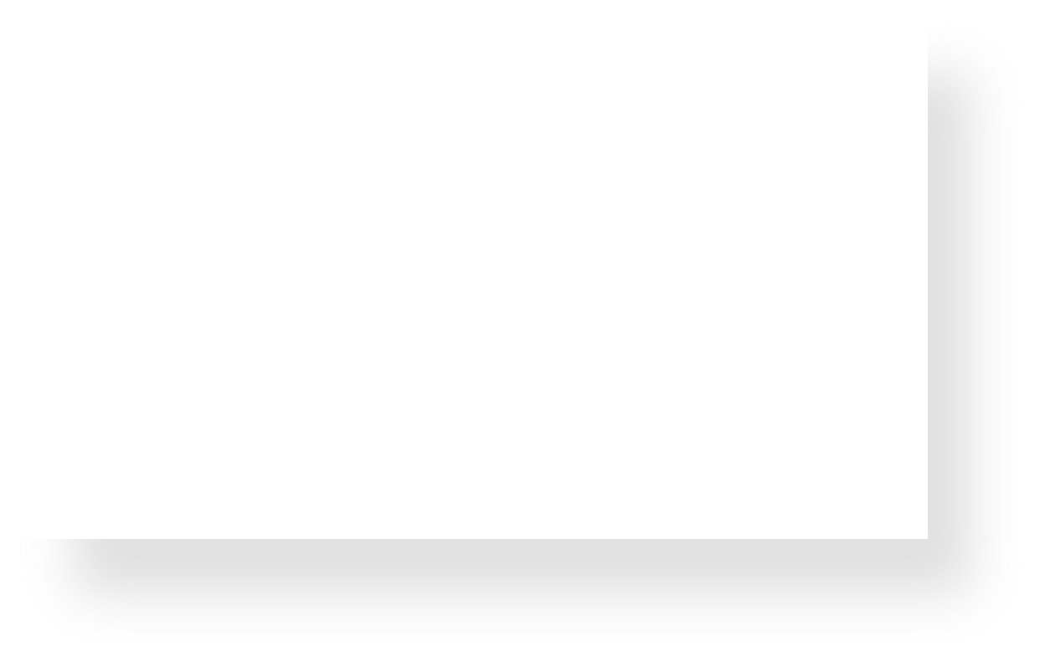

const
1
2
3
4
5
6
char buf[6]; strcpy(buf, "Hello");
const char *str = buf; str[0] = 'M';
str = "Mello"; buf[0] = 'M';
Line 4 is not allowed – it attempts to use a const pointer to characters to modify those characters.
Which lines (if any) above will cause an error due to violating const? Remember that const char * means that the characters at the location it stores cannot be changed.

Slide 118
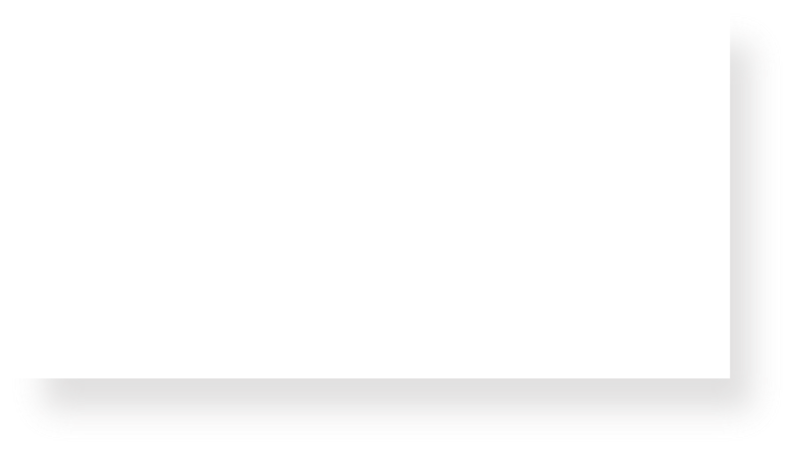
const
1
2
3
4
5
6
char buf[6]; strcpy(buf, "Hello");
const char *str = buf; str[0] = 'M';
str = "Mello"; buf[0] = 'M';
Line 5 is ok – str’s type means that while you cannot change the characters at which it points, you can change str itself to point somewhere else. str is not const – its characters are.
Which lines (if any) above will cause an error due to violating const? Remember that const char * means that the characters at the location it stores cannot be changed.

Slide 119
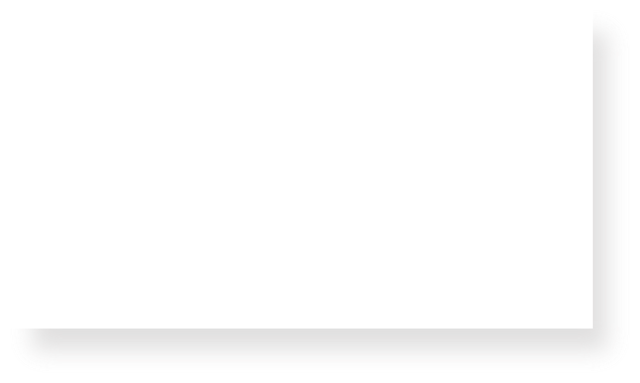
const
1
2
3
4
5
6
char buf[6]; strcpy(buf, "Hello");
const char *str = buf; str[0] = 'M';
str = "Mello"; buf[0] = 'M';
Line 6 is ok – buf is a modifiable char array, and we can use it to change its characters. Declaring str as const doesn’t mean that place in memory is not modifiable at all – it just means that you cannot modify it using str.
Which lines (if any) above will cause an error due to violating const? Remember that const char * means that the characters at the location it stores cannot be changed.

