Slide 1
CS107, Lecture 7
C Strings, Buffer Overflows and Security
Reading: K&R (1.6, 5.5, Appendix B3) or Essential C section 3
😷 masks recommended

Slide 2
CS107 Topic 2
How can a computer represent and manipulate more complex data like text?
Why is answering this question important?
Shows us how strings are represented in C and other languages (last time)
Helps us better understand buffer overflows, a common bug (this time)
Introduces us to pointers, because strings can be pointers (next time)
assign2: implement 2 functions a 1 program using those functions to find the location of different built-in commands in the filesystem. You’ll write functions to extract a list of possible locations and tokenize that list of locations.

Slide 3
Learning Goals
Understand how to use the built-in string functions for common string tasks
Learn more about the risks of buffer overflows and how to mitigate them

Slide 4
Lecture Plan
Recap: Strings so far
Searching in Strings
Practice: Password Verification
Buffer Overflows and Security
cp -r /afs/ir/class/cs107/lecture-code/lect7 .

Slide 5
Lecture Plan
Recap: Strings so far
Searching in Strings
Practice: Password Verification
Buffer Overflows and Security
cp -r /afs/ir/class/cs107/lecture-code/lect7 .

Slide 6
C Strings
C strings are arrays of characters ending with a null-terminating character '\0'.
String operations such as strlen use the null-terminating character to find the end of the string.
Side note: use strlen to get the length of a string. Don’t use sizeof!
index | 0 | 1 | 2 | 3 | 4 | 5 | 6 | 7 | 8 | 9 | 10 | 11 | 12 | 13
value | 'H' | 'e' | 'l' | 'l' | 'o' | ',' | ' ' | 'w' | 'o' | 'r' | 'l' | 'd' | '!' | '\0'

Slide 7
Common string.h Functions
Function | Description
strlen(str) | returns the # of chars in a C string (before null-terminating character).
strcmp(str1, str2), strncmp(str1, str2, n) | compares two strings; returns 0 if identical, <0 if str1 comes before str2 in alphabet, >0 if str1 comes after str2 in alphabet. strncmp stops comparing after at most n characters.
strchr(str, ch) strrchr(str, ch) | character search: returns a pointer to the first occurrence of ch in str, or NULL if ch was not found in str. strrchr find the last occurrence.
strstr(haystack, needle) | string search: returns a pointer to the start of the first occurrence of needle in haystack, or NULL if needle was not found in haystack.
strcpy(dst, src), strncpy(dst, src, n) | copies characters in src to dst, including null-terminating character. Assumes enough space in dst. Strings must not overlap. strncpy stops after at most n chars, and does not add null-terminating char.
strcat(dst, src), strncat(dst, src, n) | concatenate src onto the end of dst. strncat stops concatenating after at most n characters. Always adds a null-terminating character.
strspn(str, accept), strcspn(str, reject) | strspn returns the length of the initial part of str which contains only characters in accept. strcspn returns the length of the initial part of str which does not contain any characters in reject.

Slide 8
Substrings
We can combine pointer arithmetic and copying to make any substrings we’d like.
// Want just "ace"
char str1[8];
strcpy(str1, "racecar");
char str2[4];
strncpy(str2, str1 + 1, 3);
str2[3] = '\0';
printf("%s\n", str1); // racecar
printf("%s\n", str2); // ace

Slide 9
char * vs. char[]
char * is an 8-byte pointer – it stores an address of a character
char[] is an array of characters – it stores the actual characters in a string
When you pass a char[] as a parameter, it is automatically passed as a char * (pointer to its first character)

Slide 10
char * vs. char[]
char myString[]
vs
char *myString
You can create char * pointers to point to any character in an existing string and reassign them since they are just pointer variables. You cannot reassign an array.
char myString[6];
strcpy(myString, "Hello");
myString = "Another string"; // not allowed!
---
char *myOtherString = myString;
myOtherString = somethingElse; // ok

Slide 11
Lecture Plan
Recap: Strings so far
Searching in Strings
Practice: Password Verification
Buffer Overflows and Security
cp -r /afs/ir/class/cs107/lecture-code/lect7 .

Slide 12
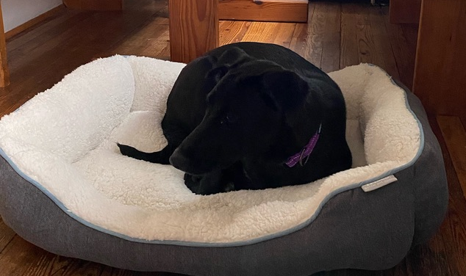
Searching For Letters
strchr returns a pointer to the first occurrence of a character in a string, or NULL if the character is not in the string.
char bailey[7];
strcpy(bailey, "Bailey");
char *letterI = strchr(bailey, 'i');
printf("%s\n", bailey); // Bailey
printf("%s\n", letterI); // iley
If there are multiple occurrences of the letter, strchr returns a pointer to the first one. Use strrchr to obtain a pointer to the last occurrence.

Slide 13
Searching For Strings
strstr returns a pointer to the first occurrence of the second string in the first, or NULL if it cannot be found.
char bailey[11];
strcpy(bailey, "Bailey Dog");
char *substr = strstr(bailey, "Dog");
printf("%s\n", bailey); // Bailey Dog
printf("%s\n", substr); // Dog
If there are multiple occurrences of the string, strstr returns a pointer to the first one.

Slide 14
String Spans
strspn returns the length of the initial part of the first string which contains only characters in the second string.
char bailey[10];
strcpy(bailey, "Bailey Dog");
int spanLength = strspn(bailey, "aBeoi"); // 3
“How many places can we go in the first string before I encounter a character not in the second string?”

Slide 15
String Spans
strcspn (c = “complement”) returns the length of the initial part of the first string which contains only characters not in the second string.
char bailey[10];
strcpy(bailey, "Bailey Dog");
int spanLength = strcspn(bailey, "driso"); // 2
“How many places can we go in the first string before I encounter a character in the second string?”

Slide 16
C Strings As Parameters
When we pass a string as a parameter, it is passed as a char *. We can still operate on the string the same way as with a char[]. (We’ll see why today!).
int doSomething(char *str) {
char secondChar = str[1];
...
}
// can also write this, but it is really a pointer
int doSomething(char str[]) { ...

Slide 17
Arrays of Strings
We can make an array of strings to group multiple strings together:
char *stringArray[5]; // space to store 5 char *s
We can also use the following shorthand to initialize a string array:
char *stringArray[] = {
"Hello",
"Hi",
"Hey there"
};

Slide 18
Arrays of Strings
We can access each string using bracket syntax:
printf("%s\n", stringArray[0]); // print out first string
When an array is passed as a parameter in C, C passes a pointer to the first element of the array. This is what argv is in main! This means we write the parameter type as:
void myFunction(char **stringArray) {
// equivalent to this, but it is really a double pointer
void myFunction(char *stringArray[]) {

Slide 19
Practice: Password Verification
Write a function verifyPassword that accepts a candidate password and certain password criteria and returns whether the password is valid.
bool verifyPassword(char *password, char *validChars, char *badSubstrings[], int numBadSubstrings);
password is valid if it contains only letters in validChars, and does not contain any substrings in badSubstrings.

Slide 20
Practice: Password Verification
bool verifyPassword(char *password, char *validChars, char *badSubstrings[], int numBadSubstrings);
Example:
char *invalidSubstrings[] = { "1234" };
bool valid1 = verifyPassword("1572", "0123456789",
invalidSubstrings, 1); // true
bool valid2 = verifyPassword("141234", "0123456789",
invalidSubstrings, 1); // false

Slide 21
Practice: Password Verification
verify_password.c
Notes:
stdbool

Slide 22
Lecture Plan
Recap: Strings so far
Searching in Strings
Practice: Password Verification
Buffer Overflows and Security
cp -r /afs/ir/class/cs107/lecture-code/lect7 .

Slide 23
Recall: Buffer Overflows
We must make sure there is enough space in the destination to hold the entire copy, including the null-terminating character. Writing past memory bounds is called a “buffer overflow”. It can allow for security vulnerabilities!
char str1[14];
strcpy(str1, "hello, world!");
char str2[6];
strcpy(str2, str1); // not enough space - overwrites other memory!
0 | 1 | 2 | 3 | 4 | 5 | 6 | 7 | 8 | 9 | 10 | 11 | 12 | 13
'h' | 'e' | 'l' | 'l' | 'o' | ',' | ' ' | 'w' | 'o' | 'r' | 'l' | 'd' | '!' | '\0'
str1
0 | 1 | 2 | 3 | 4 | 5
'h' | 'e' | 'l' | 'l' | 'o' | ','
' ' | 'w' | 'o' | 'r' | 'l' | 'd' | '!' | '\0'
str2
- other program memory -

Slide 24
Buffer Overflow Impacts
Buffer overflows are not merely functionality bugs; they can cause a range of unintended behavior:
Let the user access memory they shouldn’t be able to access
Let the user modify memory they shouldn’t be able to access
  Change a value that is used later in the program
  User changes the program to execute their own custom instructions instead
  And more…
It’s our job as programmers to find and fix buffer overflows and other bugs not just for the functional correctness of our programs, but to protect people who use and interact with our code.
Notes:
e.g. input password to expose correct password or gain unauthorized access
e.g. overwrite number of attempts to give more attempts

Slide 25
Buffer Overflow Example: ./buf
int main(int argc, char *argv[]) {
char secret[4] = "123";
// assume secret comes right after name in memory
// (this is not always true)
char name[4];
strcpy(name, argv[1]);
if (!strcmp(secret, argv[2])) {
printf("You're in!\n");
}
return 0;
}
Which of these arguments would cause the program to print “You’re in!”?
./buf abcdefgh efgh
./buf abcd abcd
./buf a a
./buf abcdefgh abcd
Respond with your thoughts on PollEv: pollev.com/cs107 or text CS107 to 22333 once to join.
🤔

Slide 26
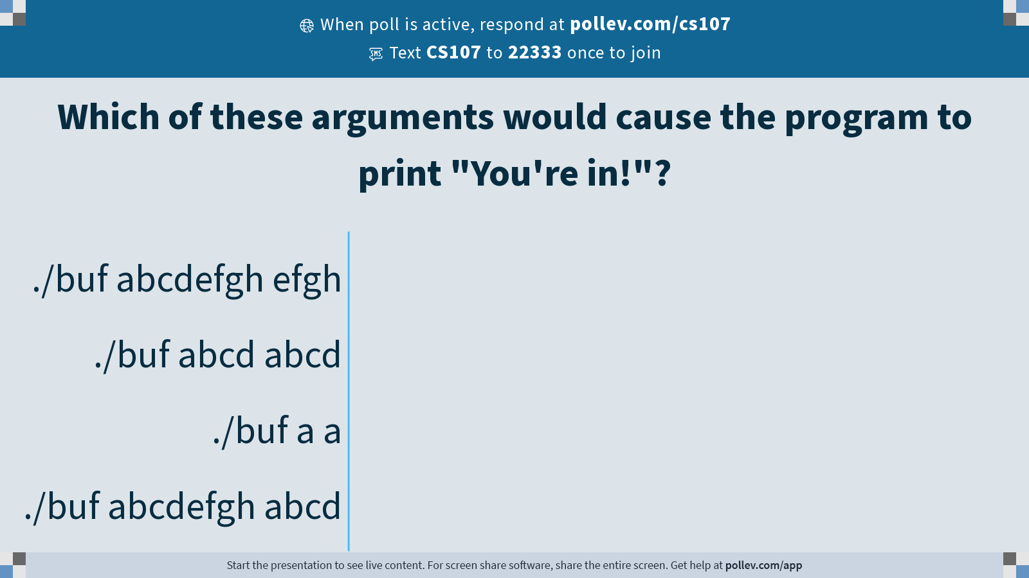
Notes:
Do not modify the notes in this section to avoid tampering with the Poll Everywhere activity.
More info at polleverywhere.com/support
Which of these arguments would cause the program to print "You're in!"?
https://www.polleverywhere.com/multiple_choice_polls/dM8bPnz52HXxyXvlYRYHX?state=opened&flow=Default&onscreen=persist

Slide 27
Recap
Recap: Strings so far
Searching in Strings
Practice: Password Verification
Buffer Overflows and Security
Lecture 7 takeaway: C strings are pointers and arrays. C strings are error-prone, and issues like buffer overflows can arise! Valgrind is a tool that can help detect memory errors.
cp -r /afs/ir/class/cs107/lecture-code/lect7 .

Slide 28
Extra Practice

Slide 29
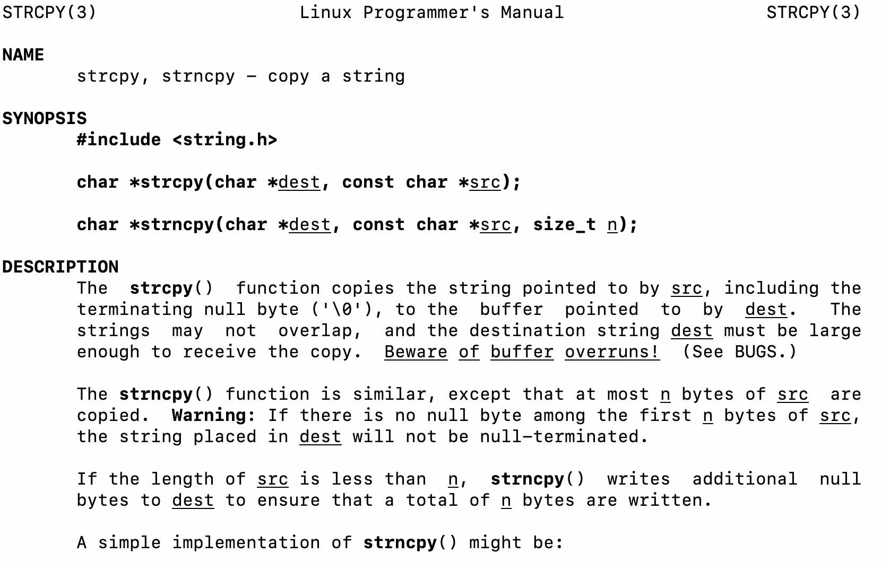
2. Code study: strncpy
0x60 | 0x61 | 0x62 | 0x63 | 0x64 | 0x65 | 0x66
'M' | 'o' | 'n' | 'd' | 'a' | 'y' | '\0'
buf
0x58 | 0x59 | 0x5a | 0x5b
'F' | 'r' | 'i' | '\0'
str
1
2
3
4
5
6
7
8
char *strncpy(char *dest, const char *src, size_t n) {
size_t i;
for (i = 0; i < n && src[i] != '\0'; i++)
dest[i] = src[i];
for ( ; i < n; i++)
dest[i] = '\0';
return dest;
}
🤔
What happens if we call strncpy(buf, str, 5);?

Slide 30
2. Code study: strncpy
0x60 | 0x61 | 0x62 | 0x63 | 0x64 | 0x65 | 0x66
'M' | 'o' | 'n' | 'd' | 'a' | 'y' | '\0'
buf
0x58 | 0x59 | 0x5a | 0x5b
'F' | 'r' | 'i' | '\0'
str
1
2
3
4
5
6
7
8
char *strncpy(char *dest, const char *src, size_t n) {
size_t i;
for (i = 0; i < n && src[i] != '\0'; i++)
dest[i] = src[i];
for ( ; i < n; i++)
dest[i] = '\0';
return dest;
}
dest
src
n
5
i
What happens if we call strncpy(buf, str, 5);?

