Slide 1
CS107, Lecture 8
C Strings, Valgrind and Pointers
Reading: K&R (5.2-5.5) or Essential C section 6
😷 masks recommended

Slide 2
CS107 Topic 2
How can a computer represent and manipulate more complex data like text?
Why is answering this question important?
Shows us how strings are represented in C and other languages (previously)
Helps us better understand buffer overflows, a common bug (previously)
Introduces us to pointers, because strings can be pointers (this time)
assign2: implement 2 functions a 1 program using those functions to find the location of different built-in commands in the filesystem. You’ll write functions to extract a list of possible locations and tokenize that list of locations.

Slide 3
Learning Goals
Learn more about the risks of buffer overflows and how to mitigate them
Understand how strings are represented as pointers and how that helps us better understand their behavior
Learn about pointers and how they help us access data without making copies
Become familiar with using memory diagrams to understand code behavior

Slide 4
Lecture Plan
Buffer Overflows, Security and Valgrind
Review: Pointers
Strings and Pointers
cp -r /afs/ir/class/cs107/lecture-code/lect8 .

Slide 5
Lecture Plan
Buffer Overflows, Security and Valgrind
Review: Pointers
Strings and Pointers
cp -r /afs/ir/class/cs107/lecture-code/lect8 .

Slide 6
Buffer Overflow Impacts
Buffer overflows are not merely functionality bugs; they can cause a range of unintended behavior:
Let the user access memory they shouldn’t be able to access
Let the user modify memory they shouldn’t be able to access
  Change a value that is used later in the program
  User changes the program to execute their own custom instructions instead
  And more…
It’s our job as programmers to find and fix buffer overflows and other bugs not just for the functional correctness of our programs, but to protect people who use and interact with our code.
Notes:
e.g. input password to expose correct password or gain unauthorized access
e.g. overwrite number of attempts to give more attempts

Slide 7
Buffer Overflow Example: ./buf
int main(int argc, char *argv[]) {
char secret[4] = "123";
// assume secret comes right after name in memory
// (this is not always true)
char name[4];
strcpy(name, argv[1]);
if (!strcmp(secret, argv[2])) {
printf("You're in!\n");
}
return 0;
}
Which of these arguments would cause the program to print “You’re in!”?
./buf abcdefg efg
./buf abcd abcd
./buf a a
./buf abcdefgh abcd
name |  |  |  | secret
'a' | 'b' | 'c' | 'd' | 'e' | 'f' | 'g' | '\0'

Slide 8
Buffer Overflow Impacts
AOL instant messenger buffer overflow: allowed remote attackers to execute code: https://www.cvedetails.com/cve/CVE-2002-0362/
Morris Worm: first internet worm to gain widespread attention; exploited buffer overflow in Unix command called ”finger”: https://www.zdnet.com/article/the-morris-worm-internet-malware-turns-25/

Slide 9
How can we fix buffer overflows?
There’s no single solution to fix all buffer overflows; instead, it’s a combination of techniques to avoid them as much as possible:
Constant vigilance while programming (checking arrays and where they are modified)
Carefully reading documentation
Thorough testing to uncover issues before release
Thorough documentation to document assumptions in your code
(Where possible) use of tools that reduce the possibility for buffer overflows

Slide 10
How can we fix buffer overflows?
There’s no single solution to fix all buffer overflows; instead, it’s a combination of techniques to avoid them as much as possible:
Constant vigilance while programming (checking arrays and where they are modified)
Carefully reading documentation
Thorough testing to uncover issues before release
Thorough documentation to document assumptions in your code
(Where possible) use of tools that reduce the possibility for buffer overflows

Slide 11
How can we fix buffer overflows?
  MAN page for gets():
  “Never use gets(). Because it is impossible to tell without knowing the data in advance how many characters gets() will read, and because gets() will continue to store characters past the end of the buffer, it is extremely dangerous to use. It has been used to break computer security. Use fgets() instead.”

Slide 12
How can we fix buffer overflows?
There’s no single solution to fix all buffer overflows; instead, it’s a combination of techniques to avoid them as much as possible:
Constant vigilance while programming (checking arrays and where they are modified)
Carefully reading documentation
Thorough testing to uncover issues before release
Thorough documentation to document assumptions in your code
(Where possible) use of tools that reduce the possibility for buffer overflows

Slide 13
How Can We Fix Overflows?
Valgrind: Your Greatest Ally
Write your own tests
Consider writing tests before writing the main program
✨ cs107.stanford.edu/testing.html ✨
Notes:
Want to find bugs in testing, not production

Slide 14
How can we fix buffer overflows?
There’s no single solution to fix all buffer overflows; instead, it’s a combination of techniques to avoid them as much as possible:
Constant vigilance while programming (checking arrays and where they are modified)
Carefully reading documentation
Thorough testing to uncover issues before release
Thorough documentation to document assumptions in your code
(Where possible) use of tools that reduce the possibility for buffer overflows

Slide 15
How Can We Fix Overflows?
Documentation & MAN Pages (Written by Others)
  “The strcpy() function copies the string pointed to by src, including the terminating null byte (‘\0’), to the buffer pointed to by dest. The strings may not overlap, and the destination string dest must be large enough to receive the copy. Beware of buffer overruns! (See BUGS.) …
  BUGS
  If the destination string of a strcpy() is not large enough, then anything might happen. Overflowing fixed-length string buffers is a favorite cracker technique for taking complete control of the machine. Any time a program reads or copies data into a buffer, the program first needs to check that there’s enough space. This may be unnecessary if you can show that overflow is impossible, but be careful: programs can get changed over time, in ways that may make the impossible possible.”

Slide 16
How can we fix buffer overflows?
There’s no single solution to fix all buffer overflows; instead, it’s a combination of techniques to avoid them as much as possible:
Constant vigilance while programming (checking arrays and where they are modified)
Carefully reading documentation
Thorough testing to uncover issues before release
Thorough documentation to document assumptions in your code
(Where possible) use of tools that reduce the possibility for buffer overflows

Slide 17
Memory Safe Systems Programming
Idea 5: Choose your Tools & Languages Carefully
Existing code bases or requirements for a project may dictate what tools you use. Knowing C is crucial – it is and will remain widely used.
When you you are choosing tools for systems programming, consider languages that can help guard against programmer error.
Rust (Mozilla)
Go (Google)
Project Verona (Microsoft)

Slide 18
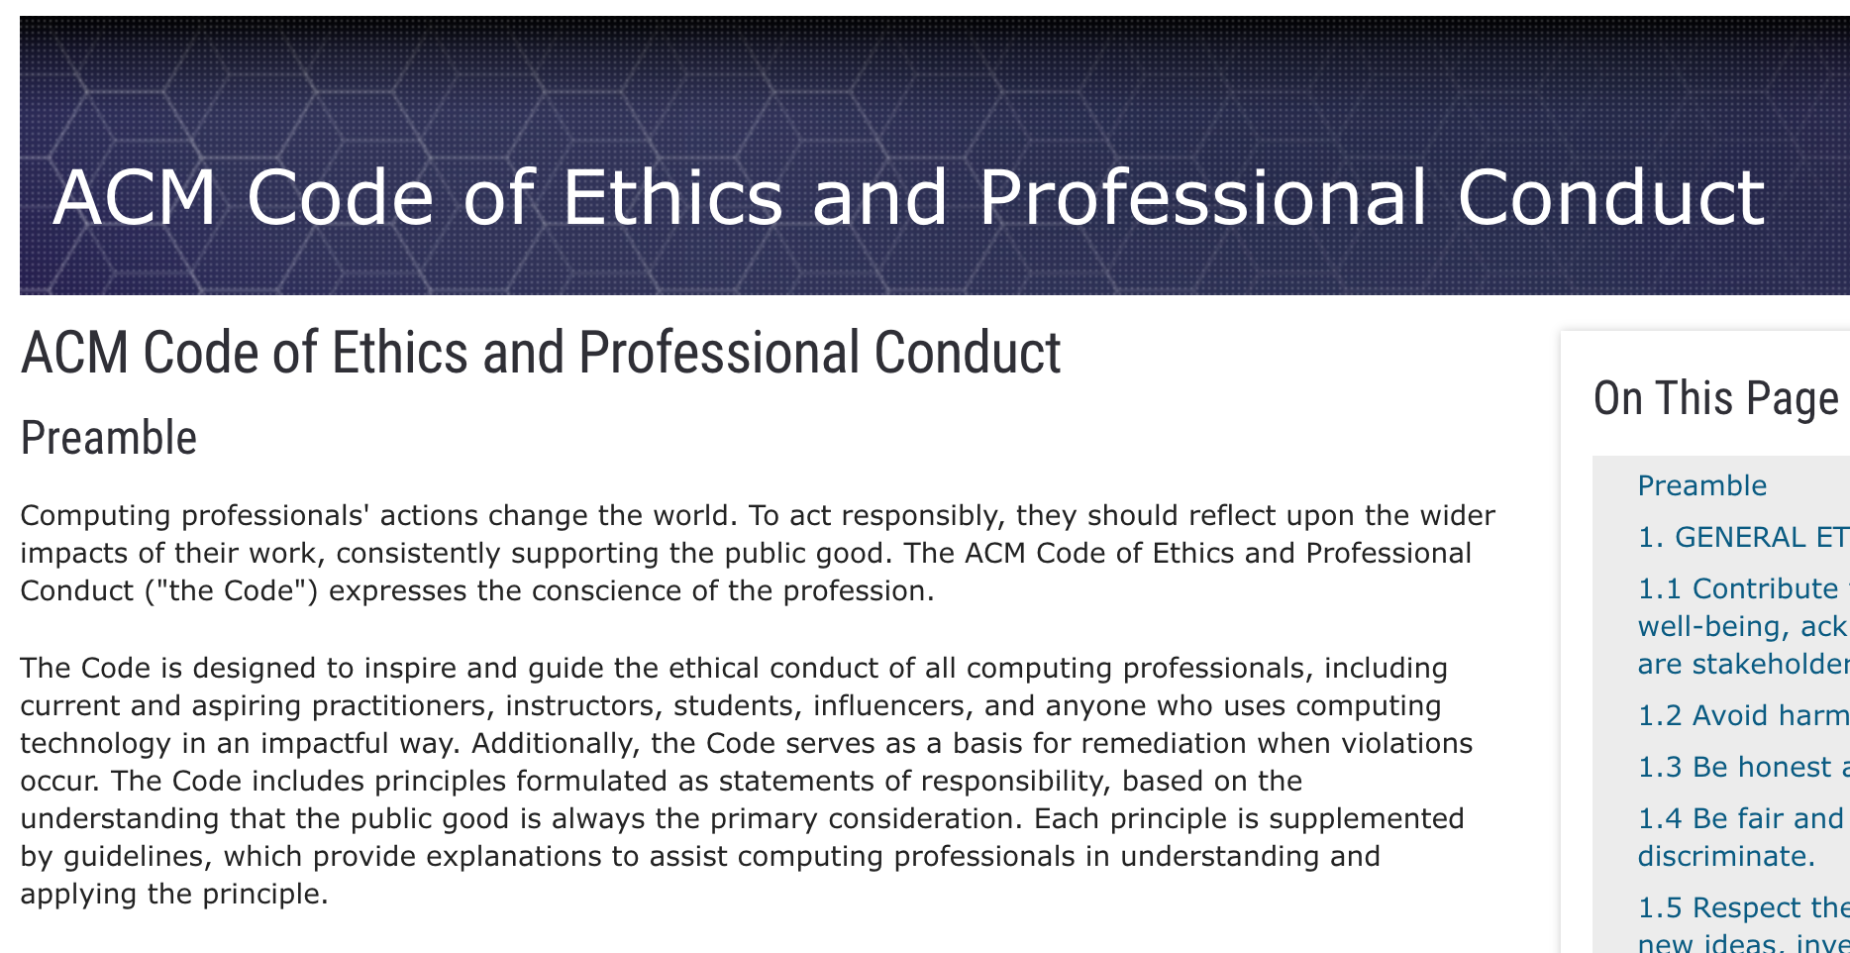
Association for Computing Machinery (ACM) Code of Ethics
https://www.acm.org/code-of-ethics
Notes:
responsibility in bigger context
Thinking about larger consequences that may put users at risk
Understand implications and risks of software we write

Slide 19
ACM Code of Ethics on Security
2.9 Design and implement systems that are robustly and usably secure.
Breaches of computer security cause harm. Robust security should be a primary consideration when designing and implementing systems. Computing professionals should perform due diligence to ensure the system functions as intended, and take appropriate action to secure resources against accidental and intentional misuse, modification, and denial of service. As threats can arise and change after a system is deployed, computing professionals should integrate mitigation techniques and policies, such as monitoring, patching, and vulnerability reporting. Computing professionals should also take steps to ensure parties affected by data breaches are notified in a timely and clear manner, providing appropriate guidance and remediation.
To ensure the system achieves its intended purpose, security features should be designed to be as intuitive and easy to use as possible. Computing professionals should discourage security precautions that are too confusing, are situationally inappropriate, or otherwise inhibit legitimate use.
In cases where misuse or harm are predictable or unavoidable, the best option may be to not implement the system.
https://www.acm.org/code-of-ethics
Notes:
Risks are real, appear in rea—world software

Slide 20
Buffer Overflows
We must always ensure that memory operations we perform don’t improperly read or write memory.
  E.g. don’t copy a string into a space that is too small!
  E.g. don’t ask for the string length of an uninitialized string!
The Valgrind tool may be able to help track down memory-related issues.
  See cs107.stanford.edu/resources/valgrind
  We’ll talk about Valgrind more when we talk about dynamically-allocated memory.
  Valgrind can detect some, but not all, stack-memory-related issues

Slide 21
Demo: Memory Errors
memory_errors.c
Notes:
Error 1 (overwrites, then longer one crashes)
Error 2 (sometimes right, sometimes not)
Adding both 1 and 2 may change behavior of error 2!
Valgrind catches error 2, but not error 1

Slide 22
Lecture Plan
Buffer Overflows, Security and Valgrind
Review: Pointers
Strings and Pointers
cp -r /afs/ir/class/cs107/lecture-code/lect8 .

Slide 23
Strings and Pointers
C strings can be represented as char[] or char *.
When we create char[], we are creating space for characters
When we create char *, we are creating space for an address of character(s)
Strings are implicitly converted to char * when passed as parameters
  E.g. all string functions take char * parameters, but accept char[]
A char * is technically a pointer to a single character. But we commonly use char * as string by having the character it points to be followed by more characters and ultimately a null terminator. But a char * could also just point to a single character (not a string).

Slide 24
Pointers and Memory
A pointer is a variable that stores a memory address.
Memory is a big array of bytes, and each byte has a unique numeric index that is commonly written in hexadecimal. A pointer stores one of these “indexes”.
Because there is no pass-by-reference in C like in C++, pointers let us pass around the address of one instance of memory, instead of making many copies.
Pointers are also essential for allocating memory on the heap, and to refer to memory generically, both of which we will cover later.
Address | Value
 | …
0x105 | '\0'
0x104 | 'e'
0x103 | 'l'
0x102 | 'p'
0x101 | 'p'
0x100 | 'a'
 | …

Slide 25
Pass By Value
When you pass a value as a parameter, C passes a copy of that value.
void myFunc(int val) {
val = 3;
}
int main(int argc, char *argv[]) {
int x = 2;
myFunc(x);
printf("%d", x); // 2!
...
}
STACK
Address | Value
 | …
0x1f0 | 2
 | …
x
main()

Slide 26
Pass By Value
When you pass a value as a parameter, C passes a copy of that value.
void myFunc(int val) {
val = 3;
}
int main(int argc, char *argv[]) {
int x = 2;
myFunc(x);
printf("%d", x); // 2!
...
}
STACK
Address | Value
 | …
0x1f0 | 2
 | …
x
main()

Slide 27
Pass By Value
When you pass a value as a parameter, C passes a copy of that value.
void myFunc(int val) {
val = 3;
}
int main(int argc, char *argv[]) {
int x = 2;
myFunc(x);
printf("%d", x); // 2!
...
}
STACK
Address | Value
 | …
0x1f0 | 2
 | …
0x10 | 2
 | …
x
main()
myFunc()
val

Slide 28
Pass By Value
When you pass a value as a parameter, C passes a copy of that value.
void myFunc(int val) {
val = 3;
}
int main(int argc, char *argv[]) {
int x = 2;
myFunc(x);
printf("%d", x); // 2!
...
}
STACK
Address | Value
 | …
0x1f0 | 2
 | …
0x10 | 2
 | …
x
main()
myFunc()
val

Slide 29
Pass By Value
When you pass a value as a parameter, C passes a copy of that value.
void myFunc(int val) {
val = 3;
}
int main(int argc, char *argv[]) {
int x = 2;
myFunc(x);
printf("%d", x); // 2!
...
}
STACK
Address | Value
 | …
0x1f0 | 2
 | …
0x10 | 3
 | …
x
main()
myFunc()
val

Slide 30
Pass By Value
When you pass a value as a parameter, C passes a copy of that value.
void myFunc(int val) {
val = 3;
}
int main(int argc, char *argv[]) {
int x = 2;
myFunc(x);
printf("%d", x); // 2!
...
}
STACK
Address | Value
 | …
0x1f0 | 2
 | …
x
main()

Slide 31
Pointers
Pointers allow us to pass around the location of data so that the original data can be modified in other functions.
Example: I want to write a function myFunc that can change the value of an existing integer to be 3.
int main(int argc, char *argv[]) {
int x = 2;
myFunc(???);
printf("%d", x); // want to print 3
...
}

Slide 32
Pointers
int x = 2;
// Make a pointer that stores the address of x.
// (& means "address of")
int *xPtr = &x;
// Dereference the pointer to go to that address.
// (* means "dereference")
printf("%d", *xPtr); // prints 2
If declaration: “pointer”
ex: int * is "pointer to an int”
If operation: "dereference/the value at address”
ex: *num is "the value at address num"
*

Slide 33
Pointers
A pointer lets us pass where a particular instance of data is, so it can be modified.
void myFunc(int *intPtr) {
*intPtr = 3;
}
int main(int argc, char *argv[]) {
int x = 2;
myFunc(&x);
printf("%d", x); // 3!
...
}
STACK
Address | Value
 | …
0x1f0 | 2
 | …
x
main()

Slide 34
Pointers
A pointer lets us pass where a particular instance of data is, so it can be modified.
void myFunc(int *intPtr) {
*intPtr = 3;
}
int main(int argc, char *argv[]) {
int x = 2;
myFunc(&x);
printf("%d", x); // 3!
...
}
STACK
Address | Value
 | …
0x1f0 | 2
 | …
x
main()

Slide 35
Pointers
A pointer lets us pass where a particular instance of data is, so it can be modified.
void myFunc(int *intPtr) {
*intPtr = 3;
}
int main(int argc, char *argv[]) {
int x = 2;
myFunc(&x);
printf("%d", x); // 3!
...
}
STACK
Address | Value
 | …
0x1f0 | 2
 | …
0x10 | 0x1f0
 | …
x
main()
myFunc()
intPtr

Slide 36
Pointers
A pointer lets us pass where a particular instance of data is, so it can be modified.
void myFunc(int *intPtr) {
*intPtr = 3;
}
int main(int argc, char *argv[]) {
int x = 2;
myFunc(&x);
printf("%d", x); // 3!
...
}
STACK
Address | Value
 | …
0x1f0 | 2
 | …
0x10 | 0x1f0
 | …
x
main()
myFunc()
intPtr

Slide 37
Pointers
A pointer lets us pass where a particular instance of data is, so it can be modified.
void myFunc(int *intPtr) {
*intPtr = 3;
}
int main(int argc, char *argv[]) {
int x = 2;
myFunc(&x);
printf("%d", x); // 3!
...
}
STACK
Address | Value
 | …
0x1f0 | 3
 | …
0x10 | 0x1f0
 | …
x
main()
myFunc()
intPtr

Slide 38
Pointers
A pointer lets us pass where a particular instance of data is, so it can be modified.
void myFunc(int *intPtr) {
*intPtr = 3;
}
int main(int argc, char *argv[]) {
int x = 2;
myFunc(&x);
printf("%d", x); // 3!
...
}
STACK
Address | Value
 | …
0x1f0 | 3
 | …
x
main()

Slide 39
C Parameters
If you are performing an operation with some input and do not care about any changes to the input, pass the data type itself.
If you are modifying a specific instance of some value, pass the location of what you would like to modify and dereference that location to access what’s there.
Do I care about modifying this instance of my data? If so, I need to pass where that instance lives, as a parameter, so it can be modified.

Slide 40
Pointers Practice
void makeUpper(char *ptr) {
__1__ = toupper(__2__);
}
int main(int argc, char *argv[]) {
char ch = 'h';
// want to modify ch to be capital
makeUpper(__3__);
printf("%c\n", ch); // should print 'H'
return 0;
}
What should go in each of the blanks so that this code correctly modifies ch to be capitalized?
Respond with your thoughts on PollEv: pollev.com/cs107 or text CS107 to 22333 once to join.
🤔

Slide 41
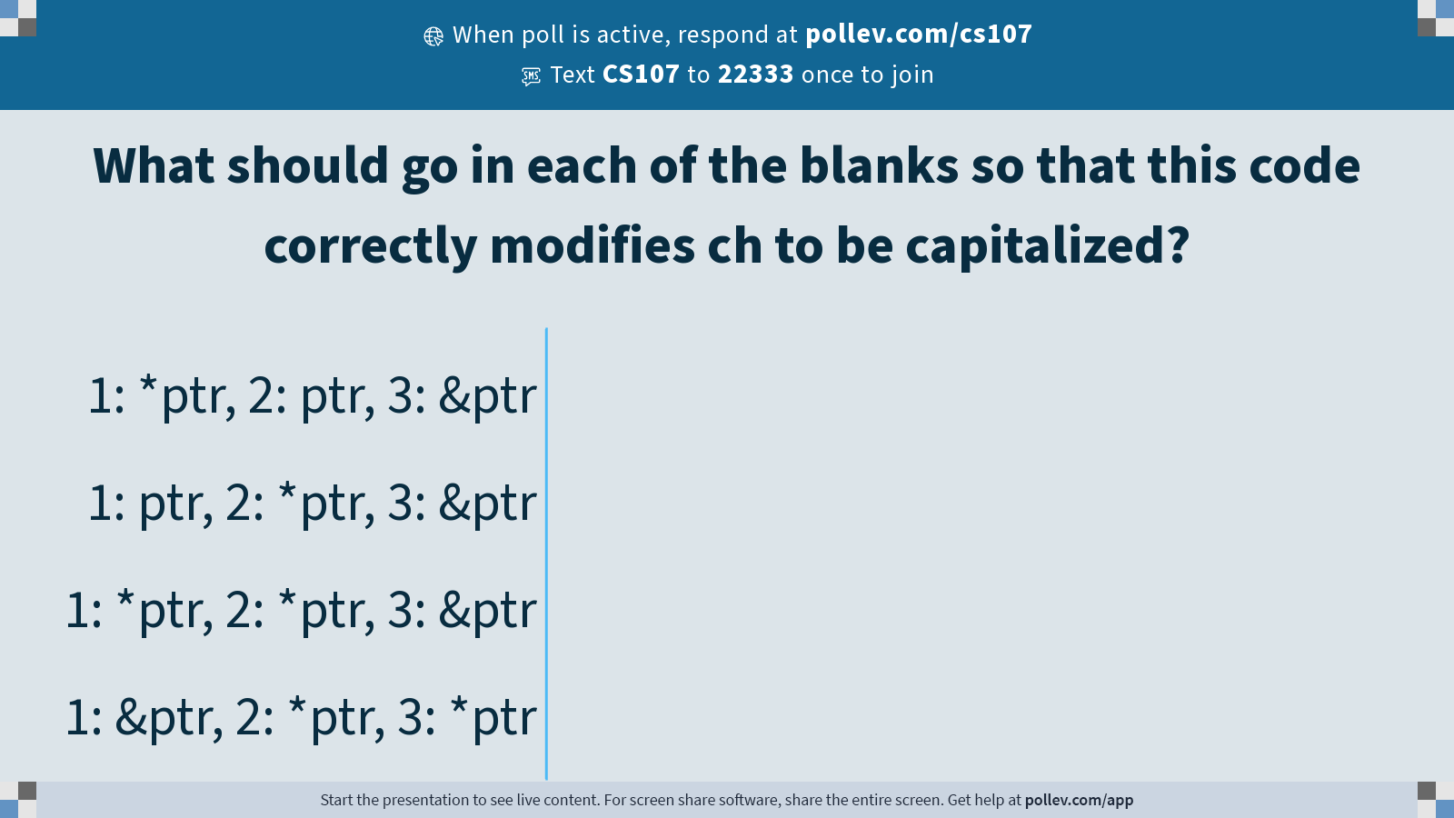
Notes:
Do not modify the notes in this section to avoid tampering with the Poll Everywhere activity.
More info at polleverywhere.com/support
What should go in each of the blanks so that this code correctly modifies ch to be capitalized?
https://www.polleverywhere.com/multiple_choice_polls/XVuzY7yfOoUTDi0j9RNpe?state=opened&flow=Default&onscreen=persist

Slide 42
Pointers Practice
void makeUpper(char *ptr) {
*ptr = toupper(*ptr);
}
int main(int argc, char *argv[]) {
char ch = 'h';
// want to modify ch to be capital
makeUpper(&ch);
printf("%c\n", ch); // should print 'H'
return 0;
}
What should go in each of the blanks so that this code correctly modifies ch to be capitalized?
🤔

Slide 43
Lecture Plan
Buffer Overflows, Security and Valgrind
Review: Pointers
Strings and Pointers
cp -r /afs/ir/class/cs107/lecture-code/lect8 .

Slide 44
char[]
STACK
When we declare an array of characters, contiguous memory is allocated on the stack to store the contents of the entire array.
int main(int argc, char *argv[]) {
char str[6];
strcpy(str, "apple");
...
Address | Value
 | …
0x105 | '\0'
0x104 | 'e'
0x103 | 'l'
0x102 | 'p'
0x101 | 'p'
0x100 | 'a'
 | …
main()
str

Slide 45
char *
STACK
When we declare a char *, we allocate space on the stack to store an address, not actual characters. But we can still generally use char * the same as char[].
int main(int argc, char *argv[]) {
char str[6];
strcpy(str, "apple");
char *strAlt = str;
...
Address | Value
 | …
0x105 | '\0'
0x104 | 'e'
0x103 | 'l'
0x102 | 'p'
0x101 | 'p'
0x100 | 'a'
 | …
0xf | 0x100
 | …
main()
str
strAlt

Slide 46
Strings as Parameters
STACK
When we pass a char array as a parameter, C makes a copy of the address of the first array element and passes it (as a char *) to the function.
void myFunc(char *myStr) {
...
}
int main(int argc, char *argv[]) {
char str[6];
strcpy(str, "apple");
myFunc(str);
...
}
Address | Value
 | …
0x105 | '\0'
0x104 | 'e'
0x103 | 'l'
0x102 | 'p'
0x101 | 'p'
0x100 | 'a'
 | …
 | …
0xf | 0x100
 | …
main()
str
myFunc()
myStr

Slide 47
Strings as Parameters
STACK
This means if we modify characters in myFunc, the changes will persist back in main!
void myFunc(char *myStr) {
myStr[4] = 'y';
}
int main(int argc, char *argv[]) {
char str[6];
strcpy(str, "apple");
myFunc(str);
printf("%s", str); // apply
...
}
Address | Value
 | …
0x105 | '\0'
0x104 | 'y'
0x103 | 'l'
0x102 | 'p'
0x101 | 'p'
0x100 | 'a'
 | …
 | …
0xf | 0x100
 | …
main()
str
myFunc()
myStr

Slide 48
Read-only Strings
There is another convenient way to create a string if we do not need to modify it later. We can create a char * and set it directly equal to a string literal.
char *myString = "Hello, world!";
...
printf("%s", myString); // Hello, world!

Slide 49
Read-only Strings
When we declare a char pointer equal to a string literal, the characters are not stored on the stack. Instead, they are stored in a special area of memory called the “data segment”. We cannot modify memory in this segment.
char *str = "hi";
The pointer variable (e.g. str) refers to the address of the first character of the string in the data segment.
Address | Value
 | …
0xff0 | 0x10
 | …
 | …
0x12 | '\0'
0x11 | 'i'
0x10 | 'h'
 | …
STACK
str
DATA SEGMENT
NOTE: not all char * strings are read-only. Only ones that point to characters in the data segment are read-only.
Notes:
Text segment stores string literals to potentially reduce duplicate memory

Slide 50
Read-only Strings
Read-only strings are convenient to use, but make sure to not use a read-only string in code that tries to modify its characters – it will crash!
char *myString = "Hello, world!";
myString[0] = 'h'; // crashes!
There’s no way in code to check if a string is read-only; it’s up to the programmer to properly use strings to avoid these crashes.
E.g. don’t pass in a read-only string as the src to strcpy
strcpy(myString, "Hi"); // crashes!

Slide 51
Read-only Strings
A string is read-only if it points to characters that live in the data segment, rather than memory we can modify.
char *readOnly = "Hi";
char modifiable[6];
strcpy(modifiable, "Hi");
// is ptr read-only?
char *ptr = modifiable;
// no, because it points to characters on the stack
ptr[0] = 'h'; // ok!

Slide 52
Read-Only Strings
/* It’s up to programmer using this function to not pass
* a read-only string.
*/
void myFunc(char *myStr) {
myStr[0] = 'h';
}

Slide 53
Recap
Buffer Overflows, Security and Valgrind
Review: Pointers
Strings and Pointers
Lecture 8 takeaway: C strings are pointers and arrays. C strings are error-prone, and issues like buffer overflows can arise! Valgrind is a tool that can help detect memory errors.
cp -r /afs/ir/class/cs107/lecture-code/lect8 .

