Slide 1
CS107, Lecture 18
Wrap-Up / What’s Next?

Slide 2
Plan For Today
Recap: Where We’ve Been
Larger Applications
What’s Next?
Q&A

Slide 3
Plan For Today
Recap: Where We’ve Been
Larger Applications
What’s Next?
Q&A

Slide 4
We’ve covered a lot in just 10 weeks! Let’s take a look back.

Slide 5
Our CS107 Journey
Bits and Bytes
Heap Allocators
C Strings
Arrays and Pointers
Stack and Heap
Generics
Assembly

Slide 6
Course Overview
Bits and Bytes - How can a computer represent integer numbers?
Chars and C-Strings - How can a computer represent and manipulate more complex data like text?
Pointers, Stack and Heap – How can we effectively manage all types of memory in our programs?
Generics - How can we use our knowledge of memory and data representation to write code that works with any data type?
Assembly - How does a computer interpret and execute C programs?
Heap Allocators - How do core memory-allocation operations like malloc and free work?

Slide 7
First Day
/*
* hello.c
* This program prints a welcome message
* to the user.
*/
#include <stdio.h> // for printf
int main(int argc, char *argv[]) {
printf("Hello, world!\n");
return 0;
}

Slide 8
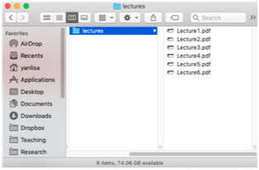
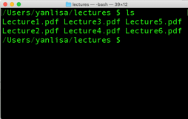
First Day
The command-line is a text-based interface to navigate a computer, instead of a Graphical User Interface (GUI).
Graphical User Interface
Text-based interface

Slide 9
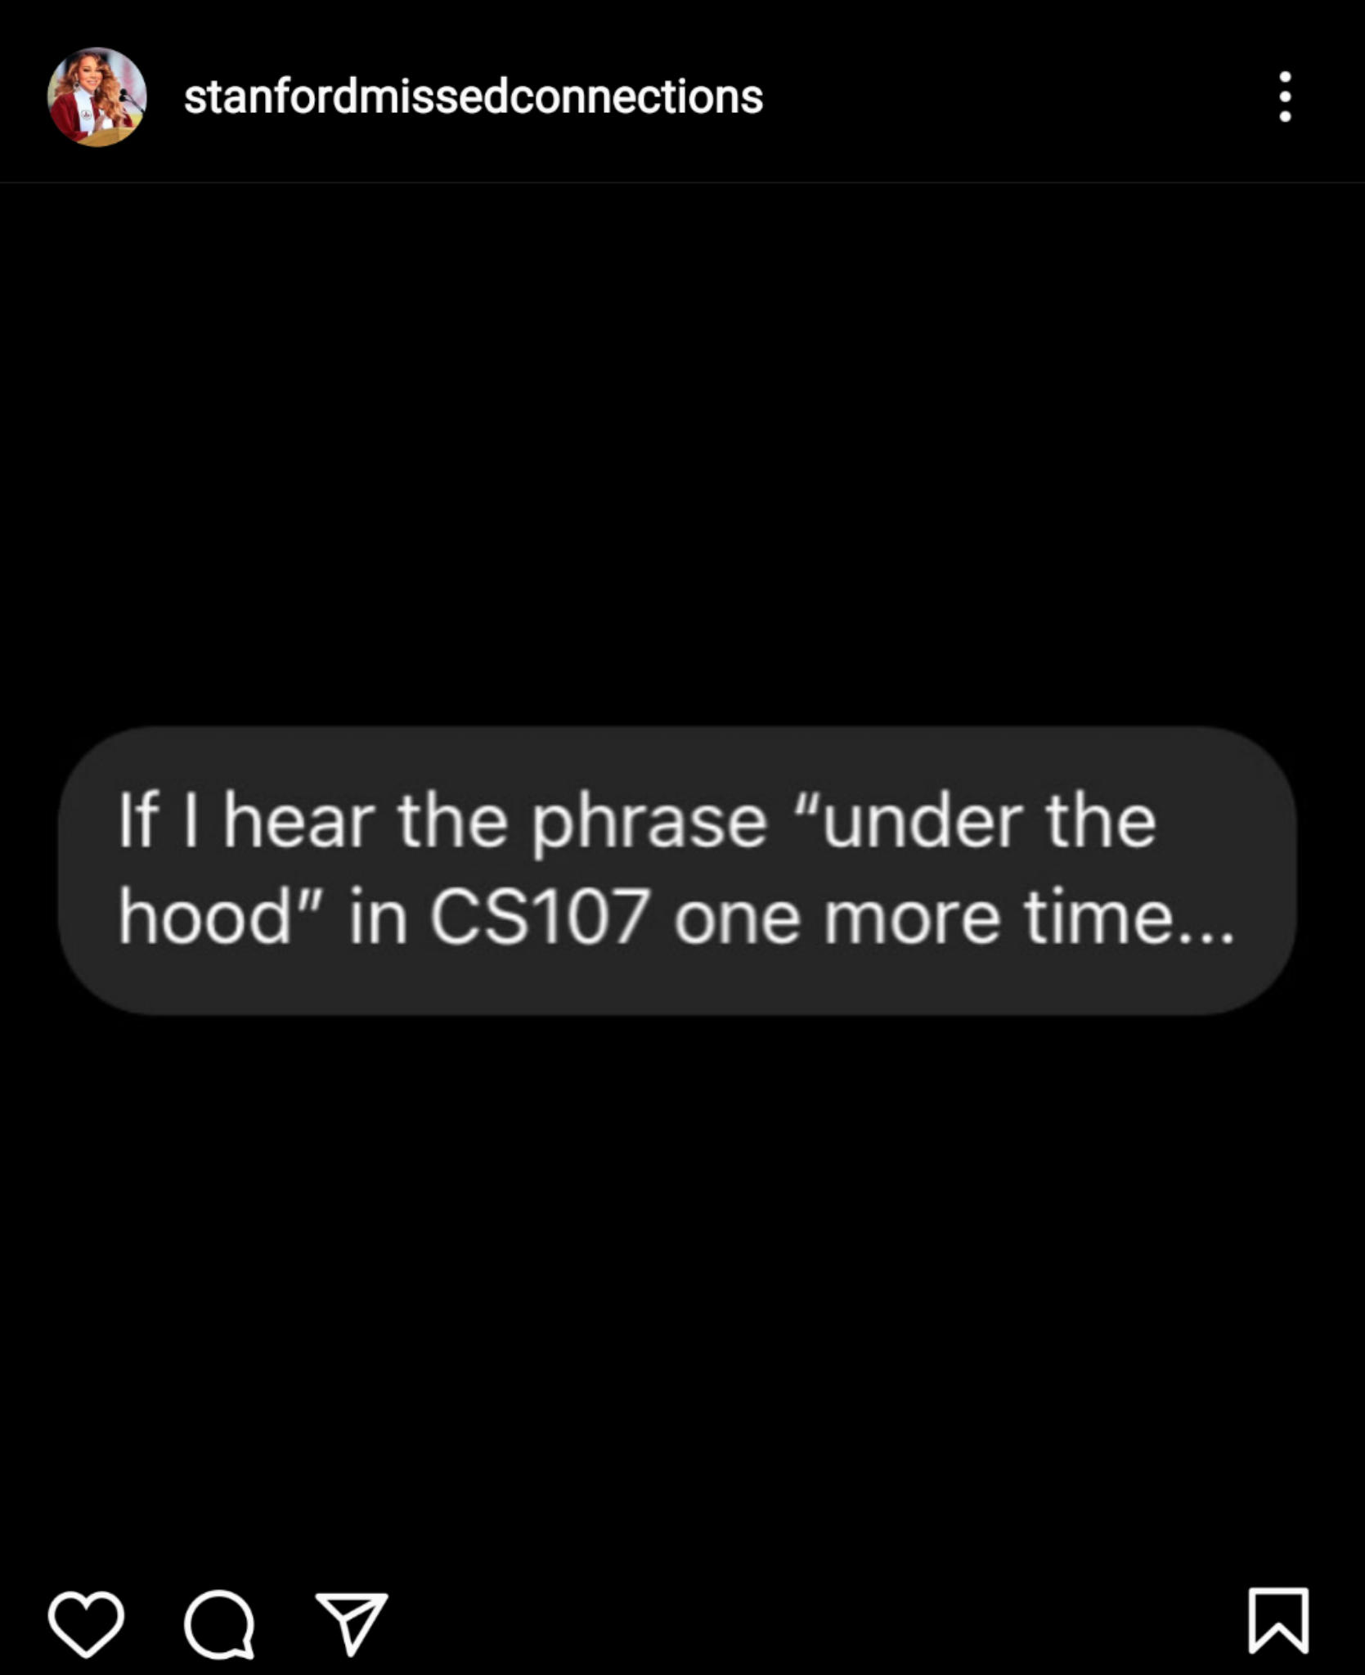
The rest of the quarter
cs107.stanford.edu/recap/index.html

Slide 10
Bits And Bytes
Key Question: How can a computer represent integer numbers?

Slide 11
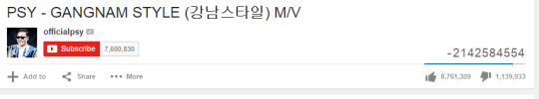
Bits And Bytes
Why does this matter?
Limitations of representation and arithmetic impact programs!
We can also efficiently manipulate data using bits.
https://kotaku.com/why-gandhi-is-such-an-asshole-in-civilization-1653818245

Slide 12
C Strings
Key Question: How can a computer represent and manipulate more complex data like text?
Strings in C are arrays of characters ending with a null terminator!
We can manipulate them using pointers and C library functions (many of which you could probably implement).
index | 0 | 1 | 2 | 3 | 4 | 5 | 6 | 7 | 8 | 9 | 10 | 11 | 12 | 13
value | 'H' | 'e' | 'l' | 'l' | 'o' | ',' | ' ' | 'w' | 'o' | 'r' | 'l' | 'd' | '!' | '\0'

Slide 13
C Strings
Why does this matter?
Understanding this representation is key to efficient string manipulation.
This is how strings are represented in both low- and high-level languages!
  C++: https://www.quora.com/How-does-C++-implement-a-string
  Python: https://www.laurentluce.com/posts/python-string-objects-implementation/

Slide 14
Pointers, Stack and Heap
Key Question: How can we effectively manage all types of memory in our programs?
Arrays let us store ordered lists of information.
Pointers let us pass addresses of data instead of the data itself.
We can use the stack, which cleans up memory for us, or the heap, which we must manually manage.
STACK
Address | Value
 | …
0x1f0 | 2
 | …
0x10 | 0x1f0
 | …
x
main()
myFunc()
intPtr

Slide 15
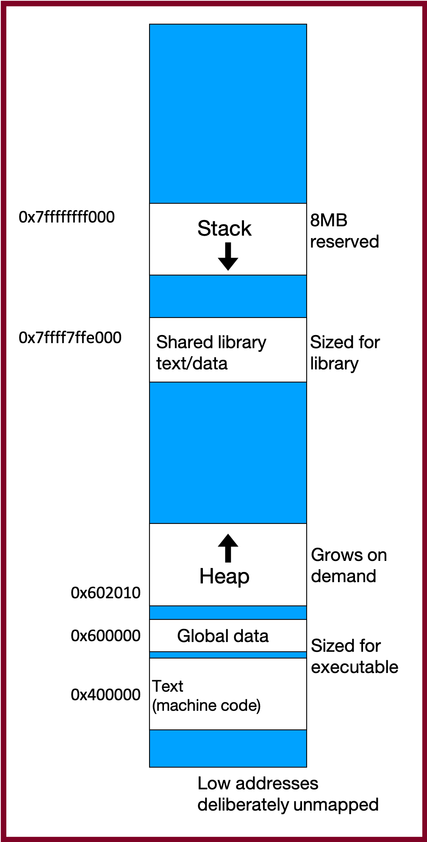
Stack And Heap
Why does this matter?
The stack and heap allow for two ways to store data in our programs, each with their own tradeoffs, and it’s crucial to understand the nuances of managing memory in any program you write!
Pointers let us pass around references to data efficiency

Slide 16
Generics
Key Question: How can we use our knowledge of memory and data representation to write code that works with any data type?
We can use void * to circumvent the type system, memcpy, etc. to copy generic data, and function pointers to pass logic around.
Why does this matter?
Working with any data type lets us write more generic, reusable code.
Using generics helps us better understand the type system in C and other languages, and where it can help and hinder our program.

Slide 17
Assembly Language
Key Question: How does a computer interpret and execute C programs?
GCC compiles our code into machine code instructions executable by our processor.
Our processor uses registers and instructions like mov to manipulate data.

Slide 18
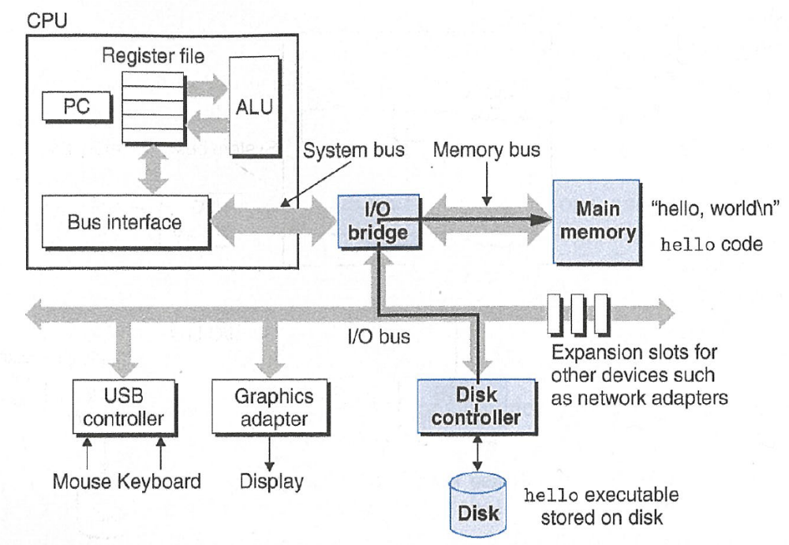
Assembly Language
Why does this matter?
We write C code because it is higher level and transferrable across machines. But it is not the representation executed by the computer!
Understanding how programs are compiled and executed, as well as computer architecture, is key to writing performant programs (e.g. fewer lines of code is not necessarily better).
We can reverse engineer and exploit programs at the assembly level!

Slide 19
Heap Allocators
Key Question: How do core memory-allocation operations like malloc and free work?
A heap allocator manages a block of memory for the heap and completes requests to use or give up memory space.
We can manage the data in a heap allocator using headers, pointers to free blocks, or other designs
Why does this matter?
Designing a heap allocator requires making many design decisions to optimize it as much as possible. There is no perfect design!
All languages have a “heap” but manipulate it in different ways.

Slide 20
Our CS107 Journey
Bits and Bytes
Heap Allocators
C Strings
Arrays and Pointers
Stack and Heap
Generics
Assembly

Slide 21
CS107 Learning Goals
The goals for CS107 are for students to gain mastery of
- writing C programs with complex use of memory and pointers
- an accurate model of the address space and compile/runtime behavior of C programs
to achieve competence in
- translating C to/from assembly
- writing programs that respect the limitations of computer arithmetic
- identifying bottlenecks and improving runtime performance
- working effectively in a Unix development environment
and have exposure to
- a working understanding of the basics of computer architecture

Slide 22

The C coding experience
https://www.youtube.com/watch?v=G7LJC9vJluU

Slide 23
Plan For Today
Recap: Where We’ve Been
Larger Applications
What’s Next?
Q&A

Slide 24
Plan For Today
Recap: Where We’ve Been
Larger Applications
  CS107 Tools and Techniques
  CS107 Concepts
  Bonus: How does an X86 processor handle floating point numbers?
What’s Next?
Q&A

Slide 25
Plan For Today
Recap: Where We’ve Been
Larger Applications
  CS107 Tools and Techniques
  CS107 Concepts
  Bonus: How does an X86 processor handle floating point numbers?
What’s Next?
Q&A

Slide 26
Tools and Techniques
Unix and the command line
Coding Style
Debugging (GDB)
Testing (Sanity Check)
Memory Checking (Valgrind)
Profiling (Callgrind)

Slide 27
Unix And The Command Line
Unix and command line tools are extremely popular tools outside of CS107 for:
Running programs (web servers, python programs, remote programs…)
Accessing remote servers (Amazon Web Services, Microsoft Azure, Heroku…)
Programming embedded devices (Raspberry Pi, etc.)
Our goal for CS107 was to help you become proficient in navigating Unix

Slide 28
Coding Style
Writing clean, readable code is crucial for any computer science project
Unfortunately, a fair amount of existing code is poorly-designed/documented
Our goal for CS107 was to help you write with good coding style, and read/understand/comment provided code.

Slide 29
Debugging (GDB)
Debugging is a crucial skill for any computer scientist
Our goal for CS107 was to help you become a better debugger
  narrow in on bugs
  diagnose the issue
  implement a fix
Practically every project you work on will have debugging facilities
  Python: “PDB”
  IDEs: built-in debuggers (e.g. QT Creator, Eclipse)
  Web development: in-browser debugger

Slide 30
Testing (Sanity Check)
Testing is a crucial skill for any computer scientist
Our goal for CS107 was to help you become a better tester
  Writing targeted tests to validate correctness
  Use tests to prevent regressions
  Use tests to develop incrementally

Slide 31
Memory Checking and Profiling
Memory checking and profiling are crucial for any computer scientist to analyze program performance and increase efficiency.
Many projects you work on will have profiling and memory analysis facilities:
  Mobile development: integrated tools (XCode Instruments, Android Profiler, etc.)
  Web development: in-browser tools

Slide 32
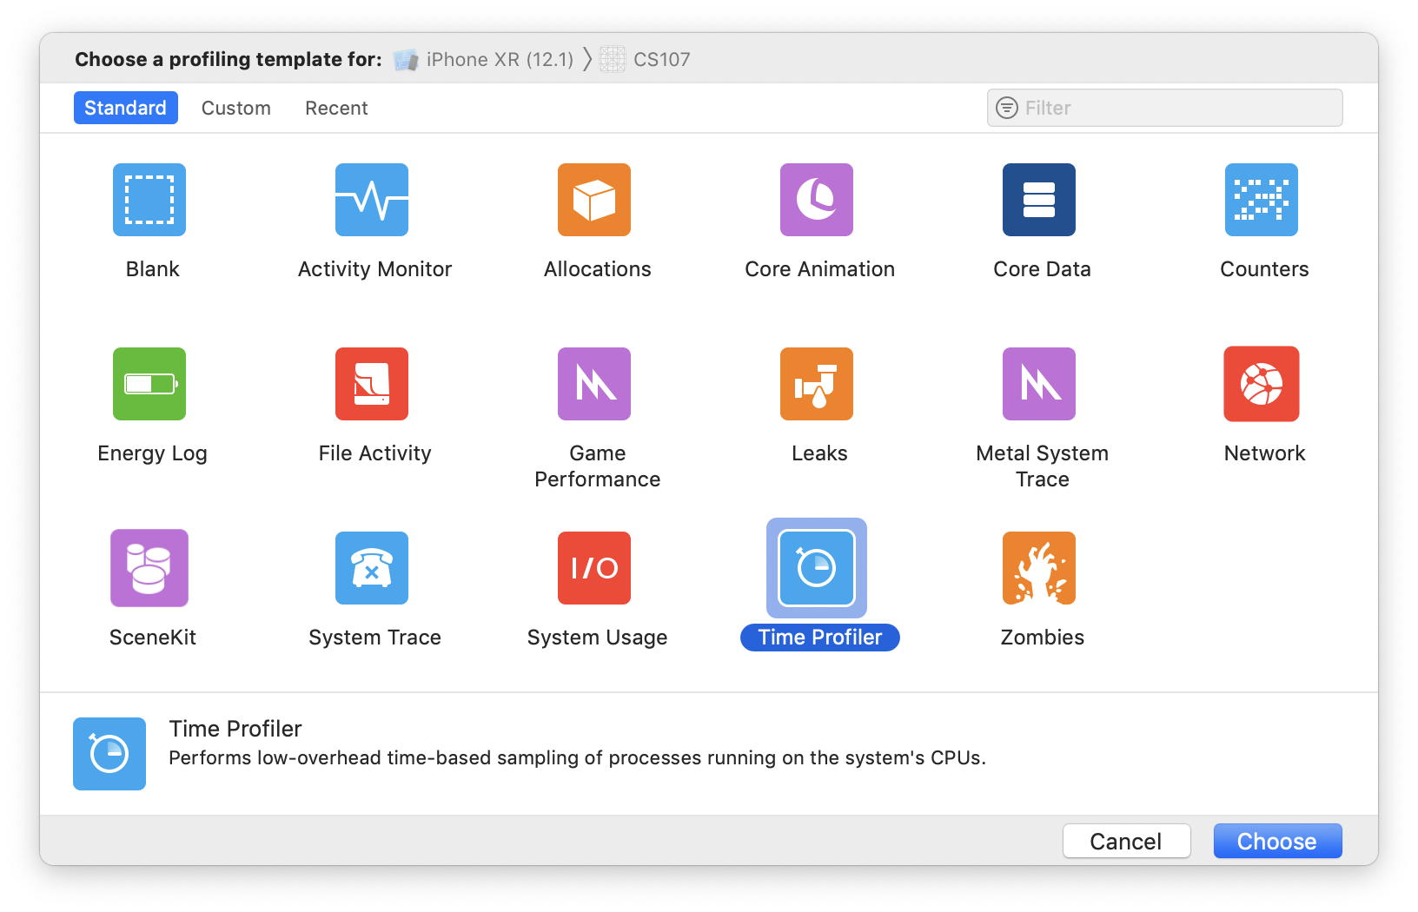
Tools
You’ll see manifestations of these tools throughout projects you work on. We hope you can use your CS107 knowledge to take advantage of them!
Notes:
Leaks + profiling time + zombies (accessing freed memory)

Slide 33
Plan For Today
Recap: Where We’ve Been
Larger Applications
  CS107 Tools and Techniques
  CS107 Concepts
  Bonus: Floating point assignment
What’s Next?
Q&A

Slide 34
Concepts
C Language
Bit-Level Representations
Arrays and Pointers
Memory Management
Generics
Assembly
cs107.stanford.edu/recap/index.html

Slide 35
Systems
How is an operating system implemented? (take CS140!)
Threads
User Programs
Virtual Memory
Filesystem
How is a compiler implemented? (take CS143!)
Lexical analysis
Parsing
Semantic Analysis
Code Generation
How can applications communicate over a network? (take CS110/CS144!)
How can we weigh different tradeoffs of network architecture design?
How can we effectively transmit bits across a network?

Slide 36
Systems
How can we write programs that execute multiple tasks simultaneously? (take CS110!)
Threads of execution
“Locks” to prevent simultaneous access

Slide 37
Machine Learning
Can we speed up machine learning training with reduced precision computation?
https://www.top500.org/news/ibm-takes-aim-at-reduced-precision-for-new-generation-of-ai-chips/
https://devblogs.nvidia.com/mixed-precision-training-deep-neural-networks/
How can we implement performant machine learning libraries?
Popular tools such as TensorFlow and PyTorch are implemented using C!
https://pytorch.org/blog/a-tour-of-pytorch-internals-1/
https://www.tensorflow.org/guide/extend/architecture

Slide 38
Web Development
How can we efficiently translate Javascript code to machine code?
The Chrome V8 JavaScript engine converts Javascript into machine code for computers to execute: https://medium.freecodecamp.org/understanding-the-core-of-nodejs-the-powerful-chrome-v8-engine-79e7eb8af964
The popular Node.js web server tool is built on Chrome V8
How can we compile programs into an efficient binary instruction format that runs in a web browser?
WebAssembly is an emerging standard instruction format that runs in browsers: https://webassembly.org
You can compile C/C++/other languages into WebAssembly for web execution

Slide 39
Programming Languages / Runtimes
How can programming languages and runtimes efficiently manage memory?
Manual memory management (C/C++)
Reference Counting (Swift)
Garbage Collection (Java)
How can we design programming languages to reduce the potential for programmer error?
Haskell/Swift ”Optionals”
How can we design portable programming languages?
Java Bytecode: https://en.wikipedia.org/wiki/Java_bytecode

Slide 40
Theory
How can compilers output efficient machine code instructions for programs?
Languages can be represented as regular expressions and context-free grammars
We can model programs as control-flow graphs for additional optimization

Slide 41
Security
How can we find / fix vulnerabilities at various levels in our programs?
Understand machine-level representation and data manipulation
Understand how a computer executes programs
macOS High Sierra Root Login Bug: https://objective-see.com/blog/blog_0x24.html

Slide 42
Plan For Today
Recap: Where We’ve Been
Larger Applications
  CS107 Tools and Techniques
  CS107 Concepts
  Bonus: Floating point assignment
What’s Next?
Q&A

Slide 43
Floats and Assembly
Unfortunately, we couldn’t cover floating point numbers this quarter
  Lecture video from past quarter here!
We wanted to give you a taste of floating point; specifically how we can use our existing knowledge of assembly to better understand it

Slide 44
Plan For Today
Recap: Where We’ve Been
Larger Applications
What’s Next?
Q&A

Slide 45
After CS107, you are prepared to take a variety of classes in various areas. What are some options?

Slide 46

Where Are We?
CS 106B/X
CS 103
Programming
Abstractions
Mathematical
Foundations of
Computing
We are here
CS 107/E
CS 109
Systems
Theory
Computer
Organization and
Systems
Intro to Probability
for Computer
Scientists
CS 110
CS 161
Principles of
Computer Systems
Design and Analysis
of Algorithms

Slide 47


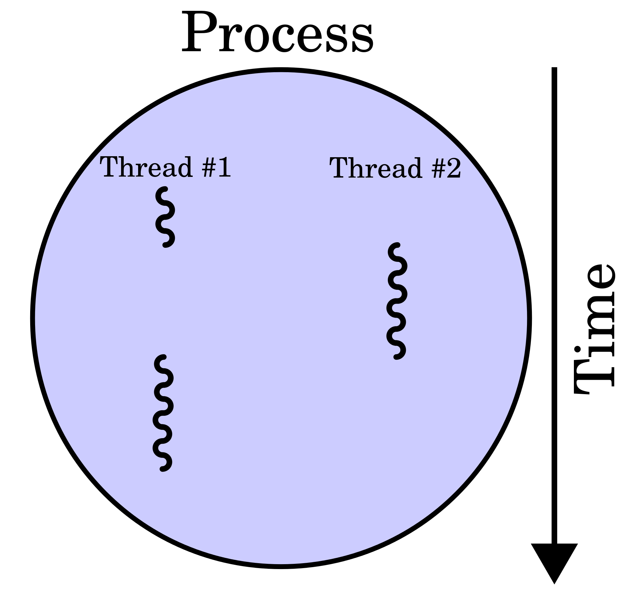
CS 110
How can we implement multithreading in our programs?
How can multiple programs communicate with each other?
How can we implement distributed software systems to do things like process petabytes of data?
How can we maximally take advantage of the hardware and operating system software available to us?
Jerry Cain
Chris Gregg
Nick Troccoli
https://en.wikipedia.org/wiki/Multithreading_(computer_architecture)#/media/File:Multithreaded_process.svg

Slide 48
Other Courses
CS140: Operating Systems
CS143: Compilers
CS144: Networking
CS145: Databases
CS166: Data Structures
CS221: Artificial Intelligence
CS246: Mining Massive Datasets
EE108: Digital Systems Design
EE180: Digital Systems Architecture

Slide 49
Plan For Today
Recap: Where We’ve Been
Larger Applications
What’s Next?
Q&A

Slide 50
Thank you!
Notes:
CS107 is a challenging class
We strive to help you learn the most per unit time
We hope you learned a lot, enjoyed the class, and that we were able to exceed your expectations
Visit anytime!

Slide 51
Course Evaluations
We hope you can take the time to fill out the end-quarter CS 107 course evaluation. We sincerely appreciate any feedback you have about the course and read every piece of feedback we receive. We are always looking for ways to improve!
Thank you!

