Slide 1
CS110 Winter 2020
Midterm Review
Shrey Gupta + Andrew Benson
Slides contributed by Kristine Guo, Peter McEvoy, Armin Namavari, Ryan Eberhardt, Grace Hong, Hemanth Kini

Slide 2
Friday, February 14, 2020
NVIDIA Aud: A-S
Cubberley Aud: T-Z
1:30pm - 2:50pm
Exam Date & Time
CS 110
CS 110

Slide 3
Exam Deets
Bring your laptop and charger
Exam will be administered on Bluebook
  Download software before exam.
If you don’t have a working laptop, we need to know by midnight tonight
Exam material emphasizes assignments, sections, lecture, readings (in order of decreasing emphasis)

Slide 4
Outline
Part 1: Filesystems
Inodes, Directories, Links
File descriptor table, open file table, vnode table
System calls (open, close, read, write, dup, dup2, pipe)
Part 3: Signals
Signal blocking and handlers
Race conditions and sigsuspend
Part 2: Multiprocessing
Processes and Virtual Memory
fork, execvp, waitpid
Pipes and multiprocessing
Part 4: Scheduling
Part 5: Threads
Thread Syntax
Race Conditions, Mutex

Slide 5
Part 1: Filesystems

Slide 6
Filesystem Layers
Pathname Layer
/home/shreyg/a.txt
Directory Layer
“A.txt” -- inode 0
“B.txt” -- inode 1
Inode Layer
2, 3
4
1, 7
Block Layer

Slide 7
Inodes & Files
BOOT + SUPER
BLOCKS
Inode 1
INODE TABLE
DATA, INDIRECT, & UNALLOCATED BLOCKS
Inode 2
Inode 16
Super block contains info on the type and config of the filesystem
Inodes contain all the metadata regarding a file/directory.
Data blocks contain actual file data or directory entries
Indirect blocks contain lists of block numbers to data/indirect blocks

Slide 8
What’s in an inode?
struct inode {
uint16_t i_mode; // bit vector of file type and permissions
uint8_t i_nlink; // number of references to file
uint8_t i_uid; // owner
uint8_t i_gid; // group of owner
uint8_t i_size0; // most significant byte of size
uint16_t i_size1; // lower two bytes of size (size is encoded in a three-byte number)
uint16_t i_addr[8]; // device addresses constituting file
uint16_t i_atime[2]; // access time
uint16_t i_mtime[2]; // modify time
};
(From ino.h, assign2)

Slide 9
Direct Addressing
file size <= 8 * 512
324 | 21 | 972 | 123 | 273 | 453 | 284 | 312
512
bytes
512
bytes
512
bytes
512
bytes
512
bytes
512
bytes
512
bytes
512
bytes

Slide 10
Singly Indirect Addressing
8 * 512 < file size <= 7 * 256 * 512
Single Indirect Block Nums
Doubly Indirect Block Num
324
0
1
254
255
623 | 142 | ... | 9232 | 1029
512 bytes
512 bytes
512 bytes
512 bytes

Slide 11
Doubly Indirect Addressing
7 * 256 * 512 < file size <=
7 * 256 * 512 + 256 * 256 * 512
Single Indirect Block Nums
Doubly Indirect Block Num
 |  |  |  |  |  |  | 643
623 | 142 | ... | 9232 | 1029
118 | 2103 | ... | 9121 | 284
512 bytes
512 bytes
512 bytes
512 bytes

Slide 12
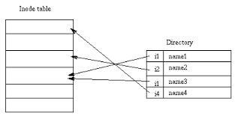
Directories
Directories are just a special type of file
Payload blocks consist of (inode block number, name) pairs

Slide 13
Links
Hard links vs. symbolic (soft) links
All three of these links go to the same file!
Can’t create hard link for directories (breaks pathnames, allows loops)
Blocks
Inodes
DIRECTORY (~/cool_dir)
i1
refcnt: 2
The quick brown fox...
i1 | a.txt
i1 | b.txt
i2 | symlinked.txt
i2 - symlink
refcnt: 1
~/cool_dir/b.txt

Slide 14
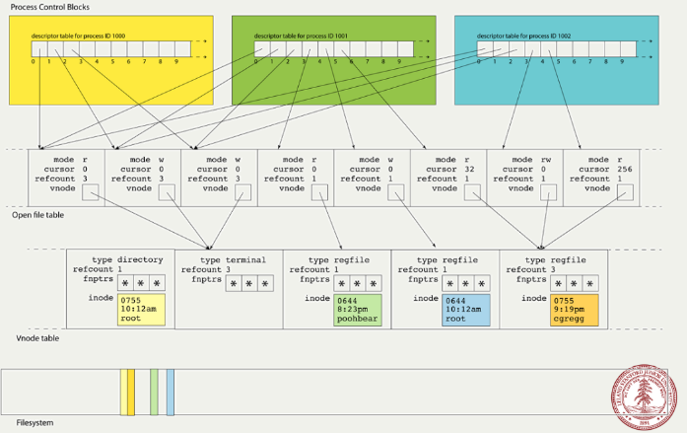
How the operating system manages files

Slide 15
How System Calls Affect the File Tables
fd table
0 | 1 | 2 | ... | 8 | 9
In | Out | Err | ...
open
file
table

Slide 16
The Effect of pipe on the File Tables
fd table
0 | 1 | 2 | ... | 8 | 9
In | Out | Err | ... | Pipe (read end) | Pipe (write end)
open
file
table
int fds[2];
pipe(fds);
// fds[0] has 8, fds[1] has 9
// Q: How do we redirect STDOUT to the pipe?

Slide 17
The Effect of dup2 on the File Tables
fd table
0 | 1 | 2 | ... | 8 | 9
In | Out | Err | ... | Pipe (read end) | Pipe (write end)
open
file
table
// int dup2(int oldfd, int newfd);
// have newfd point to what oldfd points to
dup2(fds[1], STDOUT_FILENO)

Slide 18
The Effect of close on the File Tables
fd table
0 | 1 | 2 | ... | 8 | 9
In | Out | Err | ... | Pipe (read end) | Pipe (write end)
open
file
table
close(fds[1]);
// Q: What happens when we call dup(STDOUT_FILENO)?

Slide 19
The Effect of dup on the File Tables
fd table
0 | 1 | 2 | ... | 8 | 9 | 10
In | Out | Err | ... | Pipe (read end) | Pipe (write end)
open
file
table
// Returns a new fd that points to what the
// fd passed in is pointing to.
dup(STDOUT_FILENO);

Slide 20
The Open File Table is Shared Across Processes
Q: Suppose the parent forks, then reads 4 bytes. What is the next byte the child would read from shared.txt?
parent
child
shared.txt
a | b | c | d | e | f | g
In | Out | Err | ... | shared.txt mode: r cursor: 0 refcount: 2 vnode: *

Slide 21
The Open File Table is Shared Across Processes
A: ‘e’
Q: What changes in this picture if the child closes shared.txt?
parent
child
shared.txt
a | b | c | d | e | f | g
In | Out | Err | ... | shared.txt mode: r cursor: 4 refcount: 2 vnode: *

Slide 22
The Open File Table is Shared Across Processes
A: The refcount drops to 1. The child no longer has an fd that points to the open file table entry.
parent
child
shared.txt
a | b | c | d | e | f | g
In | Out | Err | ... | shared.txt mode: r cursor: 4 refcount: 1 vnode: *

Slide 23

Part 2.1: Processes

Slide 24
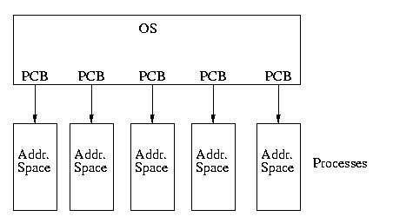
Processes
Unique PID
Not-necessarily unique PGID
At least one thread
Its own file descriptor table
Its own Virtual Memory space

Slide 25

Virtualization
When you think you have your own private address space but the next process also has the same private address space
DREAM: Every process thinks it has its own address space
i.e., each process thinks it has sole access to the addresses ranging from 0x00000000 to 0xffffffff

Slide 26
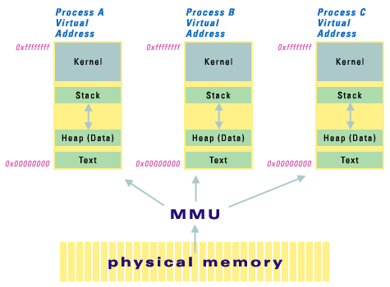
Virtual Memory
REALITY: Process address space isn’t really where data lives
Translation facilitated by kernel on every “dereference” of an address.

Slide 27
Questions
Suppose P1 and P2 are separate process running /usr/bin/ls. Which of the following are possible?
Both P1 and P2 call open(“foo.txt”) and in both the returned fd was 5.
Both P1 and P2 read 7 chars from the returned fd and read the same thing.
Both P1 and P2 store variable foo at virtual address 0xdeadbeef.
Both P1 and P2 store variable foo at physical address 0xdeadbeef.

Slide 28
Part 2.2: Multiprocessing

Slide 29
Basic Paradigm
fork
int fork_child(char **argv) {
pid_t pid = fork();
if (pid == 0) {
execvp(argv[0], argv);
exit(0);
}
int status;
waitpid(pid, &status, 0);
return WEXITSTATUS(status);
}
execve
(?)
waitpid

Slide 30
fork()
Duplicates almost everything: all of virtual memory, file descriptor table, signal handlers, signal mask, etc (not pending signals)
Return value: child pid for parent, 0 for child
I lied above: virtual memory is copied lazily i.e. Copy on Write (CoW)

Slide 31
execvp() (and friends)
Replaces memory-related things: all of virtual memory, signal handlers, etc (not file descriptor table, pending signals, signal mask which are managed by the kernel)
Return value: doesn’t return unless error (e.g. unknown program)

Slide 32
waitpid()
Block until change in child processes’ running state (by default: only termination, but can detect stopped and signaled)
Return value: -1 (error), 0 (WNOHANG specified and no children waiting), pid (of child who changed state)
If you don’t reap, you’ll have zombie children!

Slide 33
waitpid()
 | Terminated | Signaled | Stopped | Continued
Request Detection | <default> | <default> | WUNTRACED | WCONTINUED
Check State | WIFEXITED | WIFSIGNALED | WIFSTOPPED | WIFCONTINUED
Additional Info | WEXITSTATUS | WTERMSIG | WSTOPSIG | <none>
First row are flags for waitpid’s third argument, last two rows are macros that take in the status.
Also - WNOHANG, which makes waitpid return early if nothing has already changed.

Slide 34
Questions
The following is from a commit Linus Torvalds made to Linux last Saturday.
fork(); fork(); fork(); fork(); fork(); fork();
How many processes does it create?
Review the following code. What possible issues could occur? (3-4 issues)
int main(int argc, char *argv[]) {
pid_t pid = fork();
if (pid == 0) {
execvp(argv[0], argv);
}
int* status;
waitpid(pid, status, WNOHANG);
assert(WIFEXITED(*status));
return WEXITSTATUS(*status);
}

Slide 35

Part 2.3: Multiprocess
Communication

Slide 36
How do processes communicate?
What we’ve seen in CS 110:
pipes
mmap
signals

Slide 37
Pipes
What happens in the following code?
static void writeOutput(const char *array[]) {
printf("Writing output to file named \"%s\".\n", array[0]);
int outfile = open(array[0], O_WRONLY | O_CREAT | O_TRUNC, 0644);
dup2(outfile, STDOUT_FILENO);
close(outfile);
if (fork() > 0) return;
execvp(array[1], array+1);
exit(0);
}
int main(int argc, char *argv[]) {
char *array1[] = {“cal.txt”, “cal”, NULL};
char *array2[] = {“date.txt”, “date”, NULL};
writeOutput(array1); waitpid(-1, NULL, 0);
writeOutput(array2); waitpid(-1, NULL, 0);
return 0;
}

Slide 38
mmap
Like malloc, but is able to allocate memory that is shared between processes (e.g. after fork()).
Process 1
Process 2
Physical Memory Page
(Shared) Physical Memory Page
Physical Memory Page

Slide 39

Part 3: Signals

Slide 40
What are signals?
Asynchronous notifications sent to a process by the kernel or another process.
Created via kill() or raise() (what’s the difference?).
Handled by signal handlers registered via signal().
Can be blocked via sigprocmask().
Can be awaited (e.g. sleep until signal) via sigsuspend().
Examples: (why are these two lines separated?)
  SIGINT, SIGTSTP, SIGCONT, SIGCHLD
  SIGSTOP, SIGKILL

Slide 41
Signal Delivery
If a process blocks a signal, delivery of the signal is delayed until it’s unblocked.
If a process is not on CPU during signal delivery, it is delivered once it is.
Signals aren’t queued!
  The kernel tracks only what signals are delivered, not how many
Signal handlers block the signal they are handling (e.g. can be interrupted by other signals).

Slide 42
Signal Handlers
A function _you_ write that can be registered to run upon signal delivery.
  sighandler_t signal(int signum, sighandler_t handler);
Since signals are async, the signal handler might be run at any time! => beware of race conditions
Avoid race conditions by blocking signals appropriately
  sigset_t set;
  int sigemptyset(sigset_t *set);
  int sigaddset(sigset_t *set, int signum);
  int sigprocmask(int how, const sigset_t *set, sigset_t *oldset);

Slide 43
Signal Blocking (find the bugs)
static int sum = 0;
static int children = 0;
int main(int argc, char *argv[]) {
for (int i = 0; i < 5; i++) {
pid_t pid = fork();
if (pid == 0) {
// do nonsense work
exit(i);
}
children++;
}
signal(SIGCHLD, &handle);
while (children > 0) {
// busy wait :(
}
cout << “sum: “ << sum << endl;
return 0;
}
static void handle(int signal) {
int status;
waitpid(-1, &status, 0);
assert(WIFEXITED(status));
sum += WEXITSTATUS(status);
children--;
cout << “One child exited!” << endl;
}

Slide 44
Signal Blocking (fixed!)
static int sum = 0;
static int children = 0;
int main(int argc, char *argv[]) {
signal(SIGCHLD, handle);
sigset_t set;
sigemptyset(&set);
sigaddset(&set, SIGCHLD);
for (int i = 0; i < 5; i++) {
sigprocmask(SIG_BLOCK, &set, NULL);
pid_t pid = fork();
if (pid == 0) {
sigprocmask(SIG_UNBLOCK, &set, NULL);
// do nonsense work
exit(i);
}
children++;
sigprocmask(SIG_UNBLOCK, &set, NULL);
}
while (children > 0) {
// busy wait :(
}
cout << "sum: " << sum << endl;
return 0;
}
static void handle(int signal) {
int status;
while (true) {
if (waitpid(-1, &status, WNOHANG) <= 0) {
break;
}
assert(WIFEXITED(status));
sum += WEXITSTATUS(status);
children--;
cout << "One child exited!" << endl;
}
}

Slide 45
sigsuspend()
sigsuspend(&mask):
//ATOMICALLY:
sigprocmask(SIG_SETMASK, &mask, &old);
pause(); // wait for signal to wake us up
sigprocmask(SIG_SETMASK, &old, NULL);

Slide 46
Another kill-puzzle!
static pid_t pid;
static int counter = 0;
static void parentHandler(int unused) {
counter += 2;
printf("counter = %d\n", counter);
}
static void childHandler(int unused) {
counter += 1;
printf("counter = %d\n", counter);
kill(getppid(), SIGUSR1);
}
1. Can this program DEADLOCK?
BONUS: How many outputs are there?
int main(int argc, char *argv[]) {
signal(SIGUSR1, parentHandler);
if ((pid = fork()) == 0) {
signal(SIGUSR1, childHandler);
sigset_t mask; sigemptyset(&mask);
sigsuspend(&mask);
return 0;
}
kill(pid, SIGUSR1);
waitpid(pid, NULL, 0);
counter += 3;
printf("counter = %d\n", counter);
return 0;
}
Notes:
3 Outputs:
Output 1. - The child prints 2, and both the child and parent deadlock.
Output 2. - The child prints 1, the parent prints 2, and both the child and parent deadlock.
Output 3. - The child prints 1, the parent prints 2, and then the parent prints 5. Both processes exit.

Slide 47
Part 4: Scheduling

Slide 48
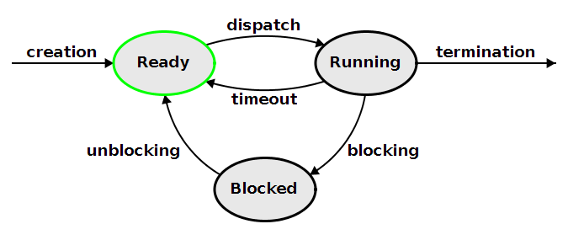
Scheduling
(not emphasized on midterm)

Slide 49
Scheduling
Process control block (PCB) - struct representing a process’ state
  What code it last was executing, register values, PID, etc
PCBs put into one of:
  blocked queue, ready/runnable queue, running queue
What causes a process to move from one queue to another?
Notes:
See lab3 for answers

Slide 50
Part 5: Threads

Slide 51
What are threads?
A thread is an independent execution sequence within a single process.
Threads share global parts of a virtual address space (text, data, heap) but have their own stack + registers.
Threads are multiplexed onto processors
Threads are often called lightweight processes.

Slide 52
C++ Thread Syntax
#include <iostream>
#include <thread>
using namespace std;
int main()
{
thread t([](a, b){
cout << a + b << endl;
}, 3, 3);
t.join();
return 0;
}
Thread constructor accepts a function and args. Processor schedules the thread to run the new function (i.e. adds thread to ready queue).
Parent thread waits for thread to finish executing.

Slide 53
Race Conditions with Threads
static float balance = 100.0;
void withdraw(float money) {
if (money <= balance)
balance -= money;
}
int main()
{
thread t2(withdraw, 100);
thread t2(withdraw, 100);
t1.join();
t2.join();
return 0;
}
Can the balance ever be negative?

Slide 54
What are mutexes?
A mutex allows you to control access to a critical section of code.
It’s like a key: if you have it, you can enter, otherwise you must wait till someone else gives you the key.
When a thread encounters a mutex:
  If it’s unlocked, lock the mutex and continue.
  If it’s locked, block until it’s unlocked.

Slide 55
Race Conditions Fixed with Mutex
static float balance = 100.0;
void withdraw(float money) {
if (money <= balance)
balance -= money;
}
int main()
{
thread t1(withdraw, 100);
thread t2(withdraw, 100);
t1.join();
t2.join();
return 0;
}
Where should we put mutexes?

Slide 56
Race Conditions Fixed with Mutex
static float balance = 100.0;
static mutex lock;
void withdraw(float money) {
lock.lock();
if (money <= balance)
balance -= money;
lock.unlock();
}
int main()
{
thread t1(withdraw, 100);
thread t2(withdraw, 100);
t1.join();
t2.join();
return 0;
}

