Slide 1
Lecture 12
Bellman-Ford, Floyd-Warshall,
and Dynamic Programming!

Slide 2
Announcements
HW5 due Wednesday!
HW6 released Wednesday!
Ed Etiquette:
  Please mark follow-up questions as “unresolved” so that we notice them!!
We are almost done grading the midterm – grades will be released soon.
  Great job everyone!
  Once grades are released, please follow standard procedure for regrade requests.

Slide 3
Today
Bellman-Ford Algorithm
Bellman-Ford is a special case of Dynamic Programming!
What is dynamic programming?
  Warm-up example: Fibonacci numbers
Another example:
  Floyd-Warshall Algorithm

Slide 4
Recall
Weights on edges represent costs.
The cost of a path is the sum of the weights along that path.
A shortest path from s to t is a directed path from s to t with the smallest cost.
The single-source shortest path problem is to find the shortest path from s to v for all v in the graph.
A weighted directed graph:
u
s
3
32
1
5
1
This is a path from s to t of cost 22.
b
v
13
a
21
2
16
t
This is a path from s to t of cost 10. It is the shortest path from s to t.

Slide 5
Last time
Dijkstra’s algorithm!
  Solves the single-source shortest path problem in weighted graphs.
Bellman-Ford algorithm!
  ALSO solves the single-source shortest path problem in weighted graphs.

Slide 6
Recap: shortest paths
BFS:
    (+) O(n+m)
  (-) only unweighted graphs
Dijkstra’s algorithm:
  (+) weighted graphs
  (+) O(nlog(n) + m) if you implement it with a Fibonacci heap
  (-) no negative edge weights
  (-) very “centralized” (need to keep track of all the vertices to know which to update).
Bellman-Ford algorithm:
  (+) weighted graphs, even with negative weights
  (+) can be done in a distributed fashion, every vertex using only information from its neighbors.
  (-) O(nm)

Slide 7
Bellman-Ford vs. Dijkstra
Dijkstra:
  Find the u with the smallest d[u]
  Update u’s neighbors: d[v] = min( d[v], d[u] + w(u,v) )
Bellman-Ford:
  Don’t bother finding the u with the smallest d[u]
    Everyone updates!
  Slower, but more flexible:
    Can handle negative edge weights (as long as there aren’t negative cycles)
    Can do updates in a decentralized way.

Slide 8
Aside: Negative Cycles
A negative cycle is a cycle whose edge weights sum to a negative number.
Shortest paths aren’t defined when there are negative cycles!
A
-10
2
B
The shortest path from A to B has cost…negative infinity?
C
1

Slide 9
Bellman-Ford vs. Dijkstra
Dijkstra:
  Find the u with the smallest d[u]
  Update u’s neighbors: d[v] = min( d[v], d[u] + w(u,v) )
Bellman-Ford:
  Don’t bother finding the u with the smallest d[u]
    Everyone updates!
  Slower, but more flexible:
    Can handle negative edge weights (as long as there aren’t negative cycles)
    Can do updates in a decentralized way.

Slide 10


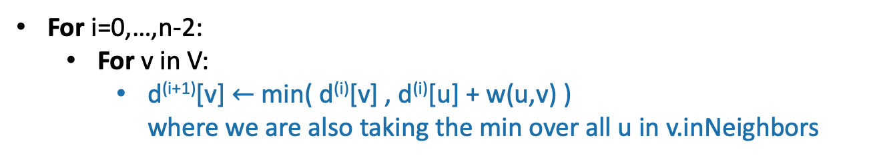





Bellman-Ford
=
Gates
0
How far is a node from Gates?
$$∞$$
1
Gates Packard CS161 Union Dish
CS161
d⁽⁰⁾
0
$$∞$$
$$∞$$
$$∞$$
$$∞$$
d⁽¹⁾
1
Packard
d⁽²⁾
4
$$∞$$
d⁽³⁾
22
$$∞$$
Union
d⁽⁴⁾
25
20
For i=0,…,n-2:
  For v in V:
    d^{(i+1)}[v] $←$min( d^{(i)}[v] , d^{(i)}[u] + w(u,v) )
    where we are also taking the min over all u in v.inNeighbors
Dish
$$∞$$

Slide 11



Bellman-Ford
Gates
0
How far is a node from Gates?
$$∞$$
1
Gates Packard CS161 Union Dish
CS161
d⁽⁰⁾
0
$$∞$$
$$∞$$
$$∞$$
$$∞$$
d⁽¹⁾
1
0
1
$$∞$$
$$∞$$
25
Packard
d⁽²⁾
4
$$1$$
d⁽³⁾
22
$$∞$$
Union
d⁽⁴⁾
25
20
For i=0,…,n-2:
  For v in V:
    d^{(i+1)}[v] $←$min( d^{(i)}[v] , d^{(i)}[u] + w(u,v) )
    where we are also taking the min over all u in v.inNeighbors
Dish
$$25$$

Slide 12




Bellman-Ford
Gates
0
How far is a node from Gates?
$$2$$
1
Gates Packard CS161 Union Dish
CS161
d⁽⁰⁾
0
$$∞$$
$$∞$$
$$∞$$
$$∞$$
d⁽¹⁾
1
0
1
$$∞$$
$$∞$$
25
Packard
d⁽²⁾
0
1
2
45
23
4
$$1$$
d⁽³⁾
22
$$45$$
Union
d⁽⁴⁾
25
20
For i=0,…,n-2:
  For v in V:
    d^{(i+1)}[v] $←$min( d^{(i)}[v] , d^{(i)}[u] + w(u,v) )
    where we are also taking the min over all u in v.inNeighbors
Dish
$$23$$

Slide 13

Bellman-Ford
Gates
0
How far is a node from Gates?
$$2$$
1
Gates Packard CS161 Union Dish
CS161
d⁽⁰⁾
0
$$∞$$
$$∞$$
$$∞$$
$$∞$$
d⁽¹⁾
1
0
1
$$∞$$
$$∞$$
25
Packard
d⁽²⁾
0
1
2
45
23
4
$$1$$
d⁽³⁾
0
1
2
6
23
22
$$6$$
Union
d⁽⁴⁾
25
20
For i=0,…,n-2:
  For v in V:
    d^{(i+1)}[v] $←$min( d^{(i)}[v] , d^{(i)}[u] + w(u,v) )
    where we are also taking the min over all u in v.inNeighbors
Dish
$$23$$

Slide 14
Bellman-Ford
Gates
0
How far is a node from Gates?
$$2$$
1
Gates Packard CS161 Union Dish
CS161
d⁽⁰⁾
0
$$∞$$
$$∞$$
$$∞$$
$$∞$$
d⁽¹⁾
1
0
1
$$∞$$
$$∞$$
25
Packard
d⁽²⁾
0
1
2
45
23
4
$$1$$
d⁽³⁾
0
1
2
6
23
22
$$6$$
Union
d⁽⁴⁾
0
1
2
6
23
25
These are the final distances!
20
For i=0,…,n-2:
  For v in V:
    d^{(i+1)}[v] $←$min( d^{(i)}[v] , d^{(i)}[u] + w(u,v) )
    where we are also taking the min over all u in v.inNeighbors
Dish
$$23$$

Slide 15
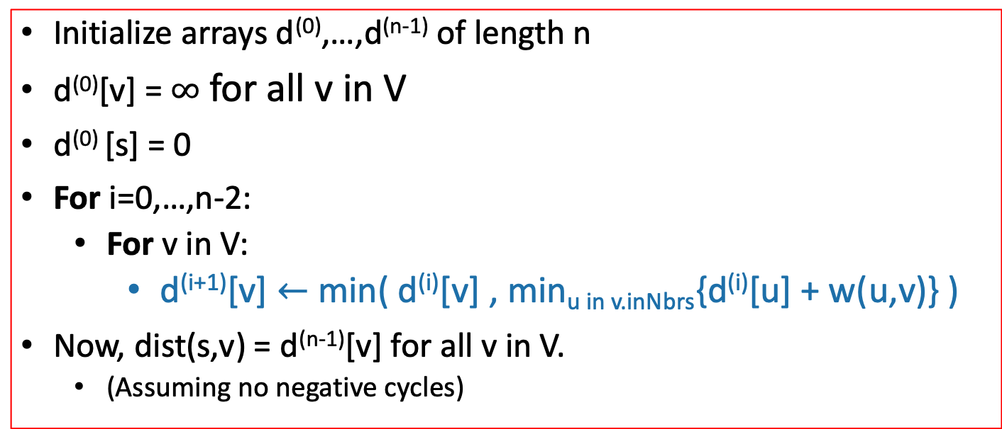
Bellman-Ford* algorithm
G = (V,E) is a graph with n vertices and m edges.
Bellman-Ford*(G,s):
Initialize arrays d⁽⁰⁾,…,d^{(n-1)} of length n
d⁽⁰⁾[v] = $∞$ for all v in V
d⁽⁰⁾ [s] = 0
For i=0,…,n-2:
  For v in V:
    d^{(i+1)}[v] $←$min( d^{(i)}[v] , min_{u in v.inNbrs}{d^{(i)}[u] + w(u,v)} )
Now, dist(s,v) = d^{(n-1)}[v] for all v in V.
  (Assuming no negative cycles)
Here, Dijkstra picked a special vertex u and updated u’s neighbors – Bellman-Ford will update all the vertices.
*Slightly different than some versions of Bellman-Ford…but this way is pedagogically convenient for today’s lecture.

Slide 16


Note on implementation
Don’t actually keep all n arrays around.
Just keep two at a time: “last round” and “this round”
Gates Packard CS161 Union Dish
d⁽⁰⁾
0
$$∞$$
$$∞$$
$$∞$$
$$∞$$
d⁽¹⁾
0
1
$$∞$$
$$∞$$
25
d⁽²⁾
0
1
2
45
23
d⁽³⁾
0
1
2
6
23
Only need these two in order to compute d⁽⁴⁾
d⁽⁴⁾
0
1
2
6
23

Slide 17
Interpretation of d^{(i)}
Gates
0
$$2$$
1
For all vertices v, d^{(i)}[v] is equal to the cost of the shortest path between s and v with at most i edges.
CS161
1
Packard
Gates Packard CS161 Union Dish
$$1$$
4
d⁽⁰⁾
0
$$∞$$
$$∞$$
$$∞$$
$$∞$$
22
$$6$$
d⁽¹⁾
0
1
$$∞$$
$$∞$$
25
Union
d⁽²⁾
0
1
2
45
23
25
d⁽³⁾
0
1
2
6
23
20
d⁽⁴⁾
0
1
2
6
23
Dish
$$23$$

Slide 18
Why does Bellman-Ford work?
Inductive hypothesis:
  For all v, d^{(i)}[v] is equal to the cost of the shortest path between s and v with at most i edges.
Conclusion:
  For all v, d^{(n-1)}[v] is equal to the cost of the shortest path between s and v with at most n-1 edges.
Do the base case and inductive step!

Slide 19
Aside: simple paths
Assume there is no negative cycle.
“Simple” means that the path has no cycles in it.
Then there is a shortest path from s to t, and moreover there is a simple shortest path.
A simple path in a graph with n vertices has at most n-1 edges in it.
So there is a shortest path with at most n-1 edges
s
-2
v
10
t
2
-5
x
y
This cycle isn’t helping. Just get rid of it.
3
s
u
Can’t add another edge without making a cycle!
t
v

Slide 20
Why does Bellman-Ford work?
Inductive hypothesis:
  For all v, d^{(i)}[v] is equal to the cost of the shortest path between s and v with at most i edges.
Conclusion:
    For all v, d^{(n-1)}[v] is equal to the cost of the shortest path between s and v with at most n-1 edges.
    If there are no negative cycles, d^{(n-1)}[v] is equal to the cost of the shortest path.
Notice that negative edge weights are fine. Just not negative cycles.

Slide 21
Bellman-Ford take-aways
Running time is O(mn)
  For each of n rounds, update m edges.
Works fine with negative edges.
Does not work with negative cycles.
  No algorithm can – shortest paths aren’t defined if there are negative cycles.
B-F can detect negative cycles!
  Fun exercise! (Hint, what happens if you run Bellman-Ford for longer than n-1 iterations?)

Slide 22
Important thing about B-F for the rest of this lecture
Gates
0
$$2$$
1
For all vertices v, d^{(i)}[v] is equal to the cost of the shortest path between s and v with at most i edges.
CS161
1
Packard
Gates Packard CS161 Union Dish
$$1$$
4
d⁽⁰⁾
0
$$∞$$
$$∞$$
$$∞$$
$$∞$$
22
$$6$$
d⁽¹⁾
0
1
$$∞$$
$$∞$$
25
Union
d⁽²⁾
0
1
2
45
23
25
d⁽³⁾
0
1
2
6
23
20
d⁽⁴⁾
0
1
2
6
23
Dish
$$23$$

Slide 23
Bellman-Ford is an example of…
Dynamic Programming!
Today:
Example of Dynamic programming:
  Fibonacci numbers.
  (And Bellman-Ford)
What is dynamic programming, exactly?
  And why is it called “dynamic programming”?
Another example: Floyd-Warshall algorithm
  An “all-pairs” shortest path algorithm

Slide 24
Pre-Lecture exercise:
How not to compute Fibonacci Numbers
Definition:
  F(n) = F(n-1) + F(n-2), with F(1) = F(2) = 1.
  The first several are:
    1
    1
    2
    3
    5
    8
    13, 21, 34, 55, 89, 144,…
Question:
  Given n, what is F(n)?

Slide 25
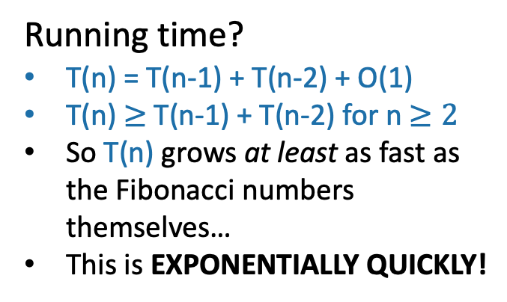
Candidate algorithm
def Fibonacci(n):
  if n == 0, return 0
  if n == 1, return 1
  return Fibonacci(n-1) + Fibonacci(n-2)
Running time?
T(n) = T(n-1) + T(n-2) + O(1)
T(n) $≥$T(n-1) + T(n-2) for n $≥2$
So T(n) grows at least as fast as the Fibonacci numbers themselves…
This is EXPONENTIALLY QUICKLY!
See IPython notebook for lecture 12

Slide 26
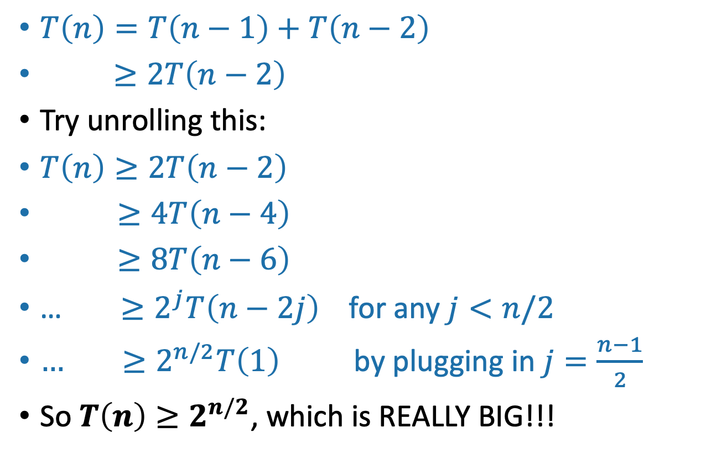
Why do the Fibonacci numbers grow exponentially quickly?
Slide skipped in class
$T\left(n\right)=T\left(n−1\right)+T\left(n−2\right)$
$≥2T\left(n−2\right)$
Try unrolling this:
$T\left(n\right)≥2T\left(n−2\right)$
$≥4T\left(n−4\right)$
$≥8T\left(n−6\right)$
… $≥2^{j}T\left(n−2j\right)$ for any $j<n/2$
$… ≥2^{n/2}T\left(1\right)$ by plugging in $j=\frac{n−1}{2}$
So $T\left(n\right)≥2^{n/2}$, which is REALLY BIG!!!
To be really precise, we could use induction! Also here we are assuming n is odd for convenience.

Slide 27
What’s going on?
Consider Fib(8)
That’s a lot of repeated computation!
8
6
7
4
5
5
6
2
3
3
4
3
4
4
5
0
1
1
2
1
2
2
3
1
2
2
3
2
3
3
4
1
2
2
etc
0
1
0
1
0
1
1
2
0
1
0
1
0
1
1
1
2
0
1
0
1
0
1
0
1

Slide 28
Maybe this would be better:
8
def fasterFibonacci(n):
  F = [0, 1, None, None, …, None ]
    \\ F has length n + 1
  for i = 2, …, n:
    F[i] = F[i-1] + F[i-2]
  return F[n]
7
6
Much better running time!
5
4
3
2
1
0

Slide 29
This was an example of…
Dynamic
Programming!

Slide 30
What is dynamic programming?
It is an algorithm design paradigm
  like divide-and-conquer is an algorithm design paradigm.
Usually it is for solving optimization problems
  eg, shortest path
  (Fibonacci numbers aren’t an optimization problem, but they are a good example of DP anyway…)

Slide 31
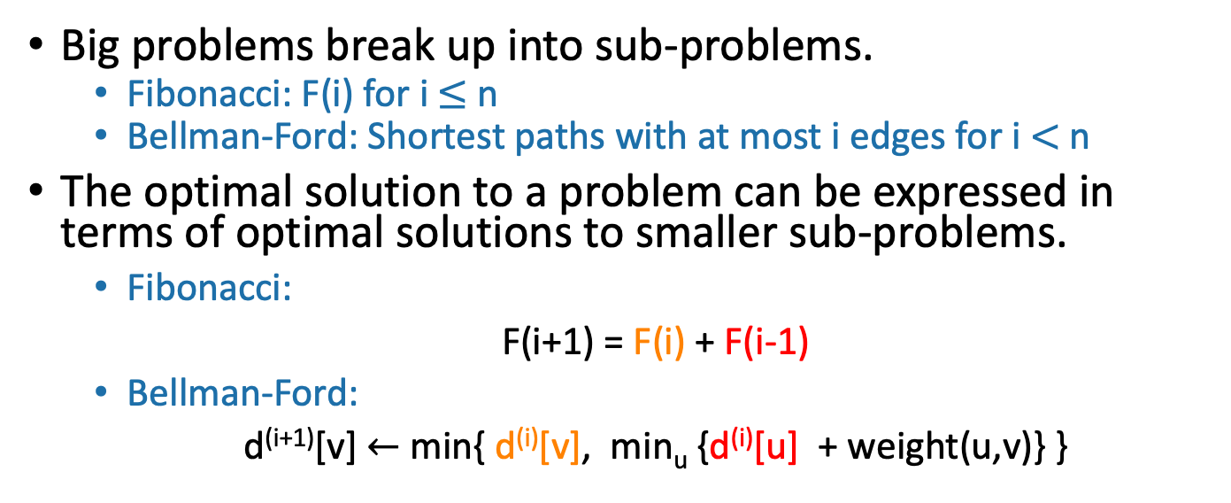
Elements of dynamic programming
1. Optimal sub-structure:
Big problems break up into sub-problems.
  Fibonacci: F(i) for i $≤$ n
  Bellman-Ford: Shortest paths with at most i edges for i $<$ n
The optimal solution to a problem can be expressed in terms of optimal solutions to smaller sub-problems.
      Fibonacci:
      F(i+1) = F(i) + F(i-1)
      Bellman-Ford:
      d^{(i+1)}[v] $←$ min{ d^{(i)}[v], min_{u} {d^{(i)}[u] + weight(u,v)} }
Shortest path with at most i edges from s to v
Shortest path with at most i edges from s to u.
*The word “optimal” makes sense in the context of optimization problems like shortest path, and is why this is called “Optimal Sub-structure.”

Slide 32
Elements of dynamic programming
2. Overlapping sub-problems:
The sub-problems overlap.
  Fibonacci:
    Both F[i+1] and F[i+2] directly use F[i].
    And lots of different F[i+x] indirectly use F[i].
  Bellman-Ford:
    Many different entries of d^{(i+1)} will directly use d^{(i)}[v].
    And lots of different entries of d^{(i+x)} will indirectly use d^{(i)}[v].
  This means that we can save time by solving a sub-problem just once and storing the answer.

Slide 33
Elements of dynamic programming
Optimal substructure.
  Optimal solutions to sub-problems can be used to find the optimal solution of the original problem.
Overlapping subproblems.
  The subproblems show up again and again
Using these properties, we can design a dynamic programming algorithm:
  Keep a table of solutions to the smaller problems.
  Use the solutions in the table to solve bigger problems.
  At the end we can use information we collected along the way to find the solution to the whole thing.

Slide 34
Two ways to think about and/or implement DP algorithms
Top down
Bottom up

Slide 35
Bottom up approach what we just saw.
For Fibonacci:
Solve the small problems first
  fill in F[0],F[1]
Then bigger problems
  fill in F[2]
…
Then bigger problems
  fill in F[n-1]
Then finally solve the real problem.
  fill in F[n]

Slide 36
Bottom up approach what we just saw.
For Bellman-Ford:
Solve the small problems first
  fill in d⁽⁰⁾
Then bigger problems
  fill in d⁽¹⁾
…
Then bigger problems
  fill in d^{(n-2)}
Then finally solve the real problem.
  fill in d^{(n-1)}

Slide 37
Top down approach
Think of it like a recursive algorithm.
To solve the big problem:
  Recurse to solve smaller problems
    Those recurse to solve smaller problems
      etc..
The difference from divide and conquer:
  Keep track of what small problems you’ve already solved to prevent re-solving the same problem twice.
  Aka, “memo-ization”

Slide 38
Example of top-down Fibonacci
define a global list F = [0,1,None, None, …, None]
def Fibonacci(n):
  if F[n] != None:
    return F[n]
  else:
    F[n] = Fibonacci(n-1) + Fibonacci(n-2)
  return F[n]
Memo-ization: Keeps track (in F) of the stuff you’ve already done.

Slide 39
Memo-ization visualization
Collapse repeated nodes and don’t do the same work twice!
8
6
7
4
5
5
6
2
3
3
4
3
4
4
5
0
1
1
2
1
2
2
3
1
2
2
3
2
3
3
4
1
2
2
etc
0
1
0
1
0
1
1
2
0
1
0
1
0
1
1
1
2
0
1
0
1
0
1
0
1

Slide 40
Memo-ization Visualization ctd
8
7
Collapse repeated nodes and don’t do the same work twice!
But otherwise treat it like the same old recursive algorithm.
6
5
4
define a global list F = [0,1,None, None, …, None]
def Fibonacci(n):
  if F[n] != None:
    return F[n]
  else:
    F[n] = Fibonacci(n-1) + Fibonacci(n-2)
  return F[n]
3
2
1
0

Slide 41
What have we learned?
Dynamic programming:
  Paradigm in algorithm design.
  Uses optimal substructure
  Uses overlapping subproblems
  Can be implemented bottom-up or top-down.
  It’s a fancy name for a pretty common-sense idea:
Don’t duplicate work if you don’t have to!

Slide 42
Why “dynamic programming” ?
Programming refers to finding the optimal “program.”
  as in, a shortest route is a plan aka a program.
Dynamic refers to the fact that it’s multi-stage.
But also it’s just a fancy-sounding name.
Manipulating computer code in an action movie?

Slide 43
Why “dynamic programming” ?
Richard Bellman invented the name in the 1950’s.
At the time, he was working for the RAND Corporation, which was basically working for the Air Force, and government projects needed flashy names to get funded.
From Bellman’s autobiography:
  “It’s impossible to use the word, dynamic, in the pejorative sense…I thought dynamic programming was a good name. It was something not even a Congressman could object to.”

Slide 44
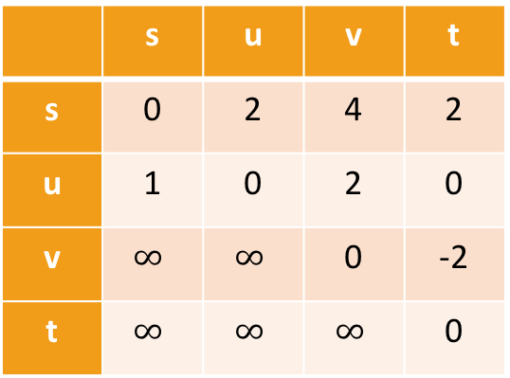
Floyd-Warshall Algorithm
Another example of DP
This is an algorithm for All-Pairs Shortest Paths (APSP)
  That is, I want to know the shortest path from u to v for ALL pairs u,v of vertices in the graph.
  Not just from a special single source s.
Destination
Source
 | s | u | v | t
s | 0 | 2 | 4 | 2
u | 1 | 0 | 2 | 0
v | $$∞$$ | $$∞$$ | 0 | -2
t | $$∞$$ | $$∞$$ | $$∞$$ | 0
s
2
u
1
5
2
t
v
-2

Slide 45
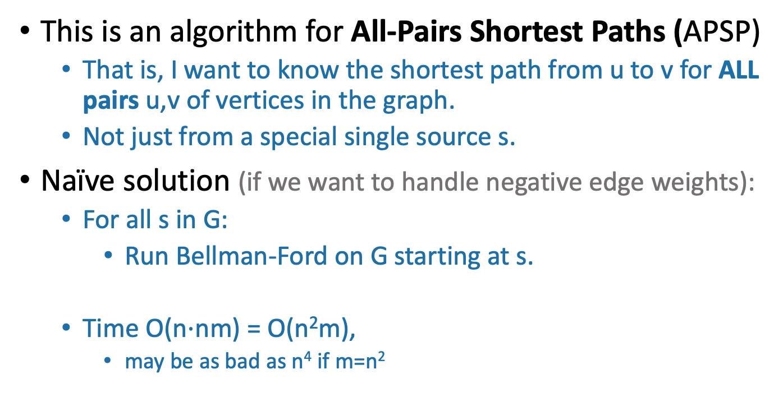
Floyd-Warshall Algorithm
Another example of DP
This is an algorithm for All-Pairs Shortest Paths (APSP)
  That is, I want to know the shortest path from u to v for ALL pairs u,v of vertices in the graph.
  Not just from a special single source s.
Naïve solution (if we want to handle negative edge weights):
  For all s in G:
    Run Bellman-Ford on G starting at s.
  Time O(n$⋅$nm) = O(n²m),
    may be as bad as n⁴ if m=n²
Can we do better?

Slide 46
Recipe for applying Dynamic Programming
Step 1: Identify optimal substructure.
  What are our subproblems?
Step 2: Find a recursive formulation for the subproblems
  How can we solve larger problems using smaller ones?
Step 3: Use dynamic programming to find the thing you want.
  Fill in a table, starting with the smallest sub-problems and building up.
(Steps 4 and 5 coming next lecture!)

Slide 47
Optimal substructure
Label the vertices 1,2,…,n
k
k+1
u
1
2
v
3
…
k-1
n

Slide 48
Optimal substructure
Label the vertices 1,2,…,n
(We omit some edges in the picture below – meant to be a cartoon, not an example).
Sub-problem(k-1):
For all pairs, u,v, find the cost of the shortest path from u to v, so that all the internal vertices on that path are in {1,…,k-1}.
k
Let D^{(k-1)}[u,v] be the solution to Sub-problem(k-1).
k+1
u
1
2
v
3
…
k-1
This is the shortest path from u to v through the blue set. It has cost D^{(k-1)}[u,v]
n
Vertices 1, …, k-1

Slide 49
Recipe for applying Dynamic Programming
Step 1: Identify optimal substructure.
  What are our subproblems?
Step 2: Find a recursive formulation for the subproblems
  How can we solve larger problems using smaller ones?
Step 3: Use dynamic programming to find the thing you want.
  Fill in a table, starting with the smallest sub-problems and building up.

Slide 50
How can we find D^{(k)}[u,v] using D^{(k-1)}?
D^{(k)}[u,v] is the cost of the shortest path from u to v so that all internal vertices on that path are in {1, …, k}.
k
k+1
Vertices 1, …, k
u
1
2
v
3
…
k-1
n
Vertices 1, …, k-1

Slide 51
How can we find D^{(k)}[u,v] using D^{(k-1)}?
D^{(k)}[u,v] is the cost of the shortest path from u to v so that all internal vertices on that path are in {1, …, k}.
Case 1: we don’t need vertex k.
k
k+1
Vertices 1, …, k
u
1
2
v
3
…
k-1
This path was the shortest before, so it’s still the shortest now.
n
Vertices 1, …, k-1
D^{(k)}[u,v] = D^{(k-1)}[u,v]

Slide 52
How can we find D^{(k)}[u,v] using D^{(k-1)}?
D^{(k)}[u,v] is the cost of the shortest path from u to v so that all internal vertices on that path are in {1, …, k}.
Case 2: we need vertex k.
k
k+1
Vertices 1, …, k
u
1
2
v
3
…
k-1
n
Vertices 1, …, k-1

Slide 53
Case 2 continued
Suppose there are no negative cycles. WLOG the shortest path from u to v through {1,…,k} is simple.
The shortest path from u to v looks like this:
This path is the shortest path from u to k through {1,…,k-1}.
  sub-paths of shortest paths are shortest paths
Similarly for this path.
Case 2: we need vertex k.
k
Vertices 1, …, k
u
1
2
v
3
…
k-1
n
Vertices 1, …, k-1
D^{(k)}[u,v] = D^{(k-1)}[u,k] + D^{(k-1)}[k,v]

Slide 54
How can we find D^{(k)}[u,v] using D^{(k-1)}?
Case 1: we don’t need vertex k.
Case 2: we need vertex k.
k
k
Vertices 1, …, k
Vertices 1, …, k
u
1
u
1
2
2
v
v
3
3
…
…
k-1
k-1
Vertices 1, …, k-1
Vertices 1, …, k-1
D^{(k)}[u,v] = D^{(k-1)}[u,v]
D^{(k)}[u,v] = D^{(k-1)}[u,k] + D^{(k-1)}[k,v]

Slide 55
How can we find D^{(k)}[u,v] using D^{(k-1)}?
D^{(k)}[u,v] = min{ D^{(k-1)}[u,v], D^{(k-1)}[u,k] + D^{(k-1)}[k,v] }
Optimal substructure:
  We can solve the big problem using solutions to smaller problems.
Overlapping sub-problems:
  D^{(k-1)}[k,v] can be used to help compute D^{(k)}[u,v] for lots of different u’s.
Case 1: Cost of shortest path through {1,…,k-1}
Case 2: Cost of shortest path from u to k and then from k to v through {1,…,k-1}

Slide 56
How can we find D^{(k)}[u,v] using D^{(k-1)}?
D^{(k)}[u,v] = min{ D^{(k-1)}[u,v], D^{(k-1)}[u,k] + D^{(k-1)}[k,v] }
Using our Dynamic programming paradigm, this gives us an algorithm!
Case 1: Cost of shortest path through {1,…,k-1}
Case 2: Cost of shortest path from u to k and then from k to v through {1,…,k-1}

Slide 57
Recipe for applying Dynamic Programming
Step 1: Identify optimal substructure.
  What are our subproblems?
Step 2: Find a recursive formulation for the subproblems
  How can we solve larger problems using smaller ones?
Step 3: Use dynamic programming to find the thing you want.
  Fill in a table, starting with the smallest sub-problems and building up.

Slide 58
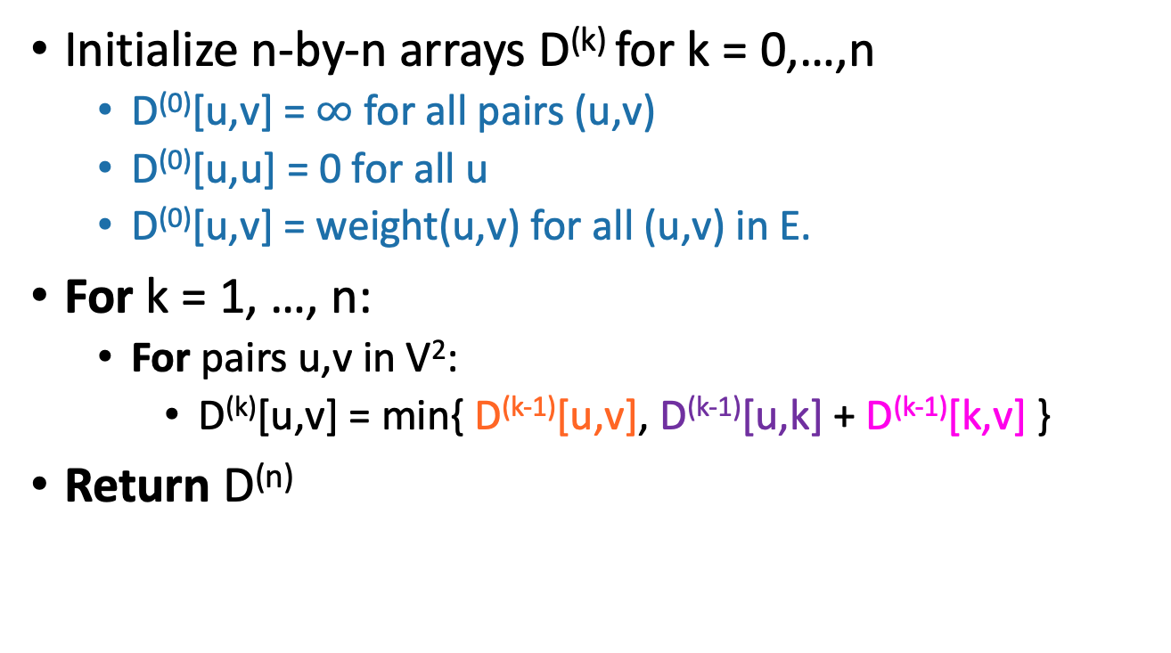
Floyd-Warshall algorithm
Initialize n-by-n arrays D^{(k)} for k = 0,…,n
  D⁽⁰⁾[u,v] = $∞$ for all pairs (u,v)
  D⁽⁰⁾[u,u] = 0 for all u
  D⁽⁰⁾[u,v] = weight(u,v) for all (u,v) in E.
For k = 1, …, n:
  For pairs u,v in V²:
    D^{(k)}[u,v] = min{ D^{(k-1)}[u,v], D^{(k-1)}[u,k] + D^{(k-1)}[k,v] }
Return D^{(n)}
The base case checks out: the only path through zero other vertices are edges directly from u to v.
This is a bottom-up Dynamic programming algorithm.

Slide 59
Our earlier logic shows
Theorem:
  If there are no negative cycles in a weighted directed graph G, then the Floyd-Warshall algorithm, running on G, returns a matrix D^{(n)} so that:
D^{(n)}[u,v] = distance between u and v in G.
Running time: O(n³)
  Better than running Bellman-Ford n times!
Storage:
  Need to store two n-by-n arrays, and the original graph.
Work out the details of a proof!
As with Bellman-Ford, we don’t really need to store all n of the D^{(k)}.

Slide 60
What if there are negative cycles?
Just like Bellman-Ford, Floyd-Warshall can detect negative cycles:
  “Negative cycle” means that there’s some v so that there is a path from v to v that has cost < 0.
  Aka, D^{(n)}[v,v] < 0.
Algorithm:
  Run Floyd-Warshall as before.
  If there is some v so that D^{(n)}[v,v] < 0:
    return negative cycle.

Slide 61
What have we learned?
The Floyd-Warshall algorithm is another example of dynamic programming.
It computes All Pairs Shortest Paths in a directed weighted graph in time O(n³).

Slide 62
Can we do better than O(n³)?
Nothing on this slide is required knowledge for this class
There is an algorithm that runs in time O(n³/log¹⁰⁰(n)).
  [Williams, “Faster APSP via Circuit Complexity”, STOC 2014]
If you can come up with an algorithm for All-Pairs-Shortest-Path that runs in time O(n^{2.99}), that would be a really big deal.
  Let me know if you can!
  See [Abboud, Vassilevska-Williams, “Popular conjectures imply strong lower bounds for dynamic problems”, FOCS 2014] for some evidence that this is a very difficult problem!

Slide 63
Recipe for applying Dynamic Programming
Step 1: Identify optimal substructure.
Step 2: Find a recursive formulation for the thing you want.
  E.g, length of shortest paths
Step 3: Use dynamic programming to find the thing you want.
  Fill in a table, starting with the smallest sub-problems and building up.
(Steps 4 and 5 coming next lecture…)

Slide 64
Recap
Two shortest-path algorithms:
  Bellman-Ford for single-source shortest path
  Floyd-Warshall for all-pairs shortest path
Dynamic programming!
  This is a fancy name for not repeating work!

Slide 65
Next time
More examples of dynamic programming!
No pre-lecture exercise for next time: go over your exam instead!
We will stop bullets with our action-packed coding skills, and also maybe find longest common subsequences.

