Slide 1
Lecture 5
Randomized algorithms and QuickSort
https://xkcd.com/1185/

Slide 2
Announcements
HW2 Due Wednesday!
Add/Drop deadline is Friday!
  We will release grades for HW1 well before then so you have some more data.
CS161A (ACE) materials are available for everyone on the course website!
  Thanks Stephan!
HW Party this week will be in BISHOP (not Gates)
Is anyone missing a red Stanford hoodie?
  Left at Michelle’s section last week
  It’s in my office (Gates 168), shoot me an email to find a time to pick it up (marykw@stanford)

Slide 3
More announcements
When submitting HW:
  If working in a group, and you want to submit together, please tag your group-mates!
  If you re-submit, you need to re-tag all your group members.
  If working in a group and you want to submit similar but separate PSETs, please list your group-mates at the top of the assignment.

Slide 4
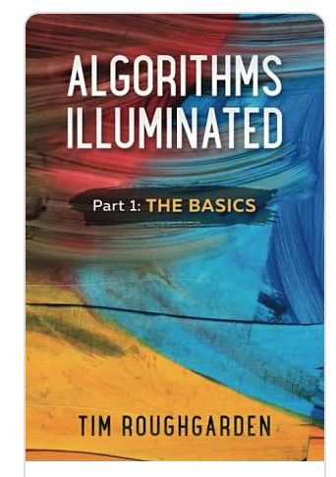
More announcements
A few notes from feedback
The laser pointer doesn’t show up on the videos
  Sorry! Better now?
Office hours are crazy!
  We are sorry and we are working on it! In the meantime, consider:
    HW party (there were way fewer people in Week 2)
    Section
    OH earlier in the HW cycle
The lectures sometimes skip over some details...where can we get those details?
  Check out the textbook! There’s a reading assignment for every lecture posted on the webpage!
Please keep sending us feedback!
  Anonymous feedback form on website
  High-resolution feedback (random sample)
  Just post on Ed

Slide 5
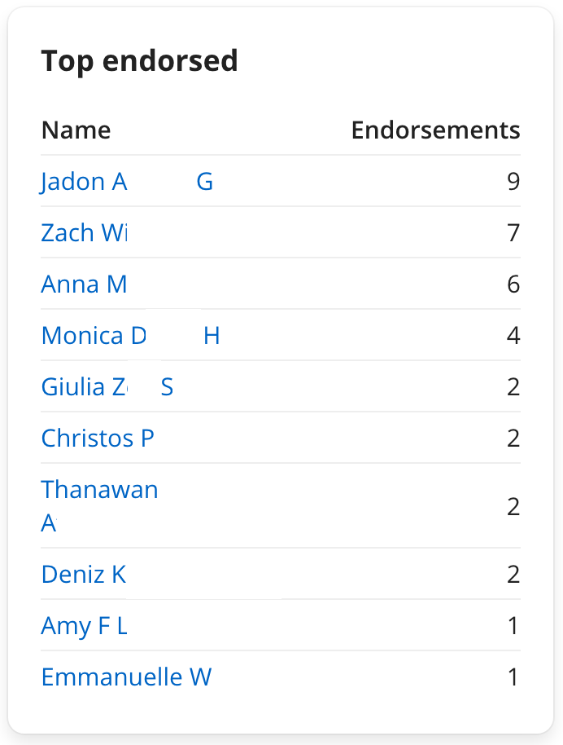
Ed Heroes!
As of Sunday evening

Slide 6
Last time
We saw a divide-and-conquer algorithm to solve the Select problem in time O(n) in the worst-case.
It all came down to picking the pivot…
We choose a pivot cleverly
We choose a pivot randomly.

Slide 7
Randomized algorithms
We make some random choices during the algorithm.
We hope the algorithm works.
We hope the algorithm is fast.
For today we will look at algorithms that always work and are probably fast.
e.g., Select with a random pivot is a randomized algorithm.
Always works (aka, is correct).
Probably fast.

Slide 8
Today
How do we analyze randomized algorithms?
A few randomized algorithms for sorting.
  BogoSort
  QuickSort
BogoSort is a pedagogical tool.
QuickSort is important to know. (in contrast with BogoSort…)

Slide 9
How do we measure the runtime of a randomized algorithm?
Scenario 1
Scenario 2
You publish your algorithm.
Bad guy picks the input.
You run your randomized algorithm.
You publish your algorithm.
Bad guy picks the input.
Bad guy chooses the randomness (fixes the dice) and runs your algorithm.
In Scenario 1, the running time is a random variable.
  It makes sense to talk about expected running time.
In Scenario 2, the running time is not random.
  We call this the worst-case running time of the randomized algorithm.

Slide 10
Today
How do we analyze randomized algorithms?
A few randomized algorithms for sorting.
  BogoSort
  QuickSort
BogoSort is a pedagogical tool.
QuickSort is important to know. (in contrast with BogoSort…)

Slide 11
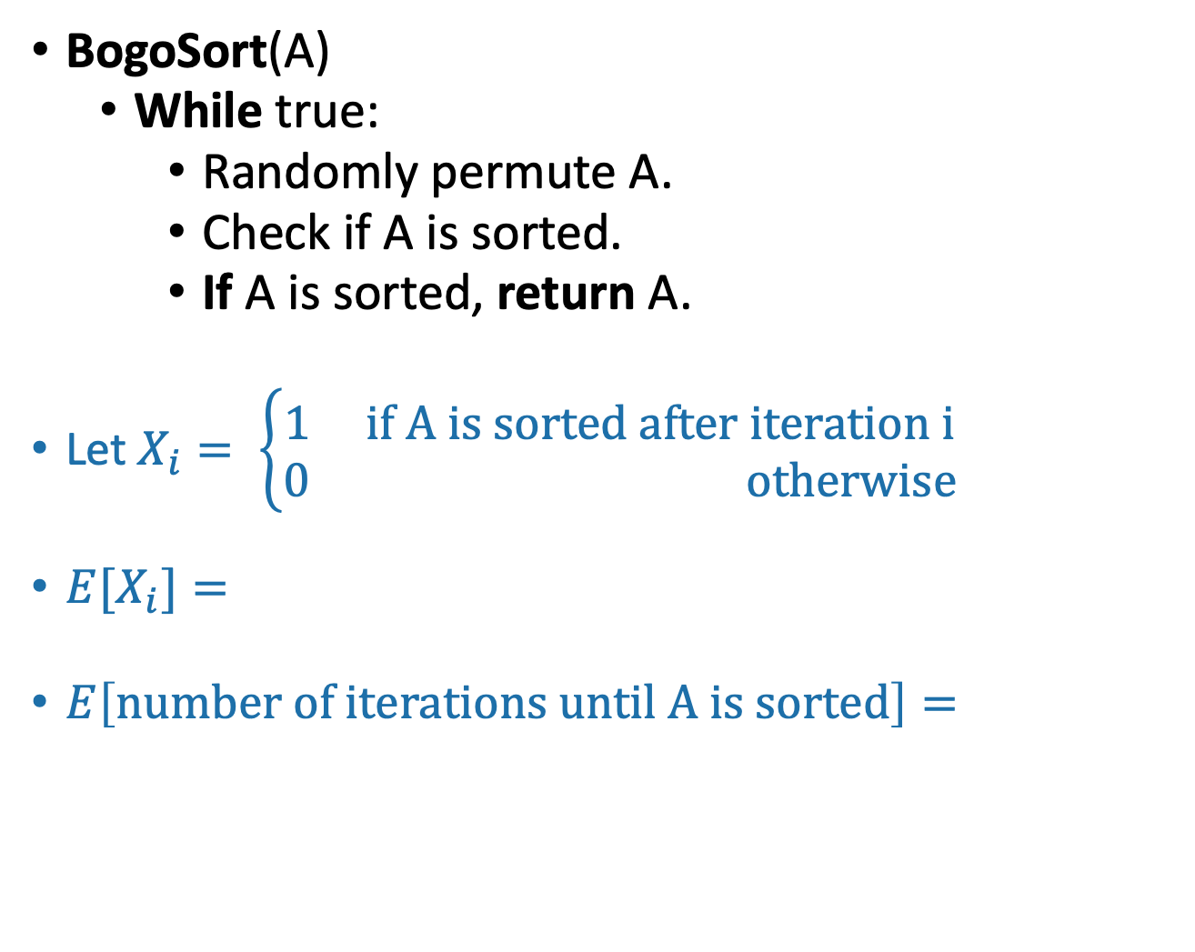
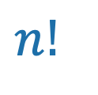
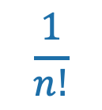
From your pre-lecture exercise:
BogoSort
Assume A has distinct entries
Suppose that you can draw a random integer in {1,…,n} in time O(1). How would you randomly permute an array in-place in time O(n)?
BogoSort(A)
  While true:
    Randomly permute A.
    Check if A is sorted.
    If A is sorted, return A.
Let $X_{i}= \left\{\begin{aligned}1 if A is sorted after iteration i \\ 0 otherwise\end{aligned}\right.$
${E[X}_{i}]=$
$E\left[number of iterations until A is sorted\right]=$
Ollie the over-achieving ostrich
$$\frac{1}{n!}$$
There are $n!$possible orderings, and only one of them is sorted.
$$n!$$
Follows from properties of geometric random variables! (c.f. CS109). Or see skipped slides.

Slide 12
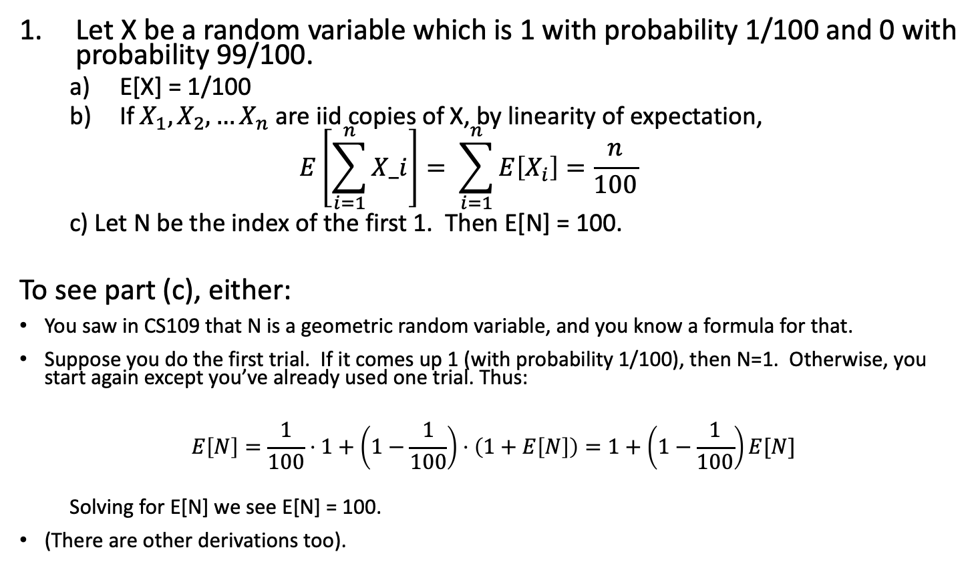
Solutions to pre-lecture exercise 1
SLIDE SKIPPED IN CLASS: For reference only.
Let X be a random variable which is 1 with probability 1/100 and 0 with probability 99/100.
  E[X] = 1/100
  If $X_{1},X_{2},…X_{n}$ are iid copies of X, by linearity of expectation,
  $$E\left[\sum_{i=1}^{n}{X_i}\right]= \sum_{i=1}^{n}{E\left[X_{i}\right]=\frac{n}{100}}$$
  c) Let N be the index of the first 1. Then E[N] = 100.
To see part (c), either:
You saw in CS109 that N is a geometric random variable, and you know a formula for that.
Suppose you do the first trial. If it comes up 1 (with probability 1/100), then N=1. Otherwise, you start again except you’ve already used one trial. Thus:
$$E\left[N\right]=\frac{1}{100}⋅1+\left(1−\frac{1}{100}\right)⋅\left(1+E\left[N\right]\right)=1+\left(1−\frac{1}{100}\right)E[N]$$
  Solving for E[N] we see E[N] = 100.
(There are other derivations too).

Slide 13
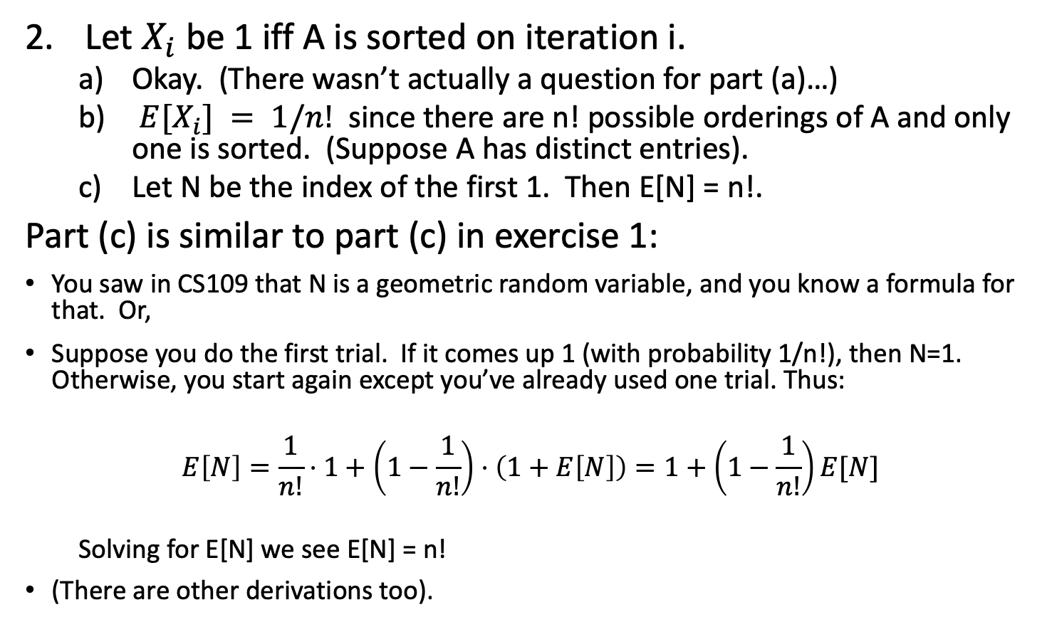
Solutions to pre-lecture exercise 2
SLIDE SKIPPED IN CLASS: For reference only.
Let$X_{i}$be 1 iff A is sorted on iteration i.
  Okay. (There wasn’t actually a question for part (a)…)
  $E[X_{i}] = 1/n!$ since there are n! possible orderings of A and only one is sorted. (Suppose A has distinct entries).
  Let N be the index of the first 1. Then E[N] = n!.
Part (c) is similar to part (c) in exercise 1:
You saw in CS109 that N is a geometric random variable, and you know a formula for that. Or,
Suppose you do the first trial. If it comes up 1 (with probability 1/n!), then N=1. Otherwise, you start again except you’ve already used one trial. Thus:
$$E\left[N\right]=\frac{1}{n!}⋅1+\left(1−\frac{1}{n!}\right)⋅\left(1+E\left[N\right]\right)=1+\left(1−\frac{1}{n!}\right)E[N]$$
  Solving for E[N] we see E[N] = n!
(There are other derivations too).

Slide 14
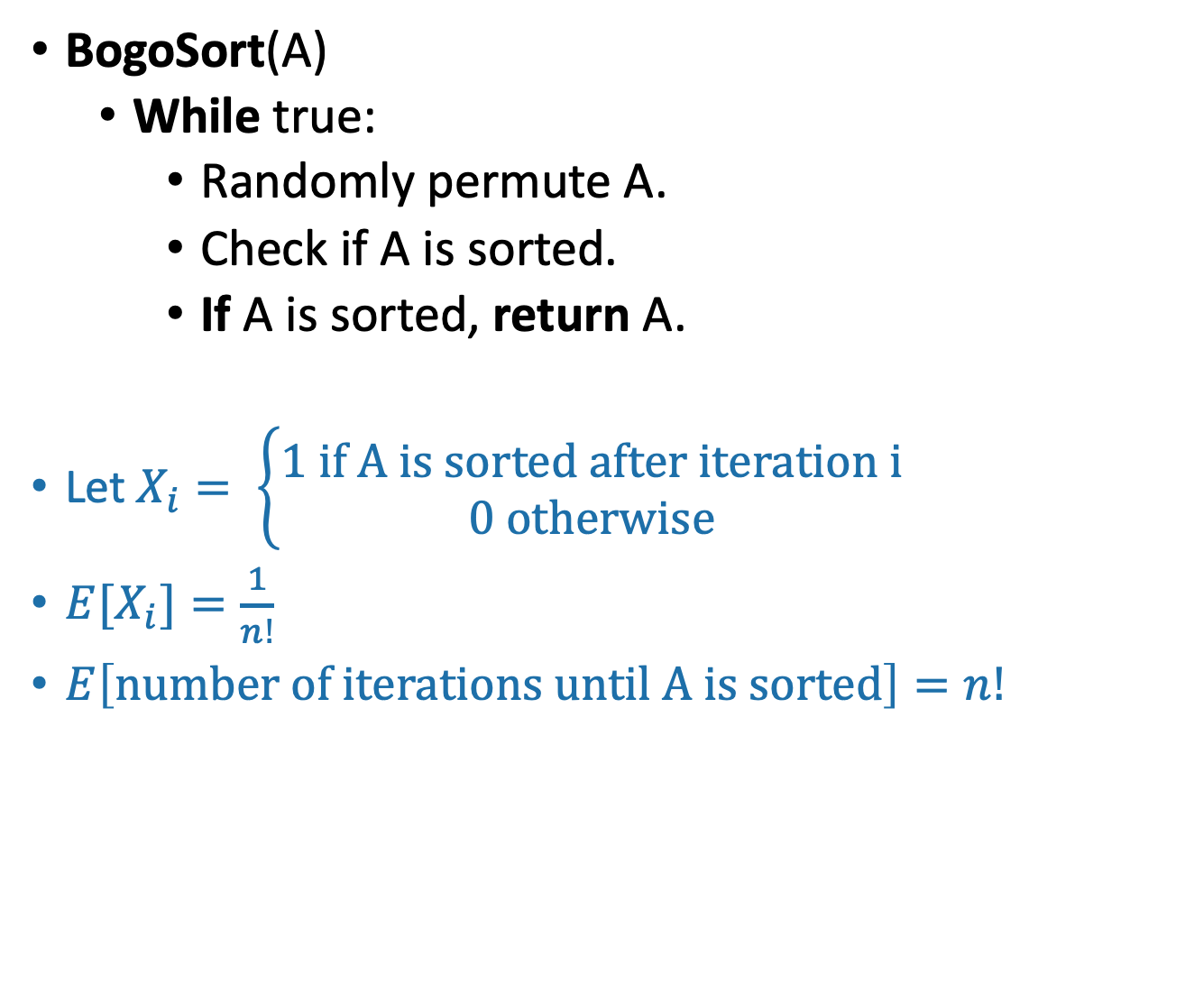
From your pre-lecture exercise:
BogoSort
Assume A has distinct entries
Suppose that you can draw a random integer in {1,…,n} in time O(1). How would you randomly permute an array in-place in time O(n)?
BogoSort(A)
  While true:
    Randomly permute A.
    Check if A is sorted.
    If A is sorted, return A.
Let $X_{i}= \left\{\begin{aligned}1 if A is sorted after iteration i \\ 0 otherwise\end{aligned}\right.$
${E[X}_{i}]=\frac{1}{n!}$
$E\left[number of iterations until A is sorted\right]=n!$
Ollie the over-achieving ostrich
There are $n!$possible orderings, and only one of them is sorted.
Follows from properties of geometric random variables! (c.f. CS109). Or see skipped slides.

Slide 15
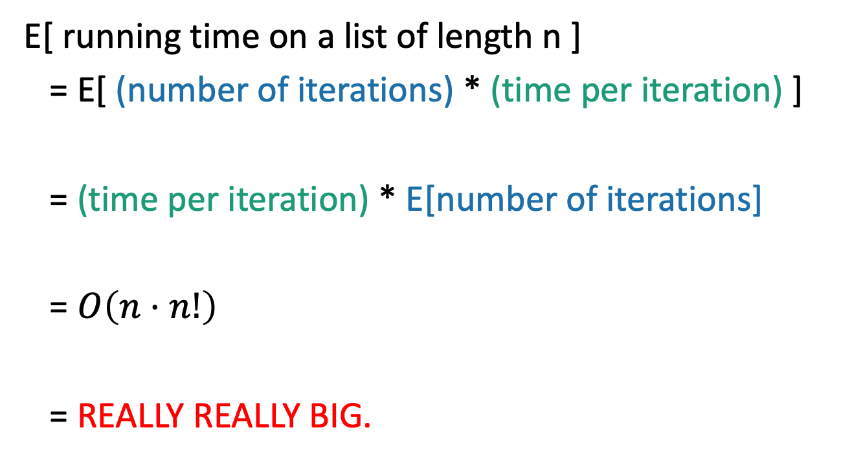
Expected Running time of BogoSort
This isn’t random, so we can pull it out of the expectation.
E[ running time on a list of length n ]
= E[ (number of iterations) * (time per iteration) ]
= (time per iteration) * E[number of iterations]
= $O\left(n⋅n!\right)$
= REALLY REALLY BIG.
This is O(n) (to permute and then check if sorted)
We just computed this. It’s n!.

Slide 16
Worst-case running time of BogoSort?
Think-Pair-Share Terrapins!
1 minute: think
1 minute: pair and share
BogoSort(A)
  While true:
    Randomly permute A.
    Check if A is sorted.
    If A is sorted, return A.

Slide 17
Worst-case running time of BogoSort?
Infinite!
Think-Pair-Share Terrapins!
BogoSort(A)
  While true:
    Randomly permute A.
    Check if A is sorted.
    If A is sorted, return A.

Slide 18
What have we learned?
Expected running time:
  You publish your randomized algorithm.
  Bad guy picks an input.
  You get to roll the dice.
Worst-case running time:
  You publish your randomized algorithm.
  Bad guy picks an input.
  Bad guy gets to “roll” the dice.
Don’t use bogoSort.

Slide 19
Today
How do we analyze randomized algorithms?
A few randomized algorithms for sorting.
  BogoSort
  QuickSort
BogoSort is a pedagogical tool.
QuickSort is important to know. (in contrast with BogoSort…)

Slide 20
a better randomized algorithm:
QuickSort
Expected runtime O(nlog(n)).
Worst-case runtime O(n²).
In practice works great!

Slide 21
Quicksort
For the rest of the lecture, assume all elements of A are distinct.
We want to sort this array.
First, pick a “pivot.”
Do it at random.
7
6
3
5
1
2
4
7
6
3
5
1
2
4
This PARTITION step takes time O(n). (Notice that we don’t sort each half).
[same as in SELECT]
Next, partition the array into “bigger than 5” or “less than 5”
random pivot!
Arrange them like so:
L = array with things smaller than A[pivot]
R = array with things larger than A[pivot]
Recurse on
L and R:
1
2
3
4
5
6
7

Slide 22
PseudoPseudoCode for what we just saw
IPython Lecture 5 notebook for actual code.
QuickSort(A):
  If len(A) <= 1:
    return
  Pick some x = A[i] at random. Call this the pivot.
  PARTITION the rest of A into:
    L (less than x) and
    R (greater than x)
  Replace A with [L, x, R] (that is, rearrange A in this order)
  QuickSort(L)
  QuickSort(R)
Assume that all elements of A are distinct. How would you change this if that’s not the case?

Slide 23

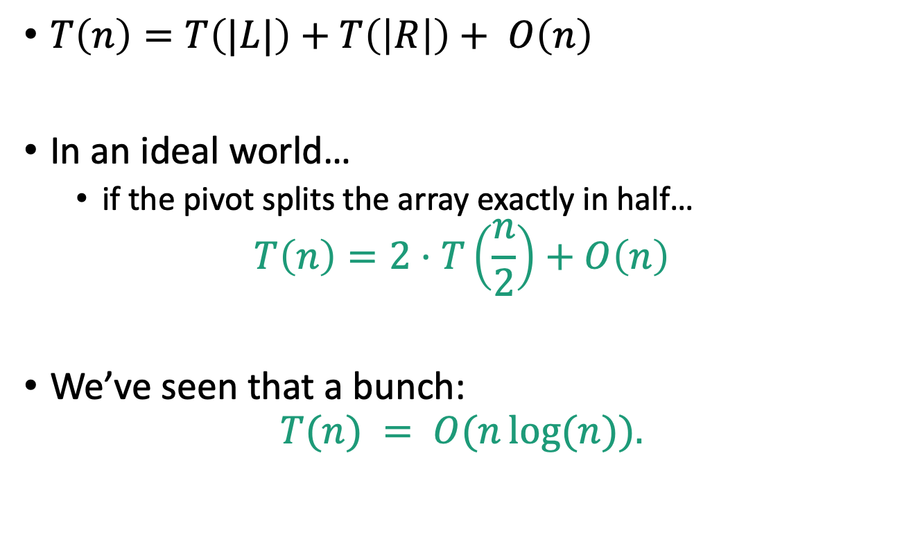
Running time?
$T\left(n\right)=T\left(|L|\right)+T\left(\left|R\right|\right)+ O\left(n\right)$
In an ideal world…
  if the pivot splits the array exactly in half…
$$T\left(n\right)=2⋅T\left(\frac{n}{2}\right)+O\left(n\right)$$
We’ve seen that a bunch:
$$T(n) = O(n\log{(n)}).$$

Slide 24
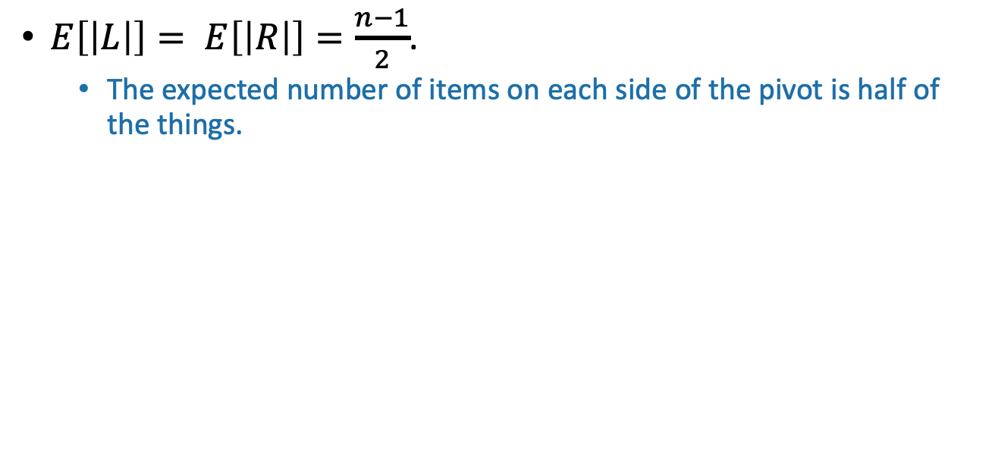
The expected running time of QuickSort is O(nlog(n)).
*
Proof:
$E\left[\left|L\right|\right]= E\left[\left|R\right|\right]=\frac{n−1}{2}$.
  The expected number of items on each side of the pivot is half of the things.

Slide 25
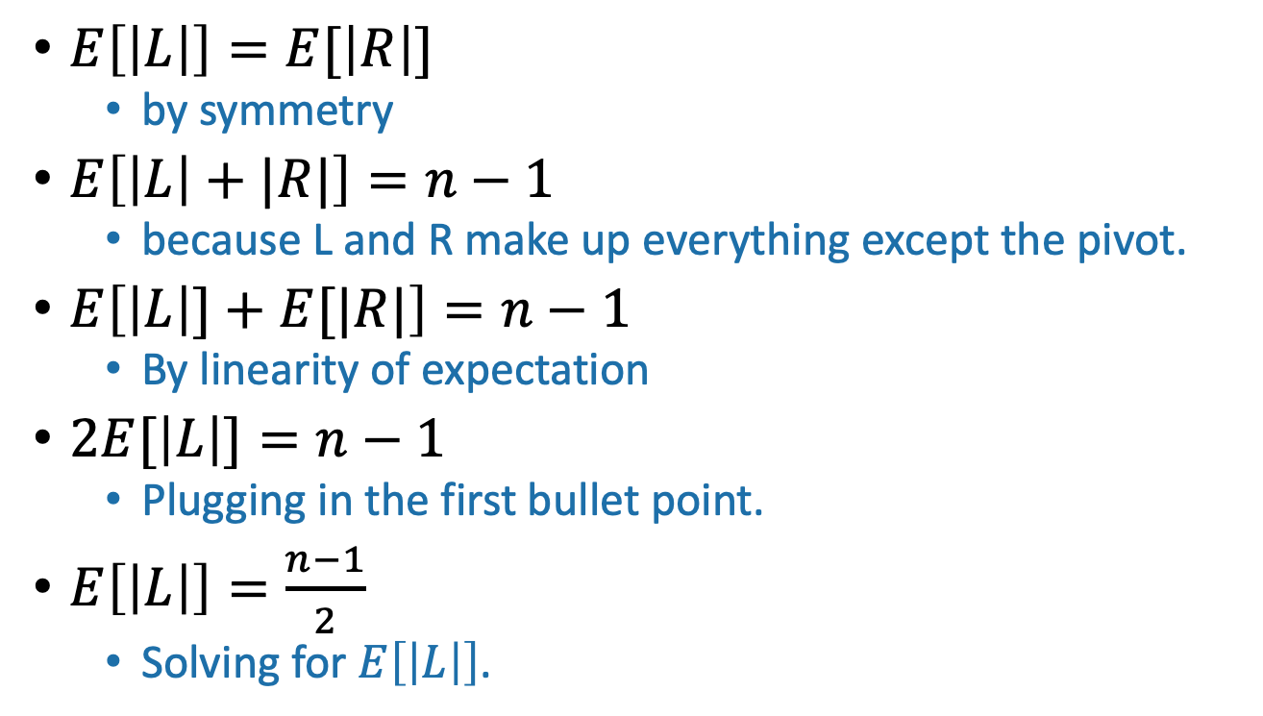
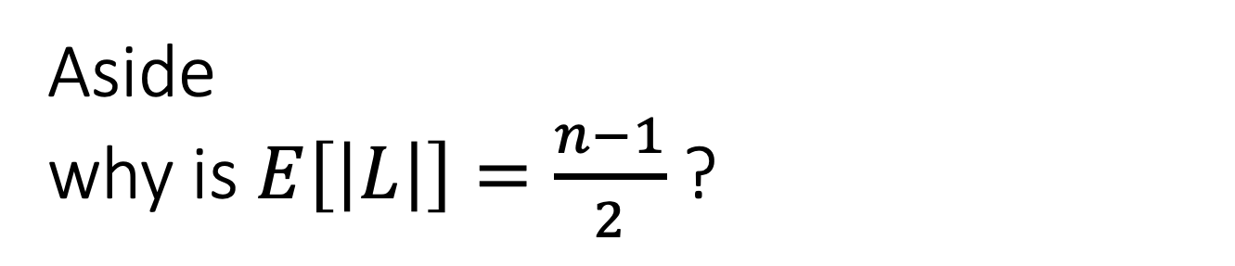
Aside why is $E\left[\left|L\right|\right]=\frac{n−1}{2}$?
Remember, we are assuming all elements of A are distinct
$E\left[\left|L\right|\right]=E[\left|R\right|]$
  by symmetry
$E\left[\left|L\right|+|R|\right]=n−1$
  because L and R make up everything except the pivot.
$E\left[\left|L\right|]+E[|R|\right]=n−1$
  By linearity of expectation
$2E[\left|L\right|]=n−1$
  Plugging in the first bullet point.
$E\left[\left|L\right|\right]=\frac{n−1}{2}$
  Solving for $E\left[\left|L\right|\right]$.

Slide 26
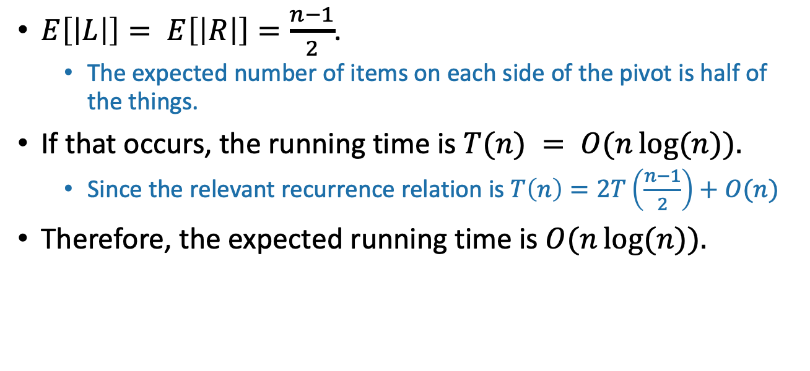
The expected running time of QuickSort is O(nlog(n)).
*
Proof:
$E\left[\left|L\right|\right]= E\left[\left|R\right|\right]=\frac{n−1}{2}$.
  The expected number of items on each side of the pivot is half of the things.
If that occurs, the running time is $T(n) = O(n\log{(n)}).$
  Since the relevant recurrence relation is $T\left(n\right)=2T\left(\frac{n−1}{2}\right)+O(n)$
Therefore, the expected running time is $O(n\log{(n)}).$
*Disclaimer: this proof is wrong.

Slide 27
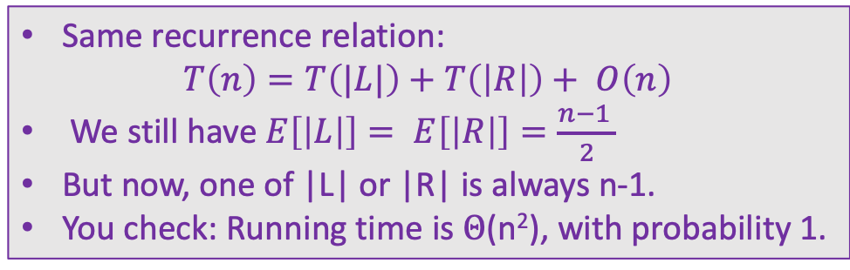
Red flag
Slow
QuickSort(A):
  If len(A) <= 1:
    return
  Pick some x = A[i] at random. Call this the pivot.
  PARTITION the rest of A into:
    L (less than x) and
    R (greater than x)
  Replace A with [L, x, R] (that is, rearrange A in this order)
  QuickSort(L)
  QuickSort(R)
We can use the same argument to prove something false.
  Pick the pivot x to be either max(A) or min(A), randomly
    \\ We can find the max and min in O(n) time
Slow
Same recurrence relation:
$$T\left(n\right)=T\left(|L|\right)+T\left(\left|R\right|\right)+ O\left(n\right)$$
We still have $E\left[\left|L\right|\right]= E\left[\left|R\right|\right]=\frac{n−1 }{2}$
But now, one of |L| or |R| is always n-1.
You check: Running time is $Θ$(n²), with probability 1.
Slow

Slide 28
The expected running time of SlowSort is O(nlog(n)).
What’s wrong???
2 minutes: think
1 minute: pair and share
*
Proof:
$E\left[\left|L\right|\right]= E\left[\left|R\right|\right]=\frac{n−1}{2}$.
  The expected number of items on each side of the pivot is half of the things.
If that occurs, the running time is $T(n) = O(n\log{(n)}).$
  Since the relevant recurrence relation is $T\left(n\right)=2T\left(\frac{n−1}{2}\right)+O(n)$
Therefore, the expected running time is $O(n\log{(n)}).$
*Disclaimer: this proof is wrong.

Slide 29
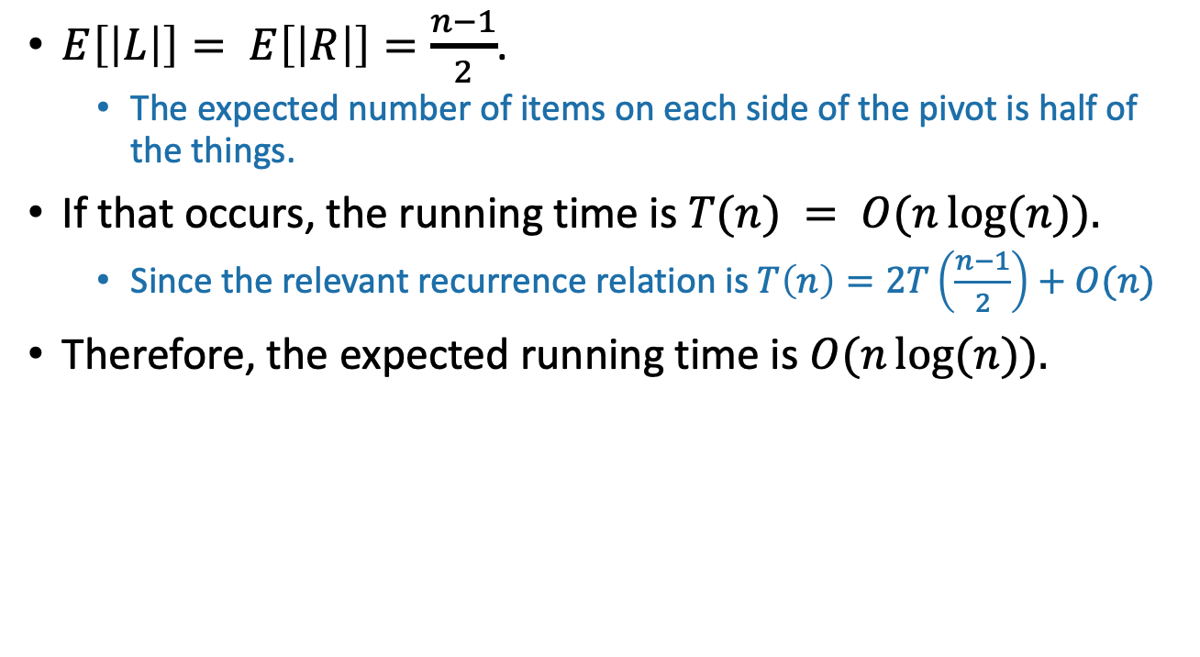
What’s wrong?
$E\left[\left|L\right|\right]= E\left[\left|R\right|\right]=\frac{n−1}{2}$.
  The expected number of items on each side of the pivot is half of the things.
If that occurs, the running time is $T(n) = O(n\log{(n)}).$
  Since the relevant recurrence relation is $T\left(n\right)=2T\left(\frac{n−1}{2}\right)+O(n)$
Therefore, the expected running time is $O(n\log{(n)}).$
That’s not how expectations work!
The running time in the “expected” situation is not the same as the expected running time.
Sort of like how E[X²] is not the same as (E[X])²
Plucky the Pedantic Penguin

Slide 30
Instead
We’ll have to think a little harder about how the algorithm works.
Next goal:
Get the same conclusion, correctly!

Slide 31
Example of recursive calls
7
6
3
5
1
2
4
Pick 5 as a pivot
3
1
2
4
5
7
6
Partition on either side of 5
Recurse on [3142] and pick 3 as a pivot.
3
1
2
4
5
7
6
Recurse on [76] and pick 6 as a pivot.
Partition around 3.
1
2
3
4
5
6
7
Partition on either side of 6
Recurse on [12] and pick 2 as a pivot.
1
2
3
4
5
6
7
Recurse on [7], it has size 1 so we’re done.
Recurse on [4] (done).
1
2
3
4
5
6
7
partition around 2.
1
2
3
4
5
6
7
Recurse on [1] (done).

Slide 32
How long does this take to run?
We will count the number of comparisons that the algorithm does.
  This turns out to give us a good idea of the runtime. (Not obvious).
How many times are any two items compared?
7
6
3
5
1
2
4
In the example before, everything was compared to 5 once in the first step….and never again.
3
1
4
2
5
7
6
3
1
2
4
5
7
6
But not everything was compared to 3.
5 was, and so were 1,2 and 4.
But not 6 or 7.
1
2
3
4
5
6
7

Slide 33
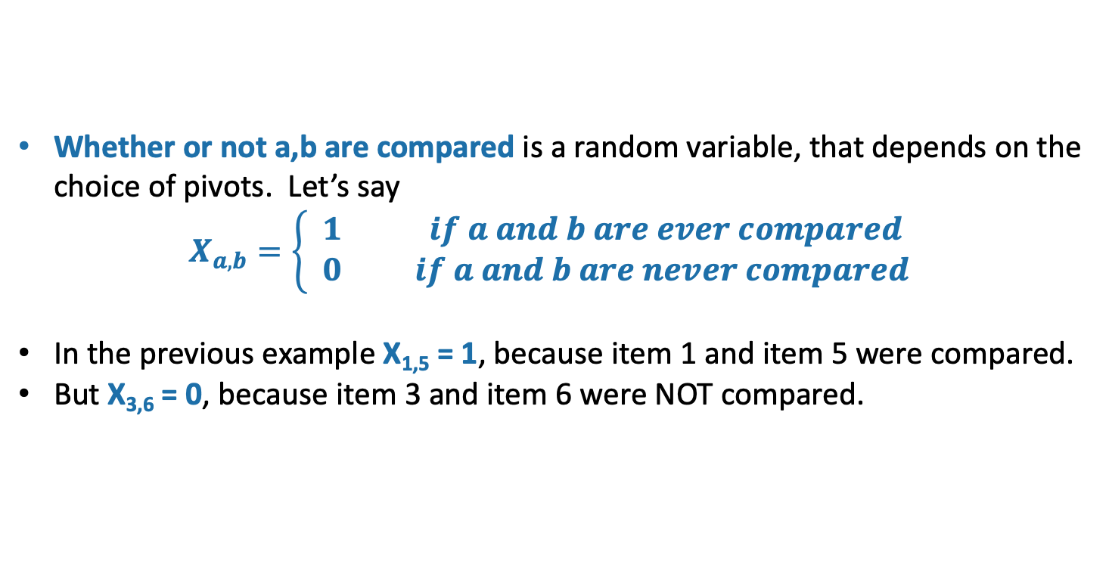
Each pair of items is compared either 0 or 1 times. Which is it?
7
6
3
5
1
2
4
Let’s assume that the numbers in the array are actually the numbers 1,…,n
Of course this doesn’t have to be the case! It’s a good exercise to convince yourself that the analysis will still go through without this assumption. (See analysis in the textbook! And there’s a hidden slide.)
Whether or not a,b are compared is a random variable, that depends on the choice of pivots. Let’s say
$$X_{a,b}=\left\{\begin{aligned}1 if a and b are ever compared \\ 0 if a and b are never compared \end{aligned}\right.$$
In the previous example X_{1,5} = 1, because item 1 and item 5 were compared.
But X_{3,6} = 0, because item 3 and item 6 were NOT compared.

Slide 34
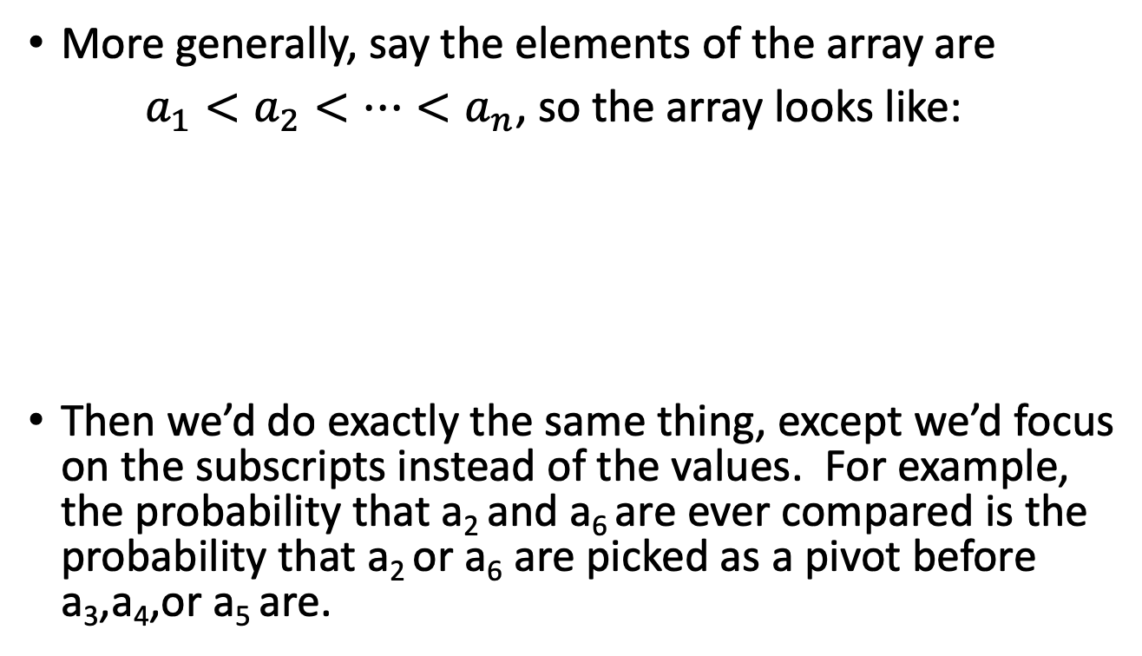
Aside:
Why can we assume that the elements of the array are {1,2,..,n}?
Slide skipped in class
More generally, say the elements of the array are
$a_{1}<a_{2}<⋯<a_{n}$, so the array looks like:
Then we’d do exactly the same thing, except we’d focus on the subscripts instead of the values. For example, the probability that a₂ and a₆ are ever compared is the probability that a₂ or a₆ are picked as a pivot before a₃,a₄,or a₅ are.
a₇
a₆
a₃
a₅
a₁
a₂
a₄

Slide 35
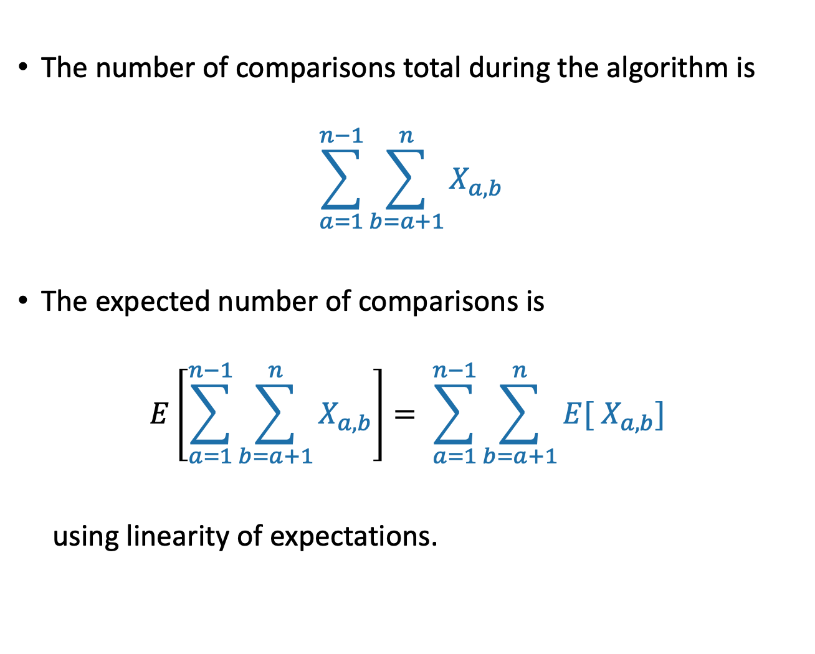
Counting comparisons
The number of comparisons total during the algorithm is
$$\sum_{a=1}^{n−1}{\sum_{b=a+1}^{n}{X_{a,b}}}$$
The expected number of comparisons is
$$E\left[\sum_{a=1}^{n−1}{\sum_{b=a+1}^{n}{X_{a,b}}}\right]= \sum_{a=1}^{n−1}{\sum_{b=a+1}^{n}{{E[ X}_{a,b}] }}$$
using linearity of expectations.

Slide 36
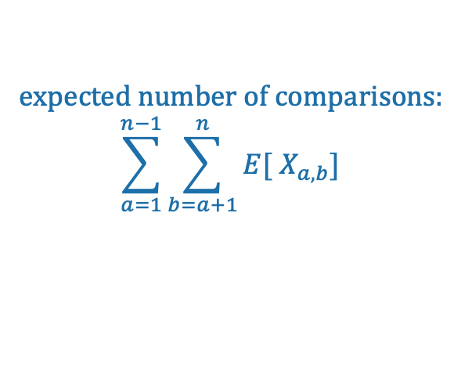
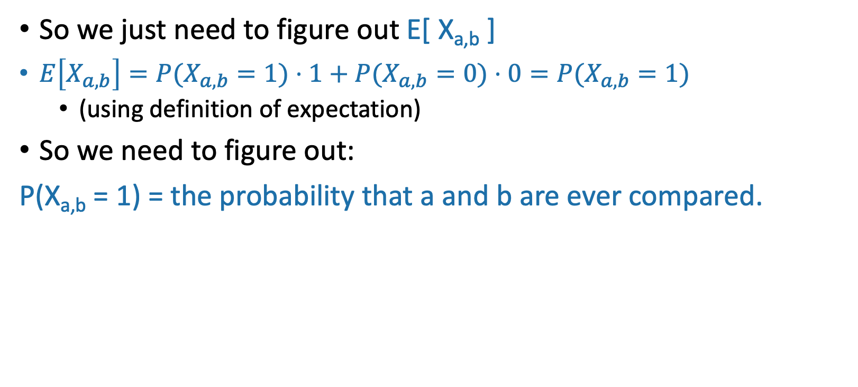
Counting comparisons
expected number of comparisons:
$$\sum_{a=1}^{n−1}{\sum_{b=a+1}^{n}{{E[ X}_{a,b}] }}$$
So we just need to figure out E[ X_{a,b} ]
$E\left[X_{a,b}\right]=P(X_{a,b}=1)⋅1+P(X_{a,b}=0)⋅0=P(X_{a,b}=1)$
  (using definition of expectation)
So we need to figure out:
P(X_{a,b} = 1) = the probability that a and b are ever compared.
7
6
3
5
1
2
4
Say that a = 2 and b = 6. What is the probability that 2 and 6 are ever compared?
7
6
3
5
1
2
4
This is exactly the probability that either 2 or 6 is first picked to be a pivot out of the highlighted entries.
Indeed, the only way 2 and 6 aren’t compared to each other is if 3,4,5 are picked first.
3
1
2
4
5
7
6
If, say, 5 were picked first, then 2 and 6 would be separated and never see each other again.

Slide 37
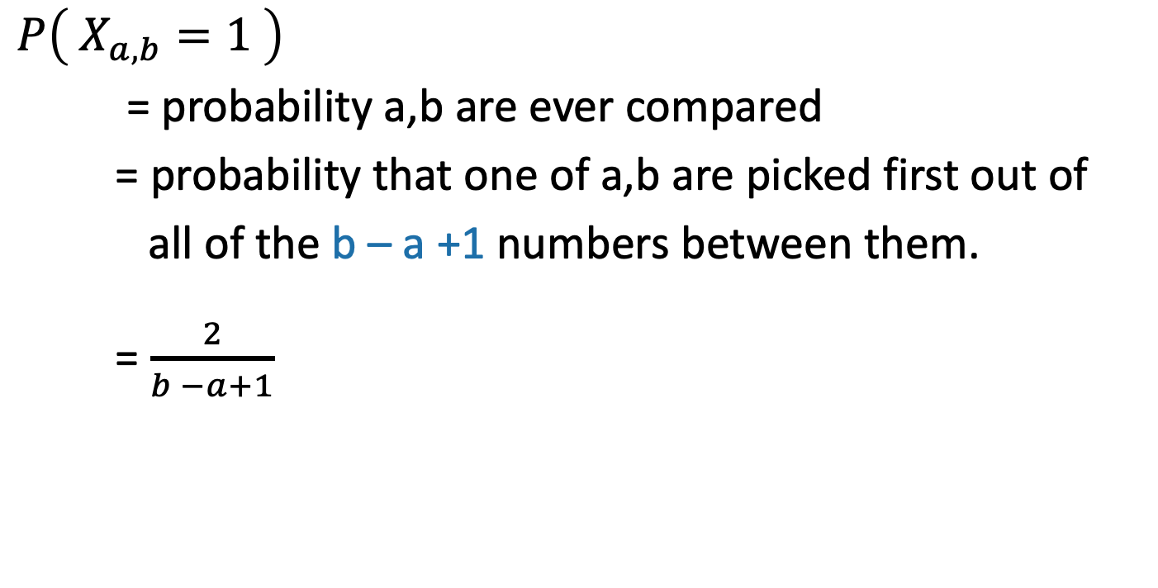
Counting comparisons
$P\left( X_{a,b}=1 \right)$
= probability a,b are ever compared
= probability that one of a,b are picked first out of
all of the b – a +1 numbers between them.
= $\frac{2}{b −a+1}$
2 choices out of b-a+1…
7
6
3
5
1
2
4

Slide 38
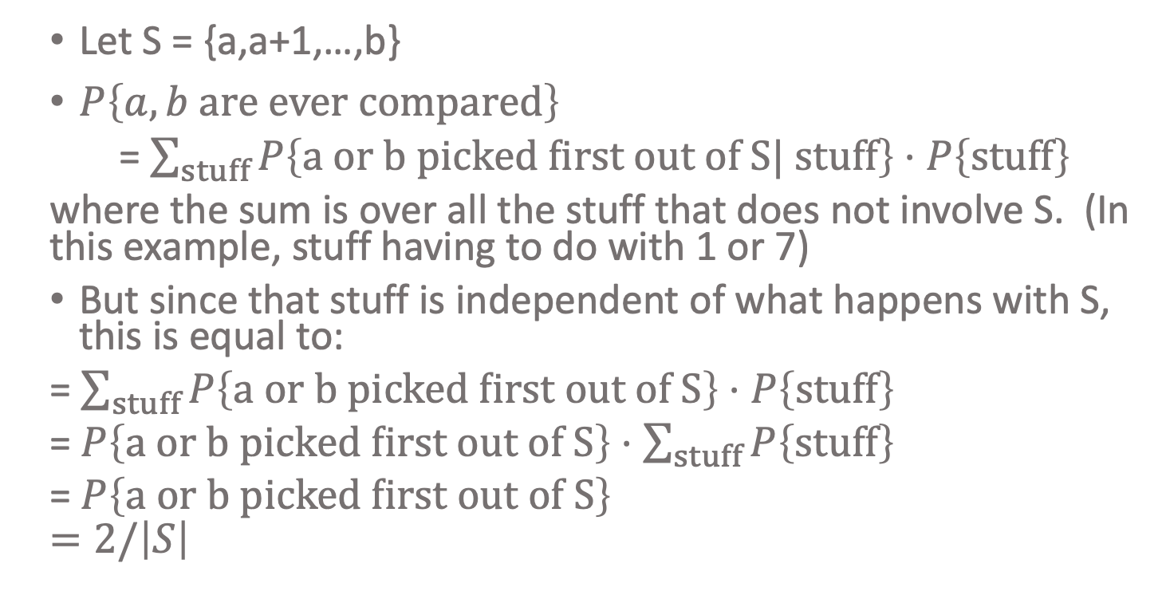
Aside:
Why don’t we care about 1 and 7?
Slide skipped in class
Short answer:
Because what happens to 1 and 7 is independent of whether or not 2 and 6 get compared.
In a bit more detail:
Let S = {a,a+1,…,b}
$P\left\{a,b are ever compared\right\}$
= $\sum_{stuff}{P\left\{a or b picked first out of S| stuff\right\}}⋅P\left\{stuff\right\}$
where the sum is over all the stuff that does not involve S. (In this example, stuff having to do with 1 or 7)
But since that stuff is independent of what happens with S, this is equal to:
= $\sum_{stuff}{P\left\{a or b picked first out of S\right\}}⋅P\left\{stuff\right\}$
=$P\left\{a or b picked first out of S\right\}⋅\sum_{stuff}{P\left\{stuff\right\}}$
= $P\left\{a or b picked first out of S\right\}$
$$=2/\left|S\right|$$

Slide 39
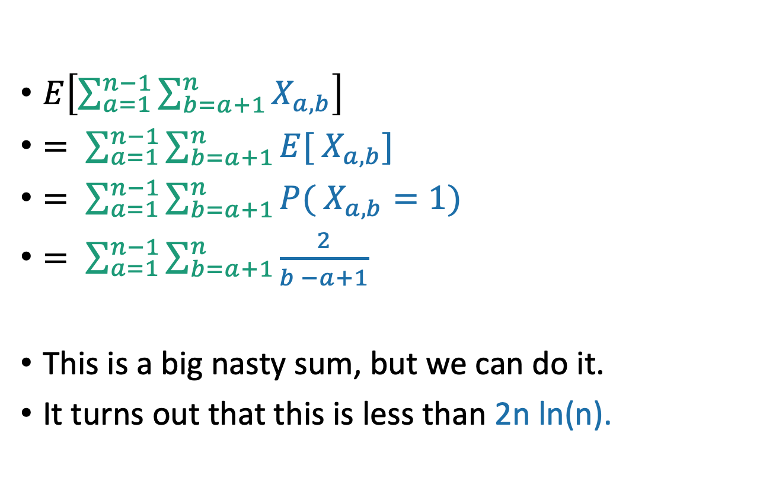
All together now…
Expected number of comparisons
This is the expected number of comparisons throughout the algorithm
$E\left[\sum_{a=1}^{n−1}{\sum_{b=a+1}^{n}{X_{a,b}}}\right]$
$= \sum_{a=1}^{n−1}{\sum_{b=a+1}^{n}{{E[ X}_{a,b}] }}$
$= \sum_{a=1}^{n−1}{\sum_{b=a+1}^{n}{{P( X}_{a,b}=1) }}$
$= \sum_{a=1}^{n−1}{\sum_{b=a+1}^{n}{\frac{2}{b −a+1}}}$
This is a big nasty sum, but we can do it.
It turns out that this is less than 2n ln(n).
linearity of expectation
definition of expectation
the reasoning we just did
Do this sum!
(It’s also in the textbook)
Ollie the over-achieving ostrich

Slide 40
Almost done
We saw that E[ number of comparisons ] = O(n log(n))
Is that the same as E[ running time ]?
In this case, yes.
We need to argue that the running time is dominated by the time to do comparisons.
See Lemma 5.2 in Algs. Illuminated.
QuickSort(A):
  If len(A) <= 1:
    return
  Pick some x = A[i] at random. Call this the pivot.
  PARTITION the rest of A into:
    L (less than x) and
    R (greater than x)
  Replace A with [L, x, R] (that is, rearrange A in this order)
  QuickSort(L)
  QuickSort(R)

Slide 41
What have we learned?
The expected running time of QuickSort is O(nlog(n))

Slide 42
Worst-case running time
Suppose that an adversary is choosing the “random” pivots for you.
Then the running time might be O(n²)
  Eg, they’d choose to implement SlowSort
  In practice, this doesn’t usually happen.

Slide 43
How should we implement this?
Our pseudocode is easy to understand and analyze, but is not a good way to implement this algorithm.
Instead, implement it in-place (without separate L and R)
  You may have seen this in 106b.
  Here are some Hungarian Folk Dancers showing you how it’s done: https://www.youtube.com/watch?v=ywWBy6J5gz8
  Check out IPython notebook for Lecture 5 for two different ways.
QuickSort(A):
  If len(A) <= 1:
    return
  Pick some x = A[i] at random. Call this the pivot.
  PARTITION the rest of A into:
    L (less than x) and
    R (greater than x)
  Replace A with [L, x, R] (that is, rearrange A in this order)
  QuickSort(L)
  QuickSort(R)

Slide 44
A better way to do Partition
Pivot
8
7
1
3
5
6
4
Choose it randomly, then swap it with the last one, so it’s at the end.
8
7
1
3
5
6
4
Initialize and
Swap!
Step forward.
1
7
8
3
5
6
4
When sees something smaller than the pivot, swap the things ahead of the bars and increment both bars.
1
3
8
7
5
6
4
1
3
8
7
5
6
4
Repeat till the end, then put the pivot in the right place.
1
3
4
7
5
6
8
See textbook/Lecture 5 IPython notebook for pseudocode/real code.

Slide 45
QuickSort vs. smarter QuickSort vs.
Mergesort?
See IPython notebook for Lecture 5
All seem pretty comparable…
Hoare Partition is a different way of doing it (c.f. CLRS Problem 7-1), which you might have seen elsewhere. You are not responsible for knowing it for this class.
In-place partition function uses less space, and also is a smidge faster on my system.

Slide 46
QuickSort vs MergeSort
*What if you want O(nlog(n)) worst-case runtime and stability? Check out “Block Sort” on Wikipedia!
 | QuickSort (random pivot) | MergeSort (deterministic)
Running time | Worst-case: O(n²) Expected: O(n log(n)) | Worst-case: O(n log(n))
Used by | Java for primitive types C qsort Unix g++ | Java for objects Perl
In-Place? (With O(log(n)) extra memory) | Yes, pretty easily | Not easily* if you want to maintain both stability and runtime. (But pretty easily if you can sacrifice runtime).
Stable? | No | Yes
Other Pros | Good cache locality if implemented for arrays | Merge step is really efficient with linked lists
Understand this
These are just for fun. (Not on exam).

Slide 47
Today
How do we analyze randomized algorithms?
A few randomized algorithms for sorting.
  BogoSort
  QuickSort
BogoSort is a pedagogical tool.
QuickSort is important to know. (in contrast with BogoSort…)
Recap

Slide 48
Recap
How do we measure the runtime of a randomized algorithm?
  Expected runtime
  Worst-case runtime
QuickSort (with a random pivot) is a randomized sorting algorithm.
  In many situations, QuickSort is nicer than MergeSort.
  In many situations, MergeSort is nicer than QuickSort.
Code up QuickSort and MergeSort in a few different languages, with a few different implementations of lists A (array vs linked list, etc). What’s faster?
(This is an exercise best done in C where you have a bit more control than in Python).
Ollie the over-achieving ostrich

Slide 49
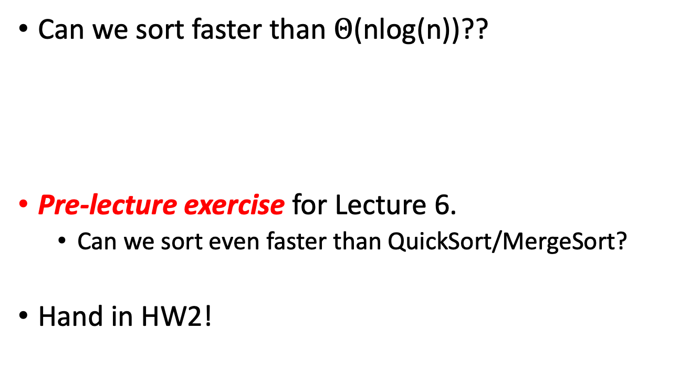
Next time
Can we sort faster than $Θ$(nlog(n))??
Pre-lecture exercise for Lecture 6.
  Can we sort even faster than QuickSort/MergeSort?
Hand in HW2!
Before next time

Slide 50
https://xkcd.com/1185/

