Slide 1
Improving Energy Efficiency using
Big Data
Ben Packer, Data Scientist
Opower
May 20, 2014
Notes:
How many pay your own energy bill?
How many have checked your email today?
How many have checked your energy usage today? This week? Last week?

Slide 2


Energy saving experiment
Your neighbors are doing better
Save the
Earth
Be a good citizen
Save $

Slide 3
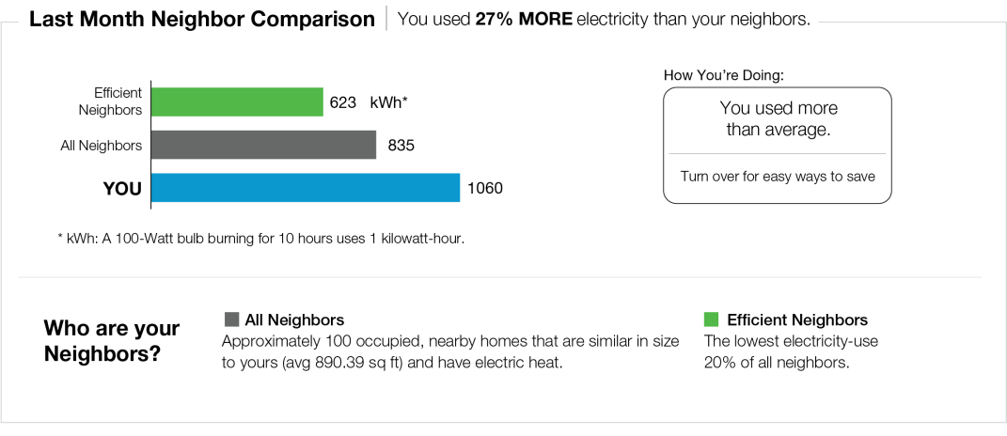
Normative Comparison
Notes:
Normative comparison. Social proof. Peer pressure.
Door hanger experiment run by Prof Robert Cialdini
Neighbor message had 6% drop in consumption versus money, environment, and citizenship messages
Take relatively small study and apply it large scale.
Among the first to do this for real for energy efficiency

Slide 4





Predictable and Verified EE savings
Average Steady State Savings = 1.5 – 3.5%
6
12
18
24
30
36
42
Months since program start
Notes:
Results measured and verified by independent third parties
And they all agree with us, we really are saving all this energy
Consistent and sustained over time

Slide 5
What is Opower?

Slide 6
Opower exists to engage the millions of people who are in the dark about their energy use.
Notes:
Here’s one way to sum up Opower
A little more detail, but let’s get specific

Slide 7
SaaS
Notes:
We are a SaaS company

Slide 8
Behavioral Science
Notes:
That uses behavior science

Slide 9
Analytics
Notes:
Understanding how people use our products

Slide 10
Data Science
Notes:
Interesting things we learn about individual users: behaviors, habits, and proclivities

Slide 11
Energy Efficiency
Notes:
To drive energy efficiency.

Slide 12
How’s it going?

Slide 13
4.1TW
Notes:
Kilowatt hours saved
Equivalent of taking Las Vegas “off the grid”

Slide 14
6.4b
Notes:
Pounds of CO2 abated
20,000 cross-country flights
200,000 cars

Slide 15
$465m
Notes:
Dollars saved

Slide 16
48TB
Notes:
Adding up to 48TB Energy data

Slide 17
What data do we have?
Monthly billing data – 60 million households
  Gas and electric usage, prices, total bill
Smart meter data – 15 million households
  Usually hourly or 15 minute intervals for electric, daily for gas
Thermostats – thousands currently deployed, increasing steadily
  100k events per month per thermostat
Weather – 26k stations globally
  We log and interpolate all historical data
Notes:
Every report has fully custom graphs and charts in full color
Meaningful and personalized tips on the back of the page
Broke new ground with print & mail company that works with large banks

Slide 18
Innovation at Opower

Slide 19
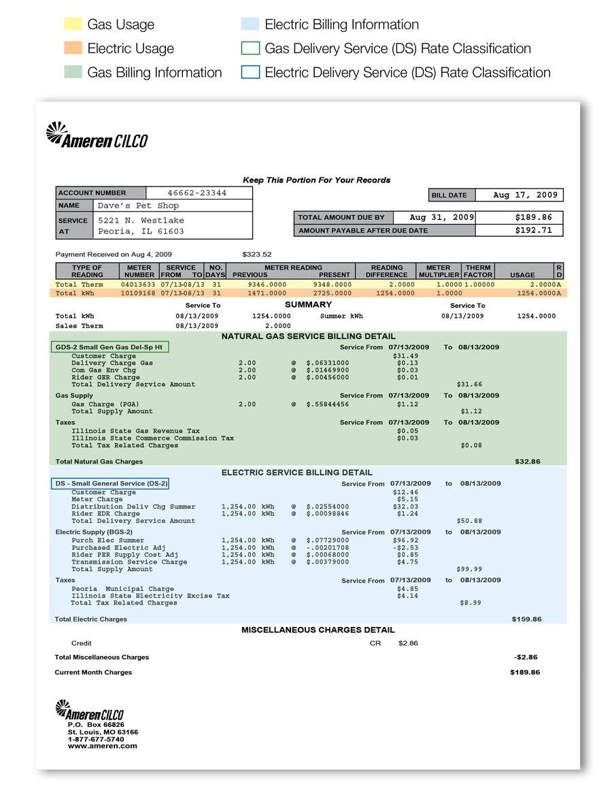
Full Custom Printed Reports

Slide 20
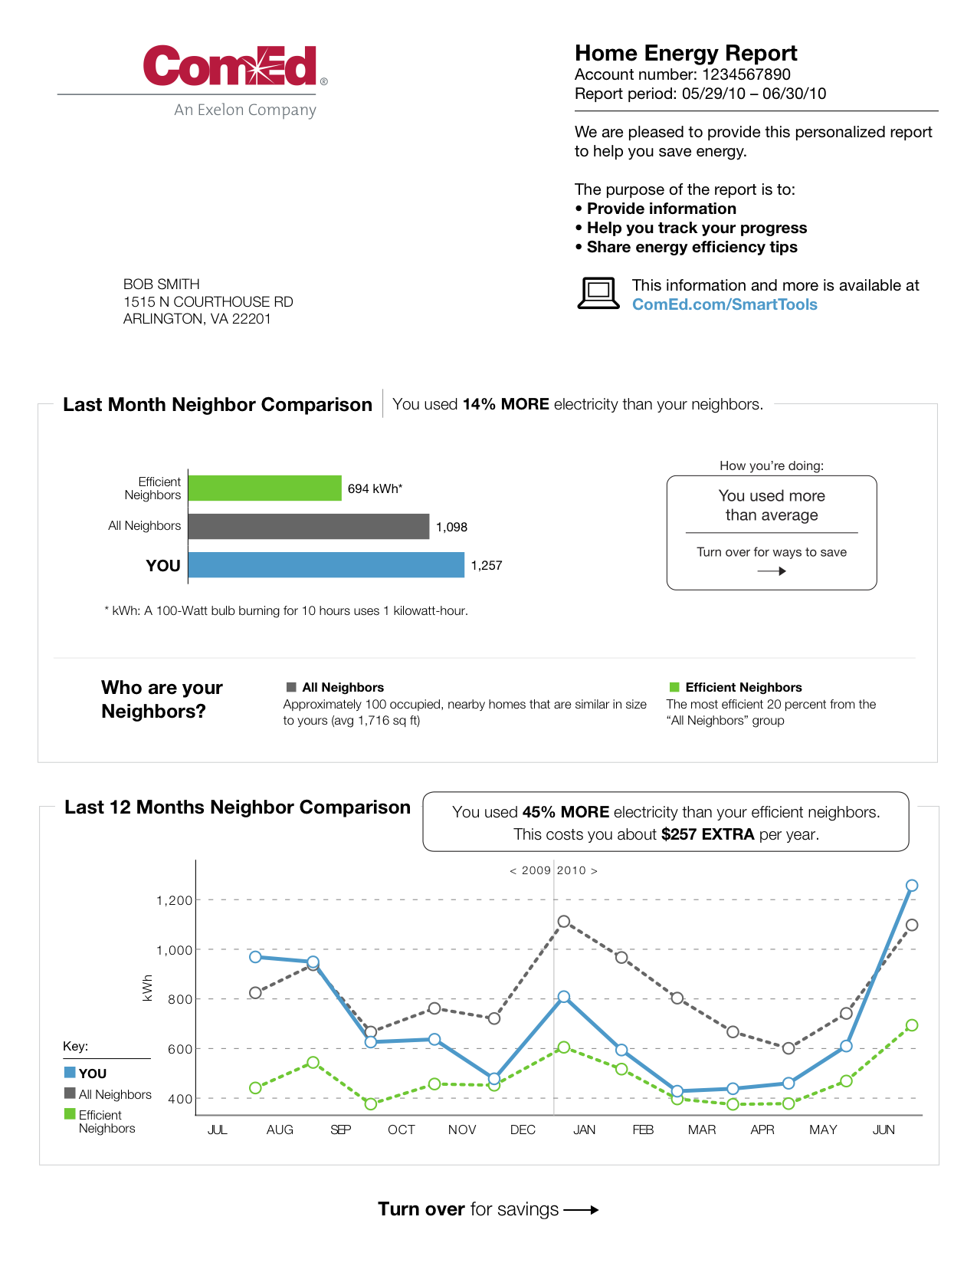
Full Custom Printed Reports
Notes:
Every report has fully custom graphs and charts in full color
Meaningful and personalized tips on the back of the page
Broke new ground with print & mail company that works with large banks

Slide 21

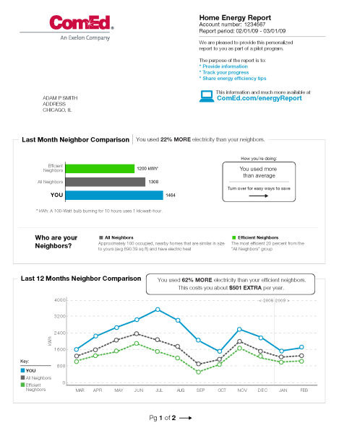
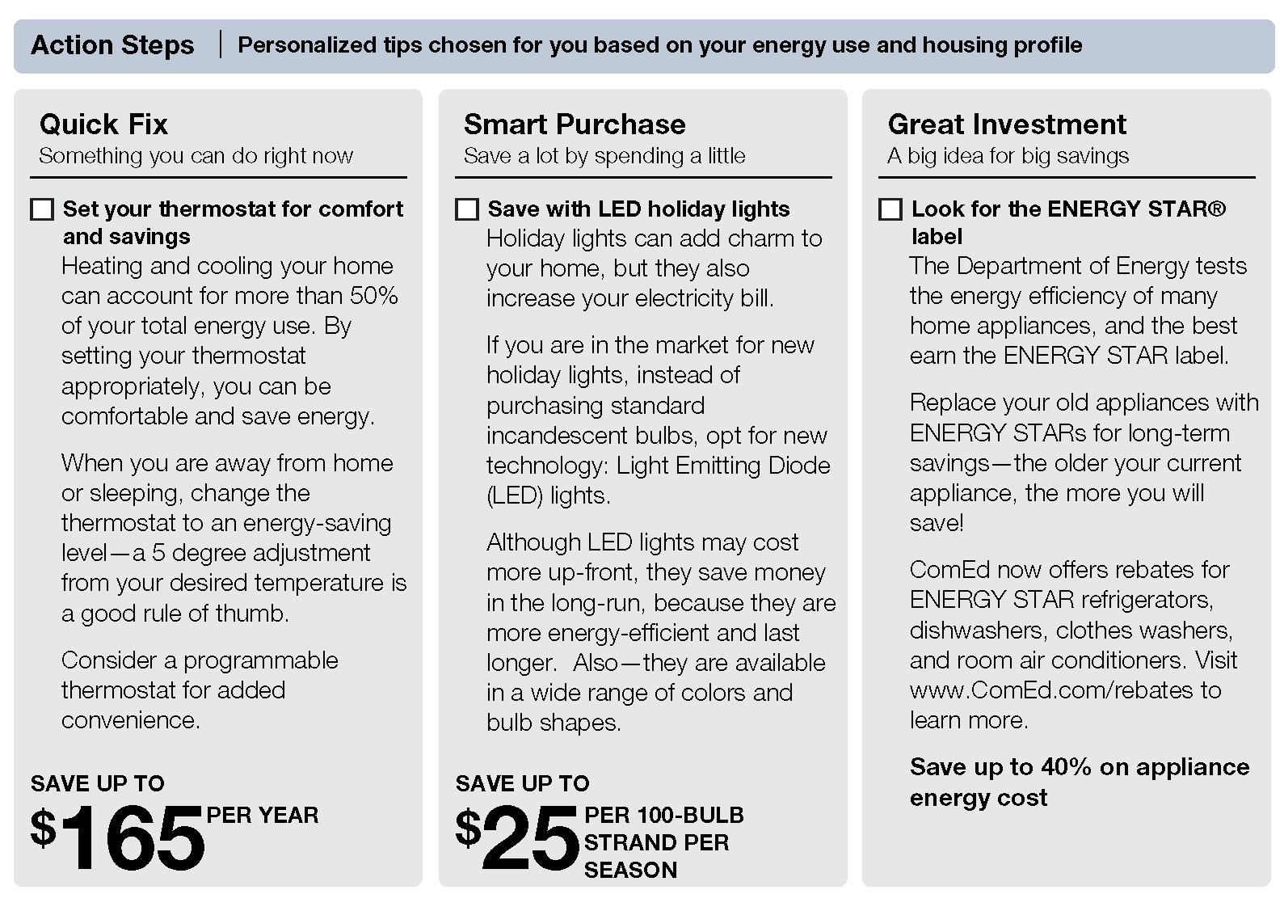
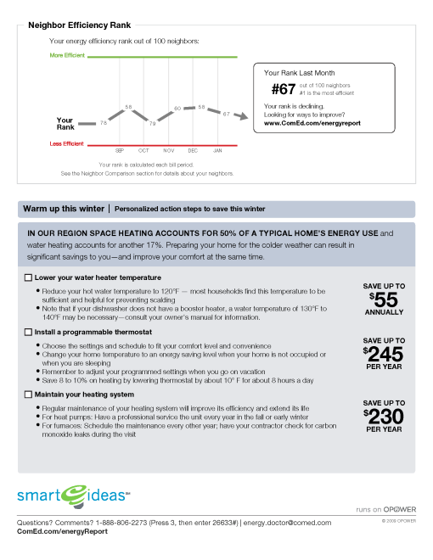

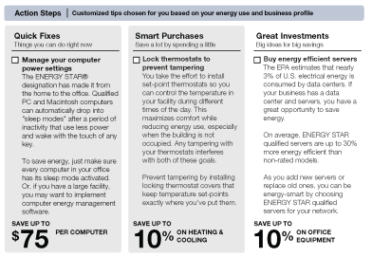
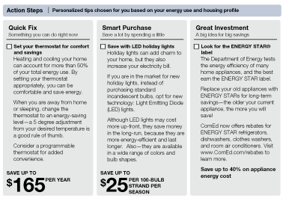
Residential Efficiency Report
Residential Efficiency Report
Energy Efficiency Tips
Normative Comparison
21
Notes:
21

Slide 22
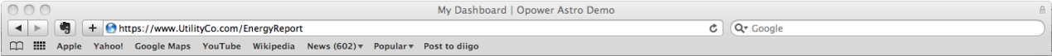
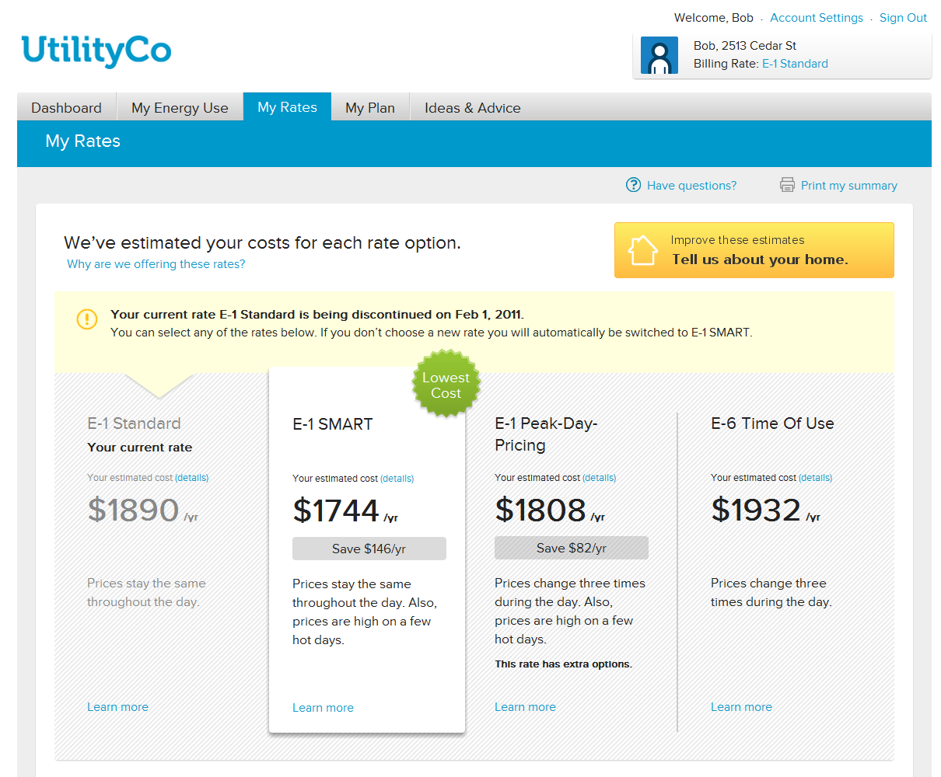

Rate Engine
Notes:
Complex rates, built custom for each utility company by companies like Oracle, IBM, and Accenture
We built an engine to handle them all with minimal engineering effort to add new rate structures
Hide complexity to present options to customer to make good decisions

Slide 23
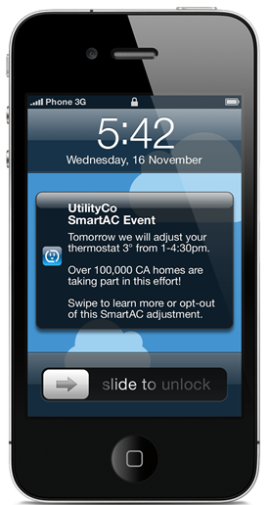
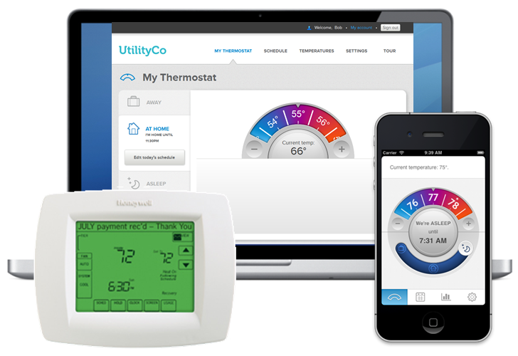
Smart Thermostats
Notes:
moving from passive behavior change to active behavior change
Push people through the programming step before installation
In home control
Behavior change
Demand response

Slide 24
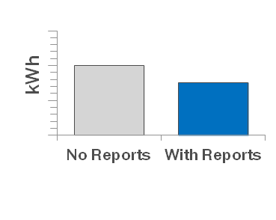
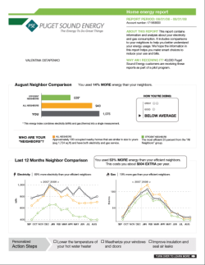
Measurement & Verification
Random
Allocation
No Reports
Control Group
+
Targeted households in utility footprint
Energy Usage
Statistically equivalent groups
Receive
Reports
Test Group
+
Notes:
From the start
Make sure we were making a difference
Differentiates us from other EE programs
talk about cfl and rebates being counted per item
versus us with program design and guaranteed savings
Boosted our business model
Allowed for EE program designation

Slide 25
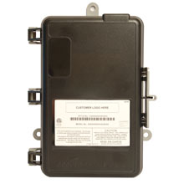
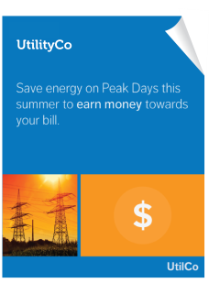
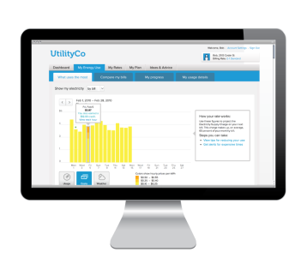
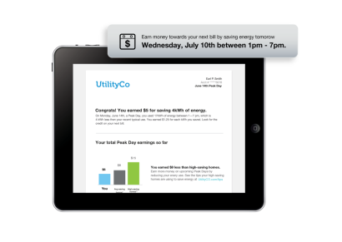
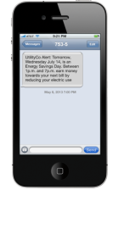


BDR provides AMI-enabled peak reduction at scale
Traditional Demand Response
Behavioral Demand Response
Notes:
According to FERC’s most recent report, only 8M customers are on residential demand response programs (roughly 7% of households)
85% of this is hardware-based direct load control, that requires high installation/maintenance, and achieves almost 1 kW on each home
Behavioral Demand Response uses software to reach a significantly higher penetration in a service territory. While the reduction is somewhat lower, it achieves a greater scale at a much lower cost

Slide 26
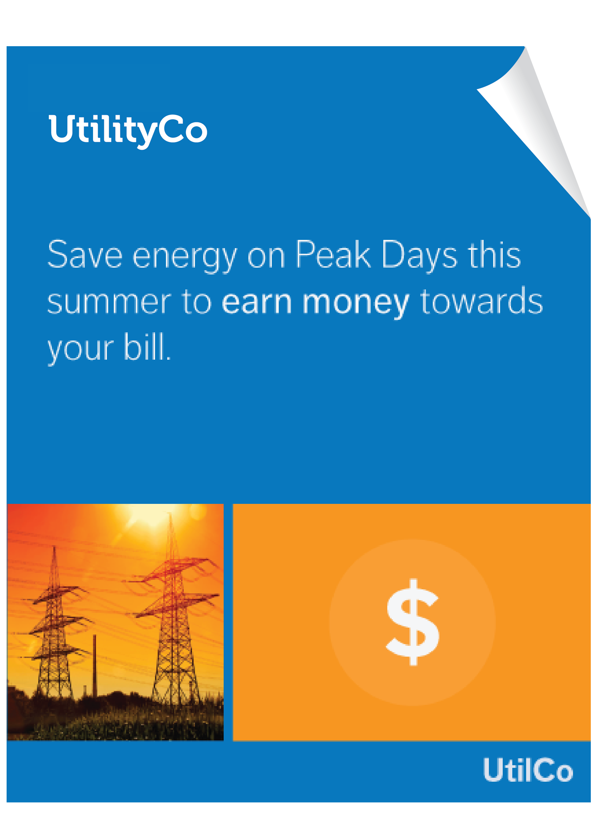

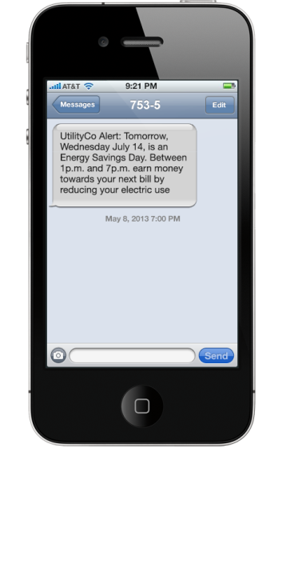
A comprehensive, multi-channel BDR platform
Pre-event notification
Build awareness prior to peak events
Post-event summary
Feedback on
energy use during peak event
Normative Comparison
Proven effective behavioral science
Multi-channel
Reach customers where they are
Notes:
PTR program for BGE is an innovative approach to dynamic rates deployment:
Comprehensive outreach campaign to educate 1.1 MM residential customers of new rate structure
Over 40 MM pre- and post-event communications during program across phone, SMS, and e-mail
Personalized feedback using normative comparison across multiple tracks

Slide 27
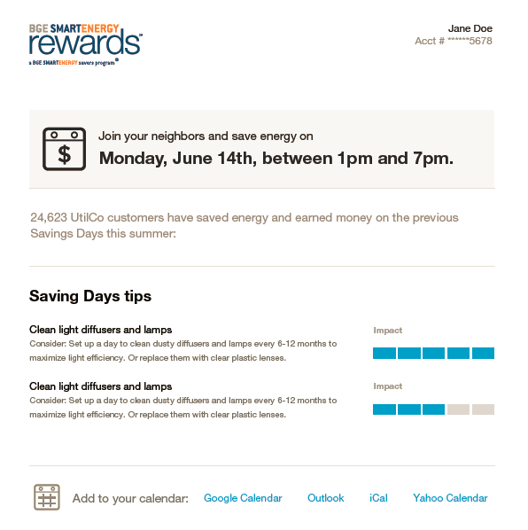
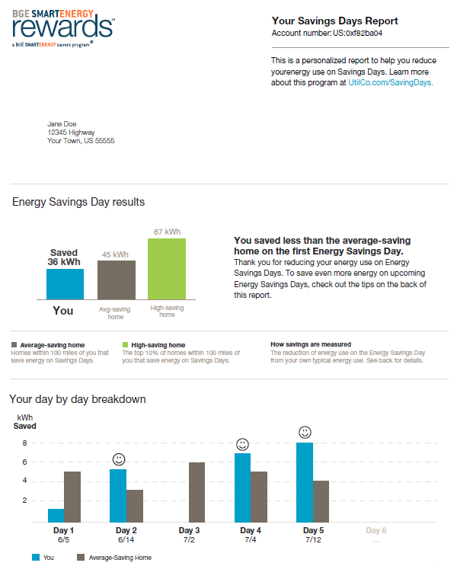








BGE’s deployment of Behavioral DR
Before peak day
Peak day
After peak day
$1.25/kWh
email
IVR
SMS
email
IVR
SMS
print
Notes:
Opower’s Behavioral Demand Response uses our multi-channel communications platform, behavioral science, and big data analytics to engage 100% of customers in DR through timely and personalized information and feedback
Our first partner on the platform is BGE who is using it to support their Peak Time Rebate Program. We are already deployed to 300,000 customers and will reach all 1.1M residential customers by 2015
How an event works:
Our first event day occurred on July 17
Before the event: customers are provided personalized pre-event notification through the channel of their choice: e-mail, IVR, SMS
During the event: customers reduce their consumption by making small changes such as delaying laundry or the dishwasher or raising the thermostat a few degrees. Customers are provided $1.25 per kWh that they reduce during the event
The morning after an event: Customers are provided a post-event notification providing them detailed and personalized information about their performance. These are also delivered via multiple channels. This is an important part of the solution – in fact BGE found that customers that are provided post-event feedback within 24 hours save 25% on the next event than customers that don’t’.

Slide 28
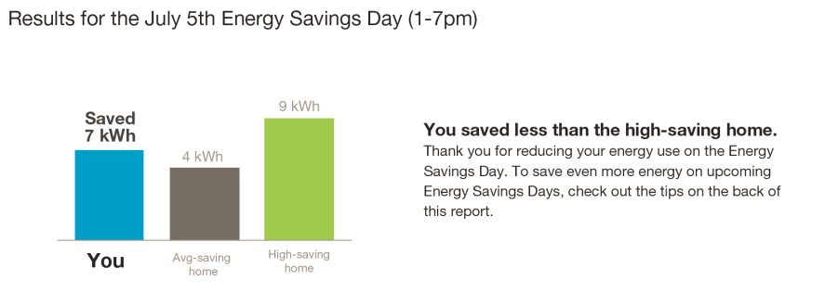
Calculating BDR Savings
Communicating accurate information to customers
Giving the customer a rebate
Calculating program savings for the utility
Notes:
This is the communication we will send out. How did we calculate the energy saved?
We need to know this number for these reasons:
Communicating the savings to the customer
Paying the customer
Telling the utility how much was saved

Slide 29
Calculating BDR Savings
What they would have used
Savings
Actual usage
Notes:
This is the communication we will send out. How did we calculate the energy saved?
We need to know this number for these reasons:
Communicating the savings to the customer
Paying the customer
Telling the utility how much was saved

Slide 30
Predicting usage for a non-event day
Predicted usage
Actual usage
Notes:
This is the communication we will send out. How did we calculate the energy saved?
We need to know this number for these reasons:
Communicating the savings to the customer
Paying the customer
Telling the utility how much was saved

Slide 31
Energy Disaggregation
Cooling
Heating
Baseload
Notes:
How much energy does it take to heat my home?
First figured it out using weather data and daily energy use
Migrating to analysis on monthly data as well as on AMI data

Slide 32
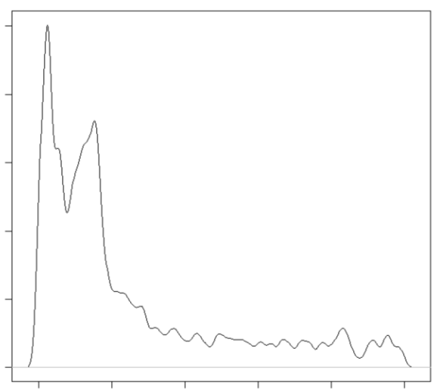
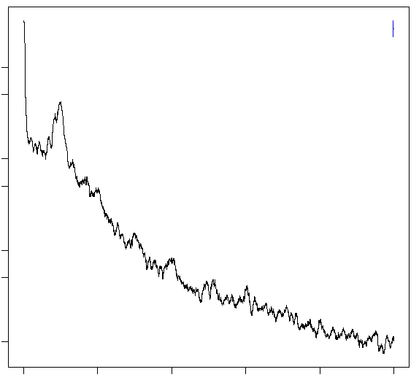
Usage Disaggregation Relies on Multiple Statistical Techniques
Baseload
Refrigerator duty cycle
Signal Processing and Machine Learning
Refrigerator
Cooling
Heating
Weather Sensitivity and Engineering Models
Baseload

Slide 33
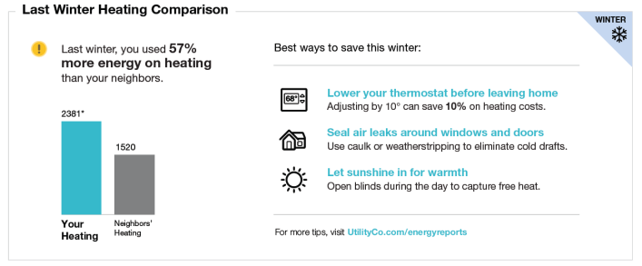
Energy Disaggregation
Notes:
Is that the right amount and what can I do about it?

Slide 34
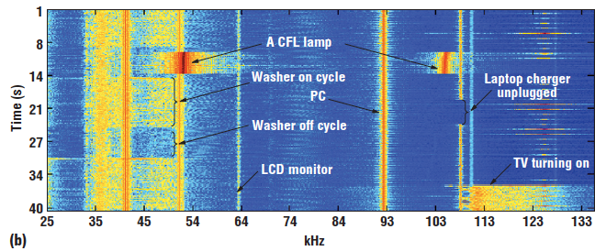
Sub-minute read disaggregation
Disaggregation for sub-minute reads is largely a solved problem (Shwetak Patel)
Enough data to pick out even the tiniest signals
Problem: adoption of devices for sub-minute reads is incredibly low

Slide 35
Energy disaggregation literature
Disaggregating categories of electrical energy end-use from whole-house hourly data
    Benjamin Birt, Guy Newsham, Ian Beausoleil-Morrison, Marianne Armstrong, Neil Saldanha, Ian Rowlands
  Fit three linear models at different percentiles of usage by temperature
  Associate the percentiles with types of usage
Thermal profiling of residential energy consumption using smart meter data
    Adrian Albert, Ram Rajagopal
  Assume unobserved “occupancy states” with different reactions to temperature (Hidden Markov Model)
  Fit linear model with breakpoints to each state
  Probabilistic assignment of each read to a given state

Slide 36
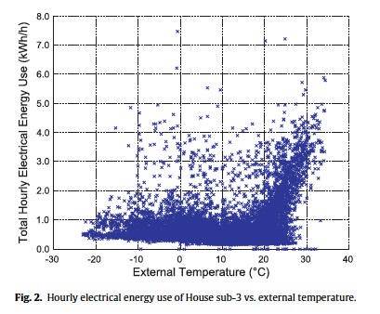
(1) Independent linear models
A single home’s energy data
  Usage in a single hour (y-axis)
  Temperature (x-axis)
Bucket in 1 degree C increments
Take 10th, 50th, and 90th percentiles (relatively arbitrary selections)
  Eliminate outliers
  Types of usage associated with certain behaviors

Slide 37
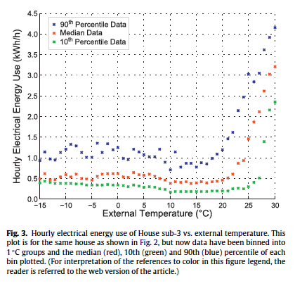
(1) Independent linear models
Aggregated view with 10th, 50th, and 90th percentiles for each bucket
Fit linear model to each section (dashed lines) such that they do not overlap and each section contains at least 5 points.
The models are independent and so are unlikely to be continuous → smush together points (technical term)

Slide 38
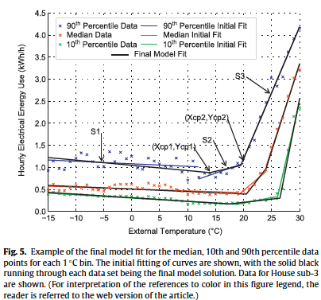
(1) Independent linear models
Nine total models: three percentiles (10th, 50th, 90th) and three models for each percentile (S1, S2, S3)
Extract behaviors
  Heating and cooling
    90th S1: Heating sensitivity (and related usage, e.g. fans)
    Max(90th S2, 90th S3): Cooling sensitivity (and related usage, e.g. fans, refrigerator)
  Baseload
    Min(10th S1, 10th S2): Household baseload (e.g. phantom loads, DVR)
  Activity load
    Min(90th S1, 90th S2) – Baseload: Little heating/cooling with active occupants
Others?

Slide 39
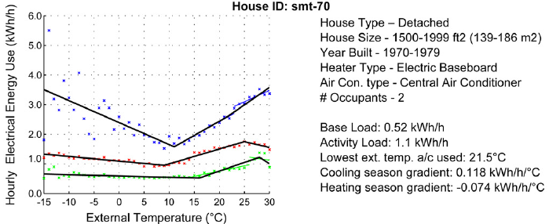
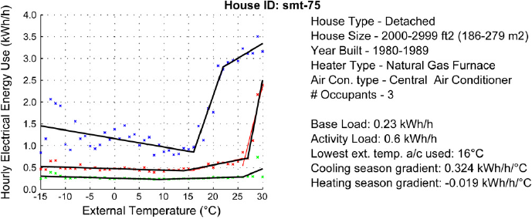
(1) Independent linear models

Slide 40
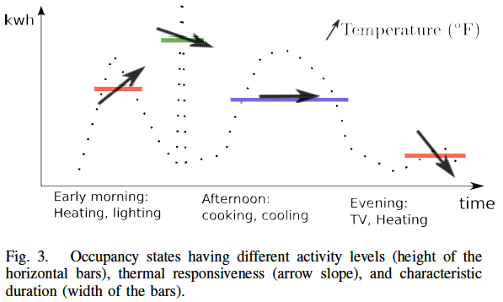
(2) Occupancy states
Assume some number of unknown occupancy states
  Each occupancy state has different length
  Different sensitivity to temperature
Extension of a Hidden Markov Model
  Each state depends on the previous state
  Extended to also depend on temperature

Slide 41
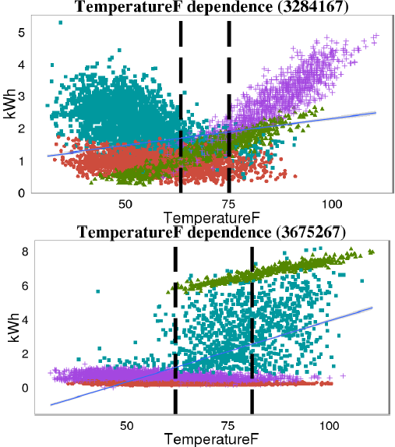
(2) Occupancy states
Four occupancy states for each of two households
Extract behaviors
  Cooling related (green in both, purple in top, teal in bottom)
  Heating related (teal in top, none in bottom)
  Baseload (red in both, purple in bottom)

Slide 42
Energy disaggregation – messaging test
vs
i has a sad
yay
Notes:
Is that the right amount and what can I do about it?

Slide 43
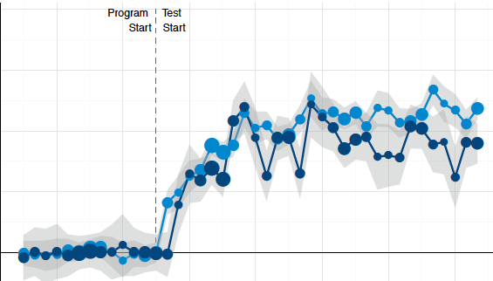
A/B testing our ideas
We test messaging, modules, and other features of our products
The best ideas are validated with data

Slide 44
Thanks! opower.com/careers

