Slide 1
Lactic Acid Bacteria
Hopkins Microbiology Course 2010
Marcus Schicklberger

Slide 2
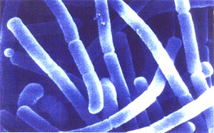
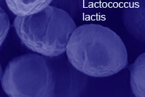
Lactic Acid Bacteria
Gram positive
Non-sporforming
Anaerobes, lack catalase
Acid- and halotolerant
Ferment glucose to only lactic acid or to lactic acid, CO₂ and EtOH
Obtain energy only from the metabolism of sugars
Have limited biosynthetic abilities → complex media
often plant- and animal-associated
Don´t need iron → advantage: no pathogens in niche
Streptococcus pneumoniae: meningitis, pneumonia
Lactobacillus acidophilus
Notes:
Because they obtain energy only from the metabolism of sugars, lactic acid bacteria are restricted to environments in which sugars are present. They have limited biosynthetic ability, having evolved in environments that are rich in amino acids, vitamins, purines and pyrimidines, so they must be cultivated in complex media that fulfill all their nutritional requirements.

Slide 3
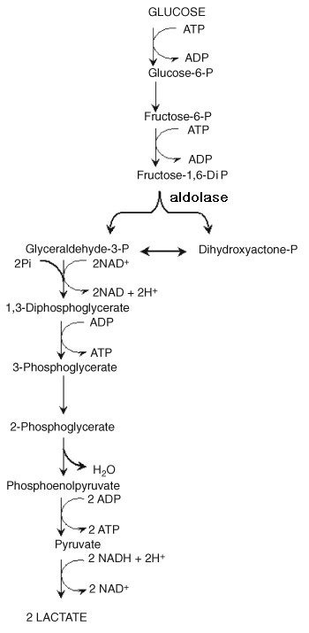
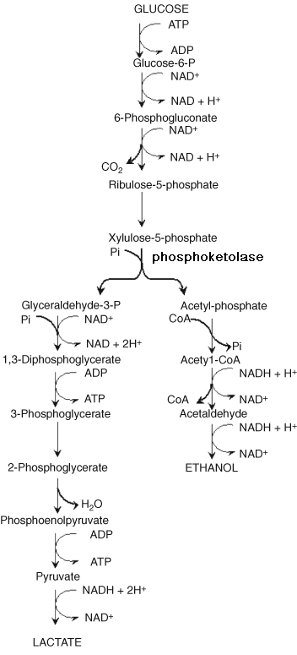
homofermentative
heterofermentative
Notes:
aparent difference is presence or absence of phosphoketolase or fructose diphosphatase. key cleavage enzymes of embden mayerhof and PK-pathway. Intracellular redox balance is maintained through the oxidation of NADH, concomitant with pyruvate reduction to lactic acid.
In this pathway, glucose-phosphate is oxidized to 6- phosphogluconic acid, which becomes oxidized and decarboxylated to form pentose phosphate. Unlike the Embden-Meyerhof pathway, NAD-mediated oxidations take place before the cleavage of the substrate being utilized. Pentose phosphate is subsequently cleaved to glyceraldehyde-3- phosphate (GAP) and acetyl phosphate. GAP is converted to lactic acid by the same enzymes as the E-M pathway. This branch of the pathway contains an oxidation coupled to a reduction while 2 ATP are produced by substrate level phosphorylation. Acetyl phosphate is reduced in two steps to ethanol, which balances the two oxidations before the cleavage but does not yield ATP. The overall reaction is Glucose
---------->1 lactic acid + 1 ethanol +1 CO2 with a net gain of 1 ATP. The efficiency is about half that of the E-M pathway.

Slide 4
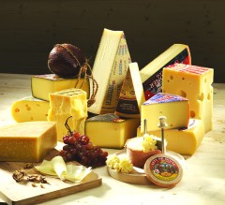
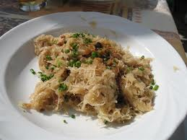
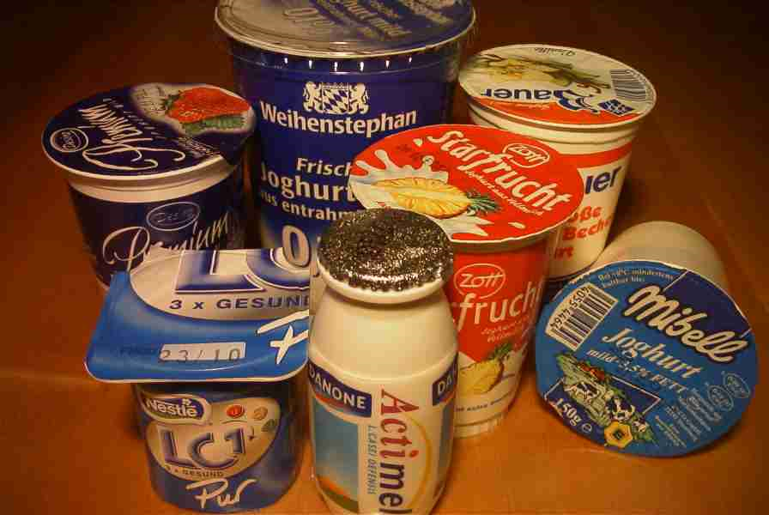
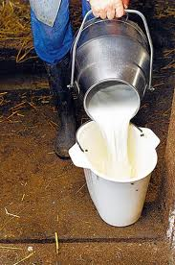
Lactic Acid Bacteria in foodproduction
among the most improtant
bacteria in food fermentation
contribute to taste and texture
of fermented products
inhibit food spoilage bacteria
by producing growth inhibiting
substances and large amounts
of lactic acid.
Notes:
Lactic acid bacteria are among the most important groups of microorganisms used in food fermentations. They contribute to the taste and texture of fermented products and inhibit food spoilage bacteria by producing growth-inhibiting substances and large amounts of lactic acid.

Slide 5
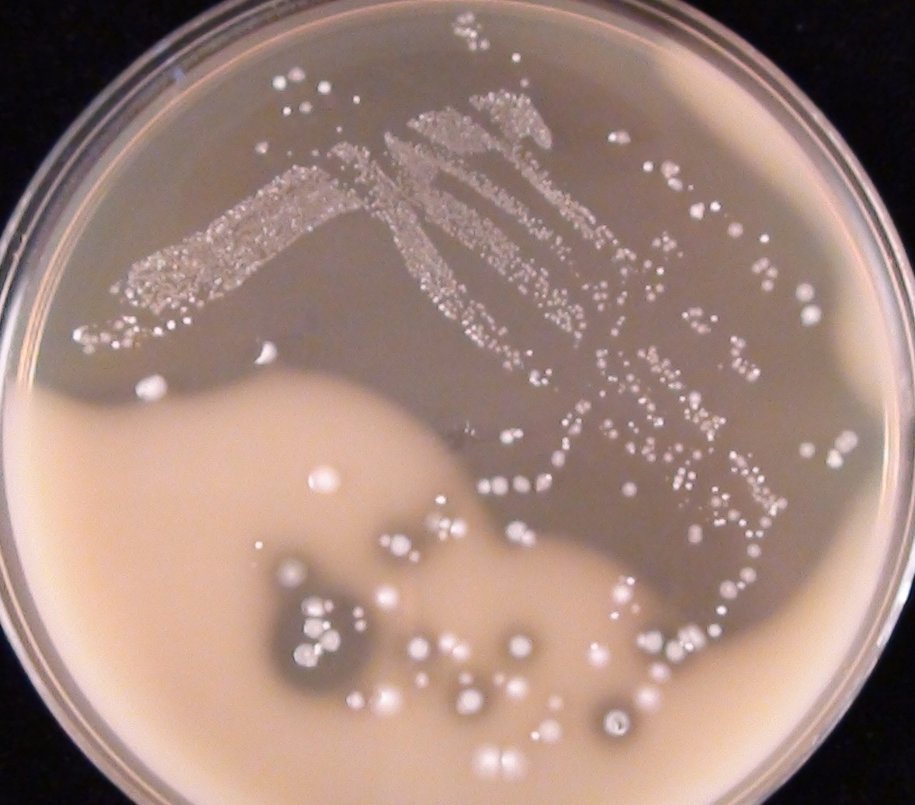
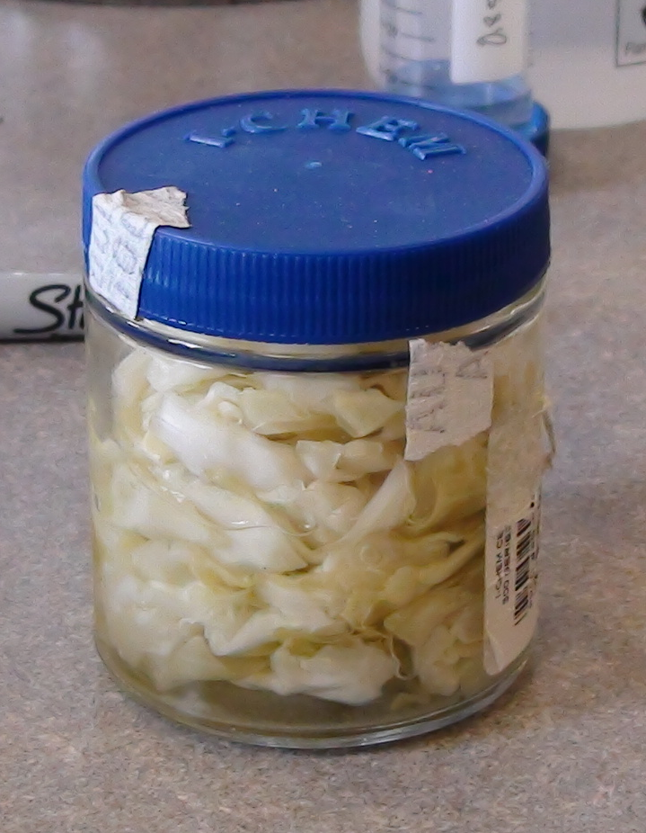
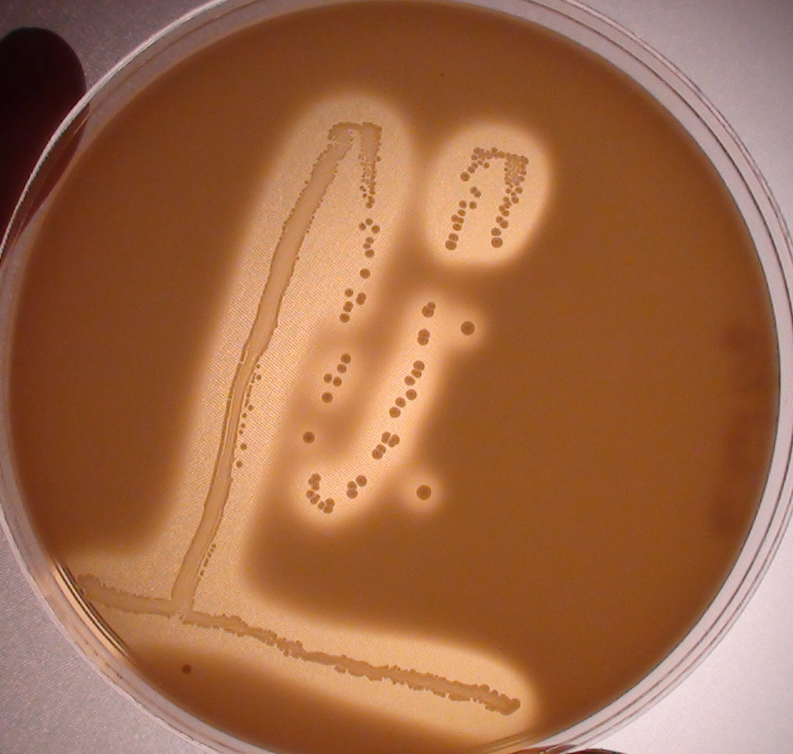
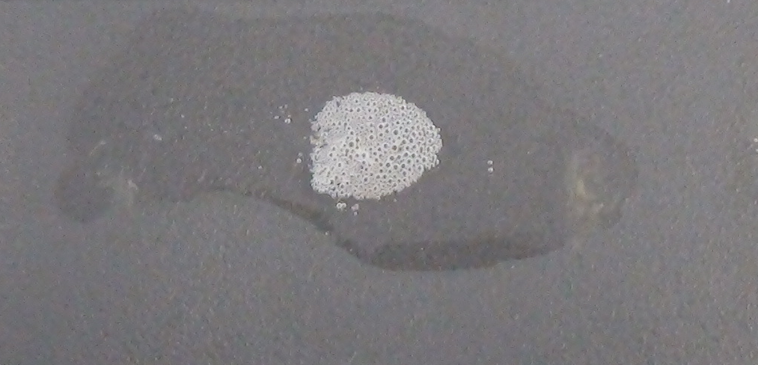
Isolation of Lactic Acid Bacteria
plate cabbage juice on glucose-CaCO₃ plates
3d @ 30°C
H⁺
H⁺
pH_{initial} = 6.0
pH_{final} = 4.2
CaCO₂ Ca₂⁺+CO₃²⁻ HCO₃⁻ H₂CO₃
H₂O+CO₂
e⁻
e⁻
catalase
O₂ O₂⁻ H₂O₂ H₂O+O₂

Slide 6
THANK YOU

