Slide 1
New Formulations of the Optimal Power Flow Problem
Daniel Kirschen
Close Professor of Electrical Engineering
University of Washington

Slide 2
Outline
A bit of background
The power flow problem
The optimal power flow problem (OPF)
The security-constrained OPF (SCOPF)
The worst-case problem

Slide 3
What is a power system?
Generators
Transmission Network
Power
Loads

Slide 4
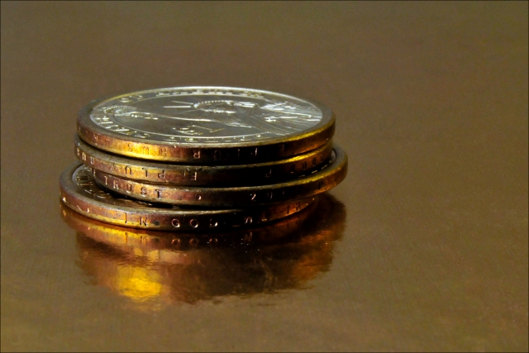
What is running a power system about?
Greed
Minimum cost
Maximum profit
Photo credit: FreeDigitalPhotos.net

Slide 5
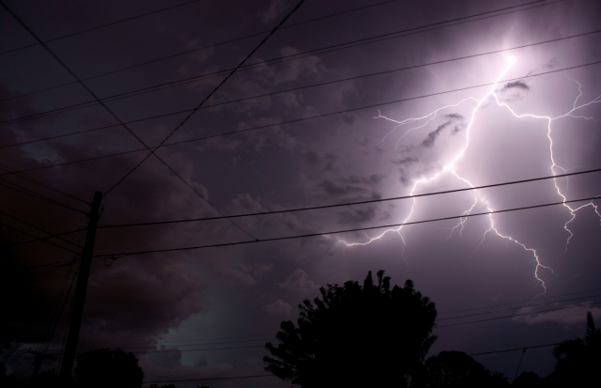
What is running a power system about?
Fear
Avoid outages and blackouts
Photo credit: FreeDigitalPhotos.net

Slide 6
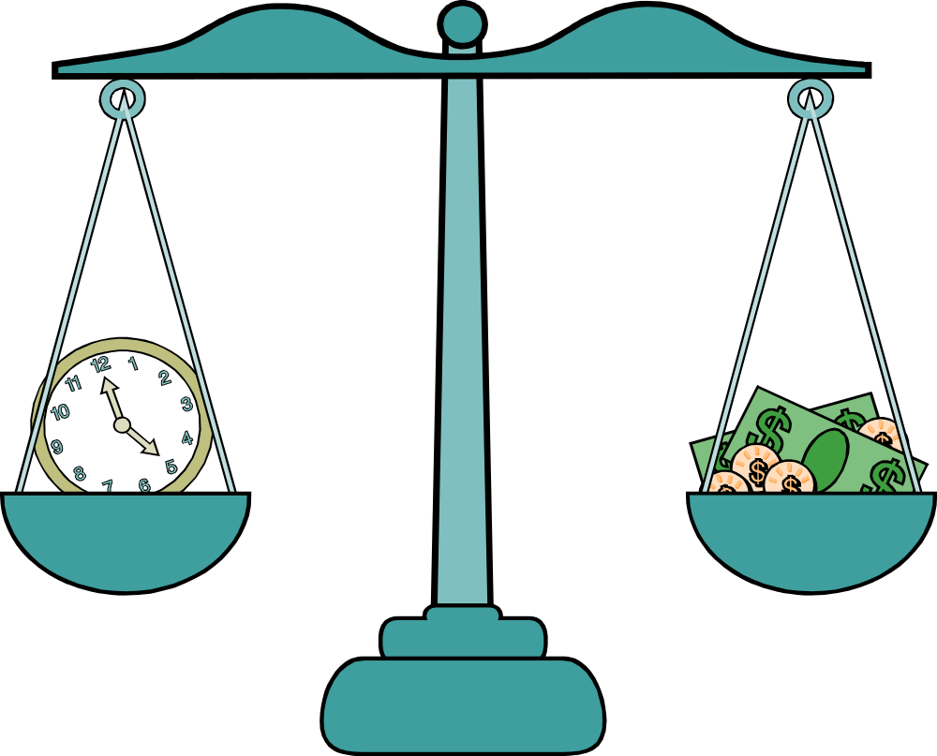
Balancing the greed and the fear

Slide 7

What is running a power system about?
Green
Accommodate renewables
Photo credit: FreeDigitalPhotos.net

Slide 8
Smart Grid

Slide 9
Structure of the optimization problems
Objective function
  Minimization of operating cost (mostly fuel)
  Minimization of deviation from current conditions
Equality constraints
  Physical flows in the network (power flow)
Inequality constraints
  Safety margin to provide stability, reliability
Renewable energy sources
  Tend to be taken as given so far

Slide 10
The Power Flow Problem

Slide 11


State variables
Voltage at every node (a.k.a. “bus”) of the network
Because we are dealing with ac, voltages are represented by phasors, i.e. complex numbers in polar representation:
  Voltage magnitude at each bus:
  Voltage angle at each bus:

Slide 12


Other variables
Active and reactive power consumed at each bus:
  a.k.a. the load at each bus
Active and reactive power produced by renewable generators:
Assumed known in deterministic problems
In practice, they are stochastic variables

Slide 13

What is reactive power?
Reactive power
Active power
Photo credit: FreeDigitalPhotos.net

Slide 14

What is reactive power?
Reactive power represents power that oscillates between the sources and the reactive components (inductors, capacitors)
It does not do any real work
Because transmission lines are inductive, the flow of reactive power is closely linked to the magnitudes of the voltages
Controlling the reactive power is thus important
Complex power:
Photo credit: FreeDigitalPhotos.net

Slide 15





Injections
Bus k
G
W
There is usually only one P and Q component at each bus

Slide 16



Injections
Bus k
Two of these four variables are specified at each bus:
Load bus:
Generator bus:
Reference bus:

Slide 17



Line flows
To bus i
To bus j
Bus k
The line flows depend on the bus voltage magnitude
and angle as well as the network parameters
(real and imaginary part of the network admittance matrix)

Slide 18




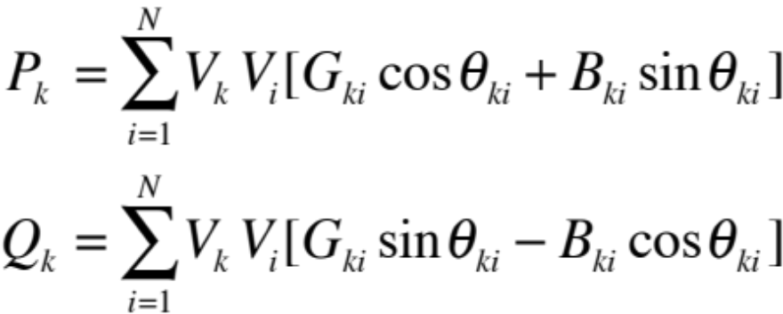

Power flow equations
To bus i
To bus j
Bus k
Write active and reactive power balance at each bus:

Slide 19
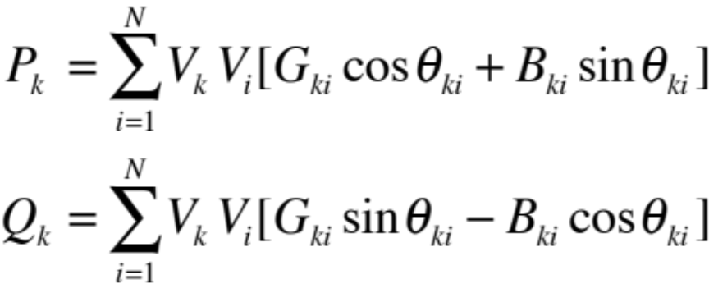
The power flow problem
Given the injections and the generator voltages,
Solve the power flow equations to find the voltage
magnitude and angle at each bus and hence the
flow in each branch
Typical values of N:
GB transmission network: N~1,500
Continental European network (UCTE): N~13,000
However, the equations are highly sparse!

Slide 20
Applications of the power flow problem
Check the state of the network
  for an actual or postulated set of injections
  for an actual or postulated network configuration
Are all the line flows within limits?
Are all the voltage magnitudes within limits?

Slide 21
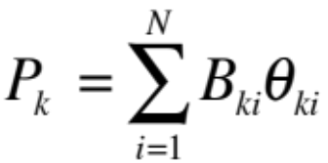
Linear approximation
Ignores reactive power
Assumes that all voltage magnitudes are nominal
Useful when concerned with line flows only

Slide 22
The Optimal Power Flow Problem
(OPF)

Slide 23



Control variables
Control variables which have a cost:
  Active power produced by thermal generating units:
Control variables that do not have a cost:
  Magnitude of voltage at the generating units:
  Tap ratio of the transformers:

Slide 24
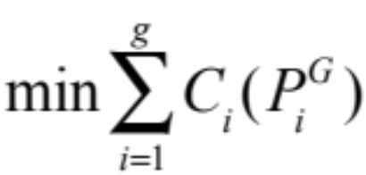
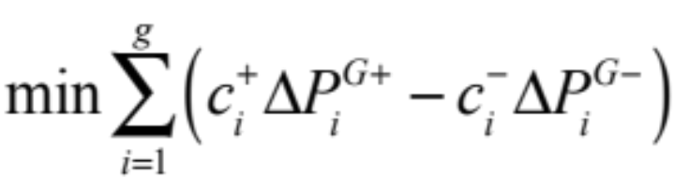
Possible objective functions
Minimise the cost of producing power with conventional generating units:
Minimise deviations of the control variables from a given operating point (e.g. the outcome of a market):

Slide 25
Equality constraints
Power balance at each node bus, i.e. power flow equations

Slide 26
Inequality constraints
Upper limit on the power flowing though every branch of the network
Upper and lower limit on the voltage at every node of the network
Upper and lower limits on the control variables
  Active and reactive power output of the generators
  Voltage settings of the generators
  Position of the transformer taps and other control devices

Slide 27
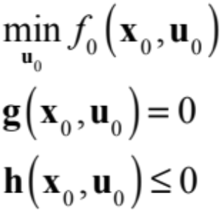


Formulation of the OPF problem
: vector of dependent (or state) variables
: vector of independent (or control) variables
Nothing extraordinary, except that we are dealing
with a fairly large (but sparse) non-linear problem.

Slide 28
The Security Constrained
Optimal Power Flow Problem
(SCOPF)

Slide 29
Bad things happen…
Photo credit: FreeDigitalPhotos.net

Slide 30
Sudden changes in the system
A line is disconnected because of an insulation failure or a lightning strike
A generator is disconnected because of a mechanical problem
A transformer blows up
The system must keep going despite such events
“N-1” security criterion

Slide 31
N-1 Security criterion
System with N components should be able to continue operating after any single outage
Losing two components at about the same time is considered “not credible”
Beloved by operators
  Implementation is straightforward
  Results are unambiguous
  No need for judgment
  Compliance is easily demonstrated

Slide 32
Security-constrained OPF
How should the control variables be set to minimise the cost of running the system while ensuring that the operating constraints are satisfied in both the normal and all the contingency states?

Slide 33
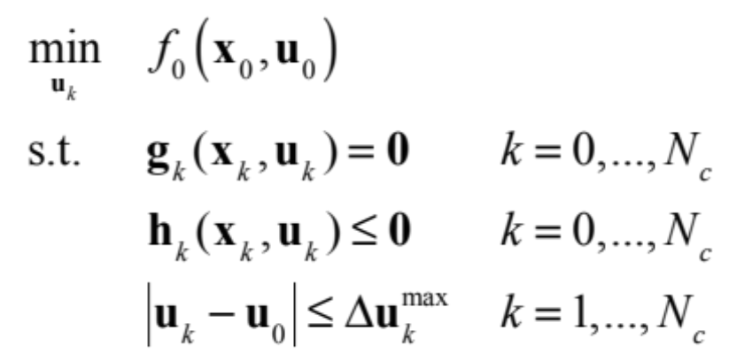



Formulation of the SCOPF problem
: normal conditions
: contingency conditions
: vector of maximum allowed adjustments after
contingency k has occured

Slide 34


Preventive or corrective SCOPF
Preventive SCOPF: no corrective actions are considered
Corrective SCOPF: some corrective actions are allowed

Slide 35
Size of the SCOPF problem
SCOPF is (N_{c}+1) times larger than the OPF
Pan-European transmission system model contains about 13,000 nodes, 20,000 branches and 2,000 generators
Based on N-1 criterion, we should consider the outage of each branch and each generator as a contingency
However:
  Not all contingencies are critical (but which ones?)
  Most contingencies affect only a part of the network (but what part of the network do we need to consider?)

Slide 36
A few additional complications…
Some of the control variables are discrete:
  Transformer and phase shifter taps
  Capacitor and reactor banks
  Starting up of generating units
There is only time for a limited number of corrective actions after a contingency

Slide 37
Limitations of N-1 criterion
Not all contingencies have the same probability
  Long lines vs. short lines
  Good weather vs. bad weather
Not all contingencies have the same consequences
  Local undervoltage vs. edge of stability limit
N-2 conditions are not always “not credible”
  Non-independent events
Does not ensure a consistent level of risk
  Risk = probability x consequences

Slide 38
Probabilistic security analysis
Goal: operate the system at a given risk level
Challenges
  Probabilities of non-independent events
    “Electrical” failures compounded by IT failures
  Estimating the consequences
    What portion of the system would be blacked out?
  What preventive measures should be taken?
    Vast number of possibilities

Slide 39
The Worst-Case Problems

Slide 40
Good things happen…
Photo credit: FreeDigitalPhotos.net

Slide 41
… but there is no free lunch!
Wind generation and solar generation can only be predicted with limited accuracy
When planning the operation of the system a day ahead, some of the injections are thus stochastic variables
Power system operators do not like probabilistic approaches

Slide 42
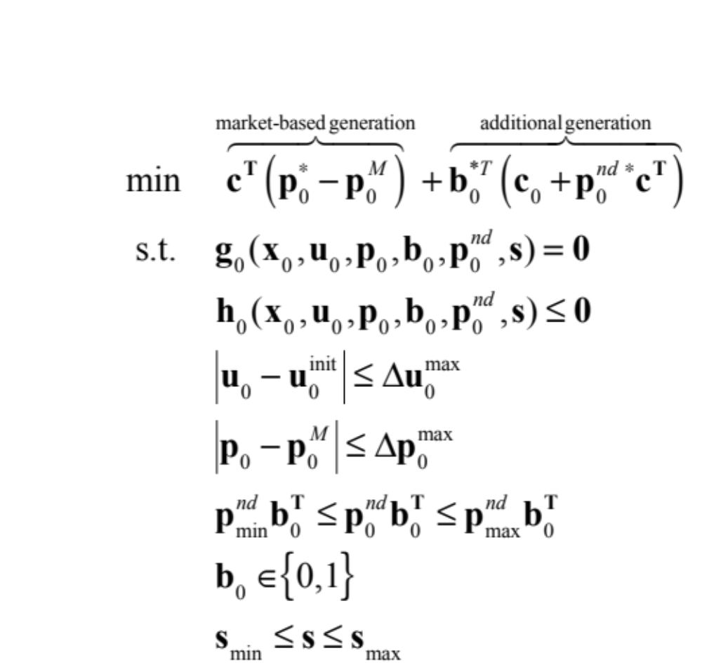
Incorporating uncertainty in the OPF
Deviations in cost-free controls
Deviations in market generation
Deviations in extra generation
Decisions about extra generation
Vector of uncertainties

Slide 43
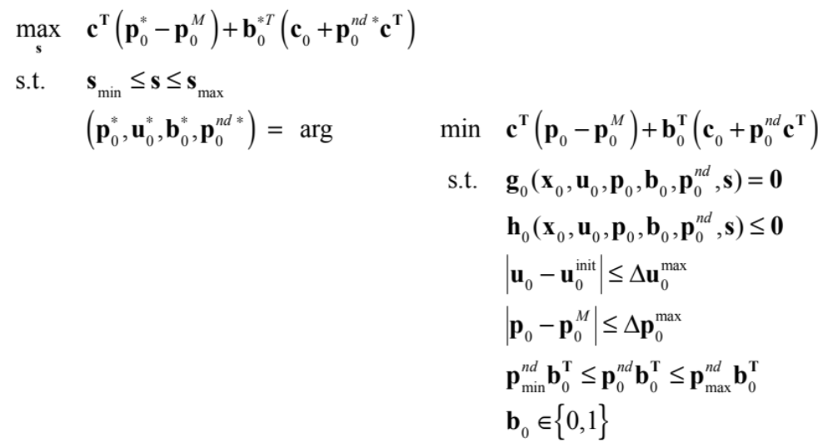
Worst-case OPF bi-level formulation

Slide 44
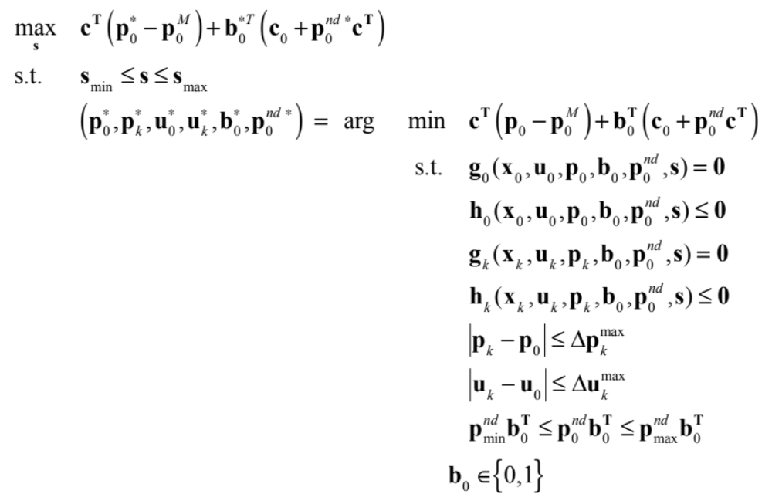
Worst-case SCOPF bi-level formulation

Slide 45
Interpretation of worst-case problem
Assume a “credible” range of uncertainty
Try to answer the question:
  Would there be enough resources to deal with any contingency under the worst-case uncertainty?
  Do I need to start-up some generating units to deal with such a situation?
Not very satisfactory but matches the power system operator’s needs and view of the world

Slide 46
Conclusions
Lots of interesting optimization problems
  Large, non-convex
  Not always properly defined
  Mathematical elegance does not always match the operator’s expectations
Develop “acceptable” probabilistic techniques?
Increased availability of demand control creates more opportunities for post-contingency corrective actions

