Slide 1
Expressions in JavaScript
Jerry Cain
CS 106AJ
October 1, 2018
slides courtesy of Eric Roberts

Slide 2
What is JavaScript?
JavaScript was developed at the Netscape Communications Corporation in 1995, reportedly by a single programmer in just 10 days. The language, which was called Mocha at the time, was designed to serve as a programming language that could be embedded in web pages viewed in the browser.
JavaScript has since become the dominant language for all interactive web content and appears in some surveys as the most popular language in the computing industry.
As always, the focus of any of the CS 106A courses is to teach you the fundamentals of programming, rather than to teach the details of any particular language.
To this end, CS 106AJ does not try to teach all of JavaScript, but focuses instead on what the JavaScript expert and evangelist Douglas Crockford calls "the good parts".

Slide 3
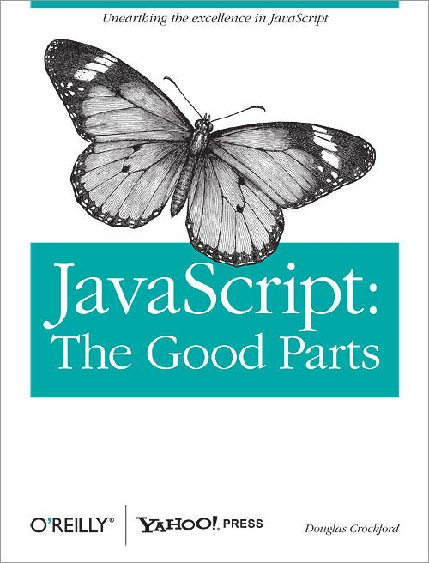
JavaScript: The Good Parts
JavaScript is a language with more than its share of bad parts. It went from non-existence to global adoption in an alarmingly short period of time. It never had an interval in the lab when it could be tried out and polished. It went straight into Netscape Navigator 2 just as it was, and it was very rough. When Java applets failed, JavaScript became the “Language of the Web” by default. JavaScript’s popularity is almost completely independent of its qualities as a programming language.
Fortunately, JavaScript has some extraordinarily good parts. In JavaScript, there is a beautiful, elegant, highly expressive language that is buried under a steaming pile of good intentions and blunders. The best nature of JavaScript is so effectively hidden that for many years the prevailing opinion of JavaScript was that it was an unsightly, incompetent toy. My intention here is to expose the goodness in JavaScript, an outstanding, dynamic programming language.

Slide 4
Arithmetic Expressions
Like most languages, JavaScript specifies computation in the form of an arithmetic expression, which consists of terms joined together by operators.
Each term in an arithmetic expression is one of the following:
  An explicit numeric value, such as 2 or 3.14159265
  A variable name that serves as a placeholder for a value
  A function call that computes a value
  An expression enclosed in parentheses
The operators are typically the familiar ones from arithmetic:
+
Addition
–
Subtraction
*
Multiplication
/
Division
%
Remainder

Slide 5
The Remainder Operator
The only arithmetic operator that has no direct counterpart in traditional mathematics is %, which computes the remainder when the first is divided by the second:
14 % 7
returns
0
14 % 5
returns
4
7 % 14
returns
7
The result of the % operator make intuitive sense only if both operands are positive integers. The examples in the book do not depend on knowing how % works with negative numbers or numbers that have fractional parts.
The remainder operator turns out to be useful in a surprising number of programming applications and is well worth a bit of study.

Slide 6
Using the JavaScript Console
The easiest way to get a sense of how arithmetic expressions work is to enter them on the JavaScript console available on the cs106aj.stanford.edu web site.
JavaScript Console
->
2 + 2
4
->
342 - 173
169
->
12345679 * 63
777777777
->
9 * 9 * 9 + 10 * 10 * 10
1729
->

Slide 7
Variables
The simplest terms that appear in expressions are constant literals and variables. A variable is a placeholder for a value that can be updated as the program runs.
A variable in JavaScript is most easily envisioned as a box capable of storing a value
answer
42
Each variable has the following attributes:
  A name, which enables you to tell the variables apart.
  A value, which represents the current contents of the variable.
The name of a variable is fixed; the value changes whenever you assign a new value to the variable.

Slide 8
Variable Declarations
In JavaScript, you must declare a variable before you can use it. The declaration establishes the name of the variable and, in most cases, specifies the initial value as well.
The most common form of a variable declaration is
let name = value;
where name is an identifier that indicates the name of the variable, and value is an expression specifying the initial value.
Most declarations appear as statements in the body of a function definition. Variables declared in this way are called local variables and are accessible only inside that function.

Slide 9
Constant Declarations
It is often useful to give names to values that you don’t intend to change while the program runs. Such values are called constants.
A constant declaration is similar to a variable declaration:
const name = value;
As before, name is an identifier that indicates the name of the constant, and value is an expression specifying its value.

Slide 10
Naming Conventions
In JavaScript, all names must conform to the syntactic rules for identifiers, which means that the first character must be a letter and the remaining characters must be letters, digits, or the underscore character.
Beyond these rules that apply to all JavaScript names, there are several conventions that programmers use to make their identifier names easier to recognize:
  Variable names and function names begin with a lowercase letter. If a name consists of more than one word, the first letter in each word is capitalized, as in numberOfStudents. This convention is called camel case.
  Class names and program names begin with an uppercase letter.
  Constant names are written entirely in uppercase and use the underscore character to separate words, as in MAX_HEADROOM.

Slide 11
Precedence
If an expression contains more than one operator, JavaScript uses precedence rules to determine the evaluation order. The arithmetic operators have the following relative precedence:
unary -
highest
* / %
+ -
lowest
Thus, JavaScript evaluates unary – operators first, then the operators *, /, and %, and then the operators + and -.
Precedence applies only when two operands compete for the same operator. If the operators are independent, JavaScript evaluates expressions from left to right. Parentheses may be used to change the order of operations.

Slide 12
Exercise: Precedence Evaluation
What is the value of the expression at the bottom of the screen?
42
51
45
6
3
2
9
15
1
*
2
*
3
+
(
4
+
5
)
%
6
*
(
7
+
8
)
-
9

Slide 13
Assignment Statements
You can change the value of a variable in your program by using an assignment statement, which has the general form:
variable = expression;
The effect of an assignment statement is to compute the value of the expression on the right side of the equal sign and assign that value to the variable that appears on the left. Thus, the assignment statement
total = total + value;
adds together the current values of the variables total and value and then stores that sum back in the variable total.
When you assign a new value to a variable, the old value of that variable is lost.

Slide 14
Shorthand Assignments
Statements such as
total = total + value;
are so common that JavaScript allows the following shorthand:
total += value;
The general form of a shorthand assignment is
variable op= expression;
where op is any of JavaScript’s binary operators. The effect of this statement is the same as
variable = variable op (expression);

Slide 15
Increment and Decrement Operators
Another important shorthand that appears frequently in JavaScript programs is the increment operator, which is most commonly written immediately after a variable, like this:
x++;
The effect of this statement is to add one to the value of x, which means that this statement is equivalent to
x += 1;
or
x = x + 1;
The -- operator (which is called the decrement operator) is similar but subtracts one instead of adding one.

Slide 16
Functions Revisited
Last week, you learned that a function in Karel is a sequence of statements that has been collected together and given a name.
Although that definition also applies in JavaScript, it fails to capture the idea that functions can process information.
In JavaScript, a function can take information from its caller, perform some computation, and then return a result.
This notion that functions exist to manipulate information and return results makes functions in programming similar to functions in mathematics, which is the historical reason for the name.

Slide 17
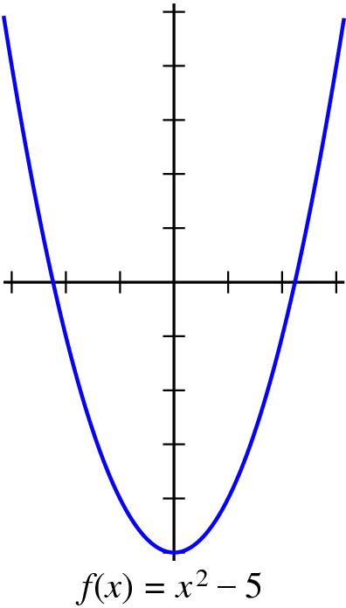
Functions in Mathematics
The graph at the right shows the values of the function
f (x) = x ² − 5
Plugging in a value for x allows you to compute the value of f (x), as follows:
f (0) = 0² − 5 = −5
f (1) = 1² − 5 = −4
f (2) = 2² − 5 = −1
f (3) = 3² − 5 = 4
The JavaScript version of f (x) is
function f(x) {
return x * x – 5;
}

Slide 18
Writing JavaScript Functions
The general form of a function definition is
function name(parameter list) {
statements in the function body
}
where name is the name of the function, and parameter list is a list of variables used to hold the values of each argument.
You can return a value from a function by including a return statement, which is usually written as
return expression;
where expression is an expression that specifies the value you want to return.

Slide 19
Examples of Simple Functions
The following function converts Fahrenheit temperatures to their Celsius equivalent:
function fahrenheitToCelsius(f) {
return 5 / 9 * (f – 32);
}
The following function computes the area of a triangle from its base and height:
function triangleArea(base, height) {
return (base * height) / 2;
}

Slide 20
Libraries
To make programming easier, all modern languages include collections of predefined functions. Those collections are called libraries.
For programming that involves mathematical calculations, the most useful library is the Math library, which includes a number of functions that will be familiar from high-school mathematics (along with many that probably aren’t). A list of the most important functions appears on the next slide.
In JavaScript, each of the functions in the Math library begins with the library name followed by a dot and then the name of the function. For example, the function that calculates square roots is named Math.sqrt.
You call library functions just like any other function, so that calling Math.sqrt(16) returns the value 4.

Slide 21
Useful Functions in the Math Library
Math.PI
The mathematical constant π
Math.E
The mathematical constant e
Math.abs(x)
The absolute value of x
Math.max(x, y, . . .)
The largest of the arguments
Math.min(x, y, . . .)
The smallest of the arguments
Math.round(x)
The closest integer to x
Math.floor(x)
The largest integer not exceeding x
Math.log(x)
The natural logarithm of x
Math.exp(x)
The inverse logarithm (e ^{x})
Math.pow(x, y)
The value x raised to the y power (x ^{y})
Math.sin(θ )
The sine of θ, measured in radians
Math.cos(θ )
The cosine of θ, measured in radians
Math.sqrt(x)
The square root of x
Math.random()
A random value between 0 and 1

Slide 22
Exercise: Calculating a Quotient
It is often useful to be able to compute the quotient of two numbers, which is the whole number that results if you divide the first by the second and then throw away any remainder.
As noted on the prior slide, there is a function called floor in the Math library that makes the quotient function easier to write, but it is possible to write it using only JavaScript’s standard arithmetic operators.
Get together with your neighbors in the class and come up with an implementation for a function quotient(x, y) that returns the quotient of the positive integers x and y.

Slide 23
Nonnumeric Data
The arithmetic expressions in the early sections of Chapter 2 enable you to perform numeric computation. Much of the excitement of modern computing, however, lies in the ability of computers to work with other types of data, such as characters, images, sounds, and video.
As you will learn in Chapter 7, all of these data types are represented inside the machine as sequences of binary digits, or bits. When you are getting started with programming, it is more important to think about data in a more abstract way in which you focus on the conceptual values rather than the underlying representation.

Slide 24
Data Types
The notion that data values come in many different forms gives rise to the notion of a data type, which defines the common characteristics of data values that have a particular form or purpose.
In computer science, each data type is defined by a domain, which is the set of values that belong to that type, and a set of operations, which shows how the values in that domain can be manipulated.
For example, the JavaScript type for numbers has a domain that consists of numeric values like 1.414213 or 42. The set of operations includes addition, subtraction, multiplication, division, remainder, and a few more that you haven’t learned yet.

Slide 25
The String Type
One of the most important data types in any programming language is the string type.
The domain of the string type is all sequences of characters. In JavaScript, you create a string simply by including that sequence of characters inside quotation marks, as in "Jerry".
The set of operations that can be applied to strings is large, but you don’t need to know the entire set. In fact, for the first six chapters in the text, the only string operation you need to know is concatenation, as described on the next slide. You will learn about other operations in Chapter 7.
All values—including numbers, strings, graphical objects, and values of many other types—can be assigned to variables, passed as arguments to functions, and returned as results.

Slide 26
Concatenation
One of the most useful operations available for strings is concatenation, which consists of combining two strings end to end with no intervening characters.
Concatenation is built into JavaScript using the + operator. For example, the expression "ABC" + "DEF" returns the string "ABCDEF".
If you use + with numeric operands, it signifies addition. If at least one of its operands is a string, JavaScript interprets + as concatenation. It automatically converts the other operand to a string and concatenates the two strings, so that
"Catch" + -22 "Catch-22"

Slide 27
The End

