Slide 1
Control Statements
Jerry Cain
CS 106AJ
October 5, 2018
slides courtesy of Eric Roberts

Slide 2
Once upon a time . . .

Slide 3

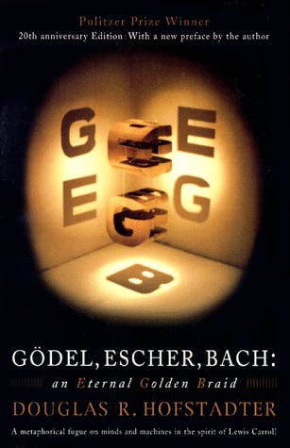
Holism vs. Reductionism
In his Pulitzer-prizewinning book, computer scientist Douglas Hofstadter identifies two concepts—holism and reductionism—that turn out to be important as you begin to learn about programming. Hofstadter explains these concepts using a dialogue in the style of Lewis Carroll:
Achilles:
I will be glad to indulge both of you, if you will first oblige me, by telling me the meaning of these strange expressions, "holism" and "reductionism".
Crab:
Holism is the most natural thing in the world to grasp. It’s simply the belief that "the whole is greater than the sum of its parts". No one in his right mind could reject holism.
Anteater:
Reductionism is the most natural thing in the world to grasp. It’s simply the belief that “a whole can be understood completely if you understand its parts, and the nature of their 'sum'". No one in her left brain could reject reductionism.

Slide 4
Control Statements

Slide 5
Statement Types in JavaScript
Statements in JavaScript fall into three basic types:
  Simple statements
  Compound statements
  Control statements
Simple statements are typically assignments, function calls, or applications of the ++ or -- operators. Simple statements are always terminated with a semicolon.
Compound statements (also called blocks) are sequences of statements enclosed in curly braces.
Control statements fall into two categories:
  Conditional statements that specify some kind of test
  Iterative statements that specify repetition

Slide 6
Boolean Expressions
JavaScript defines two types of operators that work with Boolean data: relational operators and logical operators.
There are six relational operators that compare values of other types and produce a true/false result:
= ==
Equals
!==
Not equals
<
Less than
<=
Less than or equal to
>
Greater than
>=
Greater than or equal to
For example, the expression n <= 10 has the value true if n is less than or equal to 10 and the value false otherwise.
There are also three logical operators:
&&
Logical AND
p && q means both p and q
||
Logical OR
p || q means either p or q (or both)
!
Logical NOT
!p means the opposite of p

Slide 7
Notes on the Boolean Operators
Remember that JavaScript uses = for assignment. To test whether two values are equal, you must use the = = = operator.
It is not legal in JavaScript to use more than one relational operator in a single comparison. To express the idea embodied in the mathematical expression
0 ≤ x ≤ 9
you need to make both comparisons explicit, as in
0 <= x && x <= 9
The || operator means either or both, which is not always clear in the English interpretation of or.
Be careful when you combine the ! operator with && and || because the interpretation often differs from informal English.

Slide 8
Short-Circuit Evaluation
JavaScript evaluates the && and || operators using a strategy called short-circuit mode in which it evaluates the right operand only if it needs to do so.
For example, if n is 0, the right operand of && in
n !== 0 && x % n === 0
is not evaluated at all because n !== 0 is false. Because the expression
false && anything
is always false, the rest of the expression no longer matters.
One of the advantages of short-circuit evaluation is that you can use && and || to prevent errors. If n were 0 in the earlier example, evaluating x % n would result in a division by zero.

Slide 9
The if Statement
The simplest of the control statements is the if statement, which occurs in two forms. You use the first when you need to perform an operation only if a particular condition is true:
if (condition) {
statements to be executed if the condition is true
}
You use the second form whenever you need to choose between two alternative paths, depending on whether the condition is true or false:
if (condition) {
statements to be executed if the condition is true
} else {
statements to be executed if the condition is false
}

Slide 10
Functions Involving Control Statements
The body of a function can contain statements of any type, including control statements. As an example, the following function uses an if statement to find the larger of two values:
function max(x, y) {
if (x > y) {
return x;
} else {
return y;
}
}
As this example makes clear, return statements can be used at any point in the function and may appear more than once.

Slide 11
The switch Statement
JavaScript evaluates statements in the case or default clause until it reaches a break or a return statement.
JavaScript then looks for a case clause that matches expression. If expression is equal to v₂, JavaScript chooses the second clause.
If none of the values in the case clauses match the expression, JavaScript evaluates the statements in the default clause.
The switch statement provides a convenient syntax for choosing among a set of possible paths:
When JavaScript executes a switch statement, it begins by evaluating expression.
The switch statement provides a convenient syntax for choosing among a set of possible paths:
switch ( expression ) {
case v₁:
statements to be executed if expression = v₁
break;
case v₂:
statements to be executed if expression = v₂
break;
. . . more case clauses if needed . . .
default:
statements to be executed if no values match
break;
}
switch ( expression ) {
case v₁:
statements to be executed if expression is equal to v₁
break;
case v₂:
statements to be executed if expression is equal to v₂
break;
. . . more case clauses if needed . . .
default:
statements to be executed if no values match
break;
}

Slide 12
Example of the switch Statement
The switch statement is useful when a function must choose among several cases, as in the following example:
function monthName(month) {
switch (month) {
case 1: return "January";
case 2: return "February";
case 3: return "March";
case 4: return "April";
case 5: return "May";
case 6: return "June";
case 7: return "July";
case 8: return "August";
case 9: return "September";
case 10: return "October";
case 11: return "November";
case 12: return "December";
default: return undefined;
}
}

Slide 13
The while Statement
The while statement is the simplest of JavaScript’s iterative control statements and has the following form:
while ( condition ) {
statements to be repeated
}
while ( condition ) {
statements to be repeated
}
When JavaScript encounters a while statement, it begins by evaluating the condition in parentheses.
If the value of condition is true, JavaScript executes the statements in the body of the loop.
At the end of each cycle, JavaScript reevaluates condition to see whether its value has changed. If condition evaluates to false, JavaScript exits from the loop and continues with the statement following the end of the while body.

Slide 14
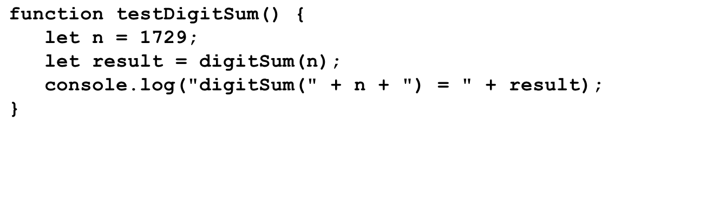
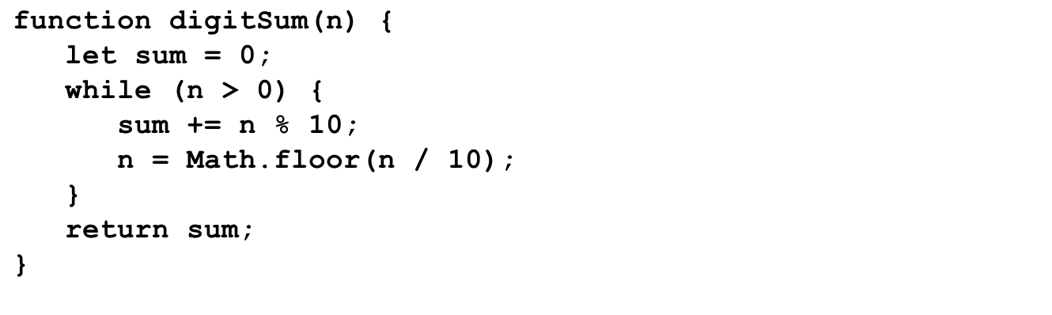
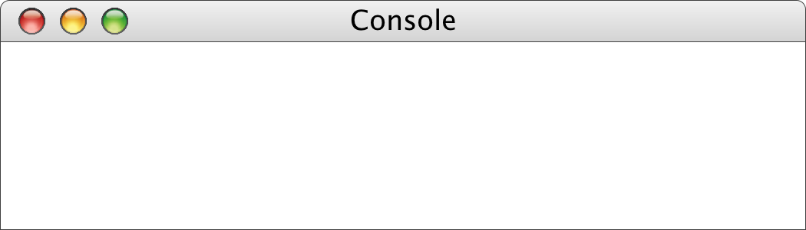
The digitSum Function
n
result
1729
n
19
sum
1729
172
17
1
0
0
9
11
18
19
digitSum(1729) = 19

Slide 15
The for Statement
The for statement in JavaScript is a powerful tool for specifying the structure of a loop independently from the operations the loop performs. The syntax looks like this:
for ( init ; test ; step ) {
statements to be repeated
}
for ( init ; test ; step ) {
statements to be repeated
}
JavaScript evaluates a for statement as follows:
1.
Evaluate init, which typically declares a control variable.
2.
Evaluate test and exit from the loop if the value is false.
3.
Execute the statements in the body of the loop.
4.
Evaluate step, which usually updates the control variable.
5.
Return to step 2 to begin the next loop cycle.

Slide 16
Exercise: Reading for Statements
Describe the effect of each of the following for statements:
1.
for (let i = 1; i <= 10; i++)
This statement executes the loop body ten times, with the control variable i taking on each successive value between 1 and 10.
2.
for (let i = 0; i < n; i++)
This statement executes the loop body n times, with i counting from 0 to n - 1. This version is the standard Repeat-n-Times idiom.
3.
for (let n = 99; n >= 1; n -= 2)
This statement counts backward from 99 to 1 by twos.
4.
for (let x = 1; x <= 1024; x *= 2)
This statement executes the loop body with the variable x taking on successive powers of two from 1 up to 1024.

Slide 17
The factorial Function
The factorial of a number n (which is usually written as n! in mathematics) is defined to be the product of the integers from 1 up to n. Thus, 5! is equal to 120, which is 1 ^{x} 2 ^{x} 3 ^{x} 4 ^{x} 5.
The following function definition uses a for loop to compute the factorial function:
function fact(n) {
let result = 1;
for (let i = 1; i <= n; i++) {
result = result * i;
}
return result;
}

Slide 18
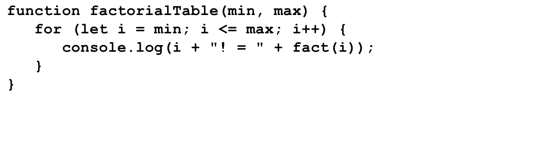
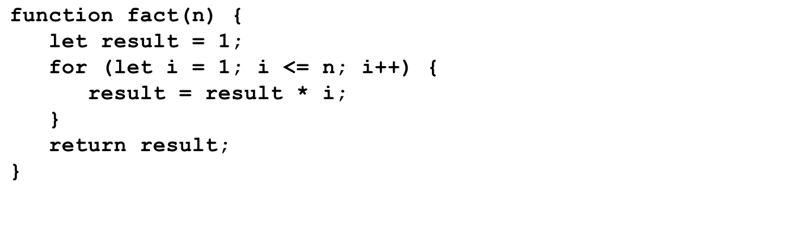
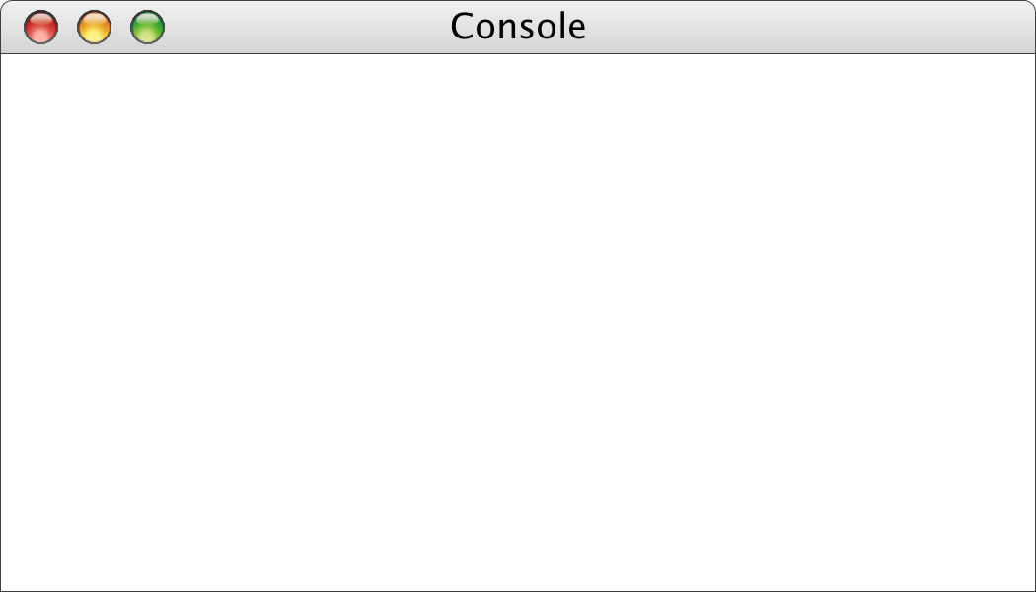
The factorialTable Function
1
5040
min
max
i
0
n
n
7
result
result
0
1
6
7
8
i
i
0
7
1
1
1
2
6
24
120
720
5040
1
1
2
3
4
5
6
7
8
->
factorialTable(0, 7);
0! = 1
1! = 1
2! = 2
3! = 6
4! = 24
5! = 120
6! = 720
7! = 5040
->

Slide 19
Comparing for and while
The for statement
for ( init ; test ; step ) {
statements to be repeated
}
is functionally equivalent to the following code using while:
init;
while ( test ) {
statements to be repeated
step;
}
The advantage of the for statement is that everything you need to know to understand how many times the loop will run is explicitly included in the header line.

Slide 20
The Checkerboard Program
const GWINDOW_WIDTH = 500; /* Width of the graphics window */
const GWINDOW_HEIGHT = 300; /* Height of the graphics window */
const N_COLUMNS = 8; /* Number of columns */
const N_ROWS = 8; /* Number of rows */
const SQUARE_SIZE = 35; /* Size of a square in pixels */
function Checkerboard() {
let gw = GWindow(GWINDOW_WIDTH, GWINDOW_HEIGHT);
let x0 = (gw.getWidth() - N_COLUMNS * SQUARE_SIZE) / 2;
let y0 = (gw.getHeight() - N_ROWS * SQUARE_SIZE) / 2;
for (let i = 0; i < N_ROWS; i++) {
for (let j = 0; j < N_COLUMNS; j++) {
let x = x0 + j * SQUARE_SIZE;
let y = y0 + i * SQUARE_SIZE;
let sq = GRect(x, y, SQUARE_SIZE, SQUARE_SIZE);
let filled = ((i + j) % 2 !== 0;
sq.setFilled(filled);
gw.add(sq);
}
}
}

Slide 21
The End

