Slide 1
String Applications
Jerry Cain
CS 106AJ
October 26, 2018
slides courtesy of Eric Roberts and Jerry Cain

Slide 2
String Calisthenics
Let’s review some String methods you learned about last time:
"AEIOUaeiou".length
"ABCDEFG".charAt(6)
"Harry Potter".indexOf("a")
"Harry Potter".indexOf("a", 6)
"Harry Potter".lastIndexOf("tt")
"bumfuzzle".substring(3, 7)
"cabotage".substring(1, 1)
"agelast".substring(3)
10
"G"
1
-1
8
"fuzz”
""
"last"

Slide 3
Generating Acronyms
An acronym is a word formed by taking the first letter of each word in a sequence, as in
"North American Free Trade Agreement"
"NAFTA"
"not in my back yard"
"nimby"
"self-contained underwater breathing apparatus"
"scuba"
The text describes and implements two versions of a function acronym(str) that generates an acronym for str:
  The first version searches for spaces in the string and includes the following character in the acronym. This version, however, fails for acronyms like scuba, in which some of the words are separated by hyphens rather than spaces.
  The second version looks at every character and keeps track of whether the algorithm is scanning a word formed composed of sequential letters. This version correctly handles scuba as well as strings that have leading, trailing, or multiple spaces.

Slide 4
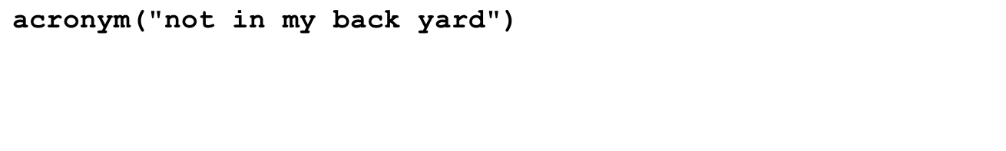
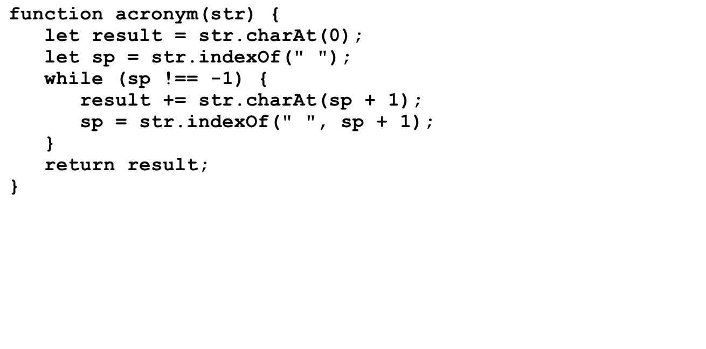

acronym , Take I
str
result
sp
"not in my back yard"
"n"
"ni"
"nim"
"nimb"
"nimby"
3
6
9
14
-1
>
acronym("not in my back yard")
nimby

Slide 5
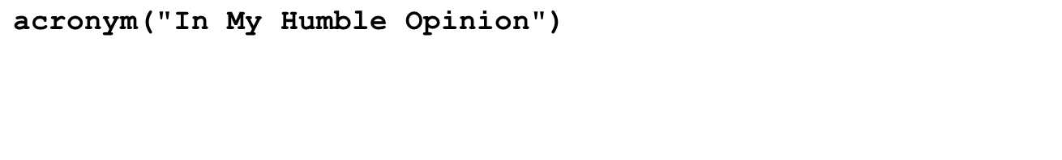
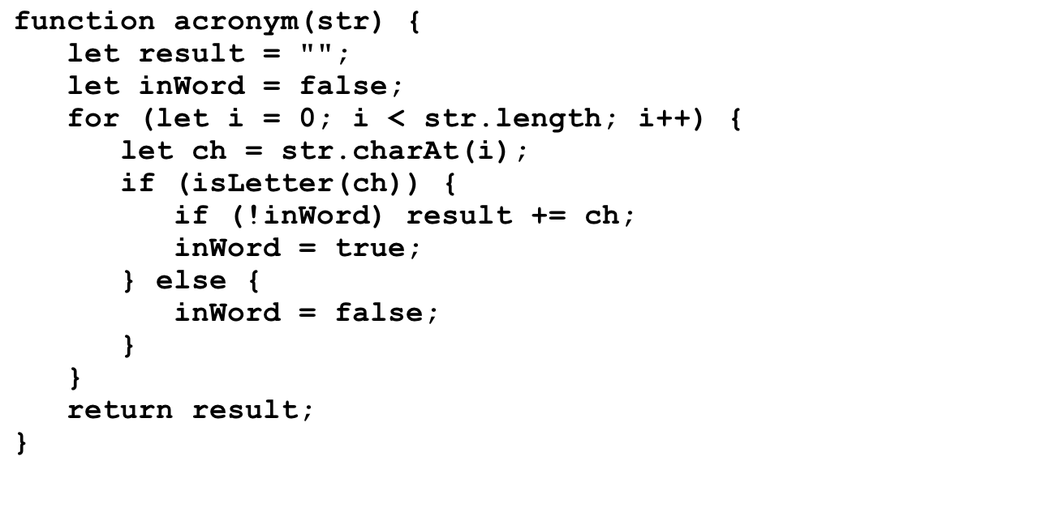
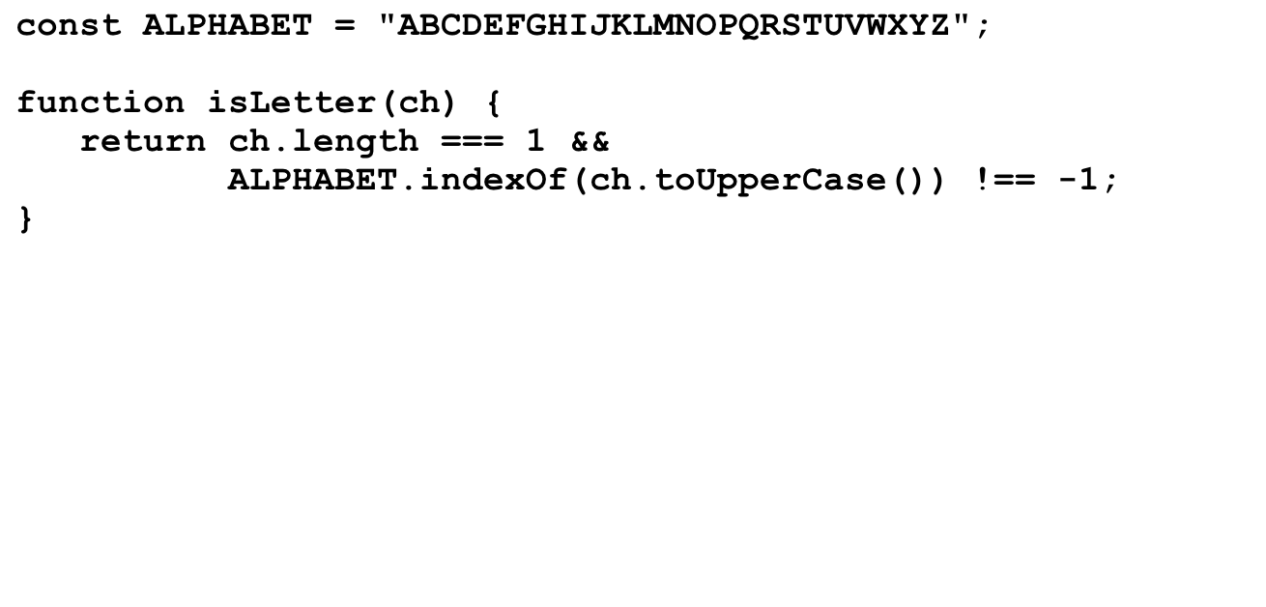

acroynm, Take II
8
-1
str
result
i
inWord
ch
ch
"In My Humble Opinion"
""
ch
"I"
"IM"
"IMH"
"IMHO"
0
1
2
3
4
5
6
7
8
9
10
11
12
13
14
15
16
17
18
19
20
false
true
true
false
true
true
false
true
true
true
true
true
true
false
true
true
true
true
true
true
true
"I"
"n"
" "
"M"
"y"
" "
"H"
"u"
"m"
"b"
"l"
"e"
" "
"O"
"p"
"i"
"n"
"i"
"o"
"n"
"I"
" "
>
acronym("In My Humble Opinion")
IMHO

Slide 6
Translating Pig Latin to English
Section 7.4 works through the design and implementation of a program to convert a sentence from English to Pig Latin. In this dialect, the Pig Latin version of a word is formed by applying the following rules:
1.
If the word begins with a consonant, the wordToPigLatin function moves the initial consonant string to the end of the word and then adds the suffix ay, as follows:
scr
scr
scr
scr
scr
scr
scr
scr
scr
scr
scr
scr
scr
scr
scr
scr
scr
scr
scr
scr
scr
scr
scr
scram
scr
scr
am
am
am
am
am
am
am
am
am
am
am
am
am
am
am
am
am
am
am
am
am
am
am
am
am
am
scr
ay
2.
If the word begins with a vowel, wordToPigLatin generates the Pig Latin version simply by adding the suffix way, like this:
apple
apple
way
3.
If the word contains no vowels at all, wordToPigLatin returns the original word unchanged.

Slide 7
Translating Pig Latin to English
"stout plunder lover"
i
0
1
2
3
4
5
6
12
13
14
18
inWord
F
T
T
T
T
T
F
T
T
F
T
T
start
-1
0
0
0
0
0
-1
6
6
-1
14
14
inWord is true if and only if we’re in a word, and start is the index of the first character of the word we’re currently in (or -1 if we’re not in a word).
inWord is now true and start is set equal to 0. We assign start to be a snapshot of i at the same time inWord transitions from false to true , so we can remember where the current word of interest begins.
This is an interesting transition, since the current word we’re in is just now ending. We can isolate the word by calling str.substring(start, i), where str is assumed to be the entire sentence or fragment to be translated.
  Right now, str.substring(start, i) produces "stout" .
  And now, str.substring(start, i) produces "plunder" .

Slide 8
Pseudocode for the Pig Latin Program
function toPigLatin(str) {
Initialize a variable called result to hold the growing string.
for (each character position in str) {
if (the current character is a letter) {
if (we’re not yet scanning a word) Remember the start of this word.
} else {
if (we were scanning a word) {
Call wordToPigLatin to translate the word.
Append the translated word to the result variable.
}
Append the separator character to the result variable.
}
}
if (we’re still scanning a word) {
Call wordToPigLatin and append the translated word to result.
}
}
function wordToPigLatin(word) {
Find the first vowel in the word.
If there are no vowels, return the original word unchanged.
If the vowel appears in the first position, return the word concatenated with "way".
Divide the string into two parts (head and tail) before the vowel.
Return the result of concatenating the tail, the head, and the string "ay".
}

Slide 9
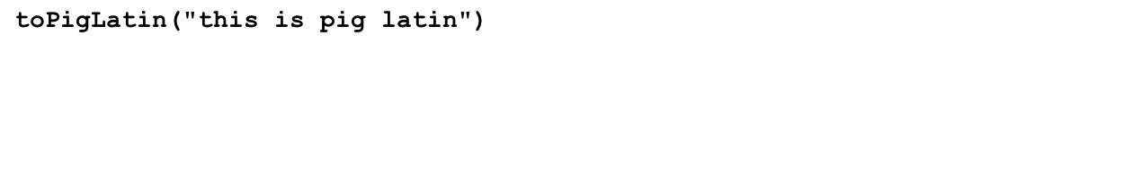
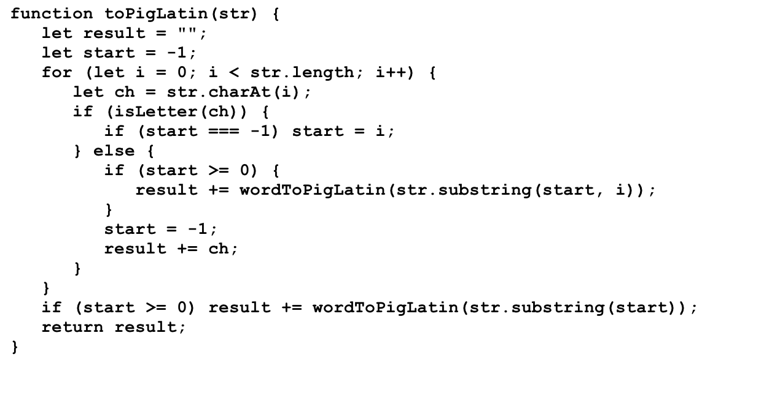
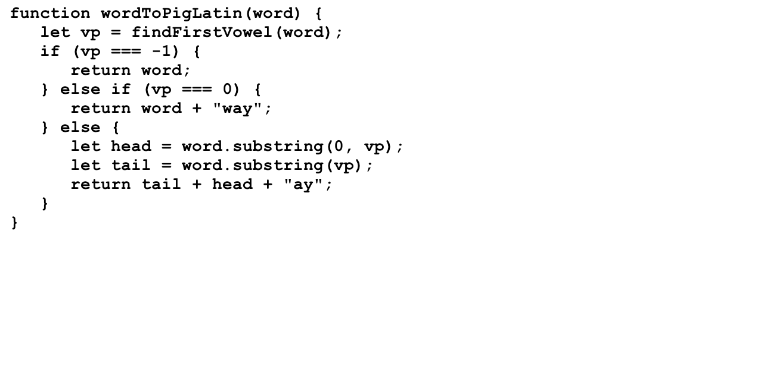
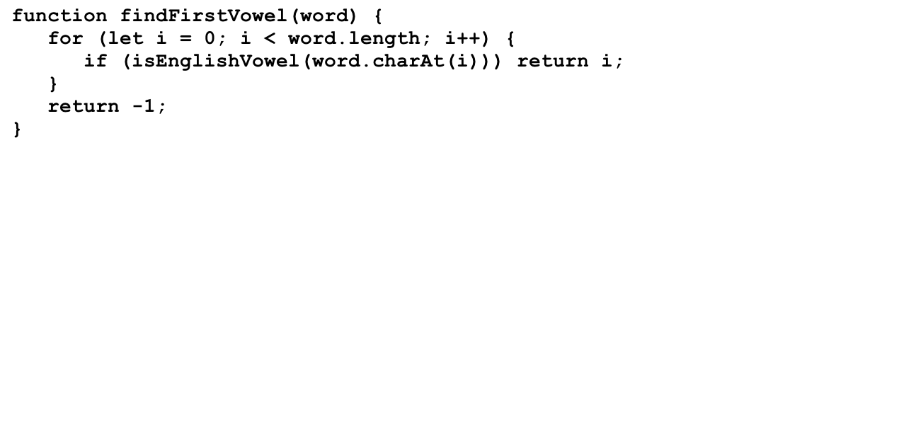
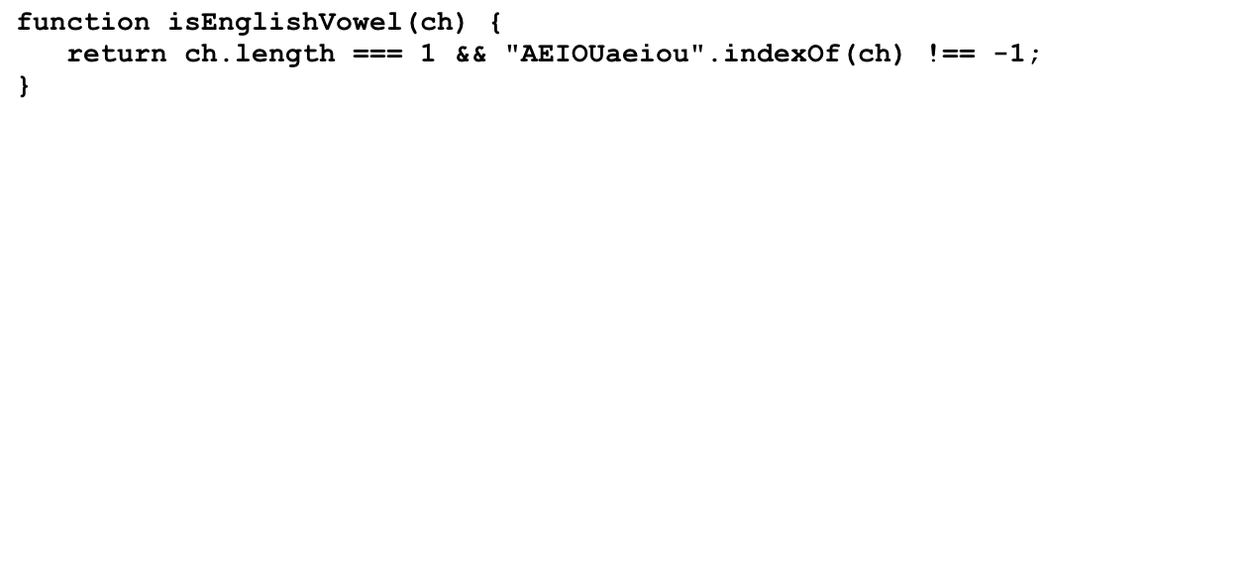
Simulating the PigLatin Program
"isthay"
"isway"
"igpay"
"atinlay"
str
result
start
i
ch
word
word
word
word
vp
vp
vp
vp
head
head
head
head
tail
tail
tail
word
tail
i
ch
"this is pig latin"
""
"isthay"
"isthay "
"isthay isway"
"isthay isway "
"isthay isway igpay"
"isthay isway igpay "
"isthay isway igpay atinlay"
-1
0
-1
5
-1
8
-1
12
0
1
2
3
4
5
6
7
8
9
10
11
12
13
14
15
16
17
"t"
"h"
"i"
"s"
" "
"i"
"s"
" "
"p"
"i"
"g"
" "
"l"
"a"
"t"
"i"
"this"
"n"
"is"
"pig"
"latin"
2
0
1
1
"th"
"p"
"l"
"is"
"ig"
"atin"
"this"
0
1
2
"t"
>
toPigLatin("this is pig latin")
isthay isway igpay atinlay

Slide 10
The End

