Slide 1

Debugging
Jerry Cain
CS 106AJ
October 29, 2019
slides courtesy of Eric Roberts

Slide 2
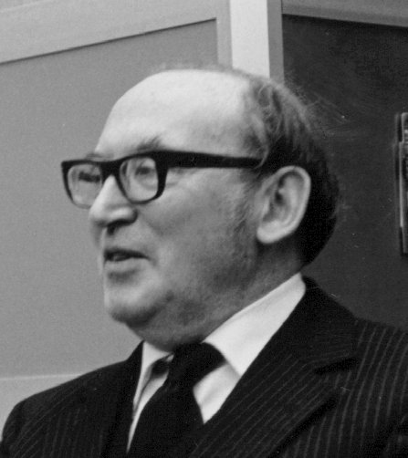
The Discovery of Debugging
“As soon as we started programming, we found to our surprise that it wasn’t as easy to get programs right as we had thought. Debugging had to be discovered. I can remember the exact instant when I realized that a large part of my life from then on was going to be spent in finding mistakes in my own programs.”
Maurice Wilkes, 1913–2010
—
Maurice Wilkes, lecture on "The Design and Use of the EDSAC," September 23, 1979

Slide 3
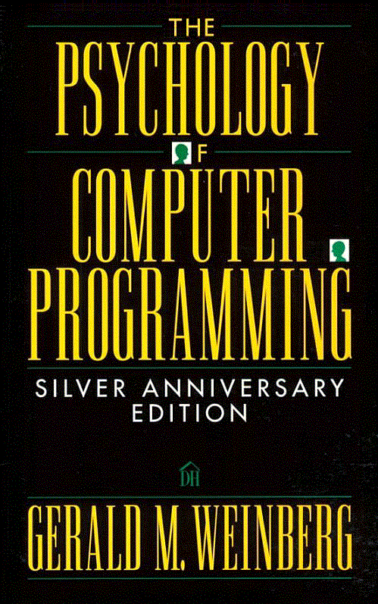
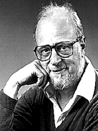
The Importance of Psychology
For programming is not just human behavior; it is complex human behavior.
Although programming is a form—a complex form—of human behavior, few people have studied programming from this point of view. But perhaps there is a reason why programming has not been so viewed? Perhaps programming is too complex a behavior to be studied and must remain largely a mysterious process.
Gerald Weinberg, 1933-

Slide 4
The Psychology of Debugging
First, there is only the gestalt, a general feeling that something is out of place without any particular localization. Then follows the ability to shake loose from an unyielding situation—the ability to change one’s point of view. . . . Then, however, one must go from the general to the particular—“focusing” as it was called here. Although one does not find errors by a detailed search of each line, word, or character, the ability to get down to details is essential in the end. Thus, for debugging, an almost complementary set of mental powers is needed. No wonder good debuggers are so rare!
—
Gerald Weinberg, The Psychology of Computer Programming, 1971

Slide 5
Example of a Psychological Barrier
As an illustration of the kind of psychological barrier that novices encounter when debugging, most students when faced with a bug set out to determine why their program isn’t doing what it’s supposed to be doing.
In general, this strategy is less effective than trying to figure out why the program is doing what it in fact does. In all likelihood, understanding what the program is actually doing provides precisely the insight necessary to repair it.

Slide 6
Roles in the Programming Process
Programming requires you to assume a variety of roles over the course of the development cycle:
Design
Architect
Coding
Engineer
Testing
Vandal
Debugging
Detective

Slide 7
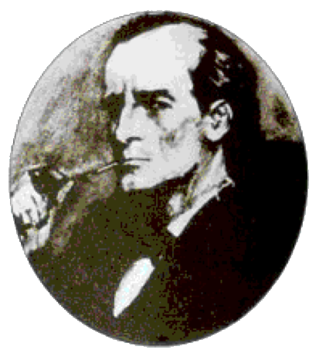
Sherlock Holmes on Debugging
There is nothing like first-hand evidence.
—
A Study in Scarlet, 1888
It is a capital mistake to theorise before one has data. Insensibly one begins to twist facts to suit theories, instead of theories to suit facts.
—
A Scandal in Bohemia, 1892
It is of the highest importance in the art of detection to be able to recognize out of a number of facts which are incidental and which vital. Otherwise your energy and attention must be dissipated instead of being concentrated.
—
The Adventure of the Reigate Squires, 1892

Slide 8
Literary Sources of Debugging Wisdom
Regard with distrust all circumstances which seem to favor our secret desires.
—
Émile Gaboriau, Monsieur Lecoq, 1868
With method and logic one can accomplish anything.
—
Agatha Christie, Poirot Investigates, 1924
A great detective must have infinite patience. That is the quality next to imagination that will serve him best. Indeed, without patience, his imagination will serve him but indifferently.
—
Cleveland Moffett, Through the Wall, 1909
Detection requires a patient persistence which amounts to obstinacy.
—
P. D. James, An Unsuitable Job for a Woman, 1972
It was always more difficult than you thought it would be.
—
Alexander McCall Smith, The No. 1 Ladies’ Detective Agency, 1998

Slide 9

And Best of All . . .
The best discussion I have ever encountered of the psychology of debugging occurs in Zen and the Art of Motorcycle Maintenance by Robert Pirsig.

Slide 10
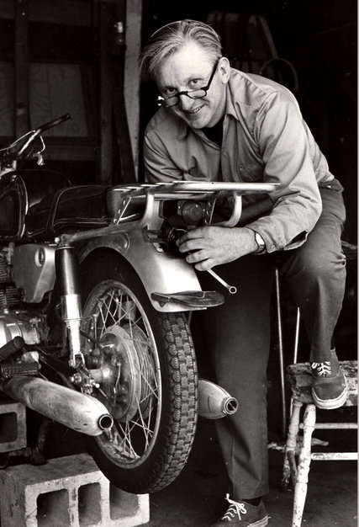
In Memoriam
Robert M. Pirsig, Author of ‘Zen and the
Art of Motorcycle Maintenance,’ Dies at 88
Robert M. Pirsig, whose “Zen and the Art of Motorcycle Maintenance,” a dense and discursive novel of ideas, became an unlikely publishing phenomenon in the mid-1970s and a touchstone in the waning days of the counterculture, died on Monday at his home in South Berwick, Me. He was 88.
His publisher, William Morrow, announced his death, saying his health had been failing. He had been living in Maine for the last 30 years.
Mr. Pirsig was a college writing instructor and freelance technical writer when the novel—its full title was “Zen and the Art of Motorcycle Maintenance: An Inquiry Into Values”—was published in 1974 to critical acclaim and explosive popularity, selling a million copies in its first year and several million more since.
—Paul Vitello, The New York Times, April 24, 2017

Slide 11
And Best of All . . .
The best discussion I have ever encountered of the psychology of debugging occurs in Zen and the Art of Motorcycle Maintenance by Robert Pirsig. In Chapter 26, Pirsig introduces the idea of the gumption trap, a psychological barrier that stands in the way of understanding the solution to a problem. Gumption traps occur frequently in computing, usually in the context of the debugging phase.

Slide 12
Lest the Title Put You Off
What follows is based on actual occurrences. Although much has been changed for rhetorical purposes, it must be regarded in its essence as fact. However, it should in no way be associated with that great body of factual information relating to orthodox Zen Buddhist practice. It’s not very factual on motorcycles, either.
—
Robert Pirsig, “Author’s Note,” Zen and the Art of Motorcycle Maintenance

Slide 13
Example of a Gumption Trap
Of the value traps, the most widespread and pernicious is value rigidity. This is an inability to revalue what one sees because of commitment to previous values. . . .
The typical situation is that the motorcycle doesn’t work. The facts are there but you don’t see them. . . .
This often shows up in premature diagnosis, when you’re sure you know what the trouble is, and then when it isn’t, you’re stuck. Then you’ve got to find some new clues, but before you can find them you’ve got to clear your head of old opinions. If you’re plagued with value rigidity you can fail to see the real answer even when it’s staring you right in the face because you can’t see the new answer’s importance.
—
Robert Pirsig, Zen and the Art of Motorcycle Maintenance, 1971

Slide 14
The End

