Slide 1
Objects as Aggregates
Jerry Cain
CS 106AJ
November 7, 2018
slides courtesy of Eric Roberts

Slide 2
Objects in JavaScript
JavaScript uses the word "object" in a frustratingly imprecise way.
Unsurprisingly, the word "object" is used for the encapsulated data collections one finds in the object-oriented programming paradigm, as we’ll will describe on Friday and next Monday.
Unfortunately, JavaScript uses the same word to refer to any collection of individual data items. In other programming languages, this idea is often called a "structure," a "record," or an "aggregate." We will use "aggregate" when we want to restrict consideration to objects of this more primitive form.

Slide 3
Objects as Aggregates
Even though modern programming practice tends to favor the object-oriented model, it is still important to understand the more traditional view of objects as data aggregates.
Aggregates are used to represent situations in the real world in which several independent pieces of data are all part of a single unified structure. In contrast to an array, the data elements in an aggregate are often of different types and are identified by name rather than by a sequence number.
The first example in the text imagines keeping track of the data for the employees of Scrooge and Marley, the company from Charles Dickens’s A Christmas Carol. Each employee is identified by a name, a job title, and a salary. A diagram of the two employees at the company appears on the next slide.

Slide 4
Employees at Scrooge and Marley
name
name
Ebenezer Scrooge
Bob Cratchit
title
title
CEO
clerk
salary
salary
£1000
£25

Slide 5
Using JSON to Create Objects
The easiest way to create new aggregates in JavaScript is to use JavaScript Object Notation or JSON.
In JSON, you specify an object simply by listing its contents as a sequence of name-value pairs. The name and the value are separated by a colon, the name-value pairs are separated by commas, and the entire list is enclosed in curly braces.
The following declarations create variables named ceo and clerk for the employees diagrammed on the previous slide:
let ceo = {
name: "Ebenezer Scrooge",
title: "CEO",
salary: 1000
};
let clerk = {
name: "Bob Cratchit",
title: "clerk",
salary: 25
};

Slide 6
Selecting Fields from an Object
Given an object, you can select an individual field by writing an expression denoting the object and then following it by a dot and the name of the field. For example, the expression ceo.name returns the string "Ebenezer Scrooge"; similarly, clerk.salary returns the number 25.
Fields are assignable. For example, the statement
clerk.salary *= 2;
doubles poor Mr. Cratchit’s salary.
Fields selection can also be expressed using square brackets enclosing the name of the field expressed as a string, as in ceo["name"]. This style is necessary if the name of the field is not a simple identifier or, more likely, if the name is computed by the program.

Slide 7
Arrays of Objects
Since arrays can contain values of any type, the elements of an array can be JavaScript objects. For example, the employees at Scrooge and Marley can be initialized like this:
let employees = [
{ name: "Ebenezer Scrooge", title: "CEO", salary: 1000 },
{ name: "Bob Cratchit", title: "clerk", salary: 25}
];
The following function prints the payroll for the employee array supplied as an argument:
function printPayroll(employees) {
for (let i = 0; i < employees.length; i++) {
let emp = employees[i];
console.log(emp.name + " (" + emp.title + ") £" +
emp.salary);
}
}

Slide 8
Exercise: Hogwarts Student Data
How would you design an aggregate for keeping track of the following information about a student at Hogwarts:
  The name of the student
  The student’s house
  The student’s year at Hogwarts
  A flag indicating if the student has passed the O.W.L. exam
How would you code this data for the following students:
  Hermione Granger, Gryffindor, 5th year, passed O.W.L. exam
  Luna Lovegood, Ravenclaw, 4th year, not yet passed O.W.L.
  Vincent Crabbe, Slytherin, 5th year, failed O.W.L exam
Just for fun, think about other data values that might be useful about a Hogwarts student and what types you would use to represent these values.

Slide 9
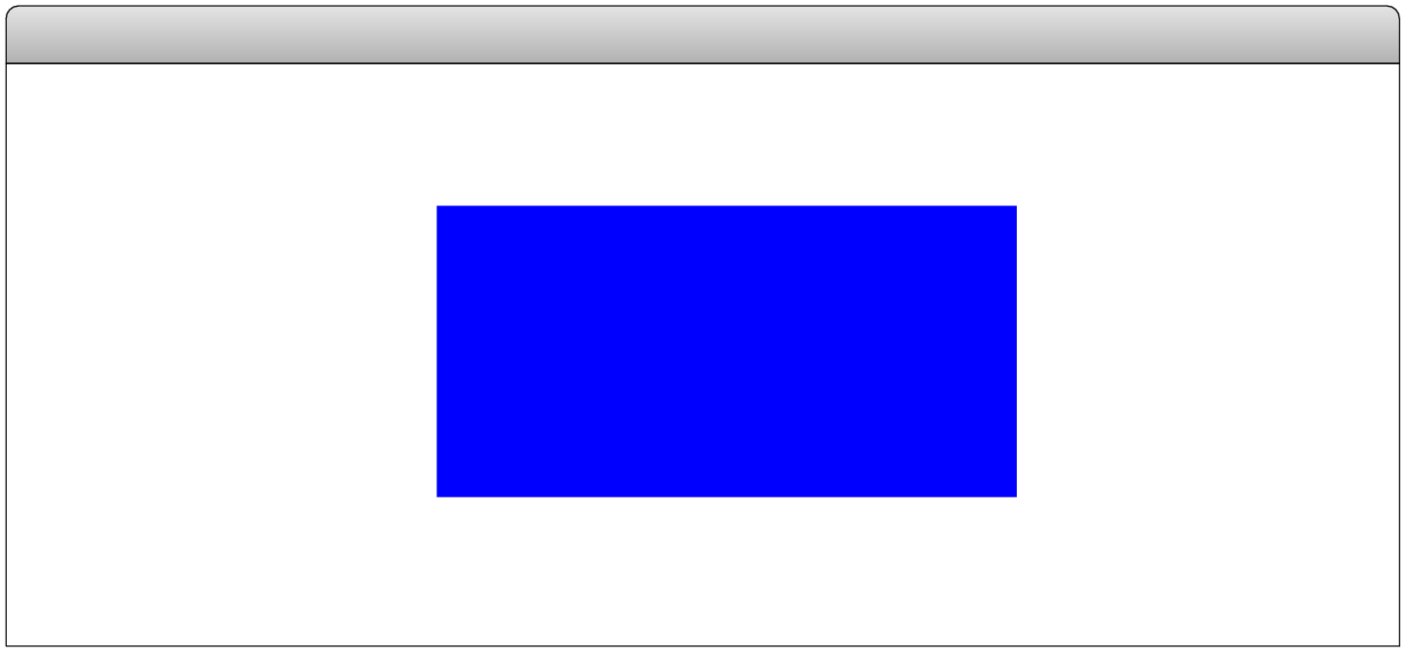
Representing Points as Aggregates
One data aggregate that comes in handy in graphics captures the abstract notion of a point in two-dimensional space, which is composed of an x and a y component.
Points can be created in JavaScript simply by writing their JSON notation, as in the following examples, which are shown along with their positions in the graphics window.
let p1 = { x: 0, y: 0 };
Graphics Window
let p2 = { x: 90, y: 70 };
The x and y components of p1 can be selected as p1.x and p1.y, respectively.

Slide 10
Factory Functions
Although JSON notation is compact and easy to read, it is often useful to define a function that creates a JavaScript object. Such functions are called factories and are written in the book using an uppercase initial letter.
The following function creates a point-valued object for which the coordinate values default to the (0, 0) point at the origin:
function Point(x, y) {
if (x === undefined) {
x = 0;
y = 0;
}
return { x: x, y: y };
}
This x is a name.
This x is a value.

Slide 11
Points and Graphics
Points turn up often in graphical applications, particularly when you need to store the points in an array or an object.
As an aesthetically pleasing illustration of the use of points and the possibility of creating dynamic pictures using nothing but straight lines, the text presents the program YarnPattern.js, which simulates the following process:
  Place a set of pegs at regular intervals around a rectangular border.
  Tie a piece of colored yarn around the peg in the upper left corner.
  Loop that yarn around the peg a certain distance DELTA ahead.
  Continue moving forward DELTA pegs until you close the loop.

Slide 12
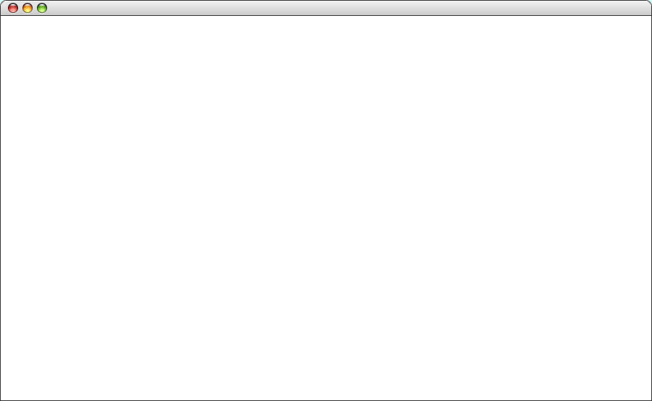
A Larger Sample Run
YarnPattern

Slide 13
The YarnPattern Program
/*
* Creates a pattern that simulates winding a piece of yarn
* around an array of pegs at the edges of the graphics window.
*/
function YarnPattern() {
let gw = GWindow(GWINDOW_WIDTH, GWINDOW_HEIGHT);
let pegs = createPegArray(GWINDOW_WIDTH, GWINDOW_HEIGHT,
N_ACROSS, N_DOWN);
let thisPeg = 0;
let nextPeg = -1;
while (thisPeg !== 0 || nextPeg === -1) {
nextPeg = (thisPeg + DELTA) % pegs.length;
let p0 = pegs[thisPeg];
let p1 = pegs[nextPeg];
let line = GLine(p0.x, p0.y, p1.x, p1.y);
line.setColor("Magenta");
gw.add(line);
thisPeg = nextPeg;
}
}
page 1 of 3

Slide 14
The YarnPattern Program
/*
* Creates a pattern that simulates winding a piece of yarn
* around an array of pegs at the edges of the graphics window.
*/
function YarnPattern() {
let gw = GWindow(GWINDOW_WIDTH, GWINDOW_HEIGHT);
let pegs = createPegArray(GWINDOW_WIDTH, GWINDOW_HEIGHT,
N_ACROSS, N_DOWN);
let thisPeg = 0;
let nextPeg = -1;
while (thisPeg !== 0 || nextPeg === -1) {
nextPeg = (thisPeg + DELTA) % pegs.length;
let p0 = pegs[thisPeg];
let p1 = pegs[nextPeg];
let line = GLine(p0.x, p0.y, p1.x, p1.y);
line.setColor("Magenta");
gw.add(line);
thisPeg = nextPeg;
}
}
/*
* Creates an array of pegs around the perimeter of a rectangle
* with the specified width and height. The number of pegs in
* each dimension is specified by nAcross and nDown.
*/
function createPegArray(width, height, nAcross, nDown) {
let dx = width / nAcross;
let dy = height / nDown;
let pegs = [ ];
for (let i = 0; i < nAcross; i++) {
pegs.push(Point(i * dx, 0));
}
for (let i = 0; i < nDown; i++) {
pegs.push(Point(nAcross * dx, i * dy));
}
for (let i = nAcross; i > 0; i--) {
pegs.push(Point(i * dx, nDown * dy));
}
for (let i = nDown; i > 0; i--) {
pegs.push(Point(0, i * dy));
}
return pegs;
}
page 2 of 3

Slide 15
The YarnPattern Program
/*
* Creates an array of pegs around the perimeter of a rectangle
* with the specified width and height. The number of pegs in
* each dimension is specified by nAcross and nDown.
*/
function createPegArray(width, height, nAcross, nDown) {
let dx = width / nAcross;
let dy = height / nDown;
let pegs = [ ];
for (let i = 0; i < nAcross; i++) {
pegs.push(Point(i * dx, 0));
}
for (let i = 0; i < nDown; i++) {
pegs.push(Point(nAcross * dx, i * dy));
}
for (let i = nAcross; i > 0; i--) {
pegs.push(Point(i * dx, nDown * dy));
}
for (let i = nDown; i > 0; i--) {
pegs.push(Point(0, i * dy));
}
return pegs;
}
/*
* Creates a new Point object. If this function is called with
* no arguments, it creates a Point object at the origin.
*/
function Point(x, y) {
if (x === undefined) {
x = 0;
y = 0;
}
return { x: x, y: y };
}
/* Constants */
const GWINDOW_WIDTH = 1000;
const GWINDOW_HEIGHT = 625;
const N_ACROSS = 80;
const N_DOWN = 50;
const DELTA = 113;
page 3 of 3

Slide 16
The End

