Slide 1
JavaScript Basics
Jerry Cain
CS 106AX
September 25, 2024
slides leveraged from those written by Eric Roberts

Slide 2
Control Statements

Slide 3
Statement Types in JavaScript
Statements in JavaScript fall into three basic types:
  Simple statements
  Compound statements
  Control statements
Simple statements are typically assignments, function calls, or applications of the ++ or -- operators. Simple statements are always terminated with a semicolon.
Compound statements (also called blocks) are sequences of statements enclosed in curly braces.
Control statements fall into two categories:
  Conditional statements that require some test be evaluated
  Iterative statements that specify repetition

Slide 4
Boolean Expressions
JavaScript defines two types of operators that work with Boolean data: relational operators and logical operators.
There are six relational operators that compare values of other types and produce a true/false result:
= ==
Equals
!==
Not equals
<
Less than
<=
Less than or equal to
>
Greater than
>=
Greater than or equal to
For example, the expression n <= 10 has the value true if n is less than or equal to 10 and the value false otherwise.
There are also three logical operators:
&&
Logical AND
p && q means both p and q
||
Logical OR
p || q means either p or q (or both)
!
Logical NOT
!p means the opposite of p

Slide 5
Notes on the Boolean Operators
Remember that JavaScript uses = for assignment. To test whether two values are equal, you must use the = = = operator.
It is not legal in JavaScript to use more than one relational operator in a single comparison. To express the idea embodied in the mathematical expression
0 ≤ x ≤ 9
you need to make both comparisons explicit, as in
0 <= x && x <= 9
The || operator means either or both, which is not always clear in the English interpretation of or.
Be careful when you combine the ! operator with && and || because the interpretation often differs from informal English.

Slide 6
Short-Circuit Evaluation
JavaScript evaluates the && and || operators using a strategy called short-circuit mode in which it evaluates the right operand only if it needs to do so.
For example, if n is 0, the right operand of && in
n !== 0 && x % n === 0
is not evaluated at all because n !== 0 is false. Because the expression
false && anything
is always false, the rest of the expression no longer matters.
One of the advantages of short-circuit evaluation is that you can use && and || to prevent errors. If n were 0 in the earlier example, evaluating x % n would result in a division by zero.

Slide 7
The if Statement
The simplest of the control statements is the if statement, which occurs in two forms. You use the first when you need to perform an operation only if a particular condition is true:
if (condition) {
statements to be executed if the condition is true
}
You use the second form whenever you need to choose between two alternative paths, depending on whether the condition is true or false:
if (condition) {
statements to be executed if the condition is true
} else {
statements to be executed if the condition is false
}

Slide 8
Functions Involving Control Statements
The body of a function can contain statements of any type, including control statements. As an example, the following function uses an if statement to find the larger of two values:
function max(x, y) {
if (x > y) {
return x;
} else {
return y;
}
}
As this example makes clear, return statements can be used at any point in the function and may appear more than once.

Slide 9
The switch Statement
JavaScript evaluates statements in the case or default clause until it reaches a break or a return statement.
JavaScript then looks for a case clause that matches expression. If expression is equal to v₂, JavaScript chooses the second clause.
If none of the values in the case clauses match the expression, JavaScript evaluates the statements in the default clause.
The switch statement provides a convenient syntax for choosing among a set of possible paths:
When JavaScript executes a switch statement, it begins by evaluating expression.
The switch statement provides a convenient syntax for choosing among a set of possible paths:
switch ( expression ) {
case v₁:
statements to be executed if expression = v₁
break;
case v₂:
statements to be executed if expression = v₂
break;
. . . more case clauses if needed . . .
default:
statements to be executed if no values match
break;
}
switch ( expression ) {
case v₁:
statements to be executed if expression is equal to v₁
break;
case v₂:
statements to be executed if expression is equal to v₂
break;
. . . more case clauses if needed . . .
default:
statements to be executed if no values match
break;
}

Slide 10
Example of the switch Statement
The switch statement is useful when a function must choose among several cases, as in the following example:
function monthName(month) {
switch (month) {
case 1: return "January";
case 2: return "February";
case 3: return "March";
case 4: return "April";
case 5: return "May";
case 6: return "June";
case 7: return "July";
case 8: return "August";
case 9: return "September";
case 10: return "October";
case 11: return "November";
case 12: return "December";
default: return undefined;
}
}

Slide 11
The while Statement
The while statement is the simplest of JavaScript’s iterative control statements and has the following form:
while ( condition ) {
statements to be repeated
}
while ( condition ) {
statements to be repeated
}
When JavaScript encounters a while statement, it begins by evaluating the condition in parentheses.
If the value of condition is true, JavaScript executes the statements in the body of the loop.
At the end of each cycle, JavaScript reevaluates condition to see whether its value has changed. If condition evaluates to false, JavaScript exits from the loop and continues with the statement following the end of the while body.

Slide 12
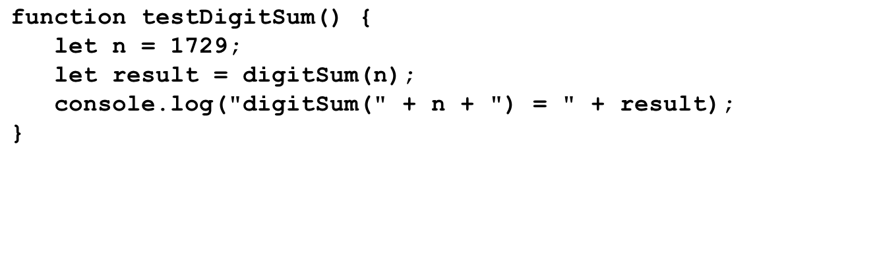
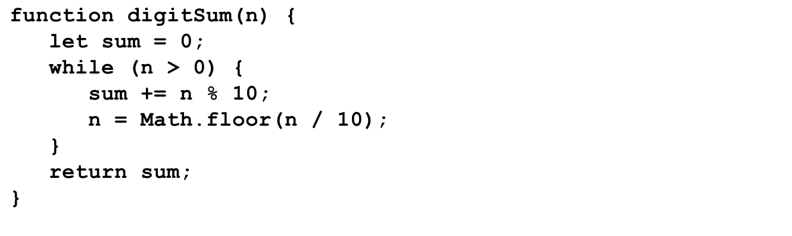
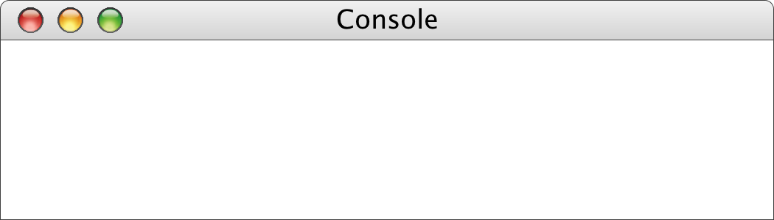
The digitSum Function
n
result
1729
n
19
sum
1729
172
17
1
0
0
9
11
18
19
digitSum(1729) = 19

Slide 13
The for Statement
The for statement in JavaScript is a powerful tool for specifying the structure of a loop independently from the operations the loop performs. The syntax looks like this:
for ( init ; test ; step ) {
statements to be repeated
}
for ( init ; test ; step ) {
statements to be repeated
}
JavaScript evaluates a for statement as follows:
1.
Evaluate init, which typically declares a control variable.
2.
Evaluate test and exit from the loop if the value is false.
3.
Execute the statements in the body of the loop.
4.
Evaluate step, which usually updates the control variable.
5.
Return to step 2 to begin the next loop cycle.

Slide 14
Exercise: Reading for Statements
Describe the effect of each of the following for statements:
1.
for (let i = 1; i <= 10; i++)
This statement executes the loop body ten times, with the control variable i taking on each successive value between 1 and 10.
2.
for (let i = 0; i < n; i++)
This statement executes the loop body n times, with i counting from 0 to n - 1. This version is the standard Repeat-n-Times idiom.
3.
for (let n = 99; n >= 1; n -= 2)
This statement counts backward from 99 to 1 by twos.
4.
for (let x = 1; x <= 1024; x *= 2)
This statement executes the loop body with the variable x taking on successive powers of two from 1 up to 1024.

Slide 15
The factorial Function
The factorial of a number n (which is usually written as n! in mathematics) is defined to be the product of the integers from 1 up to n. Thus, 5! is equal to 120, which is 1 ^{x} 2 ^{x} 3 ^{x} 4 ^{x} 5.
The following function definition uses a for loop to compute the factorial function:
function fact(n) {
let result = 1;
for (let i = 1; i <= n; i++) {
result = result * i;
}
return result;
}

Slide 16
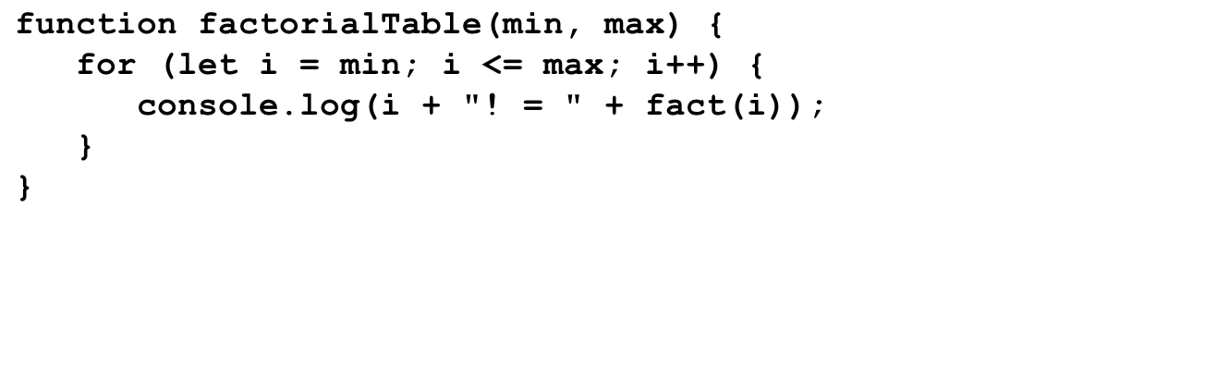
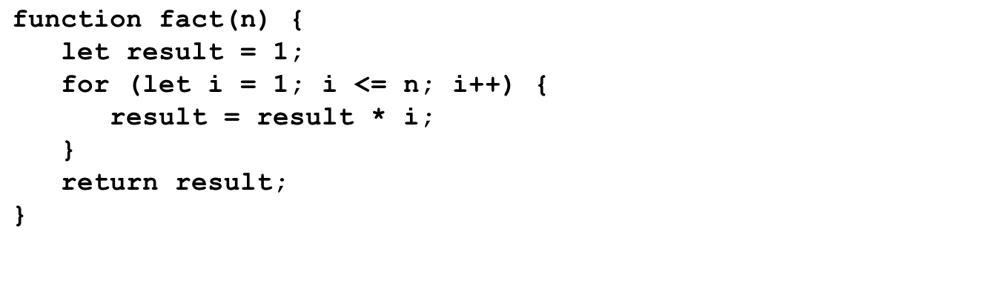
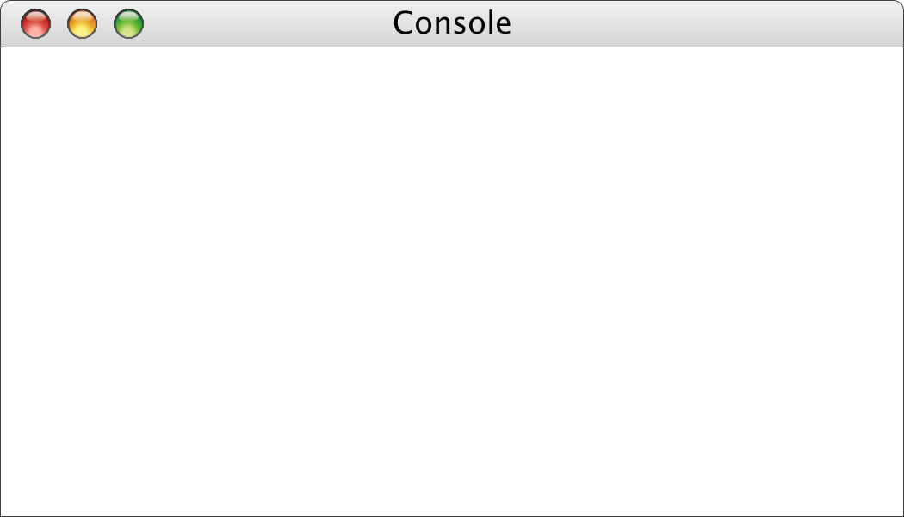
The factorialTable Function
1
5040
min
max
i
0
n
n
7
result
result
0
1
6
7
8
i
i
0
7
1
1
1
2
6
24
120
720
5040
1
1
2
3
4
5
6
7
8
->
factorialTable(0, 7);
0! = 1
1! = 1
2! = 2
3! = 6
4! = 24
5! = 120
6! = 720
7! = 5040
->

Slide 17
Comparing for and while
The for statement
for ( init ; test ; step ) {
statements to be repeated
}
is functionally equivalent to the following code using while:
init;
while ( test ) {
statements to be repeated
step;
}
The advantage of the for statement is that everything you need to know to understand how many times the loop will run is explicitly included in the header line.

Slide 18
Functions Mechanics

Slide 19
A Quick Review of Functions
The concept of a function should be familiar to you from prior programming experience. All modern programming languages allow functions to be defined.
At the most basic level, a function is a sequence of statements that has been collected together and given a name. The name makes it possible to execute the statements much more easily; instead of copying out the entire list of statements, you can just provide the function name.
The following terms are useful when working with functions:
  Invoking a function by name is known as calling that function.
  The caller passes information to a function using arguments.
  When a function completes its operation, it returns to its caller.
  A function gives information to the caller by returning a result.

Slide 20
Review: Syntax of Functions
The general form of a function definition is
function name(parameter list) {
statements in the function body
}
where name is the name of the function, and parameter list is a list of variables used to hold the values of each argument.
You can return a value from a function by including one or more return statements, which are usually written as
return expression;
where expression is an expression that specifies the value you want to return.

Slide 21
Nonnumeric Functions
Although functions return a single value, that value can be of any type.
Even without learning the full range of string operations covered in Chapter 7, you can already write string functions that depend only on concatenation, such as the following function that concatenates together n copies of the string str:
function concatNCopies(n, str) {
let result = "";
for (let i = 0; i < n; i++) {
result += str;
}
return result;
}

Slide 22
Exercise: Console Pyramid
Write a program that uses the concatNCopies function to display a pyramid on the console in which the bricks are represented by the letter x. The number of levels in the pyramid should be defined as the constant N_LEVELS.
For example, if N_LEVELS is 10, the console output should look like this:
ConsolePyramid
x
xxx
xxxxx
xxxxxxx
xxxxxxxxx
xxxxxxxxxxx
xxxxxxxxxxxxx
xxxxxxxxxxxxxxx
xxxxxxxxxxxxxxxxx
xxxxxxxxxxxxxxxxxxx

Slide 23
Predicate Functions
Functions that return Boolean values play a central role in programming and are called predicate functions. As an example, the following function returns true if the first argument is divisible by the second, and false otherwise:
function isDivisibleBy(x, y) {
return x % y === 0;
}
Once you have defined a predicate function, you can use it any conditional expression. For example, you can print the integers between 1 and 100 that are divisible by 7 as follows:
for (let i = 1; i <= 100; i++) {
if (isDivisibleBy(i, 7)) {
println(i);
}
}

Slide 24

Using Predicate Functions Effectively
New programmers often seem uncomfortable with Boolean values and end up writing ungainly code. For example, a beginner might write isDivisibleBy like this:
function isDivisibleBy(x, y) {
if (x % y === 0) {
return true;
} else {
return false;
}
}
While this code is technically correct, it is inelegant and should be replaced by return x % y === 0.
A similar problem occurs when novices explicitly check to see whether a predicate function returns true. You should be careful to avoid such redundant tests in your own programs.

Slide 25
The Purpose of Parameters
“All right, Mr. Wiseguy,” she said, “you’re so clever, you tell us what color it should be.”
—
Douglas Adams, The Restaurant at the End of the Universe, 1980
In general, functions perform some service to their callers. In order to do so, the function needs to know any details required to carry out the requested task.
Imagine that you were working as a low-level animator at Disney Studies in the days before computerized animation and that one of the senior designers asked you to draw a filled circle. What would you need to know?
At a minimum, you would need to know where the circle should be placed in the frame, how big to make it, and what color it should be. Those values are precisely the information conveyed in the parameters.

Slide 26
Libraries
To make programming easier, all modern languages include collections of predefined functions. Those collections are called libraries.
For programming that involves mathematical calculations, the most useful library is the Math library, which includes a number of functions that will be familiar from high-school mathematics (along with many that probably aren’t). A list of the most important functions appears on the next slide.
In JavaScript, each of the functions in the Math library begins with the library name followed by a dot and then the name of the function. For example, the function that calculates square roots is named Math.sqrt.
You call library functions just like any other function, so that calling Math.sqrt(16) returns the value 4.

Slide 27
Useful Functions in the Math Library
Math.PI
The mathematical constant π
Math.E
The mathematical constant e
Math.abs(x)
The absolute value of x
Math.max(x, y, . . .)
The largest of the arguments
Math.min(x, y, . . .)
The smallest of the arguments
Math.round(x)
The closest integer to x
Math.floor(x)
The largest integer not exceeding x
Math.log(x)
The natural logarithm of x
Math.exp(x)
The inverse logarithm (e ^{x})
Math.pow(x, y)
The value x raised to the y power (x ^{y})
Math.sin(θ )
The sine of θ, measured in radians
Math.cos(θ )
The cosine of θ, measured in radians
Math.sqrt(x)
The square root of x
Math.random()
A random value between 0 and 1

Slide 28
Decomposition

Slide 29
Decomposition
The most effective way to solve a complex problem is to break it down into successively simpler subproblems.
You start by breaking the whole task down into simpler parts.
Some of those tasks may themselves need subdivision.
This process is called stepwise refinement or decomposition.
Complete Task
Subtask #1
Subtask #2
Subtask #3
Subsubtask #2a
Subsubtask #2b

Slide 30
Criteria for Choosing a Decomposition
1.
The proposed steps should be easy to explain. One indication that you have succeeded is being able to find simple names.
2.
The steps should be as general as possible. Programming tools get reused all the time. If your methods perform general tasks, they are much easier to reuse.
3.
The steps should make sense at the level of abstraction at which they are used. If you have a method that does the right job but whose name doesn’t make sense in the context of the problem, it is probably worth defining a new method that calls the old one.

Slide 31
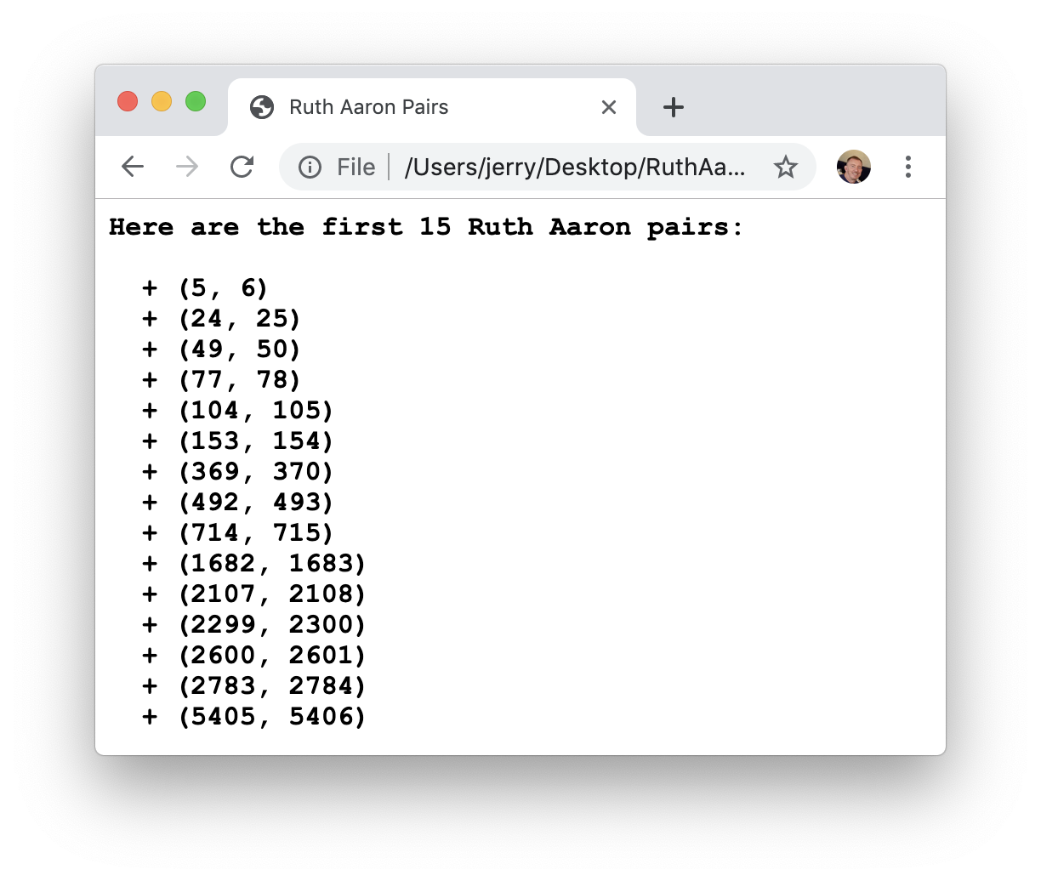
Exercise: Ruth-Aaron Pairs
Write a program that lists the first NUM_PAIRS Ruth-Aaron pairs. In recreational mathematics, a Ruth-Aaron pair consists of two neighboring integers—e.g., 714 and 715—for which the sum of the distinct prime factors of each are equal.
The pairs are named Ruth-Aaron as a nod to baseball greats Babe Ruth and Hank Aaron. Ruth held the record for most career home runs at 714 until
Aaron hit his 715th on
April 8th, 1974.
If NUM_PAIRS equals 15, the
program should publish the
output presented on the right.

Slide 32
The End

