Slide 1
JavaScript Graphics
Jerry Cain
CS 106AX
September 26, 2025
slides leveraged from those written by Eric Roberts

Slide 2
JavaScript Graphics
In addition to JSConsole.js, CS 106AX provides a library called JSGraphics.js that makes it easy to create graphical programs.
The structure of the index.html file for graphics programs is like the one used for HelloWorld. The BlueRectangle program introduced later uses the following index.html:
<!DOCTYPE html>
<html>
<head>
<title>Blue Rectangle</title>
<script type="text/javascript" src="JSGraphics.js"></script>
<script type="text/javascript" src="BlueRectangle.js"></script>
</head>
<body onload="BlueRectangle()"></body>
</html>

Slide 3
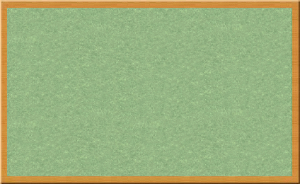
The Graphics Model
The JSGraphics.js library uses a graphics model based on the metaphor of a collage.
A collage is akin to a child’s felt board that serves as a backdrop for colored shapes that stick to the felt surface. As an example, the following diagram illustrates the process of adding a blue rectangle and a red oval to a felt board:
Note that newer objects potentially obscure those added earlier. This layering arrangement is called the stacking order.

Slide 4

The BlueRectangle Program
function BlueRectangle() {
let gw = GWindow(500, 200);
let rect = GRect(150, 50, 200, 100);
rect.setColor("Blue");
rect.setFilled(true);
gw.add(rect);
}
function BlueRectangle() {
let gw = GWindow(500, 200);
let rect = GRect(150, 50, 200, 100);
rect.setColor("Blue");
rect.setFilled(true);
gw.add(rect);
}
rect
rect
BlueRectangle

Slide 5
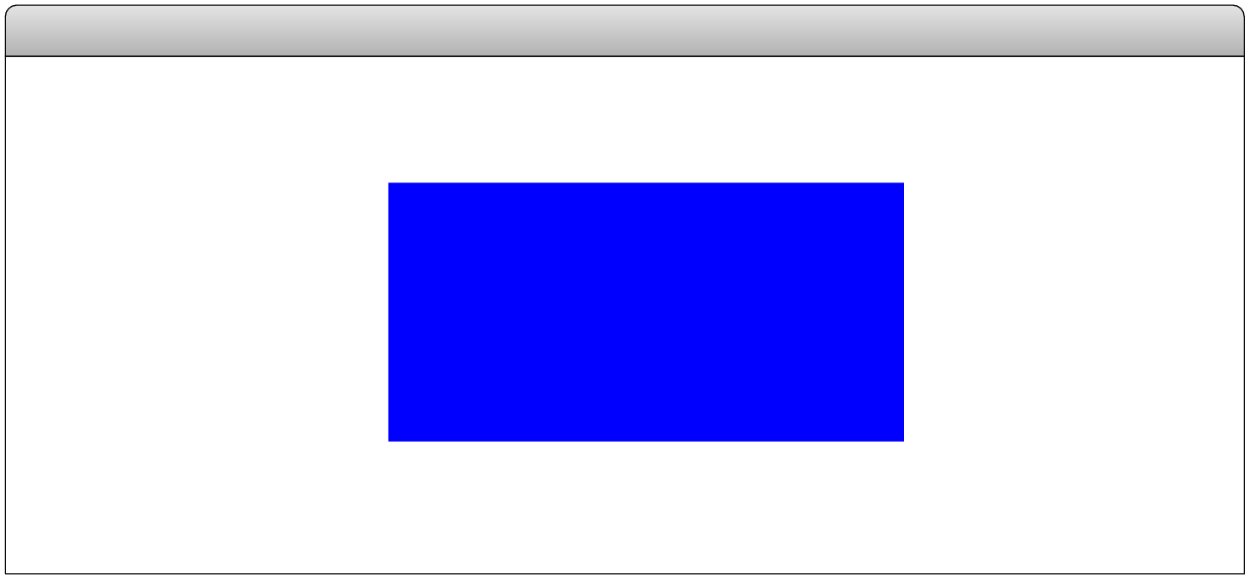
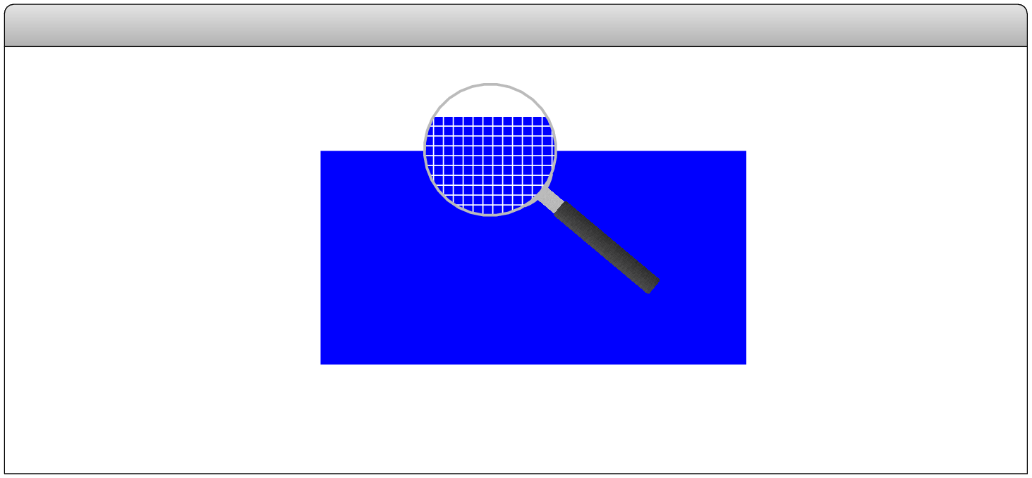
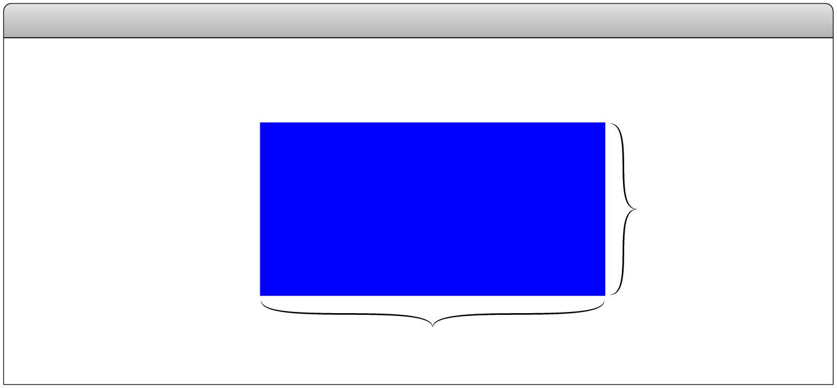
The JavaScript Coordinate System
(0, 0)
BlueRectangle
pixels
(150, 50)
100 pixels
200 pixels
Positions and distances on the screen are measured in terms of pixels, which are the small dots that cover the screen.
Unlike traditional mathematics, JavaScript defines the origin of the coordinate system to be the upper left corner. Values for the y coordinate increase as you move downward.

Slide 6
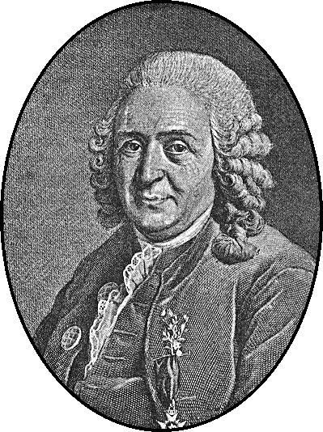
Systems of Classification
In the mid-18th century, the Scandinavian botanist Carl Linnaeus revolutionized biology by creating a new system for classifying plants and animals. His approach highlighted their structural relationships and laid the groundwork for Darwin’s theory of evolution a century later.
Linnaeus’s contribution was to recognize that organisms fit into a hierarchy in which the placement of individual species reflects their anatomical similarities.
Carl Linnaeus (1707–1778)

Slide 7
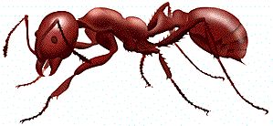
Biological Class Hierarchy
Living Things
Living Things
Plants
Animals
Kingdom
Animals
Fungi
Annelida
Brachiopoda
Arthropoda
Phylum
Arthropoda
Mollusca
Chordata
Crustacea
Insecta
Order
Insecta
Arachnida
Class
Hymenoptera
Every red ant is also an animal, an arthropod, and an insect, along with the other higher taxonomic groups in its classification chain.
Classification of the red ant Iridomyrmex purpureus
Family
Formicidae
Genus
Iridomyrmex
Species
purpureus

Slide 8
Instances vs. Patterns
Drawn after you, you pattern of all those.
—William Shakespeare, Sonnet 98
In thinking about any classification scheme—biological or otherwise—it is important to draw a distinction between a class and specific instances of that class. In the most recent example, the designation Iridomyrmex purpureus is not itself an ant, but rather the classification of one. There can be (and usually are) many ants, each of an individual belonging that class.
Each of these fire ants is an instance of a particular class of ants. Each instance is of the species purpureus, the genus Iridomyrmex, the family Formicidae (which makes it an ant), and so on. Thus, each ant is not only an ant, but also an insect, an arthropod, and an animal.

Slide 9
The GObject Hierarchy
The classes that represent graphical objects form a hierarchy, part of which looks like this:
GObject
GRect
GOval
GLine
The GObject class represents the collection of all graphical objects.
The three subclasses shown in this diagram correspond to particular types of objects: rectangles, ovals, and lines. Any GRect, GOval, or GLine is also a GObject.

Slide 10
Creating a GWindow Object
The first step in writing a graphical program is to create a window using the following function declaration, where width and height indicate the size of the window:
let gw = GWindow(width, height);
The following operations work with any GWindow object:
gw.add(object)
Adds an object to the window.
gw.add(object, x, y)
Adds an object to the window after first moving it to (x, y).
gw.remove(object)
Removes the object from the window.
gw.getWidth()
Returns the width of the graphics window in pixels.
gw.getHeight()
Returns the height of the graphics window in pixels.

Slide 11
Operations on the GObject Class
The following operations apply to all GObjects:
object.getX()
Returns the x coordinate of this object.
object.getY()
Returns the y coordinate of this object.
object.getWidth()
Returns the width of this object.
object.getHeight()
Returns the height of this object.
object.setColor(color)
Sets the color of the object to the specified color.
All coordinates and distances are measured in pixels.
Each color is a string, such as "Red" or "White". The names of the standard colors are defined in Figure 4-5 on page 125.

Slide 12
Drawing Geometrical Objects
Functions to create geometrical objects:
GRect(x, y, width, height)
Creates a rectangle whose upper left corner is at (x, y) of the specified size.
GOval(x, y, width, height)
Creates an oval that fits within a rectangle with the same dimensions.
GLine(x₀, y₀, x₁, y₁)
Creates a line extending from (x₀, y₀) to (x₁, y₁).
Methods shared by the GRect and GOval classes:
object.setFilled( fill)
If fill is true, fills in the interior of the object; if false, shows only the outline.
object.setFillColor( color)
Sets the color used to fill the interior, which can be different from the border.

Slide 13
The GRectPlusGOval Program
function GRectPlusGOval() {
let gw = GWindow(500, 200);
let rect = GRect(150, 50, 200, 100);
rect.setFilled(true);
rect.setColor("Blue");
gw.add(rect);
let oval = GOval(150, 50, 200, 100);
oval.setFilled(true);
oval.setColor("Red");
gw.add(oval);
}
function GRectPlusGOval() {
let gw = GWindow(500, 200);
let rect = GRect(150, 50, 200, 100);
rect.setFilled(true);
rect.setColor("Blue");
gw.add(rect);
let oval = GOval(150, 50, 200, 100);
oval.setFilled(true);
oval.setColor("Red");
gw.add(oval);
}
rect
rect
oval
oval
GRectPlusGOval

Slide 14
The DrawDiagonals Program
/* Constants */
const GWINDOW_WIDTH = 500;
const GWINDOW_HEIGHT = 200;
function DrawDiagonals() {
let gw = GWindow(GWINDOW_WIDTH, GWINDOW_HEIGHT);
gw.add(GLine(0, 0, GWINDOW_WIDTH, GWINDOW_HEIGHT));
gw.add(GLine(0, GWINDOW_HEIGHT, GWINDOW_WIDTH, 0));
}
/* Constants */
const GWINDOW_WIDTH = 500;
const GWINDOW_HEIGHT = 200;
function DrawDiagonals() {
let gw = GWindow(GWINDOW_WIDTH, GWINDOW_HEIGHT);
gw.add(GLine(0, 0, GWINDOW_WIDTH, GWINDOW_HEIGHT));
gw.add(GLine(0, GWINDOW_HEIGHT, GWINDOW_WIDTH, 0));
}
DrawDiagonals

Slide 15
The Checkerboard Program
const GWINDOW_WIDTH = 500; /* Width of the graphics window */
const GWINDOW_HEIGHT = 300; /* Height of the graphics window */
const N_COLUMNS = 8; /* Number of columns */
const N_ROWS = COLUMNS; /* Number of rows */
const SQUARE_SIZE = 35; /* Size of a square in pixels */
function Checkerboard() {
let gw = GWindow(GWINDOW_WIDTH, GWINDOW_HEIGHT);
let x0 = (gw.getWidth() - N_COLUMNS * SQUARE_SIZE) / 2;
let y0 = (gw.getHeight() - N_ROWS * SQUARE_SIZE) / 2;
for (let i = 0; i < N_ROWS; i++) {
for (let j = 0; j < N_COLUMNS; j++) {
let x = x0 + j * SQUARE_SIZE;
let y = y0 + i * SQUARE_SIZE;
let sq = GRect(x, y, SQUARE_SIZE, SQUARE_SIZE);
let filled = (i + j) % 2 !== 0;
sq.setFilled(filled);
gw.add(sq);
}
}
}

Slide 16
Creating Compound Objects
The GCompound class makes it possible to combine and layer several graphical objects so that the resulting structure behaves as a single GObject.
The easiest way to think about the GCompound class is as a combination of a GWindow and a GObject. A GCompound is like a GWindow in that you can add objects to it, but it is also like a GObject in that you can add it to a graphics window.
A GCompound object has its own coordinate system that is expressed relative to a reference point that you invent. When you add new objects to the GCompound, you use the local coordinate system based on that reference point. When you add the GCompound to the graphics window, all you have to do is set the location of the reference point, and then the individual components will automatically appear in the right locations relative to that point.

Slide 17
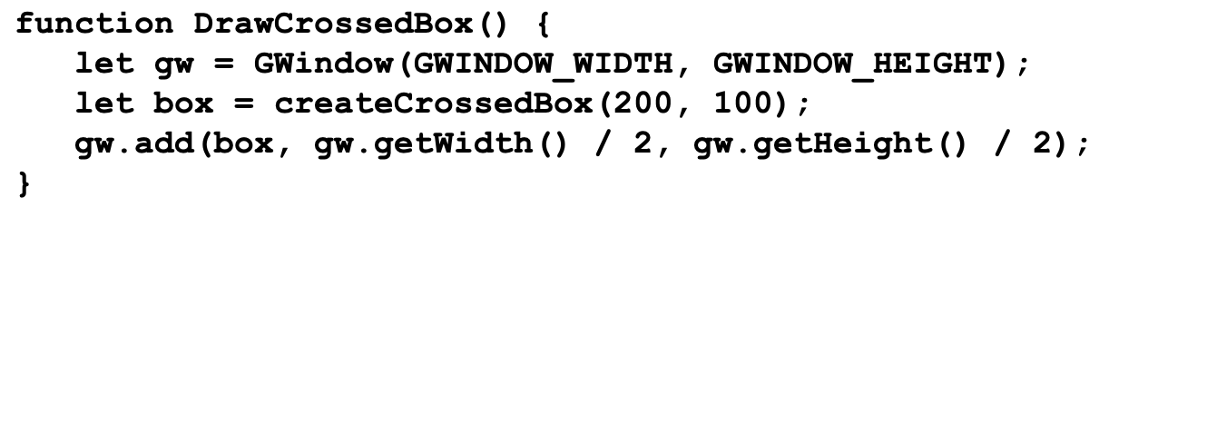
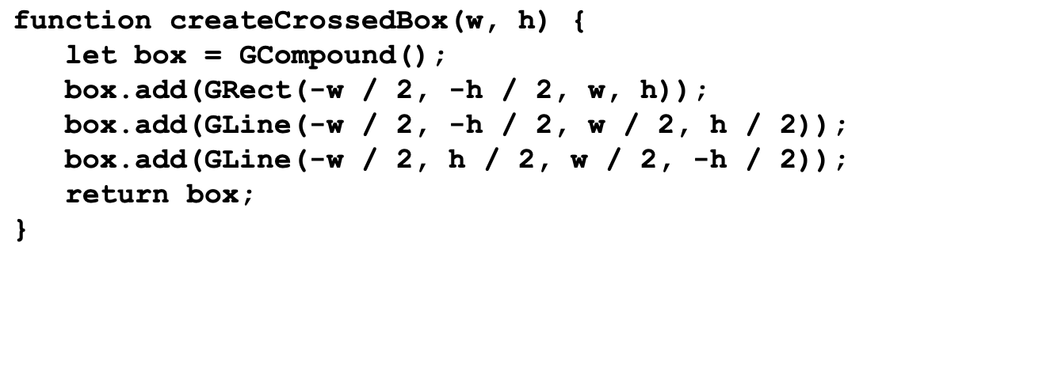

Using a GCompound class
box
box
gw
w
h
200
100
DrawCrossedBox

Slide 18
The End

