Slide 1
Advanced Animation
Jerry Cain
CS 106AX
October 3, 2025
slides leveraged from those written by Eric Roberts

Slide 2
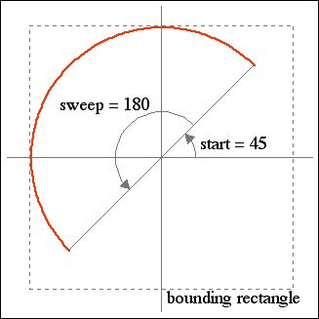
The GArc Class
The GArc class represents an arc formed by taking a section from the perimeter of an oval.
Conceptually, the steps necessary to define an arc are:
  Specify details of the bounding rectangle as you would for a full GOval.
  Specify the start angle, which is the angle at which the arc begins.
  Specify the sweep angle, which indicates how far the arc extends.
The geometry used by the GArc class is shown in the diagram on the right.
Angles are measured in degrees starting at the +x axis (the 3:00 o’clock position) and increasing counterclockwise.
Negative values for the start and sweep angles signify a clockwise direction.

Slide 3
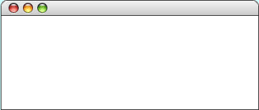
Exercise: GArc Geometry
Suppose that the variables cx and cy contain the coordinates of the center of the window and that the variable d is 0.8 times the screen height. Sketch the arcs that result from each of the following code sequences:
let a1 = GArc(d, d, 0, 90);
gw.add(a1, cx - d / 2, cy - d / 2);
let a2 = GArc(d, d, 45, 270);
gw.add(a2, cx - d / 2, cy - d / 2);
GArcExamples
GArcExamples
let a3 = GArc(d, d, -90, 45);
gw.add(a3, cx - d / 2, cy - d / 2);
let a4 = GArc(d, d, 0, -180);
gw.add(a4, cx - d / 2, cy - d / 2);
GArcExamples
GArcExamples

Slide 4

Filled Arcs
The GArc class implements the functions setFilled and setFillColor.
A filled GArc is displayed as the pie-shaped wedge formed by the center and the endpoints of the arc, as follows:
function FilledEllipticalArc() {
let gw = GWindow(GWINDOW_WIDTH, GWINDOW_HEIGHT);
let arc = GArc(0, 0, gw.getWidth(), gw.getHeight(),
0, 90);
arc.setFilled(true);
gw.add(arc);
}
FilledEllipticalArc

Slide 5
Additional Methods for GArc
setStartAngle(start)
Sets the start angle for the arc
getStartAngle()
Returns the start angle for the arc
setSweepAngle(sweep)
Sets the sweep angle for the arc
getSweepAngle()
Returns the sweep angle
setFrameRectangle(x, y, width, height)
Resets the bounds for the frame
These methods allow you to animate the appearance of an arc.
The setStartAngle and setSweepAngle methods make it possible to change the starting position and the extent of the arc dynamically.
The setFrameRectangle method changes the bounds of the rectangle circumscribing the oval from which the arc is taken.

Slide 6
Exercise: PacMan
Write a program that uses the GArc class to display a PacMan figure at the left edge of the graphics window.
Add the necessary timer animation so that PacMan moves to the right edge of the window. As it moves, your program should change the start and sweep angles of the arc so that the mouth appears to open and close.
PacMan

Slide 7
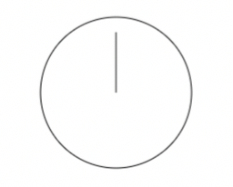
Exercise: Stopwatch
Write a simple graphics program that places a stopwatch so that it’s centered within a graphics window, as with:
The stopwatch is stationary until the user clicks the mouse anywhere in the window, at which point the stopwatch’s hand rotates at a speed of 360 degrees per minute.
When the user clicks a second time, the stopwatch stops, but a third click prompts it to continue as if never interrupted.
Our program requires both mouse and timer events!
Stopwatch

Slide 8
The End

