Slide 1
Strings in JavaScript
Jerry Cain
CS 106AX
October 6, 2025
slides leveraged from those constructed by Eric Roberts

Slide 2
Strings in JavaScript

Slide 3
Using Methods in the String Class
JavaScript provides many useful methods for working with strings. Before focusing on individual methods, it’s important to first understand the general way these methods behave.
Because strings are objects, JavaScript uses the receiver syntax to invoke string methods. So, if str is a string, you invoke the name method via str.name(arguments).
None of the methods in JavaScript’s String class change the receiver. Each method returns a new string reflecting the outcome of the method’s execution.
Classes that prohibit clients from changing an object’s state are said to be immutable. Immutable types come with many advantages and play an important role in programming.

Slide 4
Selecting Characters from a String
Conceptually, a string is an ordered collection of characters.
In JavaScript, the character positions in a string are identified by an index that begins at 0 and extends up to one less than the string length. For example, the characters in the string "hello, world" are arranged like this:
h
e
l
l
o
,
w
o
r
l
d
0
1
2
3
4
5
6
7
8
9
10
11
You can obtain the number of characters by checking the length property, as in str.length.
You can select an individual character by calling charAt(k), where k is the index of the desired character. The expression
str.charAt(7);
returns the one-character string "w" that appears at index 7.

Slide 5
Concatenation
One of the more useful operations available for strings is concatenation, which consists of combining two strings end to end with no intervening characters.
As you know from earlier in the quarter, concatenation is built into JavaScript in the form of the + operator.
It is also important to recall that JavaScript interprets the + operator as concatenation if one or both operands are strings. If both operands are numbers, the + operator signals standard addition.

Slide 6
Extracting Substrings
The substring method makes it possible to extract a piece of a larger string by providing index numbers that determine the extent of the substring.
The general form of the substring call is
str.substring(p1, p2);
where p1 is the first index position in the desired substring and p2 is the index position immediately following the last position in the substring.
As an example, if you wanted to select the substring "ell" from a string variable str containing "hello, world" you would make the following call:
str.substring(1, 4);

Slide 7
Comparing Strings
JavaScript allows you to call the standard relational operators to compare the values of two strings in a natural way. For example, if s1 and s2 are strings, the expression
s1 === s2
is true if the strings s1 and s2 contain the same characters.
String comparisons involving the operators <, <=, >, and >= are implemented in a fashion like traditional alphabetic ordering: if the first characters match, the comparison operator checks the second characters, and so on.
Characters are compared numerically using their Unicode values. For example, "cat" > "CAT" because the character code for "c" (99) is greater than the code for "C" (67). This style of comparison is called lexicographic comparison.
We’ll revisit character encodings and Unicode next week.

Slide 8
Searching in a String
The indexOf method takes a string and returns the index within the receiver at which the first instance of that string begins. If the string is not found, indexOf returns -1. For example, if str contains the string "hello, world":
str.indexOf("h")
returns
0
str.indexOf("o")
returns
4
str.indexOf("ell")
returns
1
str.indexOf("x")
returns
-1
The indexOf method takes an optional second argument that indicates the starting position for the search. Thus:
str.indexOf("o", 5)
returns
8
The lastIndexOf method works similarly except that it searches backward from the end of the receiving string.

Slide 9
Other Methods in the String Class
String.fromCharCode(code)
Returns the one-character string whose Unicode value is code.
charCodeAt(index)
Returns the Unicode value of the character at the specified index.
toLowerCase()
Returns a copy of this string converted to lower case.
toUpperCase()
Returns a copy of this string converted to upper case.
startsWith(prefix)
Returns true if this string starts with prefix.
endsWith(suffix)
Returns true if this string ends with suffix.
trim()
Returns a copy of this string with leading and trailing spaces removed.

Slide 10
Simple String Idioms
When you work with strings, there are two idiomatic patterns that are particularly important:
1.
Iterating through the characters in a string.
for (let i = 0; i < str.length; i++) {
let ch = str.charAt(i);
. . . code to process each character in turn . . .
}
2.
Growing a new string character by character.
let result = "";
for (whatever limits are appropriate to the application) {
. . . code to determine the next character to be added . . .
result += ch;
}

Slide 11
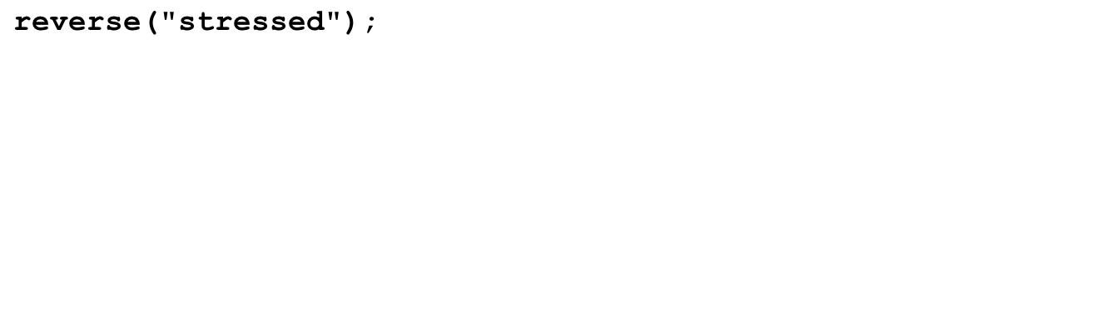
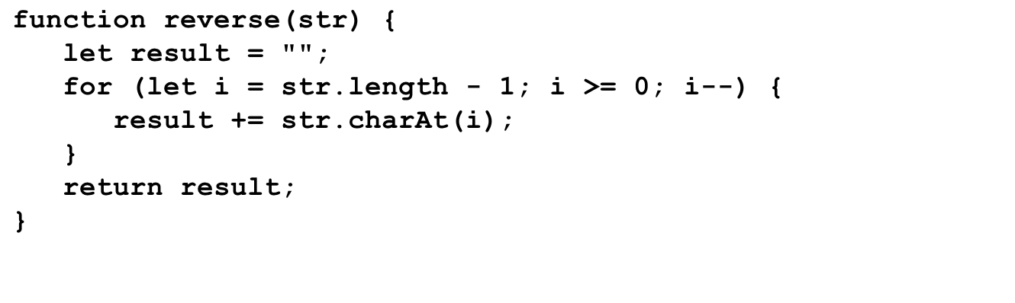
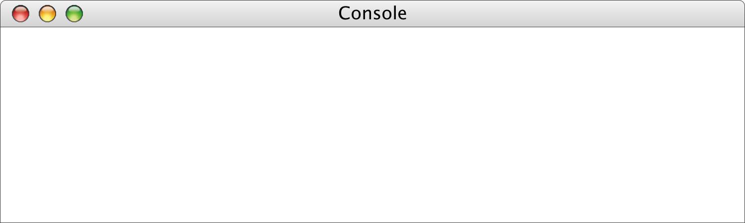
Reversing a String
str
result
i
"stressed"
""
"d"
"de"
"des"
"dess"
"desse"
"desser"
"dessert"
"desserts"
7
6
5
4
3
2
1
0
-1
>
reverse("stressed")
desserts
>

Slide 12
String Calisthenics
Let’s review some String methods before continuing:
"AEIOUaeiou".length
"ABCDEFG".charAt(6)
"Harry Potter".indexOf("a")
"Harry Potter".indexOf("a", 6)
"Harry Potter".lastIndexOf("rr")
"bumfuzzle".substring(3, 7)
"cabotage".substring(1, 1)
"agelast".substring(3)
10
"G"
1
-1
2
"fuzz"
""
"last"

Slide 13
Generating Acronyms
An acronym is a word formed by taking the first letter of each word in a sequence, as in
"North American Free Trade Agreement"
"NAFTA"
"not in my back yard"
"nimby"
"self-contained underwater breathing apparatus"
"scuba"
The text describes and implements two versions of a function acronym(str) that generates an acronym for str:
  The first version searches for spaces in the string and includes the following character in the acronym. This version, however, fails for acronyms like scuba, in which some of the words are separated by hyphens rather than spaces.
  The second version looks at every character and keeps track of whether the algorithm is scanning a word formed composed of sequential letters. This version correctly handles scuba as well as strings that have leading, trailing, or multiple spaces.

Slide 14
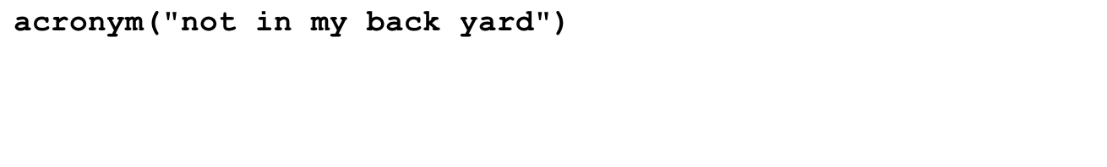
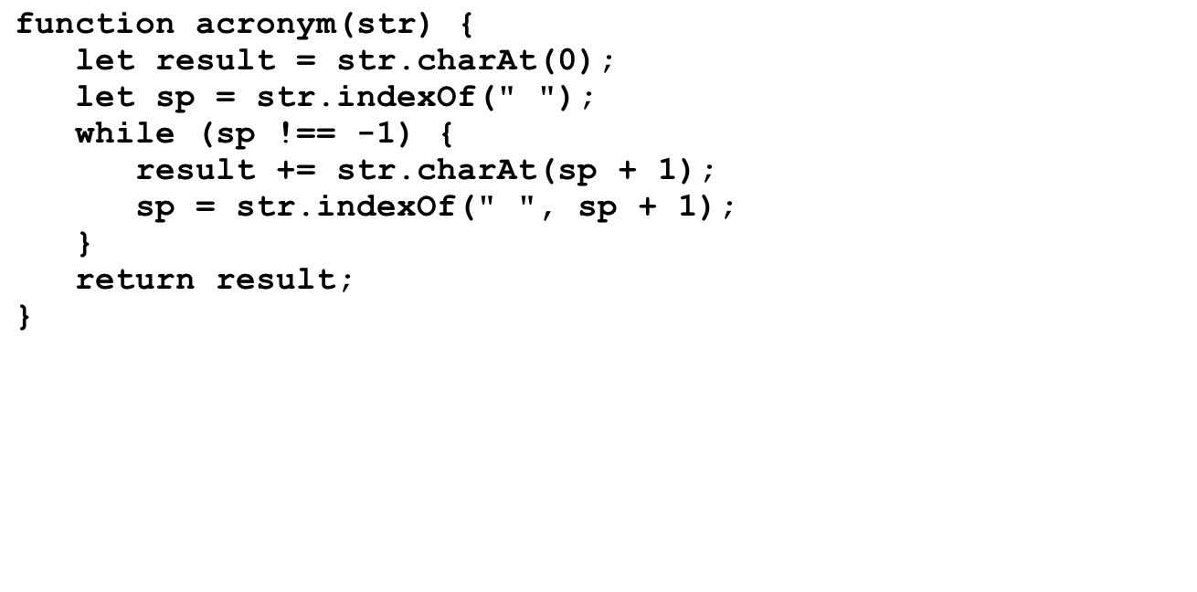
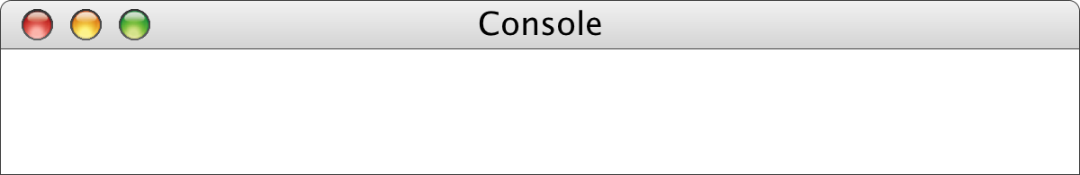
acronym , Take I
str
result
sp
"not in my back yard"
"n"
"ni"
"nim"
"nimb"
"nimby"
3
6
9
14
-1
>
acronym("not in my back yard")
nimby

Slide 15
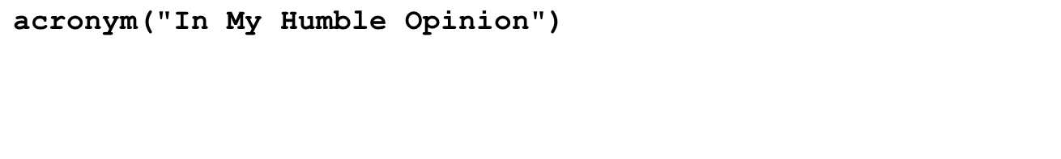
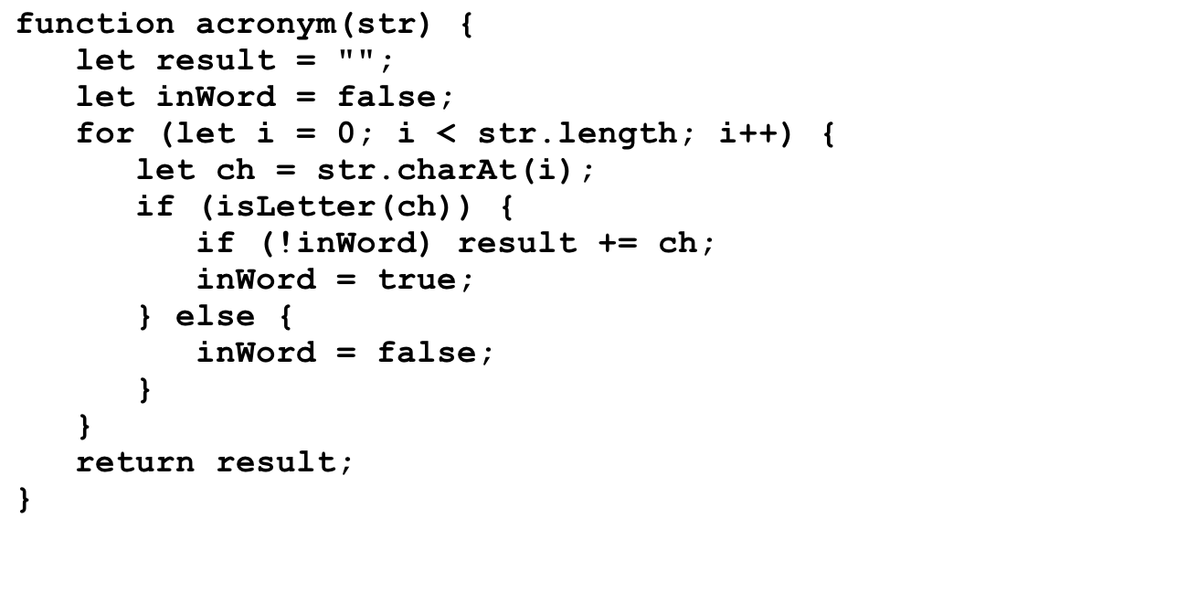
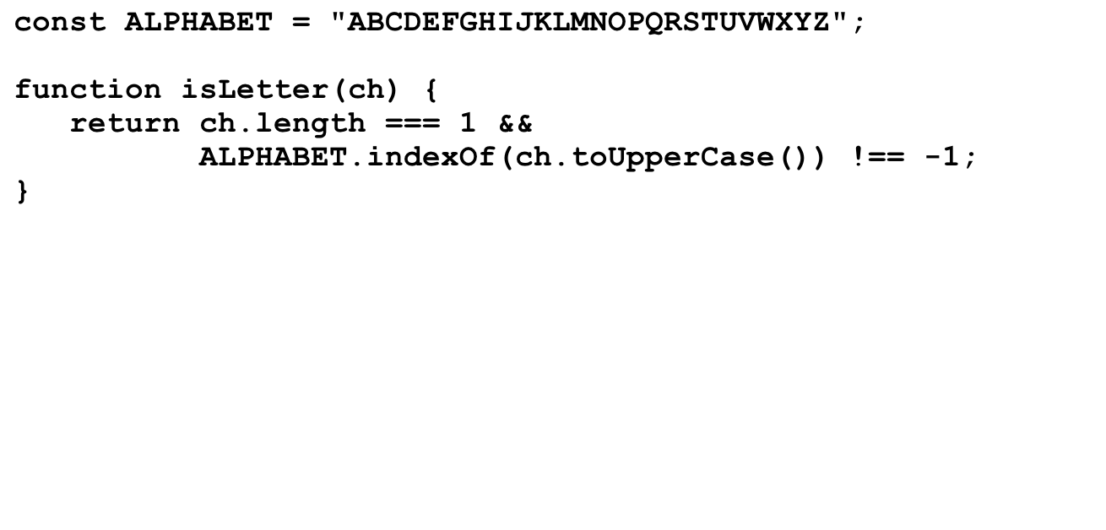
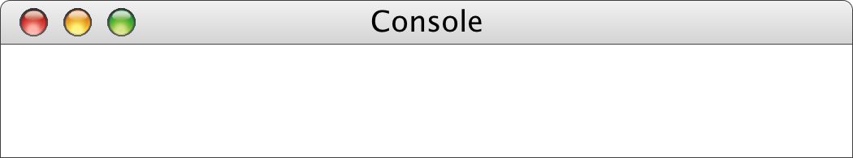
acroynm, Take II
8
-1
str
result
i
inWord
ch
ch
"In My Humble Opinion"
""
ch
"I"
"IM"
"IMH"
"IMHO"
0
1
2
3
4
5
6
7
8
9
10
11
12
13
14
15
16
17
18
19
20
false
true
true
false
true
true
false
true
true
true
true
true
true
false
true
true
true
true
true
true
true
"I"
"n"
" "
"M"
"y"
" "
"H"
"u"
"m"
"b"
"l"
"e"
" "
"O"
"p"
"i"
"n"
"i"
"o"
"n"
"I"
" "
>
acronym("In My Humble Opinion")
IMHO

Slide 16
Translating Pig Latin to English
Section 7.4 works through the design and implementation of a program to convert a sentence from English to Pig Latin. In this dialect, the Pig Latin version of a word is formed by applying the following rules:
1.
If the word begins with a consonant, the wordToPigLatin function moves the initial consonant string to the end of the word and then adds the suffix ay, as follows:
scr
scr
scr
scr
scr
scr
scr
scr
scr
scr
scr
scr
scr
scr
scr
scr
scr
scr
scr
scr
scr
scr
scr
scram
scr
scr
am
am
am
am
am
am
am
am
am
am
am
am
am
am
am
am
am
am
am
am
am
am
am
am
am
am
scr
ay
2.
If the word begins with a vowel, wordToPigLatin generates the Pig Latin version simply by adding the suffix way, like this:
apple
apple
way
3.
If the word contains no vowels at all, wordToPigLatin returns the original word unchanged.

Slide 17
Translating Pig Latin to English
"stout plunder lover"
i
0
1
2
3
4
5
6
12
13
14
18
inWord
F
T
T
T
T
T
F
T
T
F
T
T
start
-1
0
0
0
0
0
-1
6
6
-1
14
14
inWord is true if and only if we’re in a word, and start is the index of the first character of the word we’re currently in (or -1 if we’re not in a word).
inWord is now true and start is set equal to 0. We set assign the value of i to start at the same time inWord is transitioning from false to true , so we can remember where the current word of interest begins.
This is an interesting transition, since the current word we’re in is just now ending. We can isolate the word by calling str.substring(start, i), where str is assumed to be the entire sentence or fragment to be translated.
  Right now, str.substring(start, i) produces "stout".
  And now, str.substring(start, i) produces "plunder".

Slide 18
Pseudocode for the Pig Latin Program
function toPigLatin(str) {
Initialize a variable called result to hold the growing string.
for (each character position in str) {
if (the current character is a letter) {
if (we’re not yet scanning a word) Remember the start of this word.
} else {
if (we were scanning a word) {
Call wordToPigLatin to translate the word.
Append the translated word to the result variable.
}
Append the separator character to the result variable.
}
}
if (we’re still scanning a word) {
Call wordToPigLatin and append the translated word to result.
}
}
function wordToPigLatin(word) {
Find the first vowel in the word.
If there are no vowels, return the original word unchanged.
If the vowel appears in the first position, return the word concatenated with "way".
Divide the string into two parts (head and tail) before the vowel.
Return the result of concatenating the tail, the head, and the string "ay".
}

Slide 19
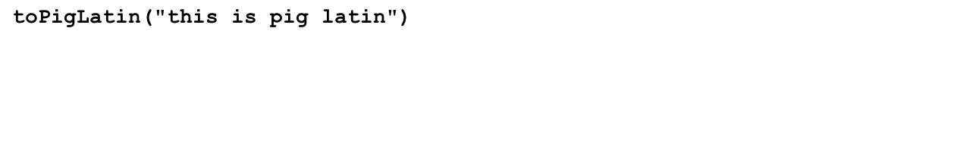
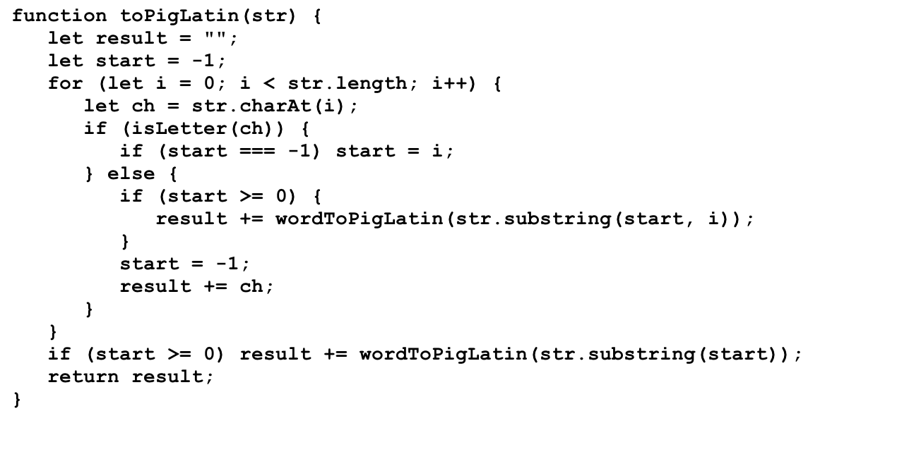
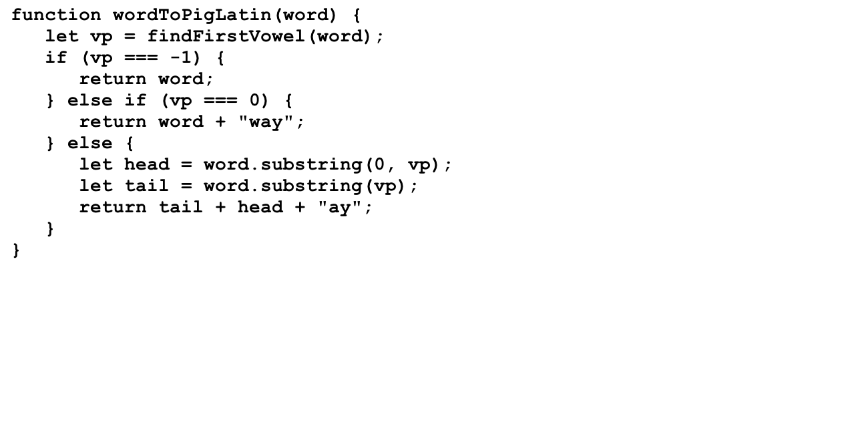
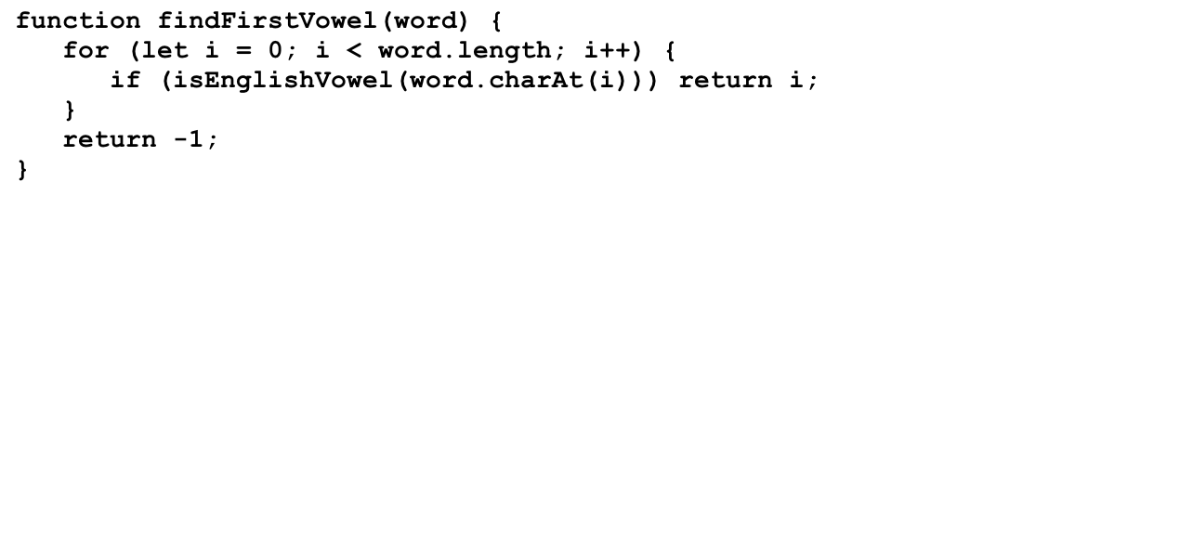
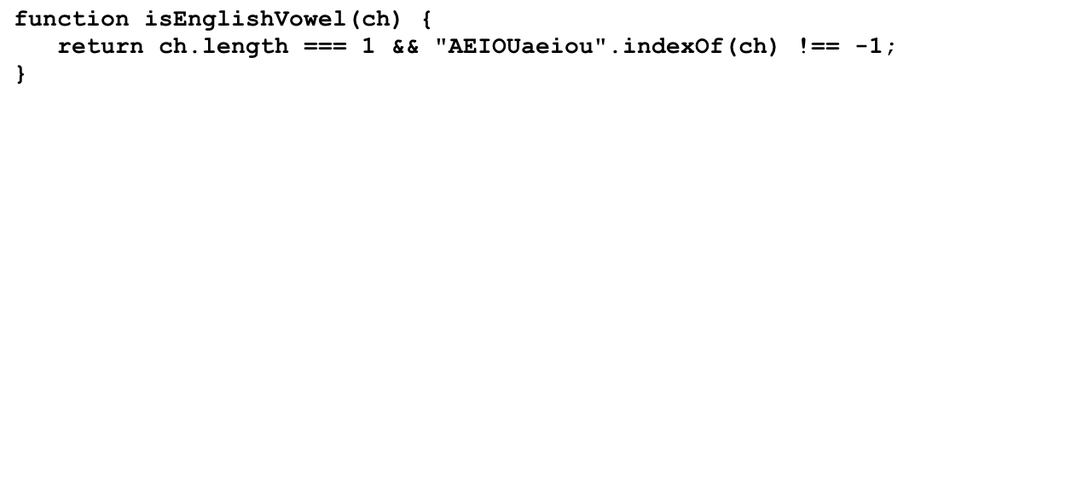
Simulating the PigLatin Program
"isthay"
"isway"
"igpay"
"atinlay"
str
result
start
i
ch
word
word
word
word
vp
vp
vp
vp
head
head
head
head
tail
tail
tail
word
tail
i
ch
"this is pig latin"
""
"isthay"
"isthay "
"isthay isway"
"isthay isway "
"isthay isway igpay"
"isthay isway igpay "
"isthay isway igpay atinlay"
-1
0
-1
5
-1
8
-1
12
0
1
2
3
4
5
6
7
8
9
10
11
12
13
14
15
16
17
"t"
"h"
"i"
"s"
" "
"i"
"s"
" "
"p"
"i"
"g"
" "
"l"
"a"
"t"
"i"
"this"
"n"
"is"
"pig"
"latin"
2
0
1
1
"th"
"p"
"l"
"is"
"ig"
"atin"
"this"
0
1
2
"t"
>
toPigLatin("this is pig latin")
isthay isway igpay atinlay

Slide 20

The GLabel Class
You can display a string in the graphics window using the GLabel class, as illustrated by the following function that displays the string "hello, world" on the graphics window:
function HelloWorld() {
let gw = GWindow(GWINDOW_WIDTH, GWINDOW_HEIGHT);
let label = GLabel("hello, world", 100, 75);
label.setFont("36px Helvetica");
label.setColor("Red");
gw.add(label);
}
HelloWorld
hello, world

Slide 21
Operations on the GLabel Class
Function to create a GLabel
GLabel(text, x, y)
Creates a label containing the specified text that begins at the point (x, y).
Methods specific to the GLabel class
label.setFont( font)
Sets the font used to display the label as specified by the font string.
The font is specified as a CSS fragment, the details of which are described in the JavaScript textbook, pp. 129-131.
Examples of legal font strings:
  "italic 36px Helvetica"
  "24px 'Times New Roman'"
  "bold 14px Courier,'Courier New',Monaco"
  "oblique bold 44px 'Lucida Blackletter',serif"

Slide 22
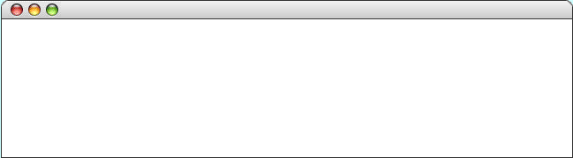
The Geometry of the GLabel Class
The GLabel class relies on a set of geometrical concepts that are derived from classical typesetting:
  The baseline is the imaginary line on which the characters rest.
  The origin is the point on the baseline at which the label begins.
  The height of the font is the distance between successive baselines.
  The ascent is the distance characters rise above the baseline.
  The descent is the distance characters drop below the baseline.
You can use the getHeight, getAscent, and getDescent methods to determine the corresponding property of the font. You can use the getWidth method to determine the width of the entire label, which depends on both the font and the text.
QuickBrownFox
origin
The quick brown fox jumps
over the lazy dog.
ascent
height
baseline
descent

Slide 23
The End

