Slide 1
The Enigma Machine
Jerry Cain
CS 106AX
October 17, 2025
slides constructed from images created by Eric Roberts for his Enigma Machine assignment

Slide 2
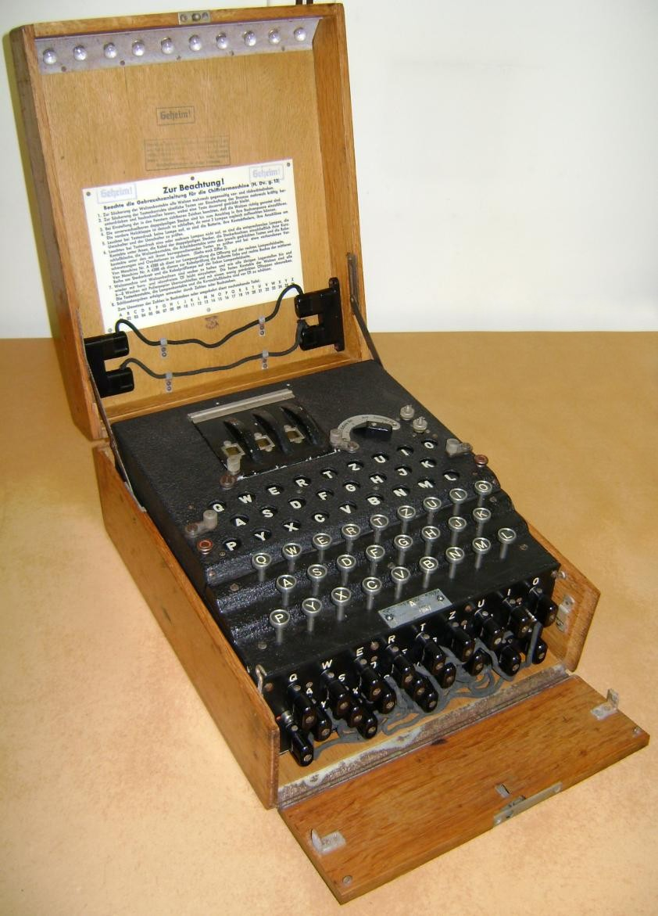
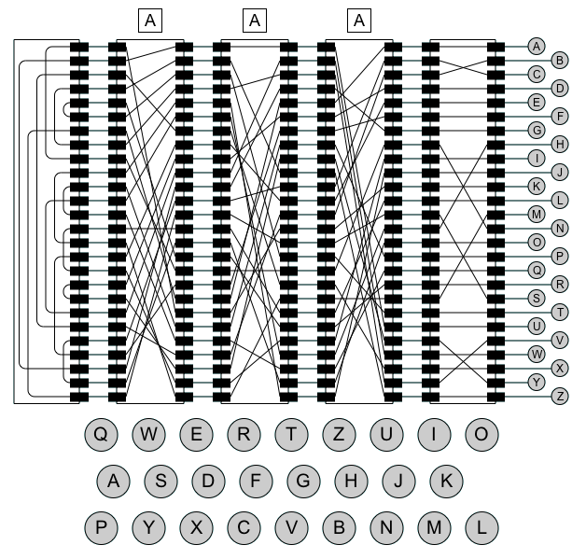
The Enigma Machine
Notes:
2

Slide 3
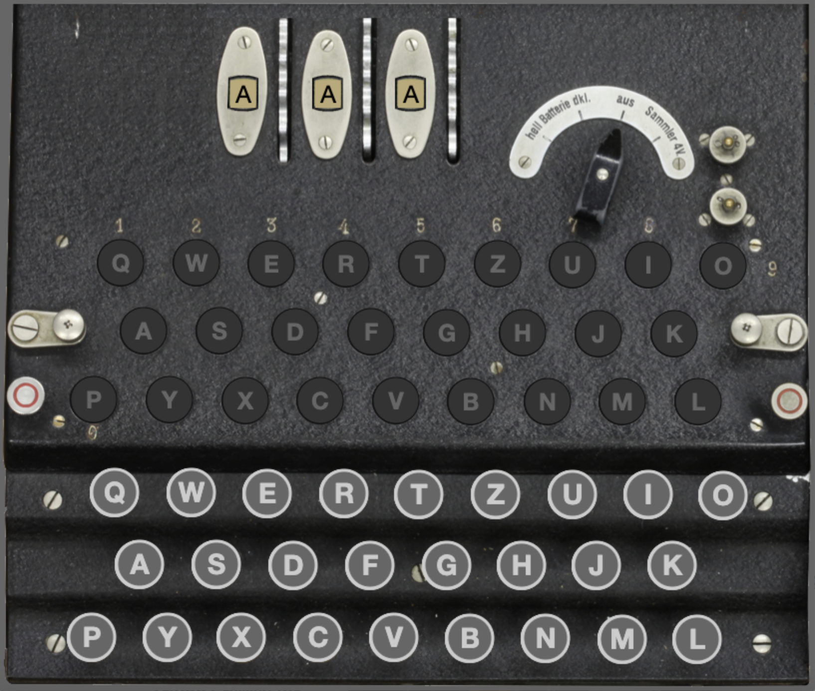
Enigma Machine in CS106AX
Assignment 4 has you simulate the Enigma machine used by the German military during much of World War II.
Your simulation implements an aerial view of an Enigma machine like that presented below and to the right.
The rotors along the top dictate how several letter-substitution ciphers are chained together to
encrypt a single key press.
The physical keys occupy the
lower third of the machine. Each
key press triggers an electrical
impulse through the rotors and
back to illuminate one of 26
lamps, which occupy the middle
portion of the machine.

Slide 4
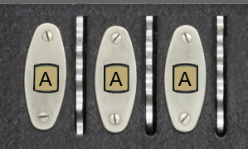
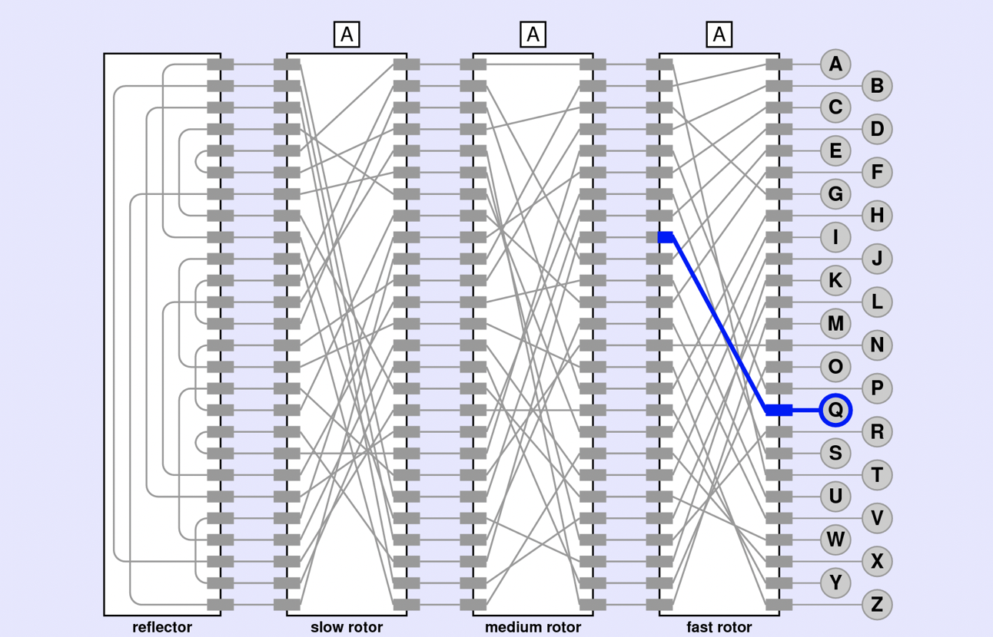
Enigma Machine Rotors
The three rotors collectively operate as a base-26 odometer. Each rotor allows current to pass from each of 26 connections on the one side to of 26 connections
on the other.
In the AAA configuration, the Q on
the fast rotor’s right is wired to
the I on the fast rotor’s left.
Similarly, the A on the
right maps to the B on
the left, B maps D, C
maps to F, and so forth.

Slide 5
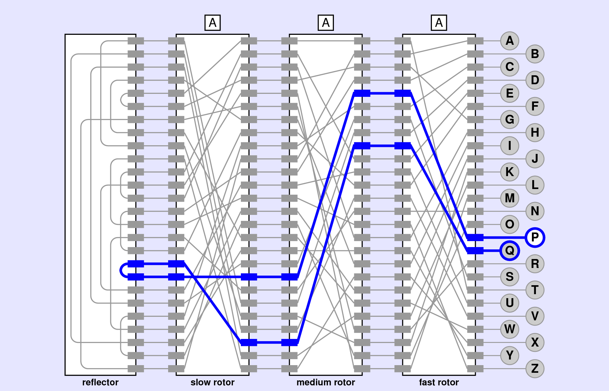
Enigma Machine Rotors
As electrical current passes from right to left, the output of the fast rotor lines up with some input on the medium rotor, which provides its own letter-
substitution cipher.
In the AAA configuration, the
medium rotor maps the I
position to the A position,
and the slow rotor maps
the X on its right to the
R own its left.
The leftmost component
is the reflector, which
connect input pairs so
current reverses direction
and passes back through
the three rotors to a lamp.

Slide 6
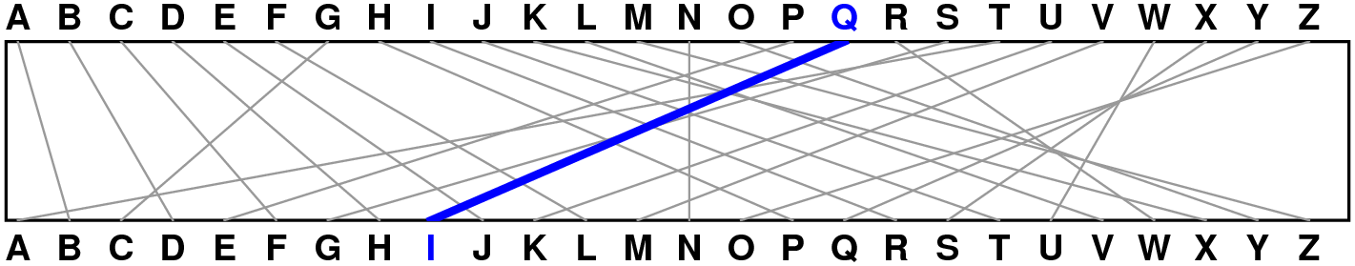
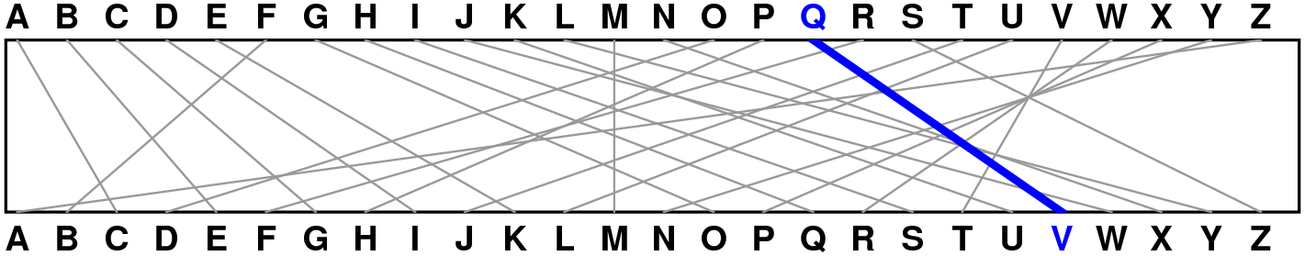
Enigma Machine Rotors
When discussing how a rotor encodes a particular input, one can articulate the encoding in two different ways:
  The physical key for the letter Q is wired to an input on the right that represents the letter I on the left, or
  The physical key for the letter Q is wired to an input on the right that encrypts the Q by rewinding it eight positions in the alphabet.
The second articulation is more useful than the first, because the rewind (and advance) rhetoric generalizes more easily as the rotor itself advances.
If the fast rotor advances
one notch, the wire that
previous advanced R five
positions now advances Q
five positions.

Slide 7
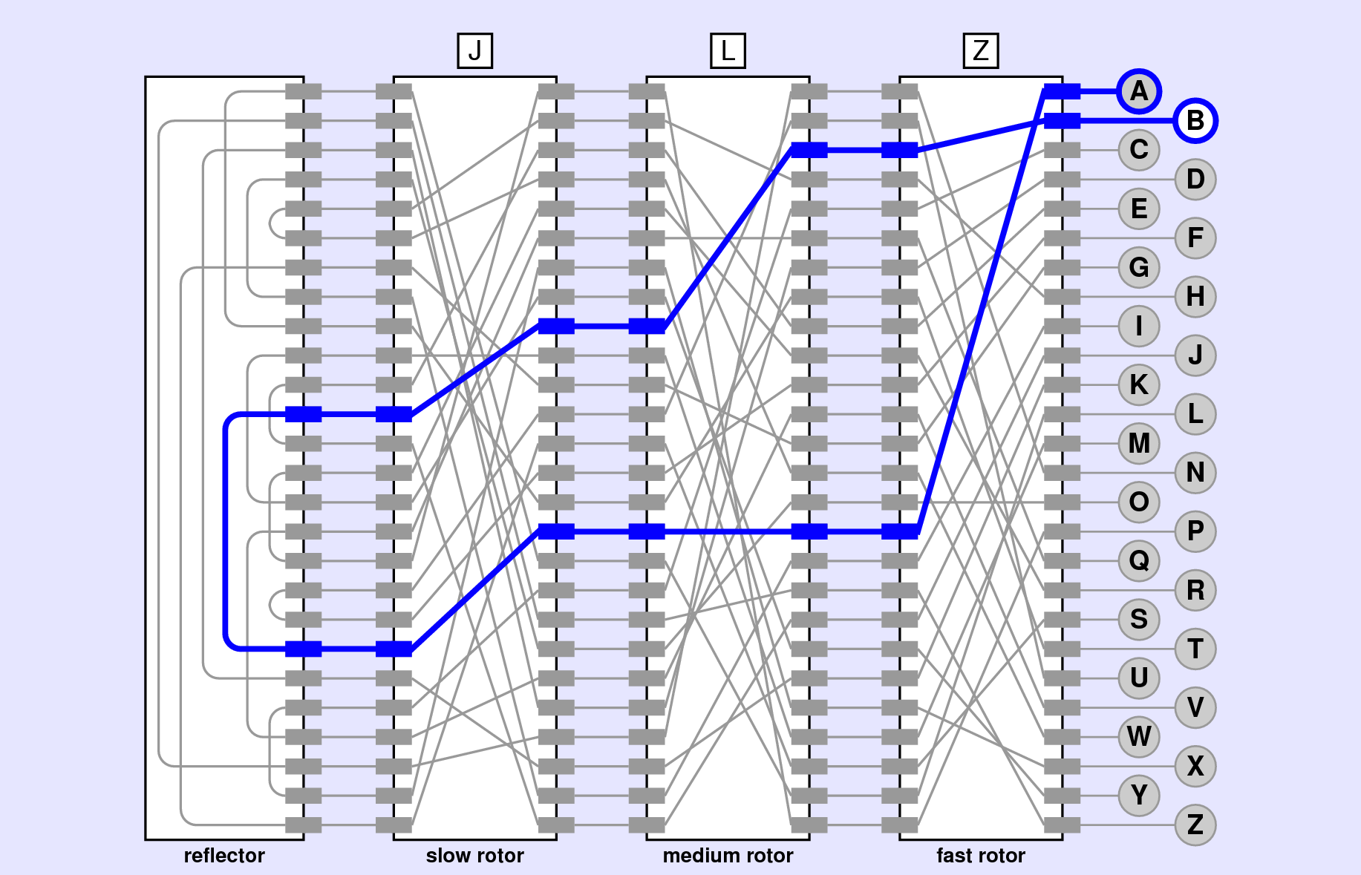
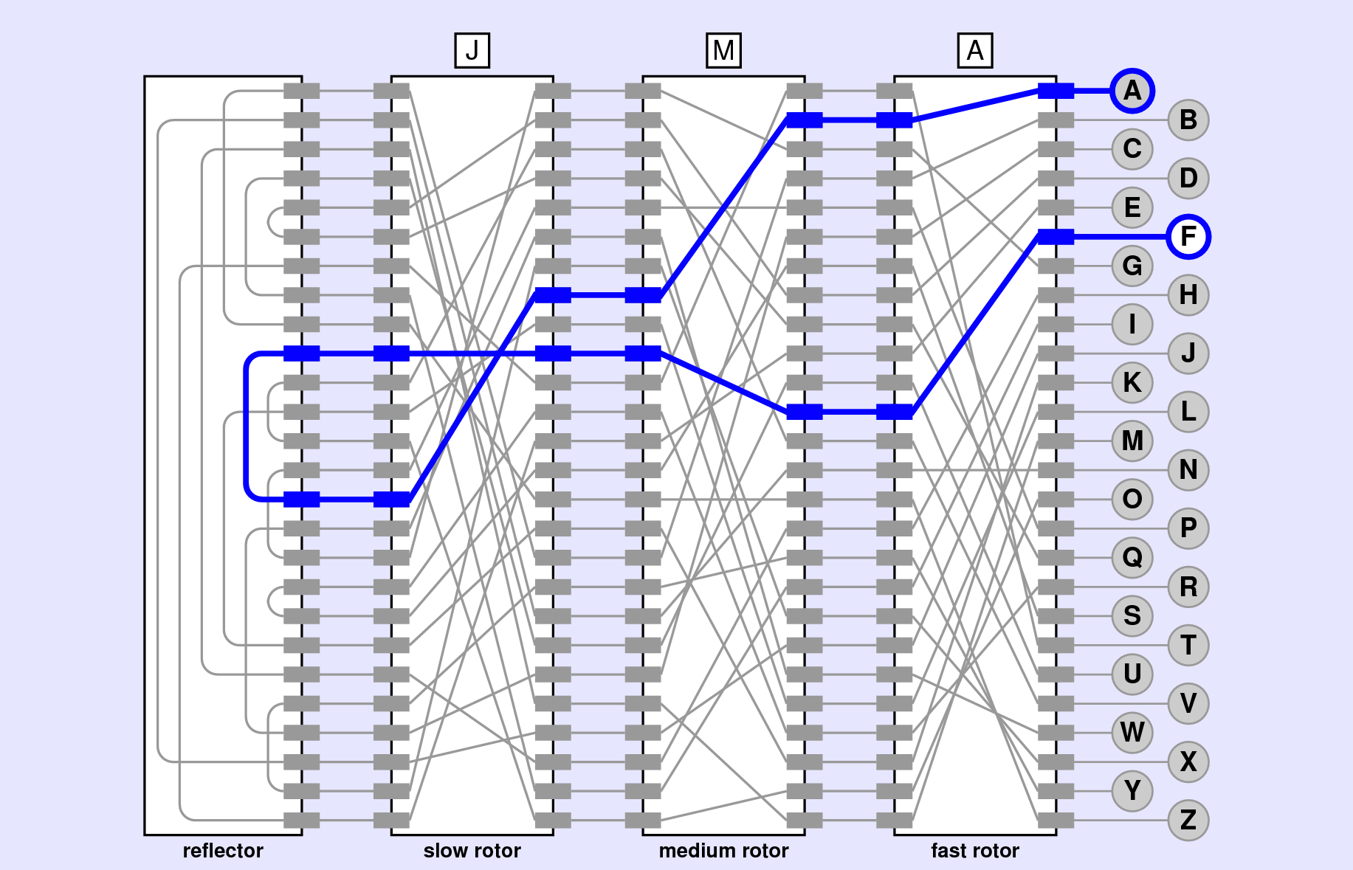
Enigma Machine Rotors
Enigma Machine Rotors
To understand how the encryption evolves, look at the encryption in the below left figure, noting that A becomes P becomes P becomes T becomes L (via reflection) becomes I becomes C becomes B.
Also notice that B on the fast rotor’s right maps to C on that rotor’s left. On the next key press, that connection will rotate so the connection that once led B to C now connects A to B, as it does in the lower right figure.

Slide 8
The End

