Slide 1
Python and Objects
Jerry Cain
CS106AX
October 29, 2025
slides are leveraged from those previously constructed by Eric Roberts

Slide 2
Review: Classes and Objects
While studying JavaScript, classes, and object orientation, we emphasized the distinction between classes and objects:
  A class is a pattern that defines the structure and behavior of a particular type.
  An object is a value that belongs to a class. A single class can be used to create any number of objects, each of which is an instance of that class.
The JSGraphics library, for example, defines a GRect class. In your Breakout assignment, you created many instances of the GRect class—one for each brick and one for the paddle—each of which was a separate object.

Slide 3




Thinking About Objects
GRect class
JSGraphics.js
GRect
GOval
GLine
GLabel
location
size
color
fill status
fill color
I need a bunch of GRects.
.
.
.
JSGraphics.js
GRect
GOval
GLine
GLabel
.
.
.
client
abstraction boundary
implementation
with thanks to Randall Monroe at xkcd.com

Slide 4
The Purposes of Objects
Python uses the concepts of objects and classes to achieve at least three different goals:
  Aggregation. Objects make it possible to represent collections of independent data values as a single unit. In Python, such collections are traditionally called records.
  Encapsulation. Classes make it possible to store data values together with the operations that manipulate them. In Python, the data values are called attributes, and the operations are called methods.
  Inheritance. Class hierarchies make it possible for a class that shares some attributes and methods from a previously defined class to inherit those definitions without explicitly repeating the definitions. We won’t speak about inheritance that much this quarter, but it’s a hallmark feature of OOP and studied extensively in later courses, particularly CS242.

Slide 5
Scrooge and Marley in Python
While learning about aggregates during the JavaScript segment, we contrived a narrative about a tiny company employing Ebenezer Scrooge and Bob Cratchit. We’ll revisit the example and work to promote our aggregates—or records, as they’re called in Python—to classes.
name
name
"Ebenezer Scrooge"
"Bob Cratchit"
title
title
"founder"
"clerk"
salary
salary
1000
15

Slide 6
Classes as Templates
The objects on the preceding slide are both instances of the same class, which for the moment means they share the same attributes. The class itself is visually defined by the template:
name
title
salary
Class definitions in Python, however, are sufficiently complex that it helps to start by using an empty template that creates blank-slate objects and then filling in the necessary fields.

Slide 7
Defining a Blank-Slate Class
Class definitions in Python start with a header line consisting of the keyword class followed by the class name.
Although the body of a class will later contain definitions of attributes and methods, it is possible to define a blank-slate version of the Employee class by leaving the body empty:
class Employee:
"""This class has an empty body"""
Python’s syntactic rules do not allow an empty body. You can either use a docstring as in this example or the keyword pass.
Once you have defined the Employee class, you can create an empty Employee object like this:
clerk = Employee()

Slide 8
Object Values are References
It is important to keep in mind that objects—like all values in Python—are stored as references. The blank-slate template created by the preceding slide therefore looks like this:
clerk
Any code that has access to this reference can manipulate the contents of the object. In particular, the reference allows code to get and set the contents of existing attributes or to create new ones.

Slide 9
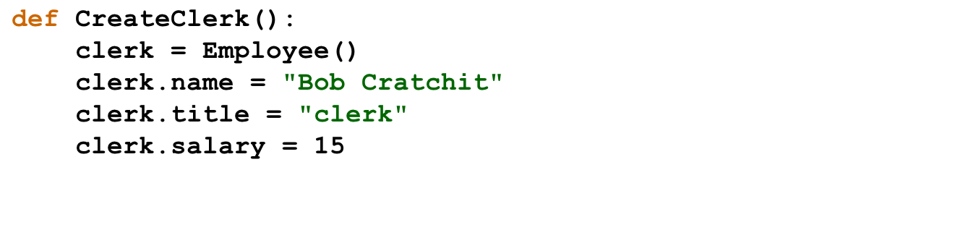
Creating an Employee by Assignment
clerk
In Python, you can create a new attribute simply by assigning it a value, in much the same way that assigning a value to a variable creates a new local variable in the current frame.
name
"Bob Cratchit"
title
"clerk"
salary
15

Slide 10
Constructors
Although the strategy from the preceding slide creates an Employee object with the correct contents, making the client responsible for creating the attributes violates the spirit of object-oriented programming. The details of the data structure are the implementor's responsibility, not the client's.
A better strategy for creating a new Employee object is to define a method called a constructor, which is responsible for initializing the attributes to the object.
In Python, you define a constructor by implementing a special method called __init__, which is automatically called when a client uses the class name as a function.
The first parameter to the __init__ method is called self and contains a reference to the new object. Any other arguments provided by the client are passed as additional parameters.

Slide 11
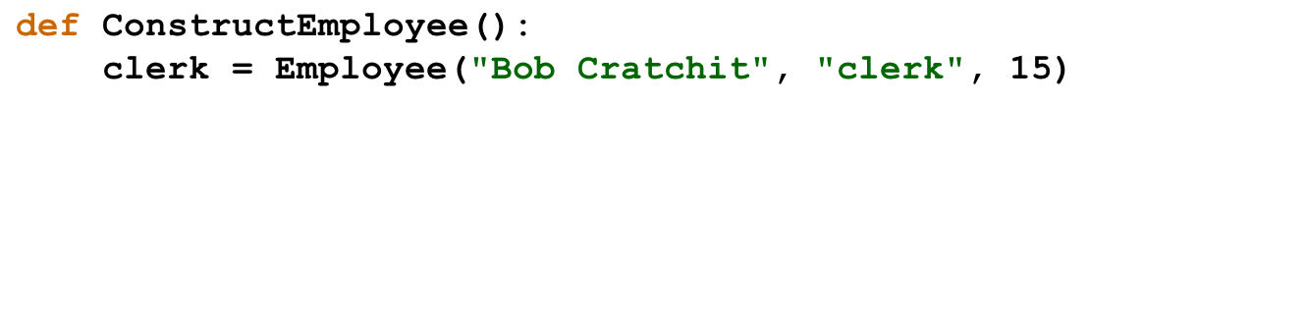
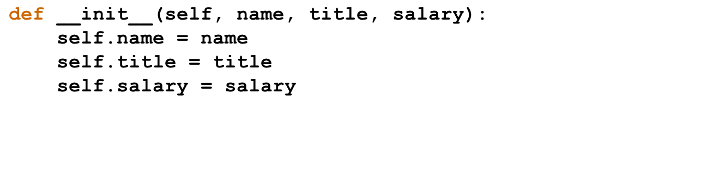
A Constructor for the Employee Class
clerk
self
name
title
salary
"Bob Cratchit"
"clerk"
15
name
"Bob Cratchit"
title
"clerk"
salary
15

Slide 12
Defining Additional Methods
In addition to the constructor, most classes define additional methods that allow clients to read or update attributes of the object or to manipulate the object in some way.
Methods always declare an explicit parameter self at the beginning of the parameter list, just as the constructor does. A method definition therefore looks like this:
def name(self, other parameters):
. . . body of the method . . .
Whenever the client calls a method on an object, Python initializes self to be a reference to the receiver, which is the object to which the method is applied.

Slide 13
Getters and Setters
The simplest methods to describe are those that retrieve the value of an attribute, which are called getters, and those that set an attribute to a new value, which are called setters.
The following definitions show the getter and setter for the salary attribute of an Employee object:
def getSalary(self):
return self.salary
def setSalary(self, salary):
self.salary = salary
Getters are much more common than setters. You need to think carefully before providing a setter as to whether you want clients to be able to change the attribute.

Slide 14
Lists of Objects
Because lists can contain values of any type, the elements of a list can be objects. For example, a list of the employees at Scrooge and Marley can be initialized like this:
SCROOGE_AND_MARLEY = [
Employee("Ebenezer Scrooge", "founder", 1000),
Employee("Bob Cratchit", "clerk", 15)
]
The following function prints the payroll for the roster of employees supplied as an argument using our getter methods:
def printPayroll(roster):
for emp in roster:
print(emp.getName() +
" (" + emp.getTitle() + "): " +
str(emp.getSalary()))

Slide 15
Converting Objects to Strings
If for no other reason than that doing so simplifies debugging, it is good practice to include a __str__ method in each class to convert an object to a string.
The __str__ method for the Employee class looks like this:
def __str__(self):
return self.name + " (" + self.title + "): " +
str(self.salary)
This definition allows you to simplify the printPayroll function to this much shorter form:
def printPayroll(roster):
for emp in roster:
print(emp)

Slide 16
The End

