Slide 1
Object-Oriented Programming and Abstraction
Jerry Cain
CS 106AX
October 31st, 2025
slides leveraged from those constructed by Eric Roberts

Slide 2
The Principles of OOP
Object-oriented programming (generally abbreviated as OOP) was invented in Norway in the 1960s but was not adopted widely for more than a decade.
Object-orientation is defined by two principles, both of which I mentioned on Wednesday during my discussion of classes and objects in Python:
  Encapsulation—The principle that data values and the methods that manipulate them should be integrated into a single coherent structure called an object.
  Inheritance—The idea that objects and the classes that those objects represent form hierarchies that allow new classes to share behavior with classes at higher levels in the hierarchy.
Today’s lecture focuses on the use of encapsulation to define both the values and operations on rational numbers.

Slide 3
Rational Numbers
Section 9.3 illustrates the idea of encapsulation by defining a class called Rational to represent rational numbers, which are simply the quotient of two integers.
Rational numbers can be useful in cases in which you need exact calculation with fractions. Even if you use a double, the floating-point number 0.1 represented internally is actually an approximation. The rational number 1 / 10 is exact.
Rational numbers support the standard arithmetic operations:
Addition:
Multiplication:
a
+
c
=
ad + bc
a
x
c
=
ac
b
d
bd
b
d
bd
Subtraction:
Division:
a
c
ad – bc
a
.
c
ad
–
=
.
=
bc
b
d
bd
b
d

Slide 4
Implementing the Rational Class
The next three slides show the initial version of the Rational class along with some brief annotations.
As you read through the code, the following features are worth special attention:
  The constructor checks that rational numbers obey certain rules. These rules are described in more detail in the text but include reducing the fraction to lowest terms.
  For now, operations are specified using the receiver syntax. When you apply an operator to two Rational values, one of the operands is the receiver and the other is passed as an argument, as in
r1.add(r2)

Slide 5
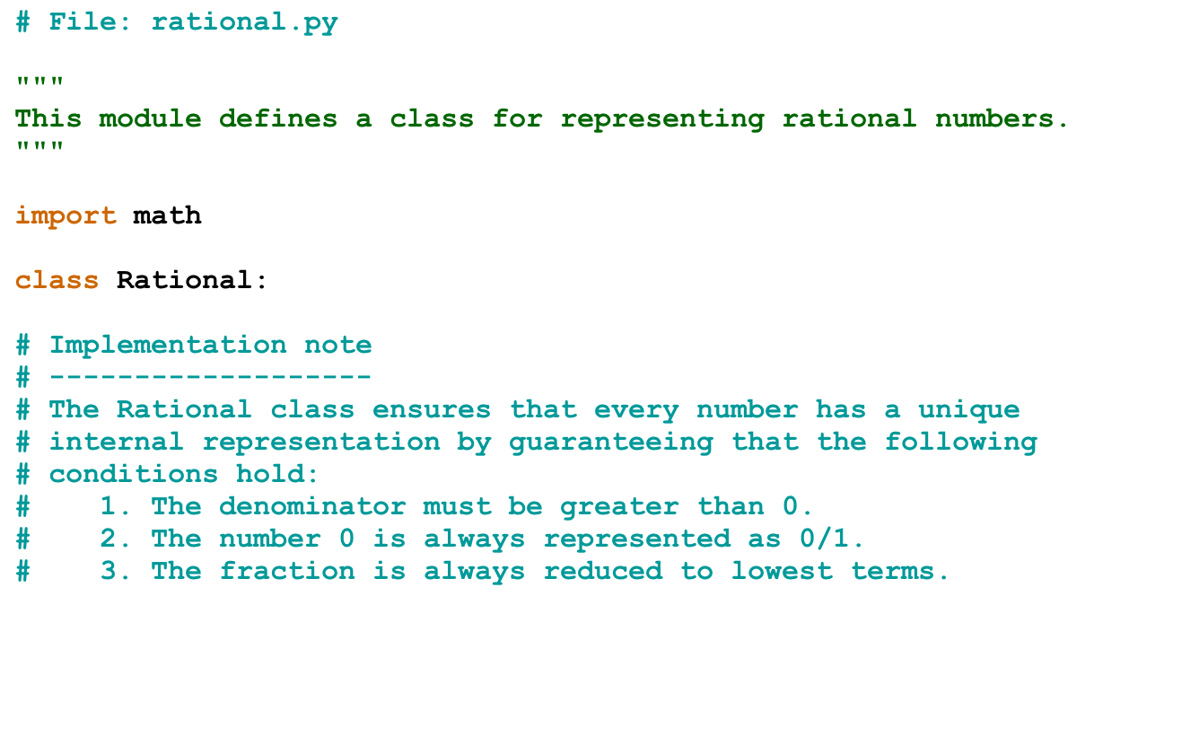
The Rational Class

Slide 6
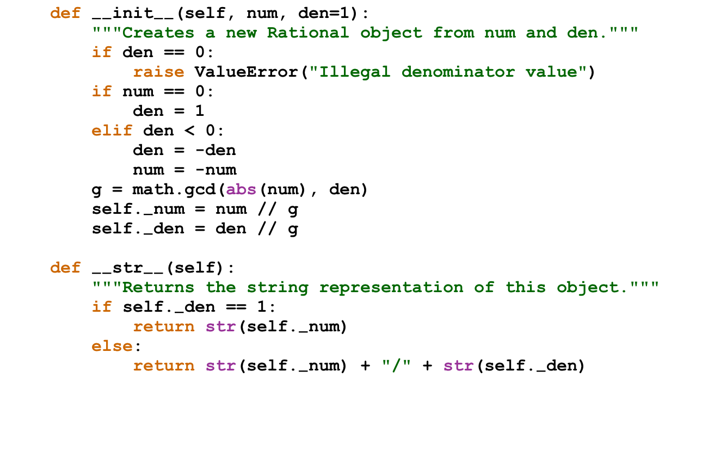
The Rational Class

Slide 7
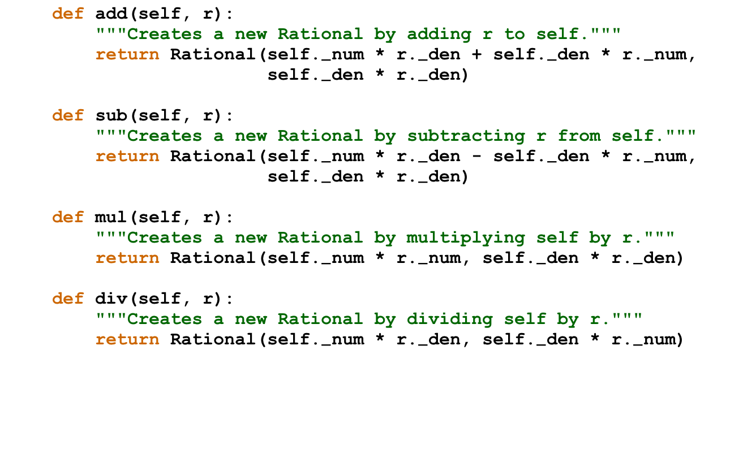
The Rational Class

Slide 8
Simulating Rational Calculation
The next slide works through all the steps in the calculation of a simple program that adds three rational numbers.
1
1
1
+
+
2
3
6
With rational arithmetic, the computation is exact. If you use floating-point arithmetic, the result looks like this:
PyCharm
>>>
1/2 + 1/3 + 1/6
0.999999999999999
>>>

Slide 9
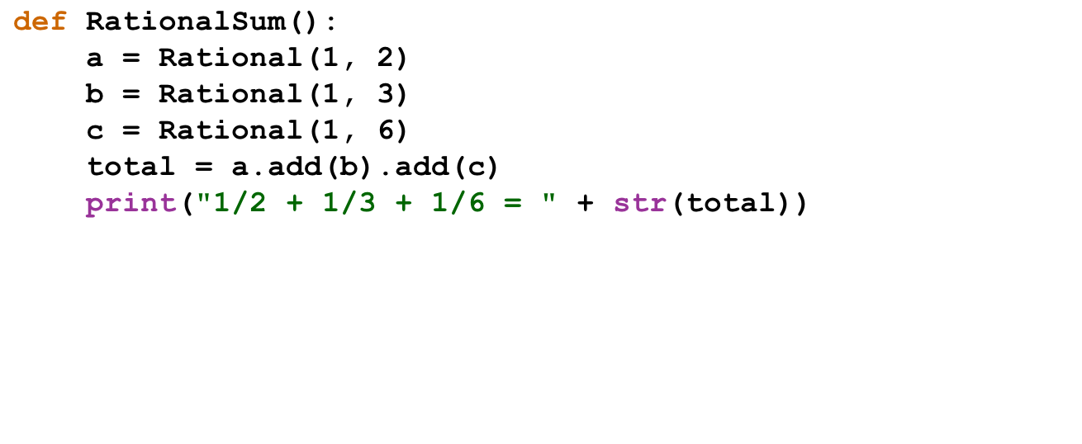
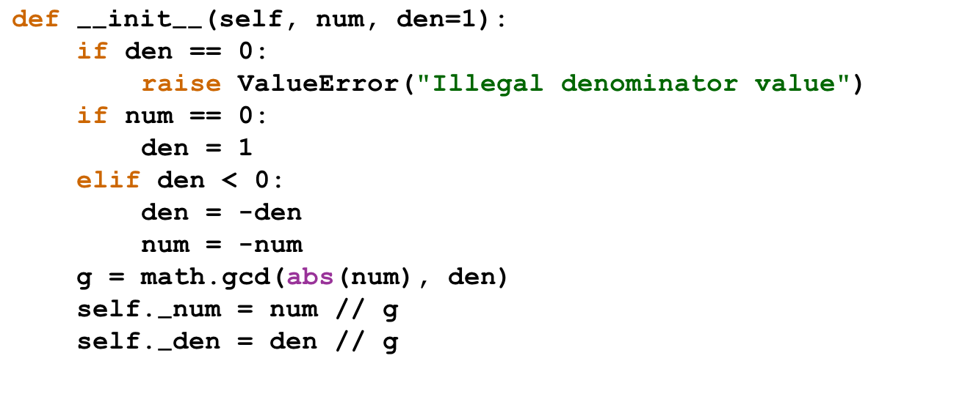
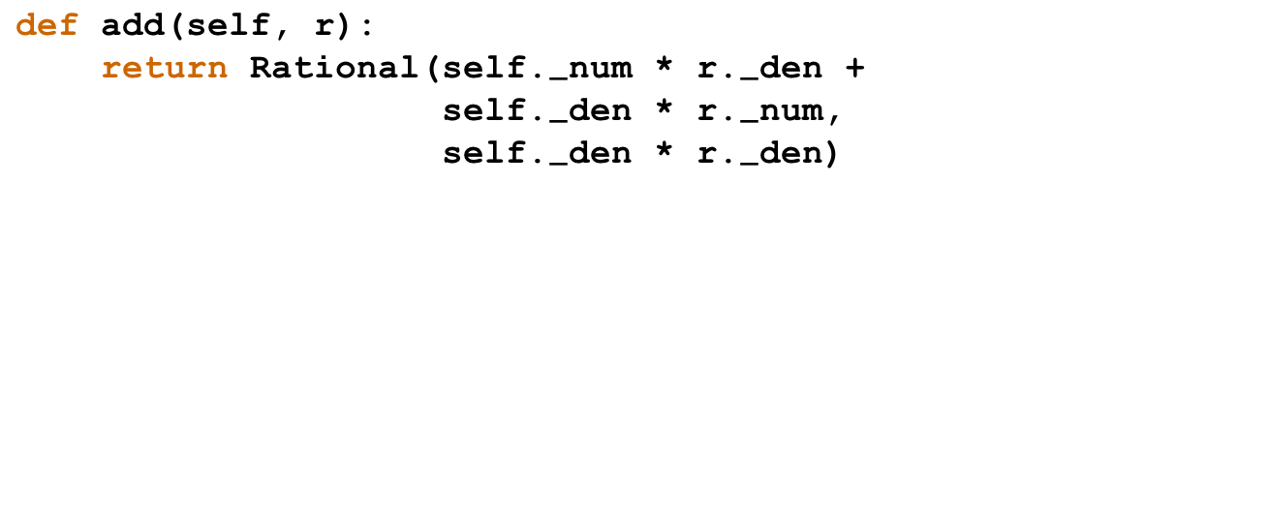
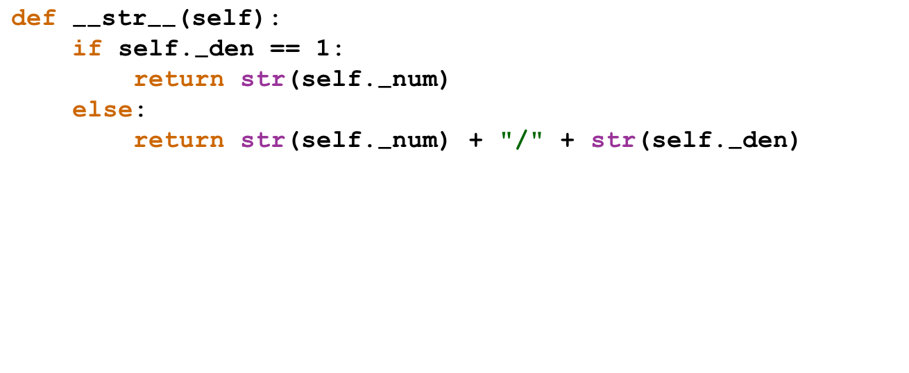

Tracing Rational Addition

Slide 10
Overloading the Arithmetic Operators
The receiver syntax used in the RationalSum program makes the program hard to read, particularly for people unfamiliar with object-oriented programming.
The program would be much clearer if you could replace
a.add(b).add(c)
with the more familiar expression
a + b + c
Unlike most modern languages, Python allows you to do just that. Each operator is associated with a special method name specifying how that operator should be implemented by the defining class. This technique is called operator overloading.

Slide 11
Redefining Addition
As an example, you can define addition for the Rational class by providing a definition for the __add__ method. If you make use of the fact that the Rational class has an add method, the definition of the __add__ operator looks like this:
def __add__(self, rhs):
return self.add(rhs)
Although this simple implementation works, it is better for clients if one can mix types in an expression.
As long as the Rational operand appears to the left of the + operator, the __add__ method can define mixed-type addition by checking the type of rhs. If the Rational operand can appear on the right, you need to define the method __radd__ as well. The code for overloading + in both directions appears on the next slide.

Slide 12
Overloading Addition on Both Sides
def __add__(self, rhs):
if type(rhs) is int:
return self.add(Rational(rhs))
elif type(rhs) is Rational:
return self.add(rhs)
else:
return NotImplemented
def __radd__(self, lhs):
if type(lhs) is int:
return Rational(lhs).add(self)
elif type(lhs) is Rational:
return lhs.add(self)
else:
return NotImplemented

Slide 13
Operator Methods in Python
__add__
__radd__
Redefines the + operator
__sub__
__rsub__
Redefines the - operator
__mul__
__rmul__
Redefines the * operator
__truediv__
__rtruediv__
Redefines the / operator
__floordiv__
__rfloordiv__
Redefines the // operator
__mod__
__rmod__
Redefines the % operator
__pow__
__rpow__
Redefines the ** operator
__neg__
(not applicable)
Redefines the unary - operator
__eq__
(symmetric)
Redefines the == operator
__ne__
(symmetric)
Redefines the != operator
__lt__
(inferred from >)
Redefines the < operator
__gt__
(inferred from <)
Redefines the > operator
__le__
(inferred from >=)
Redefines the <= operator
__ge__
(inferred from <=)
Redefines the >= operator

Slide 14
Type Abstraction
One of the most important advantages of the object-oriented paradigm is the idea of type abstraction, in which the goal is to think about types in terms of their high-level behavior rather than their low-level implementation.
In computer science, types that are defined by their behavior are called abstract data types or ADTs.
Python includes several built-in abstract types, and you have already seen a few implementations of abstract types, such as the Rational we just discussed last time.
We’ll spend the rest of lecture discussing strategies on how to define your own abstract data types.

Slide 15
Remembering Pig Latin
One of the largest examples we covered while teaching JavaScript strings was a program that translated text from English to Pig Latin. We revisited that same program when we discussed Python’s support for strings.
Both Pig Latin translators decomposed the problem into two functions: a toPigLatin function that divides the input into words and a wordToPigLatin function that translates a single word to its Pig Latin equivalent. The first phase of this operation is completely independent of Pig Latin domain.
It would be useful to have a package that divides input strings into individual units that have integrity as a unit, as words do in English. Since the same idea applies in contexts beyond human languages, computer scientists use the term token to define these units. A library that returns individual tokens from an input source is called a token scanner.

Slide 16
Designing a Token Scanner
Section 12.2 in the Python reader describes a general library class called TokenScanner, which is implemented for several programming languages just as our graphics package is.
The text also implements a small piece of that library that exports the following methods:
scanner.setInput(str)
Sets the input for this scanner to the specified string or input stream.
scanner.hasMoreTokens()
Returns true if more tokens exist, and false at the end of the token stream.
scanner.nextToken()
Returns the next token from the token stream, and "" at the end.
scanner.ignoreWhitespace()
Tells the scanner to ignore whitespace characters.
These methods are the primary TokenScanner methods you need for your next assignment.

Slide 17
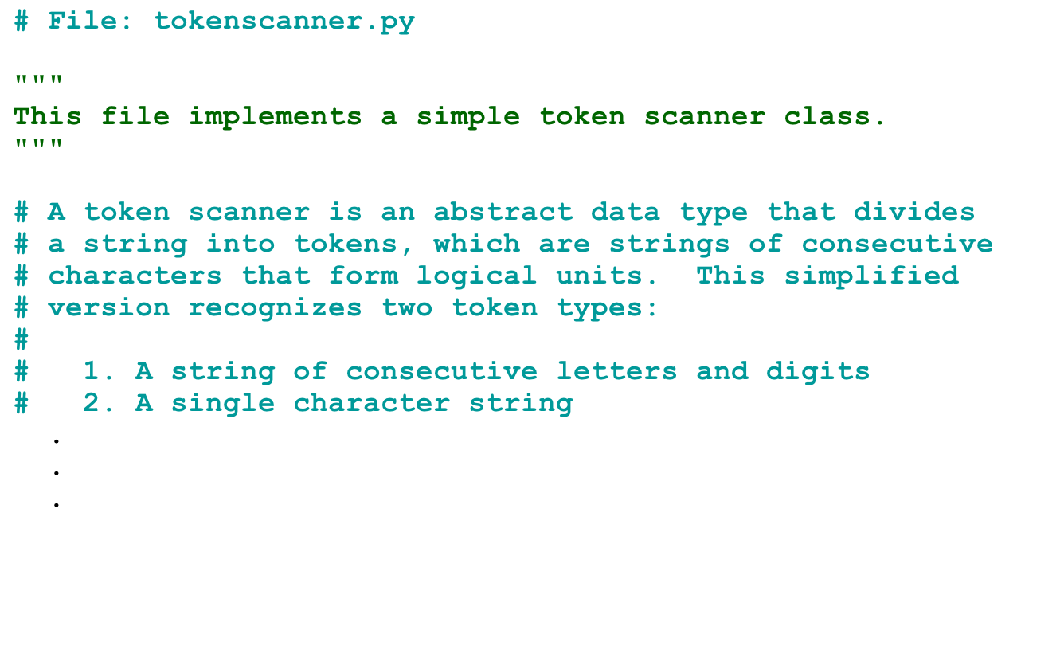
A Simple TokenScanner Class

Slide 18
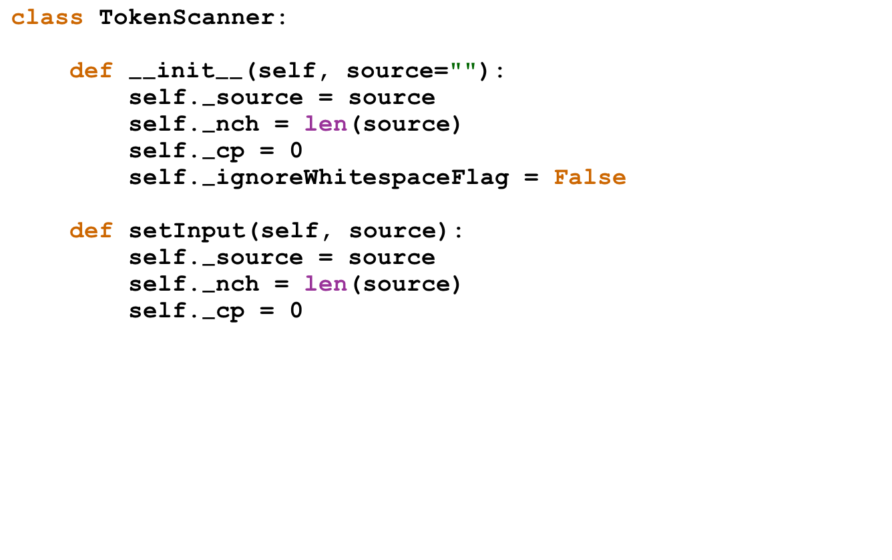
A Simple TokenScanner Class

Slide 19
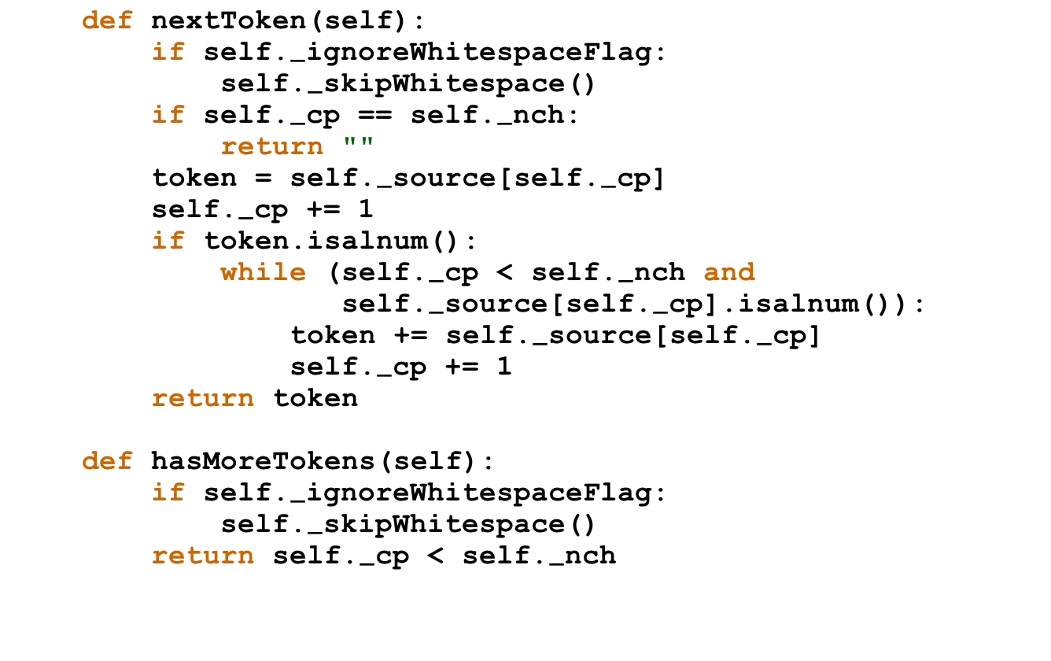
A Simple TokenScanner Class

Slide 20
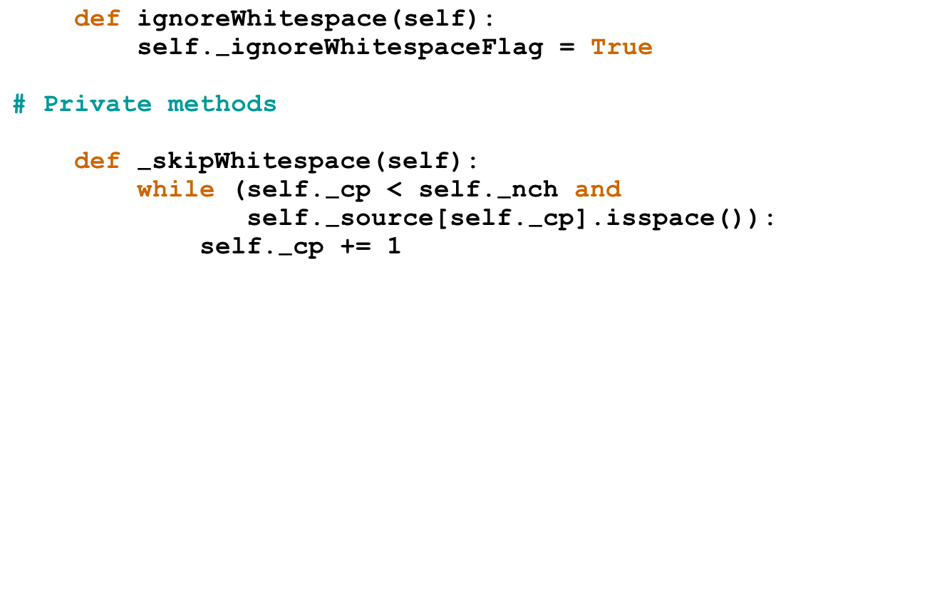
A Simple TokenScanner Class

Slide 21
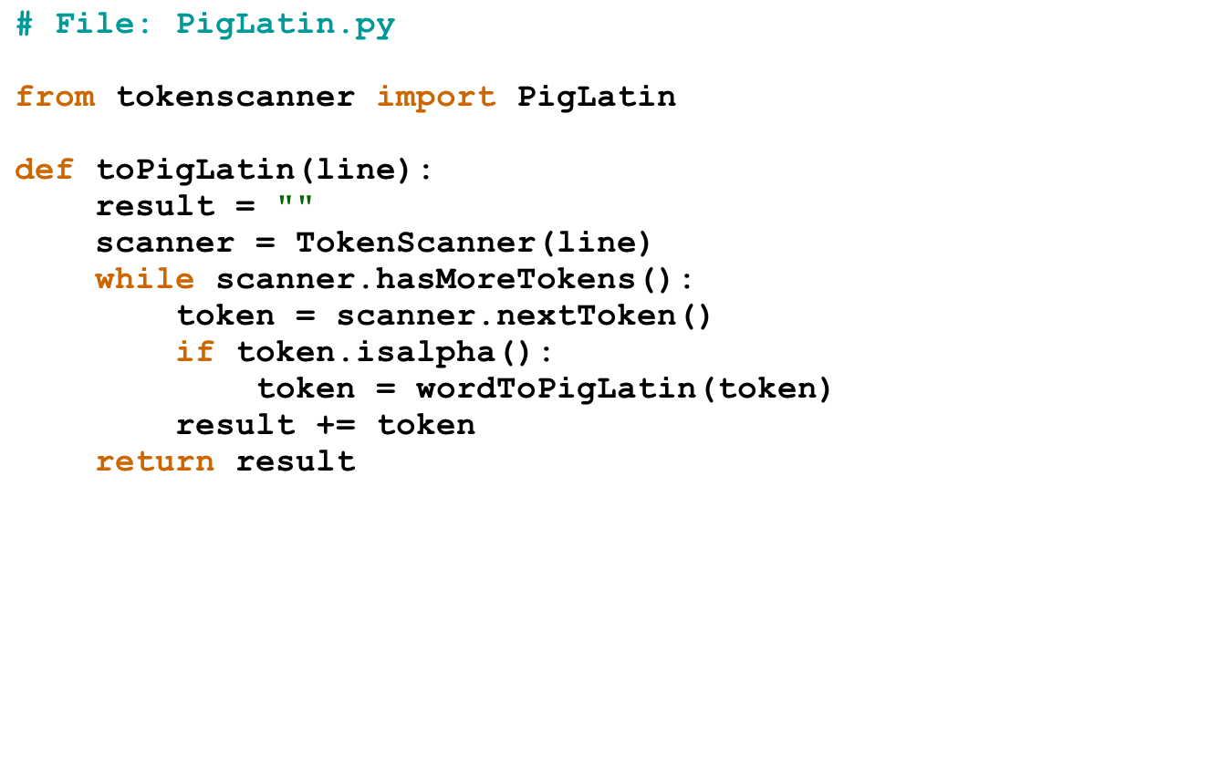
Using TokenScanner in PigLatin

Slide 22
The End

