Slide 1
Data-Driven Programs
Jerry Cain
CS 106AX
November 3rd, 2025
slides constructed by Eric Roberts

Slide 2
Data-Driven Programs
With most programming languages, data structures are easier to manipulate than code. As a result, it's often useful to design applications so that as much of their behavior as possible is represented as data rather than in the form of methods. Programs that work this way are said to be data-driven.
In a data-driven system, the actual program (which is usually called a driver) is typically very small. Such driver programs operate in two phases:
1.
Read data from a file into a suitable internal data structure.
2.
Use the data structure to control the flow of the program.
To illustrate the idea of a data-driven system, most of this lecture focuses on writing a "teaching machine" of the sort that information technology pioneer and author Ted Nelson discusses (mostly critically) in his book, Dream Machines.

Slide 3
The Course Data File
In the teaching machine application, the course designer—who is perhaps an expert in education but not necessarily a programmer—creates a data file that serves as the driver. The general format of the file is shown on the left, and a specific example of a question and its answers appears on the right.
identifying name for the first question
text of the first question
–––––
response₁: name of next question
response₂: name of next question
response₃: name of next question
.
.
.
. . . other question/answer entries . . .
RemQ1
What is the value of 17 % 4?
a. 0
b. 1
c. 3
d. 4
–––––
a: RemQ2
0: RemQ2
b: PrecQ1
1: PrecQ1
c: RemQ2
3: RemQ2
d: RemQ2
4: RemQ2

Slide 4
Choosing an Internal Representation
The first step in building the teaching machine is to design a set of classes that can represent the data and their relationships in the file. All relevant data should be accessible from a single structure that contains all relevant information in a nested series of classes.
course
TMCourse
TMQuestion
array of strings
questions
name
text
answers
name → question
string → name

Slide 5
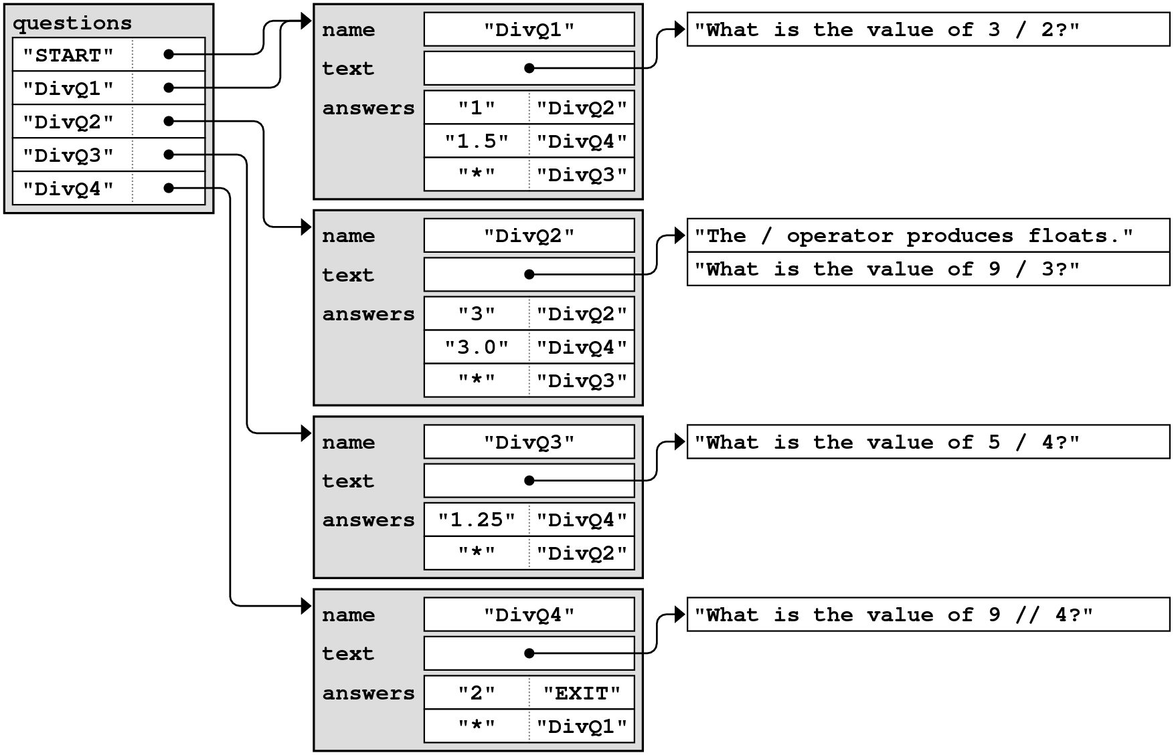
Converting External to Internal Form
DivQ1
What is the value of 3 / 2?
-----
1: DivQ2
1.5: DivQ4
*: DivQ3
DivQ2
The / operator produces floats.
What is the value of 9 / 3?
-----
3: DivQ2
3.0: DivQ4
*: DivQ3
DivQ3
What is the value of 5 / 4?
-----
1.25: DivQ4
*: DivQ2
DivQ4
What is the value of 9 // 4?
-----
2: EXIT
*: DivQ1

Slide 6
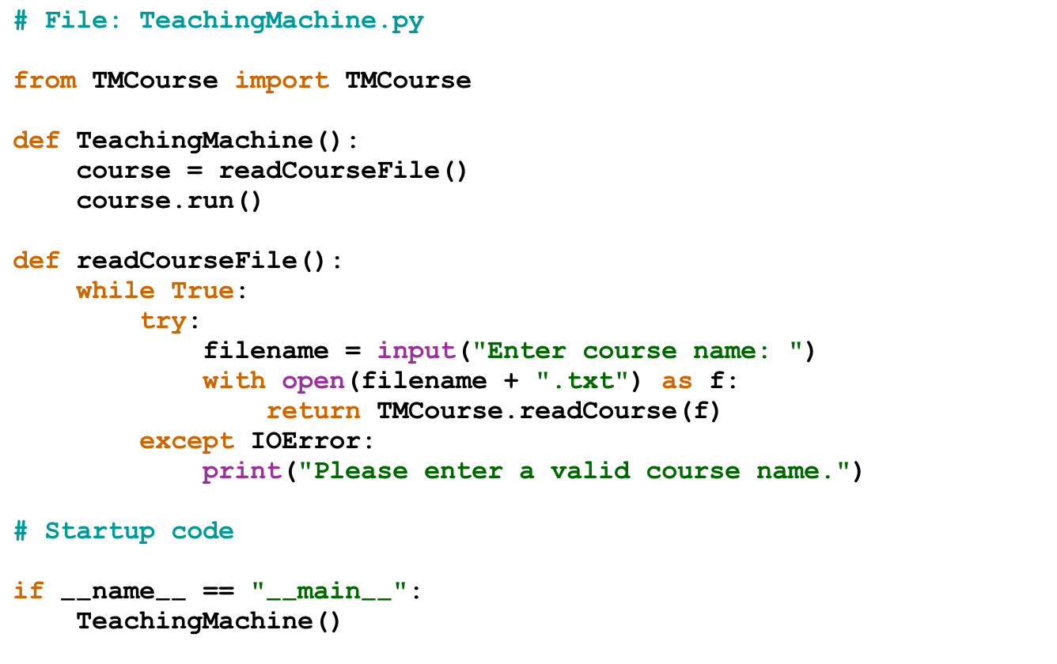
The TeachingMachine Program

Slide 7
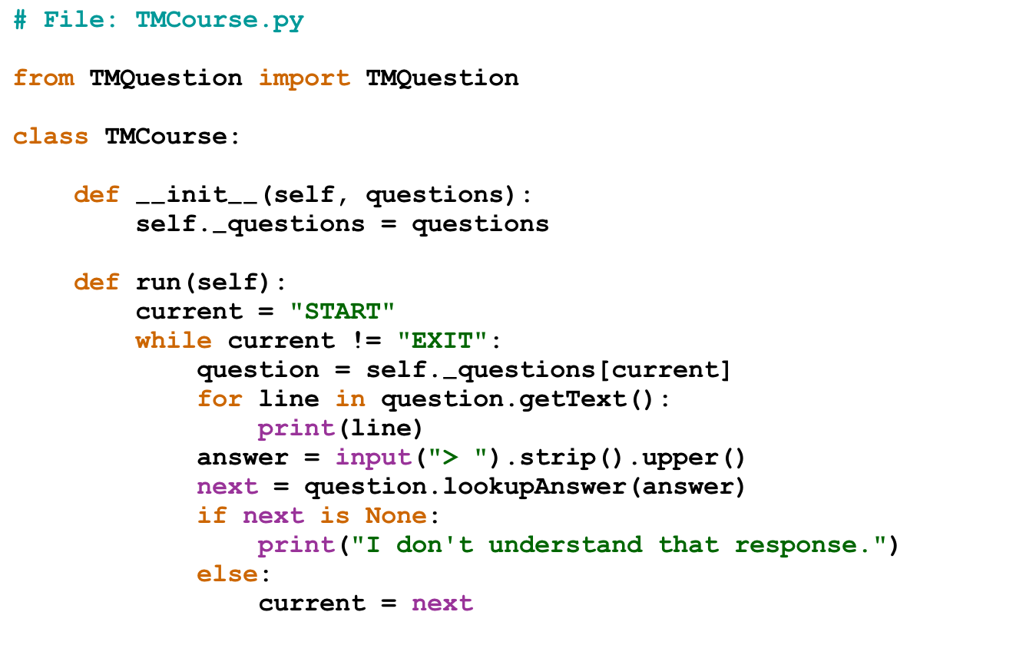
The TMCourse Class

Slide 8
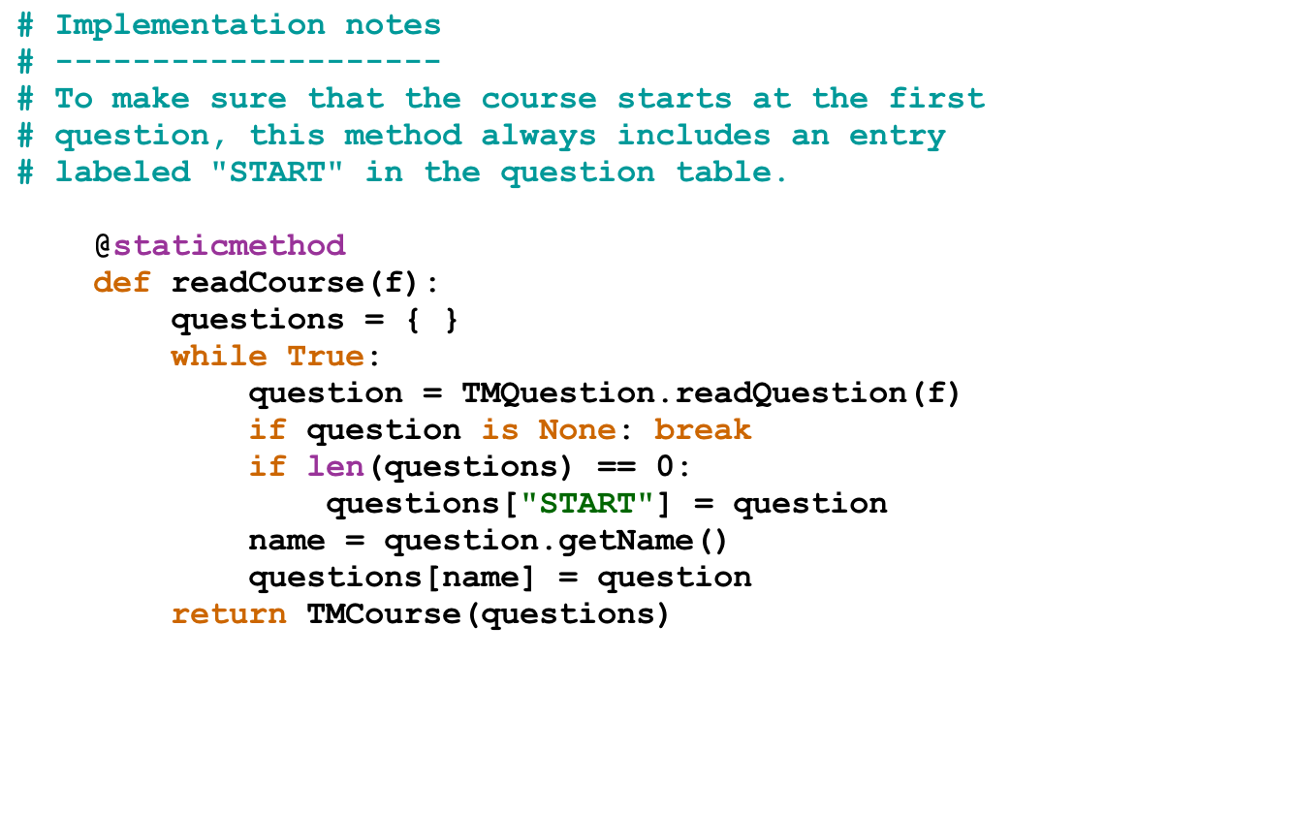
The TMCourse Class

Slide 9
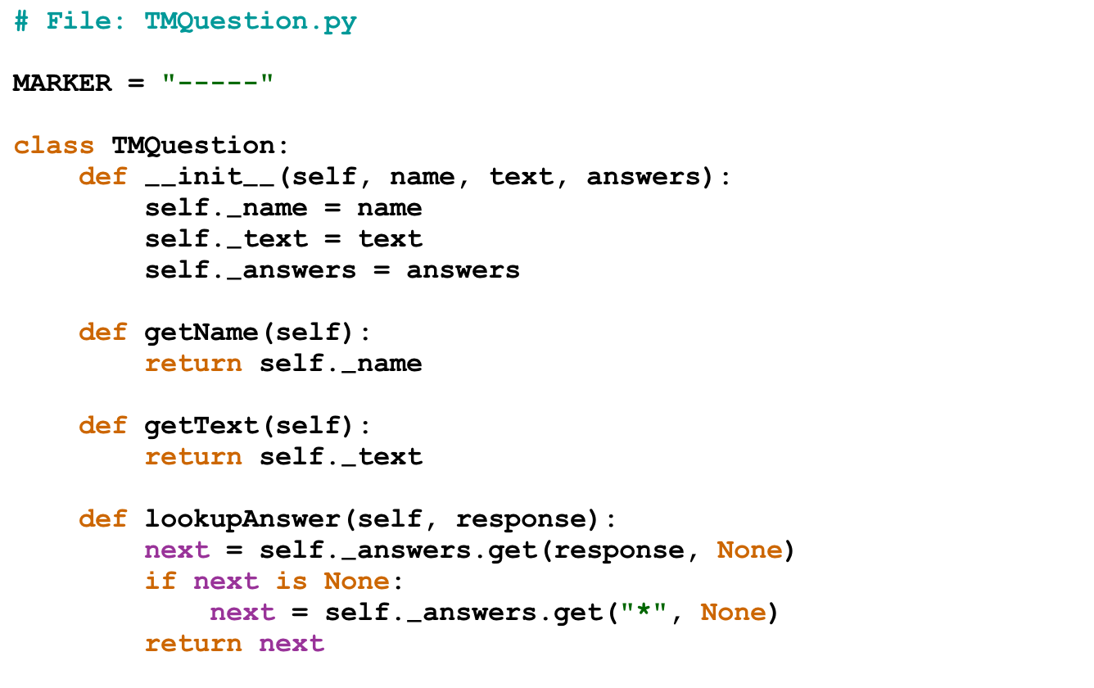
The TMQuestion Class

Slide 10
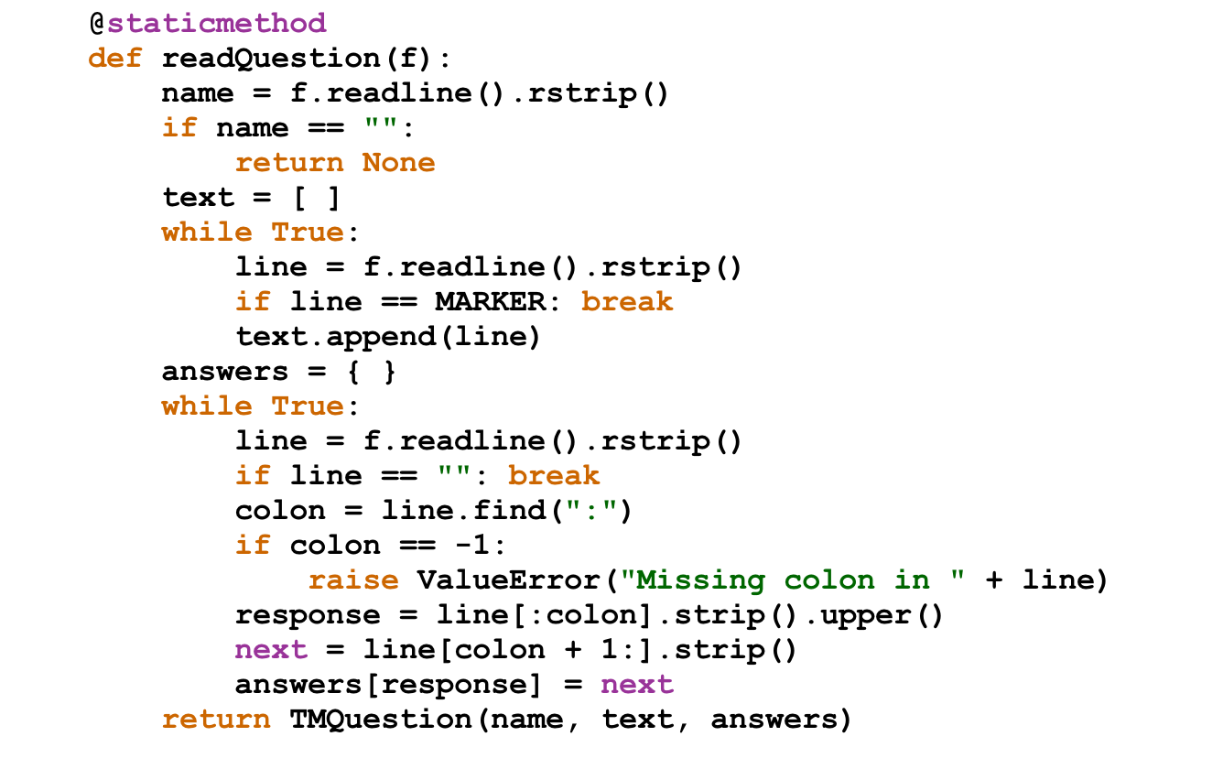
The TMQuestion Class

Slide 11
The End

