Slide 1
Adventure
Jerry Cain
CS 106AX
November 5th, 2025
slides constructed by Eric Roberts

Slide 2

The Origins of the Internet
The Internet that has become so much a part of today’s world got its start as the ARPANET in the late 1960s.
The contract to build the ARPANET was awarded to Bolt Beranek and Newman Inc. (BBN), a small, Cambridge-based research and development firm founded by MIT engineers.
On October 29th, 1969, then UCLA student Charley Kline sent the first message on ARPANET. The message was supposed to be the word "login", but only "io" was transmitted before the system crashed.
A prototype implementation of the ARPANET connecting four nodes came online in early December 1969.
The initial design for the ARPANET allowed for a maximum of 127 connected computers. Larger networks were possible only after the TCP/IP protocols were adopted in the 1980s.

Slide 3
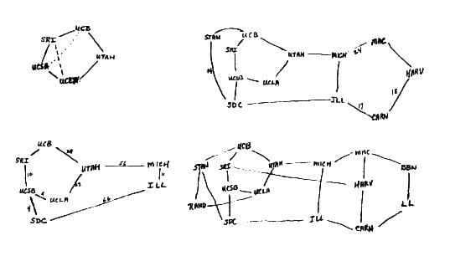
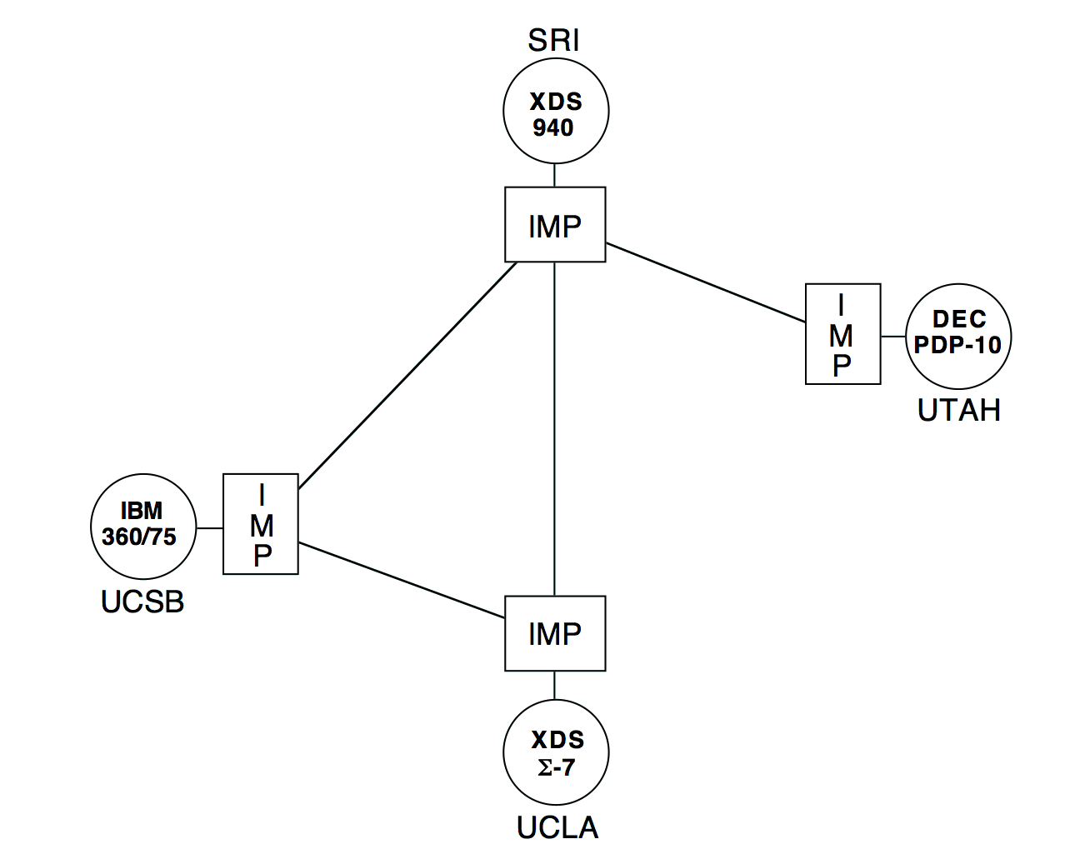
Early Designs for the ARPANET
As Larry Roberts envisioned it in his notebooks:
As deployed in 1969:

Slide 4
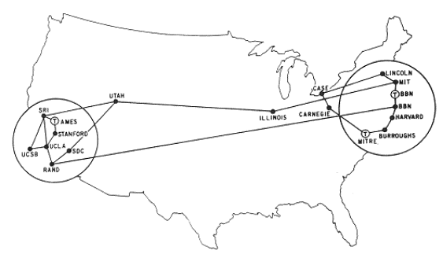
The ARPANET in 1971

Slide 5
The ARPANET in 1971
PDP-10
PDP-10
PDP-11
PDP-10
TX-2
SRI
UTAH
ILLINOIS
MIT
LINCOLN
CASE
PDP-15
IMP
IMP
IMP
IMP
IMP
IMP
PDP-10
GE-645
360/67
UCSB
STANFORD
SDC
360/67
CARNEGIE
360/75
IMP
IMP
IMP
DDP 516
IMP
PDP-10
PDP-10
PDP-10
UCLA
RAND
BBN
HARVARD
BURROUGHS
SIGMA 7
IMP
IMP
IMP
IMP
IMP
360/91
IBM 3800
DDP 516
PDP-10
PDP-1
PDP-10
86500
360/65
ILLIAC IV

Slide 6

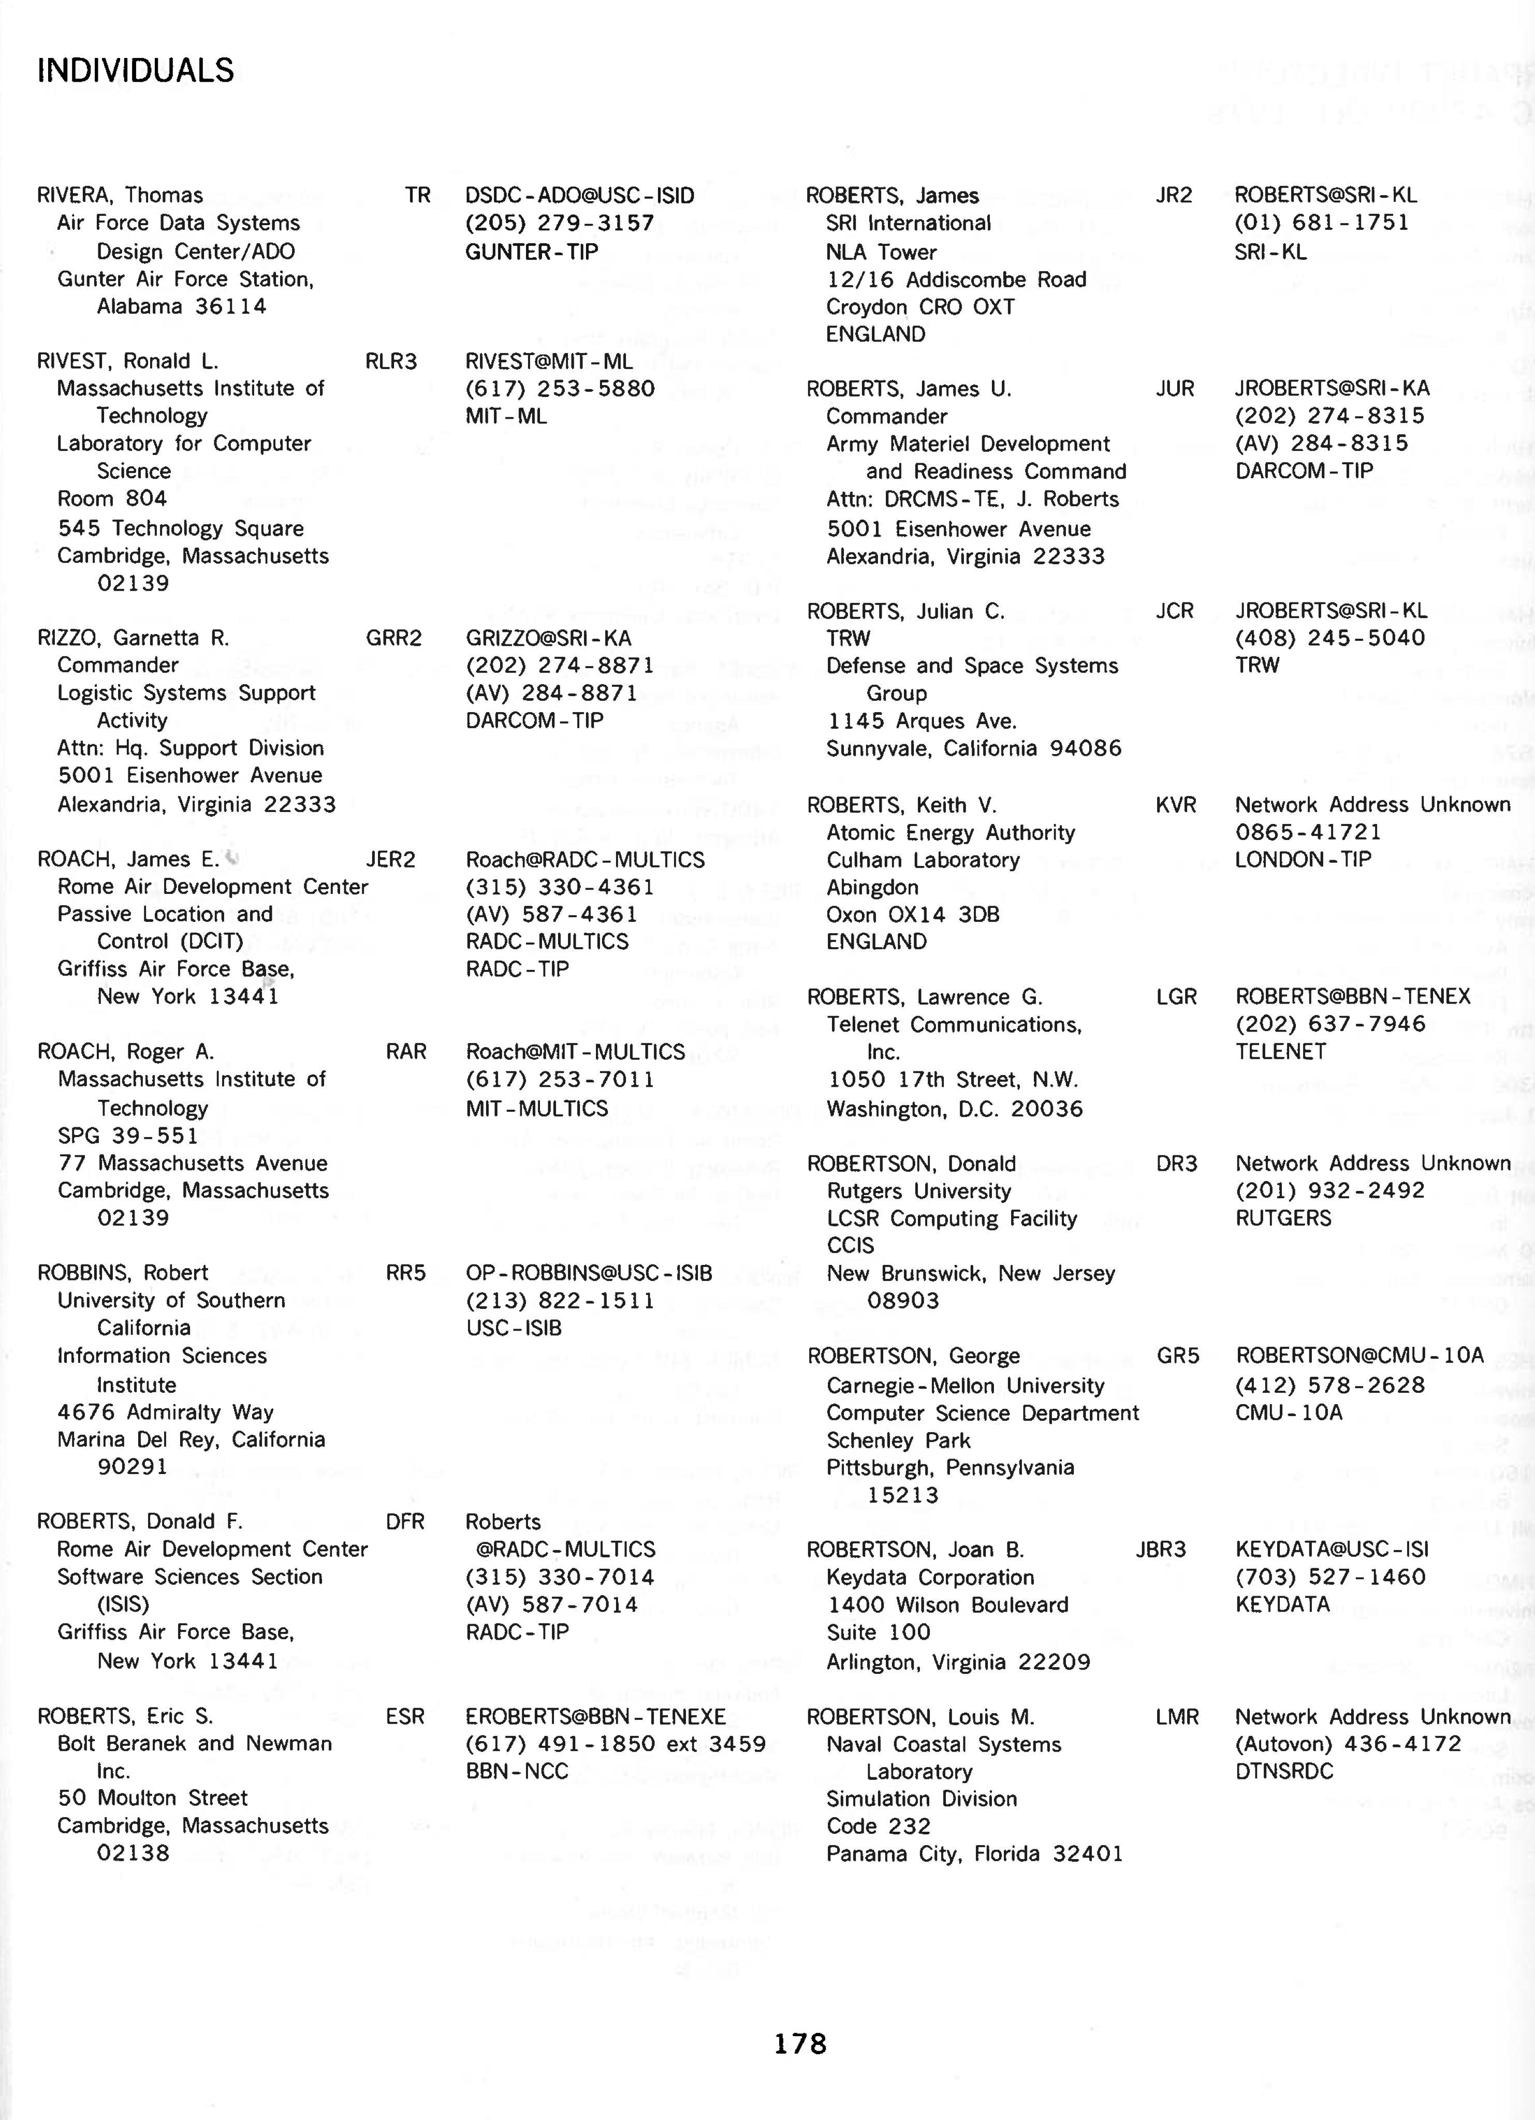
The ARPANET Directory

Slide 7


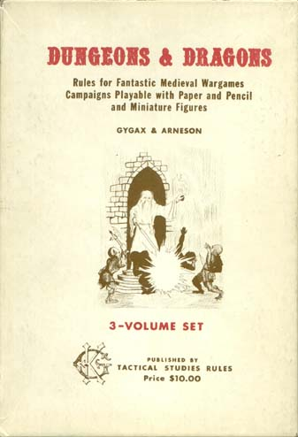
Life among the Wizards
The history of the Internet has been told in several books. One tells the following story:
A small circle of friends at BBN had gotten hooked on Dungeons and Dragons, an elaborate fantasy role-playing game in which one player invents a setting and populates it with monsters and puzzles, and the other players then make their way through that setting. The game exists only in the minds of the players.
Dave Walden got his introduction to the game one night when Eric Roberts, a student from a class he was teaching at Harvard, took him to a D&D session. Walden immediately rounded up a group of friends from the ARPANET team for continued sessions. Roberts created the Mirkwood Tales. . . .
One of the regulars was Will Crowther . . .

Slide 8
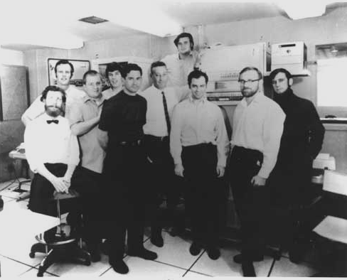
The BBN ARPANET Team
Dave
Walden
Willie
Crowther

Slide 9
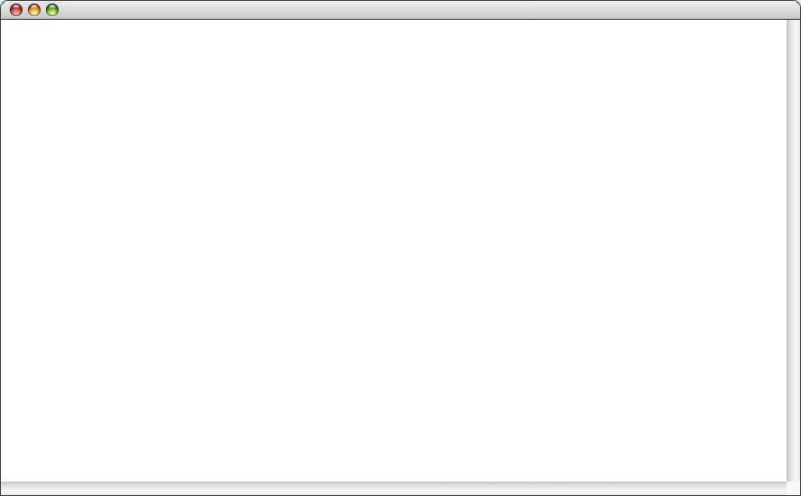
Willie Crowther’s Adventure Game
Adventure
Welcome to ADVENTURE!! Would you like instructions?
YES
Somewhere nearby is Colossal Cave, where others have found fortunes in
treasure and gold, though it is rumored that some who enter are never
seen again. Magic is said to work in the cave. I will be your eyes
and hands. Direct me with natural English commands; I don't under-
stand all of the English language, but I do a pretty good job.
(Should you get stuck, type "HELP" or "?" for some general hints.)
Good Luck!
- - - -
You are standing at the end of a road before a small brick building.
Around you is a forest. A small stream flows out of the building and
down a gully to the south. The road runs up a small hill to the west.
GO INSIDE
You are inside a building, a well house for a large spring.
There are some keys on the ground here. . . .

Slide 10
Willie Crowther’s Adventure Game
Adventure
You are in the Hall of the Mountain King, with passages off in most directions, some of which appear to be newly constructed.
A huge green fierce snake bars the way!
RELEASE BIRD
The little bird attacks the green snake, and in an astounding flurry
drives the snake away.
. . . some time later . . .
You are in a secret canyon which exits to the north and east.
A huge green fierce dragon bars the way!
The dragon is sprawled out on a persian rug!!
RELEASE BIRD
The little bird attacks the green dragon, and in an astounding flurry
gets burnt to a cinder. The ashes blow away.
Welcome to ADVENTURE!! Would you like instructions?
YES
Somewhere nearby is Colossal Cave, where others have found fortunes in
treasure and gold, though it is rumored that some who enter are never
seen again. Magic is said to work in the cave. I will be your eyes
and hands. Direct me with natural English commands; I don't under-
stand all of the English language, but I do a pretty good job.
(Should you get stuck, type "HELP" or "?" for some general hints.)
Good Luck!
- - - -
You are standing at the end of a road before a small brick building.
Around you is a forest. A small stream flows out of the building and
down a gully to the south. The road runs up a small hill to the west.
GO INSIDE
You are inside a building, a well house for a large spring.
There are some keys on the ground here. . . .

Slide 11
A Brief History of Adventure
Eric Roberts begins the Mirkwood Tales in early 1975.
Will Crowther creates Adventure later that year.
Will moves to Xerox/PARC in 1976.
Stanford graduate student Don Woods releases an expanded version of Adventure in early 1977.
Dave Lebling and others from MIT release the first version of Zork in 1977. That game later becomes the foundation of the computer game company Infocom.
Adventure is ported to a wide variety of platforms by 1980.
Eric Roberts creates an expanded version in 1984 and uses it as the basis for his first Adventure Contest at Wellesley.

Slide 12
Classes in the Adventure Game
Adventure
The main program, which gets the program started.
AdvGame
AdvRoom
AdvObject
Contains the code and data necessary to play the game.
Maintains the data structure for each room in the cave.
Maintains the data structure for each object that can be carried by the player.

Slide 13
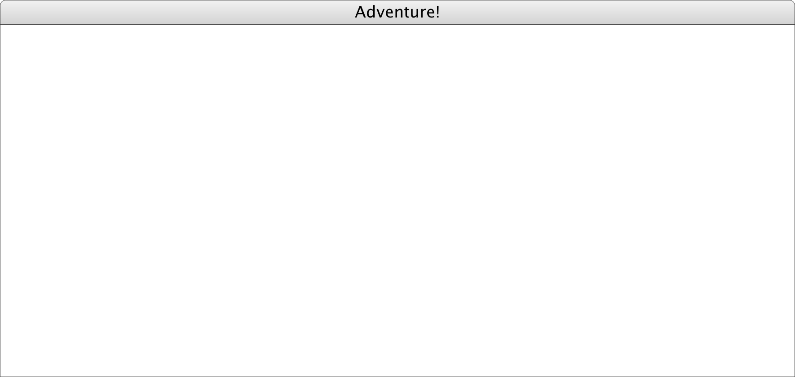
Milestone #1
Adapt the code from the Teaching Machine application so that it uses the class and method names for Adventure.
Once you finish this milestone, you should be able to wander around the surface geography of the game.
You are standing at the end of a road before a small brick
building. A small stream flows out of the building and
down a gully to the south. A road runs up a small hill
to the west.
>
W
E
S
T
You are at the end of a road at the top of a small hill.
You can see a small building in the valley to the east.
>
E
A
S
T
You are standing at the end of a road before a small brick
building. A small stream flows out of the building and
down a gully to the south. A road runs up a small hill
to the west.
>

Slide 14
The SmallRooms.txt Data File
OutsideBuilding
Outside building
You are standing at the end of a road before a small brick
building. A small stream flows out of the building and
down a gully to the south. A road runs up a small hill
to the west.
-----
WEST: EndOfRoad
UP: EndOfRoad
NORTH: InsideBuilding
IN: InsideBuilding
SOUTH: Valley
DOWN: Valley
EndOfRoad
End of road
You are at the end of a road at the top of a small hill.
You can see a small building in the valley to the east.
-----
EAST: OutsideBuilding
DOWN: OutsideBuilding

Slide 15
The SmallRooms.txt Data File
InsideBuilding
Inside building
You are inside a building, a well house for a large spring.
-----
SOUTH: OutsideBuilding
OUT: OutsideBuilding
Valley
Valley beside a stream
You are in a valley in the forest beside a stream tumbling
along a rocky bed. The stream is flowing to the south.
-----
NORTH: OutsideBuilding
UP: OutsideBuilding
SOUTH: SlitInRock
DOWN: SlitInRock
SlitInRock
Slit in rock
At your feet all the water of the stream splashes into a
two-inch slit in the rock. To the south, the streambed is
bare rock.
-----
NORTH: Valley
UP: Valley
SOUTH: OutsideGrate
DOWN: OutsideGrate
OutsideBuilding
Outside building
You are standing at the end of a road before a small brick
building. A small stream flows out of the building and
down a gully to the south. A road runs up a small hill
to the west.
-----
WEST: EndOfRoad
UP: EndOfRoad
NORTH: InsideBuilding
IN: InsideBuilding
SOUTH: Valley
DOWN: Valley
EndOfRoad
End of road
You are at the end of a road at the top of a small hill.
You can see a small building in the valley to the east.
-----
EAST: OutsideBuilding
DOWN: OutsideBuilding

Slide 16

Milestone #2
Implement the setVisited and hasBeenVisited methods in AdvRoom.
Check this flag in the code that describes a room.
Once you finish this milestone, the program should use the short descriptions when you enter a previously visited room.
You are standing at the end of a road before a small brick
building. A small stream flows out of the building and
down a gully to the south. A road runs up a small hill
to the west.
>
W
E
S
T
You are at the end of a road at the top of a small hill.
You can see a small building in the valley to the east.
>
E
A
S
T
Outside building.
>

Slide 17

Milestone #3
Implement the QUIT, HELP, and LOOK commands.
Once you finish this milestone, the player can end the game, see the help text, and redisplay the room’s long description.
You are standing at the end of a road before a small brick
building. A small stream flows out of the building and
down a gully to the south. A road runs up a small hill
to the west.
>
W
E
S
T
You are at the end of a road at the top of a small hill.
You can see a small building in the valley to the east.
>
E
A
S
T
Outside building.
>
L
O
O
K
You are standing at the end of a road before a small brick
building. A small stream flows out of the building and
down a gully to the south. A road runs up a small hill
to the west.
>
Q
U
I
T

Slide 18
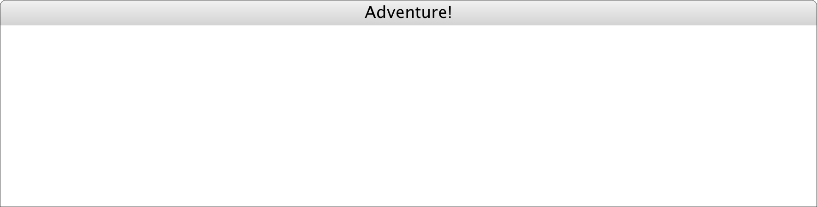
Milestone #4
Implement the AdvObject class.
Implement the methods in the AdvRoom class that make it possible to keep track of the objects in a room.
In the AdvGame class, write the code to put each object in its initial room (ignore the room name "PLAYER" for now).
Change the code to display a room so that it lists the objects.
This milestone allows you to see (but not yet take) objects.
Outside building.
>
I
N
You are inside a building, a well house for a large spring.
The exit door is to the south. There is another room to
the north, but the door is barred by a shimmering curtain.
There is a set of keys here.
>

Slide 19
The SmallObjects.txt Data File
KEYS
a set of keys
InsideBuilding
LAMP
a brightly shining brass lamp
BeneathGrate
ROD
a black rod with a rusty star
DebrisRoom
WATER
a bottle of water
PLAYER

Slide 20

Milestone #5
Implement the TAKE, DROP, and INVENTORY commands and any code you need to remember what the player is carrying.
You are inside a building, a well house for a large spring.
The exit door is to the south. There is another room to
the north, but the door is barred by a shimmering curtain.
There is a set of keys here.
>
T
A
K
E
K
E
Y
S
Taken.
>
T
A
K
E
G
O
L
D
I don't see that here.
>
I
N
V
E
N
T
O
R
Y
You are carrying:
a bottle of water
a set of keys
>
D
R
O
P
W
A
T
E
R
Dropped.
>
D
R
O
P
K
E
Y
S
Dropped.
>
I
N
V
E
N
T
O
R
Y
You are empty-handed.
>

Slide 21

Milestone #6
Implement synonym processing so that the player can use abbreviated forms of the direction verbs and alternative names for the objects.
Welcome to Adventure
You are standing at the end of a road before a small brick
building. A small stream flows out of the building and
down a gully to the south. A road runs up a small hill
to the west.
>
I
You are carrying:
a bottle of water
>
D
R
O
P
B
O
T
T
L
E
Dropped.
>
W
You are at the end of a road at the top of a small hill.
You can see a small building in the valley to the east.
>
D
Outside building.
There is a bottle of water here.
>

Slide 22
The SmallSynonyms.txt Data File
Q=QUIT
L=LOOK
I=INVENTORY
N=NORTH
S=SOUTH
E=EAST
W=WEST
U=UP
D=DOWN

Slide 23

Milestone #7
Implement locked passages, which are passages that require a particular object be held, as illustrated on the next slide.
Making this change requires moving the getNextRoom code from AdvRoom to AdvGame so that it can see the objects.
You are in a 20-foot depression floored with bare dirt.
Set into the dirt is a strong steel grate mounted in
concrete. A dry streambed leads into the depression from
the north.
>
I
N
V
E
N
T
O
R
Y
You are carrying:
a bottle of water
a set of keys
>
D
O
W
N
You are in a small chamber beneath a 3x3 steel grate to
the surface. A low crawl over cobbles leads inward to
the west.
There is a brightly shining brass lamp here.
>

Slide 24
The SmallRooms.txt Data File
InsideBuilding
Inside building
You are inside a building, a well house for a large spring.
-----
SOUTH: OutsideBuilding
OUT: OutsideBuilding
Valley
Valley beside a stream
You are in a valley in the forest beside a stream tumbling
along a rocky bed. The stream is flowing to the south.
-----
NORTH: OutsideBuilding
UP: OutsideBuilding
SOUTH: SlitInRock
DOWN: SlitInRock
SlitInRock
Slit in rock
At your feet all the water of the stream splashes into a
two-inch slit in the rock. To the south, the streambed is
bare rock.
-----
NORTH: Valley
UP: Valley
SOUTH: OutsideGrate
DOWN: OutsideGrate
OutsideGrate
Outside grate
You are in a 25-foot depression floored with bare dirt.
Set into the dirt is a strong steel grate mounted in
concrete. A dry streambed leads into the depression from
the north.
-----
NORTH: SlitInRock
UP: SlitInRock
DOWN: BeneathGrate/KEYS
DOWN: MissingKeys
MissingKeys
Above locked grate
The grate is locked and you don't have any keys.
-----
FORCED: OutsideGrate
BeneathGrate
Beneath grate
You are in a small chamber beneath a 3x3 steel grate to
the surface. A low crawl over cobbles leads inward to
the west.
-----
UP: OutsideGrate
OUT: OutsideGrate
IN: CobbleCrawl
WEST: CobbleCrawl

Slide 25

Milestone #8
Implement forced motion, in which the player is forced to move from a room even before reading a command. Forced motion is indicated by the verb FORCED.
It is important to ensure that your implementation of forced motion allows those passages to be locked. This combination of features is used to implement the shimmering curtain.
You are in a 20-foot depression floored with bare dirt.
Set into the dirt is a strong steel grate mounted in
concrete. A dry streambed leads into the depression from
the north.
>
I
N
V
E
N
T
O
R
Y
You are carrying:
a bottle of water
>
D
O
W
N
The grate is locked and you don't have any keys.
Outside grate.
>

Slide 26
The End

