Slide 1
Asynchronous Requests
Jerry Cain
CS 106AX
November 14, 2025

Slide 2
Asynchronous Data Requests
When you load a website, the initial HTML document often references many other resources (images, JavaScript files, CSS stylesheets, and so forth) to be downloaded as well.
Some resources—images and videos, in particular—can be very large. The larger the resources, the longer it takes for the application to load and properly function.
Most web applications minimize the amount of data needed for the initial user experience and interaction. By doing so, the website loads more quickly, and the application is operational with minimal lag time, or latency.
As new resources are needed, the website can download those resources in the background—or rather, asynchronously. Once the new resources have been downloaded, JavaScript can programmatically update the DOM to incorporate them.

Slide 3
Asynchronous Data Requests
The initial resource needed by most web applications is almost always formatted as HTML, which includes data and information about how they should be rendered in the browser.
Asynchronous requests, however, generally fetch data as plaintext or JSON format without the surrounding HTML. The new data can be programmatically inserted into the DOM.
As with the initial request for the HTML document, asynchronous data requests are framed as URLs, as with:
  graph.facebook.com/me (Facebook API)
  api.x.com/1.1/statuses/user_timeline.json (X/Twitter API)
  number-trivia.com/122 (Toy API providing fun facts about numbers)
  number-trivia.com/122?json=true (Same API, but respond in JSON)
Most servers can infer from the URL itself whether the response should be HTML, plaintext, or JSON.

Slide 4
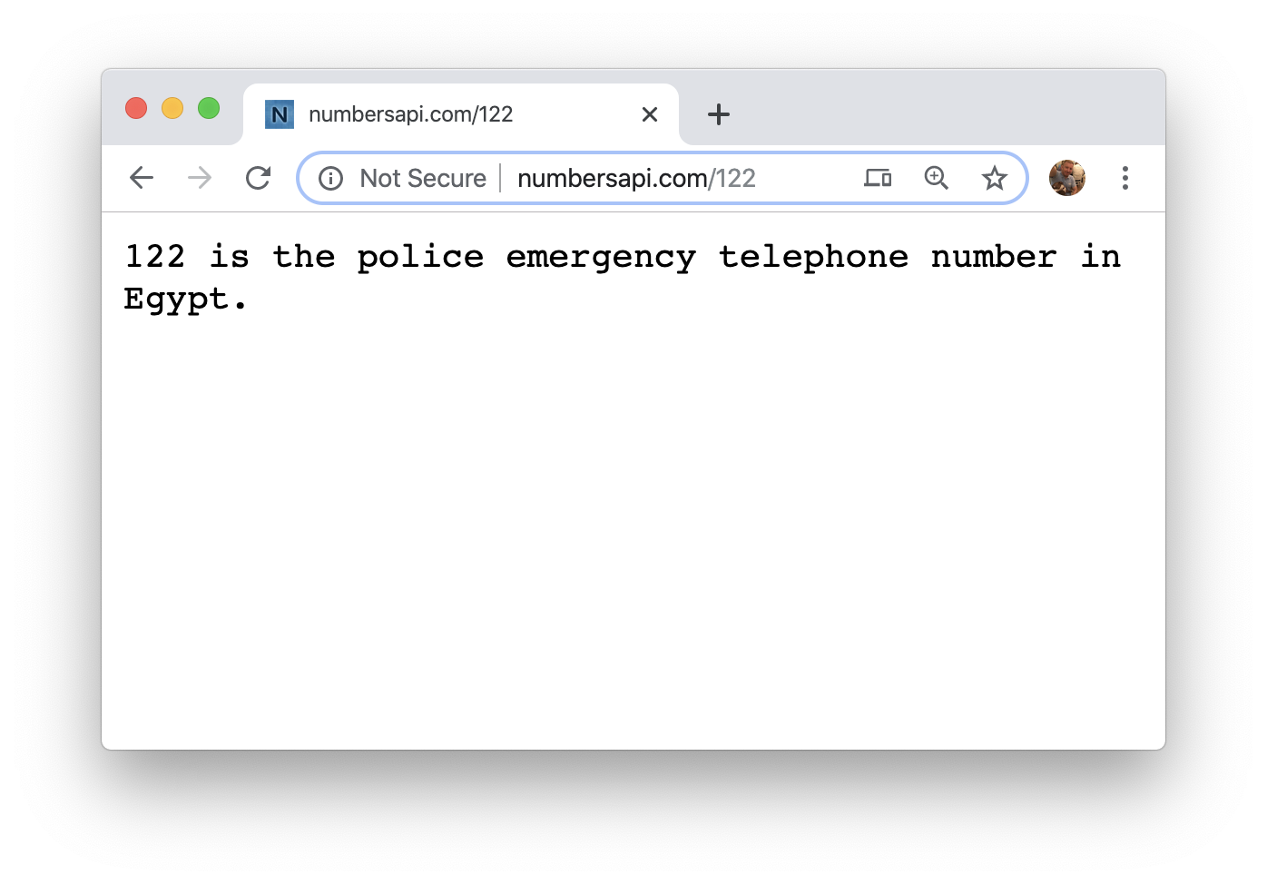
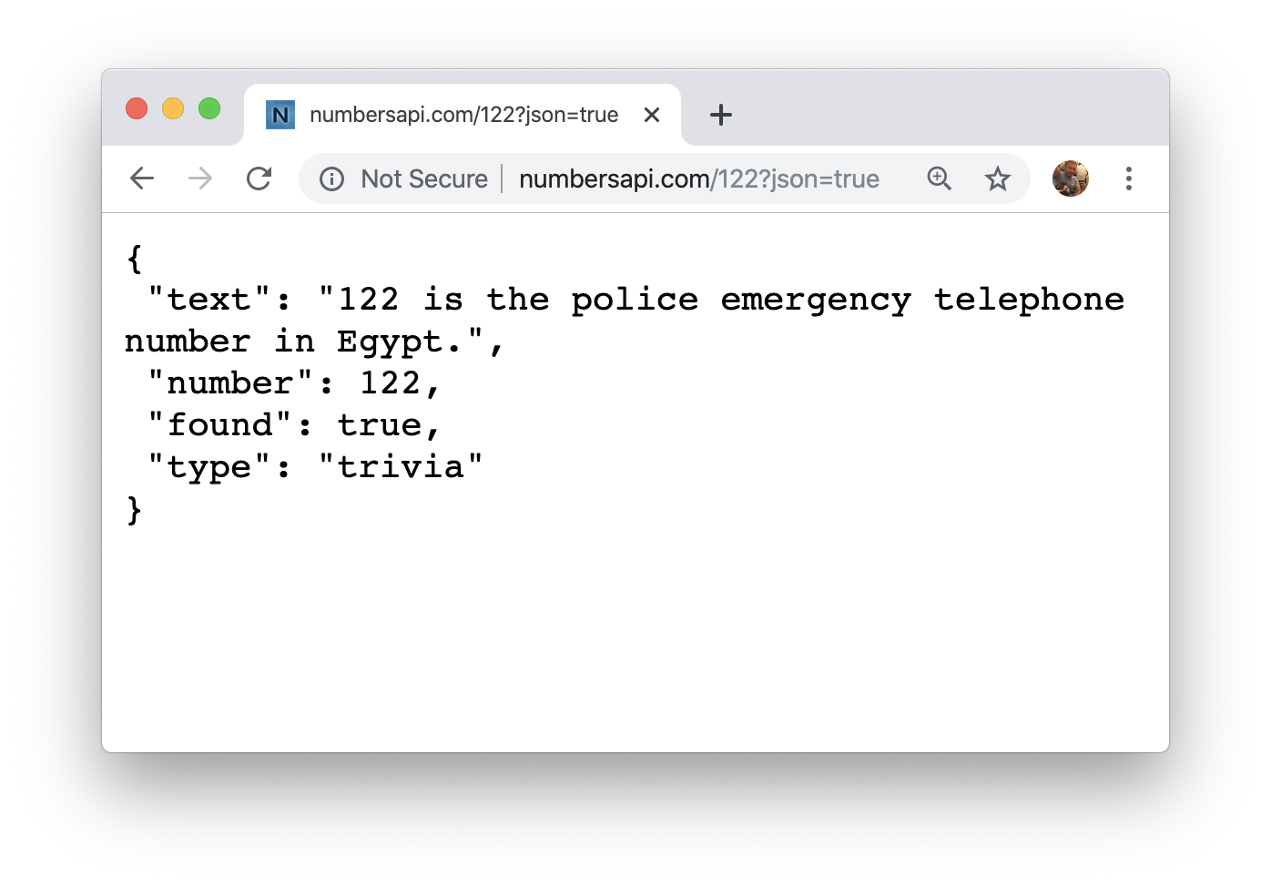
Asynchronous Data Requests
The URL used on the left fetches a plaintext resource with trivia about the number 122 and renders it once it arrives.
The URL on the right requests the same resource, formatted as JSON instead of plaintext.
In both cases, the browser opens a connection to the relevant server. It then issues a request for the resource associated with the URL, waits for the server to respond, and renders the response’s payload once it arrives.

Slide 5
Asynchronous Data Requests
Life would be terrific if we had JavaScript functionality to do the same thing a browser can—to programmatically request a resource through some URL, wait for a server response, and then process that response to suit the needs to the application.
Fortunately, life is terrific!

Slide 6
Asynchronous Data Requests
JavaScript provides built-in libraries to help asynchronously fetch resources as they’re needed. Unfortunately, they rely on JavaScript directives beyond the scope of our syllabus.
The CS106AX libraries include two classes that layer over the complexities of those built-ins so we can still asynchronously fetch new resources.
Those new classes are called AsyncRequest and AsyncResponse (modeled after libraries I used at Meta).
The code above illustrates how these classes can be used to publish some trivia about the number 538 to the console.
let req = AsyncRequest("http://number-trivia.com/538");
req.addParams({json: true});
req.setSuccessHandler(function(response) {
console.log(response.getPayload())
});
req.send();

Slide 7
AsyncRequest and AsyncResponse
Creates a request object primed to fetch a document from url.
AsyncRequest(url)
request.addParam(key, value)
Adds a key-value pair to the url’s of query string.
request.addParams(params)
Adds all key-values pairs in params to the url’s query string.
request.setSuccessHandler(callback)
Sets the callback to be executed when the server responds.
request.setErrorHandler(callback)
Sets the callback to be executed if the server fails to fetch the url.
request.send()
Initiates the request for the relevant resource.
response.getPayload()
Returns the payload from the response passed to your callback.

Slide 8
AsyncResponse and JSON.parse
The callbacks passed to request.setSuccessHandler and request.setErrorHandler should be functions that take a single argument of type AsyncResponse.
AsyncResponse exports several methods, but in a success scenario, the only one that matters is getPayload().
If the payload is formatted as a JSON string, then you should pass that string to the built-in JSON.parse function to rehydrate it into a true JavaScript object.
let req = AsyncRequest("http://number-trivia.com/222");
req.addParams({json: true});
req.setSuccessHandler(function(response) {
let payload = response.getPayload();
let info = JSON.parse(payload);
console.log("Trivia: " + info.text);
});
req.send();

Slide 9
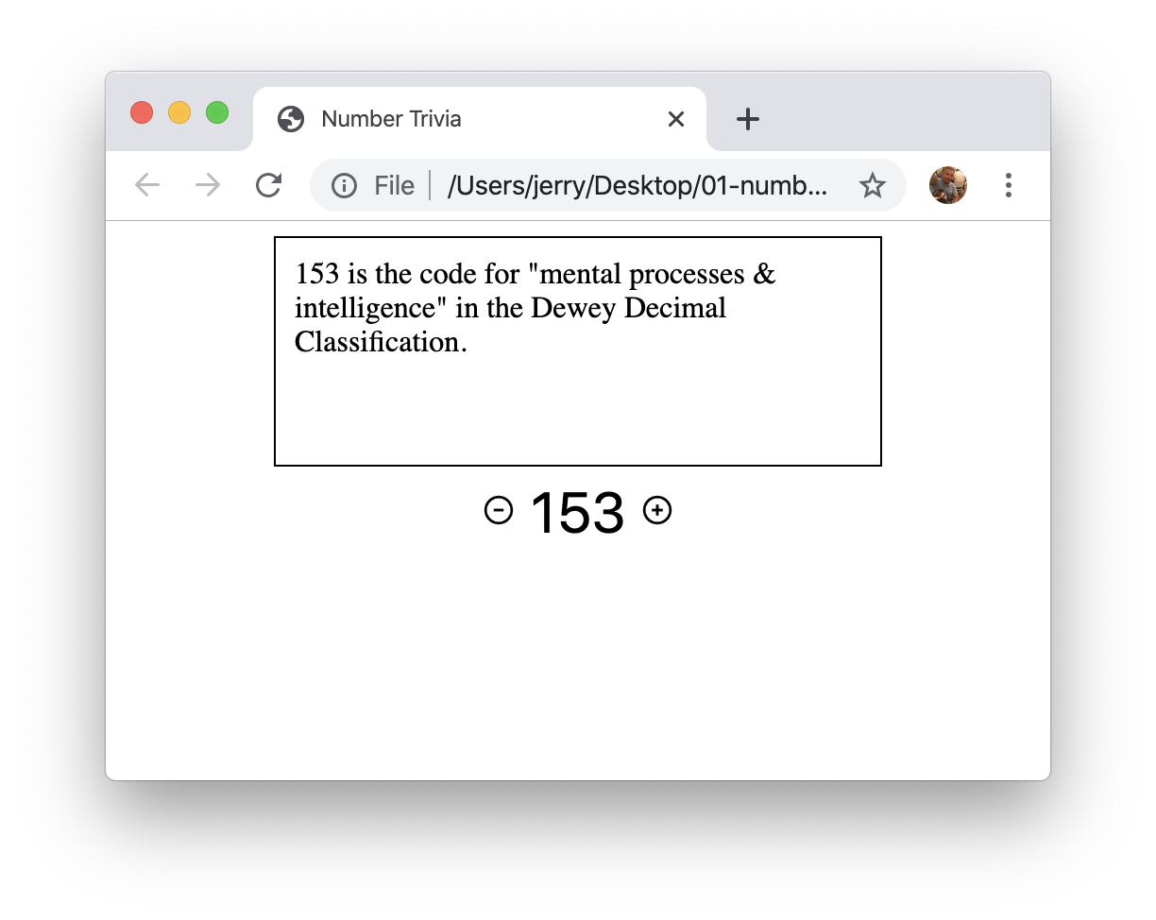
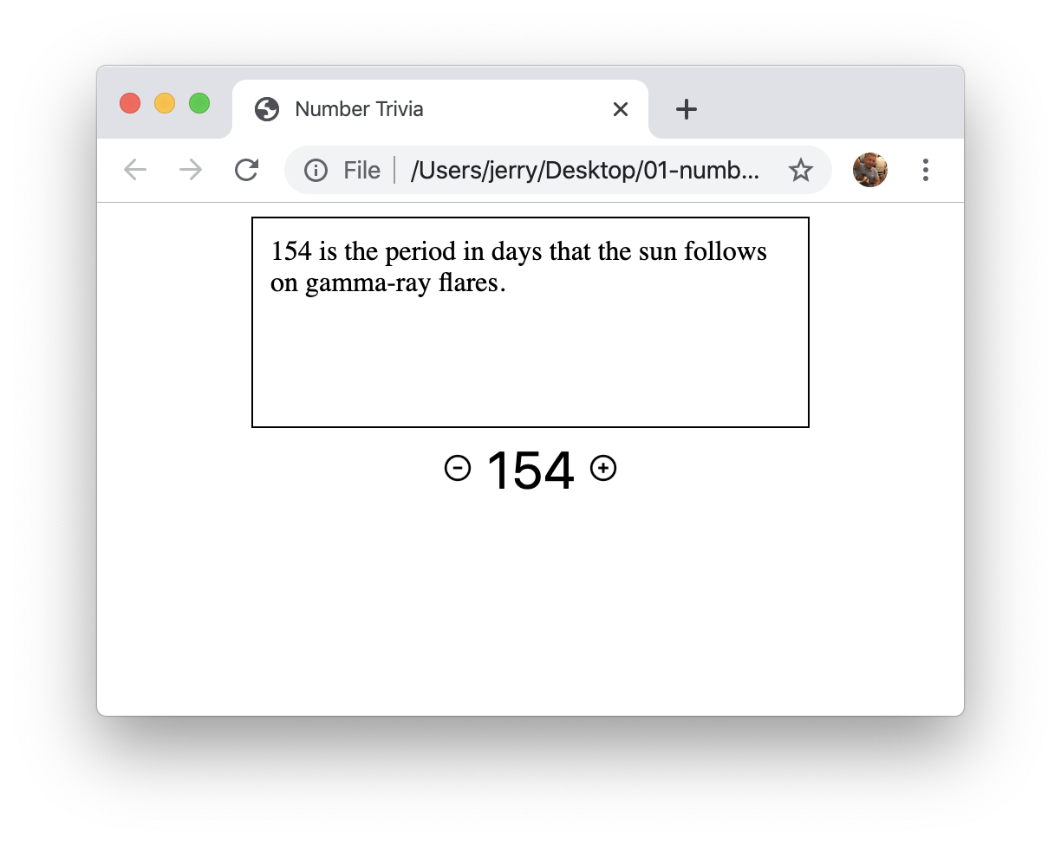
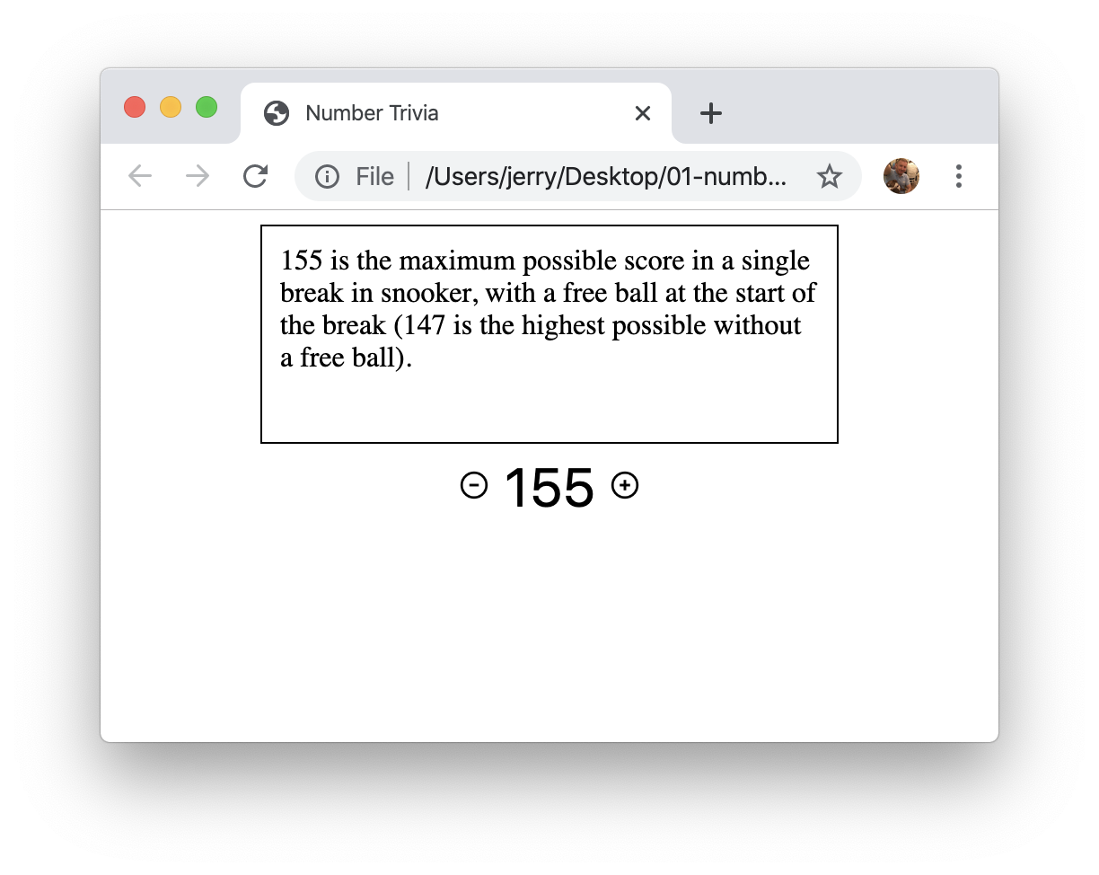
Exercise: Number Trivia Slideshow
Implement a program that generates a random number between 1 and 200 and presents a random piece of trivia about it. Allow the user to increment and decrement that number by clicking + and - buttons, and with each increment and decrement present some new morsel of information about the new number. Asynchronously fetch the trivia only as the number is being showcased.

Slide 10
Exercise: Number Trivia Slideshow
File: number-trivia.html
<!DOCTYPE html>
<html>
<head>
<meta charset="UTF-8">
<title>Number Trivia</title>
<link rel="stylesheet" type="text/css"
href="number-trivia.css">
<script type="text/javascript" src="Async.js"></script>
<script type="text/javascript" src="number-trivia.js"></script>
</head>
<body>
<div id="showcase" class="showcase"></div>
<input id="decrement-button" type="image"
src="minus.png" class="control-row"/>
<input id="number" class="control-row number"
value="42" readonly/>
<input id="increment-button" type="image"
src="plus.png" class="control-row"/>
</body>
</html>

Slide 11
Exercise: Number Trivia Slideshow
File: number-trivia.js (page 1)
function BootstrapNumberTrivia() {
/* all four variables are referenced by inner callback functions */
let contentArea = document.getElementById("showcase");
let number = document.getElementById("number");
let decrementButton = document.getElementById("decrement-button");
let incrementButton = document.getElementById("increment-button");
decrementButton.addEventListener("click", decrementNumber);
incrementButton.addEventListener("click", incrementNumber);
function showcaseTrivia(response) {
while (contentArea.childNodes.length > 0) {
contentArea.removeChild(contentArea.lastChild);
}
let info = JSON.parse(response.getPayload());
contentArea.appendChild(document.createTextNode(info.text));
}
function initiateNumberTriviaFetch() {
let req = AsyncRequest("http://number-trivia.com/" + number.value);
req.addParams({json: true});
req.setSuccessHandler(showcaseTrivia);
req.send();
}

Slide 12
Exercise: Number Trivia Slideshow
File: number-trivia.js (page 2)
function decrementNumber(e) {
incrementButton.disabled = false;
let current = parseInt(number.value) - 1;
number.value = current.toString();
if (current === 1) decrementButton.disabled = true;
initiateNumberTriviaFetch();
}
function incrementNumber(e) {
decrementButton.disabled = false;
let current = parseInt(number.value) + 1;
number.value = current.toString();
if (current === 200) incrementButton.disabled = true;
initiateNumberTriviaFetch();
}
/* seed initial presentation with a random number from [1, 200] */
number.value = (Math.floor(Math.random() * 200) + 1).toString();
initiateNumberTriviaFetch();
}
document.addEventListener("DOMContentLoaded", BootstrapNumberTrivia);

Slide 13
The End

