Slide 1
Introduction to HTTP
Jerry Cain
CS 106AX
November 17, 2025

Slide 2

The Client-Server Model, Take I
client browser
web server
https://pinterest.com
index.html
O
1. The user launches a web browser.
2. The user requests a web page.
3. The browser sends a request for the page.
4. The server sends back the requested HTML.
5. The browser interprets the HTML and renders it in the browser.

Slide 3
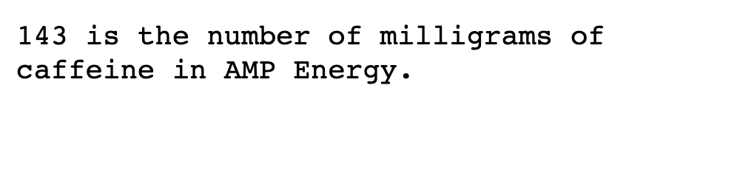
The Client-Server Model, Take II
client browser
web server
http://number-trivia.com/143
server-generated content
O
1. The user launches a web browser.
2. The user requests a document via some URL.
3. The browser sends a request for the document at that location.
4. The server synthesizes the requested document and replies with it.
5. The browser receives the document and renders it.

Slide 4
Establishing the Connection
Whenever a web browser needs some resource, it opens a network connection to the server where that resource lives.
Opening a connection to a server like www.stanford.edu or maps.google.com is akin to making a phone call, where the IP address of the host functions as the phone number.
A port number—almost always the number 80 for web servers—is used to identify the server process that’s listening for incoming web requests. Other services (e.g., email) are managed by applications listening to different port numbers.
Typically, web servers listen to port 80, secure web servers listen to port 443, email servers listen to port 993, etc.
Many port numbers between 1 and 1024 have been assigned to well known services. Those that haven’t are reserved for services that just haven’t been invented yet.

Slide 5
The Hypertext Transfer Protocol
Once the connection has been established—that is, the client has initiated the connection and the server has accepted it—the two endpoints are free to exchange data, provided the exchange respects the Hypertext Transfer Protocol, or HTTP.
In a standard exchange, the client sends over an HTTP-compliant request. The server ingests the request, processes it, and sends back an HTTP-compliant response.
  In some cases, the response is little more than the contents of a static file, like index.html or JSGraphics.js.
  Other times, the server programmatically synthesizes a response and sends that back as if the response payload were locally stored (e.g., your Google search result).

Slide 6
HTTP GET Request Structure
When we enter http://number-trivia.com/56?json=true, the browsers opens a connection to numbersapi.com, port 80, and sends a request that looks like this:
The first line is the request line contains three tokens: the method, the request path, and the protocol version.
The remaining lines are response headers—think of them as key/value pairs of a dictionary—that further inform the server how to respond.
All GET requests are terminated by a single blank line.
GET /56?json=true HTTP/1.1
Host: number-trivia.com
Cache-Control: max-age=0
Accept-Encoding: gzip, deflate
Accept-Language: en-US,en;q=0.9,fr;q=0.8
other similarly structured request headers
<blank line>

Slide 7
HTTP POST Request Structure
Whenever the browser needs to upload new data to the server, the method will be POST instead of GET, as with:
The Content-Length request header must be present, so the server knows exactly how many bytes follow the blank line.
The material after that blank line is referred to as the request payload, and it can only be present for POST requests.
The most common actions that result in POST requests are ones like secure logins, payment submissions, photo and video uploads, and so forth.
POST /scripts/addListItem.py HTTP/1.1
Host: localhost:8000
Content-Length: 41
Content-Type: application/json
other similarly structured request headers
<blank line>
"Get dry cleaning before 7:00pm closing."

Slide 8
HTTP Response Structure
HTTP responses have their own structure. Here are the two responses to each of the two requests presented earlier:
The first line is the status line that lists the protocol, the status code (200 means success, and you’ve likely seen others like 403 and 404), and a status message consistent with the code.
Everything following is structured much as HTTP requests are, except there’s almost always a payload (and hence a Content-Length response header is always included).
HTTP/1.1 200 OK
Content-Length: 136
Content-Type: application/json
other similarly structured response headers
<blank line>
{
"text": "56 is the number of curls S…
"number": 56,
"found": true,
"type": "trivia"
}
HTTP/1.1 200 Script output follows
Server: SimpleHTTP/0.6 Python/3.8.0
Date: Sun, 16 Nov 2025 04:39:35 GMT
Content-Length: 69
Content-Type: application/json
other similarly structured response headers
<blank line>
{
"id": 55,
"item": "Get dry cleaning before…
}

Slide 9
Implementing HTTP Servers
Python provides a generic HTTP server implementation that allows us to serve static resources (images, JavaScript files, etc.) and run Python scripts to dynamically generate responses.
The HTTPServer and CGIHTTPRequestHandler classes are built-ins, and the above program can be run as is. Doing so creates a server that listens for incoming requests on port 8000.
Any request path beginning with /scripts/ invokes a specific Python program that knows to programmatically synthesize a response and send it back to the client.
def runServer(port):
CGIHTTPRequestHandler.cgi_directories = ['/scripts']
server = HTTPServer(("", port), CGIHTTPRequestHandler)
server.serve_forever()
DEFAULT_PORT = 8000 # must be larger than 1024, choose 8000
runServer(DEFAULT_PORT)

Slide 10
Example: Prime Factorization Service
Let’s implement a server endpoint called factor.py that assumes assumes a single query string parameter (often called a GET parameter) called numbers and responds with an HTTP response payload that looks like this:
The implementation can assume the existence of a function called extractRequestParameter(key) that returns the string value associated with the provided key in the query string. Assume the response is formatted as JSON so the client can easily parse the response.
{
success: true,
number: 96294000,
factors: [2, 2, 2, 2, 3, 5, 5, 5, 11, 1459]
}
http://localhost:8000/scripts/factor.py?number=96294000

Slide 11
Example: Prime Factorization Service
File: factor.py
def computeFactorization(n):
factors = []
factor = 2
while n > 1:
while n % factor == 0:
factors.append(factor)
n /= factor
factor += 1
return factors
number = extractRequestParameter("number")
response = {}
response["success"] = \
number is not None and number.isdigit() and int(number) > 0
if response["success"]:
response["number"] = int(number)
response["factors"] = computeFactorization(int(number))
responsePayload = json.dumps(response)
print("Content-Length: " + str(len(responsePayload)))
print("Content-Type: application/json")
print()
print(responsePayload)

Slide 12
Example: Prime Factorization Service
The script assumes the full HTTP request has already been ingested. In fact, that’s what the HTTPServer class does.
The only thing we need from the request is the value attached to number in the query string. We rely on a function we wrote for you—extractRequestParameter—to do that.
Provided the number parameter is well-formed—that is, it’s truly a number and it’s positive so it can be factored—we tap a standard Python function that computes the prime factorization, places all factors in a list, and returns it.
Once the response dictionary has been assembled, we invoke json.dumps to generate its JSON serialization. The script publishes two response headers (Content-Length is mandatory, the other is optional if the client knows to expect JSON), followed by a blank line, followed by the payload.

Slide 13
The End

