Slide 1
Frontiers of Computer Science
Jerry Cain
CS 106AX
December 1, 2025
slides courtesy of Eric Roberts

Slide 2
CS Major Tracks
Computational Bio
AI
Visual Comp
Systems
HCI
Information

Slide 3
Artificial Intelligence

Slide 4



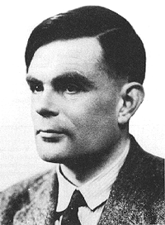
Artificial Intelligence and the Turing Test
In 1950, Alan Turing posed a thought experiment to address a question that underlies the field of Artificial Intelligence.
Computing Machinery and Intelligence
A. M. Turing
A
B
1 The Imitation Game
I propose to consider the question, ‘Can machines think?’ . . .
[A revised form of the question] can be described in terms of a game which we call the 'imitation game'. It is played with three people, a man (A), a woman (B), and an interrogator (C) who may be of either sex. The interrogator stays in a room apart from the other two. The object of the game for the interrogator is to determine which of the other two is the man and which is the woman. . . .
We now ask the question, 'What will happen when a machine takes the part of A in this game?'
C

Slide 5

A Dialogue in the Imitation Game
In his paper, Turing suggests the following as a possible dialogue between the interrogator and the unknown subject:
TuringGame
Please write me a sonnet on the subject of the Forth Bridge.
Count me out on this one. I never could write poetry.
Add 34957 to 70764.
105621.
Do you play chess?
Yes.
I have K at my K1, and no other pieces. You have only K at K6 and R at R1. It is your move. What do you play?
R-R8 mate.
Turing notes that a computer trying to fool the interrogator might wait several seconds before answering the arithmetic problem, but does not point out that the answer is incorrect.

Slide 6
Eliza
In the mid-1960s, MIT Professor Joe Weizenbaum wrote a now famous program called Eliza, which would mimic—at least in minor formulaic ways—the style of a Rogerian psychotherapist.
Eliza
Note: The Eliza program is built into GNU Emacs; to run it, type ESC-X doctor RET.

Slide 7
AI and Games

Slide 8





















Chess as the Holy Grail for AI
In 1950, Claude Shannon wrote an article for Scientific American in which he described how to write a chess-playing computer program.
Shannon’s strategy was to have the computer try every possible move for white, followed by all of black’s responses, and then all of white’s responses to those moves, and so on.
Even with modern computers, it is impossible to use this strategy for an entire game, because there are too many possibilities.
5
10
20
25
30
35
Positions evaluated:
53
~
1000
2000
3000
4000
5000
6000
7000
8000
9000
10
10
10
10
10
10
10
. . . millions of years later . . .

Slide 9


Deep Blue Beats Garry Kasparov
In 1997, IBM’s Deep Blue program beat Garry Kasparov, who was then the world champion. In 1996, Kasparov won in play that is in some ways more instructive.
Game 6
Kasparov
Deep Blue
30. b6
8
30. Bb8 ??
7
6
5
4
3
2
1
a
b
c
d
e
f
g
h

Slide 10
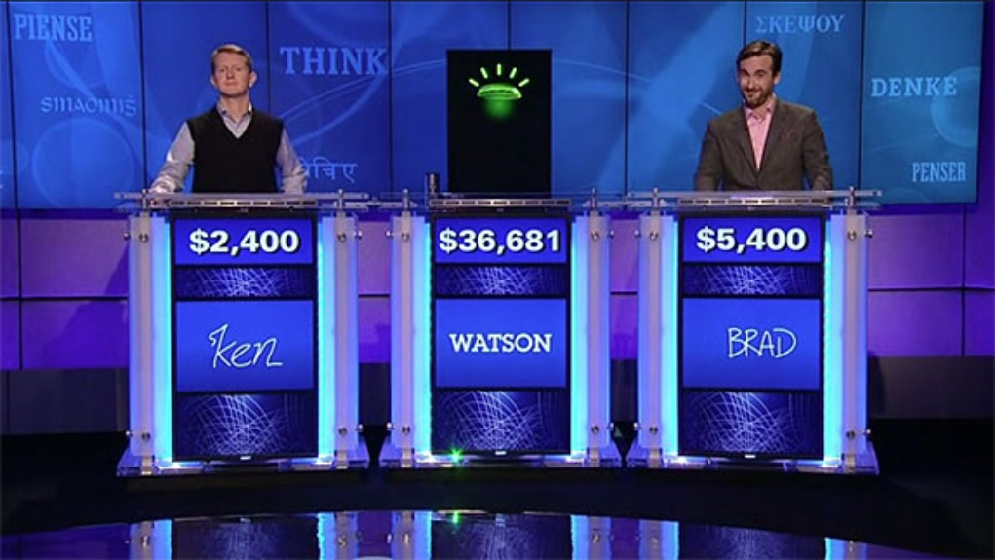
Watson Wins Jeopardy

Slide 11

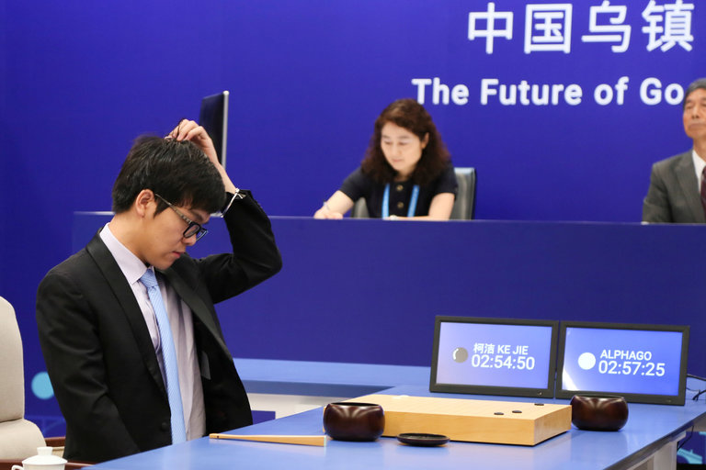
AlphaGo Beats the World Champion
Google’s AlphaGo Defeats Chinese Go Master in Win for A.I.
Ke Jie, the world’s top Go player, reacting during his match on Tuesday against AlphaGo, artificial intelligence software developed by a Google affiliate.

Slide 12
Machine Learning

Slide 13
Unsupervised Learning
The goal of unsupervised learning is to find patterns even in the absence of a training set.
The most common applications of unsupervised learning involve clustering, which is the process of dividing a data set into some number of independent, closely related clusters.
As an example, if you have plotted a set of points as shown in the x-y grid at the bottom of the slide, unsupervised learning should be able to identify the three groups based on locality.

Slide 14
K-Means Clustering Algorithm
One of the most common strategies for clustering data points is the k-means algorithm, which partitions a set into k clusters.
The k-means algorithm requires the following steps:
1.
  Choose k data points at random to serve as the initial centers of the clusters. These points are called means.
2.
  Assign each point to the closest mean.
3.
  Move each mean to the geometric center of its points.
4.
  Repeat steps 2 and 3 until the means stop changing.

Slide 15

A Larger Clustering Example (k = 5)
Cygnus
Little Dipper
Lyra
Big Dipper
Scorpius
1. Choose five random points as the initial means.
2. Assign each point to the closest mean.
3. Move each mean to the geometric center of its points.

Slide 16
Neural Networks
In AI today, the hot topic is neural networks, which are collections of nodes that simulate neurons in the brain.
Neural networks contain an input layer that provides a stimulus, an output layer that registers the results, and some number of hidden layers between the two.
input
layer
hidden
layers
output
layer
Neural networks learn by updating the weights in the neurons through a process called back propagation.

Slide 17
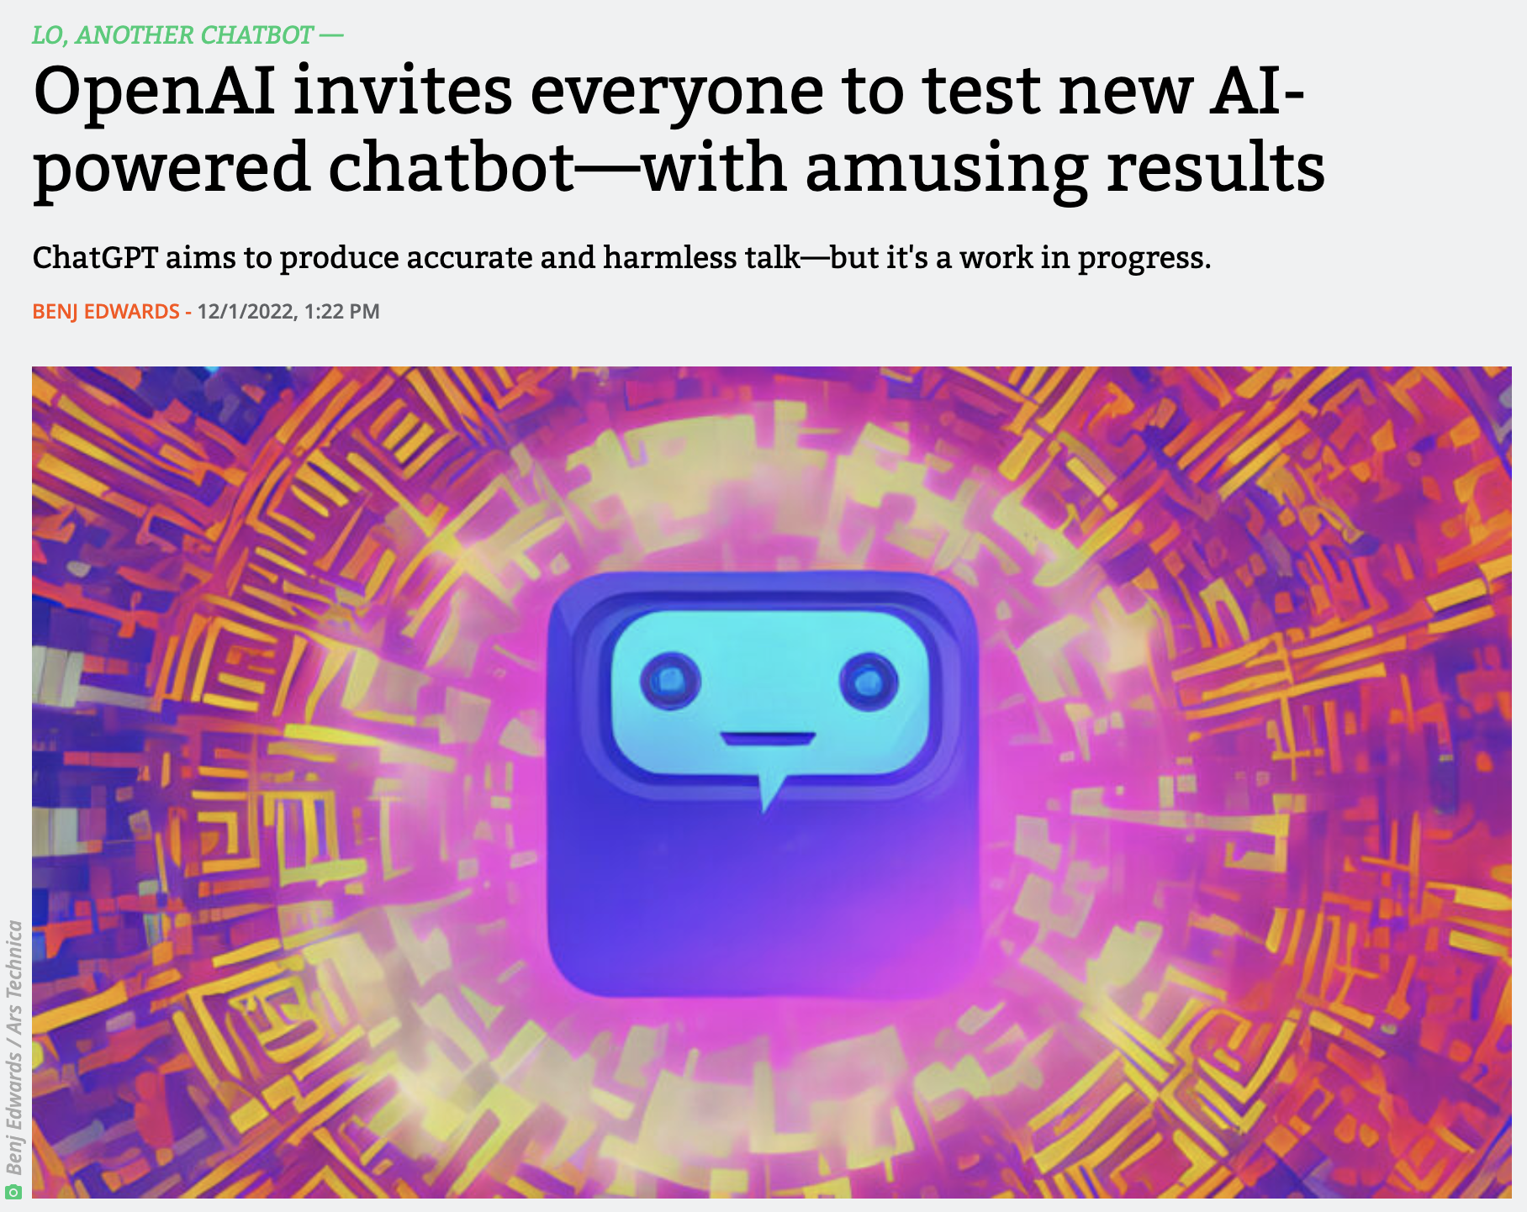
Generative Pre-trained Transformer: Chat
"We’ve trained a model called ChatGPT which interacts in a conversational way. The dialogue format makes it possible for ChatGPT to answer followup questions, admit its mistakes, challenge incorrect premises, and reject inappropriate requests. ChatGPT is a sibling model to InstructGPT, which is trained to follow an instruction in a prompt and provide a detailed response."
https://openai.com/blog/chatgpt/

Slide 18
Robotics

Slide 19

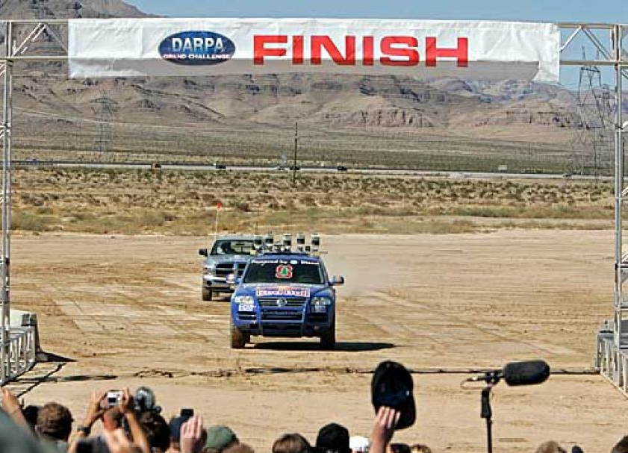
Stanley’s Victory in the Desert
Sunday, October 9, 2005
NEVADA DESERT / Computers, start your engines / Stanford team apparent winners in robot car race
Tom Abate, Chronicle Staff Writer
Chronicle/Kurt Rogers
Primm, Nev. -- Stanford engineers steered the world toward a new era of driverless vehicles Saturday when their robotic Volkswagen SUV was the first to cross the finish line after a 132-mile race across the Nevada desert.
The Stanford car, nicknamed Stanley, unofficially edged out two robotic Hummers from Carnegie Mellon University. The three vehicles were competitors in a race sponsored by the Defense Advanced Research Projects Agency. DARPA, which backed the early research behind the Internet, drummed up interest in the race by offering $2 million to the first team to complete the course in less than 10 hours.

Slide 20
Computational Biology

Slide 21
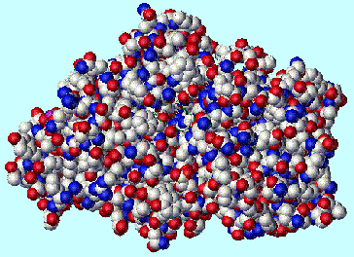
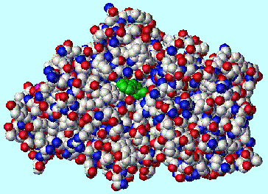

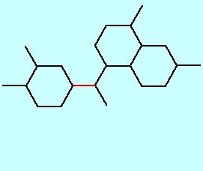
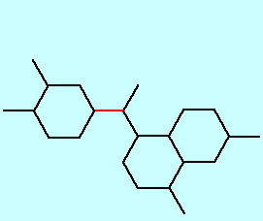
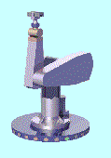
Computer-Assisted Pharmaceutical Design
—Professors Jean-Claude Latombe and Lydia Kavraki
Designing new therapeutic drugs is an expensive, time-consuming process, in which computation can be of tremendous value.
Most proteins are large molecules with a rigid, complex structure.
Many drugs operate by blocking a reaction site in a protein. Such inhibitor drugs tend to be small and flexible.
Understanding whether a drug molecule can fit into a reaction site is analogous to determining whether a robot arm can move in a particular way.

Slide 22
Visual Computing

Slide 23

Marc Levoy’s Graphics Projects
http://graphics.stanford.edu/projects/mich/

Slide 24
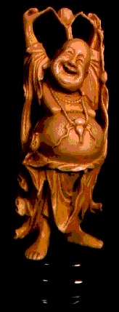
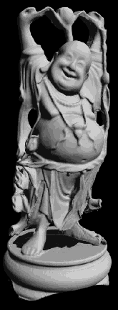
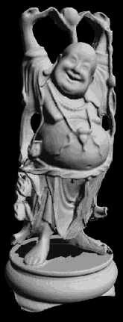
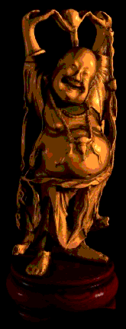
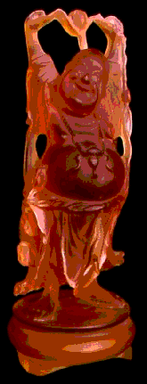
The 3-D Fax Machine
1. Start with a statue of the Happy Buddha.
2. Use laser range scanning to produce a triangle mesh from a single perspective.
3. Merge scans from different perspectives.
4. Construct a digital model using shaded rendering.
5. Use stereolithography to construct a lucite copy.
http://graphics.stanford.edu/projects/faxing/

Slide 25
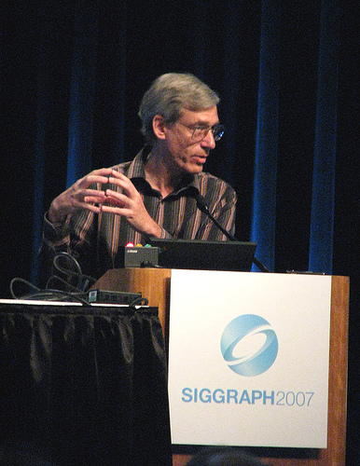
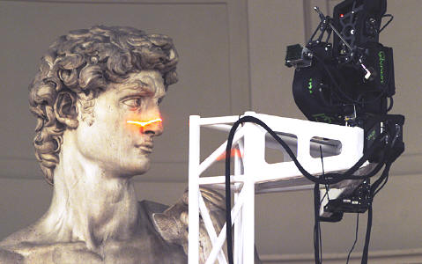
Scanning Michelangelo’s David
In 1999, Professor Marc Levoy spent a year at Stanford’s Overseas Studies campus in Florence, at which he and the approximately 30 students who spent at least part of their year there used the technology developed for the 3-D fax machine project to scan the Michelangelo sculptures open to the public.
The laser range-scanning technology allowed Marc to construct a model of each statue with sub-millimeter accuracy — accurate enough to tell when the sculptor changed chisels. This data makes it possible to view statues from any perspective and to analyze them mathematically.

Slide 26
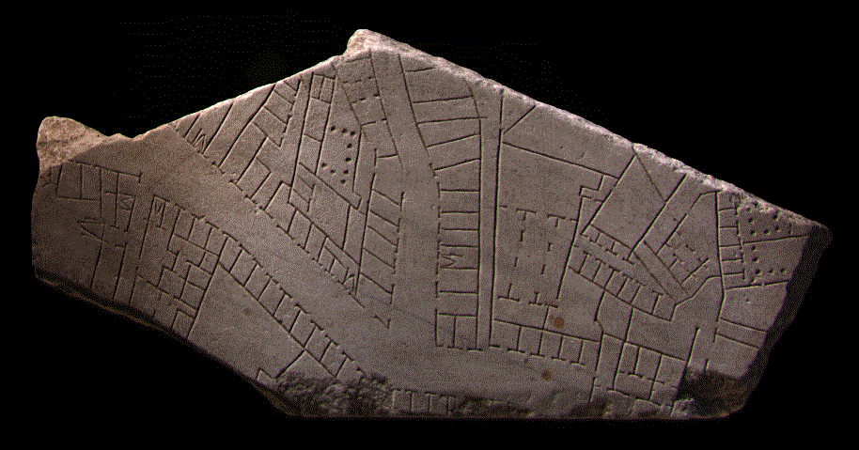
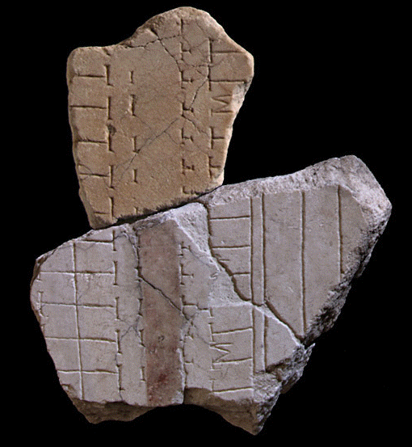
The Forma Urbis Romae Project
While in Italy, Professor Levoy and his students also scanned fragments of the Forma Urbis Romae, a huge marble map from the 3rd century AD that is now a jigsaw puzzle with 1,186 pieces.
Scanning the fragments makes it possible to use computational techniques to reassemble the pieces of the puzzle. The first match found by Levoy’s team is shown at the left. Since that time, the Stanford group has been able to determine the placement of missing pieces at a far faster rate than was previously possible.
http://graphics.stanford.edu/projects/forma-urbis/

Slide 27
Thank You!

