Slide 1

Programming Fundamentals in C++
What programming language are you most comfortable with?
(put your answers in the chat)

Slide 2
Roadmap
Object-Oriented Programming
Roadmap graphic courtesy of Nick Bowman & Kylie Jue
C++ basics
Implementation
User/client
vectors + grids
stacks + queues
sets + maps
arrays
dynamic memory
management
linked data structures
real-world algorithms
Diagnostic
Life after CS106B!
Core Tools
algorithmic analysis
recursive problem-solving
testing

Slide 3
Roadmap
Object-Oriented Programming
C++ basics
Implementation
User/client
vectors + grids
stacks + queues
sets + maps
arrays
dynamic memory
management
linked data structures
real-world algorithms
Diagnostic
Life after CS106B!
Core Tools
algorithmic analysis
recursive problem-solving
testing

Slide 4
Today’s questions
Why C++?
What do core programming fundamentals look like in C++?
What’s next?

Slide 5
Why C++?

Slide 6
Review: How is C++ different from other languages?
C++ is a compiled language (vs. interpreted)
  This means that before running a C++ program, you must first compile it to machine code.

Slide 7
Review: How is C++ different from other languages?
C++ is a compiled language (vs. interpreted)
C++ gives us access to lower-level computing resources (for example, more direct control over computer memory)
  This makes it a great tool for better understanding abstractions!

Slide 8
Review: How is C++ different from other languages?
C++ is a compiled language (vs. interpreted)
C++ gives us access to lower-level computing resources (for example, more direct control over computer memory)
If you’re coming from a language like Python, the syntax will take some getting used to.
  Like learning the grammar and rules of a new language, typos are expected. But don’t let this get in the way of working toward literacy!

Slide 9
Review: How is C++ different from other languages?
C++ is a compiled language (vs. interpreted)
C++ gives us access to lower-level computing resources (for example, more direct control over computer memory)
If you’re coming from a language like Python, the syntax will take some getting used to.

Slide 10
Quick Survey!
Where does C++ rank among the popular programming languages of the world?
(Put answers in chat – 1st? 2nd? 10th?)

Slide 11
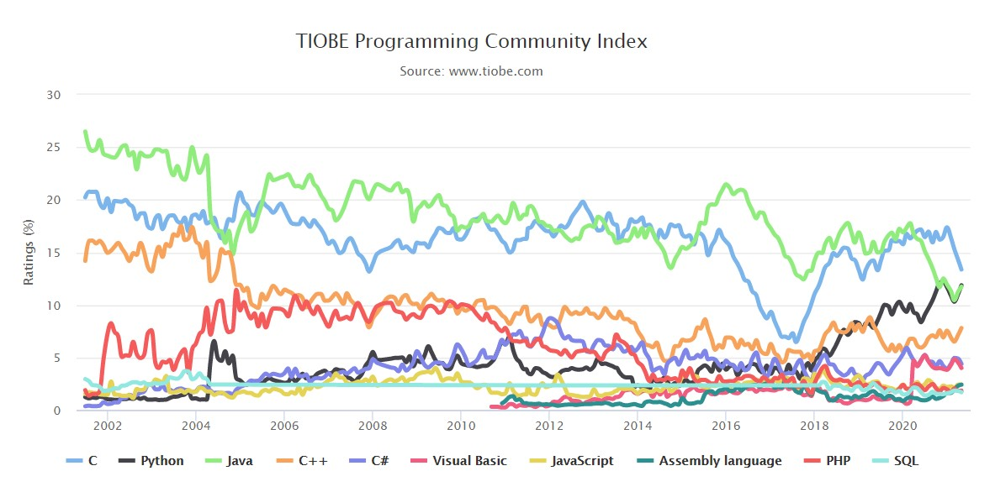

Slide 12
C++ Overview
If someone claims to have the perfect programming language,
he is either a fool or a salesman or both.
– Bjarne Stroustrup, Inventor of C++

Slide 13
C++ History
C++ is a high-performance, robust (and complex) language built on top of the C programming language (originally named C with Classes)
  Bjarne Stroustrup, the inventor of C++, chose to build on top of C because it was fast, powerful, and widely-used

Slide 14
C++ History
C++ is a high-performance, robust (and complex) language built on top of the C programming language (originally named C with Classes)
  Bjarne Stroustrup, the inventor of C++, chose to build on top of C because it was fast, powerful, and widely-used
C++ has been an object-oriented language from the beginning
  We will spend the middle portion of this class talking about the paradigm of object-oriented programming

Slide 15
C++ History
C++ is a high-performance, robust (and complex) language built on top of the C programming language (originally named C with Classes)
  Bjarne Stroustrup, the inventor of C++, chose to build on top of C because it was fast, powerful, and widely-used
C++ has been an object-oriented language from the beginning
  We will spend the middle portion of this class talking about the paradigm of object-oriented programming
C++ is quite mature and has become complex enough that it is challenging to master the language
  Our goal in this class will be to help you become literate in C++ as a second programming language

Slide 16
C++ History
C++ is a high-performance, robust (and complex) language built on top of the C programming language (originally named C with Classes)
  Bjarne Stroustrup, the inventor of C++, chose to build on top of C because it was fast, powerful, and widely-used
C++ has been an object-oriented language from the beginning
  We will spend the middle portion of this class talking about the paradigm of object-oriented programming
C++ is quite mature and has become complex enough that it is challenging to master the language
  Our goal in this class will be to help you become literate in C++ as a second programming language

Slide 17
C++ Benefits and Drawbacks
Benefits

Slide 18
C++ Benefits and Drawbacks
Benefits
C++ is fast
  Get ready for the Python vs C++ speed showdown during Assignment 1!

Slide 19
C++ Benefits and Drawbacks
Benefits
C++ is fast
  Get ready for the Python vs C++ speed showdown during Assignment 1!
C++ is popular
  Many companies and research projects use C++ and it is common for coding interviews to be conducted in C++

Slide 20
C++ Benefits and Drawbacks
Benefits
C++ is fast
  Get ready for the Python vs C++ speed showdown during Assignment 1!
C++ is popular
  Many companies and research projects use C++ and it is common for coding interviews to be conducted in C++
C++ is powerful
  C++ brings you closer to the raw computing power that your computer has to offer

Slide 21
C++ Benefits and Drawbacks
Benefits
C++ is fast
  Get ready for the Python vs C++ speed showdown during Assignment 1!
C++ is popular
  Many companies and research projects use C++ and it is common for coding interviews to be conducted in C++
C++ is powerful
  C++ brings you closer to the raw computing power that your computer has to offer
Drawbacks

Slide 22
C++ Benefits and Drawbacks
Benefits
C++ is fast
  Get ready for the Python vs C++ speed showdown during Assignment 1!
C++ is popular
  Many companies and research projects use C++ and it is common for coding interviews to be conducted in C++
C++ is powerful
  C++ brings you closer to the raw computing power that your computer has to offer
Drawbacks
C++ is complex
  We will rely on the Stanford C++ libraries to provide a friendlier level of abstraction
  In the future, you may choose to explore the standard libraries

Slide 23
C++ Benefits and Drawbacks
Benefits
C++ is fast
  Get ready for the Python vs C++ speed showdown during Assignment 1!
C++ is popular
  Many companies and research projects use C++ and it is common for coding interviews to be conducted in C++
C++ is powerful
  C++ brings you closer to the raw computing power that your computer has to offer
Drawbacks
C++ is complex
  We will rely on the Stanford C++ libraries to provide a friendlier level of abstraction
  In the future, you may choose to explore the standard libraries
C++ can be dangerous
  "With great power comes great responsibility"

Slide 24
What do core programming fundamentals look like in C++?

Slide 25
What do core programming fundamentals look like in C++?
Get ready for a whirlwind tour!

Slide 26
Comments, Includes, and Console Output

Slide 27
Comments
Single-line comments
// Two forward slashes comment out the rest of the line
cout << "Hello, World!" << endl; // everything past the double-slash is a comment
Multi-line comments
/* This is a multi-line comment.
* It begins and ends with an asterisk-slash.
*/

Slide 28
Includes
Utilizing code written by other programmers is one of the most powerful things that you can do when writing code.
In order to make the compiler aware of other code libraries or other code files that you want to use, you must include a header file. There are two ways that you can do so:
  #include <iostream>
    Use of the angle bracket operators is usually reserved for code from the C++ Standard library
  #include "console.h"
    Use of the quotes is usually reserved for code from the Stanford C++ libraries, or code in files that you have written yourself

Slide 29
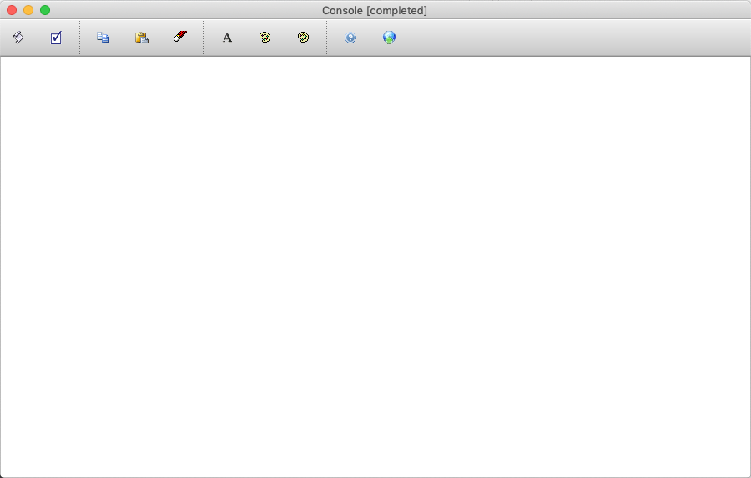
Console Output
The console is the main venue that we will use in this class to communicate information from a program to the user of the program.

Slide 30
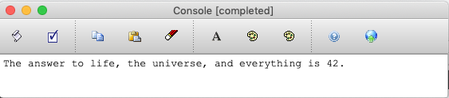
Console Output
The console is the main venue that we will use in this class to communicate information from a program to the user of the program.
In C++, the way that you get information to the console is by using the cout keyword and angle bracket operators (<<).
cout << "The answer to life, the universe, and everything is " << 42 << "." << endl;

Slide 31
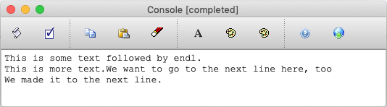
Console Output
The console is the main venue that we will use in this class to communicate information from a program to the user of the program.
In C++, the way that you get information to the console is by using the cout keyword and angle bracket operators (<<).
The endl is necessary to put the cursor on a different line. Here is an example with and without the endl keyword.
cout << "This is some text followed by endl." << endl;
cout << "This is more text.";
cout << "We want to go to the next line here, too" << endl;
cout << "We made it to the next line." << endl;

Slide 32
Console Output
The console is the main venue that we will use in this class to communicate information from a program to the user of the program.
In C++, the way that you get information to the console is by using the cout keyword and angle bracket operators (<<).
The endl is necessary to put the cursor on a different line. Here is an example with and without the endl keyword.
cout << "This is some text followed by endl." << endl;
cout << "This is more text.";
cout << "We want to go to the next line here, too" << endl;
cout << "We made it to the next line." << endl;
Note: In C++, all programming statements must end in a semicolon.

Slide 33
Variables and Types

Slide 34
Variables
A way for code to store information by associating a value with a name

Slide 35

Variables
A way for code to store information by associating a value with a name
106
classNum
76.7
tuesdayTemp

Slide 36
Variables
A way for code to store information by associating a value with a name
We will think of a variable as a named container storing a value.
106
classNum
76.7
tuesdayTemp

Slide 37
Variables
A way for code to store information by associating a value with a name
Note: C++ uses the camelCase naming convention
106
classNum
76.7
tuesdayTemp

Slide 38
Variables
A way for code to store information by associating a value with a name
Variables are perhaps one of the most fundamental aspects of programming! Without variables, the expressive power of our computer programs would be severely degraded.

Slide 39
Types
As you should know from prior programming classes, all variables have a type associated with them, where the type describes the representation of the variable.

Slide 40
Types
As you should know from prior programming classes, all variables have a type associated with them, where the type describes the representation of the variable.
Examples of types in C++
  int
42
106
-3

Slide 41
Types
As you should know from prior programming classes, all variables have a type associated with them, where the type describes the representation of the variable.
Examples of types in C++
  int
  double
1.06
4.00
-18.3454545

Slide 42
Types
As you should know from prior programming classes, all variables have a type associated with them, where the type describes the representation of the variable.
Examples of types in C++
  int
  double
  string
"Hello, World!"
"CS106B"
"I love computer science <3"

Slide 43
Types
As you should know from prior programming classes, all variables have a type associated with them, where the type describes the representation of the variable.
Examples of types in C++
  int (or long)
  double
  string
  char
'a'
'&'
'3'

Slide 44
Types
As you should know from prior programming classes, all variables have a type associated with them, where the type describes the representation of the variable.
Examples of types in C++
  int (or long)
  double
  string
  char
In C++, all types must be explicitly defined when the variable is created, and a variable cannot change its type.

Slide 45
Typed Variables
int
int a; // declare a new integer variable
a

Slide 46
Typed Variables
int
5
int a; // declare a new integer variable
a = 5; // initialize the variable value
a

Slide 47
Typed Variables
int
5
int a; // declare a new integer variable
a = 5; // initialize the variable value
char b = 'x'; // b is a char ("character")
char
'x'
a
b

Slide 48
Typed Variables
int
5
int a; // declare a new integer variable
a = 5; // initialize the variable value
char c = 'x'; // c is a char ("character")
double d = 1.06; // d is a double, a type used to represent decimal numbers
char
'x'
a
c
double
1.06
d

Slide 49
Typed Variables
int
5
int a; // declare a new integer variable
a = 5; // initialize the variable value
char c = 'x'; // c is a char ("character")
double d = 1.06; // d is a double, a type used to represent decimal numbers
string s = "this is a C++ string";
char
'x'
a
c
double
1.06
string
"this is a C++ string"
d
s

Slide 50
Typed Variables
int
5
int a; // declare a new integer variable
a = 5; // initialize the variable value
char c = 'x'; // b is a char ("character")
double d = 1.06; // d is a double, a type used to represent decimal numbers
string s = "this is a C++ string";
double a = 4.2; // ERROR! You cannot redefine a variable to be another type
char
'x'
a
c
double
1.06
string
"this is a C++ string"
d
s

Slide 51
Typed Variables
int
5
int a; // declare a new integer variable
a = 5; // initialize the variable value
char c = 'x'; // b is a char ("character")
double d = 1.06; // d is a double, a type used to represent decimal numbers
string s = "this is a C++ string";
double a = 4.2; // ERROR! You cannot redefine a variable to be another type
int a = 12; // ERROR! You do not need the type when re-assigning a variable
char
'x'
a
c
double
1.06
string
"this is a C++ string"
d
s

Slide 52
Typed Variables
int
12
int a; // declare a new integer variable
a = 5; // initialize the variable value
char c = 'x'; // b is a char ("character")
double d = 1.06; // d is a double, a type used to represent decimal numbers
string s = "this is a C++ string";
double a = 4.2; // ERROR! You cannot redefine a variable to be another type
int a = 12; // ERROR! You do not need the type when re-assigning a variable
a = 12; // this is okay, updates variable value
char
'x'
a
c
double
1.06
string
"this is a C++ string"
d
s

Slide 53
Functions and Parameters

Slide 54
Anatomy of a function
function(input)
input
output

Slide 55

Anatomy of a function
function(input)
input
output
parameters /
arguments

Slide 56
Anatomy of a function
function(input)
input
output
Definition
parameter(s)
One or more variables that your function expects as input
parameters /
arguments

Slide 57
Anatomy of a function
function(input)
input
output
Definition
argument(s)
The values passed into your function and assigned to its parameter variables
parameters/
arguments

Slide 58
Anatomy of a function
function(input)
input
output
return value

Slide 59
Anatomy of a function
function(input)
input
output
Definition
return value
The value that your function hands back to the “calling” function
return value

Slide 60
Anatomy of a function
function(input)
input
output
parameters/
arguments
return value

Slide 61
Anatomy of a function
returnType functionName(varType parameter1, varType parameter2, ...);
function prototype

Slide 62
Anatomy of a function
returnType functionName(varType parameter1, varType parameter2, ...);
function name

Slide 63
Anatomy of a function
returnType functionName(varType parameter1, varType parameter2, ...);
input expected (parameters)

Slide 64
Anatomy of a function
returnType functionName(varType parameter1, varType parameter2, ...);
Notice that these look very similar to variable declarations! You can think of parameters as a special set of local variables that belong to a function.
input expected (parameters)

Slide 65
Anatomy of a function
returnType functionName(varType parameter1, varType parameter2, ...);
output expected (return type)

Slide 66
Anatomy of a function
returnType functionName(varType parameter1, varType parameter2, ...);
How do you designate a function that doesn't return a value? You can use the special void keyword. Note that this type is only applicable for return types, not parameters/variables.
output expected (return type)

Slide 67
Anatomy of a function
returnType functionName(varType parameter1, varType parameter2, ...);
returnType functionName(varType parameter1, varType parameter2, ...) {
returnType variable = /* Some fancy code. */
/* Some more code to actually do things. */
return variable;
}
function definition

Slide 68
Anatomy of a function
returnType functionName(varType parameter1, varType parameter2, ...);
returnType functionName(varType parameter1, varType parameter2, ...) {
returnType variable = /* Some fancy code. */
/* Some more code to actually do things. */
return variable;
}
returned value

Slide 69
Function Example
double average(double a, double b){
double sum = a + b;
return sum / 2;
}
int main(){
double mid = average(10.6, 7.2);
cout << mid << endl;
return 0;
}

Slide 70
Function Example
double average(double a, double b){
double sum = a + b;
return sum / 2;
}
int main(){
double mid = average(10.6, 7.2);
cout << mid << endl;
return 0;
}
Order matters! A function must always be defined before it is called.

Slide 71
Function Example
double average(double a, double b){
double sum = a + b;
return sum / 2;
}
int main(){
double mid = average(10.6, 7.2);
cout << mid << endl;
return 0;
}
callee
(called function)
caller
(calling function)

Slide 72
Function Example
double average(double a, double b){
double sum = a + b;
return sum / 2;
}
int main(){
double mid = average(10.6, 7.2);
cout << mid << endl;
return 0;
}
parameters
return value
arguments

Slide 73
Function Example
double average(double a, double b){
double sum = a + b;
return sum / 2;
}
int main(){
double mid = average(10.6, 7.2);
cout << mid << endl;
return 0;
}
double
10.6
a
7.2
double
b
double
17.8
sum

Slide 74
Function Example
double average(double a, double b){
double sum = a + b;
return sum / 2;
}
int main(){
double mid = average(10.6, 7.2);
cout << mid << endl;
return 0;
}
double
10.6
a
These variables only exist inside average()!
7.2
double
b
double
17.8
sum

Slide 75
Function Example
double average(double a, double b){
double sum = a + b;
return sum / 2;
}
int main(){
double mid = average(10.6, 7.2);
cout << mid << endl;
return 0;
}
double
8.9
mid

Slide 76
Function Example
double average(double a, double b){
double sum = a + b;
return sum / 2;
}
int main(){
double mid = average(10.6, 7.2);
cout << mid << endl;
return 0;
}
double
8.9
mid
This variable only exists inside main()!

Slide 77
Pass by Value
// C++:
#include<iostream>
using namespace std;
int doubleValue(int x) {
x *= 2;
return x;
}
int main() {
int myValue = 5;
int result = doubleValue(myValue);
cout << "myValue: " << myValue << " ";
cout << "result: " << result << endl;
}
Poll!
What is the console output of this block of code?

Slide 78
Pass by Value
// C++:
#include<iostream>
using namespace std;
int doubleValue(int x) {
x *= 2;
return x;
}
int main() {
int myValue = 5;
int result = doubleValue(myValue);
cout << "myValue: " << myValue << " ";
cout << "result: " << result << endl;
}
myValue: 5 result: 10
Why is this the case?

Slide 79
Pass by Value
The reason for the output is that the parameter x was passed to the doubleValue function by value, meaning that the variable x is a copy of the variable passed in. Changing it inside the function does not change the value in the calling function.
Pass-by-value is the default mode of operation when it comes to parameters in C++
C++ also supports a different, more nuanced way of passing parameters – we will see this tomorrow!
// C++:
#include<iostream>
using namespace std;
int doubleValue(int x) {
x *= 2;
return x;
}
int main() {
int myValue = 5;
int result = doubleValue(myValue);
cout << "myValue: " << myValue << " ";
cout << "result: " << result << endl;
}

Slide 80
What Questions do You Have?

Slide 81
Mid-Lecture Announcements Break!

Slide 82
Announcements
Fill out your section time preferences by today at 5pm PDT.
  Make sure to check what time you’ve been assigned tomorrow morning.
Finish Assignment 0 by tomorrow (Wednesday) at 11:59 pm PDT.
  If you’re running into issues with Qt Creator, come to LaIR tonight between 7-9pm PDT or a special Qt Installation Help Session tomorrow from 9-10am PDT. Join LaIR to get help.
Assignment 1 will be released later today, and after this lecture is over, you will have the skills you need to get started on the first part!
  There be a YEAH (Your Early Assignment Help) session held for Assignment 1 tomorrow (6/23) right after lecture (3:00PM PT). A link will be available on the “zoom details” page on the website.

Slide 83
Control Flow

Slide 84
Boolean Expressions
Expression | Meaning
a < b | a is less than b
a <= b | a is less than or equal to b
a > b | a is greater than b
a >= b | a is greater than or equal to b
a == b | a is equal to b
a != b | a is not equal to b
Operator | Meaning
a && b | Both a AND b are true
a || b | Either a OR b are true
!a | If a is true, returns false, and vice-versa

Slide 85
Conditional Statements
The C++ if statement tests a boolean expression and runs a block of code if the expression is true, and, optionally, runs a different block of code if the expression is false. The if statement has the following format:
if (expression) {
statements if expression is true
} else {
statements if expression is false
}
Note: The parentheses around expression are required.

Slide 86
Conditional Statements
The C++ if statement tests a boolean expression and runs a block of code if the expression is true, and, optionally, runs a different block of code if the expression is false. The if statement has the following format:
if (expression) {
statements if expression is true
} else {
statements if expression is false
}
Note: The parentheses around expression are required.
In Python, a block is defined as an indentation level, where whitespace is important. C++ does not have any whitespace restrictions, so blocks are denoted with curly braces, { to begin a block, and } to end a block.
Blocks are used primarily for conditional statements, functions, and loops.

Slide 87
Conditional Statements
The C++ if statement tests a boolean expression and runs a block of code if the expression is true, and, optionally, runs a different block of code if the expression is false. The if statement has the following format:
Additional else if statements can be used to check for additional conditions as well
if (expression) {
statements if expression is true
} else {
statements if expression is false
}
if (expression1) {
statements if expression1 is true
} else if (expression2) {
statements if expression2 is true
} else {
statements if neither expression1 nor expression2 is true
}

Slide 88
while loops
Loops allow you to repeat the execution of a certain block of code multiple times

Slide 89
while loops
Loops allow you to repeat the execution of a certain block of code multiple times
while loops are great when you want to continue executing something until a certain condition is met and you don't know exactly how many times you want to iterate for

Slide 90
while loops
Loops allow you to repeat the execution of a certain block of code multiple times
while loops are great when you want to continue executing something until a certain condition is met and you don't know exactly how many times you want to iterate for
while (expression) {
statement;
statement;
...
}
Execution continues until expression evaluates to false

Slide 91
while loops
Loops allow you to repeat the execution of a certain block of code multiple times
while loops are great when you want to continue executing something until a certain condition is met and you don't know exactly how many times you want to iterate for
Output:
0
1
2
3
4
while (expression) {
statement;
statement;
...
}
int i = 0;
while (i < 5) {
cout << i << endl;
i++;
}

Slide 92
while loops
Loops allow you to repeat the execution of a certain block of code multiple times
while loops are great when you want to continue executing something until a certain condition is met and you don't know exactly how many times you want to iterate for
Output:
0
1
2
3
4
while (expression) {
statement;
statement;
...
}
int i = 0;
while (i < 5) {
cout << i << endl;
i++;
}
Note: The i++ increments the variable i by 1, and is the reason C++ got its name! (and there is a corresponding decrement operator, --, as in i--).

Slide 93
for loops
for loops are great when you have a known, fixed number of times that you want to execute a block of code

Slide 94
for loops
for loops are great when you have a known, fixed number of times that you want to execute a block of code
for loop syntax in C++ can look a little strange, let's investigate!

Slide 95
for loops
for loops are great when you have a known, fixed number of times that you want to execute a block of code
for (initializationStatement; testExpression; updateStatement) {
statement;
statement;
...
}

Slide 96
for loops
for loops are great when you have a known, fixed number of times that you want to execute a block of code
for (initializationStatement; testExpression; updateStatement) {
statement;
statement;
...
}
The initializationStatement happens at the beginning of the loop, and initializes a variable.
E.g., int i = 0.

Slide 97
for loops
for loops are great when you have a known, fixed number of times that you want to execute a block of code
for (initializationStatement; testExpression; updateStatement) {
statement;
statement;
...
}
The testExpression is evaluated initially, and after each run through the loop, and if it is true, the loop continues for another iteration.
E.g., i < 3.

Slide 98
for loops
for loops are great when you have a known, fixed number of times that you want to execute a block of code
for (initializationStatement; testExpression; updateStatement) {
statement;
statement;
...
}
The updateStatement happens after each loop, but before testExpression is evaluated.
E.g., i++.

Slide 99
for loops
for loops are great when you have a known, fixed number of times that you want to execute a block of code
for (initializationStatement; testExpression; updateStatement) {
statement;
statement;
...
}
for (int i = 0; i < 3; i++) {
cout << i << endl;
}

Slide 100
for loops
for loops are great when you have a known, fixed number of times that you want to execute a block of code
for (initializationStatement; testExpression; updateStatement) {
statement;
statement;
...
}
Output:
0
1
2
for (int i = 0; i < 3; i++) {
cout << i << endl;
}

Slide 101
What’s next?

Slide 102

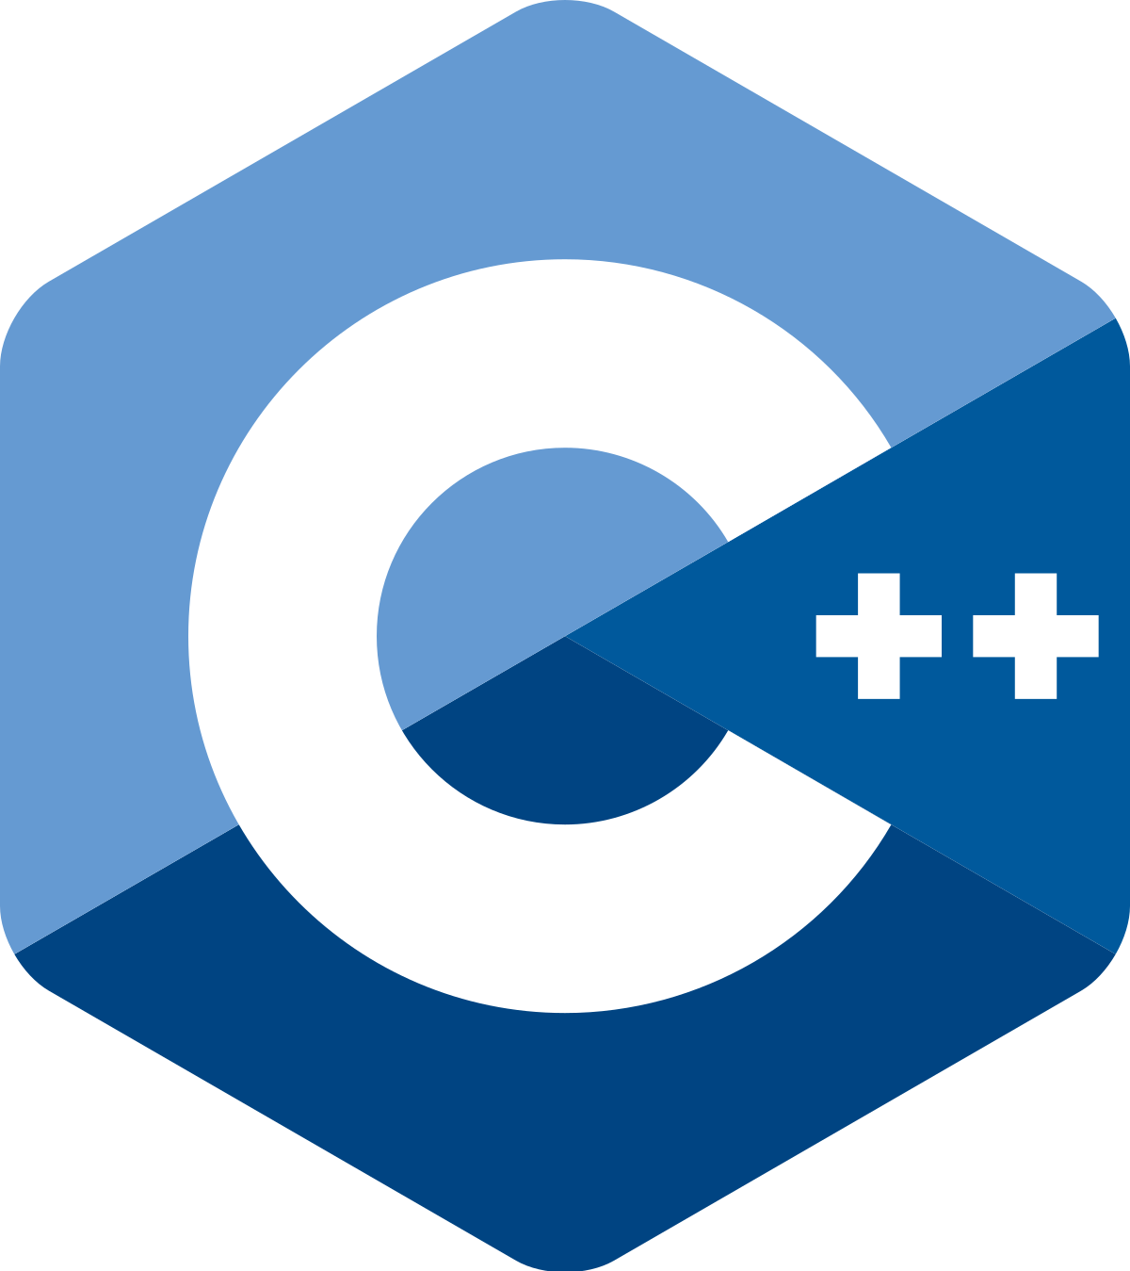
Strings, Testing, C++ Review

