Slide 1
Recommender Systems and Collaborative Filtering
Introduction to Recommender Systems
Notes:
In this series of lectures we introduce the task of recommender systems and the important collaborative filtering algorithm

Slide 2

Recommender systems: The task
  Plays an Ella Fitzgerald song
  What should we recommend next?
Thomas Quella
Wikimedia Commons
Customer W
Slides adapted from Jure Leskovec
Notes:
Here's an example of the recommender system task. Customer W here CLICK plays an ella fitzgerlad song CLICK What should we recommend to them next?

Slide 3
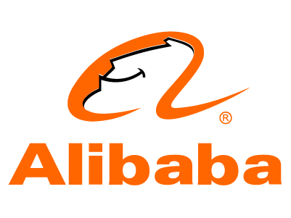


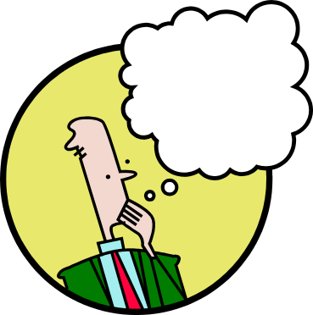







Recommendations
Search
Recommendations
Items
Products, web sites,
blogs, news items, …
Slides adapted from Jure Leskovec, CS246 and J. Leskovec, A. Rajaraman, J. Ullman: Mining of Massive Datasets
Notes:
A common setup of the recommender system task is that the user is searching for something, CLICK it could be a product, a news item, a web site, CLICK and the system returns recommendations. That turns out to be CLICK a huge application space that billions of people deal with every day. Seller of products like Amazon or Alibaba, news aggregators like Apple, Facebook, and Google, Video sites like YouTube, bilibili, providers of movies or music on demand like Netflix, Spotify or Apple Music.

Slide 4
Types of Recommendations
Editorial and hand curated
  List of favorites
  Lists of “essential” items
Simple aggregates
  Top 10, Most Popular, Recent Uploads
Tailored to individual users
  Amazon, Netflix, Apple Music…
Today's class
Slides adapted from Jure Leskovec, CS246 and J. Leskovec, A. Rajaraman, J. Ullman: Mining of Massive Datasets
Notes:
Of course there are many ways that recommendations happen. Someone could curate a list of favorites, or an outlet could publish some lists of essential items. Or we could rely on user data, but via simple aggregates; top 10 lists, most popular lists.
CLICK. What we'll focus on today, however, is the 3rd : making recommendations tailored to individual users.

Slide 5
Knowing how personalized recommendations work
Relevant for building practical news or product recommenders.
Notes:
Knowing how these personalized recommendation systems work is relevant for building pratical news or product recommenders

Slide 6

Relevant for understanding how misinformation spreads
QAnon Supporters And Anti-Vaxxers
Are Spreading a Hoax That Bill Gates
Created the Coronavirus
It has no basis in reality, but that hasn't slowed its spread across Facebook and Twitter
The
Guardian
Las Vegas survivors furious as YouTube
promotes clips calling shooting a hoax
'Fiction is outperforming
reality': how YouTube's
algorithm distorts truth
How YouTube Drives People to the Internet's Darkest Corners
Google's video site often recommends divisive or misleading material, despite recent changes designed to fix the problems
Notes:
But also, there are ethical dimensions of these systems. Recommendation systems can spread misinformation and radicalization. Developing solutions to this problem requires understanding how they work.

Slide 7
Formal Model
X = set of Users
S = set of Items
Utility function u: X × S → R
  R = set of ratings
  R is a totally ordered set
  e.g., 1-5 stars, real number in [0,1]
Slides adapted from Jure Leskovec, CS246 and J. Leskovec, A. Rajaraman, J. Ullman: Mining of Massive Datasets
Notes:
Let's see a formal model. We'll have users and items. Users have preferences for certain items, represented as a utility matrix, giving a value representing, for each user-item pair, what we know about the preference of that user for that item. Values come from an ordered set, for example, integers 1–5 representing the number of stars that the user gave as a rating for that item. The matrix is sparse, meaning that most entries are “unknown, ” we have no explicit information about the user’s preference for the item.

Slide 8
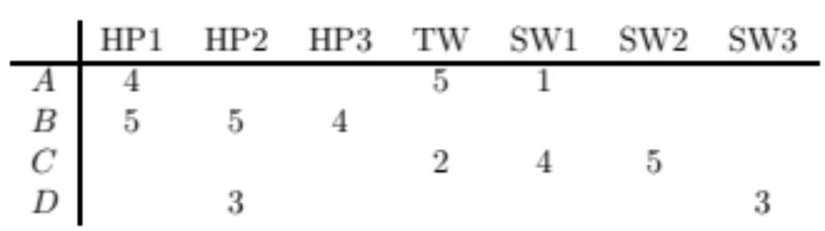
Utility Matrix
Harry Potter
Twilight
Star Wars
Anita
Beyonce
Calvin
David
Slides adapted from Jure Leskovec, CS246 and J. Leskovec, A. Rajaraman, J. Ullman: Mining of Massive Datasets
Notes:
Here's an example utility matrix, representing ratings from users Anita, Beyonce, Calvin, and David, of movies on a 1–5 scale, with 5 the highest rating. Blanks represent the situation where the user has not rated the movie. The movie names are HP1, HP2, and HP3 for Harry Potter I, II, and III, TW for Twilight, and SW1, SW2, and SW3 for Star Wars episodes 1, 2, and 3.
The goal of a recommendation system is to predict the blanks in the utility matrix. For example, would Anita like SW2?

Slide 9
Key Problems
Gathering “known” ratings for matrix
  How to collect the data in the utility matrix
Extrapolate unknown ratings from known ones
  Mainly interested in high unknown ratings
  We are not interested in knowing what you don’t like
  but what you like
Evaluating extrapolation methods
  How to measure performance of recommendation methods
Slides adapted from Jure Leskovec, CS246 and J. Leskovec, A. Rajaraman, J. Ullman: Mining of Massive Datasets
Notes:
We'll discuss 3 key problems in this space in subsequent lectures. First, we need to get those ratings.
Second, the main problem for today, predicting unknown ratings.
Note that we don't need to predict every blank entry in a utility matrix. We just need to find some entries in each row that are likely to be high. We don't usually care about un-recommending things that the user might hate.
Finally, we'll need some way to evaluate..

Slide 10
(1) Gathering Ratings
Explicit
  Ask people to rate items
  Doesn’t work well in practice – people can't be bothered
  Crowdsourcing: Pay people to label items
Implicit
  Learn ratings from user actions
    E.g., purchase (or watch video, or read article) implies high rating
Slides adapted from Jure Leskovec, CS246 and J. Leskovec, A. Rajaraman, J. Ullman: Mining of Massive Datasets
Notes:
How do we get ratings? We could just explicitly ask people, either to volunteer or to pay them, and that can help in some tasks. But more often we rely on implicit signals, learning the ratings from user actions. If someone buys a book, or picks a song, or finishes watching a YouTube video, that suggests it has a high rating.
There is a problem (maybe you looked at the video but hated it, or maybe you bought the thing and hated it. Nonetheless, it's a reasonable heuristic.
Note that this sort of rating system really has only one value: 1 means that the user likes the item. Often, we'll see a utility matrix with this kind of data shown with 0’s rather than blanks, but it's important to remember that 0 is not a lower rating than 1; it is no rating at all; this will be relevant later.

Slide 11
(2) Extrapolating Utilities
Key problem: Utility matrix U is sparse
  Most people have not rated most items
  The "Cold Start" Problem:
    New items have no ratings
    New users have no history
Slides adapted from Jure Leskovec, CS246 and J. Leskovec, A. Rajaraman, J. Ullman: Mining of Massive Datasets
Notes:
The utlity matrix is really really sparse. Most people have not rated most items. And we'll see what we call the Cold Start problem: new items have no ratings, and new users have no history.
If you register for music , they ask you genres you like, to avoid the cold start problem. That increases user retention, at the risk of making users do extra stuff.

Slide 12
(2) Extrapolating Utilities
Three approaches to recommender systems:
  Content-based
  Collaborative Filtering
  Latent factor (Neural embedding) based
This lecture!
Slides adapted from Jure Leskovec, CS246 and J. Leskovec, A. Rajaraman, J. Ullman: Mining of Massive Datasets
Notes:
There are 3 main approaches to recommender systems, two of which we'll cover in these lectures. Contet-based, Collaborative Filtering, and Latent factor based. We'll very briefly mention modern Latent systems based on neural embeddings.

Slide 13

Content-based vs. Collaborative Filtering
Database
  Ella Fitzgerald: Jazz, Mid-20th century, vocal legend, famous duets, …
  Louis Armstrong: Jazz, Mid-20th century, vocal legend, famous duets, …
Content-based
  Suggest Louis Armstrong
Customer W
  Plays Ella Fitzgerald
  What should we recommend next?
Collaborative filtering
Customer D
  Plays Ella Fitzgerald
  Plays Louis Armstrong
Thomas Quella
Wikimedia Commons
Photographer: Paul Stafford for www.travelmag.com
https://www.flickr.com/photos/113306963@N05/33886542421
Slides adapted from Jure Leskovec
Notes:
Let's see the difference between content-based and collaborative filtering.
Here's Customer W, who's playing an Ella Fitzgerald song. What should we play them next?
Here's one source of information: A data base, in which songs or musician have content features, so we know that Ella Fitzgerland is a mid-20th century jazz vocal legend, who recorded many famous duets. And hmm, we also know that Louis Armstrong is a mid-20th century jazz vocal legend who recorded many famous duets.
Let's suggest Louis Armstrong! This is content-based recommendation
Another source of information comes from customer D, who played an Ella Fitzgerald song too, but also played Louis Armstrong. We might suggest Louis Armstrong as well. Systems that rely on using information from other users's choices are called collaborative filtering recommender systems.

Slide 14
Recommender Systems and Collaborative Filtering
Introduction to Recommender Systems
Notes:
We've introduce the concept of recommender systems. Now let's see the details, starting content-based systems

Slide 15
Recommender Systems and Collaborative Filtering
Content-based Recommender Systems
Notes:
Let's turn to the first method: recommending based on features of the content itself

Slide 16
Content-based Recommendations
Main idea: Recommend items to customer x similar to previous items rated highly by x
Movie recommendations
  Recommend movies with same actor(s), director, genre, …
Websites, blogs, news
  Recommend other sites with similar types or words
Slides adapted from Jure Leskovec, CS246 and J. Leskovec, A. Rajaraman, J. Ullman: Mining of Massive Datasets
Notes:
The main idea of content-based recommendations is to recommend items to customer X that are similar to things X already rated highly
What do we mean by similar? Having similar content. So for movie recommendations, we could recommend movies with the same a ctors, director, genre
Or for website or blogs we could recommend other sites with similar genre tags, like cooking news or science news, or similar words

Slide 17
Plan of Action
Item profiles
likes
build
recommend
match
Red
Circles
Triangles
User profile
Slides adapted from Jure Leskovec, CS246 and J. Leskovec, A. Rajaraman, J. Ullman: Mining of Massive Datasets

Slide 18
Item Profiles
For each item, create an item profile
Profile is a set (vector) of features
  Movies: genre, director, actors, year…
  Text: Set of “important” words in document
How to pick important features?
  TF-IDF (Term frequency * Inverse Doc Frequency)
  For example use all words whose tf-idf > threshold, normalized for document length
Slides adapted from Jure Leskovec, CS246 and J. Leskovec, A. Rajaraman, J. Ullman: Mining of Massive Datasets
Notes:
We'll need to create a profile for each item, a vector of features. For example, for movies, a typical feature could be the genre, the director, the actors. For text we could use sets of words.
CLICK How do we pick out important features? We can set some by hand (for example using our knowledge about movies to suggest genre is important. For words we can use only a subset, for example, compute t—idf values for the words and only including words that had high=tf-idf dimension in training. Maybe we don't include the actual tf-idf value, but we keep only words that have tf-idf value over a threshold, create an element in our vector for each of thos words, then put a 1 in that dimension if the document has that word, and a 0 otherwise.

Slide 19
Content-based Item Profiles
Melissa
McCarthy
Actor
A
Actor
B
Johnny
Depp
Comic
Genre
Spy
Genre
Pirate
Genre
…
Movie X
0 | 1 | 1 | 0 | 1 | 1 | 0 | 1
1 | 1 | 0 | 1 | 0 | 1 | 1 | 0
Movie Y
But what if we want to have real or ordinal features too?
Slides adapted from Jure Leskovec, CS246 and J. Leskovec, A. Rajaraman, J. Ullman: Mining of Massive Datasets
Notes:
OK, here's a sample item profile for two items, movie X, and Johnny Depp pirate movie, and movie Y, a Melissa McCarthy comedy. Each is a vector of binary values, 1s or 0s.
But what if we want to have real or ordinal features too?

Slide 20
Content-based Item Profiles
Melissa
McCarthy
Actor
A
Actor
B
Johnny
Depp
Comic
Genre
Spy
Genre
Pirate
Genre
Avg
Rating
…
Movie X
0 | 1 | 1 | 0 | 1 | 1 | 0 | 1 | 3
1 | 1 | 0 | 1 | 0 | 1 | 1 | 0 | 4
Movie Y
For example "average rating"
Maybe we want a scaling factor α between binary and numeric features
Slides adapted from Jure Leskovec, CS246 and J. Leskovec, A. Rajaraman, J. Ullman: Mining of Massive Datasets
Notes:
For instance, we might take the average rating for movies to be a feature, and this average is a real number.
That's fine, cosine still works with combinations of binary and real-valued values in the cells.
CLICK
We might, however, want to scale the non-Boolean components with some alpha, so that they neither dominate the calculation nor are they irrelevant.

Slide 21
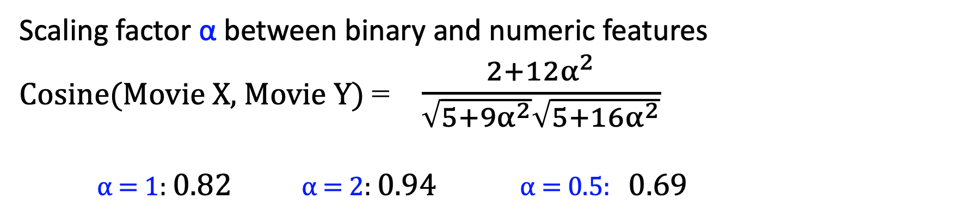
Content-based Item Profiles
Melissa
McCarthy
Actor
A
Actor
B
Johnny
Depp
Comic
Genre
Spy
Genre
Pirate
Genre
Avg
Rating
…
Movie X
0 | 1 | 1 | 0 | 1 | 1 | 0 | 1 | 3α
1 | 1 | 0 | 1 | 0 | 1 | 1 | 0 | 4α
Movie Y
Scaling factor α between binary and numeric features
Cosine(Movie X, Movie Y) = $\frac{2+12α^{2}}{\sqrt{5+9α^{2}}\sqrt{5+16α^{2}}}$
α = 1: 0.82 α = 2: 0.94 α = 0.5: 0.69
Slides adapted from Jure Leskovec, CS246 and J. Leskovec, A. Rajaraman, J. Ullman: Mining of Massive Datasets
Notes:
If we compute cosine of the angle between the vectors for movie X and Y, we can see that The dot product is 2 + 12α^2, and the √lengths of the vectors are
√ 5 + 9α^2, and √5 + 16α^2, . Thus, the cosine of the angle between the vectors is
If we choose α = 1, that is, we take the average ratings as they are, then the value of the above expression is 0.816. If we use α = 2, that is, we double the value of the ratings, then the cosine is 0.940, that is the similarity is higher, because we're emphasizing that these ratings are similar. But if alpha is only 0.5, then we get a lower similarity of .69
So the choice of alpha is very influential, and that's something we'll need to set, perhaps on a held-out set, to maximize our evaluation metric.

Slide 22
User Profiles
Want a vector with the same components/dimensions as items
  Could be 1s representing user purchases
  Or arbitrary numbers from a rating
User profile is aggregate of items:
  Weighted average of rated item profiles
Slides adapted from Jure Leskovec, CS246 and J. Leskovec, A. Rajaraman, J. Ullman: Mining of Massive Datasets
Notes:
We not only need to create vectors describing items; we need to create vectors with the same components that describe the user’s preferences.
We have the utility matrix representing the connection between users and items
We estimate the values for items the user likes as some aggregation of the profiles of those items like the average of those items with ratings

Slide 23
Sample user profile
Items are movies
Utility matrix has 1 if user has seen movie
20% of the movies user U has seen have Melissa McCarthy
U[“Melissa McCarthy”] = 0.2
Melissa
McCarthy
Actor
A
Actor
B
…
User U
0.2 | .005 | 0 | 0 | …
Slides adapted from Jure Leskovec, CS246 and J. Leskovec, A. Rajaraman, J. Ullman: Mining of Massive Datasets
Notes:
For example, suppose items are movies, represented by Boolean profiles with components corresponding to actors. Also, the utility matrix has a 1 if the user has seen the movie and is blank otherwise. If 20% of the movies that user U likes have Melissa McCarthy as one of the actors, then the user profile for U will have 0.2 in the component for Melissa McCarthy.

Slide 24
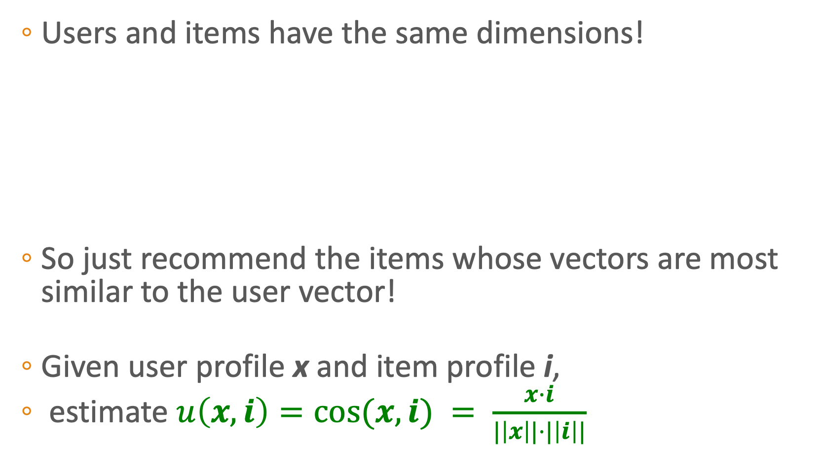
Prediction
  Users and items have the same dimensions!
  So just recommend the items whose vectors are most similar to the user vector!
  Given user profile x and item profile i,
  estimate $u\left(x,i\right)=cos⁡(x,i) = \frac{x·i}{|\left|x\right||⋅|\left|i\right||}$
Melissa
McCarthy
Actor
A
Actor
B
…
Movie i
0 | 1 | 1 | 0 | …
0.2 | .005 | 0 | 0 | 0
User x
Slides adapted from Jure Leskovec, CS246 and J. Leskovec, A. Rajaraman, J. Ullman: Mining of Massive Datasets
Notes:
Now that we have profile vectors for both users and items in the same dimensions, we can estimate the degree to which a user would prefer an item CLICK by finding the most similar item, i.e. by computing the cosine distance between the user’s and item’s vectors.

Slide 25
Pros: Content-based Approach
+: No need for data on other users
  No user sparsity problems
+: Able to recommend to users with unique tastes
+: Able to recommend new & unpopular items
  No first-rater problem
+: Able to provide explanations
  Just list the content-features that caused an item to be recommended
Slides adapted from Jure Leskovec, CS246 and J. Leskovec, A. Rajaraman, J. Ullman: Mining of Massive Datasets
Notes:
The content-based approach doesn't rely on sparse information about other users. And we can recommend to users with unique tastes, if they just played an obscure song, we can play another equally obscure song. And we can recommend new or rare items, because they all have features. And this algorithm has transparency: we can explain to the user why we recommended the item

Slide 26
Cons: Content-based Approach
– Finding the appropriate features is hard
  E.g., images, movies, music
– Recommendations for new users
  How to build a user profile?
– Overspecialization
  Never recommends items outside user's content profile
  People might have multiple interests
  Unable to exploit quality judgments of other users
Slides adapted from Jure Leskovec, CS246 and J. Leskovec, A. Rajaraman, J. Ullman: Mining of Massive Datasets
Notes:
On the other hand the content based approach requires that we come up with the features! That's hard. And we do have a new user problem, we need to build a profile for a new user., the content-based approach can give very non-diverse suggestions. We never recommend items outside the users's content profile.
And finally, the content-based approach is unable to exploit the quality judgments of other users, something that the collaborative filtering approach is designed for.

Slide 27
Recommender Systems and Collaborative Filtering
Content-based Recommender Systems
Notes:
We've seen how to recommend items go users based on their feature similarity.

Slide 28
Recommender Systems and Collaborative Filtering
Collaborative Filtering: User-User
Notes:
We turn now to collaborative filtering, beginning with the user-user version

Slide 29
Collaborative filtering
Instead of using content features of items to determine what to recommend
Find similar users and recommend items that they like!

Slide 30
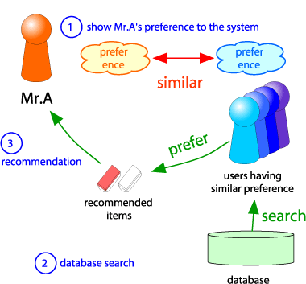
Collaborative Filtering
Version 1: "User-User" Collaborative Filtering
Consider user x
and unrated item i
Find set N of other
users whose ratings
are “similar” to
x’s ratings
Estimate x’s ratings
for i based on ratings for i
of users in N
x
N
Slides adapted from Jure Leskovec, CS246 and J. Leskovec, A. Rajaraman, J. Ullman: Mining of Massive Datasets
Notes:
Consider user X. CLICK. Let's say we've learned something about user x's preferences. CLICK Now we find a set N of other users whose ratings are similar to x's ratings. And now we estimate x's UNKNOWN ratings, like the rating for I, based on the ratings of the users in N

Slide 31
Collaborative filtering
Find similar users and recommend items that they like:
Represent users by their rows in the utility matrix
Two users are similar if their vectors are similar!
Harry Potter
Twilight
Star Wars

Slide 32
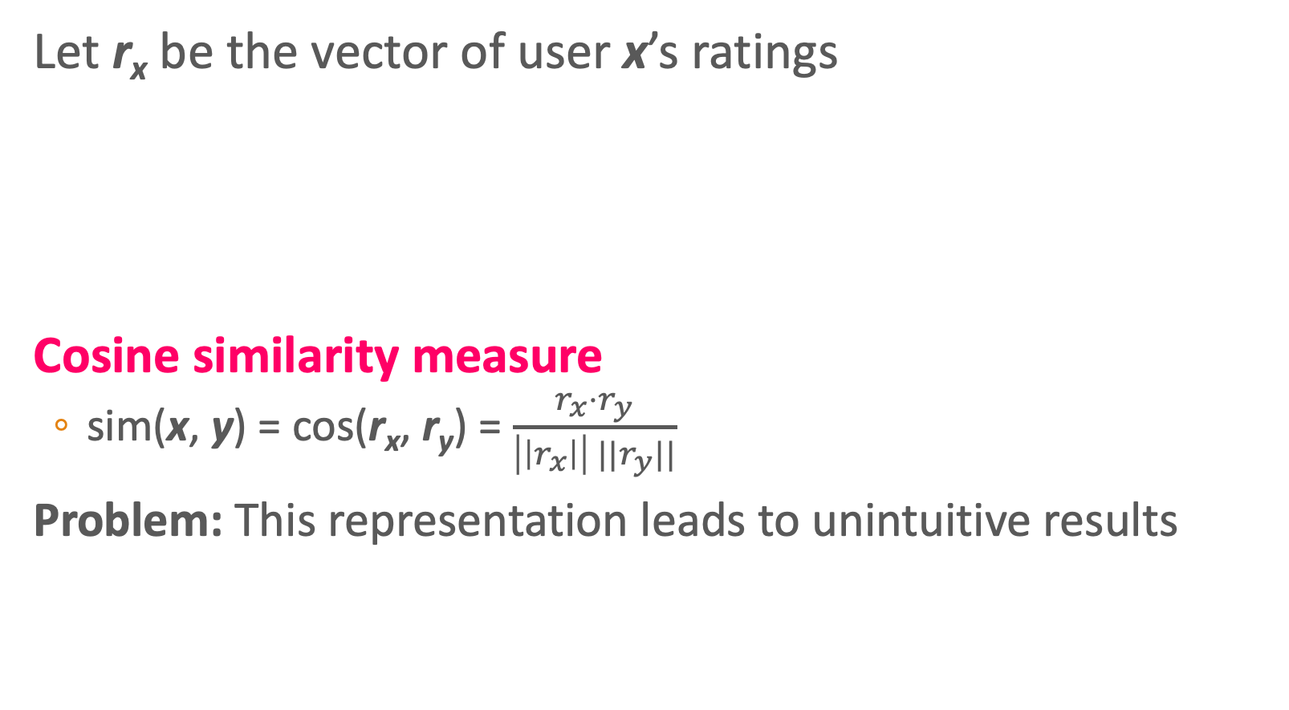
Finding Similar Users
Let r_{x} be the vector of user x’s ratings
Cosine similarity measure
  sim(x, y) = cos(r_{x}, r_{y}) = $\frac{r_{x}⋅r_{y}}{\left|\left|r_{x}\right|\right| {||r}_{y}||}$
Problem: This representation leads to unintuitive results
r_{x} = [*, _, _, *, ***]
r_{y} = [*, _, **, **, _]
r_{x} = {1, 0, 0, 1, 3}
r_{y} = {1, 0, 2, 2, 0}
Slides adapted from Jure Leskovec, CS246 and J. Leskovec, A. Rajaraman, J. Ullman: Mining of Massive Datasets
Notes:
OK, let's turn our ratings into vectors. Let's suppose two users have these *-rating values. Let's for the moment represent a blank rating by a zero.
Now e can just compute the similarity with cosine, we know how to do that.
But this representation ahs a problem leading to unintuitive results

Slide 33
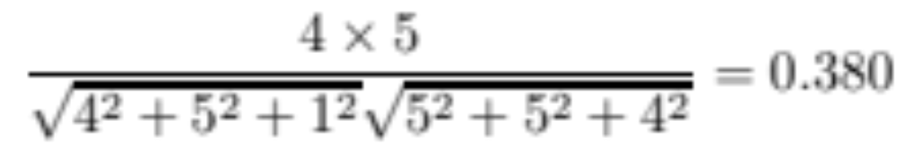
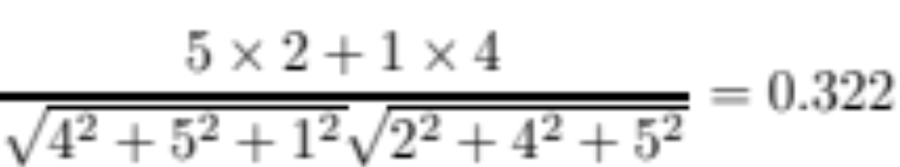
Problems with raw utility matrix cosine
Harry Potter
Twilight
Star Wars
Intuitively we want: sim(A, B) > sim(A, C)
sim(A,B) =
Yes, 0.380 > 0.322
But only barely works…
sim(A,C) =
Notes:
Cosnider our utility matrix again. We'd intuitively like A to be more like B than C. A and C had exactly opposite opinions about star wars 1; C loved it; A hated it. But the cosine doesn't treat 1 as a negative rating. And it doesn't properly treat a lack of rating as uninformative.

Slide 34
Problem with raw cosine
Problem with cosine:
  C really loves SW
  A hates SW
  B just hasn’t seen it
Another problem: we’d like to normalize the raters
  D rated everything the same; not very useful
Notes:
The problem with cosine is that it doesn't really capture how opposite A is from C
Another problem is that we'd like to normalize for raters; D rated everything the same, so their ratings are not helpful
What we'd like is a way to treat the zeros as uninformative, the low numbers are negative ratings, and people who like everything the same as not helpful.

Slide 35
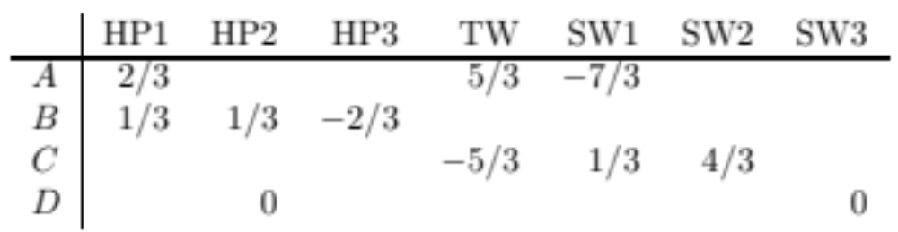
Mean-Centered Utility Matrix: subtract the means of each row
Now a 0 means no information
And negative ratings means viewers with opposite ratings will have vectors in opposite directions!
Notes:
The solution is to mean-center the users, subtracting the means from each row.
Now a 0 means no information. 0s can happen because we have no rating, or because the rater is uninformative. And negative ratings means viewers with opposite ratings will have vectors in opposite directions!
This kind of mean-centering is useful in many problem in processing natural language and data, whenever we have a scale like rating or sentiment that intuitive has both positive and negative ends.

Slide 36
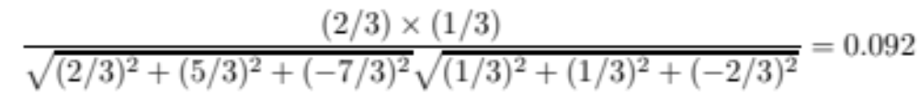
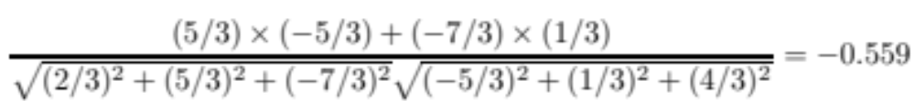
Modified Utility Matrix: subtract the means of each row
Cos(A,B) =
Cos(A,C) =
Now A and C are (correctly) way further apart than A,B
Notes:
Notice that A and C now have opposite values and their vectors are very very dfferent

Slide 37
Terminological Note: subtracting the mean is mean-centering, not normalizing
(normalizing is dividing by a norm to turn something into a probability), but the textbook (and common usage) sometimes overloads the term “normalize”

Slide 38
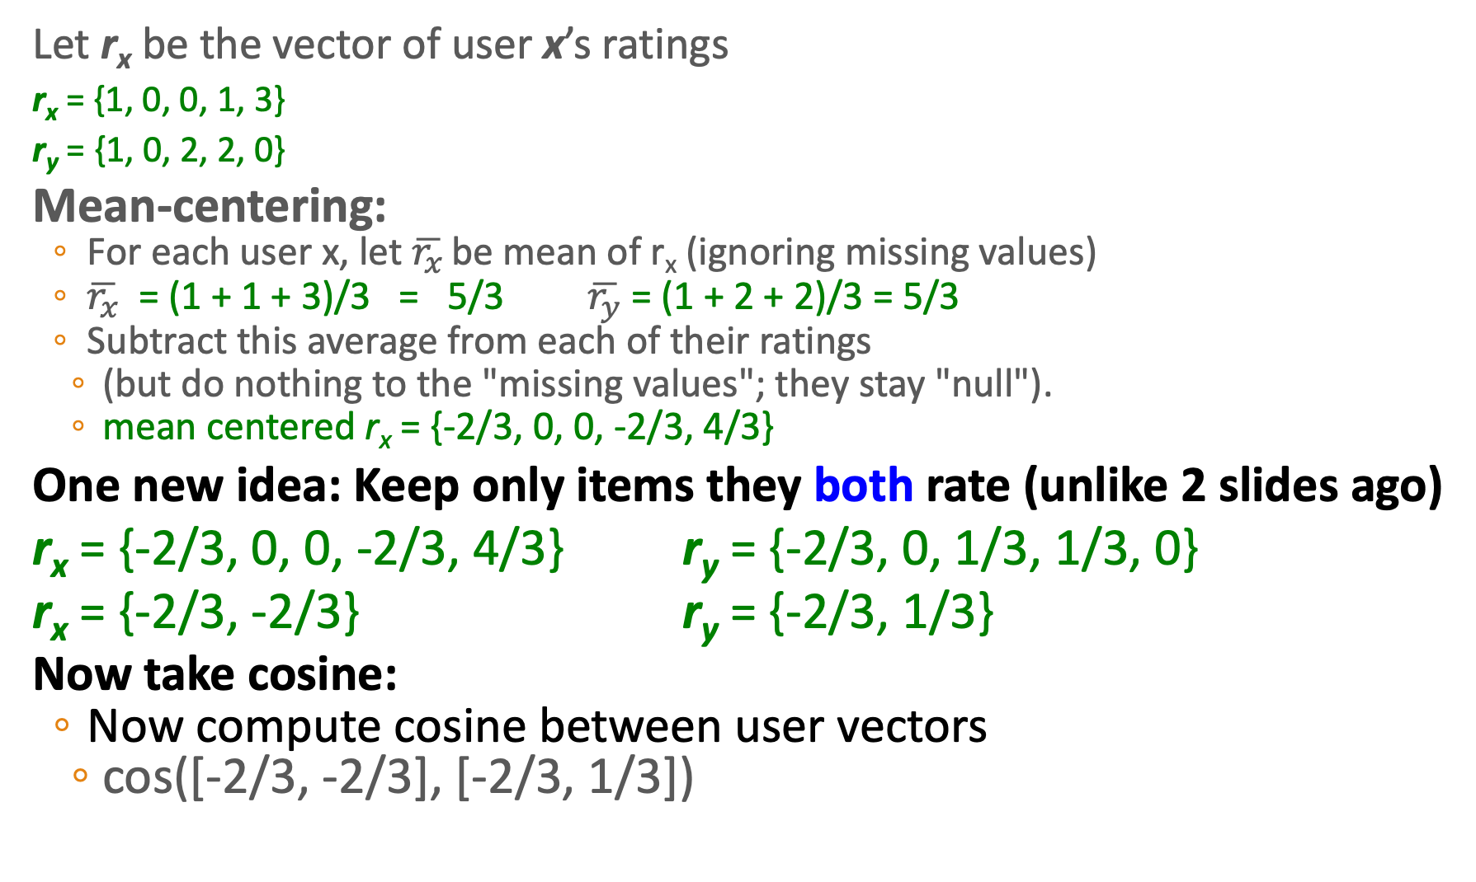
Finding similar users with overlapping-item mean-centering
Let r_{x} be the vector of user x’s ratings
r_{x} = {1, 0, 0, 1, 3}
r_{y} = {1, 0, 2, 2, 0}
Mean-centering:
  For each user x, let $\overline{r_{x}}$ be mean of r_{x} (ignoring missing values)
  $\overline{r_{x}}$ = (1 + 1 + 3)/3 = 5/3 $\overline{r_{y}}$ = (1 + 2 + 2)/3 = 5/3
  Subtract this average from each of their ratings
    (but do nothing to the "missing values"; they stay "null").
    mean centered r_{x} = {-2/3, 0, 0, -2/3, 4/3}
One new idea: Keep only items they both rate (unlike 2 slides ago)
r_{x} = {-2/3, 0, 0, -2/3, 4/3} r_{y} = {-2/3, 0, 1/3, 1/3, 0}
r_{x} = {-2/3, -2/3} r_{y} = {-2/3, 1/3}
Now take cosine:
  Now compute cosine between user vectors
    cos([-2/3, -2/3], [-2/3, 1/3])
r_{x} = [*, _, _, *, ***]
r_{y} = [*, _, **, **, _]
Slides adapted from Jure Leskovec, CS246 and J. Leskovec, A. Rajaraman, J. Ullman: Mining of Massive Datasets
Notes:
All right, let's see the final modified version of cosine we're going to use. We have our vectors of users rating.
For each user, we compute the mean (ignoring missing values)
We subtract this average from each of their ratings (but do nothing to the missing values, which stay null), giving us a mean-centered value.
Now we are going to add one more change: we're only going to keep items that both users rate.
So here we're going to remove these three items which weren't rated by both users, and get two shorter vectors, and take the cosine between these shorter vectors. This won't change the numerator, since the zeros will cancel out, but it does change the denominator, since the lengths of each vector change.

Slide 39
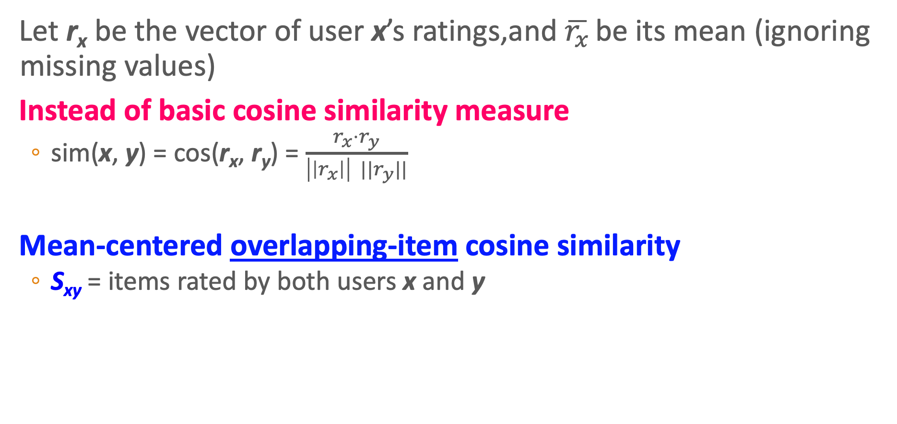
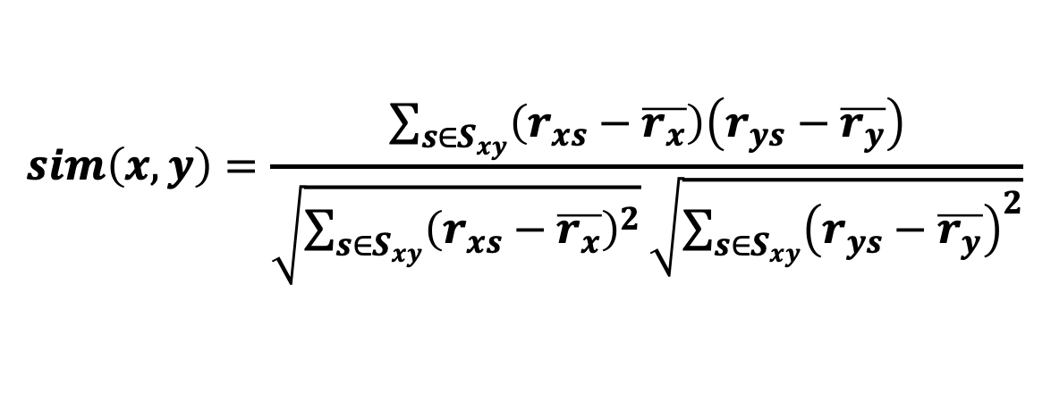
Mean-centered overlapping-item cosine similarity
Let r_{x} be the vector of user x’s ratings,and $\overline{r_{x}}$ be its mean (ignoring missing values)
Instead of basic cosine similarity measure
  sim(x, y) = cos(r_{x}, r_{y}) = $\frac{r_{x}⋅r_{y}}{\left|\left|r_{x}\right|\right| {||r}_{y}||}$
Mean-centered overlapping-item cosine similarity
  S_{xy} = items rated by both users x and y
(Variant of
Pearson correlation)
$$sim\left(x,y\right)=\frac{\sum_{s∈S_{xy}}{\left(r_{xs}−\overline{r_{x}}\right)\left(r_{ys}−\overline{r_{y}}\right)}}{\sqrt{\sum_{s∈S_{xy}}{{\left(r_{xs}−\overline{r_{x}}\right)}^{2}}}\sqrt{\sum_{s∈S_{xy}}{{\left(r_{ys}−\overline{r_{y}}\right)}^{2}}}}$$
Slides adapted from Jure Leskovec, CS246 and J. Leskovec, A. Rajaraman, J. Ullman: Mining of Massive Datasets
Notes:
In summary, here's the mean-centered overlapping-item cosine similarity algorithm for user-user similarity.
CLICK
It turns out, by the way, that mean-centered overlapping-item cosine similarity is a slight variant of the Pearson correlation.

Slide 40
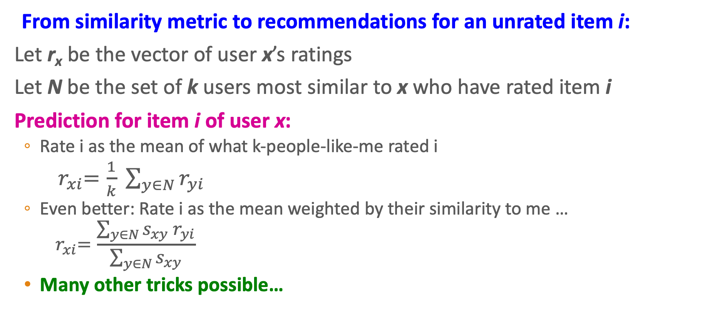
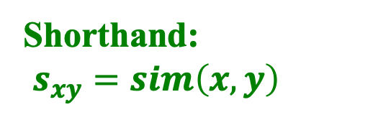
Rating Predictions
From similarity metric to recommendations for an unrated item i:
Let r_{x} be the vector of user x’s ratings
Let N be the set of k users most similar to x who have rated item i
Prediction for item i of user x:
  Rate i as the mean of what k-people-like-me rated i
    ${ r}_{xi}=\frac{1}{k} \sum_{y∈N}{r_{yi}}$
  Even better: Rate i as the mean weighted by their similarity to me …
    $${ r}_{xi}=\frac{\sum_{y∈N}{s_{xy} r_{yi}}}{\sum_{y∈N}{s_{xy}}}$$
  Many other tricks possible…
Shorthand:
$s_{xy}=sim\left(x,y\right)$
Slides adapted from Jure Leskovec, CS246 and J. Leskovec, A. Rajaraman, J. Ullman: Mining of Massive Datasets

Slide 41
Recommender Systems and Collaborative Filtering
Collaborative Filtering: User-User
Notes:
We've seen the user-user version of collaborative filtering

Slide 42
Recommender Systems and Collaborative Filtering
Collaborative Filtering: Item-Item
Notes:
Let's now see a different version of collaborative filtering, called item-item

Slide 43
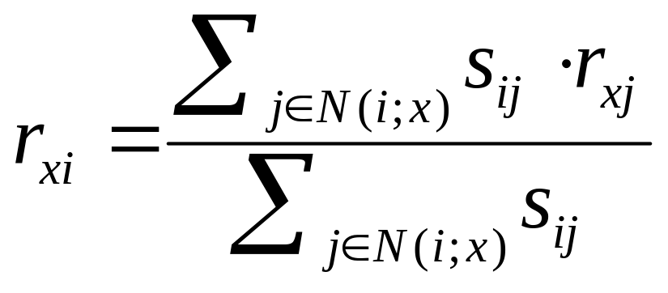
Collaborative Filtering Version 2:
Item-Item Collaborative Filtering
So far: User-user collaborative filtering
Alternate view that often works better: Item-item
  For item i, find other similar items
  Estimate rating for item i based on ratings for those similar items
  Can use same similarity metrics and prediction functions as in user-user model
  "Rate i as the mean of my ratings for other items, weighted by their similarity to i"
N(i;x)…set of items rated by x and similar to i
s_{ij}… similarity of items i and j
r_{xj}…rating of user x on item j
Slides adapted from Jure Leskovec, CS246 and J. Leskovec, A. Rajaraman, J. Ullman: Mining of Massive Datasets

Slide 44
Item-Item CF (|N|=2)
users
12 | 11 | 10 | 9 | 8 | 7 | 6 | 5 | 4 | 3 | 2 | 1
 | 4 |  | 5 |  |  | 5 |  |  | 3 |  | 1 | 1
3 | 1 | 2 |  |  | 4 |  |  | 4 | 5 |  |  | 2
 | 5 | 3 | 4 |  | 3 |  | 2 | 1 |  | 4 | 2 | 3
 | 2 |  |  | 4 |  |  | 5 |  | 4 | 2 |  | 4
5 | 2 |  |  |  |  | 2 | 4 | 3 | 4 |  |  | 5
 | 4 |  |  | 2 |  |  | 3 |  | 3 |  | 1 | 6
movies
- unknown rating
- rating between 1 to 5
Notes:
Let's walk through an example again. Here's a utility matrix for users rating movies. Let's set N=2, meaning we'll be rating an unknown movie by averaging the two most similar movies rated by that user

Slide 45
Item-Item CF (|N|=2)
users
12 | 11 | 10 | 9 | 8 | 7 | 6 | 5 | 4 | 3 | 2 | 1
 | 4 |  | 5 |  |  | 5 | ? |  | 3 |  | 1 | 1
3 | 1 | 2 |  |  | 4 |  |  | 4 | 5 |  |  | 2
 | 5 | 3 | 4 |  | 3 |  | 2 | 1 |  | 4 | 2 | 3
 | 2 |  |  | 4 |  |  | 5 |  | 4 | 2 |  | 4
5 | 2 |  |  |  |  | 2 | 4 | 3 | 4 |  |  | 5
 | 4 |  |  | 2 |  |  | 3 |  | 3 |  | 1 | 6
movies
- estimate rating of movie 1 by user 5
Slides adapted from Jure Leskovec, CS246 and J. Leskovec, A. Rajaraman, J. Ullman: Mining of Massive Datasets
Notes:
Let's say we want to know "what would user 5 think about movie 1"

Slide 46
Item-Item CF (|N|=2)
users
12 | 11 | 10 | 9 | 8 | 7 | 6 | 5 | 4 | 3 | 2 | 1
 | 4 |  | 5 |  |  | 5 | ? |  | 3 |  | 1 | 1
3 | 1 | 2 |  |  | 4 |  |  | 4 | 5 |  |  | 2
 | 5 | 3 | 4 |  | 3 |  | 2 | 1 |  | 4 | 2 | 3
 | 2 |  |  | 4 |  |  | 5 |  | 4 | 2 |  | 4
5 | 2 |  |  |  |  | 2 | 4 | 3 | 4 |  |  | 5
 | 4 |  |  | 2 |  |  | 3 |  | 3 |  | 1 | 6
sim(1,m)
1.00
..
?
..
..
movies
Neighbor selection:
Identify movies similar to
movie 1, rated by user 5
Here we use mean centered item-overlap cosine as similarity:
1) Subtract mean rating m_{i} from each movie i between rows
2) Compute (item-overlapping) cosine similarities
Notes:
First, we want to find the 2 movies that are most similar to movie 1, and rated by user 5
We're using mean-centered item-overlap cosine as similarity
We're going to compute the mean rating from each *movie* I, and subtract it from the whole row
Then we'll compute cosine similarities between rows to find the movies that are most like movie 1
I'm going to give you a hint that it's going to be movies 3 and 6, so I'll just show the computation for them

Slide 47
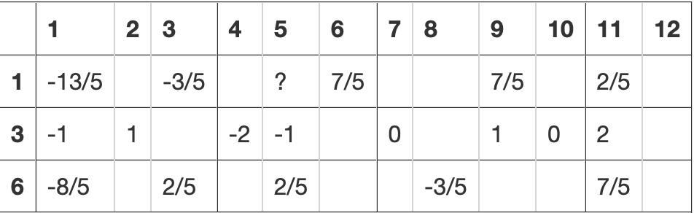
Item-Item CF (|N|=2)
users
12 | 11 | 10 | 9 | 8 | 7 | 6 | 5 | 4 | 3 | 2 | 1
 | 4 |  | 5 |  |  | 5 | ? |  | 3 |  | 1 | 1
3 | 1 | 2 |  |  | 4 |  |  | 4 | 5 |  |  | 2
 | 5 | 3 | 4 |  | 3 |  | 2 | 1 |  | 4 | 2 | 3
 | 2 |  |  | 4 |  |  | 5 |  | 4 | 2 |  | 4
5 | 2 |  |  |  |  | 2 | 4 | 3 | 4 |  |  | 5
 | 4 |  |  | 2 |  |  | 3 |  | 3 |  | 1 | 6
Subtract mean rating m_{i} from each movie i
m₁ = (1+3+5+5+4)/5 = 18/5
movies
Showing computation only for #3 and #6
Neighbor selection:
Identify movies similar to
movie 1, rated by user 5
Here we use mean centered item-overlap cosine as similarity:
1) Subtract mean rating m_{i} from each movie i
2) Compute (item-overlapping) cosine similarities between rows
Notes:
Here's movies 1,3, and 6 with the means subtracted

Slide 48
Item-Item CF (|N|=2)
users
12 | 11 | 10 | 9 | 8 | 7 | 6 | 5 | 4 | 3 | 2 | 1
 | 2/5 |  | 7/5 |  |  | 7/5 | ? |  | -3/5 |  | -13/5 | 1
3 | 1 | 2 |  |  | 4 |  |  | 4 | 5 |  |  | 2
 | 2 | 0 | 1 |  | 0 |  | -1 | -2 |  | 1 | -1 | 3
 | 2 |  |  | 4 |  |  | 5 |  | 4 | 2 |  | 4
5 | 2 |  |  |  |  | 2 | 4 | 3 | 4 |  |  | 5
 | 7/5 |  |  | -3/5 |  |  | 2/5 |  | 2/5 |  | -8/5 | 6
sim(1,m)
1.00
..
?
..
..
?
movies
Neighbor selection:
Identify movies similar to
movie 1, rated by user 5
Here we use mean centered item-overlap cosine as similarity:
1) Subtract mean rating m_{i} from each movie i
2) Compute (item-overlapping) cosine similarities between rows
Notes:
OK, now we just need to know how similar all the movies are to movie 1. Again, I'm just computing for 3 and 6 so this video doesn't become endless.
So for 1 and 3, we do the item-overlapping cosine, so we're going to do be doing the dot product for users 1, user 9, and user 11, so we'll treat these as if they are vectors with three elements.

Slide 49

Compute Cosine Similarity:
For rows 1 and 3, they both have values for users 1, 9 and 11.
For rows 1 and 6, they both have values for users 1, 3 and 11.
Notes:
Here's the cosine, remember we're just coming it for the user dimensions they both have values for.

Slide 50
Item-Item CF (|N|=2)
users
12 | 11 | 10 | 9 | 8 | 7 | 6 | 5 | 4 | 3 | 2 | 1
 | 4 |  | 5 |  |  | 5 | ? |  | 3 |  | 1 | 1
3 | 1 | 2 |  |  | 4 |  |  | 4 | 5 |  |  | 2
 | 5 | 3 | 4 |  | 3 |  | 2 | 1 |  | 4 | 2 | 3
 | 2 |  |  | 4 |  |  | 5 |  | 4 | 2 |  | 4
5 | 2 |  |  |  |  | 2 | 4 | 3 | 4 |  |  | 5
 | 4 |  |  | 2 |  |  | 3 |  | 3 |  | 1 | 6
sim(1,m)
1.000
..
.658
..
..
.768
movies
Compute similarity weights:
s_{1,3}=.658, s_{1,6}=.768 (we compute s_{1,2}, s_{1,4}, s_{1,5} too; let's assume those are smaller)
Slides adapted from Jure Leskovec, CS246 and J. Leskovec, A. Rajaraman, J. Ullman: Mining of Massive Datasets
Notes:
So let's put those cosines here in the similarity column to mean how similar these movies are to movie 1, of course we would have to compute the similarity of all the other movies to movie 1 too, but I'm cheating by telling you that all the other similarities are smaller, and we're just doing |N|=2, we're just estimating this missing value from the 2 most similar movies

Slide 51
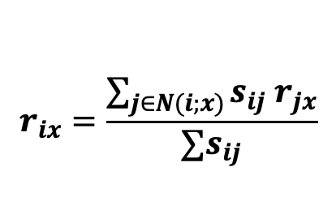
Item-Item CF (|N|=2)
Approximate rating with weighted mean
users
12 | 11 | 10 | 9 | 8 | 7 | 6 | 5 | 4 | 3 | 2 | 1
 | 4 |  | 5 |  |  | 5 | 2.54 |  | 3 |  | 1 | 1
3 | 1 | 2 |  |  | 4 |  |  | 4 | 5 |  |  | 2
 | 5 | 3 | 4 |  | 3 |  | 2 | 1 |  | 4 | 2 | 3
 | 2 |  |  | 4 |  |  | 5 |  | 4 | 2 |  | 4
5 | 2 |  |  |  |  | 2 | 4 | 3 | 4 |  |  | 5
 | 4 |  |  | 2 |  |  | 3 |  | 3 |  | 1 | 6
sim(1,m)
1.000
..
.658
..
..
.768
movies
Predict by taking weighted average:
r_{1,5} = (0.658*2 + 0.768*3) / (0.658+0.768) = 2.54
$$r_{ix}=\frac{\sum_{j∈N(i;x)}{s_{ij} r_{jx}}}{∑s_{ij}}$$
Slides adapted from Jure Leskovec, CS246 and J. Leskovec, A. Rajaraman, J. Ullman: Mining of Massive Datasets
Notes:
And here's the weighted average. If we just took the non-weighted average, it would be the average of 2 and 3, so 2.5.
So get a slightly different number, which turns out to work slight better, by saying that movie 6 is slightly more similar to movie 1, so we're going to weight it a bit more

Slide 52
Item-Item vs. User-User
In practice, item-item often works better than user-user
Why? Items are simpler, users have multiple tastes
  (People are more complex than objects)
Slides adapted from Jure Leskovec, CS246 and J. Leskovec, A. Rajaraman, J. Ullman: Mining of Massive Datasets
Notes:
In practice, item-item works better than user-user. Why? items tend to be classifiable in simple
terms. For example, music tends to belong to a single genre. It is hard to imagine how a piece of music could be both a Beyonce song and 1700’s baroque. On the other hand, there are individuals who like both Beyonce and 1700’s baroque, and who listen to both. Furthermore, items are relatively constant (a bach fugue is always a bach fugue) but people are dynamic, their tastes change.
The consequence is that it is easier to discover items that are similar than users that are similar.

Slide 53
Pros/Cons of Collaborative Filtering
+ Works for any kind of item
  No feature selection needed
- Cold Start:
  Need enough users in the system to find a match
- Sparsity:
  The user/ratings matrix is sparse
  Hard to find users that have rated the same items
- First rater:
  Cannot recommend an item that has not been previously rated
- Popularity bias:
  Cannot recommend items to someone with unique taste
  Tends to recommend popular items
- Ethical and social issues:
  Can lead to filter bubbles and radicalization spirals
Slides adapted from Jure Leskovec, CS246 and J. Leskovec, A. Rajaraman, J. Ullman: Mining of Massive Datasets

Slide 54
Recommender Systems and Collaborative Filtering
Collaborative Filtering: Item-Item
Notes:
We've now seen both the user-user and item-item algorithms for collaborative filtering

Slide 55
Recommender Systems and Collaborative Filtering
Simplified item-item similarity computation for our tiny PA6 dataset
Notes:
For our dataset from programming assignment 6, you are going to implement a simplified version of item-item collaborative filtering, because it happens to work better on our tiny dataset.

Slide 56
Simplified item-item for our tiny PA6 dataset
First, assume you've converted all the values to
+1 (like),
0 (no rating)
-1 (dislike)
users
12 | 11 | 10 | 9 | 8 | 7 | 6 | 5 | 4 | 3 | 2 | 1
 | 4 |  | 5 |  |  | 5 |  |  | 3 |  | 1 | 1
3 | 1 | 2 |  |  | 4 |  |  | 4 | 5 |  |  | 2
 | 5 | 3 | 4 |  | 3 |  | 2 | 1 |  | 4 | 2 | 3
 | 2 |  |  | 4 |  |  | 5 |  | 4 | 2 |  | 4
5 | 2 |  |  |  |  | 2 | 4 | 3 | 4 |  |  | 5
 | 4 |  |  | 2 |  |  | 3 |  | 3 |  | 1 | 6
movies

Slide 57
Simplified item-item for our tiny PA6 dataset
First, assume you've converted all the values to
+1 (like),
0 (no rating)
-1 (dislike)
users
12 | 11 | 10 | 9 | 8 | 7 | 6 | 5 | 4 | 3 | 2 | 1
 | 1 |  | 1 |  |  | 1 |  |  | 1 |  | -1 | 1
1 | -1 | -1 |  |  | 1 |  |  | 1 | 1 |  |  | 2
 | 1 | 1 | 1 |  | 1 |  | -1 | -1 |  | 1 | -1 | 3
 | -1 |  |  | 1 |  |  | 1 |  | 1 | -1 |  | 4
1 | -1 |  |  |  |  | -1 | 1 | 1 | 1 |  |  | 5
 | 1 |  |  | -1 |  |  | 1 |  | 1 |  | -1 | 6
movies

Slide 58
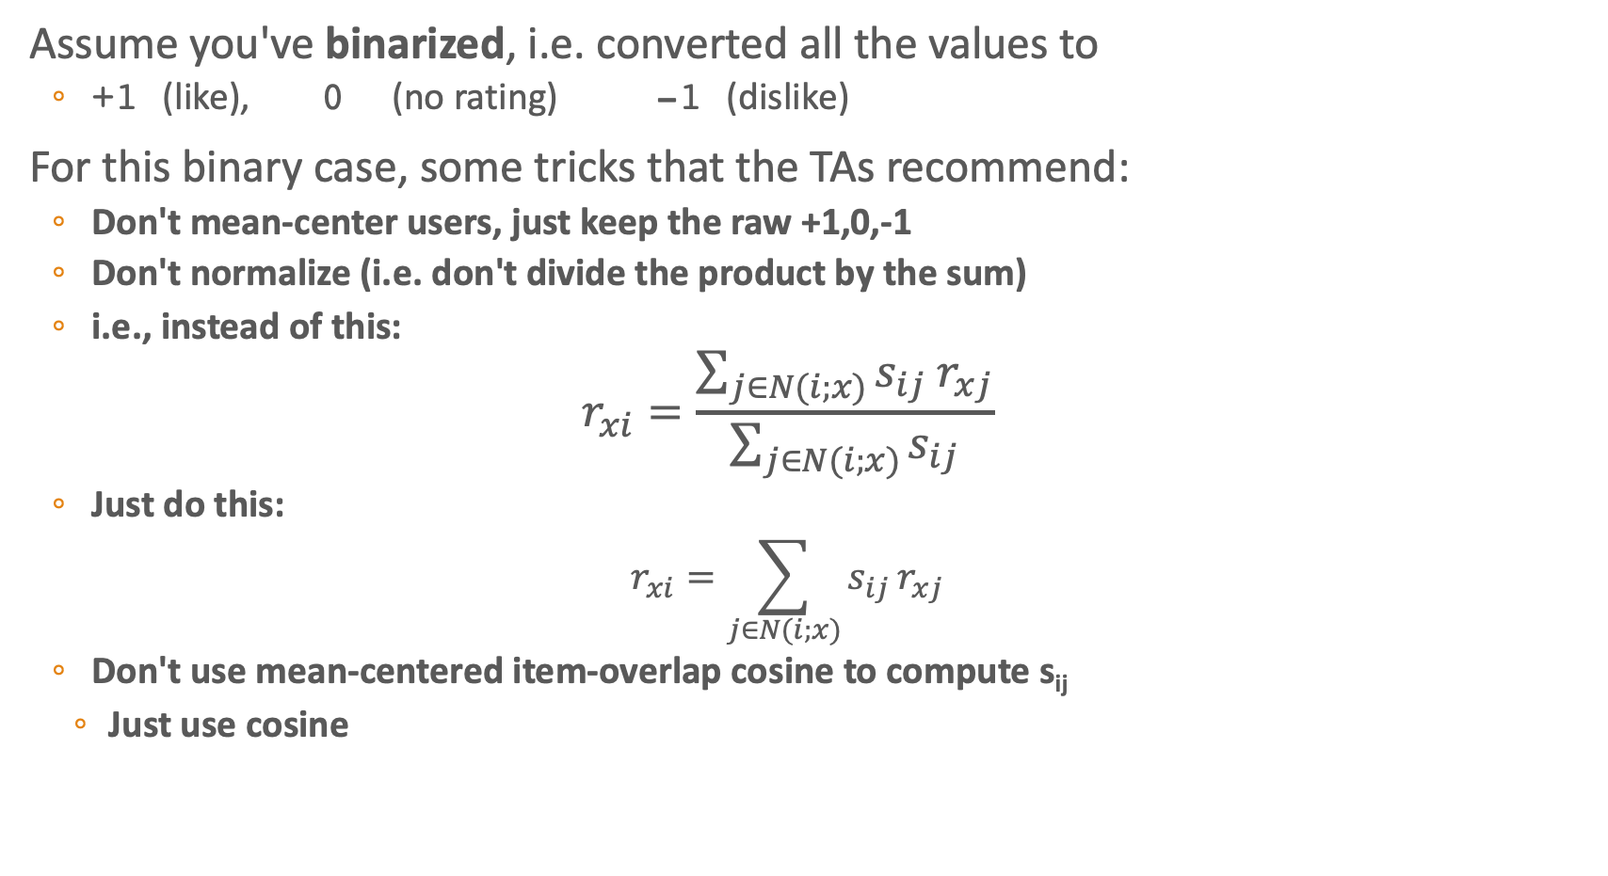
Simplified item-item for our tiny PA6 dataset
Assume you've binarized, i.e. converted all the values to
  +1 (like), 0 (no rating) -1 (dislike)
For this binary case, some tricks that the TAs recommend:
  Don't mean-center users, just keep the raw +1,0,-1
  Don't normalize (i.e. don't divide the product by the sum)
  i.e., instead of this:
    $$r_{xi}=\frac{\sum_{j∈N(i;x)}{s_{ij} r_{xj}}}{\sum_{j∈N(i;x)}{s_{ij}}}$$
  Just do this:
    $$r_{xi}=\sum_{j∈N(i;x)}{s_{ij }r_{xj}}$$
  Don't use mean-centered item-overlap cosine to compute s_{ij}
    Just use cosine
s_{ij}… similarity of items i and j
r_{xj}…rating of user x on item j
N(i;x)…set of items rated by x

Slide 59
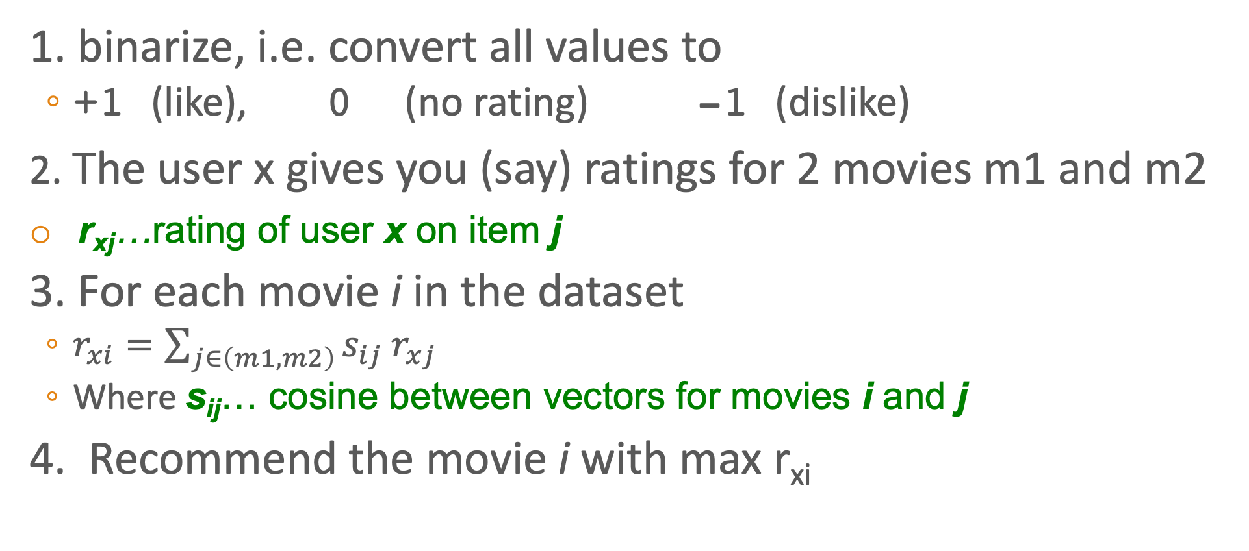
Simplified item-item for our tiny PA6 dataset
1. binarize, i.e. convert all values to
  +1 (like), 0 (no rating) -1 (dislike)
2. The user x gives you (say) ratings for 2 movies m1 and m2
r_{xj}…rating of user x on item j
3. For each movie i in the dataset
  $r_{xi}=\sum_{j∈\left(m1,m2\right)}{s_{ij} r_{xj}}$
  Where s_{ij}… cosine between vectors for movies i and j
4. Recommend the movie i with max r_{xi}

Slide 60
Recommender Systems and Collaborative Filtering
Simplified item-item similarity computation for our tiny PA6 dataset
Notes:
So the computation for PA6 is much simpler

Slide 61
Recommender Systems and Collaborative Filtering
Evaluation and Implications
Notes:
Let's talk about evaluation and some social implications

Slide 62
YouTube's Recommendation Algorithm
Covington, Adams, Sargin 2016. Deep Neural Networks for YouTube Recommendations
Represent each video and user as an embedding
Train a huge neural net classifier (softmax over millions of possible videos) to predict the next video the user will watch
Input features:
  User's watch history (video ids)
  User's recent queries (word embeddings)
  Date, popularity, virality of video
Learn embeddings for videos and users in training
Notes:
Let's first mention very briefly a more recent recommendation system algorithm, which basically combines collaborative filtering and content filtering by learning embeddings for both videos and users. What YouTube does, or did as of this paper, was train a huge neural net, with a softmax over millions of possible videos, to predict the next video the user will watch.
It takes as input features
And by training on huge numbesr of users selection of videos, the system learns a classifier, and simultaneously learns embeddings.
Now what's the loss function for this classifier? Accuracy at predicting whether a user will watch a video

Slide 63
Evaluation
movies
1 | 3 | 4
 | 3 | 5 |  |  | 5
 |  | 4 | 5 |  | 5
 |  | 3
 |  | 3
2 |  |  | 2 |  | 2
 |  |  |  | 5
 | 2 | 1 |  |  | 1
 | 3 |  |  | 3
1
users
Slides adapted from Jure Leskovec, CS246 and J. Leskovec, A. Rajaraman, J. Ullman: Mining of Massive Datasets
Notes:
That same loss function, or a related one, can be used to evaluate recommendation engines. In other words, we take our utility matrix

Slide 64
Evaluation
movies
1 | 3 | 4
 | 3 | 5 |  |  | 5
 |  | 4 | 5 |  | 5
 |  | 3
 |  | 3
2 |  |  | ? |  | ?
 |  |  |  | ?
 | 2 | 1 |  |  | ?
 | 3 |  |  | ?
1
users
Test Data Set
Notes:
and, like most other applications we've seen, hold out an unseen test set

Slide 65
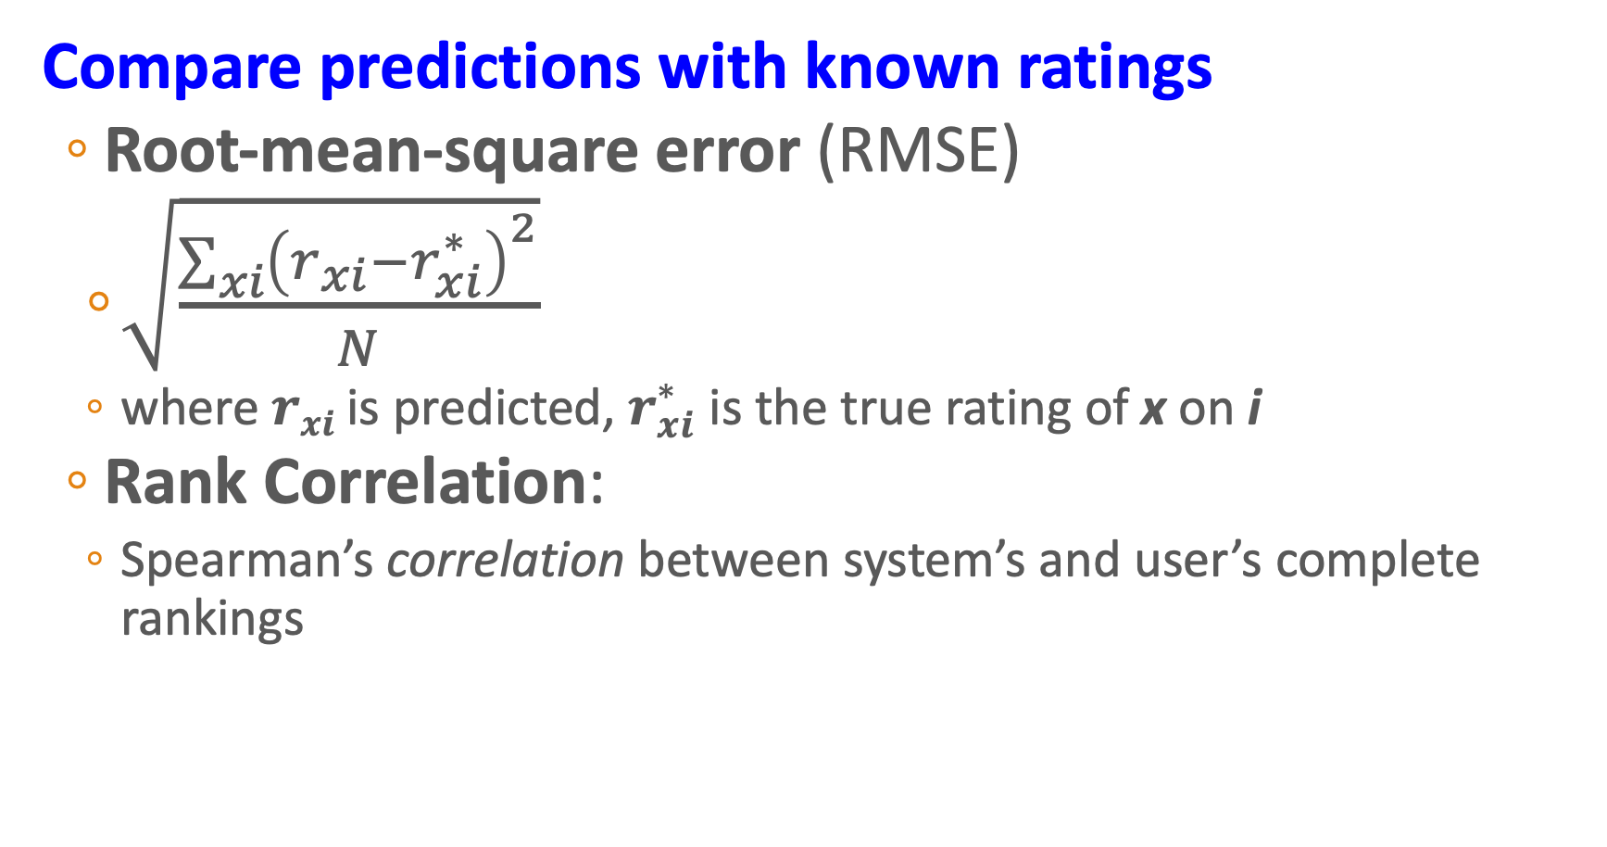
Evaluating Predictions
Compare predictions with known ratings
  Root-mean-square error (RMSE)
    $\sqrt{\frac{\sum_{xi}{{\left(r_{xi}−r_{xi}^{∗}\right)}^{2}}}{N}}$
    where $rxi$ is predicted, $r_{xi}^{∗}$ is the true rating of x on i
  Rank Correlation:
    Spearman’s correlation between system’s and user’s complete rankings
Slides adapted from Jure Leskovec, CS246 and J. Leskovec, A. Rajaraman, J. Ullman: Mining of Massive Datasets
Notes:
And then compare our system with what the users actual wanted or rated or purchased or listened to. Using the difference between the true and predicting videos (either by RMS error, or by a correlation with rankings)

Slide 66
But is predicting watching the right loss function?

Slide 67
What could go wrong? Ethical and societal implications in recommendation engines.
Milano, Silvia, Mariarosaria Taddeo, and Luciano Floridi. "Recommender systems and their ethical challenges." AI & SOCIETY 35, no. 4 (2020): 957-967.
Spread of misinformation and propaganda
Filter bubbles
Inappropriate or unethical content
Opacity
Violating user privacy

Slide 68
What could go wrong? Ethical and societal implications
Howard, Ganesh, Lioustiou. 2019. The IRA, Social Media, and Political Polarization in the United States, 2012-2018
Propaganda campaigns
  Russia Internet Research Agency (IRA)
    attack on the United States 2013-2018
    computational propaganda on YouTube, Facebook, Instagram, to misinform/polarize US voters.
    Goal: induce African American, Mexican American voters to boycott elections

Slide 69
Ethical and societal implications: Filter bubbles
How YouTube Drives People to the Internet's Darkest Corners
Google's video site often recommends divisive or misleading material, despite recent changes designed to fix the problems
“I realized really fast that YouTube’s recommendation was putting people into filter bubbles,” Chaslot said. “There was no way out. If a person was into Flat Earth conspiracies, it was bad for watch-time to recommend anti-Flat Earth videos, so it won’t even recommend them.”

Slide 70
“The question before us is the ethics of leading people down hateful rabbit holes full of misinformation and lies at scale just because it works to increase the time people spend on the site – and it does work”
  – Zeynep Tufekci

Slide 71
Open research questions
What would algorithms look like that could recommend but also include these social costs?

Slide 72
Recommender Systems and Collaborative Filtering
Evaluation and Implications
Notes:
It's crucial to study how to design more socially responsible recommender systems

