Slide 1

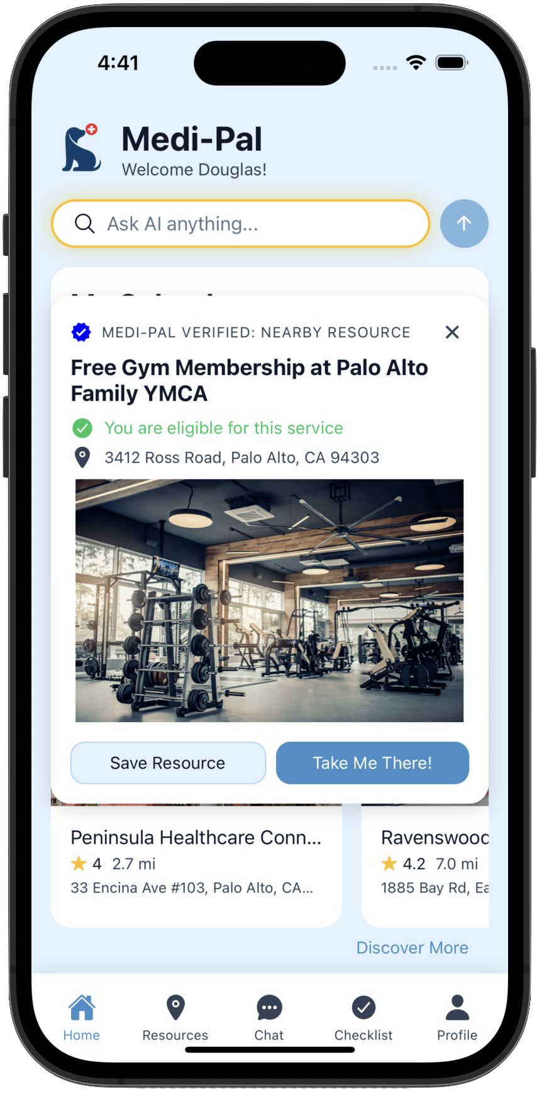
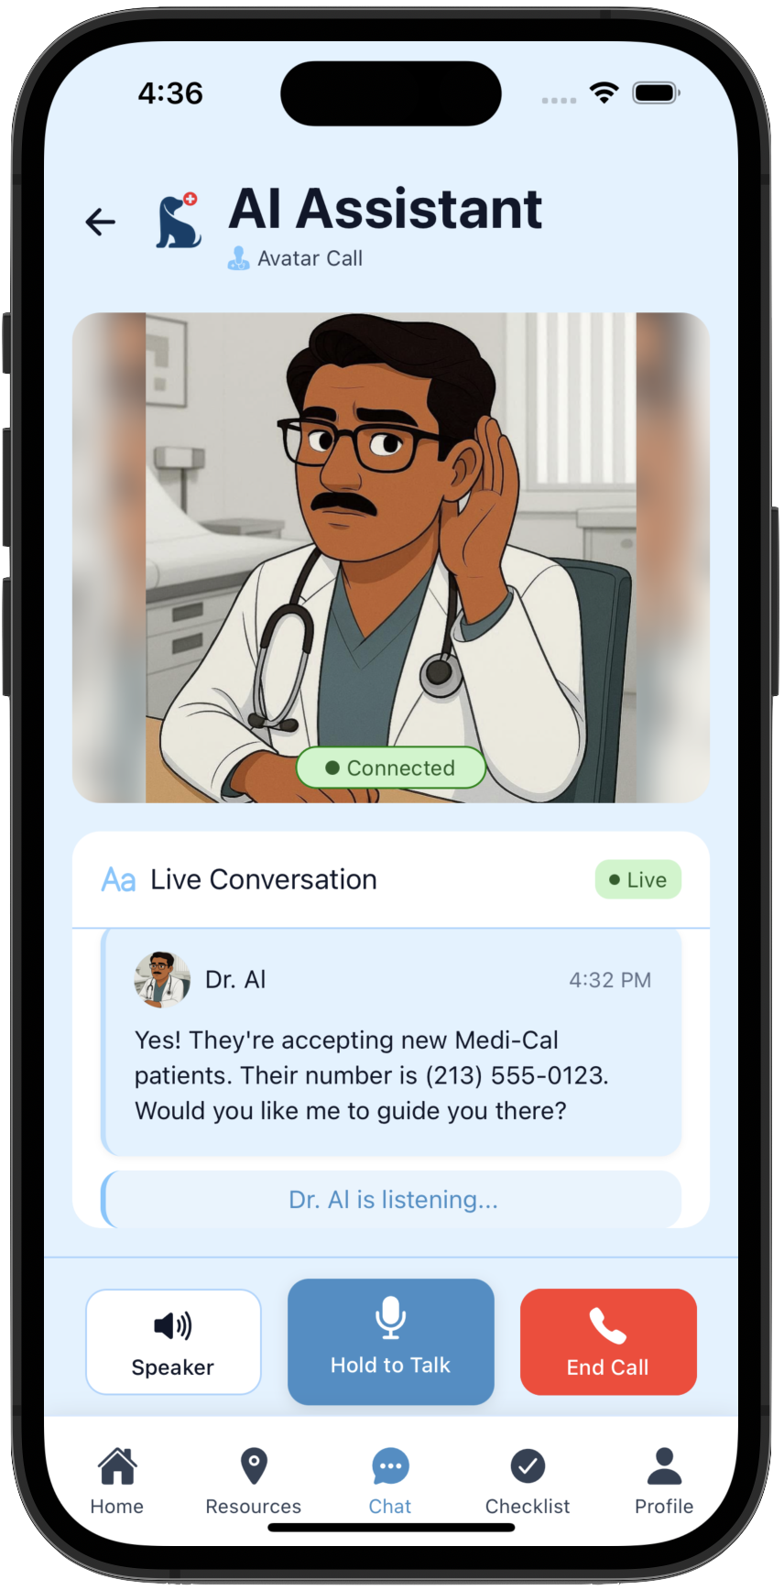
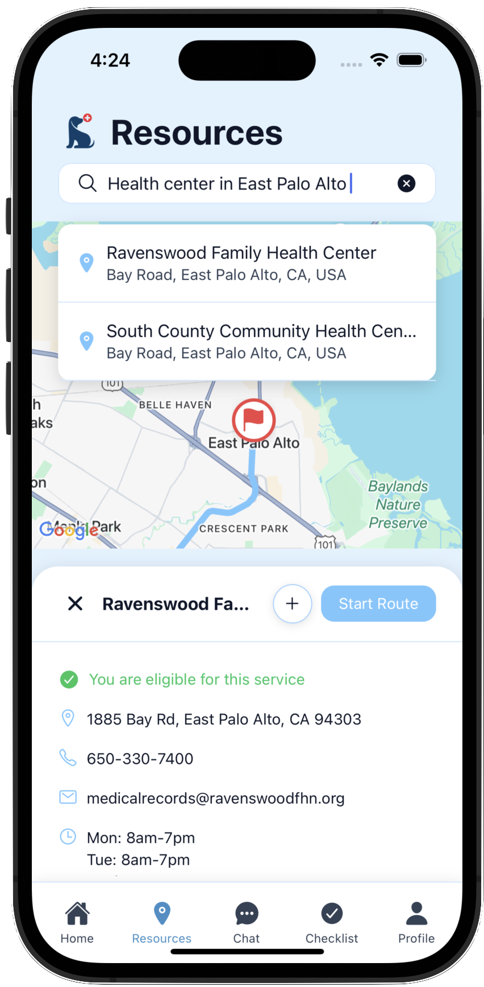
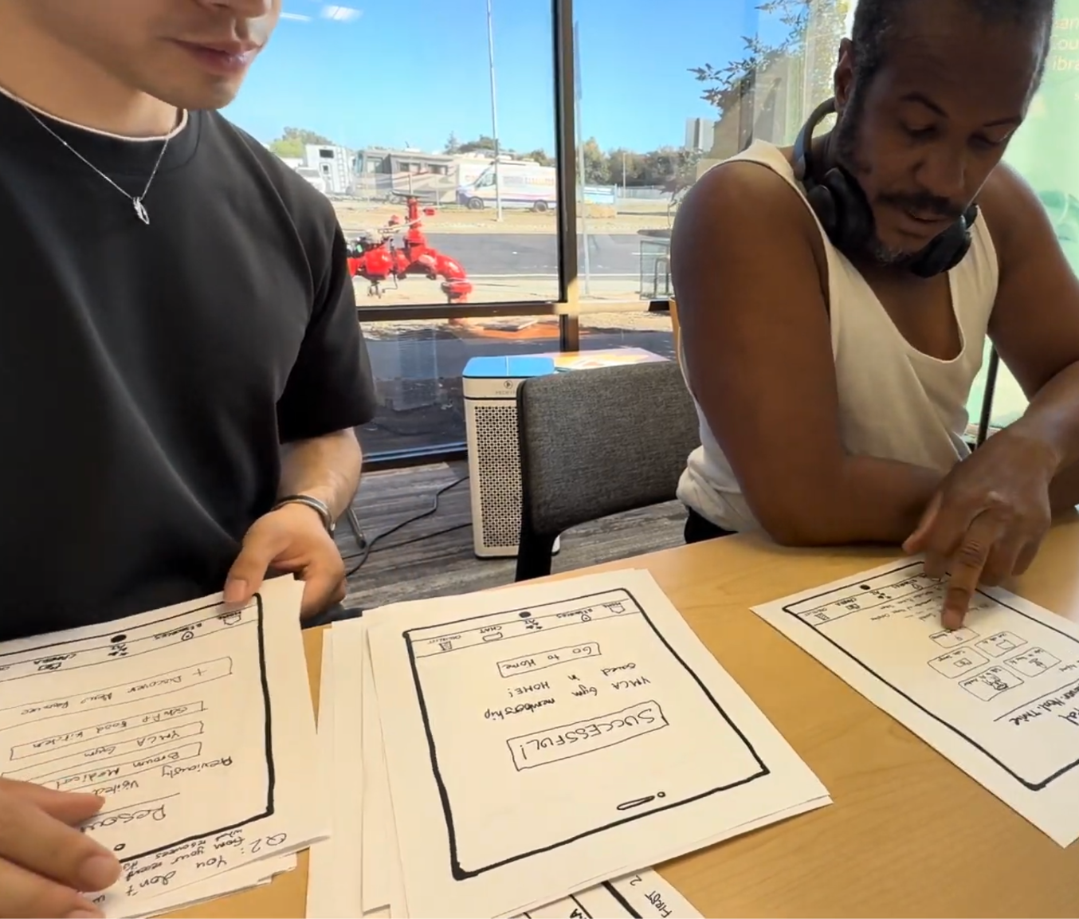
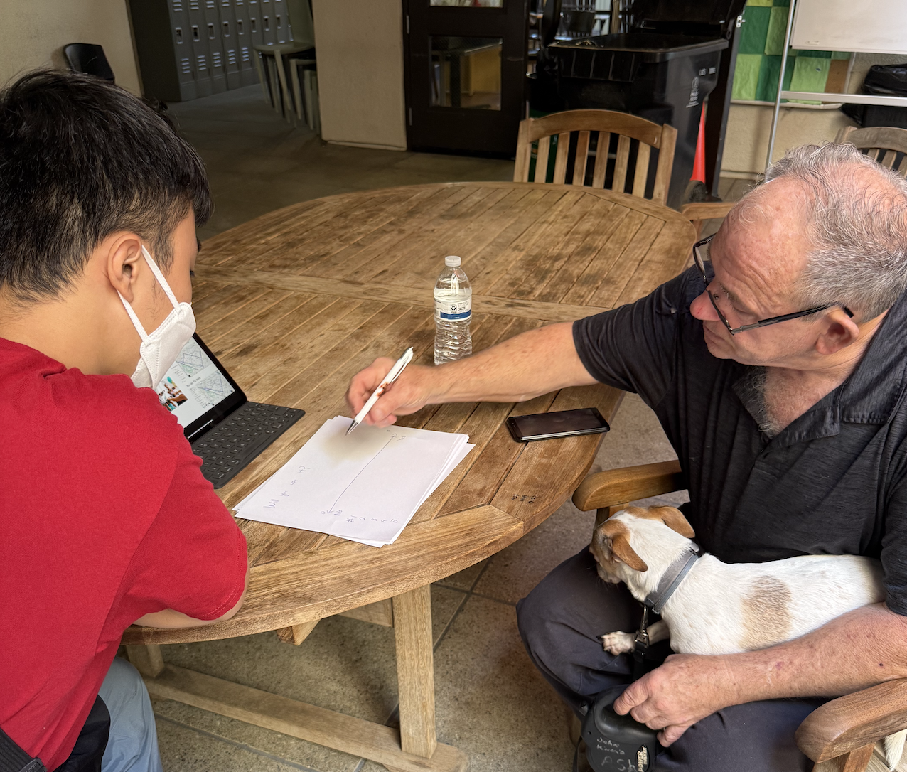
Medi-Pal
Designed by the people, for the people
Discover. Heal. Thrive.
Notes:
Script: We all feel like taxes keep going up, but have you ever stopped to wonder if all that money actually reaches the people who need it most? This year, California spent over $44.9 billion on Medi-Cal alone, nearly 40% of the state budget. Yet millions of low-income Californians who qualify for these benefits don’t even know where to start. The system is confusing, directories are overwhelming, and most platforms just wait for users to figure it out. That’s where we step in. Our platform instantly connects users to nearby Medi-Cal resources, provides personalized recommendations and reminders, and uses voice and avatar AI to make the experience feel human. We don’t wait for people to search; we actively guide them to get the care they deserve.
Source: https://lao.ca.gov/Publications/Report/5092#:~:text=our%20outlook%20estimates.-,Background,rising%20costs%20in%20the%20program.

