Slide 1

Medi-Pal
A6: Siddhartha J, Douglas K, Nash Y

Slide 2
Team Name and Value Proposition
Why Medi-Pal?
Conveys a sense of friendliness and companionship
Designed to be a ‘pal’ that guides through complexities of Medi-Cal: an always-available assistant that feels approachable
Medi-Pal Discover. Heal. Thrive.
Why this value proposition?
Helps users find, truly understand, and leverage Medi-Cal resources to improve health and well-being
Unlike catalogs or resource databases, Medi-Pal takes a proactive approach in users’ health

Slide 3
Problem & Solution
Problem
Solution
Low awareness, confusion, and inaction due to complex Medi-Cal information and lack of personalized guidance
Millions of low-income Californians qualify for Medi-Cal benefits but don’t know where to start or how to access/leverage them
Existing directories are overwhelming, hard to act on, and unintuitive
Platform that helps users instantly find nearby Medi-Cal resources with clear contact and access details
Personalized recommendations and reminders based on each user’s needs, eligibility, and location
More targeted and proactive than existing platforms: Medi-Pal actively nudges users instead of waiting for them to search + leverages voice/avatar AI to provide a human-touch

Slide 4
Values in Design: Overview
1
2
3
Reliability
Inclusivity
Hyper-Personalization
Definition: Medi-Pal consistently delivers accurate and dependable support.
Context: Users need a platform they can trust to work every time with low friction, especially when navigating complex medical information.
Definition: Medi-Pal is designed to be accessible for everyone, regardless of background, education, or technical ability.
Context: Clear design and language ensure marginalized users can confidently use the platform, as highlighted in prototype feedback.
Definition: Medi-Pal provides empathetic and human-centered guidance to provide a hyper-personalized experience.
Context: Users want to feel understood and supported, creating a sense of solidarity when seeking help (Experience Prototype feedback).

Slide 5
Values in Design: Expression
Reliability
Inclusivity
Hyper-Personalization
Database of resources strictly managed by social workers and clinics: ensures only verified, credible information reaches users
Limited AI scope to resource-finding only: prevents overreach into medical advice or diagnoses outside system competency
Professional oversight and accountability: users can trust information source rather than unmoderated content
Voice input option: accommodates users with limited literacy, visual impairments, or physical disabilities
Cross-platform support including kiosk access: reaches users without smartphones or reliable internet
Simple, clean interface design: reduces cognitive load for users with limited digital literacy or high stress
Community ambassadors & avatars in AI chat: creates tailored, relatable representation that reflects user communities
Conversational AI interface: adapts responses to individual user needs and communication styles
Dog mascot in branding: adds friendly, personalized touch that makes each interaction feel warm and individualized rather than institutional

Slide 6
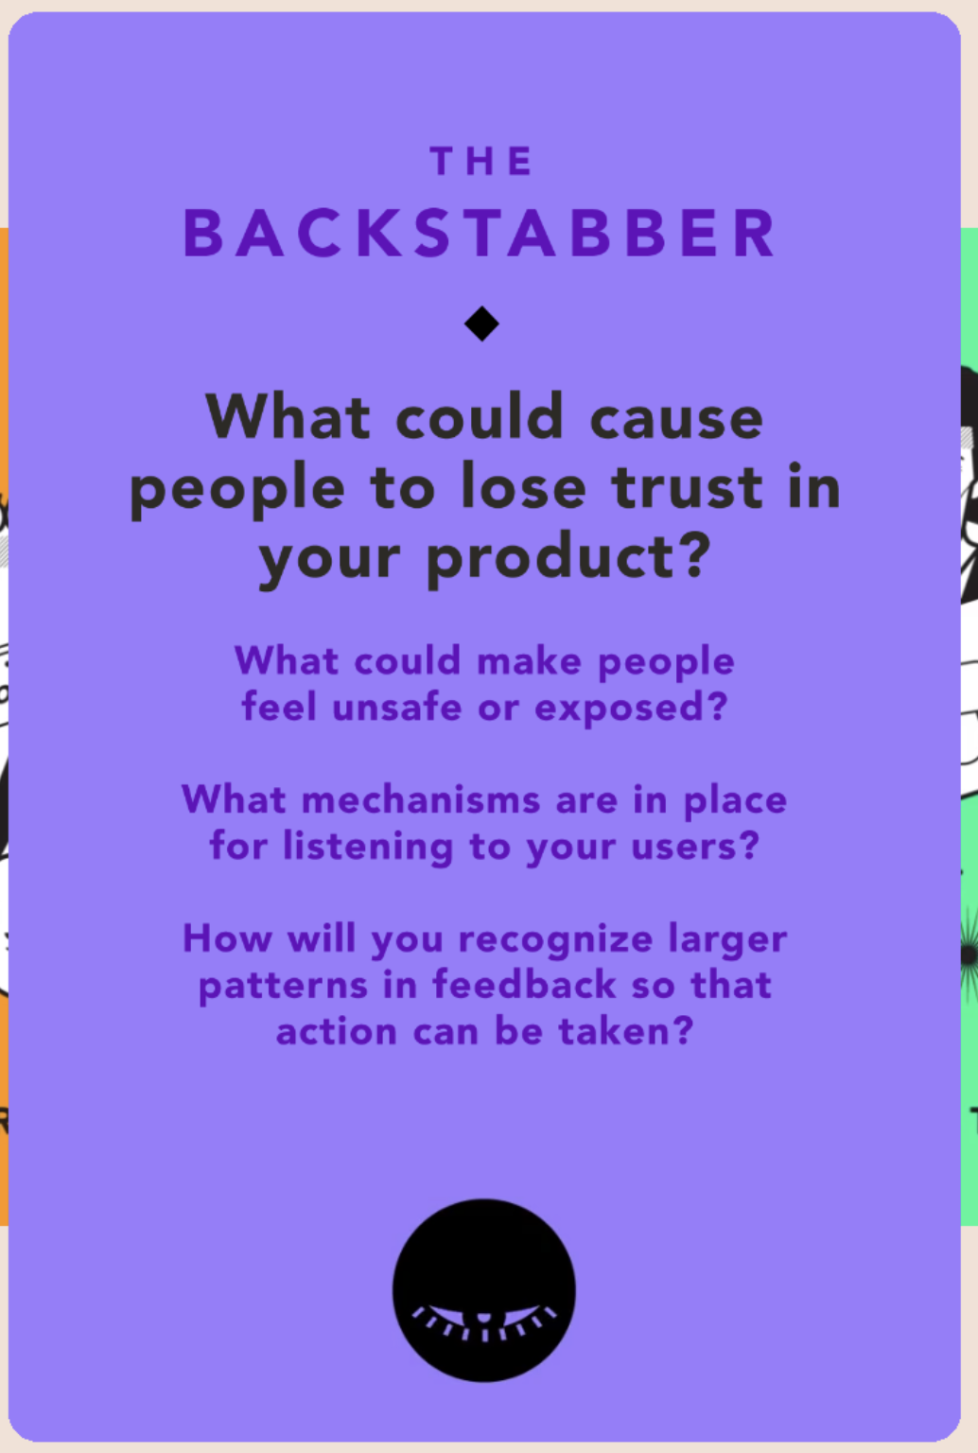
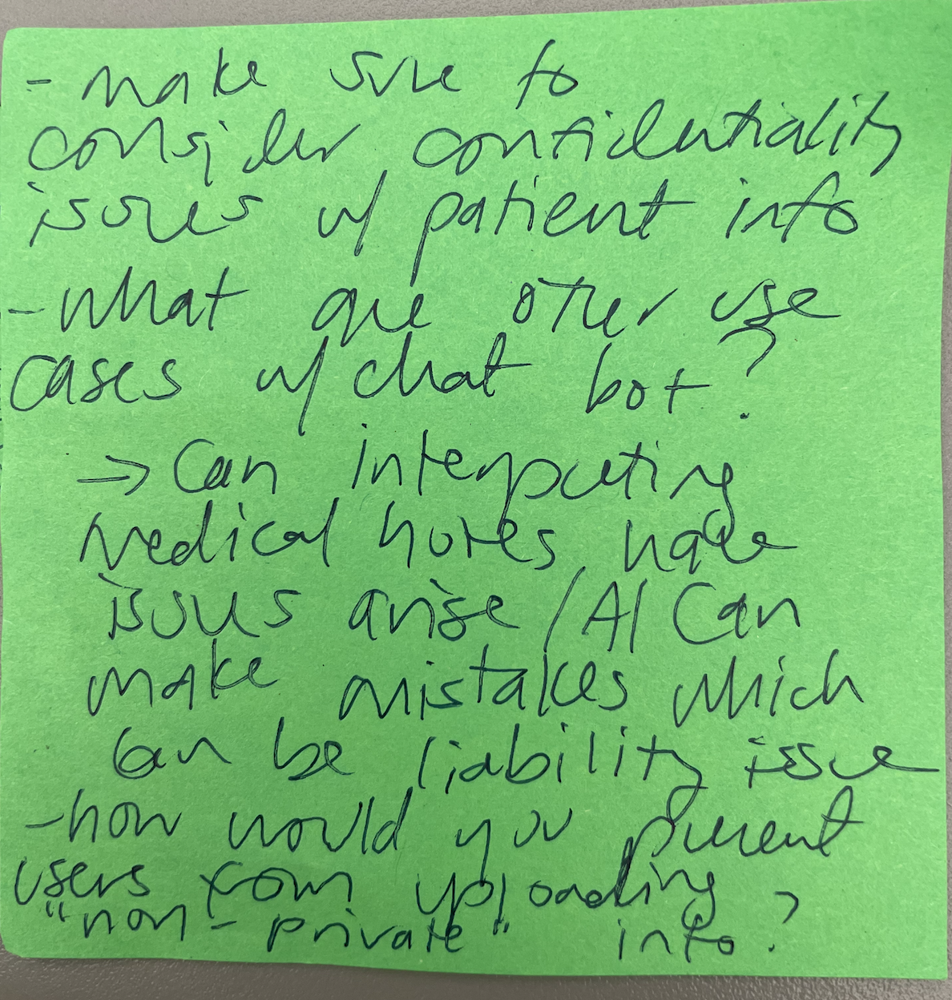
Value Tensions: Reliability
Factual Errors and Misinformation
Risk of harm: If Medi-Pal contains outdated or incorrect information about a resource, users would have to waste unnecessary costs on travelling and even lost wages. This is detrimental to our target demographic of low-income users.
Diversity of Choice vs Accurate Information: Should we provide users with a wide range of resources to choose from (which may contain unverified information), or a smaller set of verified resources that are carefully audited?
Overlooked stakeholders: Regulators such as California Department of Health Care Services (DHCS) may hold us accountable for any misrepresentation or harm.
Mitigation strategy: Allow users to report incorrect information, so we can perform audits.
Incorporation of Artificial Intelligence
Risk of harm: AI-generated guidance may inadvertently reinforce biases or provide recommendations that are not equitable across all populations due to limitations in training data. Users could make decisions based on AI suggestions that unintentionally disadvantage them.
Transparency vs Usability: Should we fully disclose how AI makes recommendations, even if it complicates the user experience, or simplify explanations at the risk of obscuring potential biases?
Overlooked stakeholders: Regulators, advocacy groups, and ethics boards may hold us accountable if AI recommendations lead to unfair outcomes or biased guidance.
Mitigation strategy: Implement clear disclaimers, allow users to provide feedback on AI suggestions, and frequently train/fine-tune LLMs on verified medical content.
Saniya's feedback note to provide guardrails on AI usage to limit uncontrollable outputs
Notes:
Do any value tensions arise as a consequence of your design decisions? How can these tensions be addressed?

Slide 7
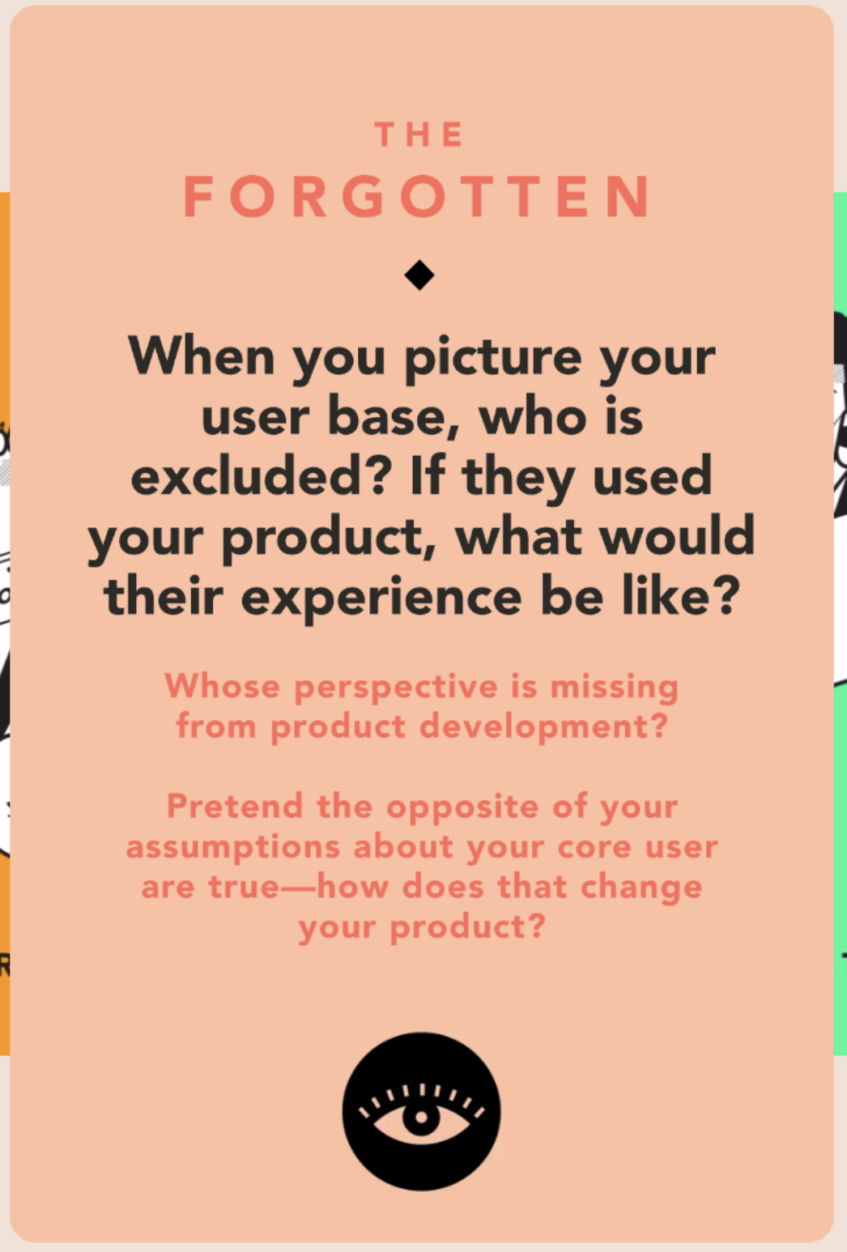
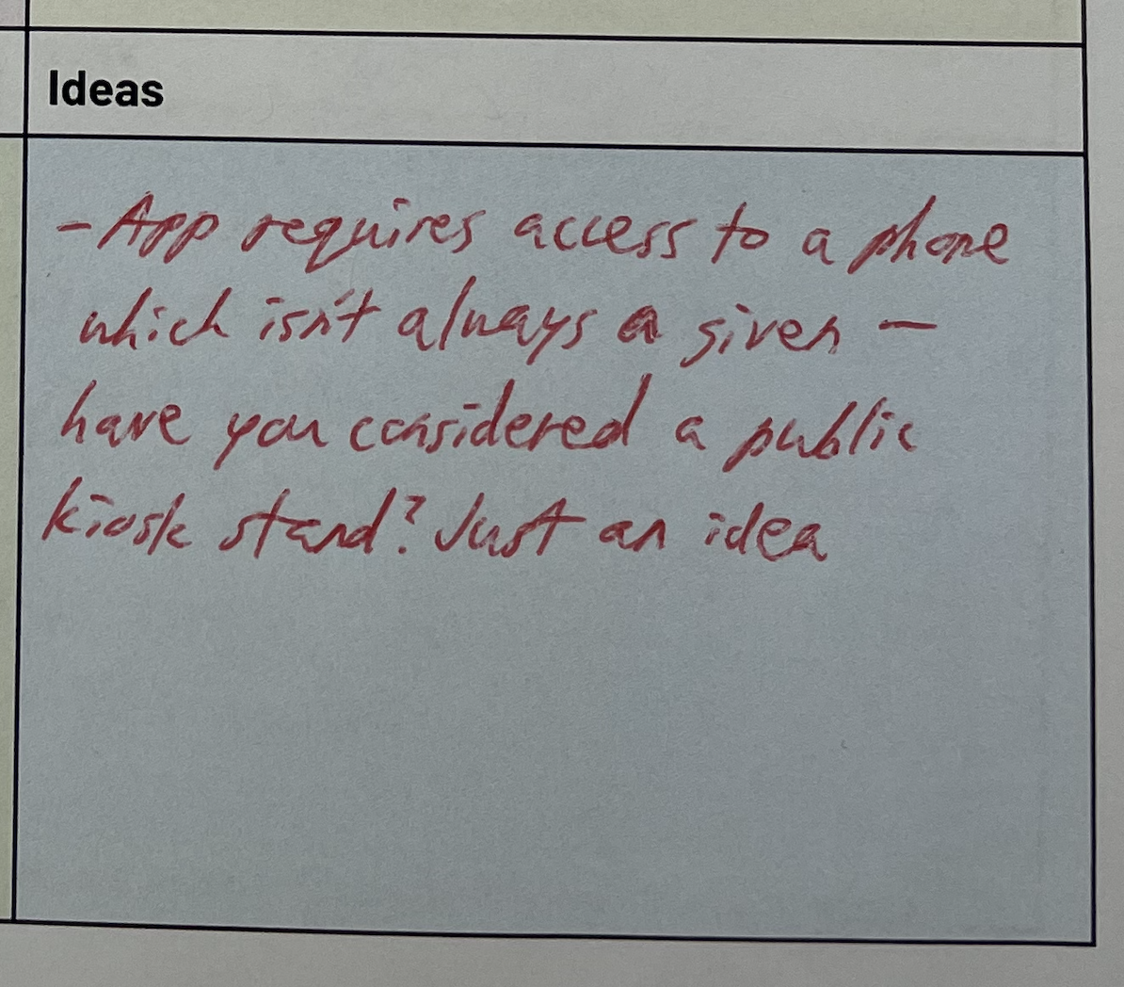
Value Tensions: Inclusivity
No Digital Device
Risk of harm: Users without smartphones or computers may be excluded from Medi-Pal entirely, limiting access to crucial resources. This disproportionately affects low-income users.
Tradeoff: Should we focus on building a feature-rich digital platform, or also provide offline/low-tech alternatives (e.g., SMS, printed guides) to ensure access for everyone?
Overlooked stakeholders: Community organizations and clinics that serve low-income populations may be impacted if some users can’t access the platform digitally.
Mitigation strategy: Explore alternative access methods such as SMS-based guidance, community kiosks, or printable resources to reach users without digital devices.
Multilingual Users
Risk of harm: Users who prefer Spanish or other non-English languages may misunderstand critical health or resource information, leading to missteps or missed care.
Tradeoff: Should we provide translations for all content (resource-intensive), or prioritize the most common languages first, potentially leaving smaller language groups underserved?
Overlooked stakeholders: Multilingual users, translators, and advocacy groups who ensure equitable access to healthcare information.
Mitigation strategy: Start with translations for the most common languages (e.g., Spanish), include clear language selection, and allow users to request additional language support over time.
Samuel’s suggestion of using a kiosk stand
Notes:
Do any value tensions arise as a consequence of your design decisions? How can these tensions be addressed?

Slide 8
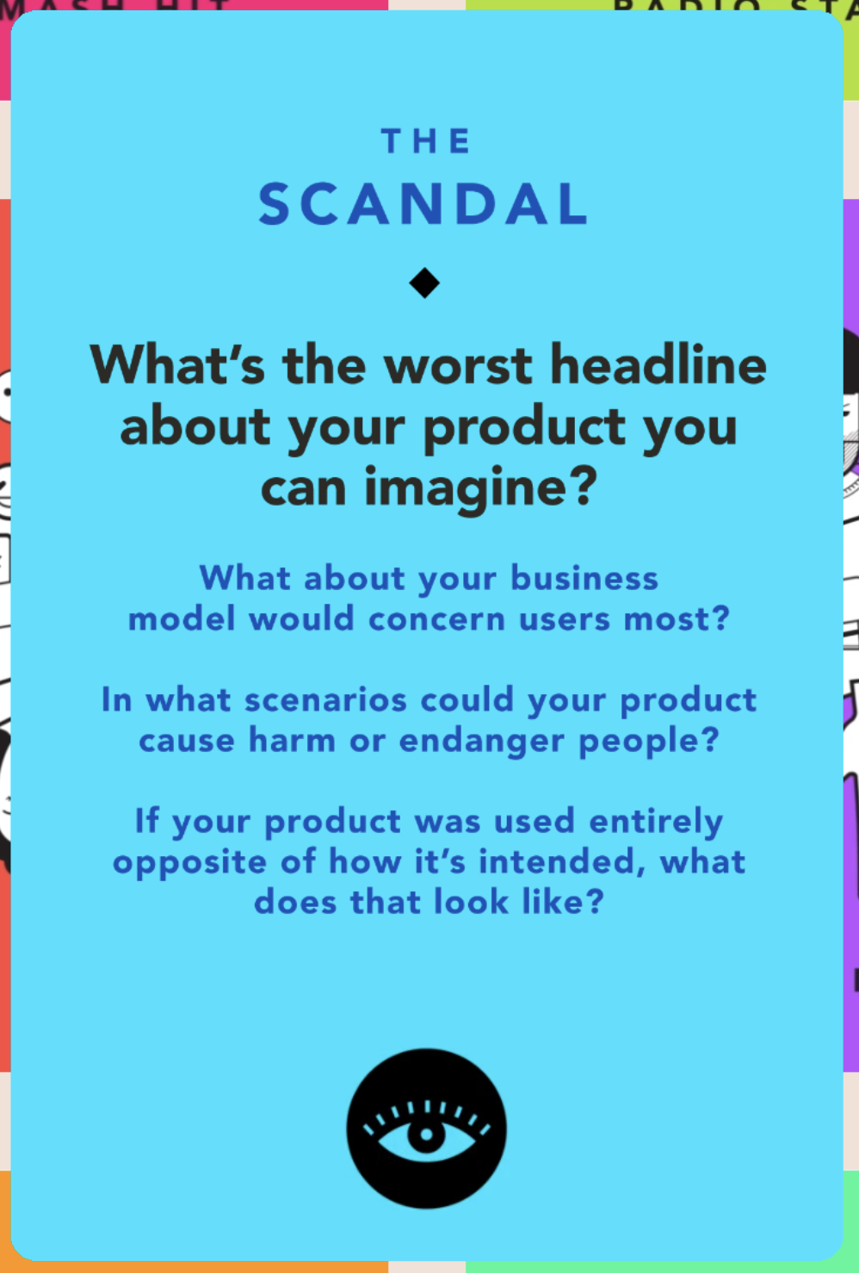
Value Tensions: Hyper-Personalization
Data Privacy Issue
Risk of harm: Personalized recommendations based on user data may inadvertently expose sensitive information or reinforce existing disparities.
Privacy vs Usefulness: Should Medi-Pal collect detailed personal data to provide highly tailored guidance, even if it raises privacy concerns, or limit data collection to protect users but provide less personalized recommendations?
Overlooked stakeholders: Users, privacy regulators, and ethics boards may hold Medi-Pal accountable if personalization leads to privacy breaches or biased outcomes.
Mitigation strategy: Implement strict data privacy measures, anonymize data where possible, allow users to control personalization settings, and regularly audit recommendations for fairness and equity.
AI Avatar Cloning
Risk of harm: Cloning avatars of real community members could misrepresent people, spread false impressions, or unintentionally create content that users might take as real advice or endorsements.
Authenticity vs Engagement: Should the platform allow AI-generated avatars for enhanced engagement, even if there’s a risk of misrepresentation, or limit avatar use to avoid potential ethical issues?
Overlooked stakeholders: Community members whose identities are cloned, users who might rely on misleading avatars, and regulators concerned with digital impersonation or misinformation.
Mitigation strategy: Clearly label AI-generated avatars, obtain consent before replicating real people, and implement safeguards to prevent misuse of cloned avatars.
Notes:
Do any value tensions arise as a consequence of your design decisions? How can these tensions be addressed?

Slide 9
Old Tasks
Discover nearby resources
Search for specific resource
Personalized Wellness Planner
Simple Task
Moderate Task
Complex Task
Users learn about which Medi-Cal resources/ facilities are near their location.
Users can proactively find specific Medi-Cal resources based on their specified criteria.
Users receive personalized guidance from Medi-Pal on how they can leverage Medi-Cal resources to support and maintain a healthy lifestyle and wellbeing.

Slide 10
Modifications:
Discover nearby resources
Search for specific resource
Personalized Wellness Planner
Make plans for healthy habits
Users want to learn about which Medi-Cal resources / facilities are near their location.
Users can proactively find specific Medi-Cal resources based on their specified criteria.
Users receive personalized guidance from Medi-Pal on how they can leverage Medi-Cal resources to support and maintain a healthy lifestyle and wellbeing.
User-Goal Focused vs Feature-Focused
The original "Personalized Wellness Planner" was feature-focused - it described what the system does (provides personalized guidance). The new "Make plans for healthy habits" is goal-focused - it describes what the user wants to accomplish.
Users want to form new habits for maintaining a healthy lifestyle and wellbeing.
Notes:
User wants to make everyday, healthy living practices habits, rather than after-thoughts

Slide 11
New Tasks
Discover nearby resources
Proactively find specific resource
Make plans for healthy habits
Simple Task
Moderate Task
Complex Task
Users learn about which Medi-Cal resources/ facilities are near their location.
Users can proactively find specific Medi-Cal resources based on their specified criteria.
Users want to form new habits for maintaining a healthy lifestyle and wellbeing.

Slide 12
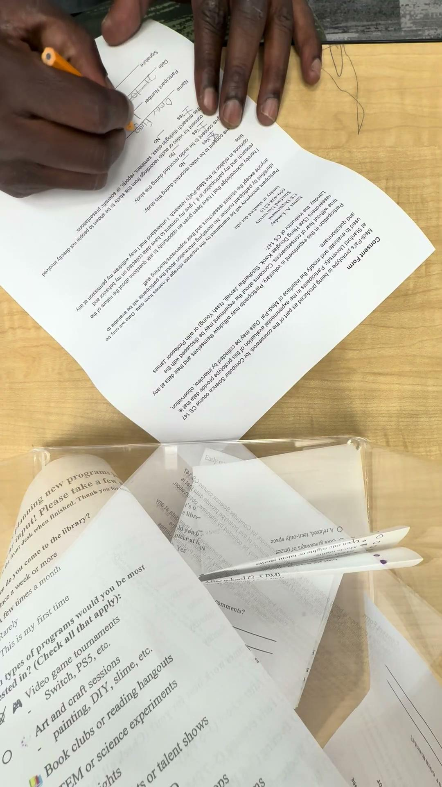
Usability Goals & Progress: Learnability
Results in Low-Fi Prototype
Task 1: Several users were confused about how to locate the pop-up notification.
Task 2: Significant learnability barriers. Confusion between “Find Nearby Resources” button & “Resources” tab → high variability in number of errors & explanations.
Task 3: Users were able to quickly learn how to complete this task.
  Caveat: User input was predetermined and we could not truly evaluate if users can learn how to ask queries that gave the desired responses.
Changes needed
Redesign pop-up notification for nearby resources
Pop-up notification should be larger, and shifted to the center/ bottom half of the screen.
Rationale: In our low-fi prototype testing, several users did not notice the pop-up notification. One user ignored it multiple times because he thought it was an advertisement, as he explains in the video on the right.
Task | Avg. number of errors (SD) | Avg. number of explanations (SD)
Task 1: Discover Nearby Resources | 2.50 (0.58) Should be lowered. | 0.75 (0.50) Can be lowered.
Task 2: Search for specific resource | 4.00 (2.45) Should be lowered. | 2.00 (1.41) Should be lowered.
Task 3: Make plans for healthy habits | 0.50 (0.58) No changes required. | 0.00 (0.00) No changes required.
How this helps us achieve our key goals: This change addresses the root cause of user errors. Most errors occurred because some users failed to notice the pop-up notification, and fixing this issue would improve learnability as users make fewer mistakes.
Merge “Find Nearby Resources” button & “Resources” tab
We need to make both buttons point to the same “Resources” page instead of different pages.
Rationale: In our low-fi prototype testing, several users could not complete the task independently because they kept pressing the “Find Nearby Resources” button when trying to access the “Resources” page. The word “find” was misleading as users may associate it with initiating a search.
How this helps us achieve our key goals: This confusion was a significant learnability barrier, and removing it would significantly decrease the number of errors made & explanations needed, allowing users to complete the task independently. This is important because if users cannot easily figure how to use Medi-Pal, they would refuse to use it.
Notes:
During low-fidelity prototype testing, several users were unable to complete the task independently because they repeatedly clicked the “Find Nearby Resources” button when trying to access the “Resources” page. The wording “find” was misleading, as users associated it with initiating a search rather than navigating to the resources.

Slide 13
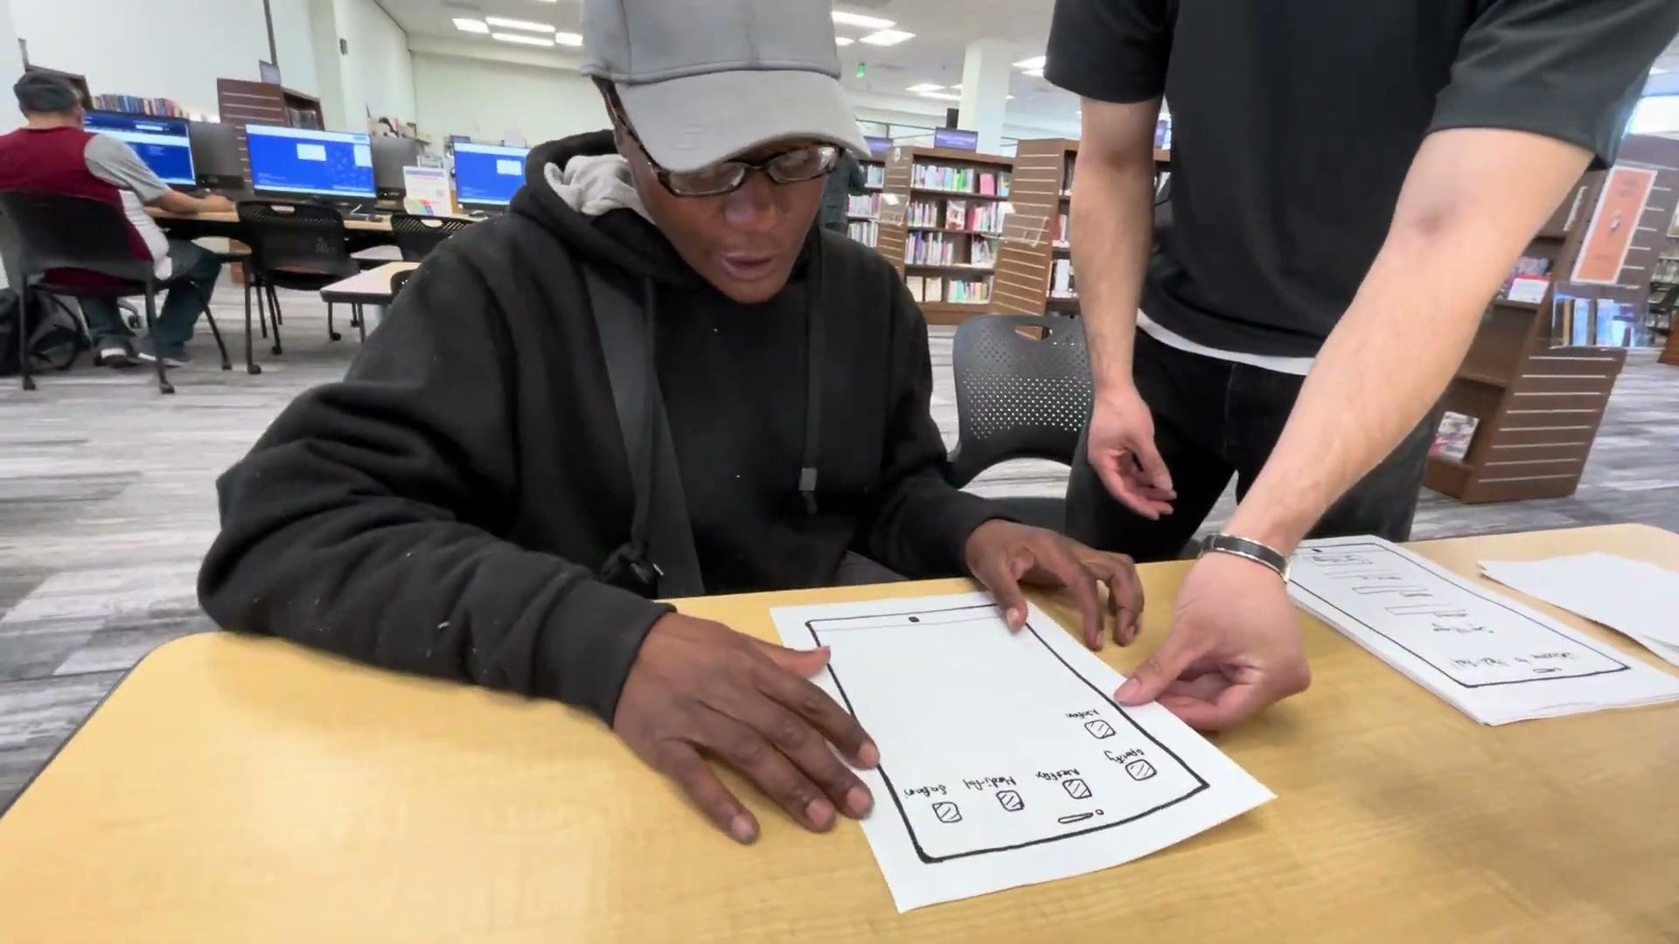

Usability Goals & Progress: Efficiency
Results in Low-Fi Prototype
Task 1: Users were slowed down by the confusing layout of the pop-up notification. Efficiency can be enhanced with an AI-driven menu.
Task 2: There were efficiency bottlenecks as users did not notice the bottom tabs.
Task 3: Users were not slowed down by any errors and were highly efficient, as users did not have to search for any buttons.
Key Takeaway: Interacting with AI is faster and more effortless than searching for navigation buttons.
Changes needed
Larger navigation buttons in home screen
Users should be able to complete all tasks using the large buttons in the home screen, and not have to search the bottom tabs.
Rationale: During the low-fi prototype testing phase, most users noticed the home screen buttons and would even (incorrectly) interact with them repeatedly. This suggests that the home screen buttons are intuitive and visible entry points for completing the task.
Task | Avg. task completion time (SD)
Task 1: Discover Nearby Resources | 2:29 (0:49) Should be lowered.
Task 2: Search for specific resource | 3:42 (2:11) Should be lowered.
Task 3: Make plans for healthy habits | 1:46 (0:38) No changes required.
How this helps us achieve our key goals: According to Fitt’s Law, the large buttons in the home screen are more easily accessible than the bottom tabs, which are typically smaller and further away from the user’s focus. This allows users to complete their task more efficiently.
Speed up navigation by allowing users to chat with AI instead of search for buttons
Each page of Medi-Pal should be accessible via our AI chat feature (i.e., our AI chat feature should be able to guide users to the relevant page).
Rationale: For multiple tasks, most of our users’ first instinct was to click “Chat with AI” instead of search the navigation menu, as shown in the videos on the right. This suggests that users view interacting with AI as more effortless than searching for navigation buttons.
How this helps us achieve our key goals: For Task 2, our users’ (i.e., Quinn’s) task efficiency improved significantly after we allowed users to directly access specific pages through the “Chat with AI” button. From this observation, we extrapolate that an AI-powered navigation system would increase user efficiency and reduce the difficulty of navigating the app.
Notes:
During low-fidelity prototype testing, most users noticed and interacted with the home screen buttons repeatedly, indicating that these were the most intuitive and visible entry points for completing tasks.
According to Fitt’s Law, the large buttons in the home screen are more easily accessible than the bottom tabs, which are typically smaller and further away from the user’s focus.

Slide 14
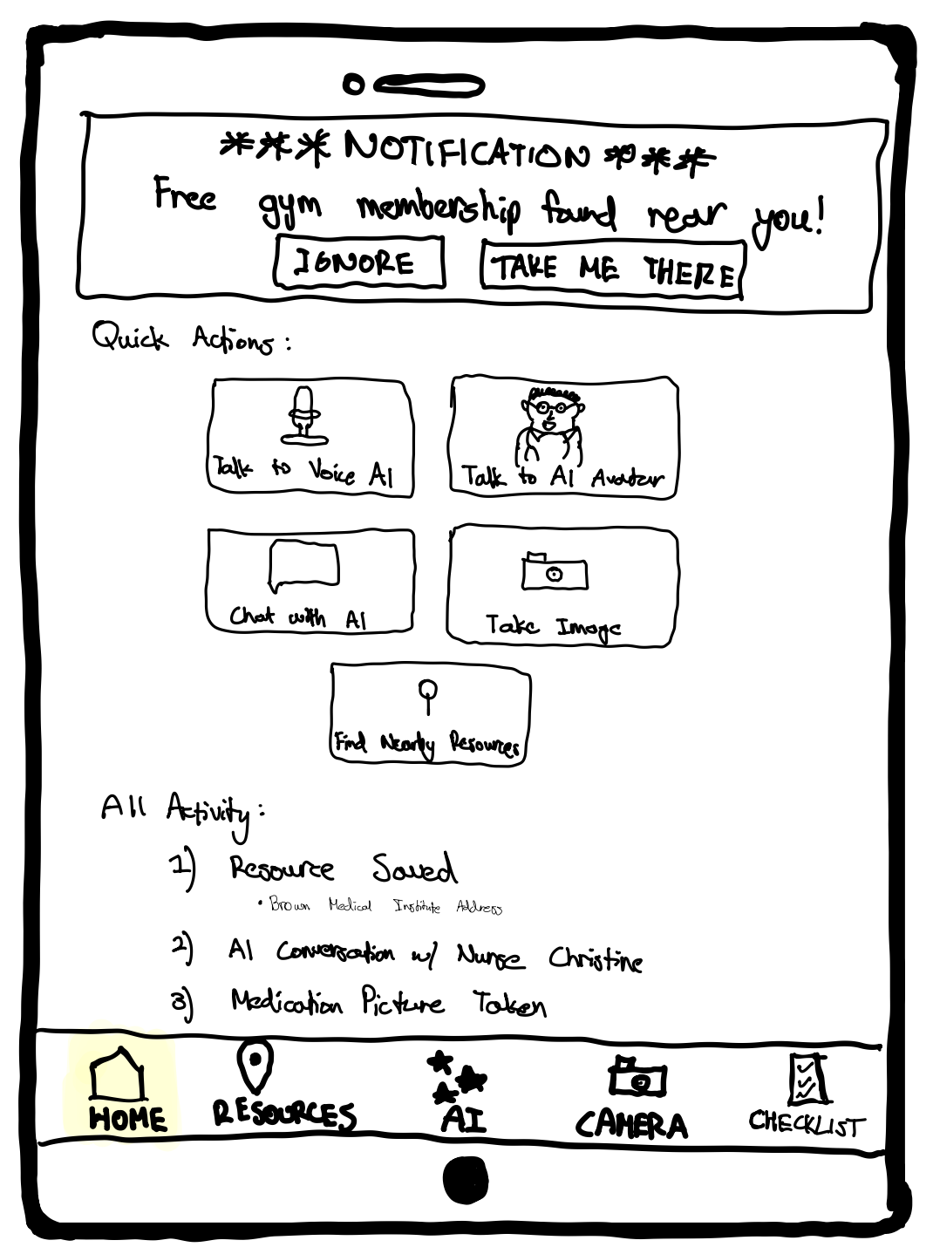
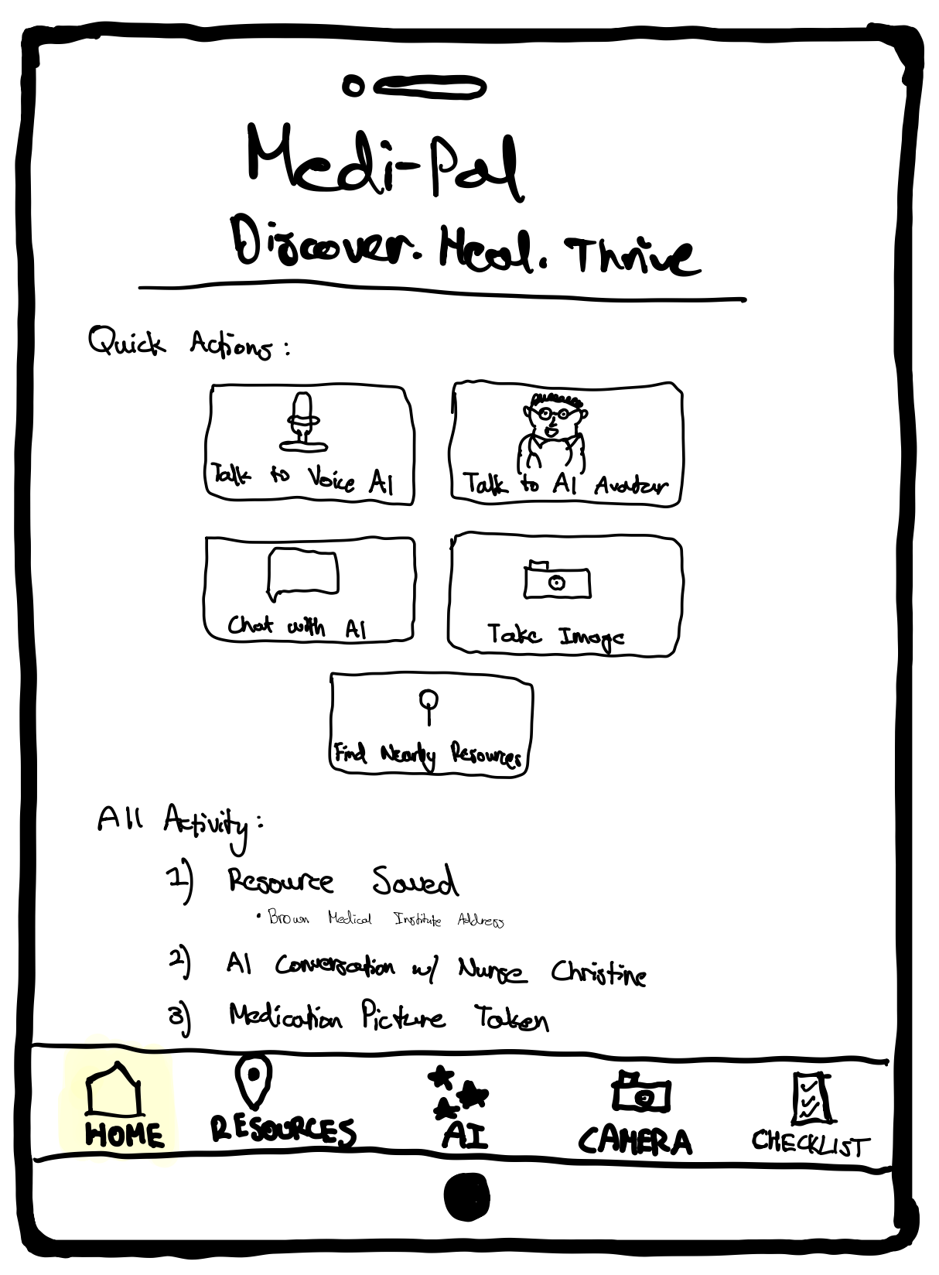
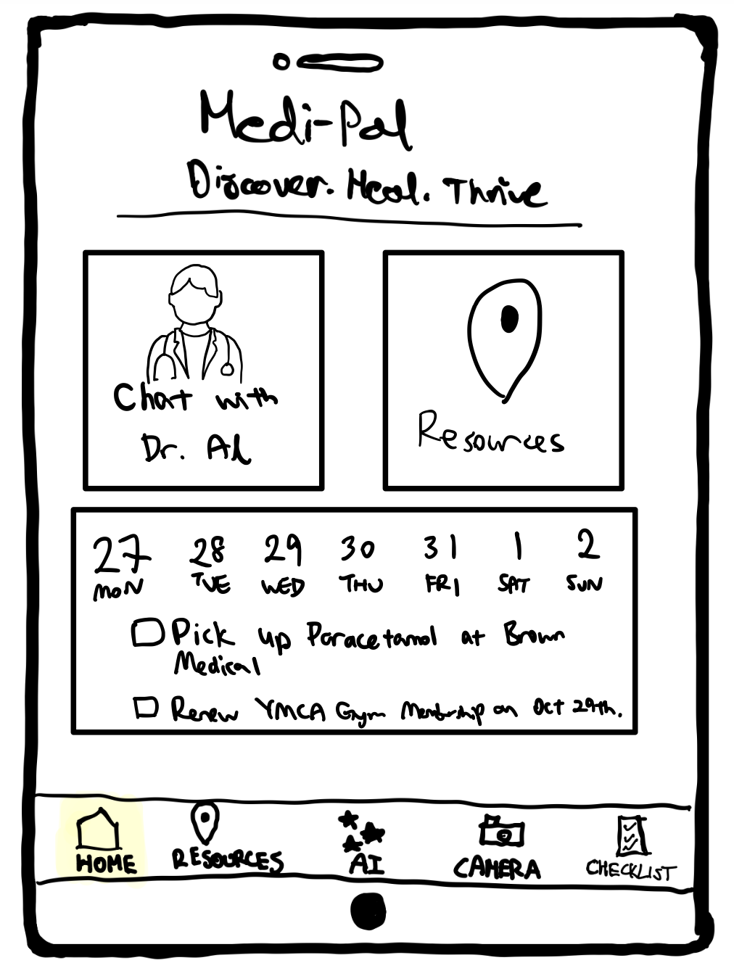
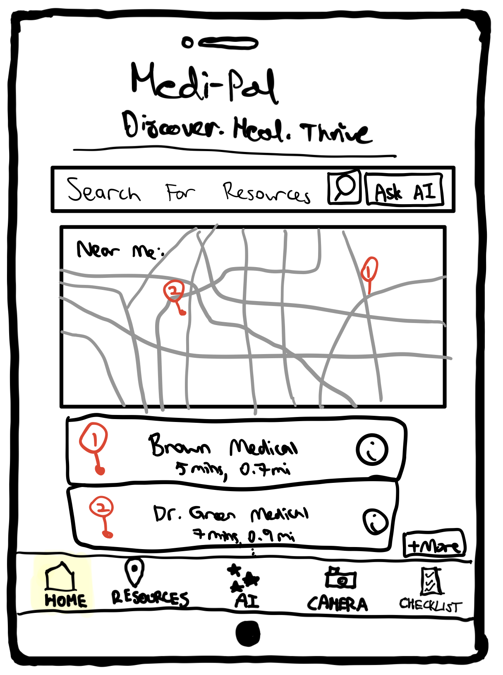
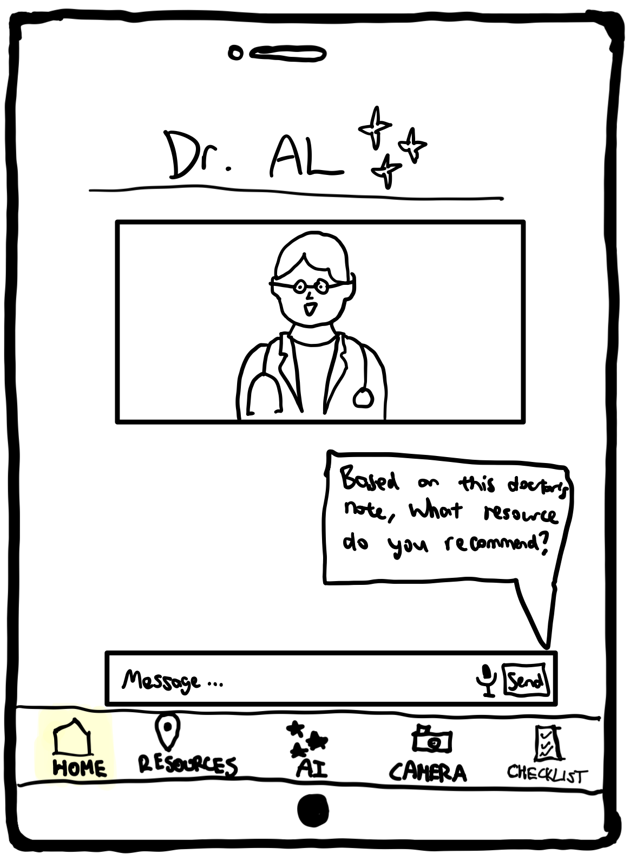
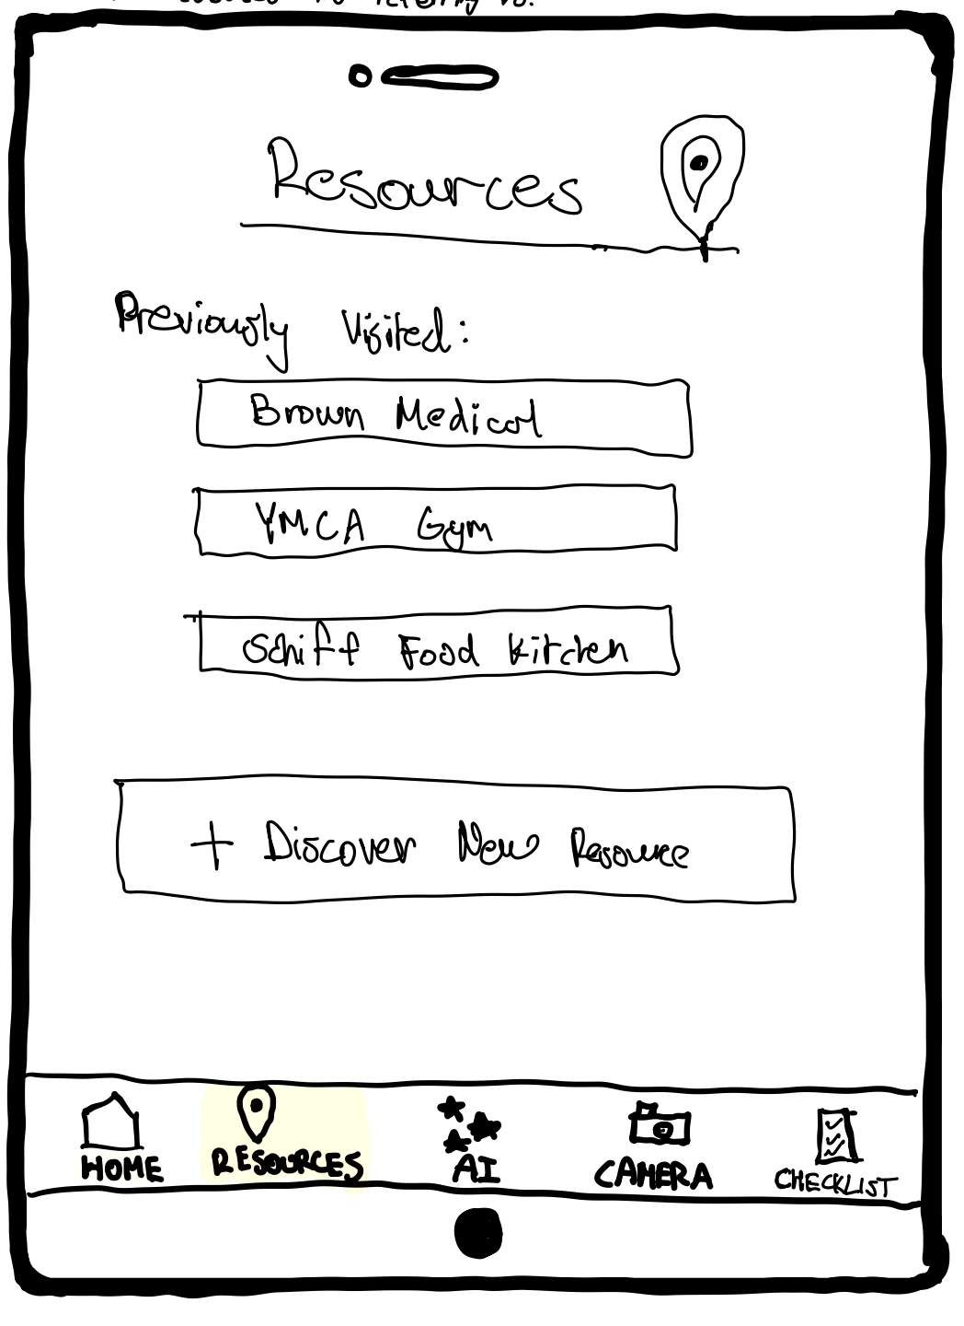
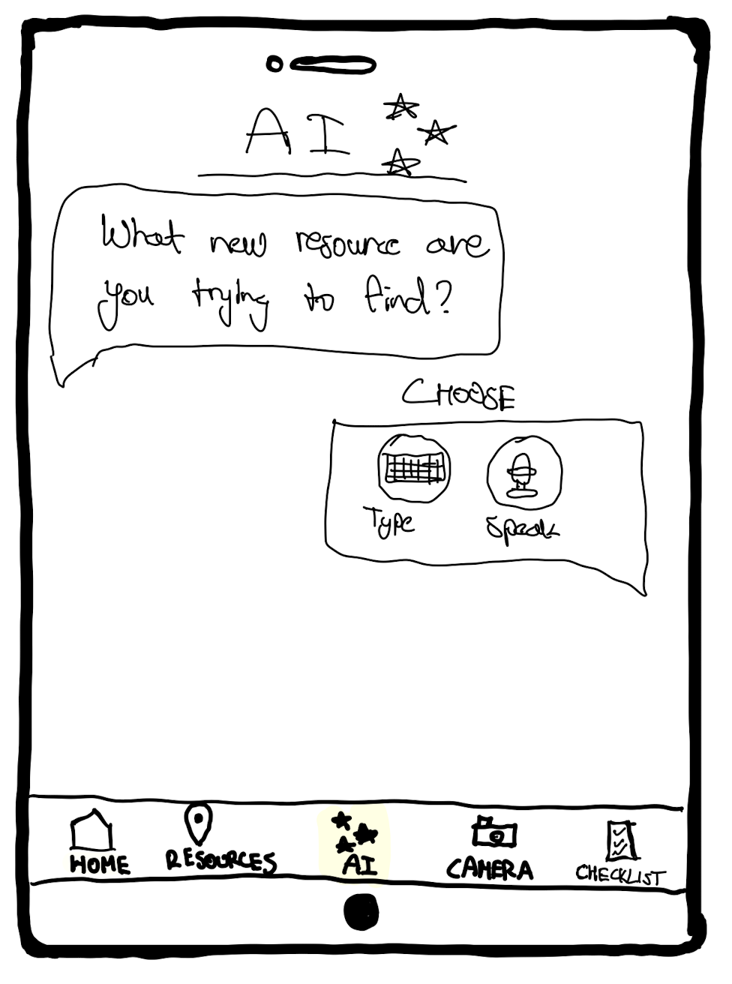
Major Change #1: Re-design of “Resources” page
Before
(Moderate Task)
After
Users had to click different buttons for searching resources and finding nearby resources, which caused confusion.
Both buttons bring users to the same “Resources” page.
The “Resources” page satisfies both functionalities of allowing users to search for resources and viewing nearby resources.
We changed the button name to “Resources” to emphasize that this is the same page as the “Resources” tab on the bottom.
User is automatically notified about nearby resources by default - no setup needed
User clicks “Find Nearby Resources”
Users can type in their query and press “Ask AI” to send their query to the AI avatar.
Home button made larger for more efficient access (Fitt’s Law)
Clicking both buttons lead to the same page
User is notified about nearby resource
User clicks “Resources” tab
User clicks “Discover New Resources
Home Page
Home Page
Resources Page
AI page for searching new resources
(details & rationale of new design are shown in Major Change #3)
We merged “nearby resources” and “search for resources” into the same page to fulfill the user’s expectations of the app.
Map is added so users can browse nearby resources.
Resources Page
AI page for searching new resources
Notes:
b. How will these changes aid in progressing forward with your usability goals?
c. Explain how the changes address issues identified from low-fi testing results, studio feedback, user needs, etc. Include evidence to back up the changes made. d. Before and after comparisons with annotations and labels as needed e. If you have more than 3 changes you want to show, add the rest to the appendix

Slide 15
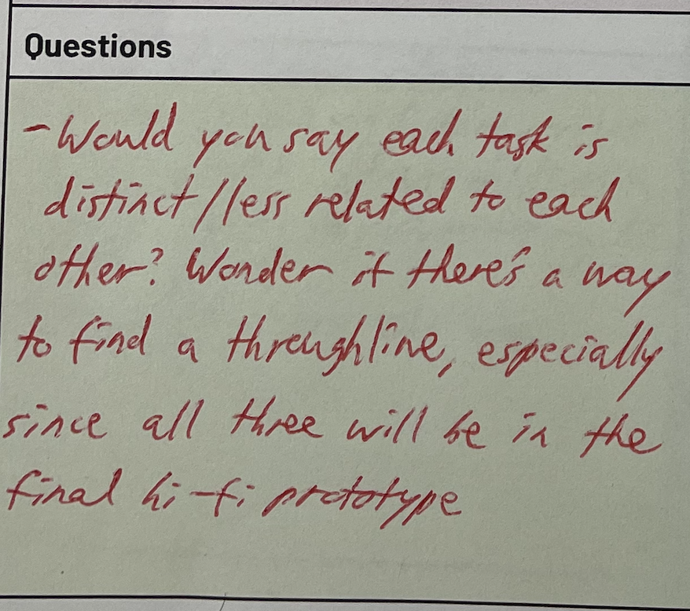
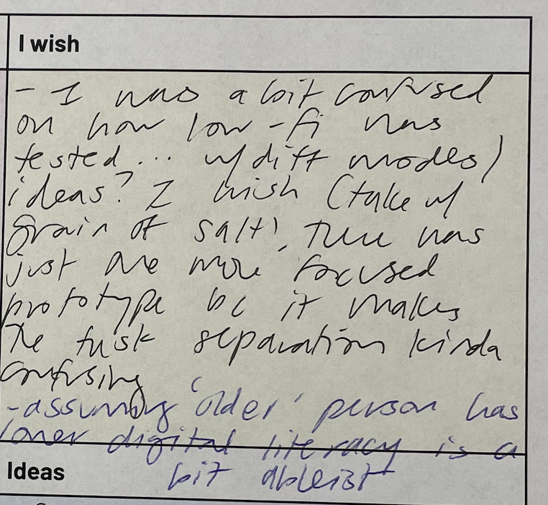
Major Change #1: Re-design of “Resources” page
Rationale
Progress on Usability Goals
Low-fi Prototype Feedback
Users could not distinguish between the “Find Nearby Resources” and “Resources” → this suggests a mismatch in our conceptual models → we will resolve this by following the user’s conceptual model.
Learnability: Alignment to the user’s conceptual model leads to increased learnability. They would make fewer errors (key metric) and need fewer explanations (key metric), as the app behavior aligns with their expectations.
Efficiency: Repeated mistakes are alleviated when our design matches the user’s conceptual model → reduces task completion time (key metric).
Usefulness: Polly gave the lowest rating, likely because of frustrations with learnability and efficiency → by addressing these concerns, users like Polly may perceive our app to be more useful (key metric).
Critical Incident: Polly spent >6 minutes on this task because of repeatedly clicking the wrong buttons. Only completed the task after we improvised a new task flow to accommodate her.
Modifications: Combined “Resources” and “Find Nearby Resources” into a centralized page where users can view nearby resources and search for specific resources. This new conceptual model is emphasized by our redesign of the “Find Nearby Resources” button into a “Resources” button that is identical to the “Resources” tab on the bottom.
Studio Feedback from Peers
Saniya AND Samuel noted that our simple & moderate tasks felt too similar - both involved finding resources, and both needed users to press a button.
In our redesign, we clarified the distinction:
  Simple Task: Users receive notifications AUTOMATICALLY without needing to click a button. They can also see resources without needing to input.
  Moderate Task: Users put additional effort to specify which resource they want and interpret the AI’s suggestions.
Usefulness: If users are confused between how they can use our app to complete different tasks, they may feel that our app is not relevant to their needs. Adding more clarity between tasks helps users understand when and how each feature is used → increased perceived usefulness rating (key metric).
Samuel’s and Saniya’s feedback about the tasks being too similar.
Modifications: Added search bar in the “Resources” page, which explicitly signals to users that they will need to provide input to complete the Moderate task (i.e., search for particular resource); removed the confusing task flow where clicking “Find Nearby Resources” results in a pop-up notification.
Theoretical Support
Another Modification: We enlarged and centered the buttons on the home page to make the “Resources” page easily accessible. This helps increase efficiency, as users can complete tasks faster when buttons were larger and positioned closer to the part of the screen they usually interact with (i.e., the center), according to Fitt’s Law.
Efficiency: Enlarging the home page buttons may not save much time per interaction, but this action is performed repeatedly → leads to reduced task completion time (key metric).
Notes:
How will these changes aid in progressing forward with your usability goals? c. Explain how the changes address issues identified from low-fi testing results, studio feedback, user needs, etc. Include evidence to back up the changes made.

Slide 16
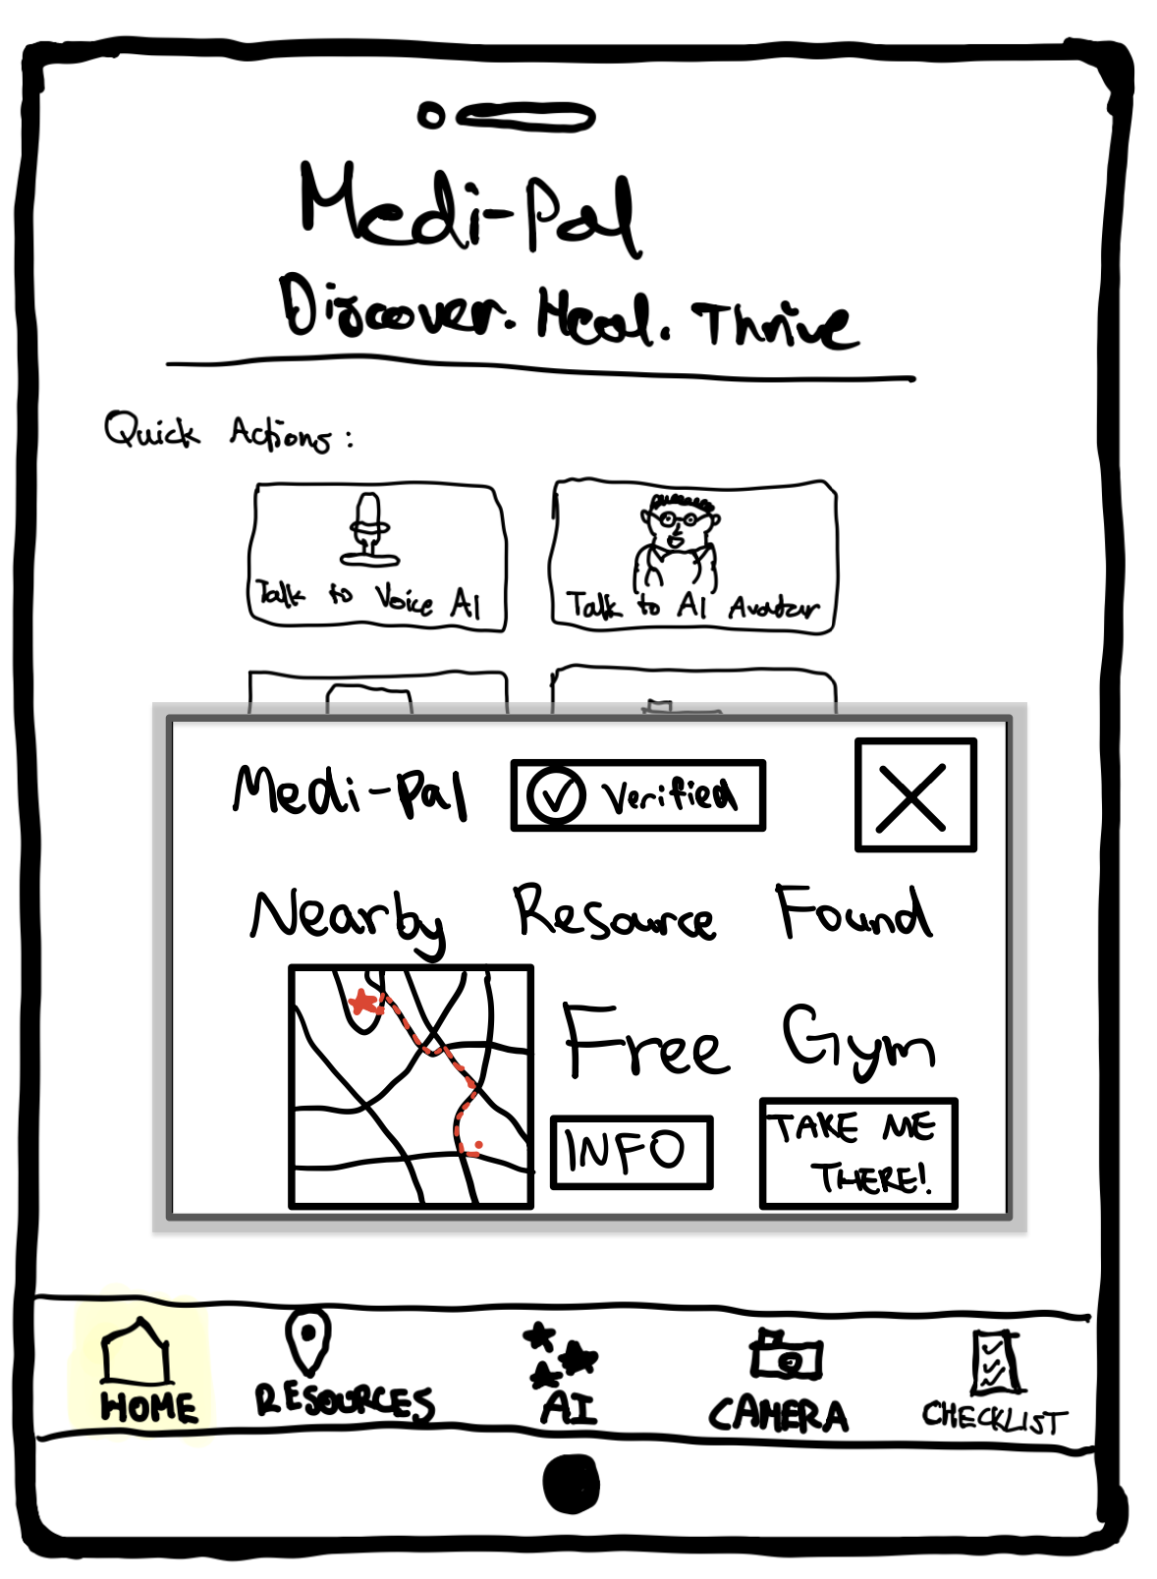
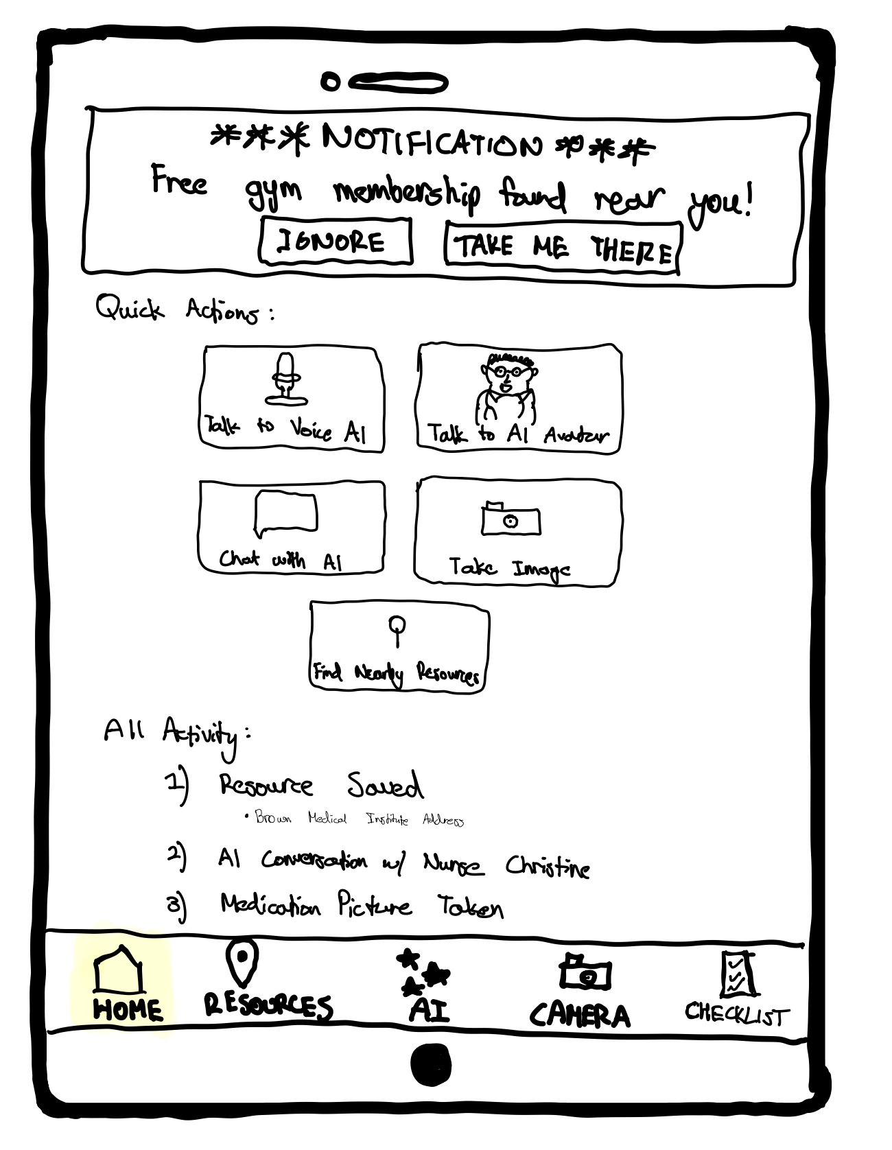
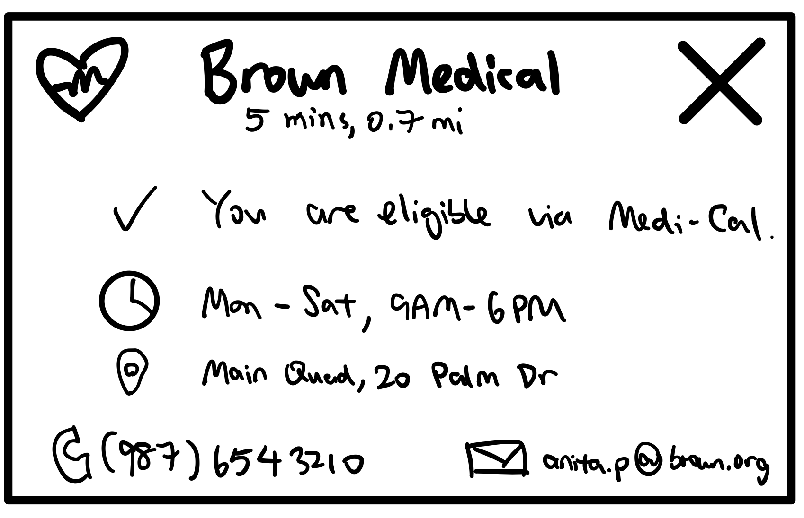
Major Change #2: Re-design of pop-up notification
Before
(Simple Task)
After
Users receive a pop-up notification about nearby resources, which is shown on the top of the screen.
Pop-up notification is significantly enlarged and shifted to the lower half of the screen.
“Info” button is added so users can view eligibility and contact details.
Medi-Pal name and verified icon to show credibility.
Notification is on top
Notification is shifted lower, closer to the “Find Nearby Resources” button
Users can click the “info” button to view a pop-up more information related to the resource
Larger size and shadows for emphasis
Home Page w/ notification
YMCA Gym .
Indicates commute time + distance
Indicates user’s eligibility + reason
Home Page w/ notification
Provides two different contact methods (phone, email)
Info pop-up about resource (NEW)
Notes:
b. How will these changes aid in progressing forward with your usability goals?
c. Explain how the changes address issues identified from low-fi testing results, studio feedback, user needs, etc. Include evidence to back up the changes made. d. Before and after comparisons with annotations and labels as needed e. If you have more than 3 changes you want to show, add the rest to the appendix

Slide 17
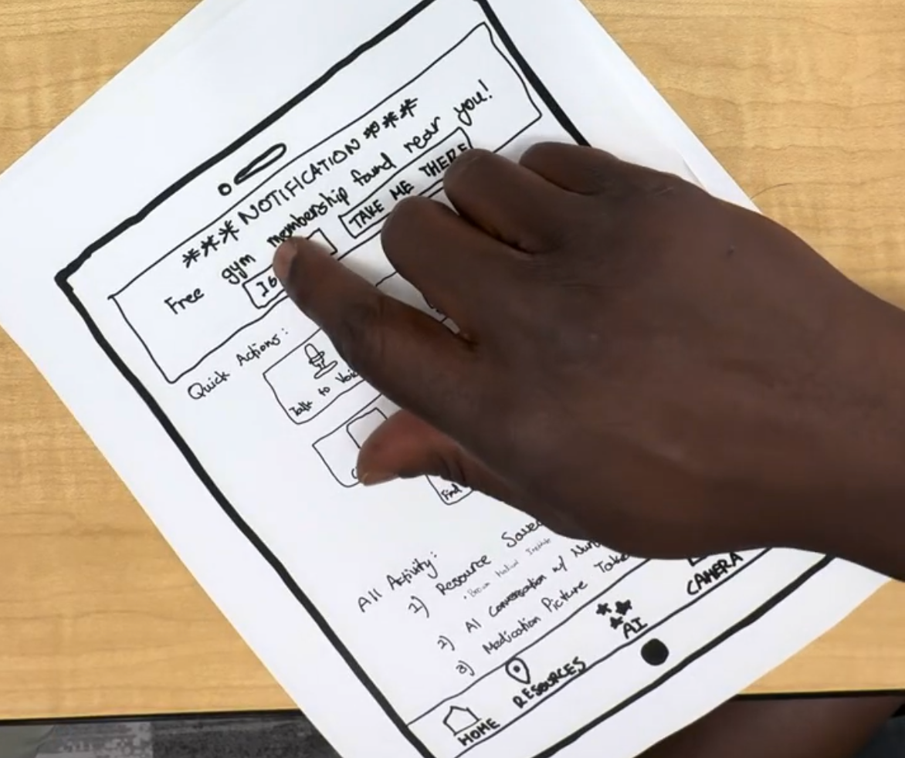
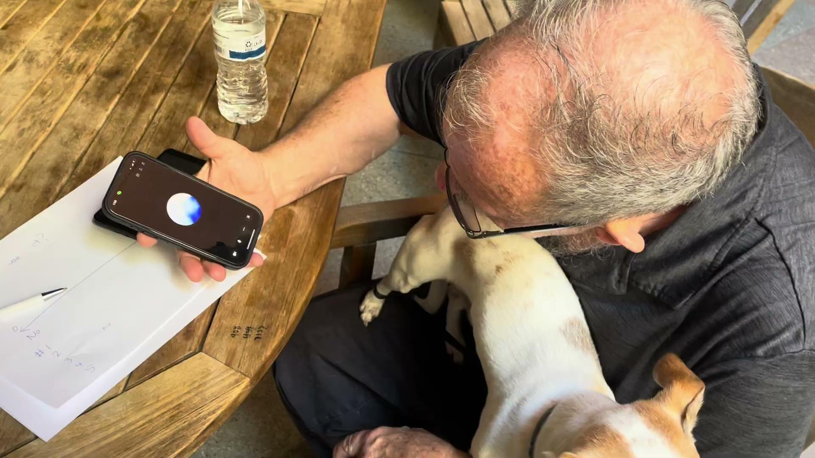
Major Change #2: Re-design of pop-up notification
Rationale
Progress on Usability Goals
Low-fi Prototype Feedback
Some users did not see the pop-up notification because of its location on the top of the screen. One of the users even treated it as a pop-up advertisement.
Efficiency: The main cause of inefficiency in our Simple Task was users failing to notice the pop-up notification. By shifting this pop-up notification to a more visible location on the screen, users would not need to spend time trying to find the pop-up notification, which reduces task completion time (key metric).
Usefulness: Our “Nearby Resources” feature is useless if users do not engage with it. Explicit communication that the pop-up notification is sent from Medi-Pal helps establish trust and encourages engagement → users truly benefit from this important feature and perceive the app as more useful (key metric).
Critical Incident: Kevin ignored the pop-up notification for nearby resource multiple times because he thought it was an advertisement.
Kevin clicking “ignore” on the pop-up notification.
Modifications:
Pop-up notification should be larger and positioned near the center of the screen to capture the user’s attention.
Added Medi-Pal logo and “Verified” tag so users believe that the pop-up notification is from Medi-Pal rather than a third-party advertisement provider.
Experience Prototype Feedback & User Needs
From our Experience Prototype, we observed that users often requested for the contact information of a Medi-Cal resource, even when talking to AI. Some users would also ask about their eligibility when shown a resource, and Kevin (from low-fi prototype testing) mentioned in his feedback that he wishes Medi-Pal to communicate why they are eligible for the resource (e.g., via Medi-Cal coverage).
This was initially part of our 5 tasks, but removed from our low-fi prototype as we only required 3 tasks. We plan to reintroduce “receiving contact info” and “checking eligibility” into the task flows of our first two tasks, as these actions appear to be meaningful and highly frequent for users.
Usefulness: On average, users would perceive the app as more useful (key metric) if it addresses a common need. Checking for eligibility and obtaining contact information of resources is one of these common needs, as we identified during the Experience Prototype phase.
Liam asks for the email address of a suggested resource.
Modifications: Added an “info” pop-up for users to view more information about suggested resources, such as eligibility (with reason), contact information, and commute time (which we identified during our experience prototype testing as a key factor that influences whether users choose to use a resource).
Notes:
How will these changes aid in progressing forward with your usability goals? c. Explain how the changes address issues identified from low-fi testing results, studio feedback, user needs, etc. Include evidence to back up the changes made.

Slide 18
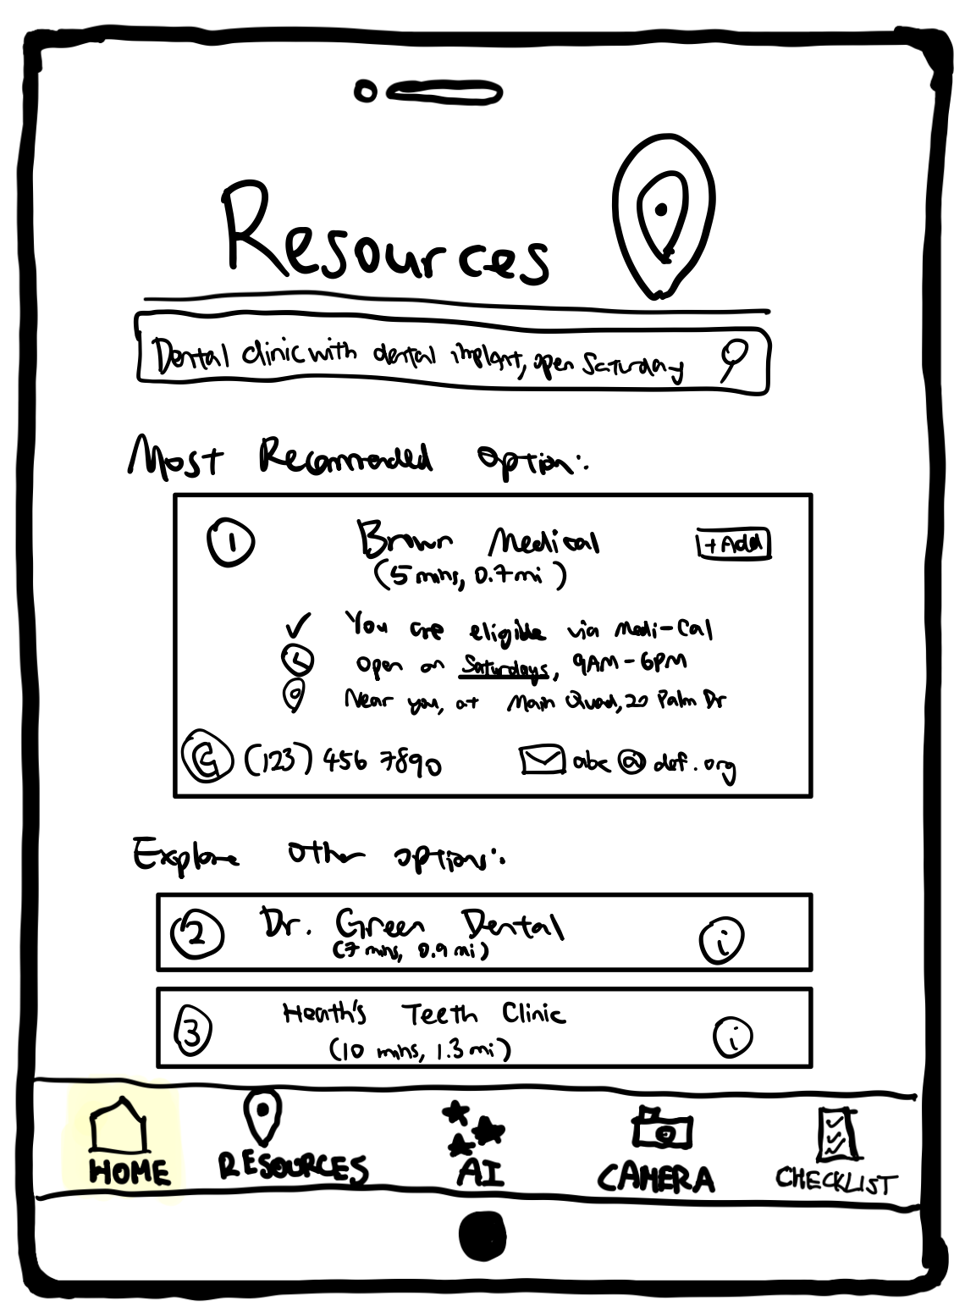
Major Change #3: Adapted the task flow of searching for resources to support general use cases.
(Moderate Task)
Before
After
Users can only search for new resources via the AI chat, by clicking the “+ Discover New Resource” button.
Users can choose to submit their search query for regular search (for quick response) or Ask AI (for more detailed responses), depending on use case.
Search bar for users to search their resource. Compared to the original “Discover New Resource” button, users can specify their needs with more clarity in the search bar.
User clicks “Discover New Resources
User clicks “Discover New Resources
AI page for searching new resources (minimized as this is not main focus)
Users ask for specific resource and provide constraints (e.g., with dental implant surgery)
New flow: user clicks search
Resources Page
AI page for searching new resources
Resources Page
Alternative options with “info” button that shows same pop-up as “Major Change #2”
Most recommended option is shown, which users can add. The same information (e.g., contact details) is shown as the “Info” popup introduced in “Major Change #2”.
Search Results Page (NEW)
Notes:
b. How will these changes aid in progressing forward with your usability goals?
c. Explain how the changes address issues identified from low-fi testing results, studio feedback, user needs, etc. Include evidence to back up the changes made. d. Before and after comparisons with annotations and labels as needed e. If you have more than 3 changes you want to show, add the rest to the appendix

Slide 19
Major Change #3: Adapted the task flow of searching for resources to support general use cases.
Rationale
Progress on Usability Goals
Low-fi Prototype Feedback
Some users did not like the lack of flexibility and options supported by the app.
Polly highlighted that she has different preferences over text-based methods (e.g., search, text chat)/avatar chat depending on scenario - i.e., she would use text-based methods for quick questions and avatar chat for more detailed queries.
Efficiency: If users have a quick query, they do not need to converse with AI in multiple rounds. Instead, they can just click “search” and receive a list of results, which is more efficient. This reduces task completion time (key metric) for users who wish to identify resources by specifying key words, which a significant use case.
Polly explaining how she has different interaction preferences depending on situation.
Modifications:
Give users the option to choose between search (for quick queries) and chatting with AI (for detailed conversations) after writing the query in the search bar.
For traditional search, we designed a search results page for users to view the most recommended resources. For each resource, we would display information about contact information and eligibility, as we explained in “Major Change #2”.
Studio Feedback from CA, Expert, and Peers
Usefulness: From the experience prototype phase, we learned that some users feel uncomfortable with asking AI for help. If we only support an AI-powered task flow, these users may not perceive the app as useful (key metric), and would be reluctant to use our app. Providing a non-AI alternative allows these users to fully enjoy Medi-Pal’s benefits.
During our Medium-fi prototype checkpoint, the expert highlighted that there may be concerns and liability issues regarding the use of chatbots. Saniya also mentioned this in her feedback form, shown on the right.
The possibility of liability issues with AI motivate us to support a non-chatbot alternative to our Moderate Task.
Modifications: Give users the option to search for resources in the search bar and view results on a page. We labelled the alternative option of chatting with AI as “Ask AI”, to make sure that users are aware that they would be talking to AI if they select this option.
Notes:
ensuring users understand they are engaging with an AI and can choose this option or opt out as desired.

Slide 20
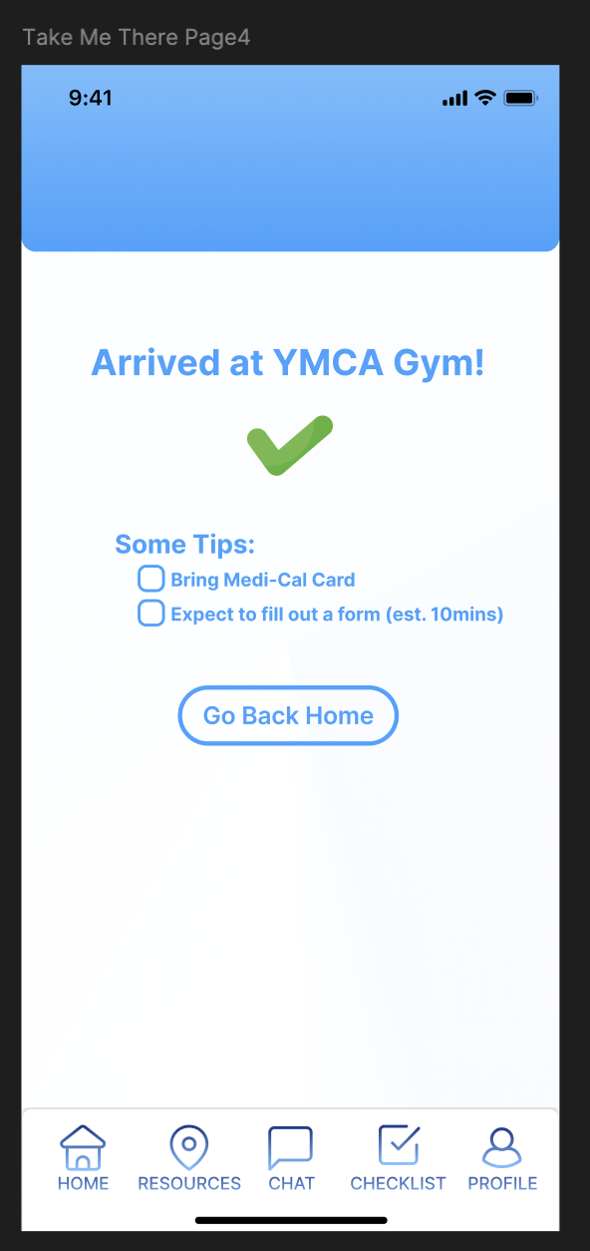
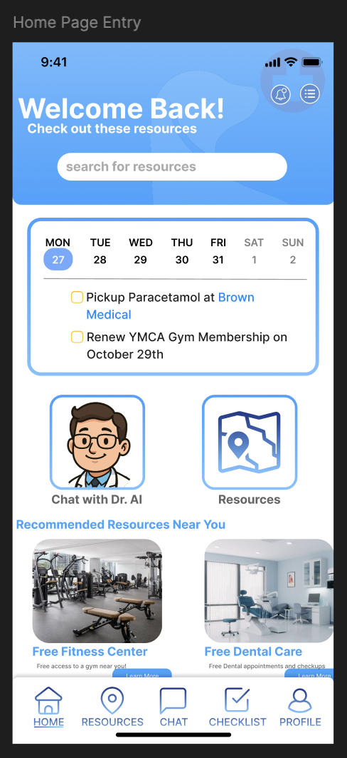
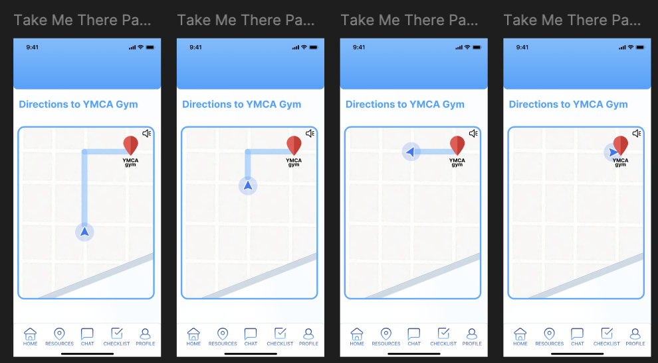
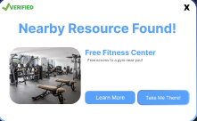
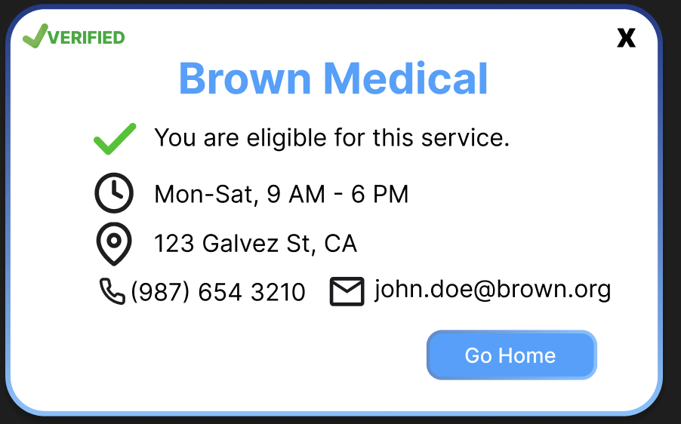
Task Flow: Discover Nearby Resource
Users can check off completed items in the checklist.
Users click “Take Me There”
Users follow directions to navigate to the nearby resource.
Users click “Learn more” on the resource pop-up
After arriving, users see a checklist of tips, which they can select.
Users can check their eligibility.
Users arrives on home page.
Users receive automatic pop-up notification about nearby resource.
Users can access contact info
Users can view more information about the resource.
Notes:
How will these changes aid in progressing forward with your usability goals? c. Explain how the changes address issues identified from low-fi testing results, studio feedback, user needs, etc. Include evidence to back up the changes made.

Slide 21
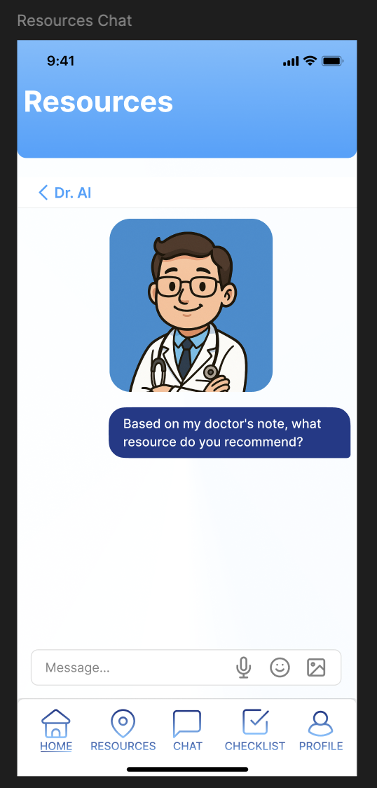
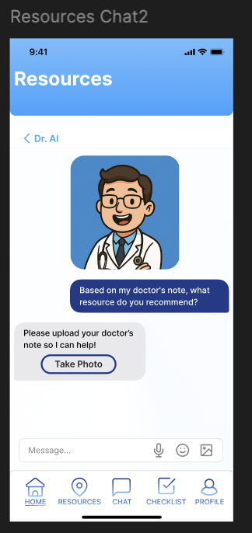
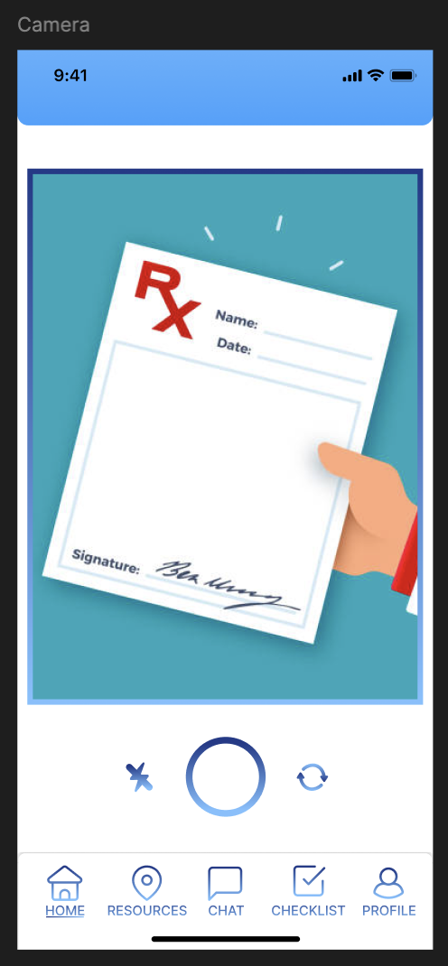
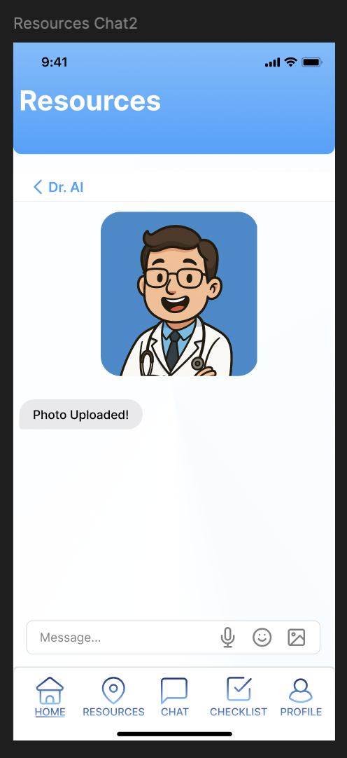
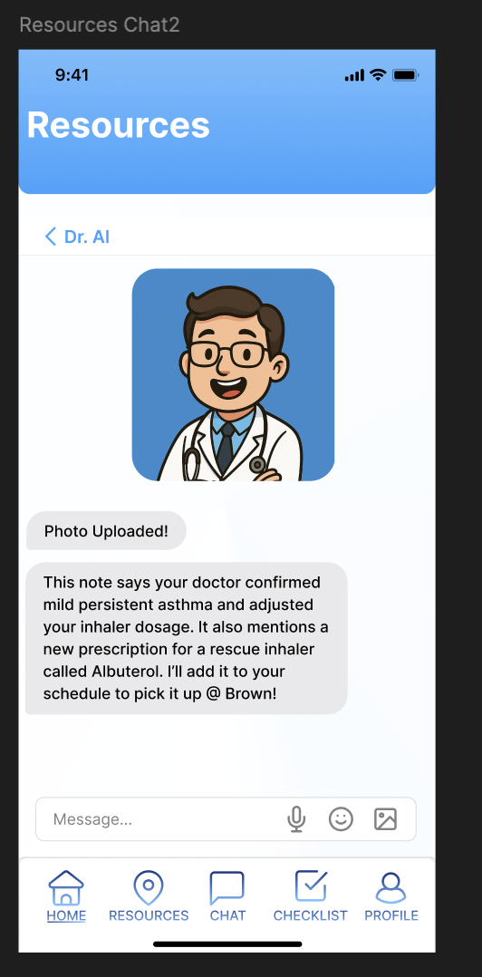
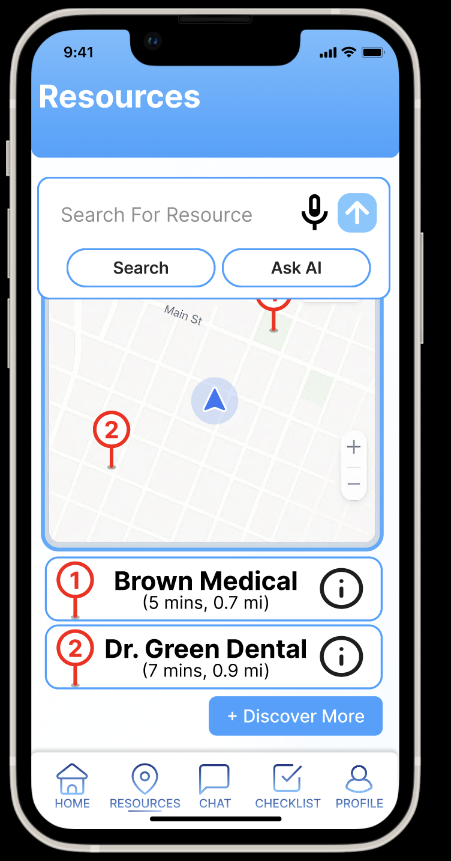
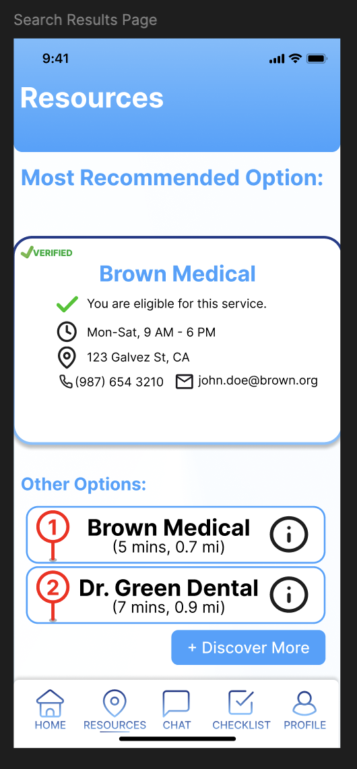
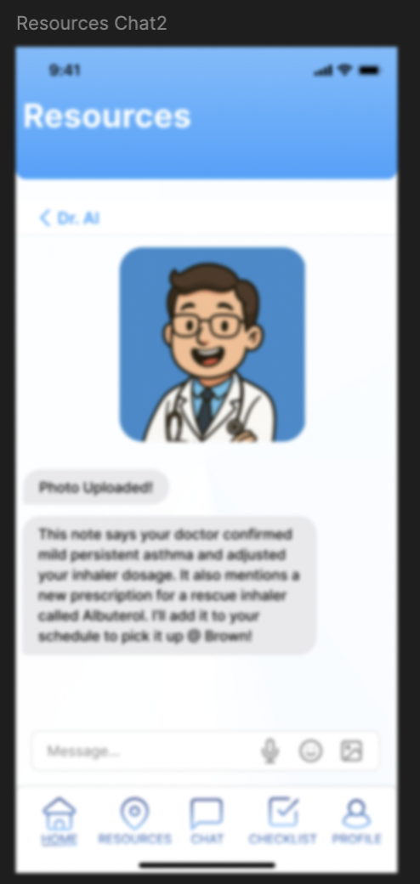
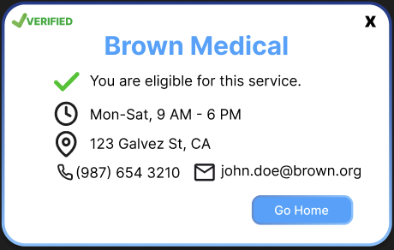
Task Flow: Proactively find specific resource
Users type their query and click “Ask AI”
Users begin chat with AI
AI prompts user for additional input (e.g., photo)
User takes photo
Confirmation message for photo taken
AI suggests which resource(s) users should access
Users type their query and click “Search”
Most recommended option is shown, with relevant information such as eligibility and contact info.
Users arrives on “Resources” page
Users arrives on home page.
Alternative options are shown, with an “info” button.
Users can view search results
Pop-up of suggested resource is shown.
Notes:
How will these changes aid in progressing forward with your usability goals? c. Explain how the changes address issues identified from low-fi testing results, studio feedback, user needs, etc. Include evidence to back up the changes made.

Slide 22
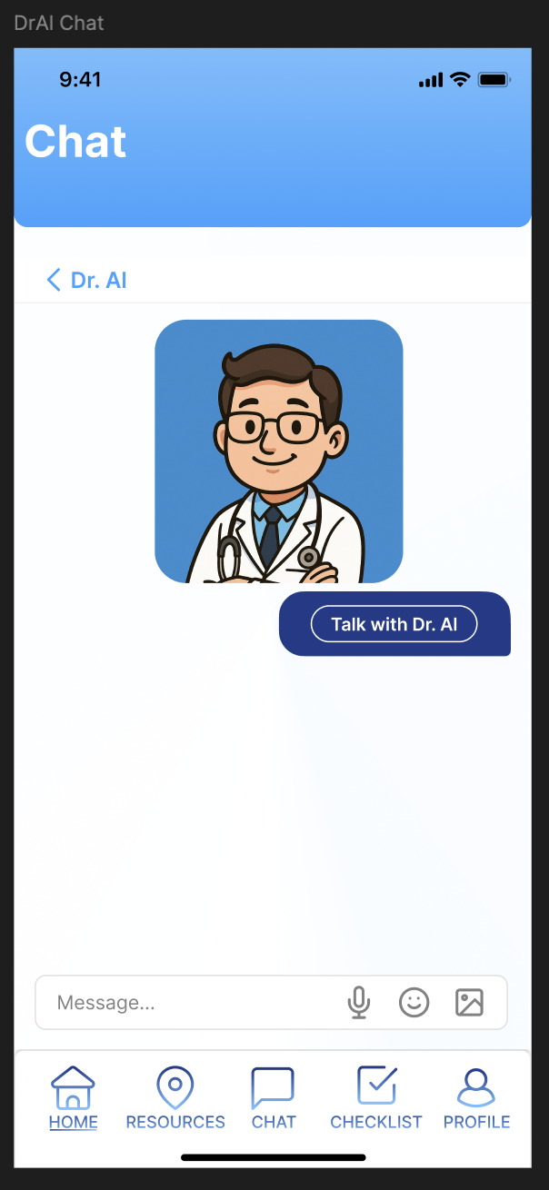
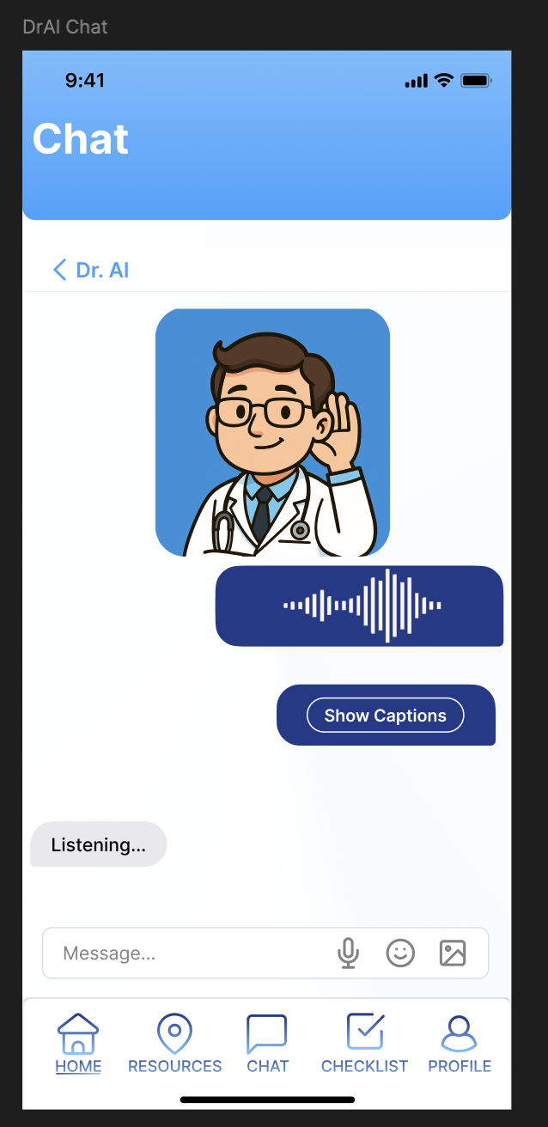
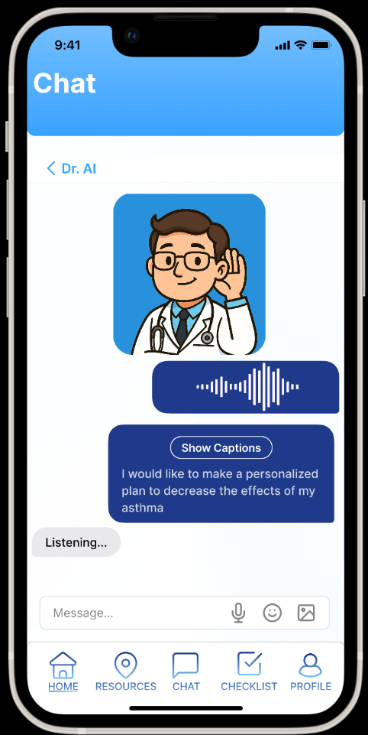
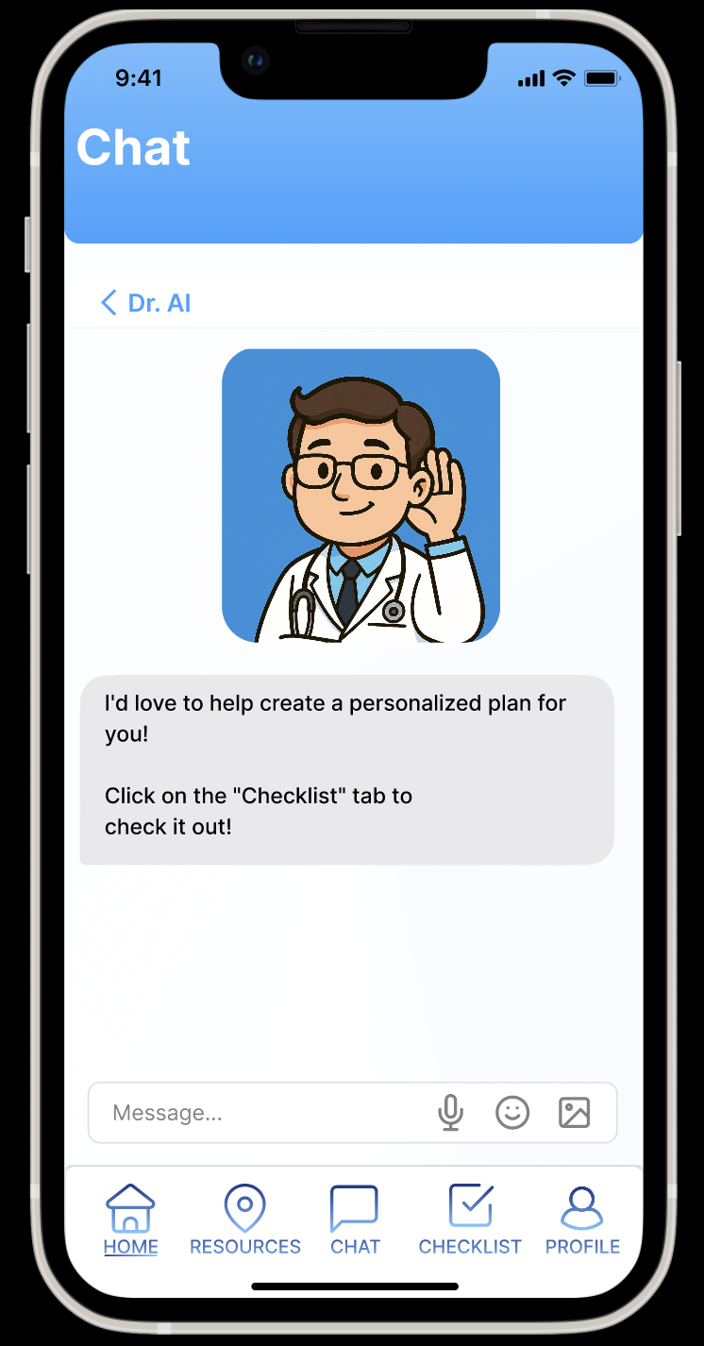
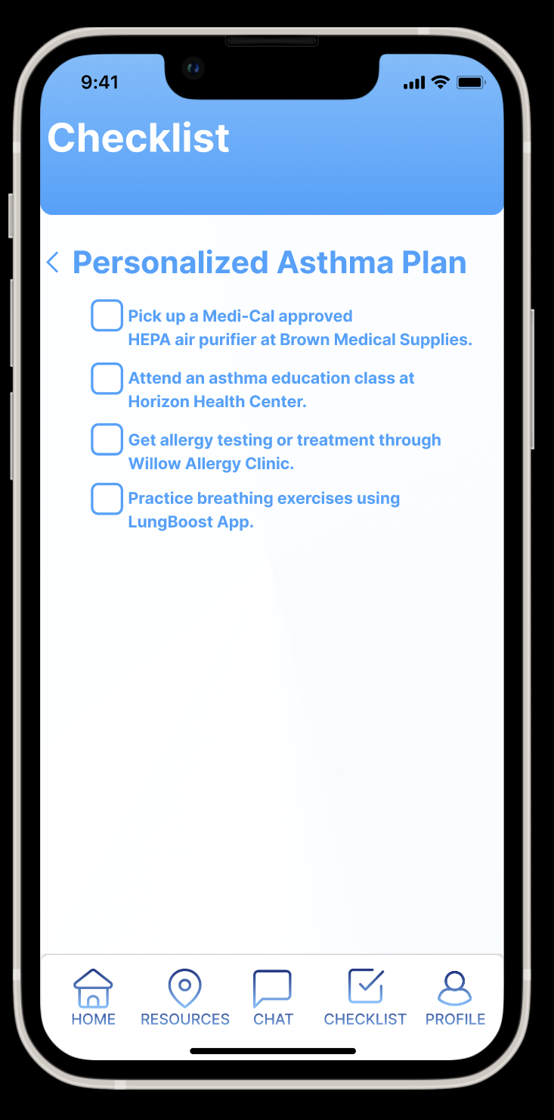
Task Flow: Make Plans for Healthy Habits
Doctor avatar shows actions such as listening to the user, to make users feel that someone is listening.
Based on the feedback from our peers and the expert during the Med-fi prototype checkpoint at our studio about AI liability issues, we have decided to change the checklist items to strictly recommendations of Medi-Cal resources.
Back button to leave conversation.
The screen renders a 3D avatar of a doctor to build rapport with users and make them feel listened to.
User clicks “Chat with Dr. Al”
User selects “talk with Dr. Al” and initiates conversation via voice/text.
Users click the “Checklist” tab to view the AI’s personalized plan.
Users can click to see captions.
Users arrives on home page.
Users arrives to the “Chat with Dr. Al page” to chat with Dr. Al
User initiates conversation and asks for a personalized wellness plan.
(In this interface, we show the user giving voice input, as text input for chatting with Dr. Al is demonstrated in another task)
“Dr. Al” responds saying that the personalized plan is done.
User can view their personalized plan in the “Checklist” page.
Notes:
How will these changes aid in progressing forward with your usability goals? c. Explain how the changes address issues identified from low-fi testing results, studio feedback, user needs, etc. Include evidence to back up the changes made.

Slide 23


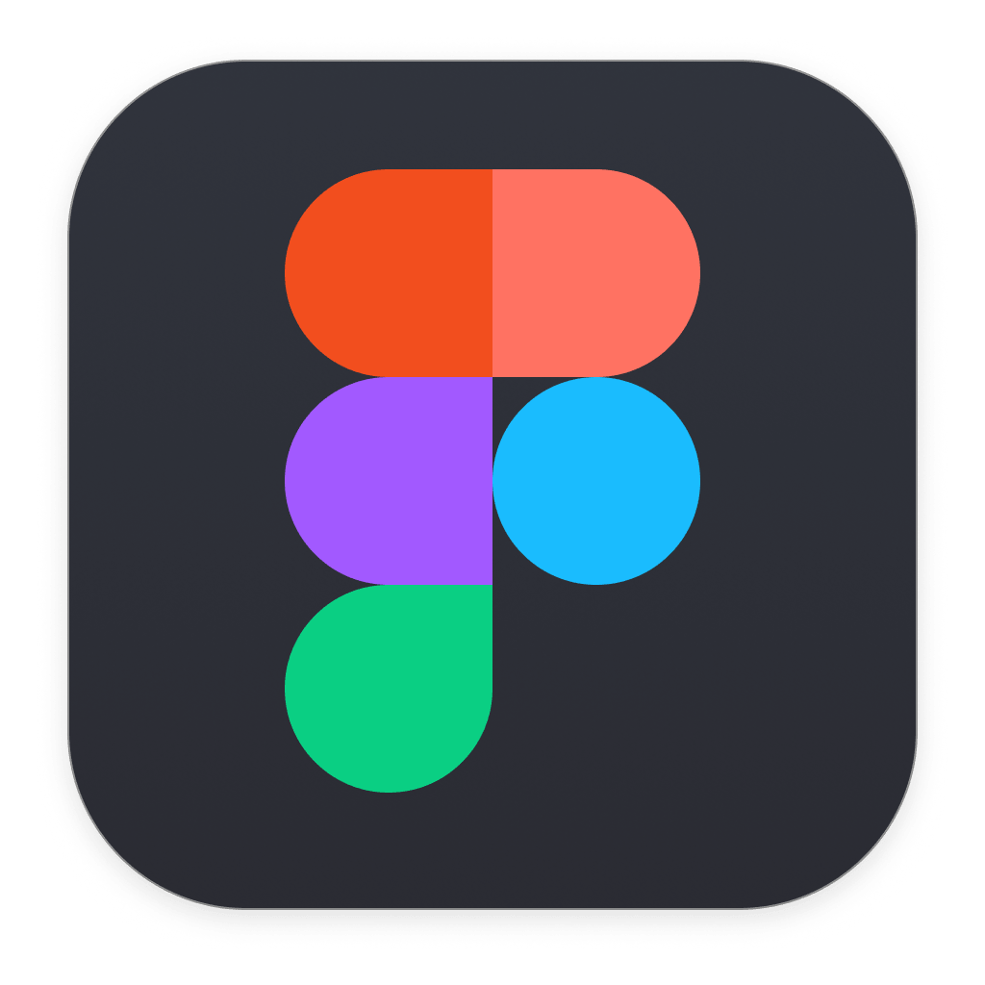
Prototype Tools + Pros & Cons
Low-fi: Notability, Goodnotes
Medium-fi: Figma
Rationale: All of us have iPads and are regular users of these apps. So, we selected them because of familiarity. This is important for low-fi prototyping because we wish to be efficient.
Pros:
Customizable and easy to edit. Unlike pen and paper, we can erase and redraw things quickly on Notability and Goodnotes. This reduces the cost of making mistakes as we can always make edits.
Allows us to standardize layouts by copy and pasting, which saves a lot of prototyping time.
Cons:
We cannot make edits collaboratively, as these apps are installed on a single device.
Both are paid apps: Notability ($20/yr), Goodnotes ($10/yr)
Lacks a layer system and overlay support. All overlays must be drawn manually, by first drawing a base color and then drawing additional elements on top.
Why this pros/cons tradeoff is acceptable: Although we cannot edits collaboratively in real time, we can still contribute asynchronously by drawing on top of each other’s sketches. We also already own these apps so do not need to pay for it.
Rationale: Figma is widely used in the industry for UI design, and we have two members who are already familiar with Figma. Furthermore, this course offers Figma workshops, and this means that we can receive assistance from CAs when needed. We will not have this benefit if we use other prototyping tools.
Pros:
We can collaborate in real-time across team members. Involving multiple team members into prototype creation allows the team to achieve a common understanding more easily.
Offers reusable components and style libraries (e.g., buttons, fonts, etc.). This helps us maintain a consistent UI without needing much effort.
Allows us to simulate our app and observe how our screens change when different buttons are clicked. This allows us to conduct user tests on the prototype.
Supports Developer Mode and provides code that can be used for our high-fi prototype. This speeds up the high-fi prototyping process.
Cons:
Steep learning curve for new users, as some features are complicated.
May experience lag during collaborative sessions.
Why this pros/cons tradeoff is acceptable: two team members are experienced with Figma, which minimizes the learning cost for our team. Lag is not an issue as we only have a small team of 3 members.

Slide 24
Limitations of Prototype + Implications on User Experience
1
2
3
Fails to Predict Long-Term Impact
Inability to test advanced features in real-world settings
Made-up Scenarios
Medium-fi usability tests only capture specific interactions within a single session, and do not explore how user behavior may change over time as they become more familiar with the app. This means that we would not be able to test how often users used Medi-Pal, whether users view Medi-Pal as useful after regular use, and how users may adopt new features.
We were unable to test how users would interact with features such as talking to AI agents and location services, as medium-fi prototypes generally have pre-defined layouts and text that only support fictional scenarios. As a result of this, our participant’s learnability and efficiency scores for AI-related tasks may be higher than they are supposed to be.
The medium-fi prototype is designed to be identical for all participants. As some of our tasks were scenario-specific, participants had to role-play as a predefined persona while testing our prototype, rather than interact with the app based on their own use cases and preferences. This prevents us from viewing how users may naturally interact with our app.

Slide 25
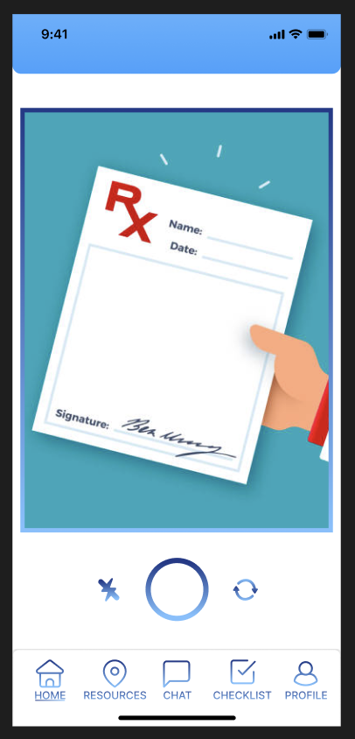
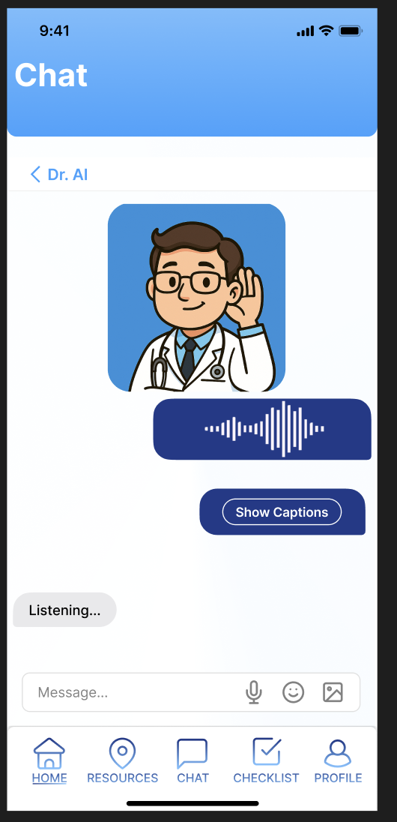
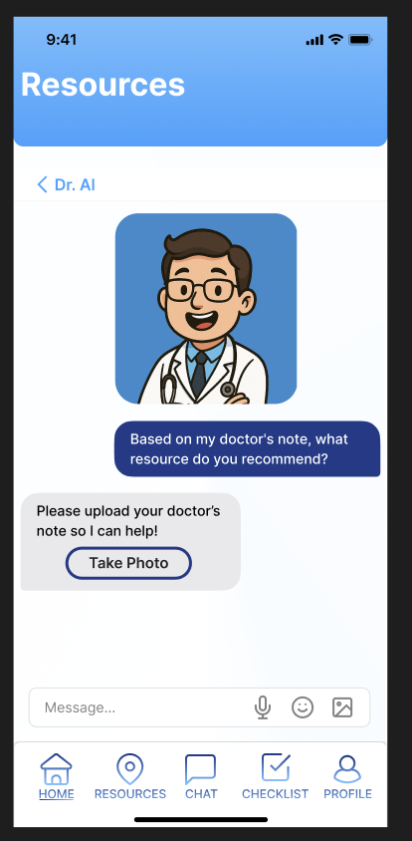
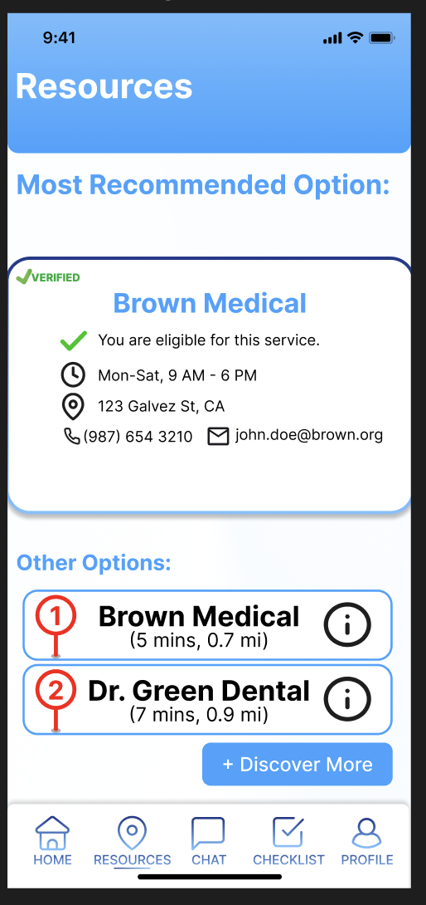
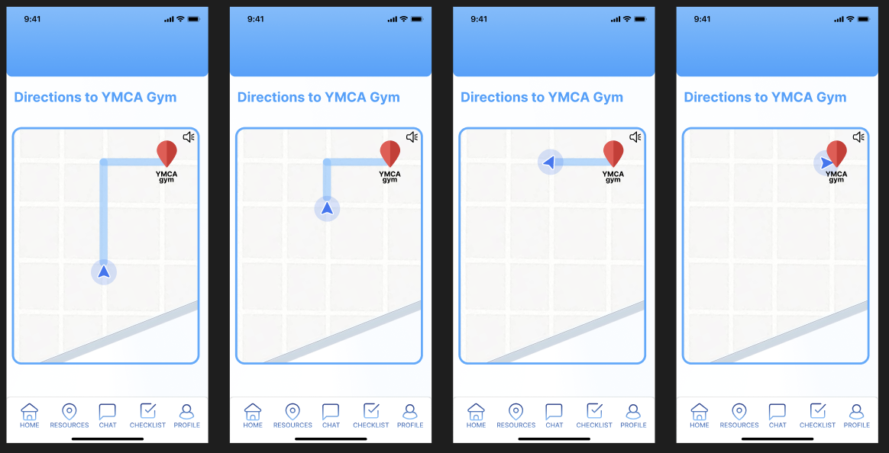
Hardcoded & Wizard-of-Oz Features + Implications
AI features (e.g., chats, search results)
Navigation map for finding nearby resources
Multimodal inputs
All chats and search results are hardcoded, due to our lack of a functioning backend. This means that we cannot test whether users are satisfied with the AI’s outputs and suggestions during our testing phases, or if they are able to write prompts that give desired results, which are major usability concerns.
Implications: As shown in our low-fi prototype, users complete tasks involving AI with minimal errors because they are just clicking a sequence of screens instead of actually interacting with AI. This gives us the false impression that our app is very efficient and learnable for this task during our tests.
Restrictions of the medium-fi prototype did not allow us to implement a functioning map, as this requires a functioning backend and location services. This means that users can only pretend that they are walking towards their destination. Nonetheless, we tried to make several screens to show the user gradually navigating to the destination, as shown below:
Implications: We are unable to meaningfully assess potential learnability issues for this feature in our low- and medium-fi prototypes. We can only assess learnability issues in our high-fi prototype after implementing this feature, which requires significant implementation cost.
Some of our tasks require multimodal inputs, such as taking a photo and voice input. Restrictions of the medium-fi prototype do not allow us let users specify inputs, as this again requires a functioning backend and access control to different functionalities of the device (e.g., camera, microphone). This means that we can only let users pretend that they are taking a photo.
Implications: We are unable to meaningfully assess usability concerns with providing inputs. Efficiency issues may emerge when users attempt to provide inputs in the full version of the app, and this cannot be tested in the medium-fi prototype.
Notes:
potential efficiency issues may emerge when users attempt to provide inputs in the full version of the app, as the time and effort required cannot be accurately captured in our current prototype.

Slide 26
Link to Figma Prototype:
Link: https://www.figma.com/proto/HZy6lCGpZ2aFE0qZW9itwM/Medi-Pal?node-id=0-1&t=3AIGf5IAt9jJnLm8-1

Slide 27
Appendix

Slide 28
Other Major Changes Made: Unified Chat Interface
Before
After

Slide 29
Other Major Changes Made: Restrict AI recommendations to resource suggestion
Before
After

Slide 30
Other Major Changes Made: Checklist for arrived
Before
After

