Slide 1
ROOTS:
designing for family connectedness
f

Slide 2
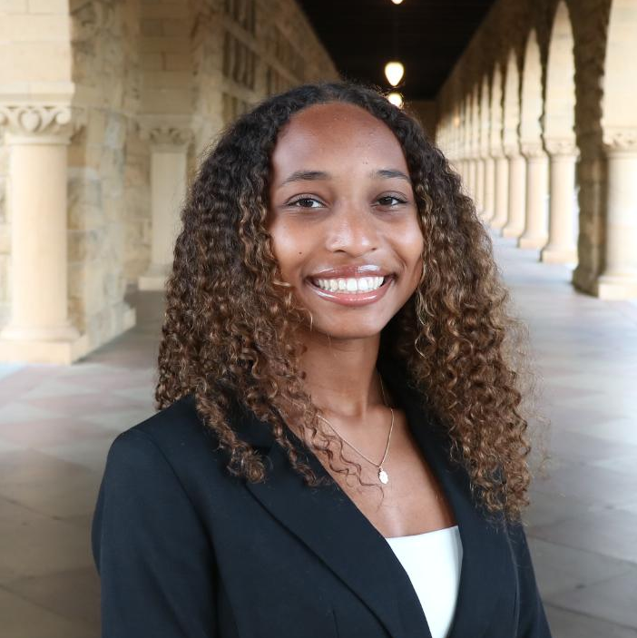
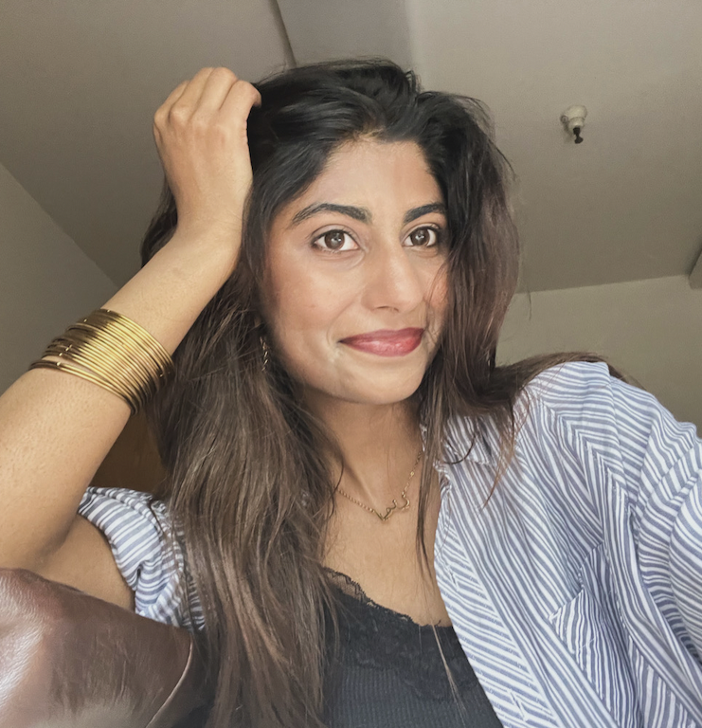

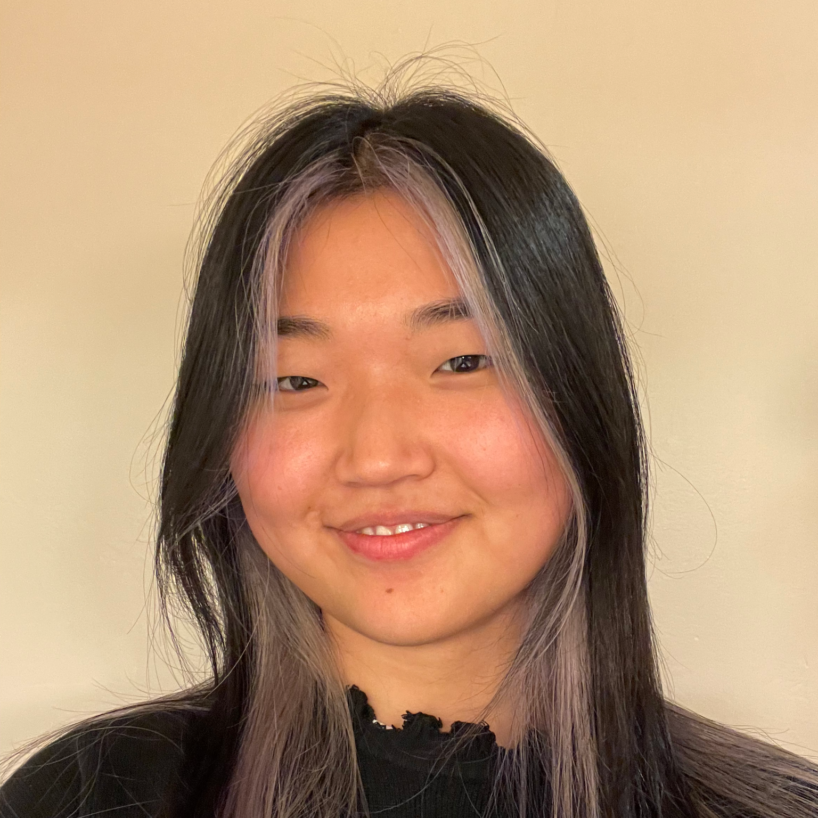
the team
Naomi
Aimen
Mai
Angela

Slide 3
01
intro

Slide 4
domain narrowing
parents + children
generational connectedness
generational connectedness in immigrant families

Slide 5
02
additional needfinding

Slide 6
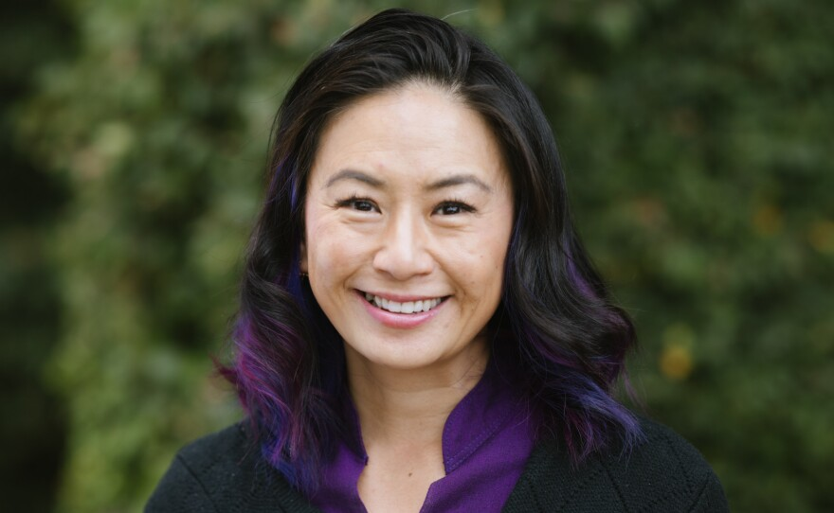

additional interviews
dr. helen hsu
“olivia”
outreach director @ caps,
20+ years of experience
aapa fellow, bicultural/bilingual clinician
14 year old girl
from palo alto
salvadorian & taiwanese

Slide 7

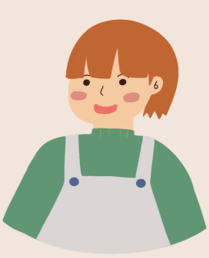

additional interviews
+
“james”
“cathy” and “dan”
13 year old boy
from the bay area
parents to 3 kids 18+
kids are in the US and Europe
“martha”
30 year old palo alto native

Slide 8
learnings
“Immigrant parents really, really want to talk to their kids but don’t know how.”
Empathy/communication are learnable skills for everyone, no matter their age (worked with geriatric patients)
Not many culturally specific resources available for immigrant families
Referred us to great existing resources like CHIPAO and other outreach programs
dr. helen hsu
“I think people have a stereotype that the people are impossible to change. And I'm like, that's absolutely not true.”

Slide 9
learnings
El Salvadorian mom, Taiwanese dad
Has a great relationship with her parents – because of great communication
Mother “broke so many generational cycles,” but nevertheless has “damaging habits” – being aware of them has helped Olivia “deal” with them
“olivia”
14 year old girl from palo alto
“Every single opinion I have given them, I don’t think I have ever felt judged. There have been times where they have been disappointed in me but they’ve never been like ‘you’re wrong’ or I feel like I’m going to be judged.”

Slide 10
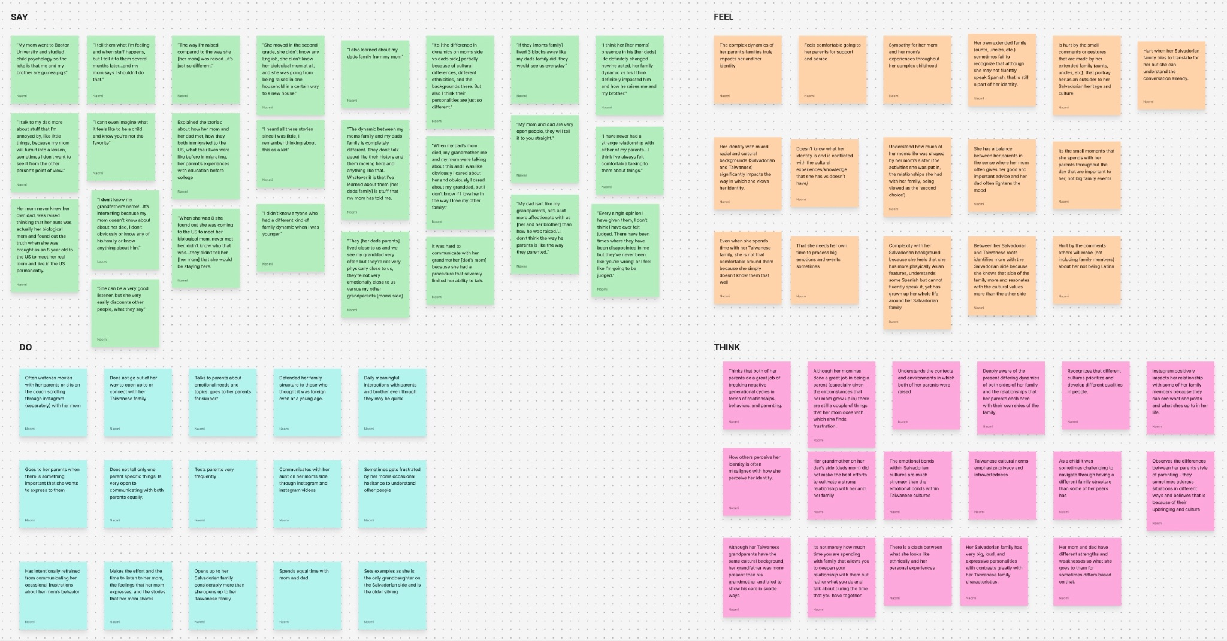
empathy map

Slide 11
03
povs + hmws

Slide 12
original interviews (refresher)
lucia, 44
ananya, 14
mohammed, 30s
mexican american, full time business owner, mom of three boys
indian american (but grew up in singapore), high school student
afghan american, co-owner of family business

Slide 13
POV #1: Lucia

Slide 14
POV #1: Lucia
we met…
Lucia, a 44 year old mom of 3 boys, full time business owner, and daughter of immigrants from Mexico.

Slide 15
POV #1: Lucia
we met…
we were surprised to notice…
Lucia, a 44 year old mom of 3 boys, full time business owner, and daughter of immigrants from Mexico.
that even with her packed schedule, she prioritized getting even 10 minute chunks of time with her kids - while these small blocks seem “routine” for other parents, Lucia feels closer and more secure in her relationships with her children.

Slide 16
POV #1: Lucia
we met…
we were surprised to notice…
Lucia, a 44 year old mom of 3 boys, full time business owner, and daughter of immigrants from Mexico.
that even with her packed schedule, she prioritized getting even 10 minute chunks of time with her kids - while these small blocks seem “routine” for other parents, Lucia feels closer and more secure in her relationships with her children.
we wonder if this means…
that to her, parenting means presence rather than elaborate gestures. with the time and financial constraints of working parents, they care about intention and consistency rather than grand emotional or financial gestures.

Slide 17
POV #1: Lucia
we met…
we were surprised to notice…
Lucia, a 44 year old mom of 3 boys, full time business owner, and daughter of immigrants from Mexico.
that even with her packed schedule, she prioritized getting even 10 minute chunks of time with her kids - while these small blocks seem “routine” for other parents, Lucia feels closer and more secure in her relationships with her children.
we wonder if this means…
it would be gamechanging if…
that to her, parenting means presence rather than elaborate gestures. with the time and financial constraints of working parents, they care about intention and consistency rather than grand emotional or financial gestures.
we stopped designing for family time as a big event and started designing for these small and brief, but meaningful moments of connection.

Slide 18
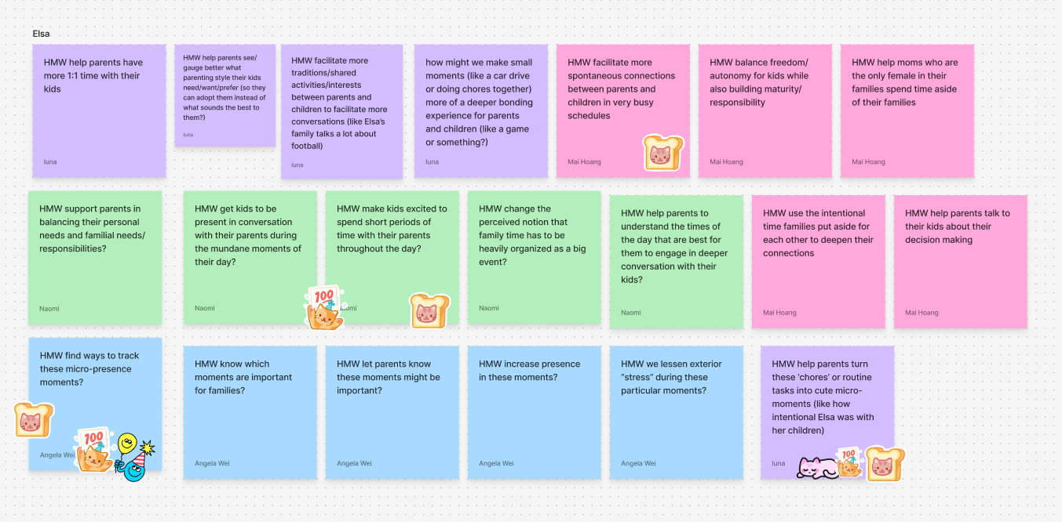
how might we…

Slide 19
how might we…
HMW make the in-between moments of everyday life (commutes, meal prep, clean up) into small moments of connection between working parents like Elsa and her children?

Slide 20
POV #2: Mohammed

Slide 21
POV #2: Mohammed
we met…
Mohammed, a 30 year old son of Afghan immigrants and a co-owner of the family business

Slide 22
POV #2: Mohammed
we met…
we were surprised to notice…
Mohammed, a 30 year old son of Afghan immigrants and a co-owner of the family business
the shift from a strained, culturally charged relationship with his father transformed into a more intentional and collaborative one, not in spite of their cultural differences but because of them

Slide 23
POV #2: Mohammed
we met…
we were surprised to notice…
Mohammed, a 30 year old son of Afghan immigrants and a co-owner of the family business
the shift from a strained, culturally charged relationship with his father transformed into a more intentional and collaborative one, not in spite of their cultural differences but because of them
we wonder if this means…
that cultural differences don’t just create barriers, but could give rise to deeper connections precisely because the labor of translating across cultures is itself a bonding ritual that strengthens trust and understanding

Slide 24
POV #2: Mohammed
we met…
we were surprised to notice…
Mohammed, a 30 year old son of Afghan immigrants and a co-owner of the family business
the shift from a strained, culturally charged relationship with his father transformed into a more intentional and collaborative one, not in spite of their cultural differences but because of them
we wonder if this means…
it would be gamechanging if…
that cultural differences don’t just create barriers, but could give rise to deeper connections precisely because the labor of translating across cultures is itself a bonding ritual that strengthens trust and understanding
we created conditions where difficult cross-cultural conversations feel safe, so that cultural differences can become sources of strength rather than weakness

Slide 25
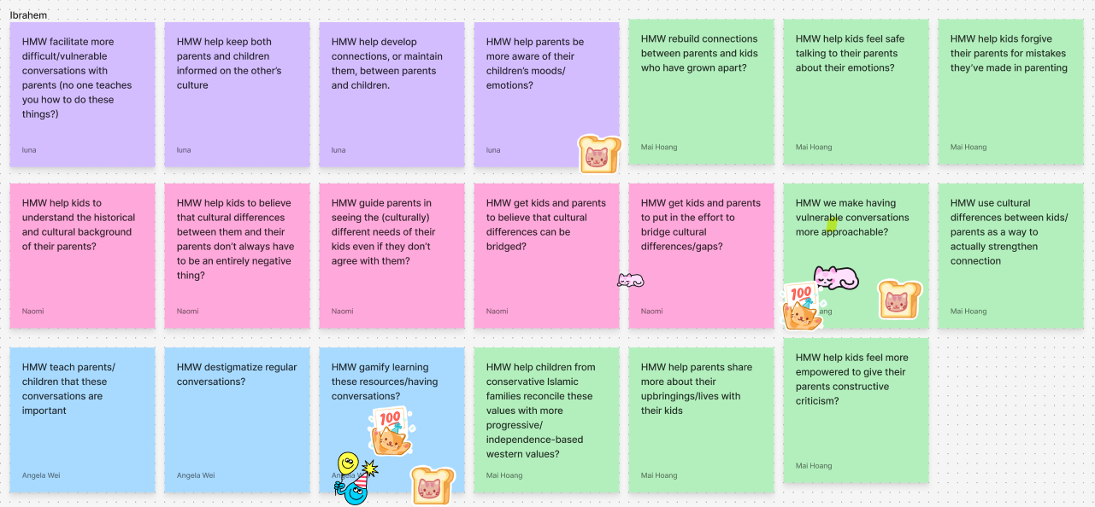
how might we…

Slide 26
how might we…
HMW build structured activities to make vulnerability between immigrant parents and children feel less intimidating?

Slide 27
POV #3: Ananya

Slide 28
POV #3: Ananya
we met…
Ananya, a 14 year old high school freshman at palo alto high school, child of Indian immigrants.

Slide 29
POV #3: Ananya
we met…
we were surprised to notice…
Ananya, a 14 year old high school freshman at palo alto high school, child of Indian immigrants.
that even though she said she trusted her family, she relied more on her American friends for support because she had to develop that trust more

Slide 30
POV #3: Ananya
we met…
we were surprised to notice…
Ananya, a 14 year old high school freshman at palo alto high school, child of Indian immigrants.
that even though she said she trusted her family, she relied more on her American friends for support because she had to develop that trust more
we wonder if this means…
her definition of trust depends on the cultural context: her trust for her family means something different than her trust for her friends.

Slide 31
POV #3: Ananya
we met…
we were surprised to notice…
Ananya, a 14 year old high school freshman at palo alto high school, child of Indian immigrants.
that even though she said she trusted her family, she relied more on her American friends for support because she had to develop that trust more
we wonder if this means…
it would be gamechanging if…
her definition of trust depends on the cultural context: her trust for her family means something different than her trust for her friends.
there were opportunities for families to express the differences in these big, emotional definitions, so that they can understand each other more fully

Slide 32
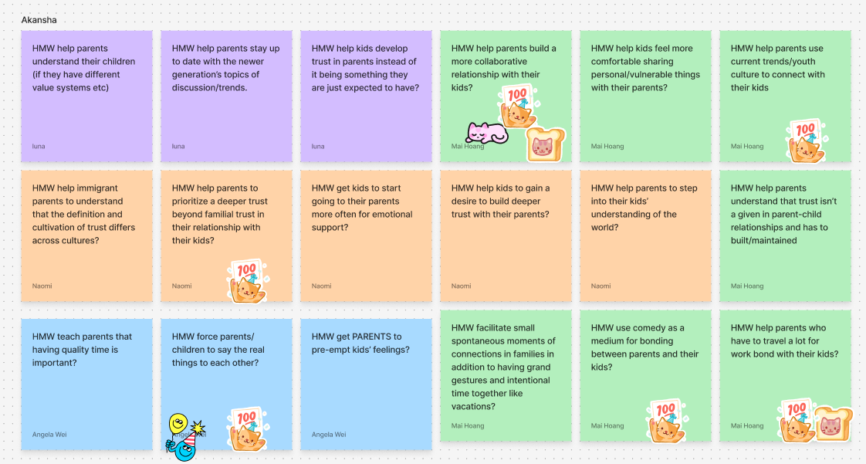
how might we…

Slide 33
how might we…
HMW turn the process of learning how to empathize across cultures into something fun and enjoyable?

Slide 34
04
solutions + experience prototypes

Slide 35
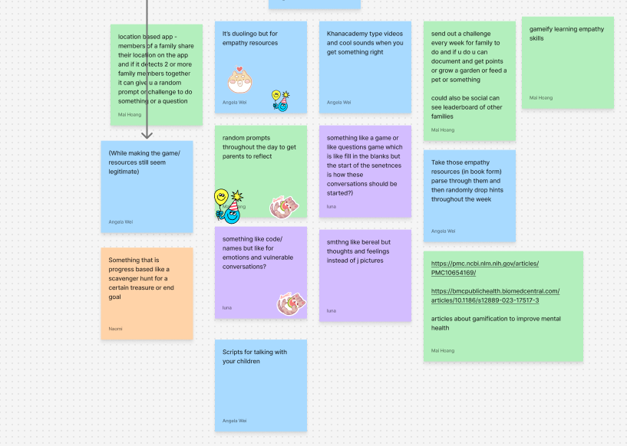
Solution #1:
Gamify learning - users advance through short empathy and communication-building lessons using CHIPAO. Points, streaks, and badges are awarded for completing lessons.

Slide 36
solution 1:
solution
assumption
Gamify learning: users advance through short empathy and communication-building lessons. Points, streaks, and badges are awarded for completing lessons.
Parents find that online resources are a worthwhile way to learn about communication skills

Slide 37
experience prototype
assumption
Parents find that online resources are a worthwhile way to learn about communication skills
props
a 5-minute YouTube skit from CHIPAO that teaches culturally-specific communication skills
actors
2 Chinese parents
data
asked the participants a brief survey about their experience with learning about communication skills before the video, and then some questions about what they learned about the video/how engaging it felt/whether they would do it by themselves

Slide 38
experience prototype
what worked
parents were really, really receptive to vid
  “the video is short, so it’s good.”
skits provide concrete example
what didn’t work
self researching would “take too long” – a lot of “prerequisites”
gap isn’t knowledge—it's using skills in the moment

Slide 39
experience prototype
what we learned
“communication skills,” interpreted in business context
skills still transferable to communicating with family
  one person said that learning these skills in a business setting helped her communicate with her family)
communicating is easy in theory, hard in practice
what this means moving forward:
design for families for whom therapy is not in their conceptual framework
making an app that doesn’t just provide information, but one that helps practice those communication skills

Slide 40
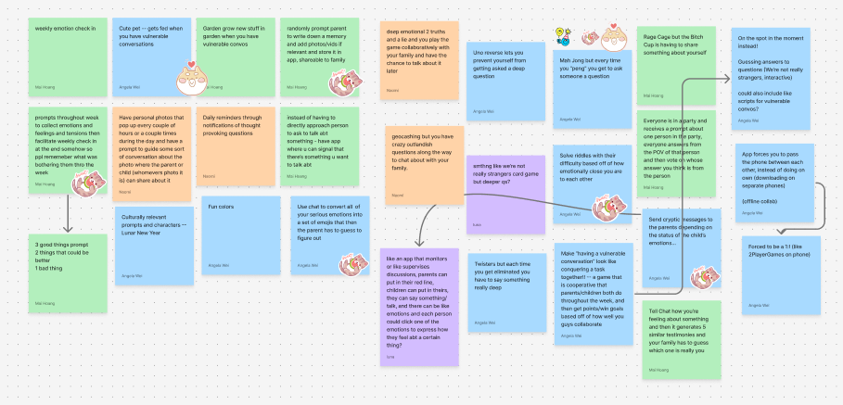
Solution #2:
Random reflection pings: prompts arrive randomly in the day asking parents/children to reflect on a moment/conflict or consider the other person’s view. Each takes 3-5 minutes.

Slide 41
solution 2:
solution
assumption
Random reflection pings: prompts arrive randomly in the day asking parents/children to reflect on a moment or consider the other person’s view. Each takes 3-5 minutes.
People who opt in to a reflection app already have above-average willingness to reflect, and—when given brief, guided prompts—this reflection increases relational awareness (empathy/perspective-taking) rather than reinforcing self-bias.

Slide 42
experience prototype
assumption
people who opt in to a reflection app already have above-average willingness to reflect, and—when given brief, guided prompts—this reflection increases relational awareness (empathy/perspective-taking) rather than reinforcing self-bias.
props
a text message thread where people respond to self-reflection prompts about their relationships with others 2-3 times throughout the day
actors
5 people, 4 adult children and one immigrant parent
data
have participants take a survey before and after the experience that asks about how much they care about introspection and how willing they are to change their behavior for others, and how engaging in self reflection helped them

Slide 43
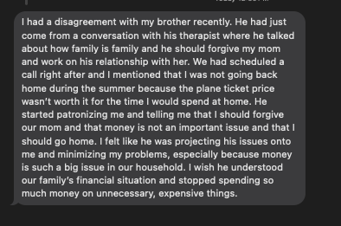
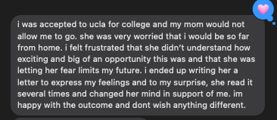
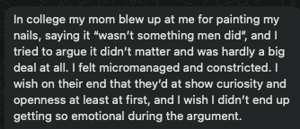
experience prototype
what worked:
users engaged with depth
prompts were specific
users reported feeling more empathetic toward others after responding
what didn’t work:
some users get too bogged down trying to come up with polished answers and would respond much later
1 user was not able to respond at all due to being too busy
lower tech usage -> less comprehensive answers

Slide 44
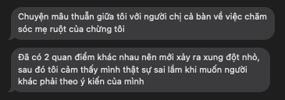
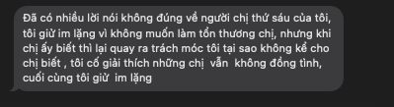
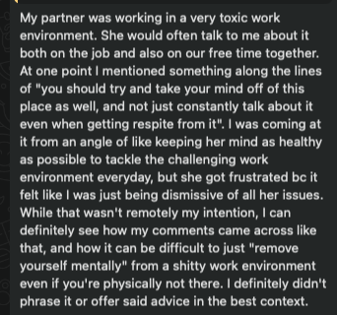
experience prototype
what we learned:
some immigrant parents are open to reflection but haven’t been socialized into Western psych practices (journaling, therapy-speak)
performative reflection is an issue
what this means moving forward:
at most 1 prompt a day, even maybe 1 prompt every few days
anti-rumination guardrails: set a time limit, after 90 s move on
user-set time window
need to design for low English users / low tech knowledge users
  Viet mom wanted to call

Slide 45
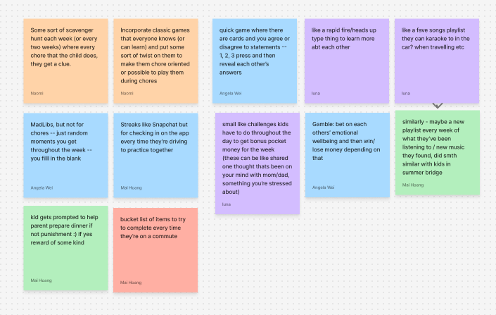
Solution #3:
Build up to vulnerability through a co-op quest: parent and child tackle weekly mini-games & challenges together, earn points for collaboration, and unlock goals by completing tiny actions.

Slide 46
solution 3:
solution
assumption
build up to vulnerability through a co-op quest: parent and child tackle weekly mini-games & challenges together, earn points for collaboration, and unlock goals by completing tiny actions.
games help parents and children open up and build deeper connections because they’re casual and lower the stakes.

Slide 47
experience prototype
assumption
games help parents and children open up and build deeper connections because they’re casual and lower the stakes.
props
live phone call with parent; random questions asked, if they choose not to answer -> do a silly light hearted “dare”
actors
an international parent + child
data
asked the participant to share a photo from their album and the story behind it or
about their daily conversations and what sort of things they talk about.

Slide 48
experience prototype
what worked
questions felt new and sparked learning (“we don’t ask these daily”).
positive energy: lots of laughter; more back-and-forth than usual.
what didn’t work
answering ≠ opening up
what we learned
play lowers the barrier: light settings help people leave their comfort zone.
genuinely enjoyable for both parent and child
what this means going forward
timebox each question (60–90s).
balance tone: mix light prompts with 1–2 deeper “step-up” prompts

Slide 49
05
what’s next?

Slide 50
moving forward
combining collaborative mini-games like parents are human (solution #3) with a responsive teaching component (solution #1)
ethically: don’t want app to replace in-person connection, don’t want children to be dependent on technology for relationships, cultural/linguistic respect, gamification -> addiction
for: bicultural households who want more communication and connection but lack the resources, but might leave out; families in the dominant culture, families with low literacy or access to technology

Slide 51
the point: making a communicating app that’s “for us”

Slide 52
06
appendix

Slide 53
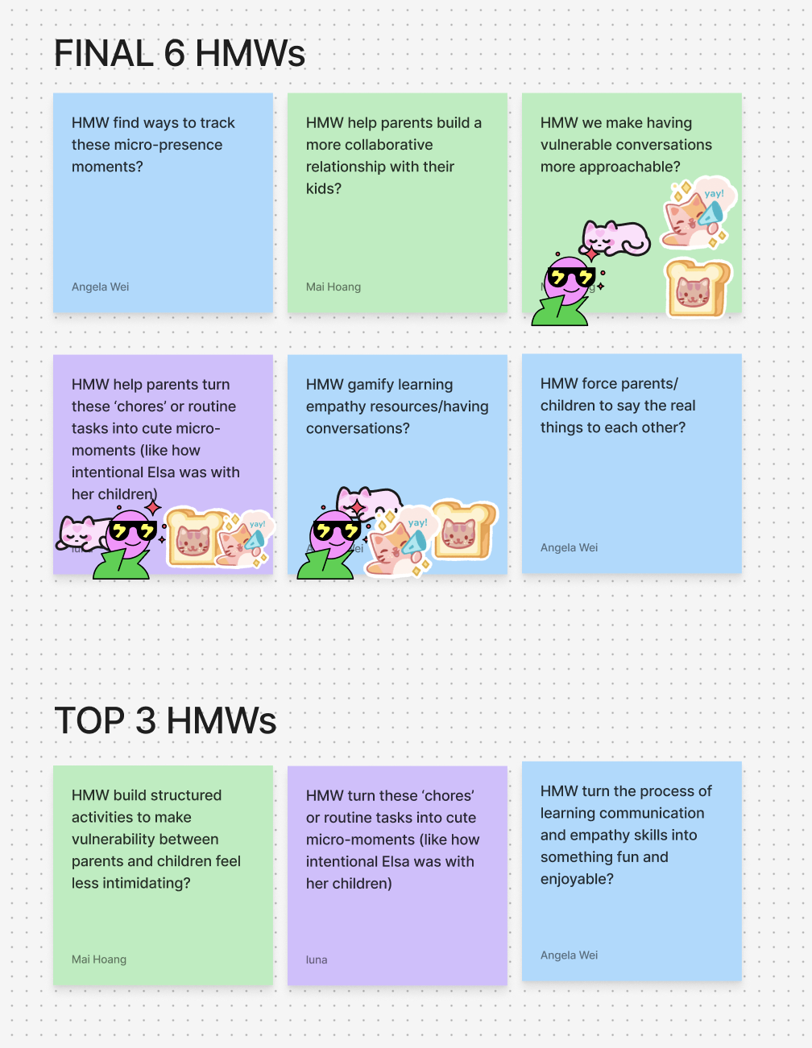
narrowing down the HMWs
used sticker method – top three for every HMW, and then top three of final HMWs

Slide 54
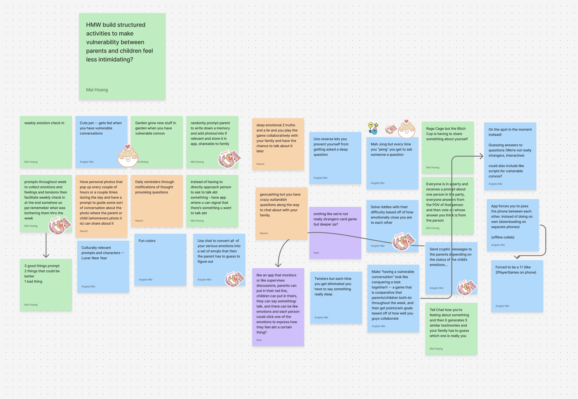
HMW from Mohammed

Slide 55
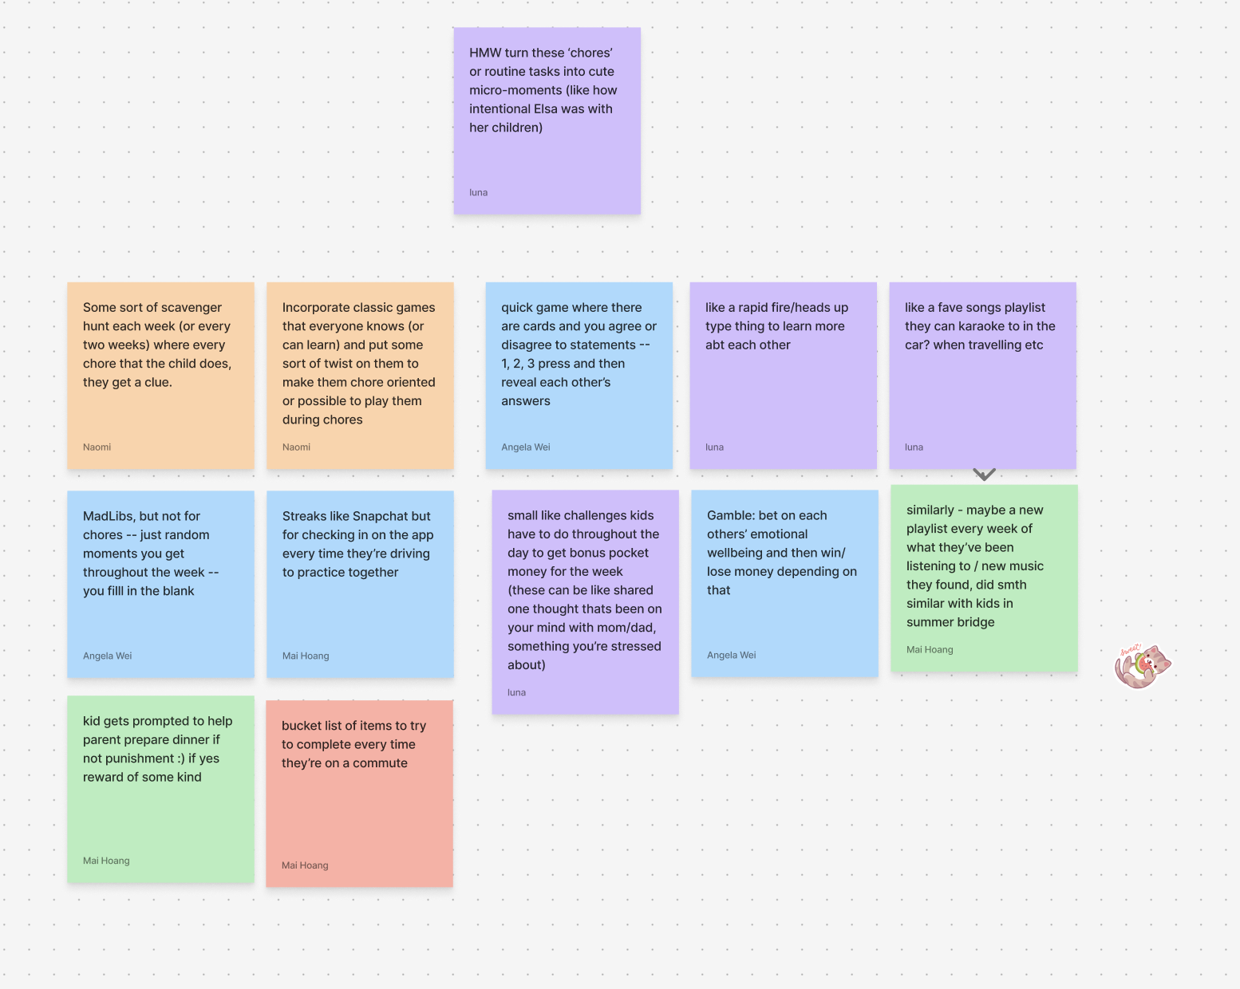
HMW from Lucia

Slide 56
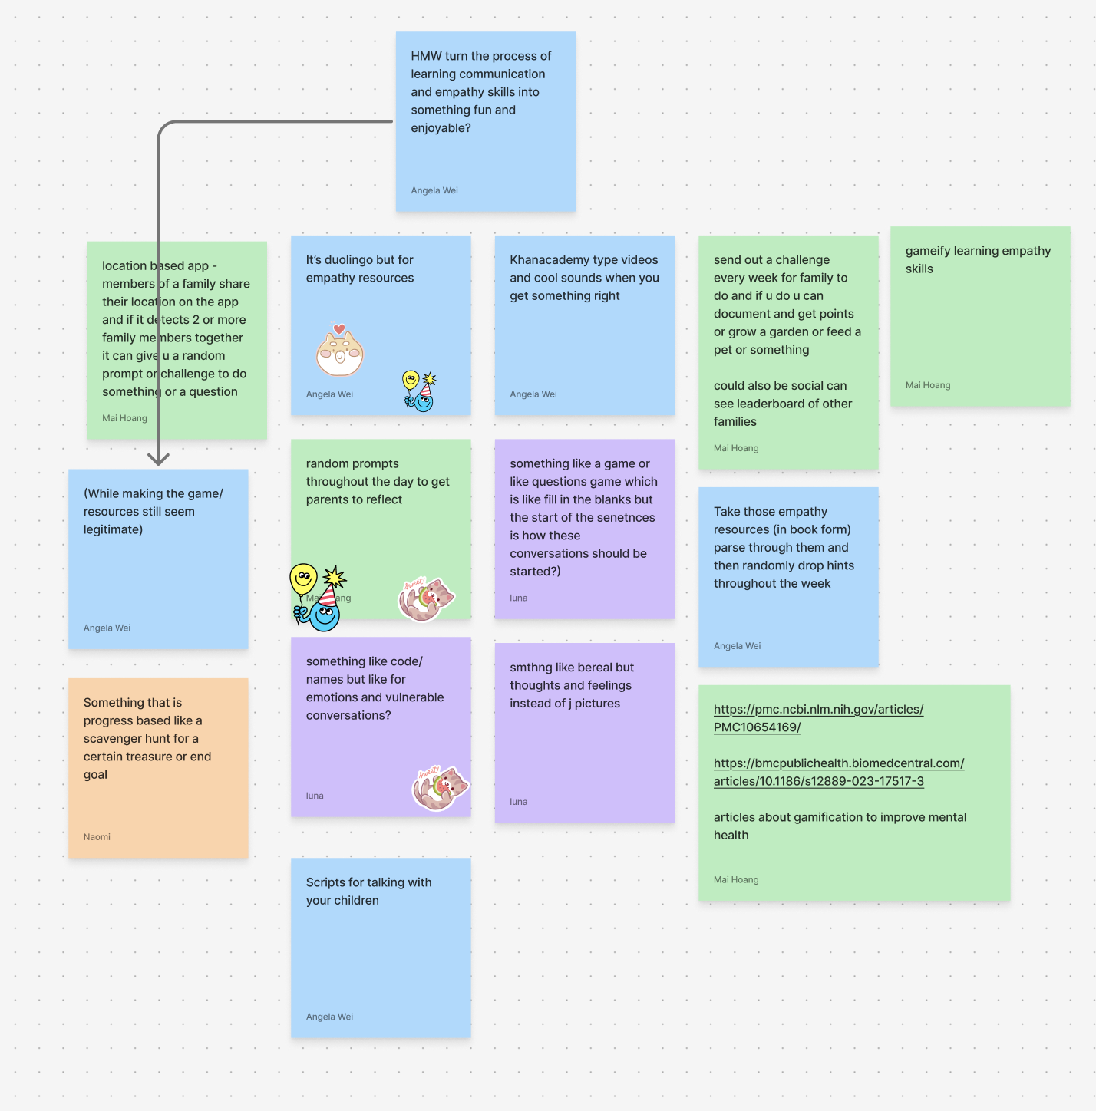
HMW from Ananya

Slide 57
assumption maps

Slide 58
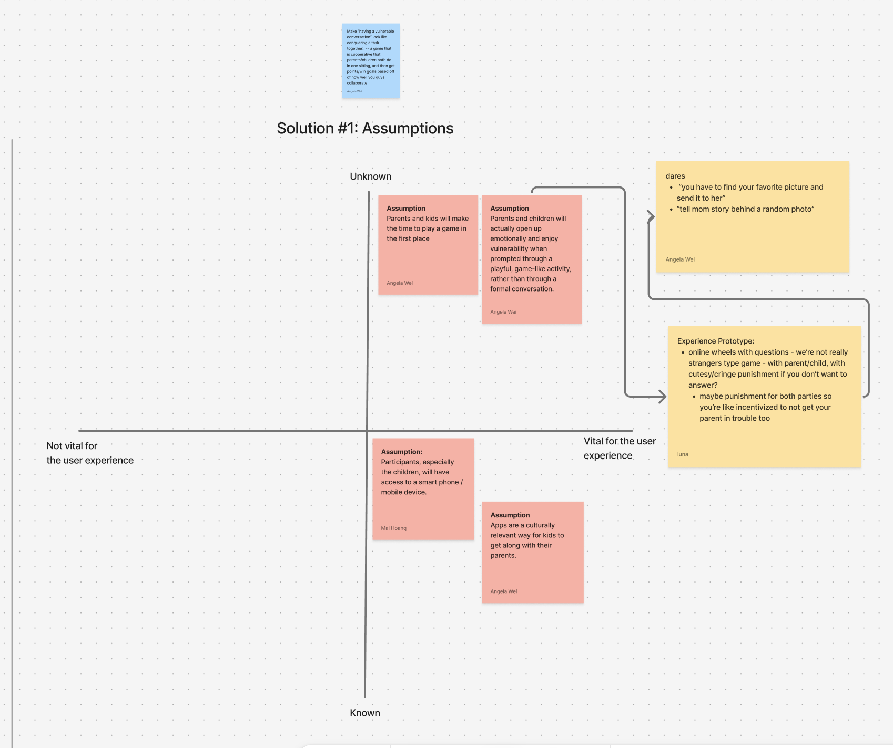

Slide 59
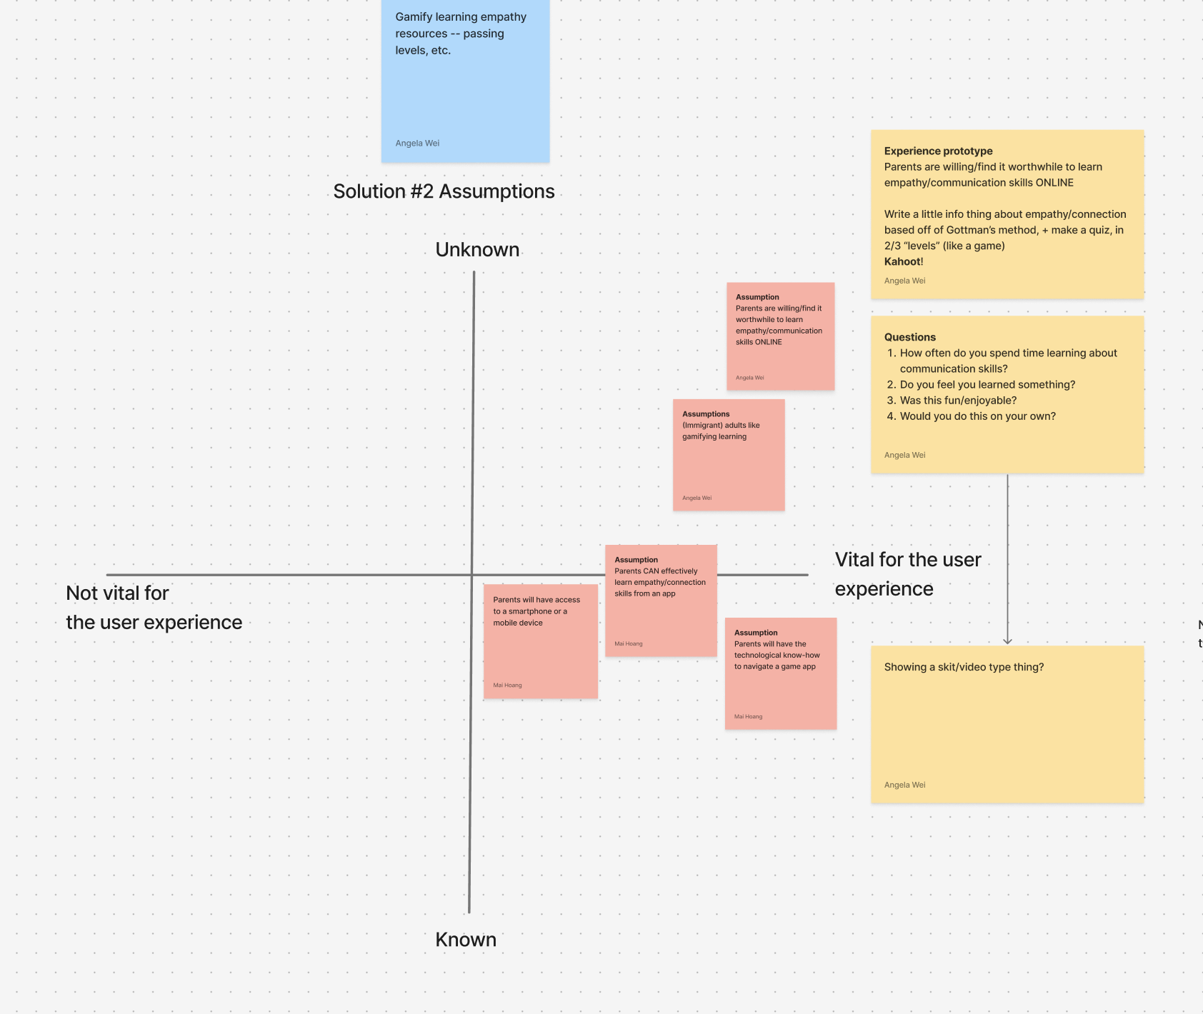

Slide 60
