Slide 1
assignment 4 CONCEPTVIDEO
20
XX
Naomi, Mai, Angela, Aimen

Slide 2
TABLE OF CONTENTS
(01)
(02)
(03)
(04)
(05)
(06)
(07)
project name + value proposition
problem + solution
market research
design values
tasks
storyboard
concept video

Slide 3
01
name & value proposition
20
XX

Slide 4
ROOTS

Slide 5
ROOTS
what’s in a name?

Slide 6
ROOTS
what’s in a name?
origin & identity: where you come from
growth & future: stronger roots = stronger branches
stability & origin: where you come from (culture, language, values)
growing together

Slide 7
ROOTS
one line value proposition: tools to help immigrant parents and children learn and practice vulnerability and grow closer

Slide 8
01
problem & solution
20
XX

Slide 9
Problem:
Solution:
Primary Users:
Immigrant parents and children often struggle to connect across cultural and generational gaps. Conversations about identity, heritage, and emotion can feel awkward or easily avoided.
Roots provides guided prompts, storytelling activities, and shared reflection spaces that make it easy and natural for families to talk, preserve heritage, and strengthen their bond.
Immigrant families, especially parents and teens navigating cross-cultural life.

Slide 10
01
market research
20
XX

Slide 11

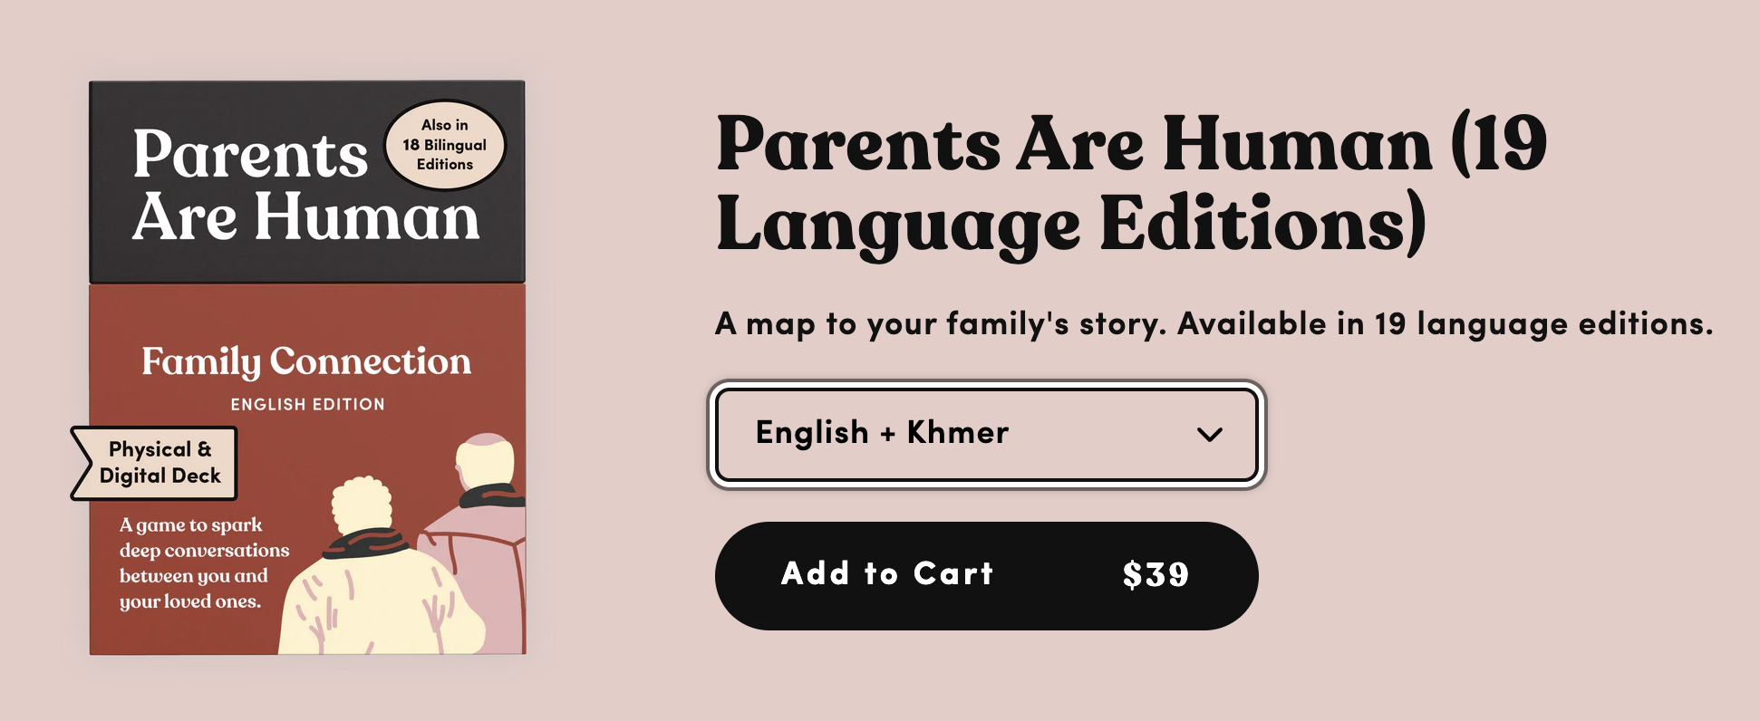
PARENTS ARE HUMANS
WHAT IT IS
Curated deck of question/activity cards in various languages to connect with immigrant family members
SIMILARITIES
Curates culturally and linguistically responsive questions for parents and children
DIFFERENCES
Our solution is not contained to a deck of cards
Our solution is virtual
WHAT’S WORKED
Culturally responsive
WHAT HASN'T WORKED
Paywalled - financial inaccessibility

Slide 12
PARENTS ARE HUMANS
OUR SOLUTION IS BETTER BECAUSE:
Cost Free
Individual components that can be done in our solution without family members present if you want to take the time for personal reflection and learning
Incorporates conflict resolution tools

Slide 13

CHIPAO
WHAT IT IS
Videos + live performances teaching communication skills for parents
SIMILARITIES
We’re also providing resources for parents (going to provide the same information)
DIFFERENCES
Not scalable – community events are local, have to travel
Different format/medium, serves a different purposes
Videos alone are not interactive, don’t provide PRACTICE (only theory/teaching)
WHAT’S WORKED
Really successful – parents love this kind of stuff; helps develop in-person communities
Videos are wonderful concrete examples of applying concepts in real life;

Slide 14
CHIPAO
OUR SOLUTION IS BETTER BECAUSE:
Combines theory + praxis
Facilitates ACTUAL parent/children interaction in the moment (and not teaching outside of the moment)
Guided personal prompts for reflection to facilitate deeper understanding of the material learned and connect it to personal experiences

Slide 15
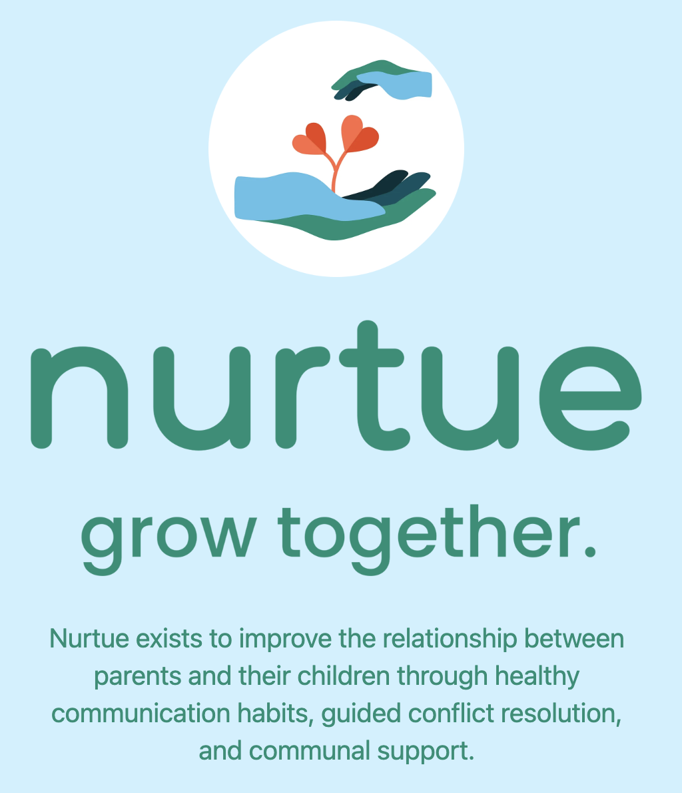
NURTUE
WHAT IT IS
Platform to connect parents to a supportive community of experts and fellow parents, promote effective communication via interactive modules, and guide parents through healthy conflict resolution
SIMILARITIES
Similar questions/quizzes to educate parents (specifically in conflict resolution) to the ones we will have in our learning modules
DIFFERENCES
Specifically for parents, whereas roots is geared towards both parents and children
Creates a community for parents to help each other out, whereas roots is focused primarily on improving the parent-child bonding experiences.
WHAT’S WORKED
Teaches conflict resolution
WHAT HASN'T WORKED
There isn’t a one size fits all when it comes to parenting

Slide 16
NURTUE
OUR SOLUTION IS BETTER BECAUSE:
Connects the divide between resources for parents and resources for children by attempting to create a common ground for both groups of users
Our solution incorporates learning modules that explore concepts that do not only pertain to conflict resolution (which nurtue has a strong focus on)

Slide 17

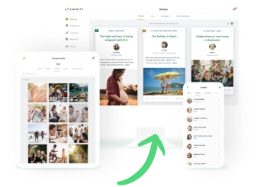
SIMIRITY
WHAT IT IS
Private family journaling app
Storytelling space
SIMILARITIES
Focus primarily on enabling connection through family storytelling and photo journaling
DIFFERENCES
Incorporates the aspect of text journaling
Focused on multi-person familial connection (not only parent to child connection)
WHAT’S WORKED
Builds long lasting family legacy of stories
WHAT HASN'T WORKED
Requires paid subscription to use app to full capacity
All family members must be present on the app to see content and upload content

Slide 18
SIMIRITY
OUR SOLUTION IS BETTER BECAUSE:
Culturally responsive to the needs and concerns that are specific to immigrant communities
Engaging interactive games that may appear to young adults more than simply uploading pictures and journal entry descriptions

Slide 19
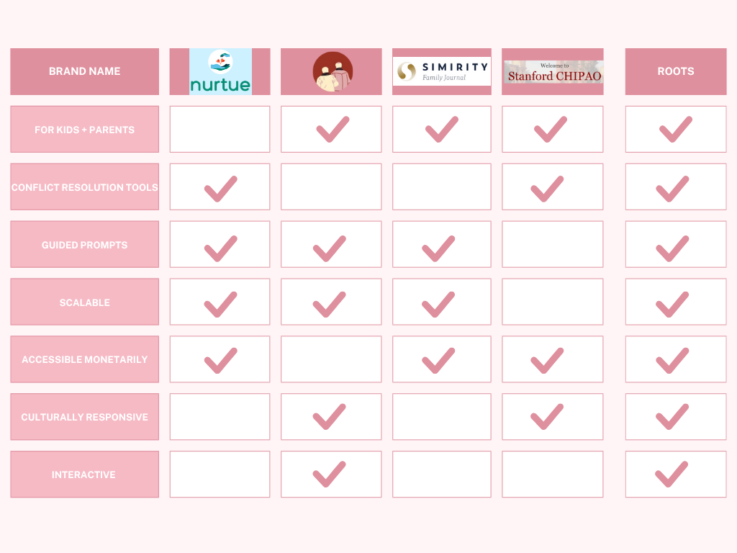

Slide 20
01
design values
20
XX

Slide 21

Direct
Stakeholders
Indirect
Stakeholders
Immigrant Parents
Second-Generation Young Adults
(ages 14-18)
Extended family members of immigrant parents (grandparents, aunts/uncles, cousins)
Ethnic Community Resource Centers
Cultural Organizations

Slide 22
Tarot Cards of Tech

Slide 23
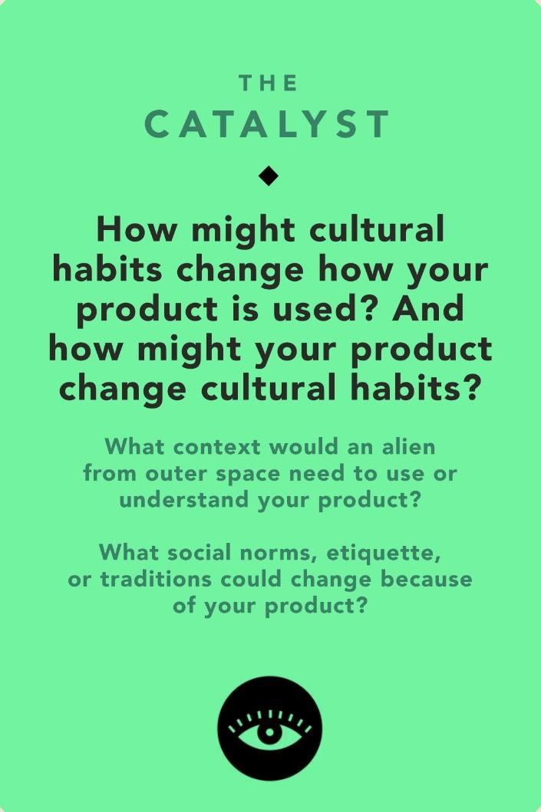
THE CATALYST
Engrained cultural habits of indirect communication may slow down users abilities to learn and utilize direct communication habits
Cultural norms of power hierarchies related to age and gender within families may initially limit the potential for collective change that this app aims to have
Ethical consideration of the language of the app
  Certain languages may affect the range of vocabulary with which users speak about their emotions/feelings/thoughts
Users may transition to relying on communication through virtual games, replacing the cultural habit of traditional face-to-face games

Slide 24
THE CATALYST
Underlying Value Tension:
  Tension between removing negative cultural habits (lack of direct communication,avoidance of vulnerability, dismission of emotions) and maintaining positive cultural habits
Risk of Harm against subgroup:
  Where there is extreme cultural dissonance between parents/child, they may be discouraged when their first attempts at communication are unsuccessful
Ethical Implications in Design:
  There are varying emotional depth levels to the learning modules and games that are integrated in our gap
  To “unlock” more emotionally engaging games, users have to first play the games that are not as deep

Slide 25
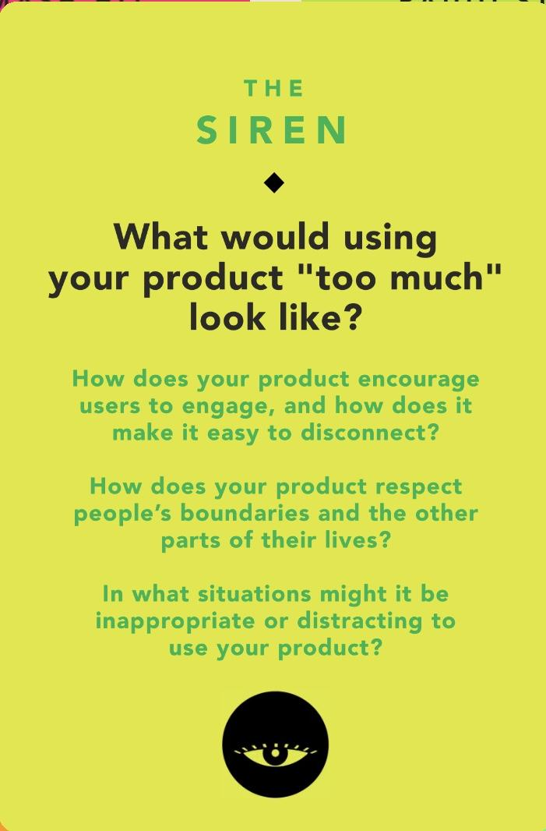
THE SIREN
Replaces in person interaction with learning modules
  Growth may begin to be recognized as learning about generalized concepts, without being able to actually apply them
Minimizes consistent in person connection if people become reliant on the app for personal interaction
Limits the amount of extremely deep conversations as there is a certain level of heartfelt conversation that our app may not be appropriate for

Slide 26
THE SIREN
Underlying Value Tension:
  The consistent weekly use of this app may be necessary for optimal learning, application, and communication results
Risk of Harm against subgroup:
  May contribute to the high amount of screen time of young adults with screen time addictions already struggle with
Ethical Implications in Design:
  Offline communication and connection tasks, built in time boundaries in the form of clear learning module start and end cues, and daily personal reflection prompts

Slide 27
01
tasks
20
XX

Slide 28
TASKS
simple
moderate
complex
user completes a learning module
user plays a game with their parent/child
user captures a selfie with their parent/child & adds it to the memory book

Slide 29
01
storyboard
20
XX

Slide 30
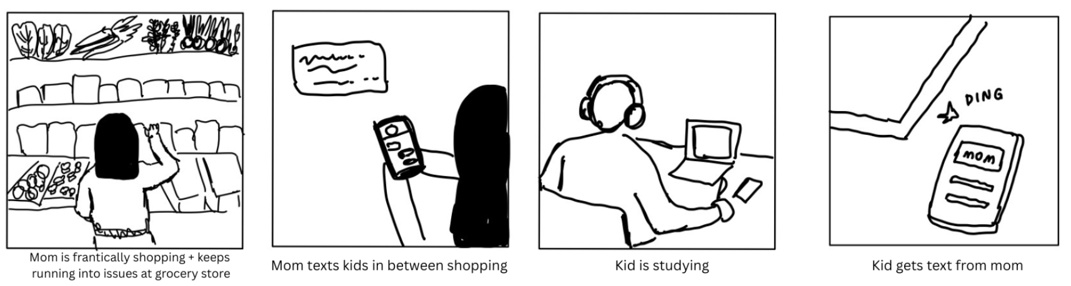
scene changes to showing kid’s room

Slide 31
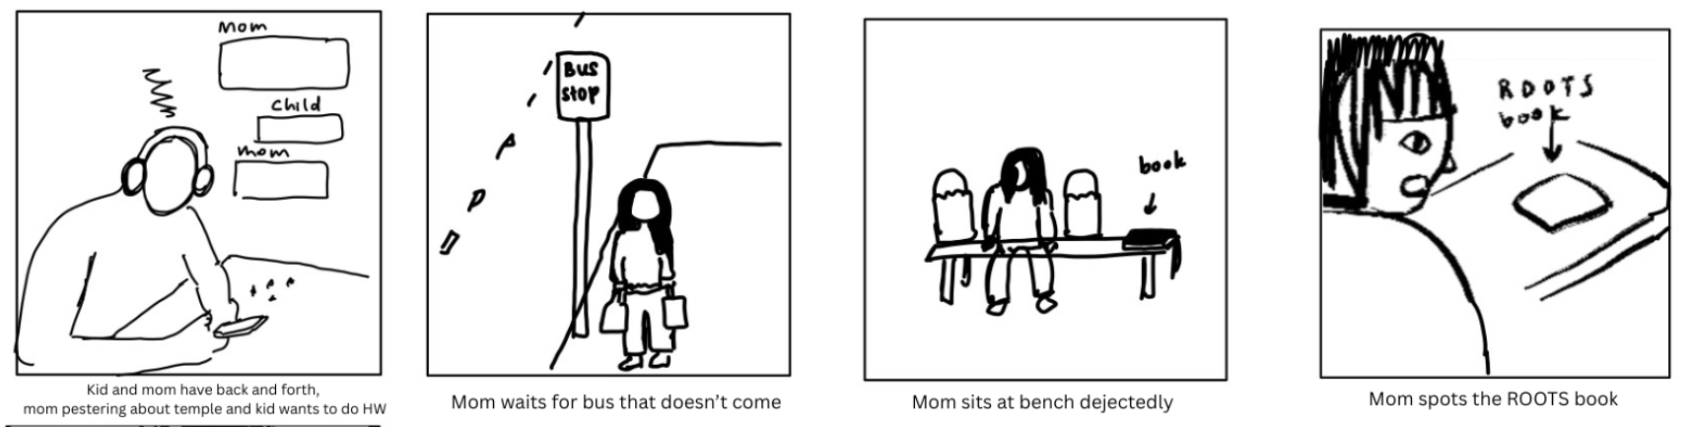
both upset with the other

Slide 32
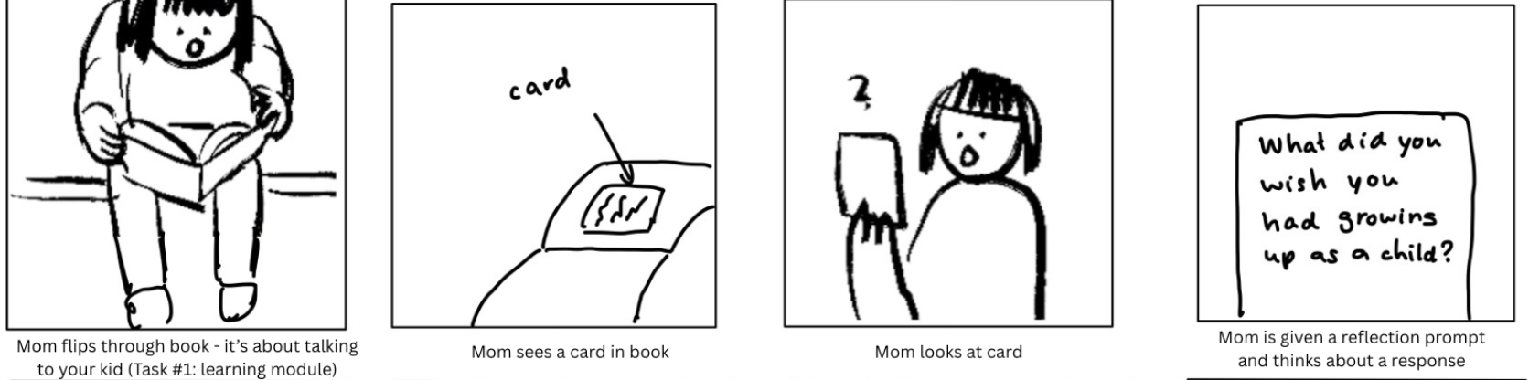
task 1: learning module
mood change:
disheartened -> fascinated

Slide 33
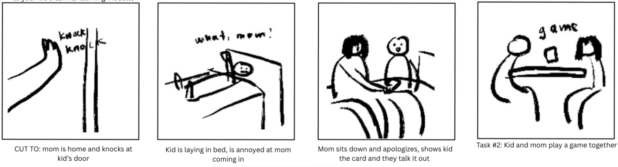
mood change:
misunderstood -> understood
task 2:
play fun vulnerable questions game

Slide 34
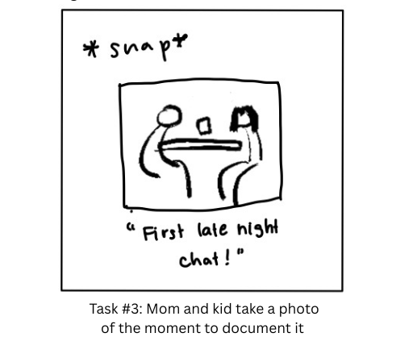

Slide 35
01
concept video
20
XX

Slide 36


Slide 37
THANK
YOU
20
XX

