Slide 1

a6: medium fi prototype
roots
connecting for us
naomi l, aimen e, mai h, angela w

Slide 2





table of contents
01
05
our team
usability goals + measurements
02
06
problem + solution
revised UI interface
03
07
values in design
medium-fi prototype &
implementation
04
tasks

Slide 3




our team
Naomi
Aimen
Mai
Angela

Slide 4

02
problem & solution

Slide 5



problem & solution
problem
immigrant parents and children often struggle to connect across cultural and generational gaps.
solution
roots provides guided prompts, storytelling activities, and shared reflection spaces that make it easy and natural for families to talk, preserve heritage, and strengthen their bond.

Slide 6
problem & solution
primary users
immigrant parents
problem
immigrant parents and children often struggle to connect across cultural and generational gaps.
solution
roots provides culturally-sensitive guided learning modules, in-person activities, and reflection spaces that make it easy and natural for parents and children to talk, preserve their heritage, and strengthen their bond.

Slide 7



03
values in design

Slide 8

value 1: education

Slide 9
value 1: education
value 2: culturally sensitive

Slide 10
value 1: education
value 3: connection-oriented
value 2: culturally sensitive

Slide 11
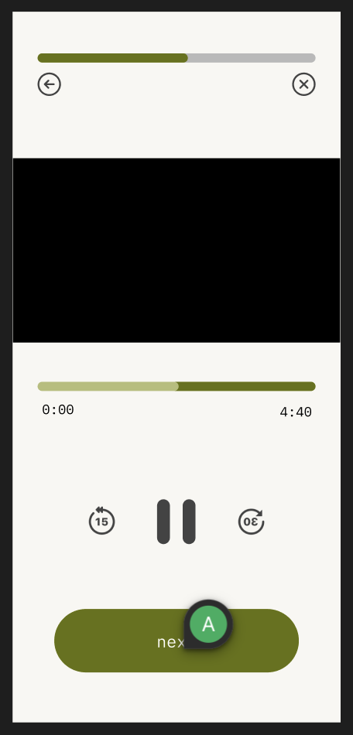
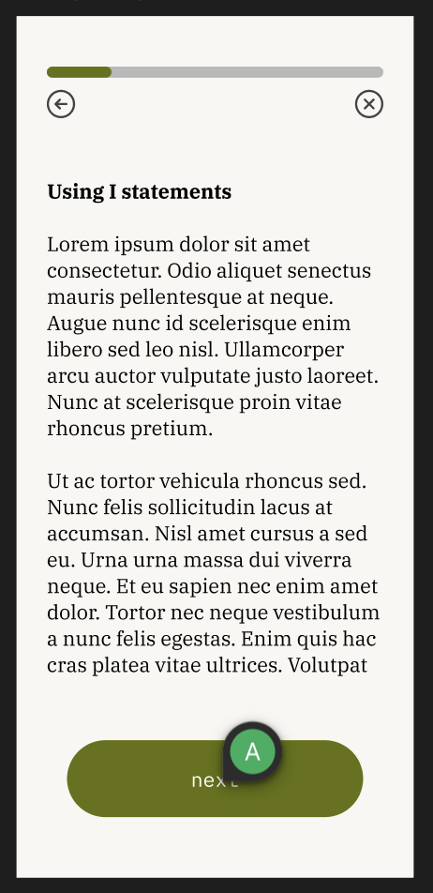
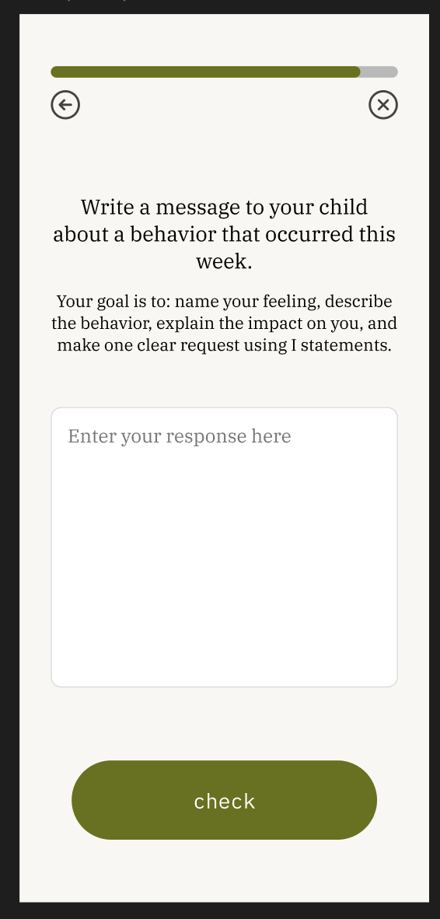
value 1: education
anyone can grow empathy and effective communication if given the opportunity to learn and apply these skills.
users can progress through bite-sized, multi-modal lessons + practice skills they learn

Slide 12
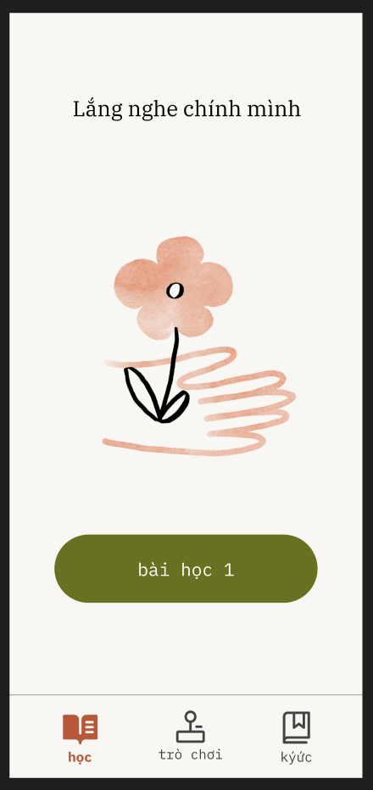
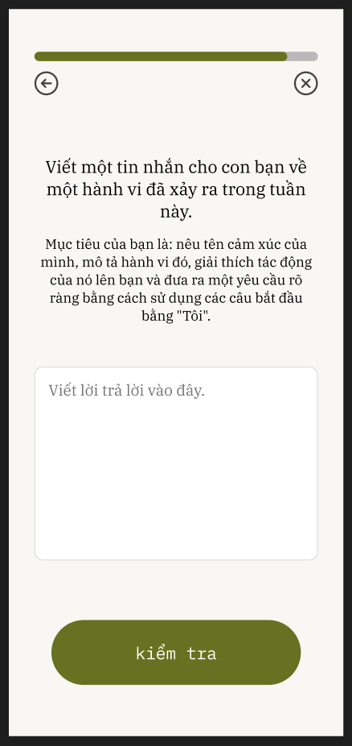


value 2: culturally sensitive
roots honors diverse immigrant family norms, languages, and values without stereotyping or forcing a one-size-fits-all model.
users can toggle language settings

Slide 13
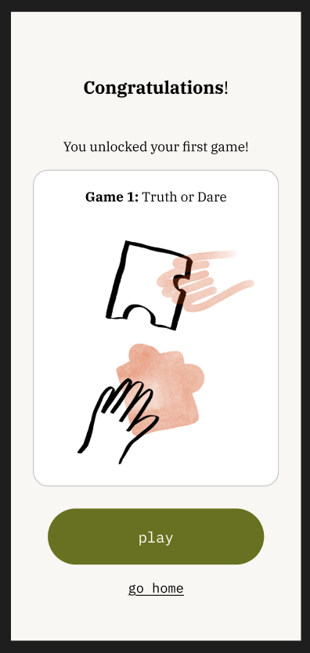
value 3: connection-focused
users should feel empowered to connect with each other through play and record these moments
users can unlock games to play with their child to get to know them better
users are prompted to take a photo after playing to record the moment + write a reflection about it

Slide 14
tensions in values
value 1 (education) and value 3 (connection): teaching “how to connect” can make moments feel coached or inauthentic.

Slide 15
tensions in values
value 1 (education) and value 3 (connection): teaching “how to connect” can make moments feel coached or inauthentic.
value 2 (culturally sensitive) and value 3 (connection): encouraging sharing (more western) may clash with norms around privacy and sharing

Slide 16
tensions in values
value 1 (education) and value 3 (connection): teaching “how to connect” can make moments feel coached or inauthentic.
value 2 (culturally sensitive) and value 3 (connection): encouraging sharing (more western) may clash with norms around privacy and sharing
value 1 (education) and value 2 (culturally sensitive): a single curriculum risks flattening cultural nuance or prescribing one “right” way to communicate.

Slide 17
tensions in values
value 1 (education) and value 3 (connection): teaching “how to connect” can make moments feel coached or inauthentic.
address by: invitational language (“try this”), single-device play
value 2 (culturally sensitive) and value 3 (connection): encouraging sharing (more western) may clash with norms around privacy and sharing
value 1 (education) and value 2 (culturally sensitive): a single curriculum risks flattening cultural nuance or prescribing one “right” way to communicate.

Slide 18
tensions in values
value 1 (education) and value 3 (connection): teaching “how to connect” can make moments feel coached or inauthentic.
address by: invitational language (“try this”), single-device play
value 2 (culturally sensitive) and value 3 (connection): encouraging sharing (more western) may clash with norms around privacy and sharing
address by: prompts progress by difficulty, responsive prompts w/ ai
value 1 (education) and value 2 (culturally sensitive): a single curriculum risks flattening cultural nuance or prescribing one “right” way to communicate.

Slide 19
tensions in values
value 1 (education) and value 3 (connection): teaching “how to connect” can make moments feel coached or inauthentic.
address by: invitational language (“try this”), single-device play
value 2 (culturally sensitive) and value 3 (connection): encouraging sharing (more western) may clash with norms around privacy and sharing
address by: prompts progress by difficulty, responsive prompts w/ ai
value 1 (education) and value 2 (culturally sensitive): a single curriculum risks flattening cultural nuance or prescribing one “right” way to communicate.
address by: add cultural overlays, editable examples

Slide 20

04
tasks

Slide 21
04
tasks
complex:
reflect on a memory
moderate:
practice vulnerability
simple:
learn an empathy skill

Slide 22
05
usability goals & measurement

Slide 23
usability goals & measurements
Ease of navigation: how intuitive is it to use our app?
Measured by number of misclicks
Design features to enhance efficiency:
  More intuitive explicit icons
  Text with icons
  Make text bigger
  Simplistic UI overall

Slide 24
usability goals & measurements
Eagerness to use: how likely is it that they would use different features of the app, on a scale of 1-10.
Measured by asking users how likely they are to use each of the tasks again on a scale of 1-10
Design features for improvement:
  Only targeted towards parents because kids are likely to use when brought to them by parents but not vice versa
  Have labelled icons
  Have text in different languages for immigrant parents
  Have larger text

Slide 25
06
revised interface sketches

Slide 26
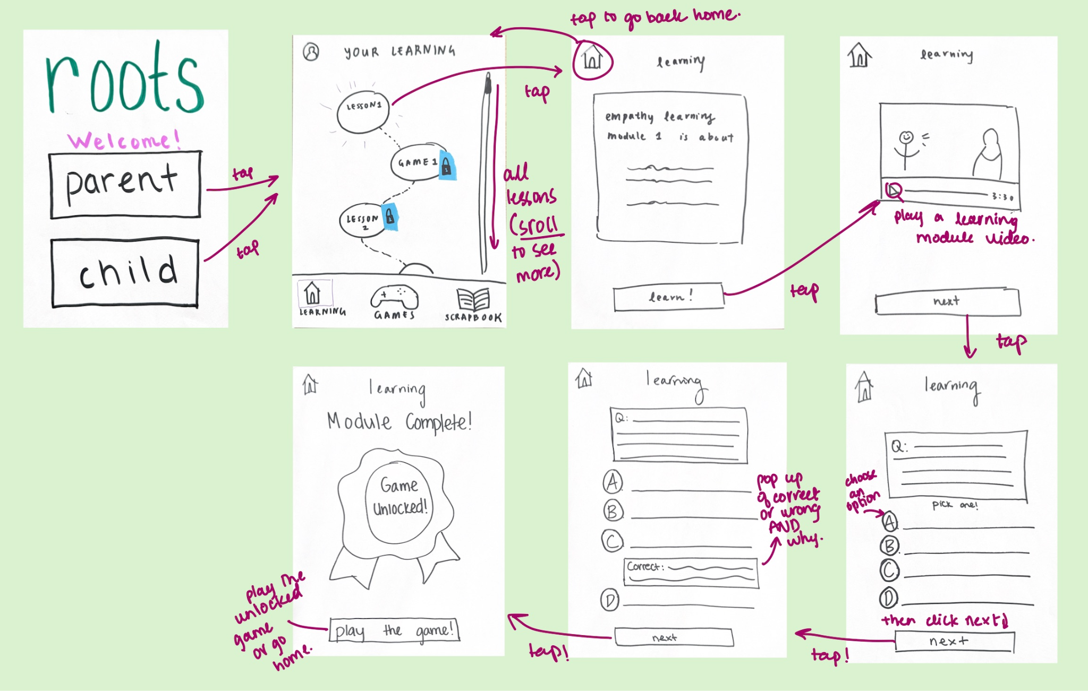
simple task - doing a learning module

Slide 27
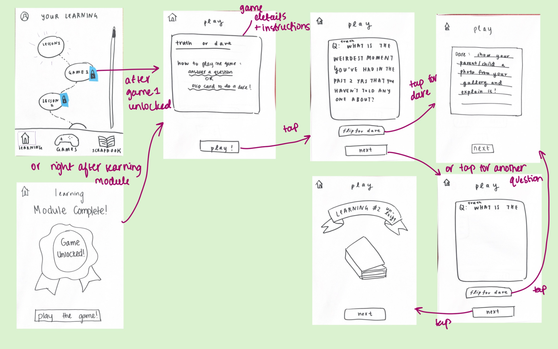
moderate task - playing a game

Slide 28
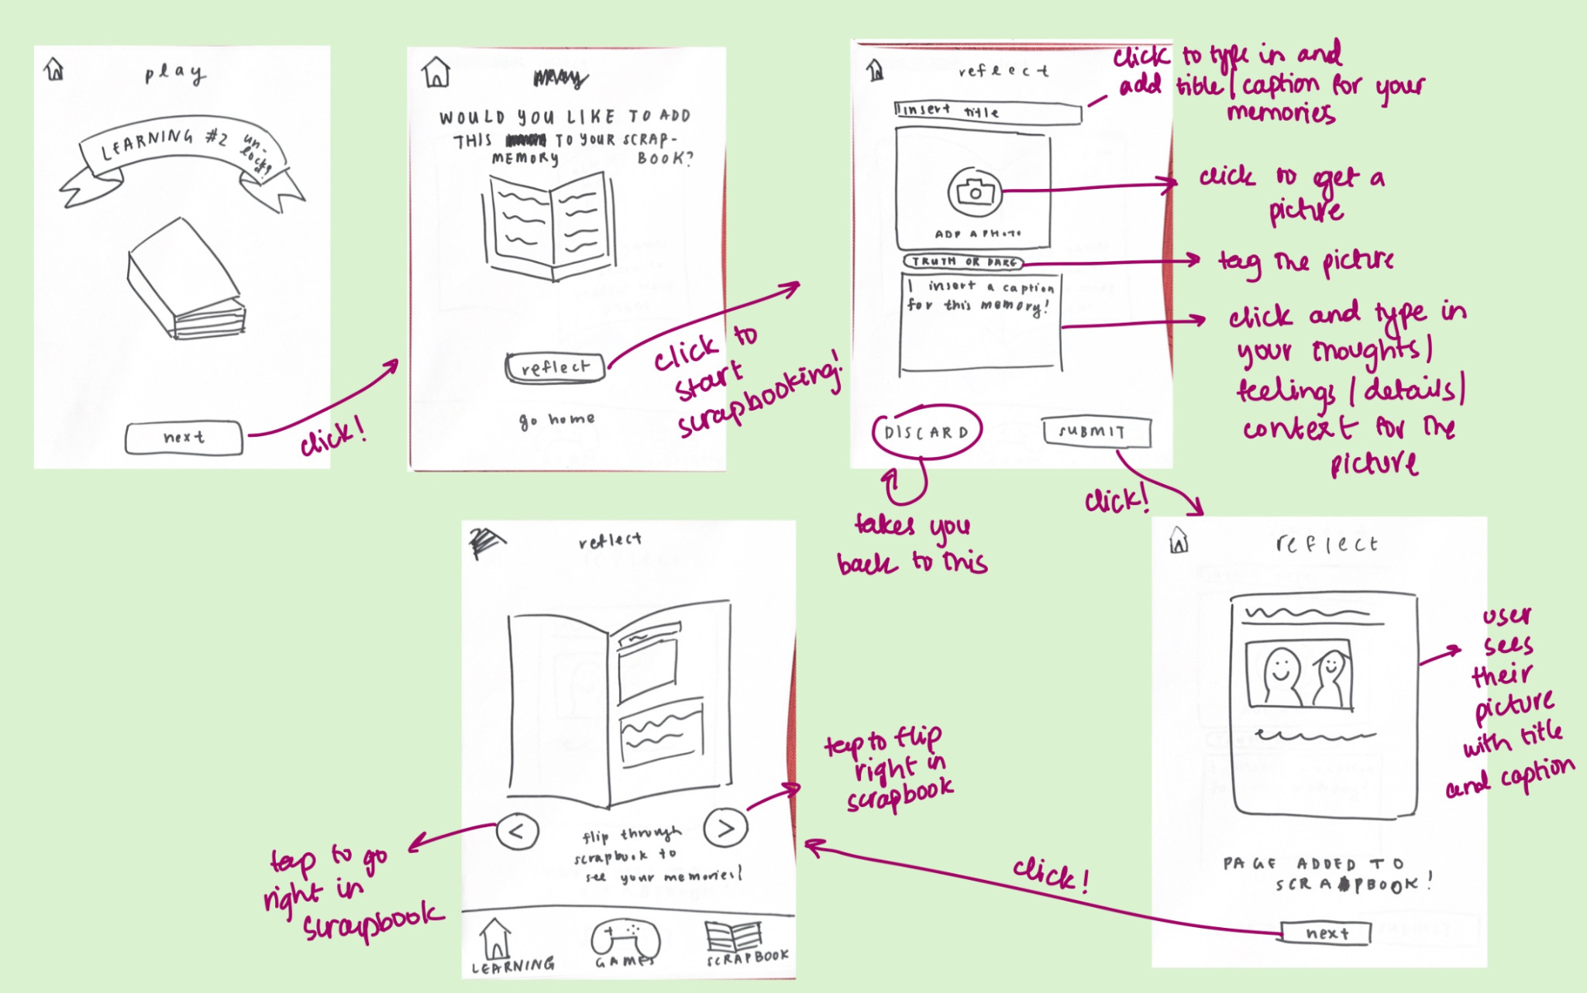
complex task - reflecting on a memory

Slide 29
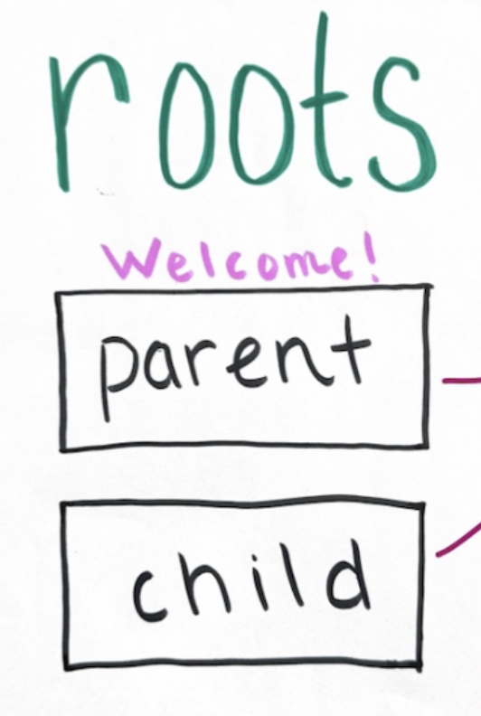
design change 1 - shift target audience to only parents
Before:
Had a start page for both parents and children
Users would select and use the app accordingly
Feedback:
Users (children) mentioned they would only use the app if brought to them by their parents
Parents mentioned wanting onboarding in the start of the app
lo-fi prototype
start page

Slide 30
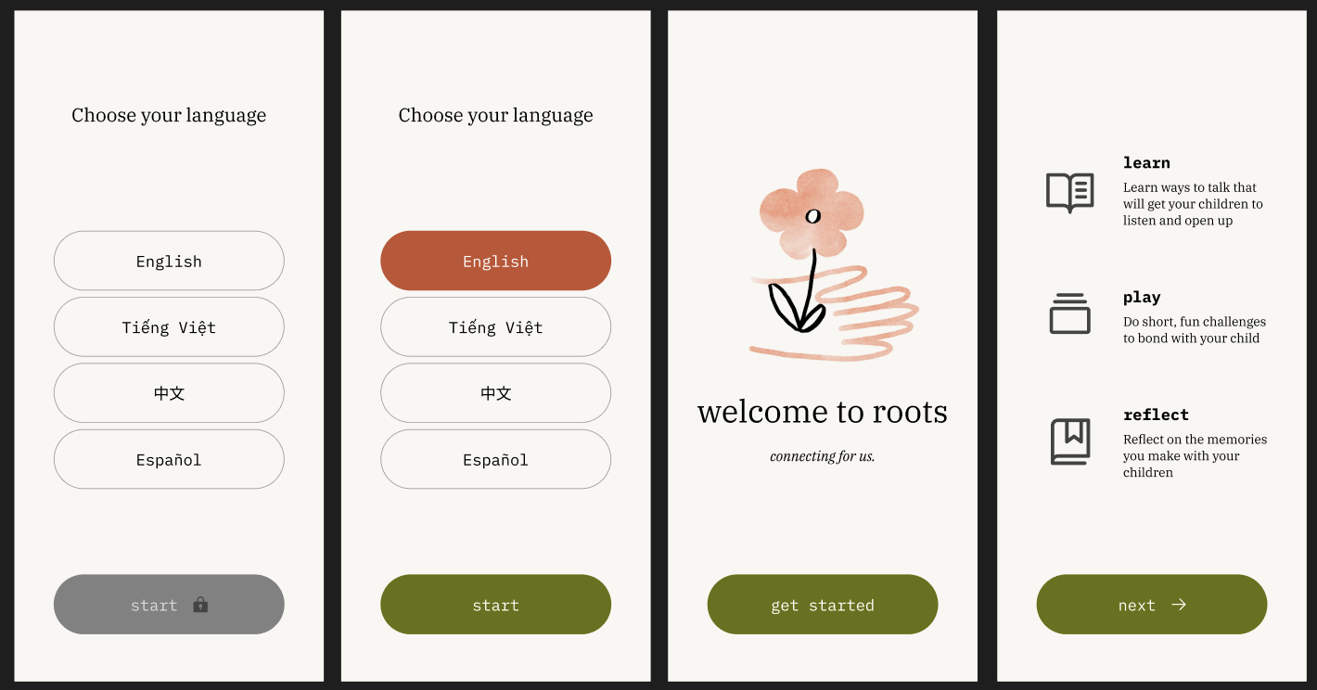
design change 1 - shift target audience to only parents
Change:
Removed child option
Introduced onboarding to inform parents of the app and what it’s about
Rationale:
Making it less confusing for our primary target audience - parents.
Narrowing our focus
med-fi prototype
starting pages

Slide 31
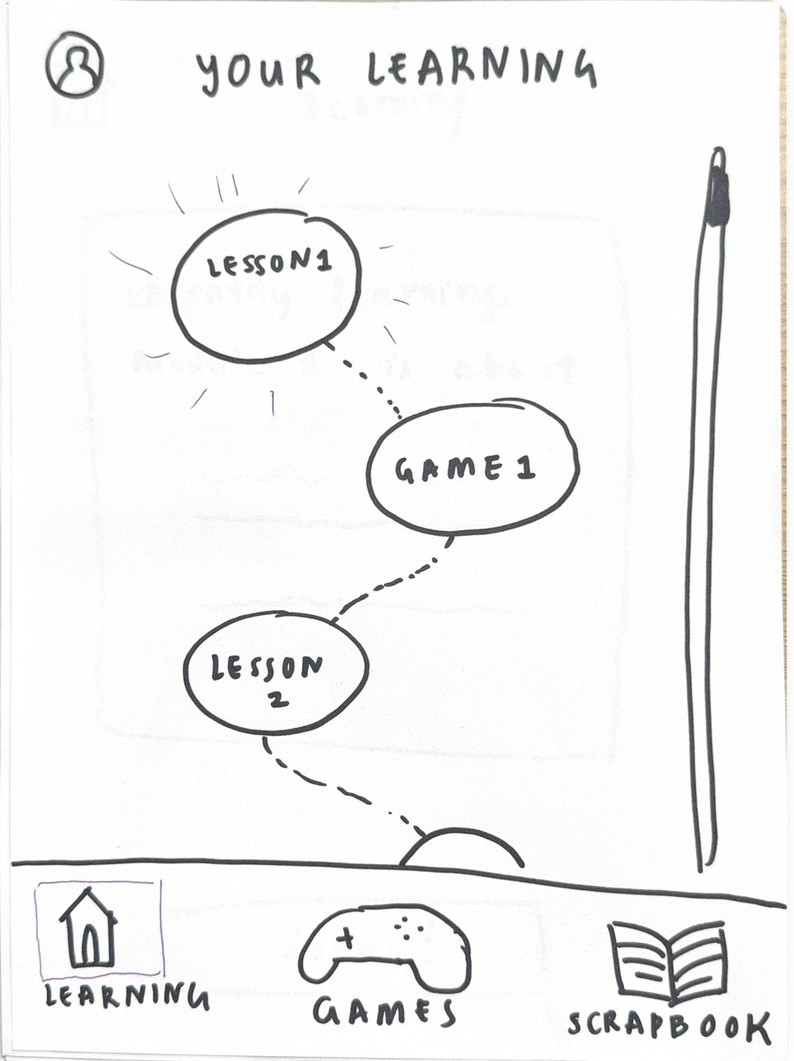
design change 2 - learning journey page instead of learning map
Before:
A top-to-down learning map with round and game-like interface
Feedback:
Older users confused about the order of unlocking games
low-fi prototype: learning journey page

Slide 32
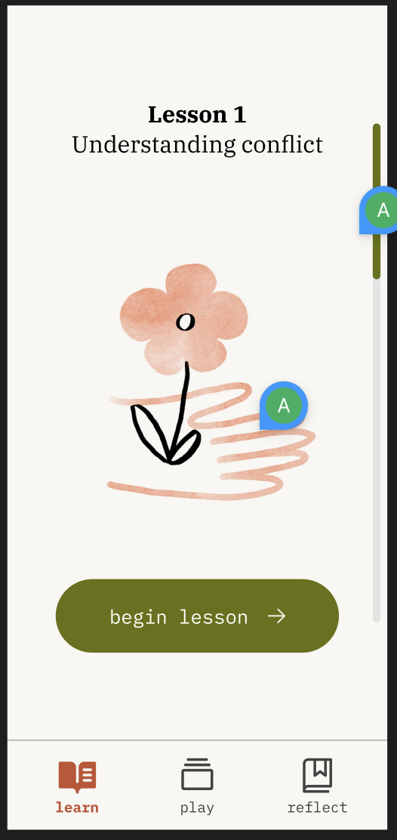
design change 2 - learning journey page instead of learning map
Change:
We shifted from using a map to a simple modular interface
Rationale:
Older users prefer simplicity and might get confused by the map style
Map format looked too childish after our shift to parents only
med-fi prototype: learning journey page

Slide 33
design change 3 - clarifying the games progression
Before:
Games were integrated into the map, and part of the learning journey
Feedback:
Needed more clarity to the core of the app – is it games or is it lessons?
Older users confused why there were games in the progression, and confused about the order of games/learnings
lo-fi prototype: learning journey page

Slide 34
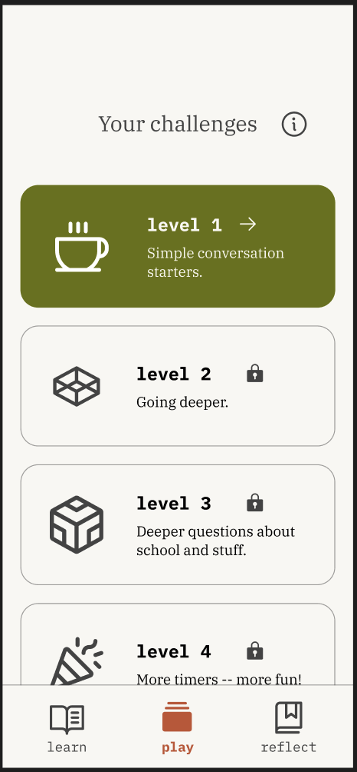
design change 3 - clarifying the games progression
Change:
Games are divorced from the learnings; completing learning 1 unlocks your first game, but after that, the learning and game tracks are separate (learning 1 unlocks learning 2, game 1 unlocks game 2)
Rationale:
Allows users to learn at their own pace – more agency
Easy onboarding flow, while also being an intuitive way of unlocking
med-fi prototype: play page

Slide 35
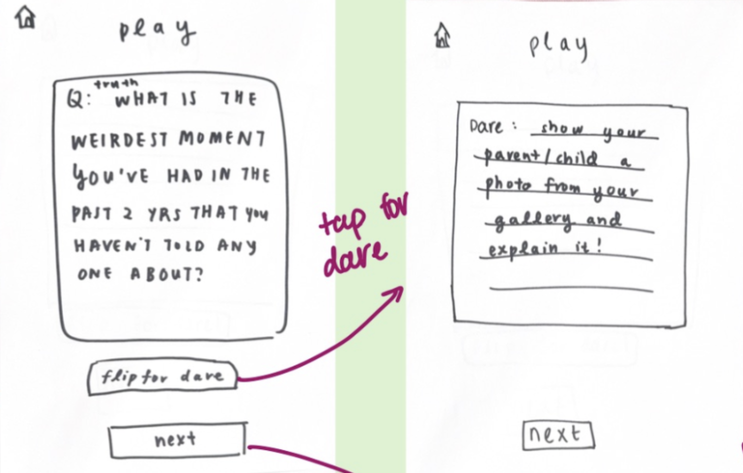
design change 4 - we turned the game into action & question cards, “challenges”
Before:
Our game was truth or dare - users would have to answer questions, and if they didn't, they had to do dares
Feedback:
Users avoided the deeper questions in that model and preferred to do dares.
For example: “I would not want to answer that with my mom.”
lo-fi prototype: truth OR dare

Slide 36
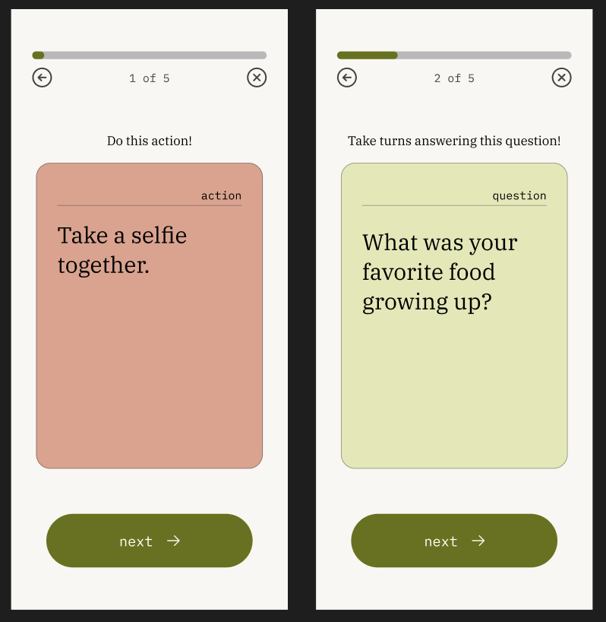
design change 4 - we turned the game into action & question cards, “challenges”
Change:
We instead turned it onto a question card AND action card model and reframed it as “challenges”
Users have to do the action card, and then take turns answering the question card, like Parents are Human
Games now progress in difficulty (different actions/questions per level)
Rationale:
Action is often easier than conversation
More natural progression through levels of closeness
Can’t avoid conversation by doing a dare
med-fi prototype: question AND action cards

Slide 37
07
medium-fi task flows

Slide 38
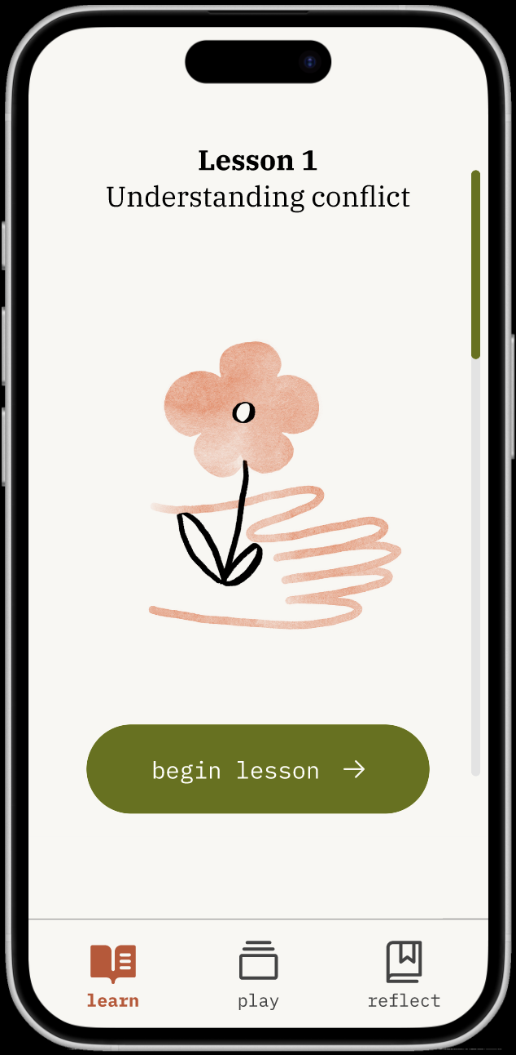
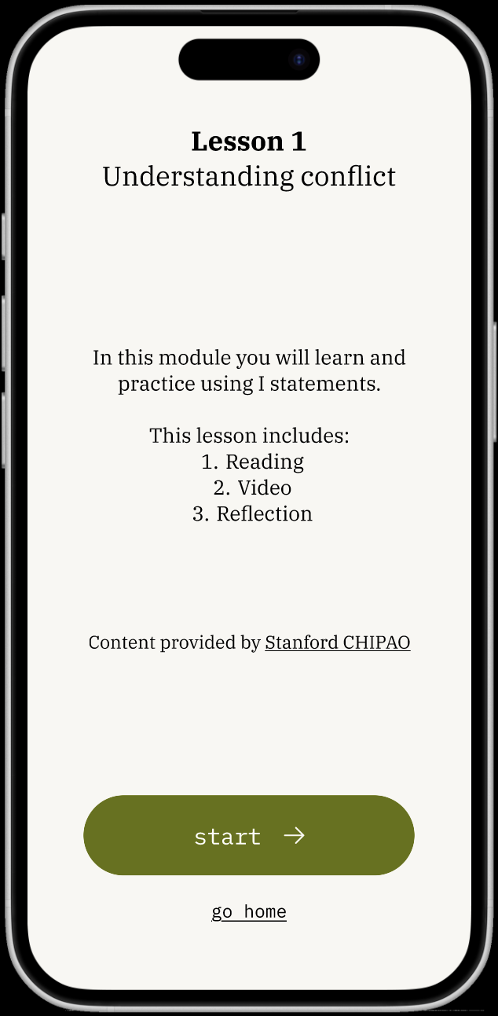
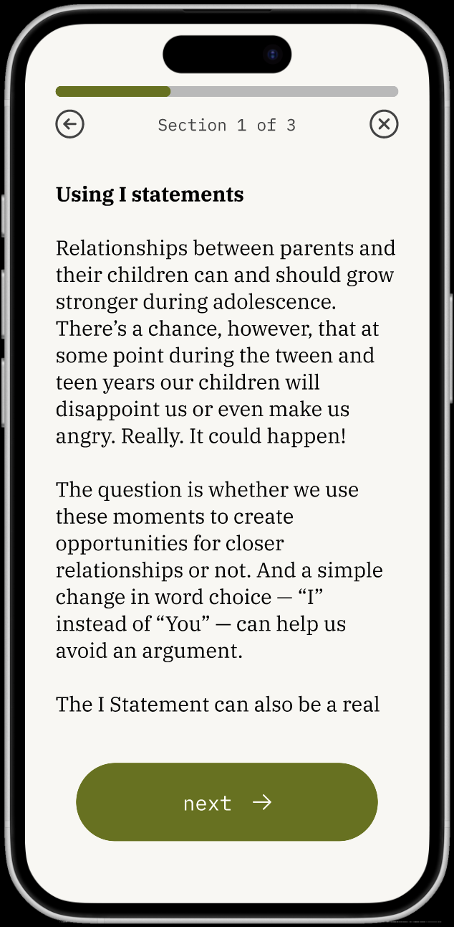
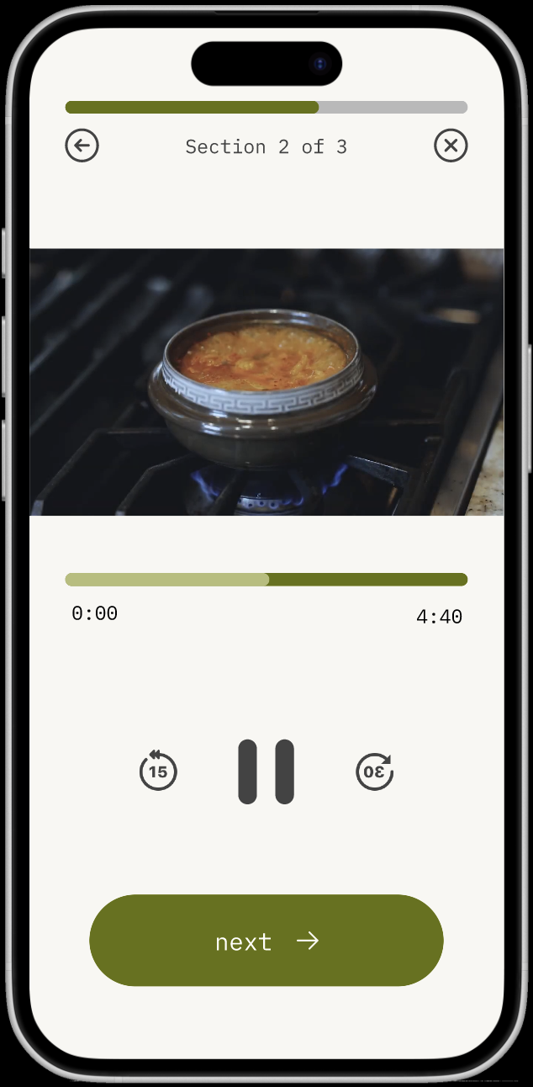
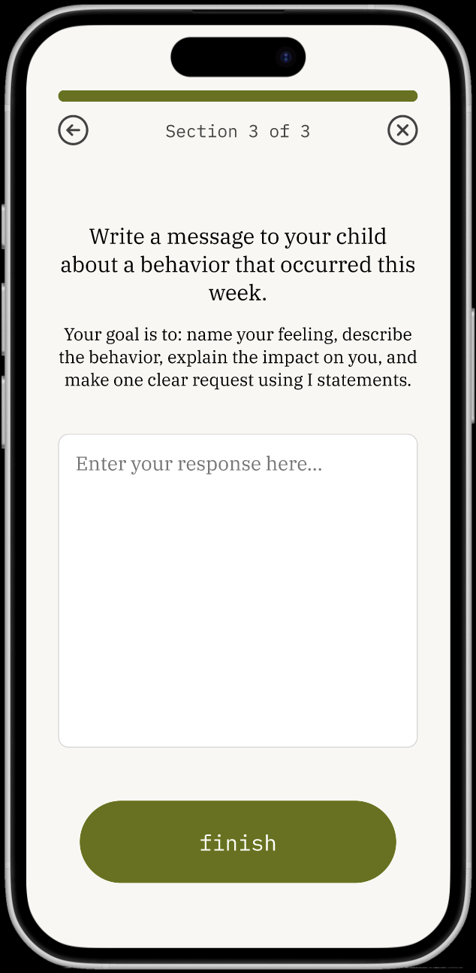
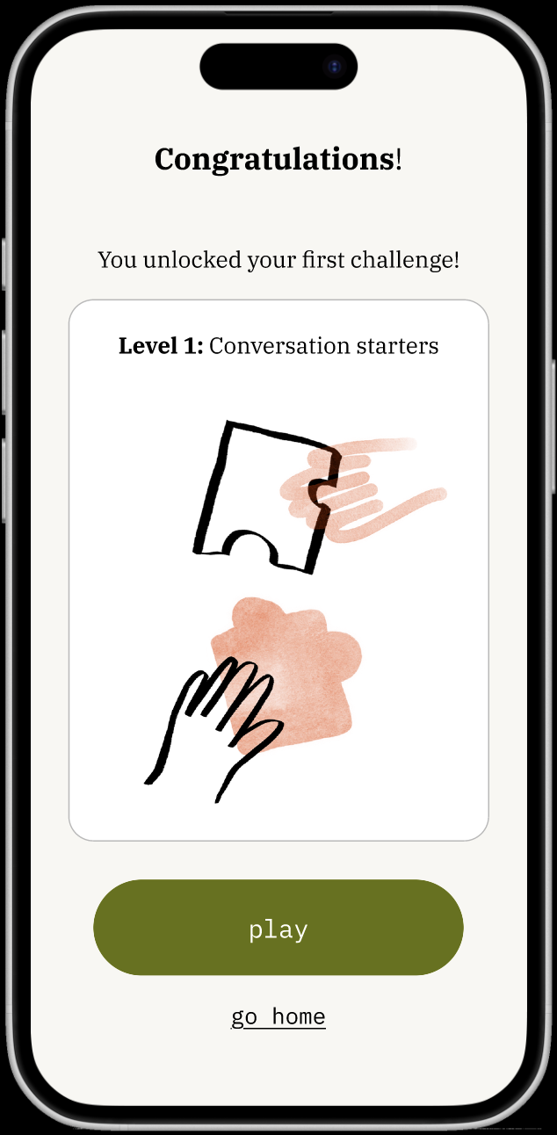
simple task: do a learning module
scrollable lessons page
practice based on lesson learnings:
introduction to the lesson:
a small reading excerpt:
a video lesson:
*here*
to go to game
to open scrapbook

Slide 39
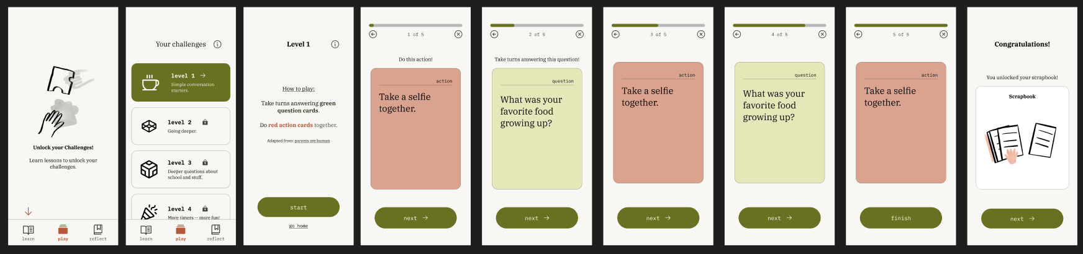
moderate task: play a game (“challenge”)
users must do learning modules before they can unlock games
instructions for the game
click next for more questions/action cards
click to proceed to the scrapbook

Slide 40
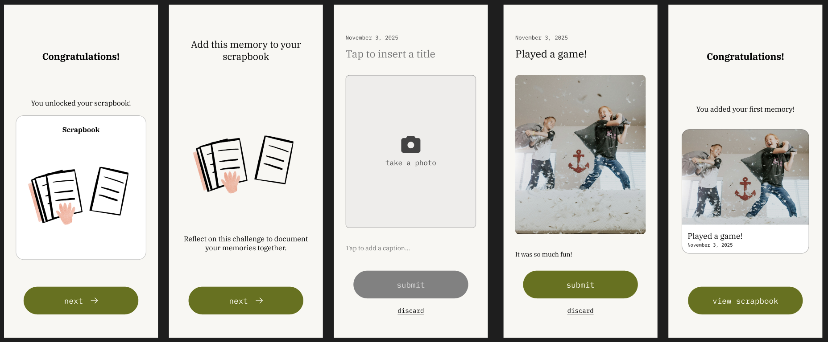
complex task: reflect on a memory
continuing from game
introductory screen to the scrapbook to tell parents what it is
users take a photo with their children, add a title/caption and submit it

Slide 41
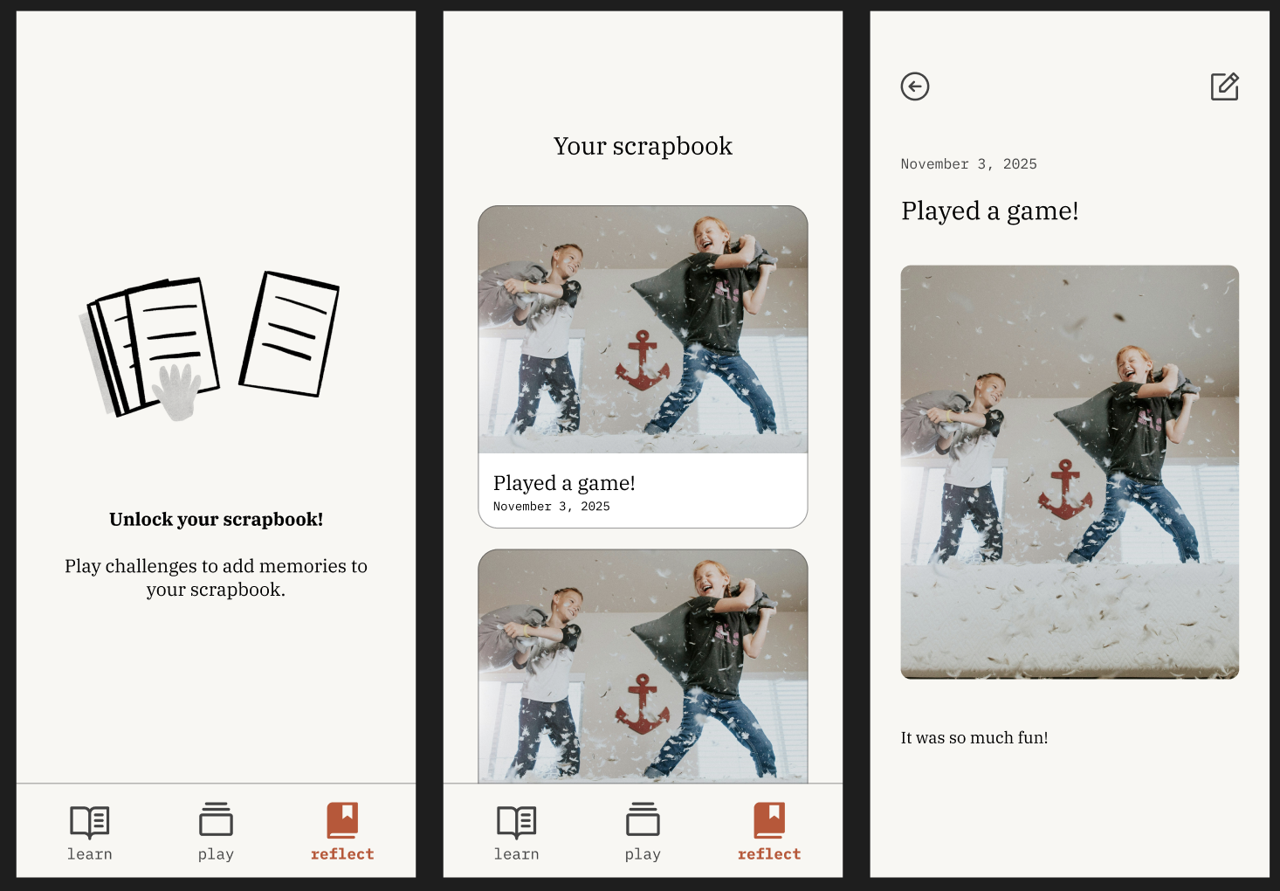
users must do games before they can unlock the scrapbook
Once scrapbook is unlocked, display memories
Users can scroll or click into individual memories to edit them

Slide 42

prototype implementation tools: goodnotes
for initial sketching and brainstorming, we used goodnotes!!
Pros:
Allows for quick sketches
Beginner-friendly tool
Cons
Can't necessarily vectorise drawings

Slide 43

prototype implementation tools: figma
For design mockups & prototyping, we used Figma!!
Pros:
Better organisation of task flows
Has features our app needed (like video insertion)
Allows for commenting
Components
Allows for conditional flows (e.g. if a user selects a language other than English all subsequent screens will be in that language for the med-fi)
Cons
No backend interactivity (e.g. storing inputs)
Not beginner friendly

Slide 44
limitations & trade-offs
The scrollbar on the home page does not work.
On the video page, the buttons are nonfunctional. There is no way in Figma to actually pause the video or rewind using the buttons; the video will autoplay no matter what.
There is also no way for the “next” button in the lesson to dynamically change depending on whether the user has read the text or watched the video.
We did not implement saving progress during the lesson because that required an excessive amount of backend work.

Slide 45
hard coded features
When doing a reflection in a lesson or adding a memory, all of the inputs are hardcoded. This is because the prototype cannot store input.
The questions for level 1 are currently hardcoded. In the future, each level will be replayable, because each level will have a randomized set of questions which draw from the same “pack.”
The date when adding a memory is hardcoded. Moreover, all of the memories in your scrapbook are currently hardcoded.

Slide 46
wizard of oz
Once you have completed level 1, the scrapbook automatically populates with three memories, to demonstrate what multiple memories would look like.

Slide 47
appendix

Slide 48
link to figma prototype: https://www.figma.com/proto/g7NBlxFkh3qOVYDqGFfxaZ/A6-Design-System?page-id=32%3A2&node-id=141-213&viewport=-425%2C270%2C0.19&t=q3Cpi9UD88XJWSIu-1&scaling=scale-down&content-scaling=fixed&starting-point-node-id=141%3A213

Slide 49
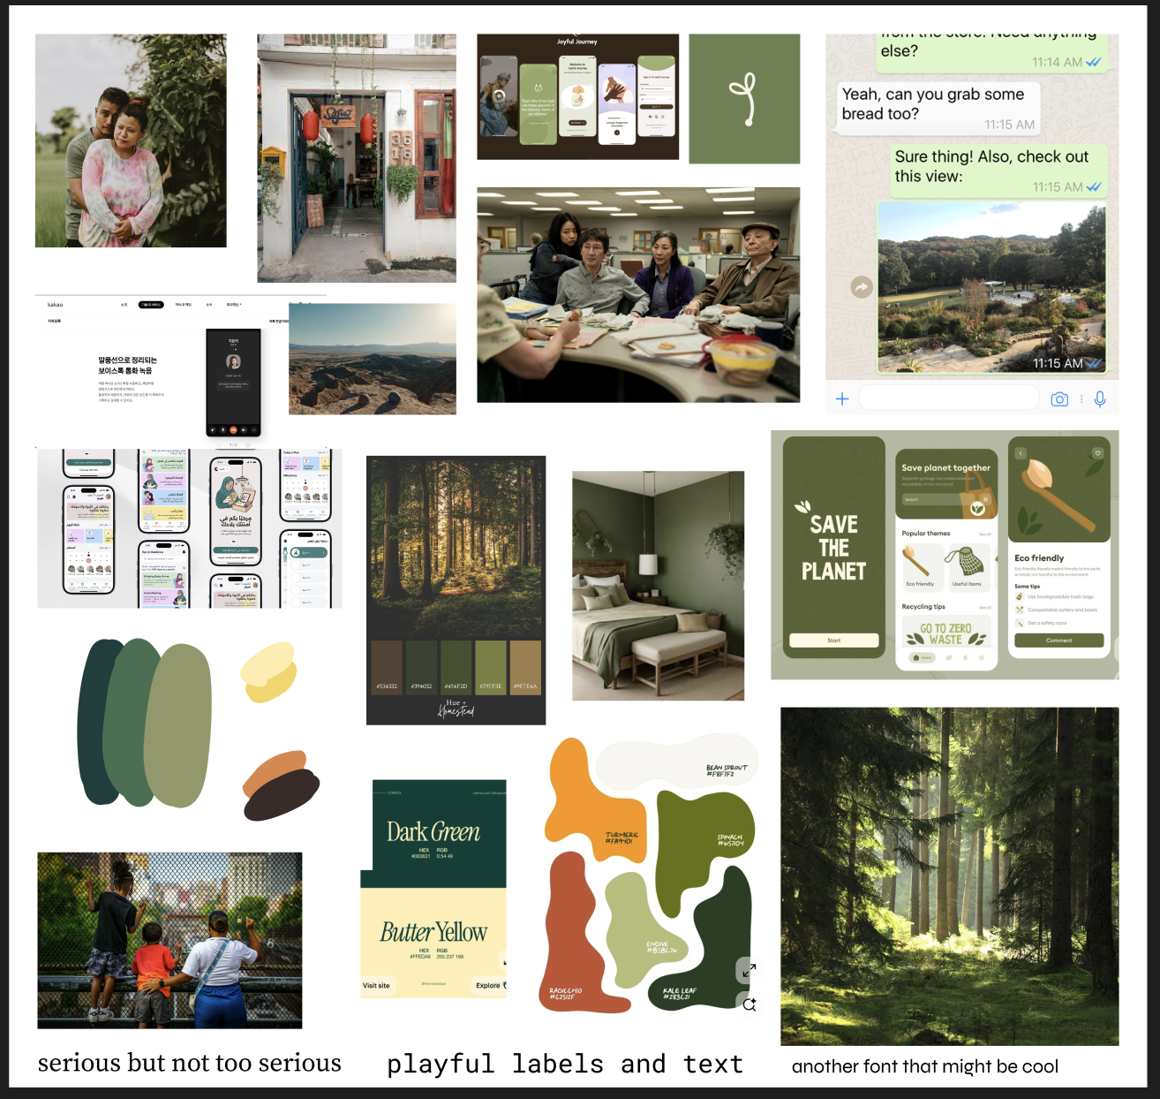
moodboard & design guide

