Slide 1






roots connecting for us
A8: High-Fi Check In
Aimen E, Mai H, Naomi L, Angela W

Slide 2




team
Naomi
Aimen
Mai
Angela

Slide 3
Table of contents
01
02
03
04
05
our solution
heuristic eval results
major revisions
implementation status
demo

Slide 4

01
problem + solution

Slide 5
problem + solution
Problem
immigrant parents and children often struggle to connect across cultural and generational gaps.
Solution
roots provides culturally-sensitive guided learning modules, in-person activities, and reflection spaces that make it easy and natural for parents and children to talk, preserve their heritage, and strengthen their bond.

Slide 6
02
heuristic eval results

Slide 7
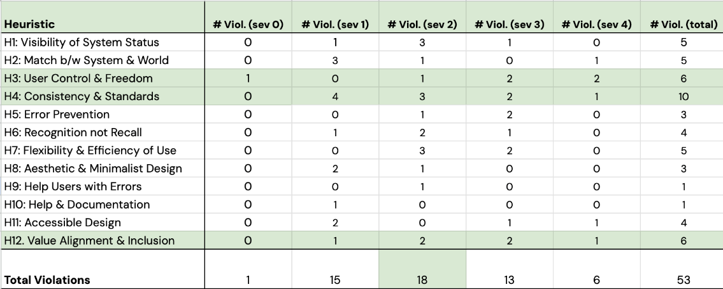
violation summary
Notes:
Summary:

Slide 8
most frequent violations
10
H4: Consistency & Standards
6
H3: User Control & Freedom
6
H12: Value Alignment & Inclusion

Slide 9

total revisions
30
Total Revisions
Severity 1-2
Severity 3-4
33 Violations
21 Revisions
19 Violations
9 Revisions

Slide 10
unincorporated feedback
Intention of App
Consistency
User Capabilities
“Text assumes parent-child relationship only”
“Excludes users with other family roles”
“Go home” link differs from bottom navigation icons (e.g., learn, not home). Therefore, users may get confused about what "going home" entails without prior knowledge that learn tab is actually the home tab”
“Scrapbook feature uses game-like terminologies: "Unlock", "Play Challenges"...For immigrant parents preserving cultural heritage, game-like framing undermines the emotional significance of documentation”
Notes:
Intention of App: As explained in the README, the intent of the app is parent-child relationship, therefore this will not be changing.
Consistency: This is an intentional design choice, which we did because in-game/in-learning modules is different than the non-in-game hierarchy/flow; also, the text link makes it the less "desirable" option.
User Capabilities: important to have that “gamified” language to an extent to lesson how “serious” it is. Important to consider children’s openness to it as well
Additional Unincorporated Feedback:
Violations that were addressed in the README (“Only English is supported” - false)
Violations that will be addressed in the High-Fi automatically (such as the native iOS scroll bar for scrolling concerns)
Duplicate Violations
Figma Constraints

Slide 11


important takeaways
Accessibility
Error Prevention
Captions for videos, Voice Option for readings
User understanding of app functionality
Confusing or inconsistent wording
Clear descriptions for non functional aspects (ie locked game that needs to be unlocked)
Functionality
Navigation & Tasks
Choices for optimized task flow (Save & Exit, Skip, etc.)
Flexibility (Edit, Delete)
Confirmation from the app of completed tasks (uploading photo, completing learning module)
Notes:
Accessibility: Include Visually Impaired users with voice option for readings and deaf/hard of hearing users with captions for videos

Slide 12
03
major revisions

Slide 13
Usability Goals
Goal #1: Ease of Navigation
How intuitive is it to use our app?
Goal #2: Eagerness to Use
How likely is it that users would use different features of the app, on a scale of 1-10?
11 Addressed Concerns

Slide 14
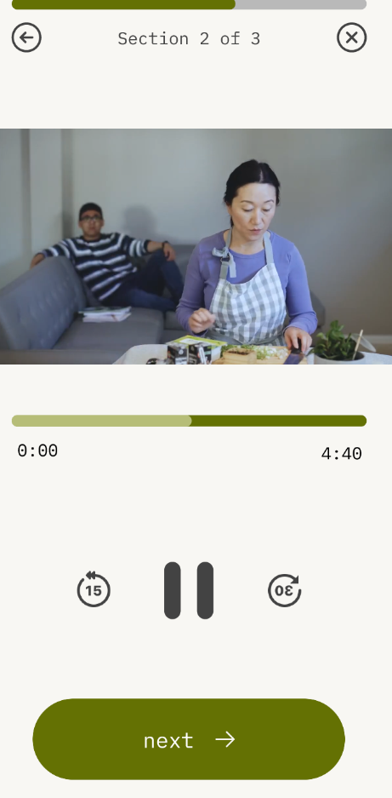
simple task
Violation Level: 3-4
concern #1
[H11] No captions for videos, which may be difficult for speakers where English isn't their first language.

Slide 15
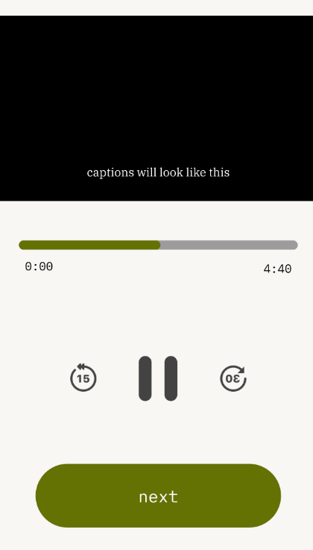
simple task
Violation Level: 3-4
revision
Added captions on videos
rationale
Accessibility for all is a key value for us
Being Deaf of Hard of Hearing should never restrict the user’s experience

Slide 16
simple task
Violation Level: 3-4
impact
this makes further progress towards our design value of making the app more culturally sensitive
it also helps further achieve our second usability goal of making users more eager to use our app again

Slide 17
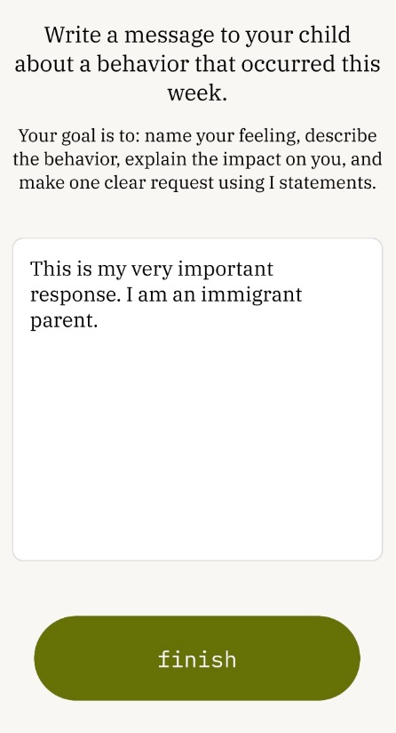
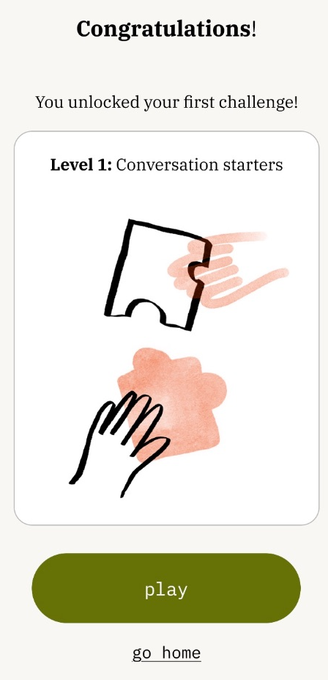
simple task
Violation Level: 3-4
concern #2
[H3] Once a user hits “Finish,” there’s no way to go back to edit their reflection or even look at their old reflection.

Slide 18
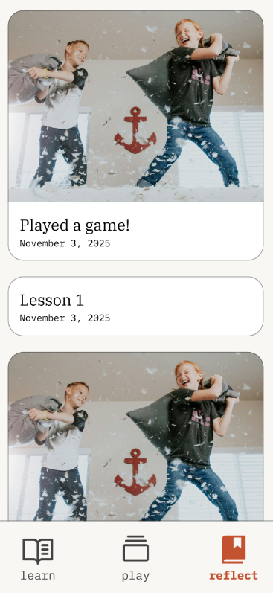
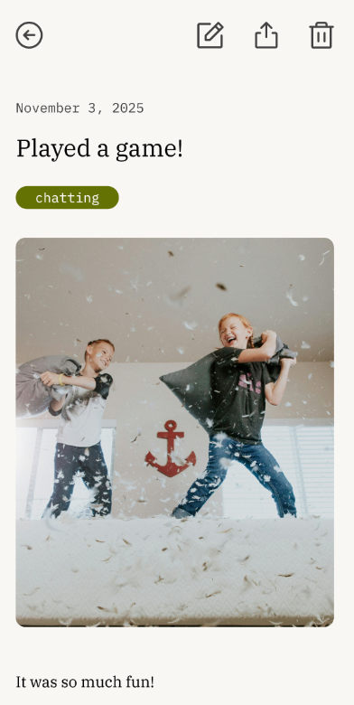
simple task
Violation Level: 3-4
revision
Added edit and delete button
Added option to see lesson reflection in scrapbook
rationale
User freedom is crucial
Lesson reflection is a core aspect of app intent

Slide 19
simple task
Violation Level: 3-4
impact
this would advance our progress towards achieving our first usability goal of making the app easier to navigate/more intuitive.

Slide 20
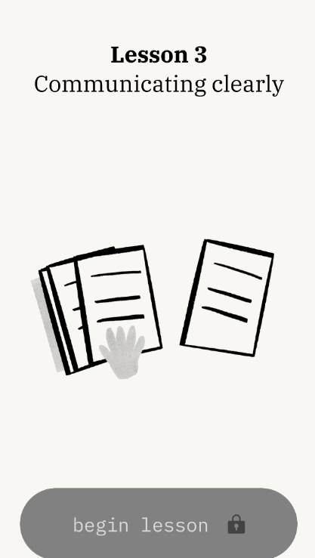
simple task
Violation Level: 3-4
concern #3
[H4] Locked Lesson 3 with no explanation: Lesson 3 button appears on the home page but is completely non-functional. Users see it as an available option but cannot interact with it, with no clear explanation of why it's inaccessible or what steps to take to unlock it.

Slide 21
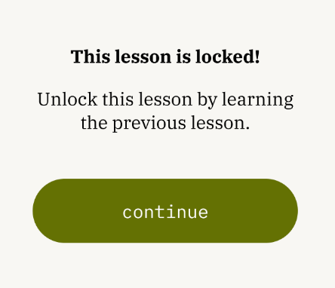
simple task
Violation Level: 3-4
revision
Added popup with information about locked lesson
rationale
Minimize user confusion

Slide 22
simple task
Violation Level: 3-4
impact
this helps make progress towards usability goal #1 - making our app more intuitive by reducing the number of misclicks

Slide 23
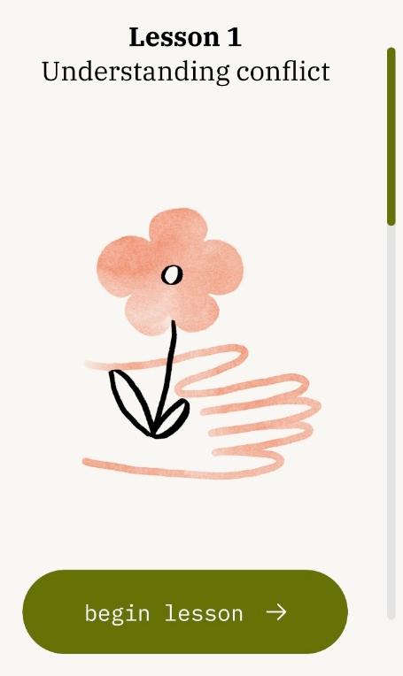
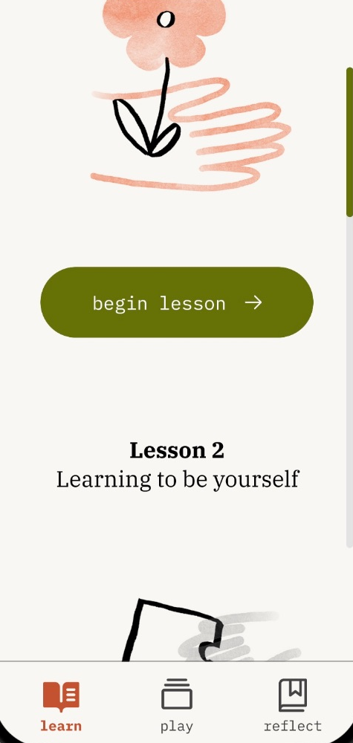
simple task
Violation Level: 3-4
concern #4 and #5
[H6] No indication, especially for older users, that the scroll indicator on the right of the "Learn" tab means that there are multiple lessons if you scroll down.
[H7] When users complete a task, they must scroll down to the next task available, which may take a long time if they have completed many lessons on the app.

Slide 24
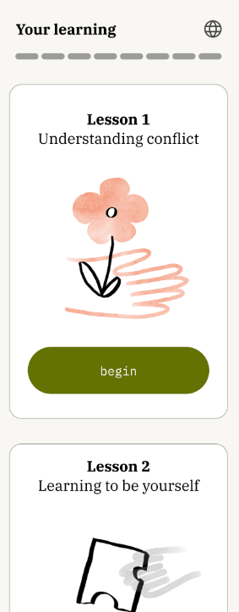
simple task
Violation Level: 3-4
revision
Implemented clearer scroll feature
Added tap feature to quickly reach lesson
rationale
Clear design to enable users to use all features of the app

Slide 25
simple task
Violation Level: 3-4
impact
This helped us make progress towards usability goal #1 - making the app easier to navigate for users

Slide 26
simple task
Violation Level: 3-4
concern #6
[H7] No visible confirmation after tapping “Finish” that one of the lessons is done and now we are transitioning to a game/another tab.

Slide 27
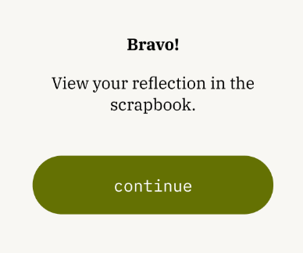
simple task
Violation Level: 3-4
revision
Added popup to view reflection in scrapbook
rationale
Grant users confirmation about completed actions

Slide 28
simple task
Violation Level: 3-4
impact
This design feature makes it more intuitive for users that a lesson is completed thus advancing progress for usability goal #1 - ease of navigation.

Slide 29
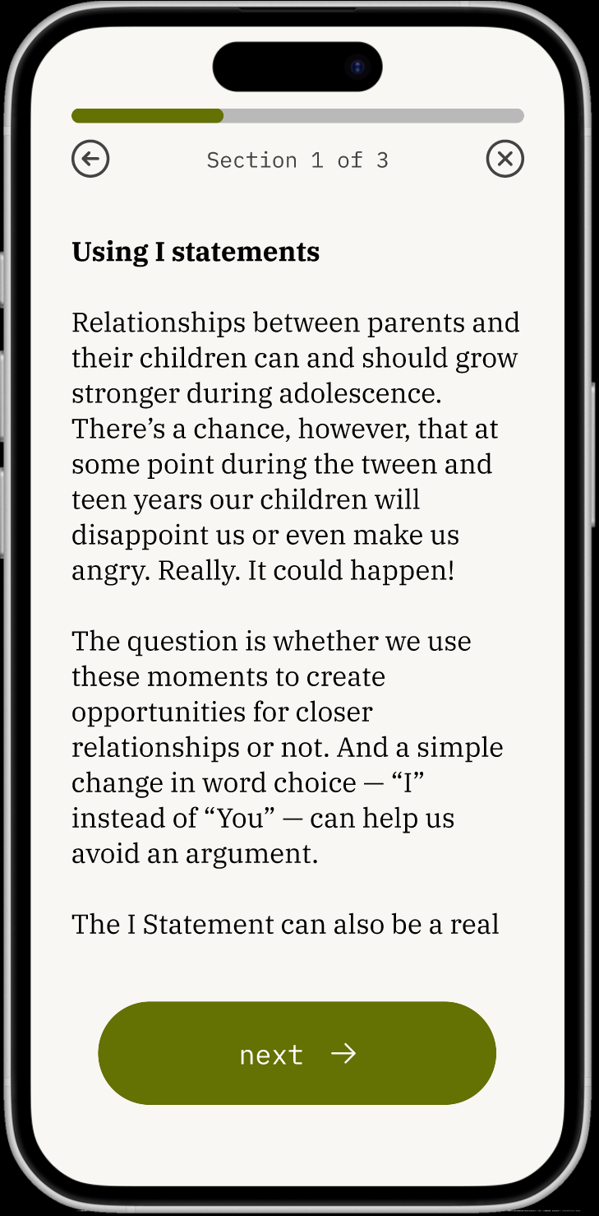
moderate task
Violation Level: 3-4
concern #7
[H11] Too much text...not readable. Would be nice to have a speaker icon to indicate (text to speech) capabilities that read out the content.

Slide 30
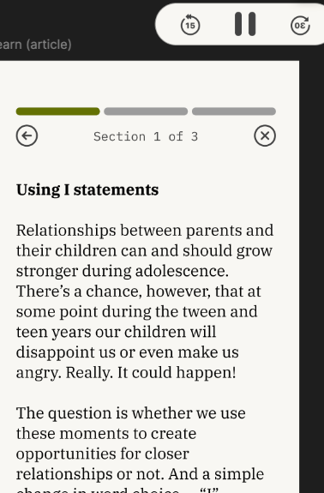
moderate task
Violation Level: 3-4
revision
Added voice feature that pops up
rationale
Value of Accessibility
Eyesight, age, or other needs should never hinder users from app usage

Slide 31
moderate task
Violation Level: 3-4
impact
This feature helps make the app easier to navigate (achieving usability goal #1)
It also makes users who are old and don’t want to read so much text more likely to use the app again (thus achieving usability goal #2)
It also helps make our app more culturally sensitive/more inclusive and accessible (design value #2)

Slide 32
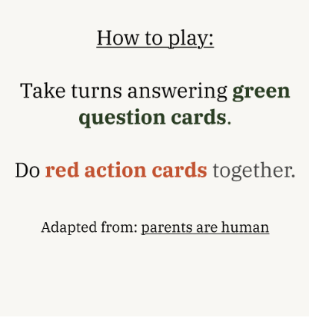
moderate task
Violation Level: 3-4
concern #8
[H2] "Take turns answering cards" -- take turns with who?

Slide 33
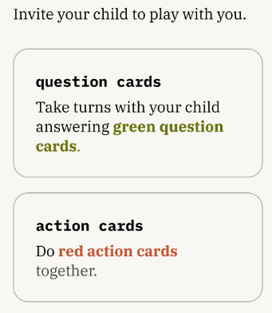
moderate task
Violation Level: 3-4
revision
Changed wording of text
rationale
Minimize user confusion

Slide 34
moderate task
Violation Level: 3-4
impact
This makes the app more intuitive for the user (usability goal #1)

Slide 35
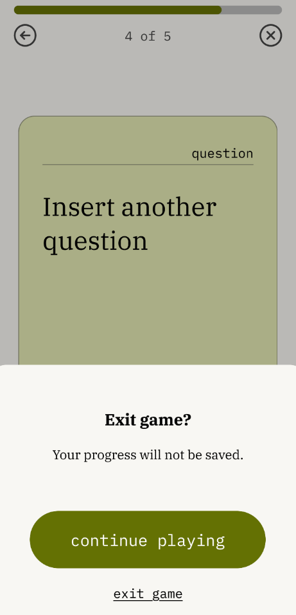
moderate task
Violation Level: 3-4
concern #9
[H3] No clear way to save progress mid-game, if someone wants to take a break or skip the game, the option isn't allowed.

Slide 36
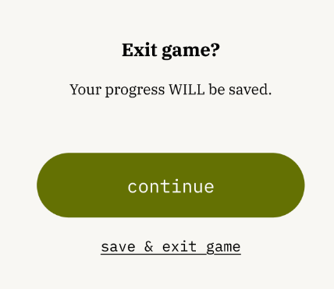
moderate task
Violation Level: 3-4
revision
Added “Save & Exit Game” feature
rationale
User freedom is crucial
App usage in small pockets of the day

Slide 37
moderate task
Violation Level: 3-4
impact
This makes the app easier to navigate for the user (usability goal #1)
It helps users navigate it without additional help/documentations

Slide 38
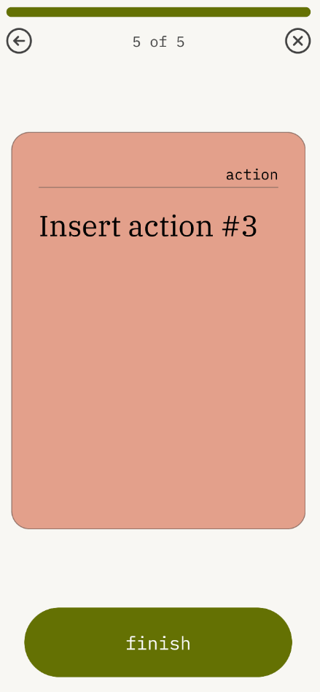
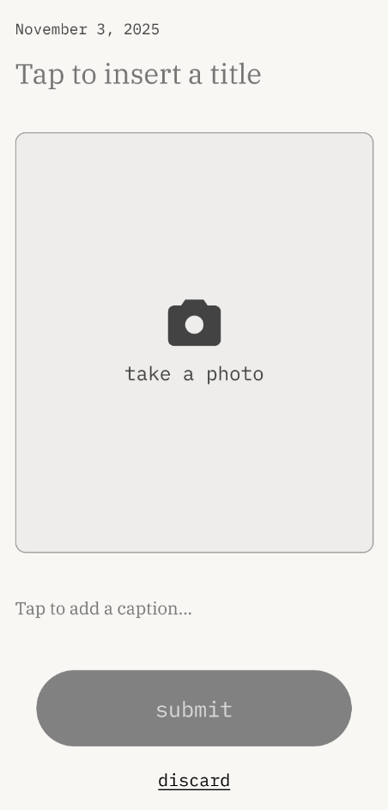
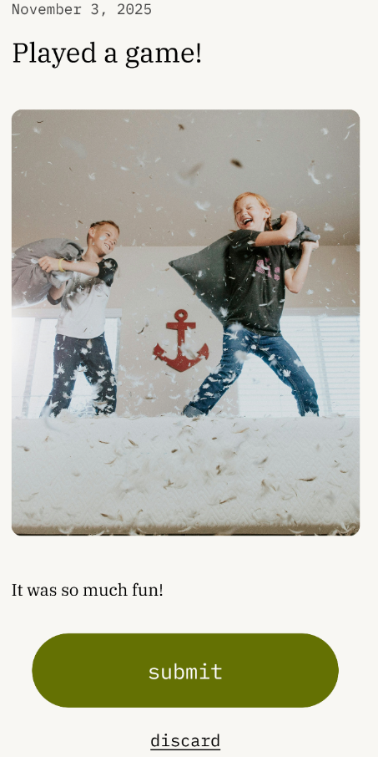
complex task
Violation Level: 3-4
concern #10
[H3] No clear way to skip scrapbook part of app, if users maybe don't want to take a picture or save the memory.

Slide 39
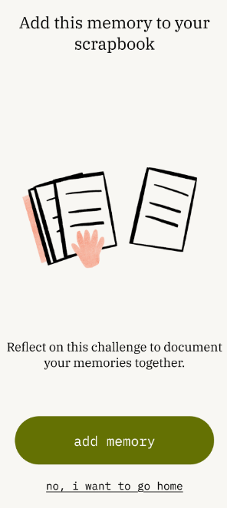
complex task
Violation Level: 3-4
revision
Added option for user to skip adding memory to scrapbook and navigate “home” instead
rationale
User freedom is crucial
Minimal stops to user flow

Slide 40
complex task
Violation Level: 3-4
impact
This makes the app more intuitive for the user (usability goal #1)
It also makes the app more flexible to use for users, enhancing feature eagerness to use (usability goal #2).

Slide 41
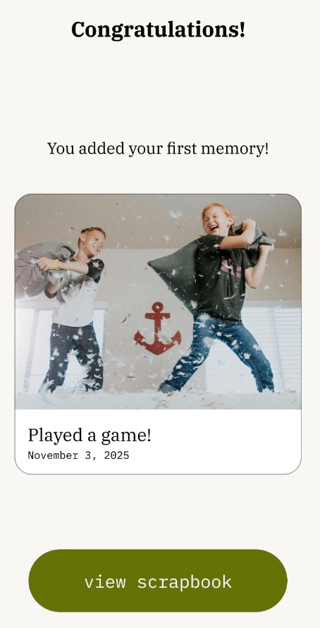
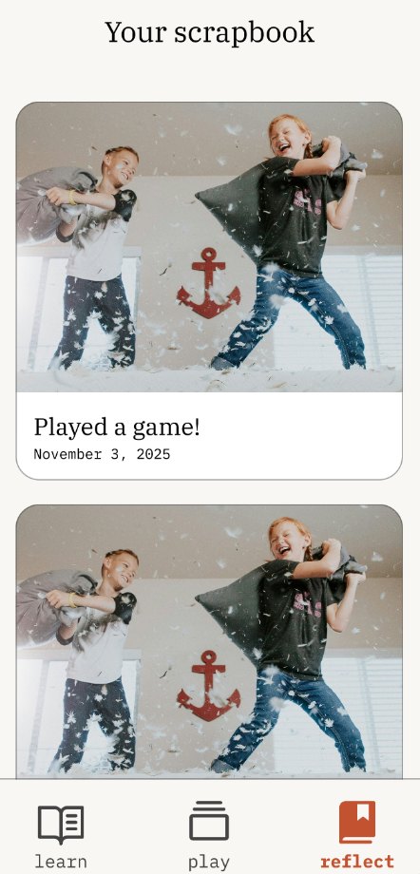
complex task
Violation Level: 3-4
concern #11
[H3] Once users submit and save a memory to the scrapbook, there is no way to edit or delete it. Users are locked into their submission even if they made a typo, want to update a caption, or accidentally saved the wrong memory. There is no undo, no delete option, and no escape from the submitted box option.

Slide 42
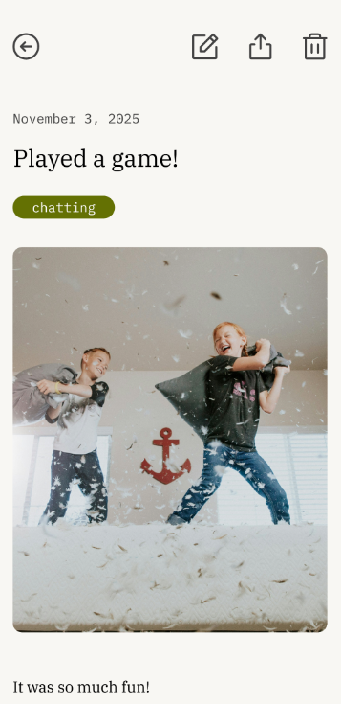
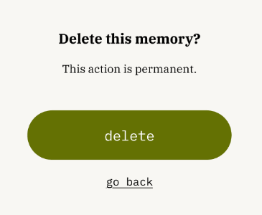
complex task
Violation Level: 3-4
revision
Added edit & delete options for memories submitted to the scrapbook
rationale
User freedom is crucial
Lack of pressure with user actions

Slide 43
complex task
Violation Level: 3-4
impact
This allows user more control and freedom to use the app, making them more eager to use it again (usability goal #2)

Slide 44
04
implementation status

Slide 45




frameworks & tools
React Native
React Navigation through Expo Router
Supabase (backend)
Figma (design)
Github (version control)
i18n React library (multilingual support)

Slide 46
implemented features
moderate task
playing a game

Slide 47
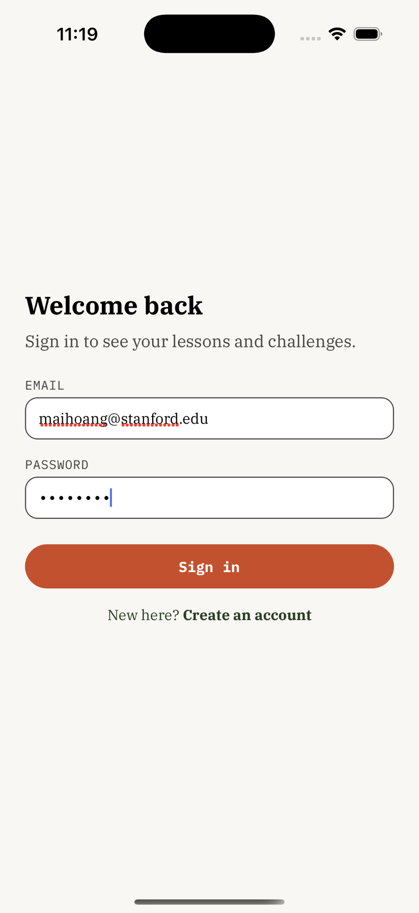
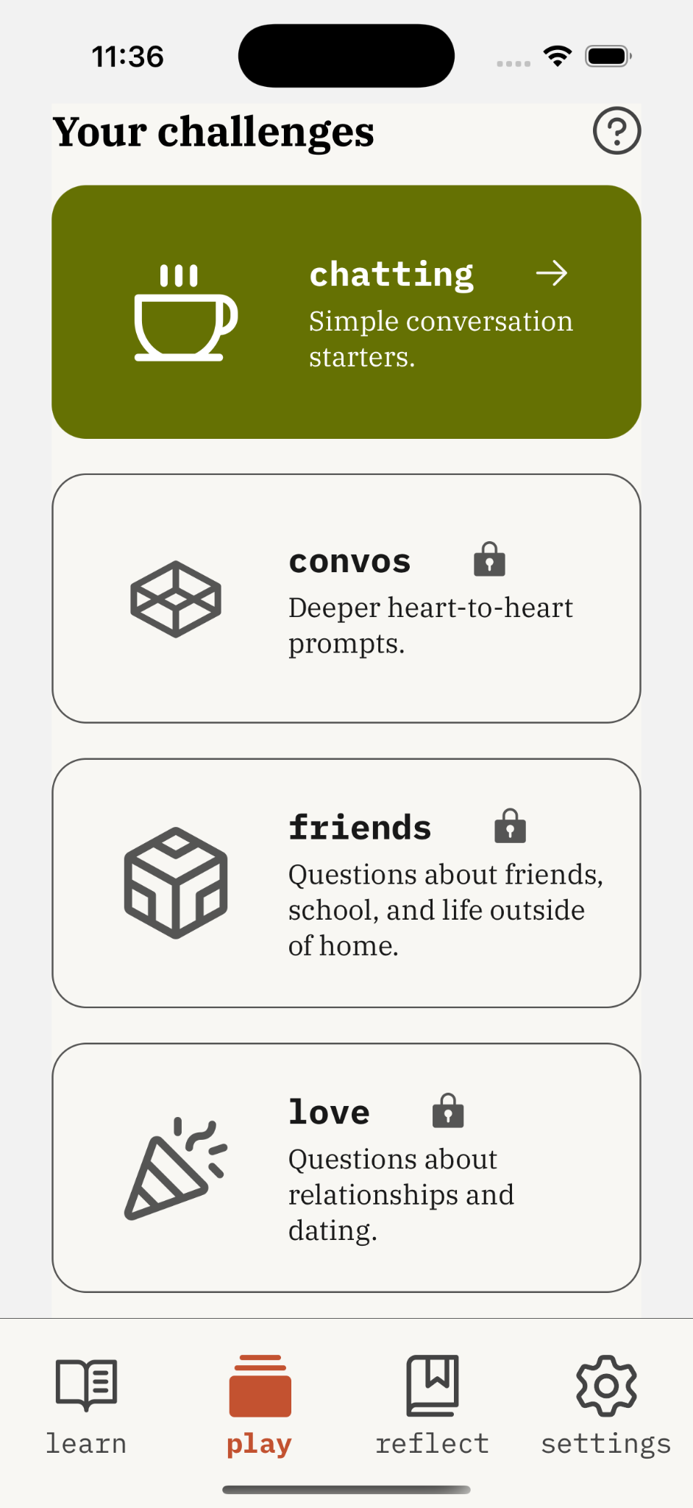
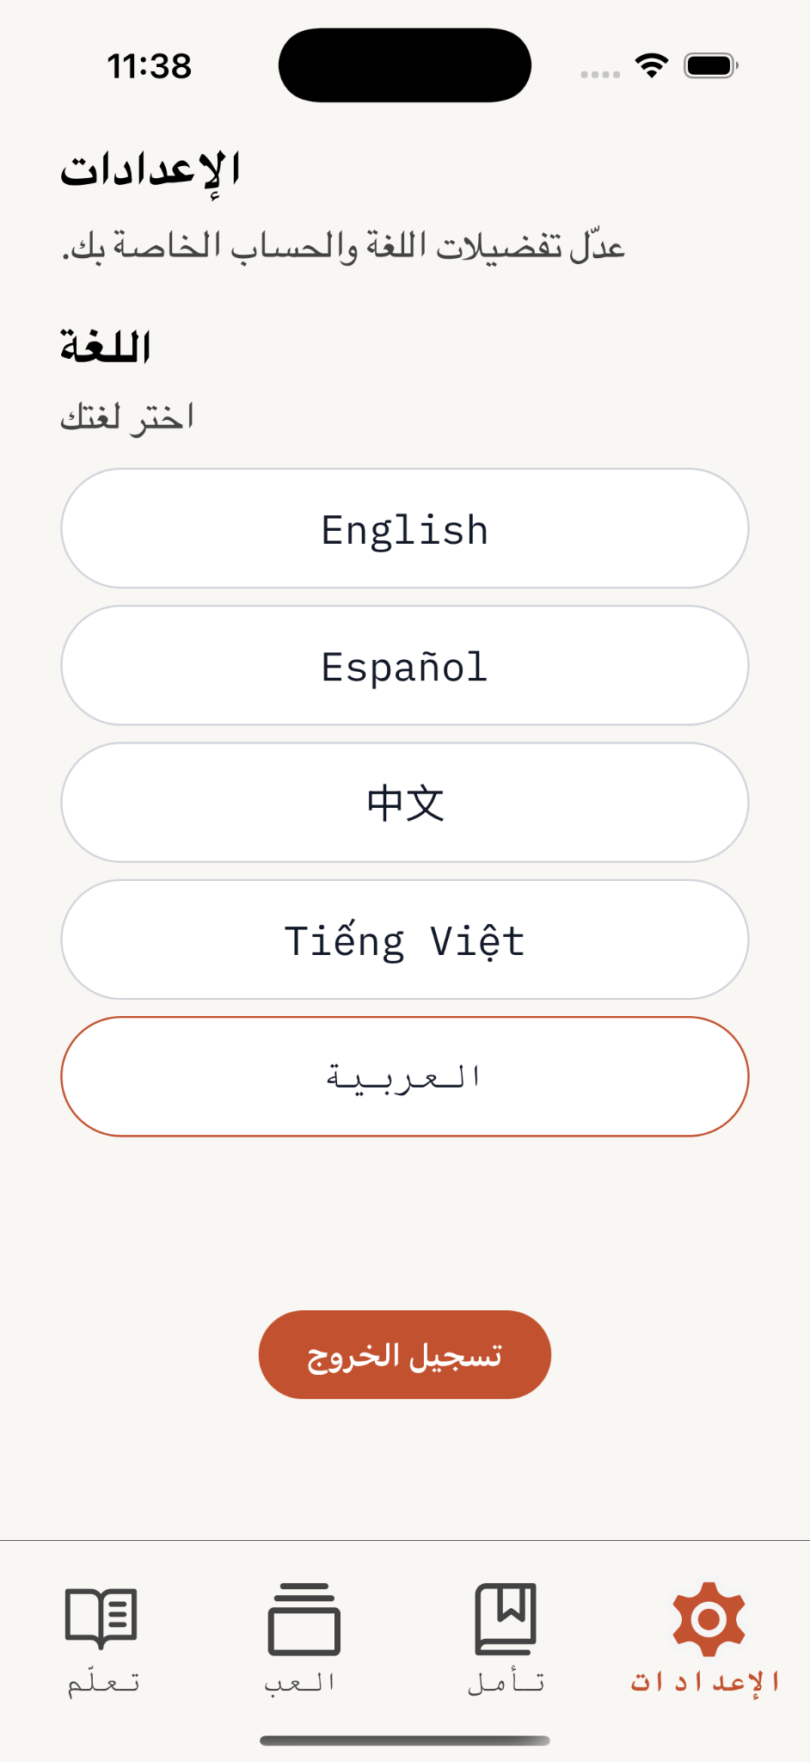
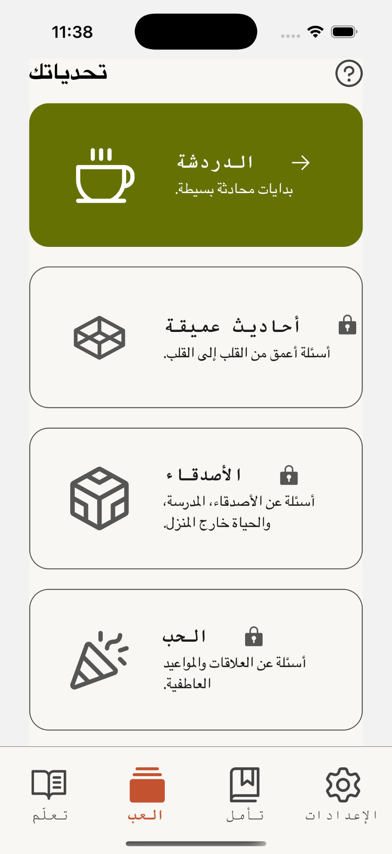
implemented features
multilingual support
“play” page (moderate task)
authentication flow
navigation bar

Slide 48
unimplemented features
simple task
moderate task
complex task
completing a lesson
  completing quiz(zes) in lesson
  saving written responses to Supabase
save lesson completion / progress to Supabase
“unlock” game 1 upon lesson completion
add edge function to Supabase to translate fetched data
add additional games and card decks to Supabase
define logic in Supabase to “unlock” new games
add a memory
save memory to Supabase
dynamically update scrapbook UI

Slide 49
plans to finish
mon, 11/24
wed, 12/3
Priority: completing task flows
Aimen: complex task
Naomi: simple task
Mai: continue building out moderate task + multilingual support, and support simple/complex task implementation
Mai: implement extra features for moderate task
Naomi, Mai, Aimen: finetune all tasks, attempt stretch features
friday, 11/28
fri, 12/5
Naomi & Aimen: simple task and complex task complete
turn in hi-fi

Slide 50

wizard of oz techniques
“Multilingual” toggle with partial/manual translations, not many languages supported
  Why: let us test whether families value multilingual support
“Fake-ish” card deck shuffle
  Why: simulate real game logic, experiment with play modes before investing in advanced logic
Visually “locked” games and components but not tied to real logic in Supabase
  Why: simulate progress for users

Slide 51
hard-coded aspects
What: Deck structure (categories, number of cards shown), navigation flows, and some UI copy / language keys are hard-coded in the client
Why necessary: lets us quickly test flows and content structure without building complex configuration tools or logic

Slide 52
questions/issues
Game progression & unlock logic
  hard to rigorously define when decks/games unlock, how difficulty should ramp, and how to encode that logic technically
Multilingual at scale
  challenging to manage high-quality translations

Slide 53
05
demo

Slide 54
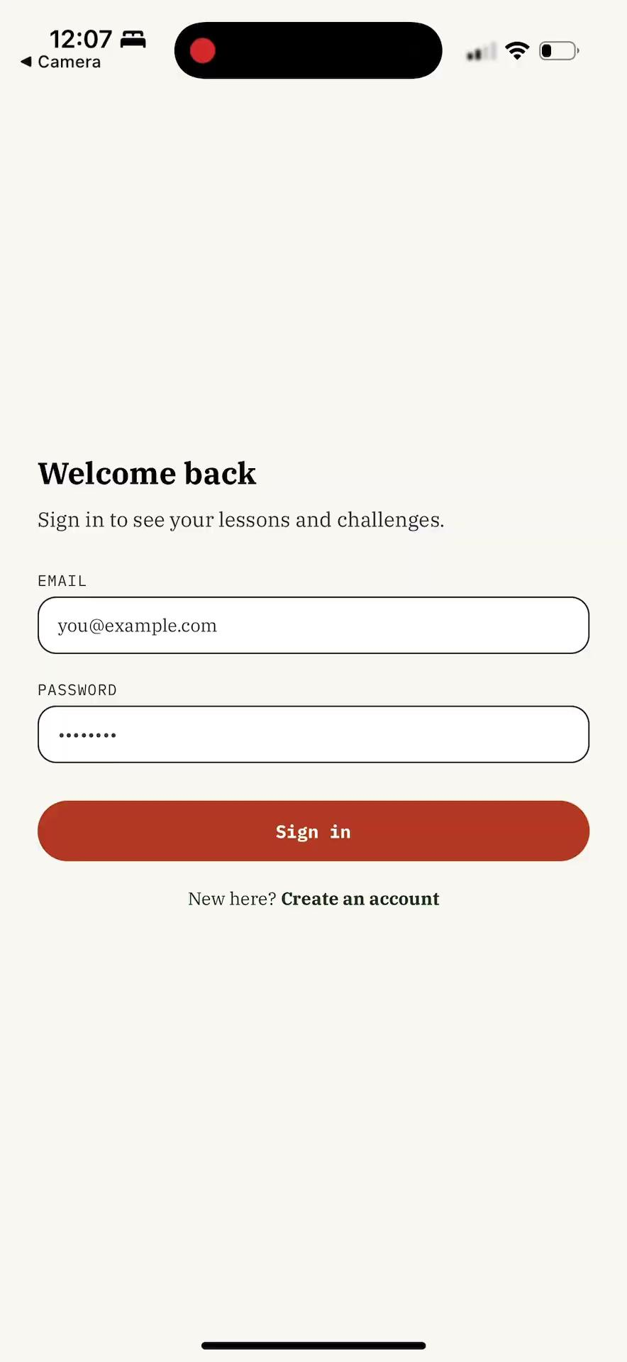

Slide 55


Thank You

