Slide 1
BlooMe
A4: Concept Video
Healing Relationships With Food

Slide 2
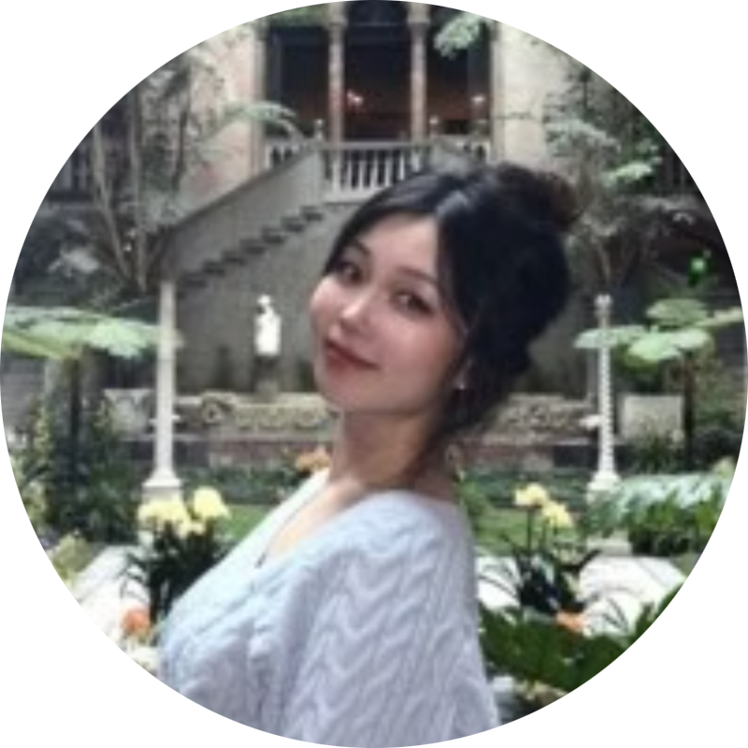
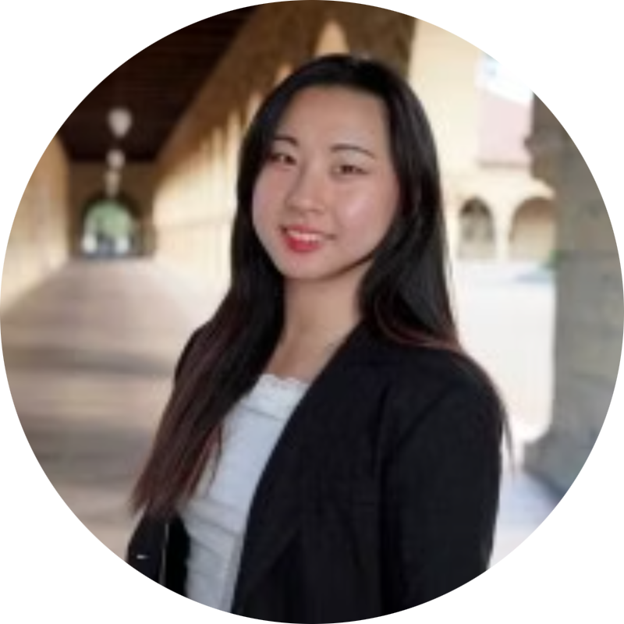
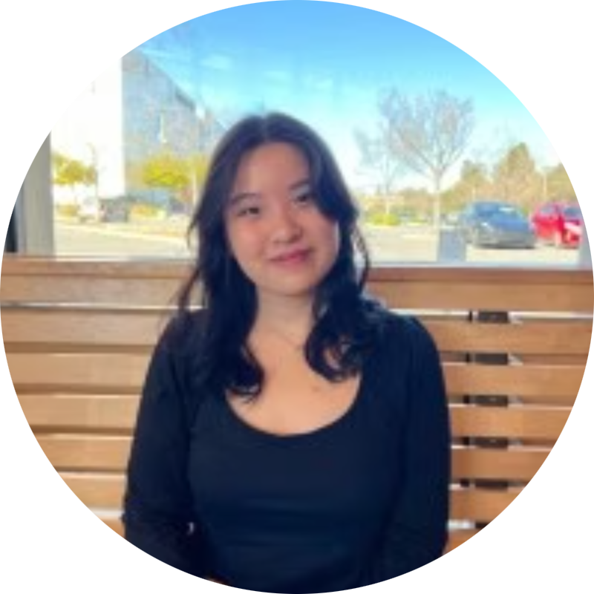
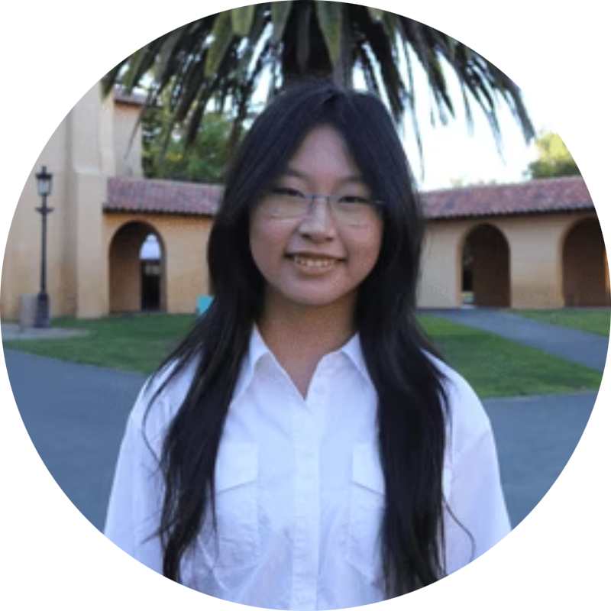
MEET JJYC
JASMINE X.
YUJEN L.
JADE C.
CLARE L.
Psychology & CS ‘27
Symbolic Systems ‘27
Symbolic Systems ‘27
Design ‘28

Slide 3
Where We Left Off!
Our Previous Solution
1.
2.
What Didn’t Work
A companion that shares short, personalized notes and stories from others who’ve been there.
Bite-sized, customizable learning modules that explain the science and psychology behind recovery guidelines.
It wasn’t feasible to add so many features into one solution. We needed to narrow in on education vs creating community.

Slide 4
What is our project name and tagline?

Slide 5
BlooME
Grow your mind,
Nourish your body

Slide 6
We chose “BlooME” as our product name because it symbolizes both growth and selfhood—a reminder that healing is not about becoming someone new, but blooming into yourself. The “ME” highlights personal agency and individuality in recovery.
We chose “Grow your mind, Nourish your body” as our tagline/value proposition because it reflects our belief that true healing requires tending to both thought and nourishment—uniting psychological growth with compassionate care for the body.

Slide 7
Problem + Solution

Slide 8
Problem
Many people who struggle with food, whether they fall into subclinical or clinical categories, often keep their pain to themselves. They hesitate to reach out to friends, family, or professionals because they feel a persisting anxiety in being a burden to others, and continue to live with their guilt around eating.
Notes:
Many people who struggle with food but haven’t received professional treatment experience persistent anxiety and guilt around eating, often feeling isolated and believing they’re “not sick enough” compared to others.

Slide 9
Solution
BlooMe is a peer-to-peer note-sharing app that pairs community warmth with daily structure. It also offers journaling prompts, a personal “butterfly sanctuary” to store encouraging messages, and meal reminders with affirmations to guide recovery routines.

Slide 10
Market Research

Slide 11
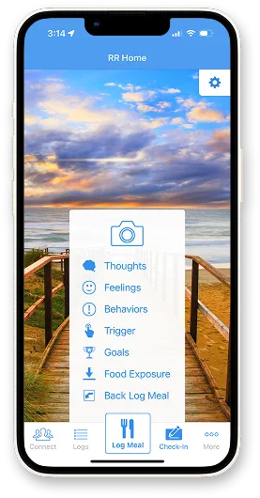
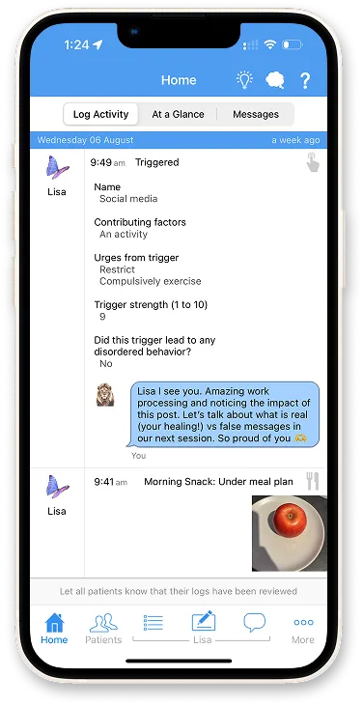
Recovery Record
Evidence-based self-monitoring app with a full clinician portal for treatment-team collaboration.
Features:
Meal/thought/urge logs
CBT/DBT/ACT/FBT skills set by clinicians
Patient–clinician communication
BlooME’s uniqueness:
Peer-peer communication & support
Light structure that’s easy to use
Implications: monitored treatment supports recovery, but extensive logging is most valuable when shared with clinicians

Slide 12
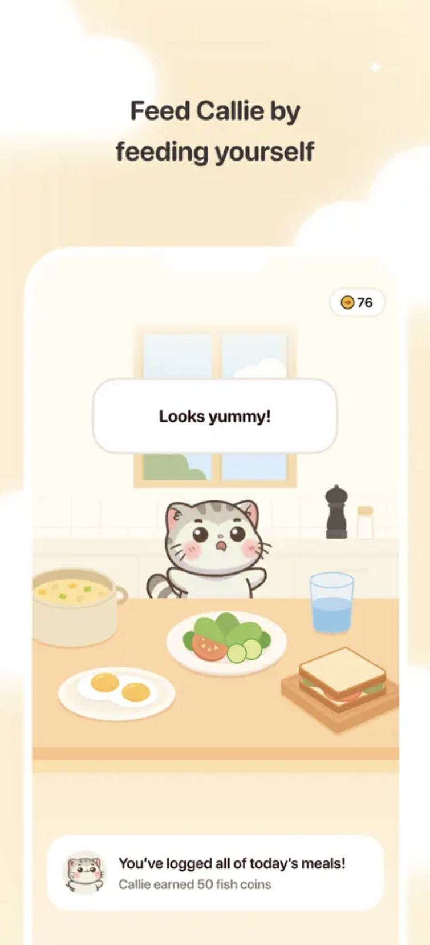
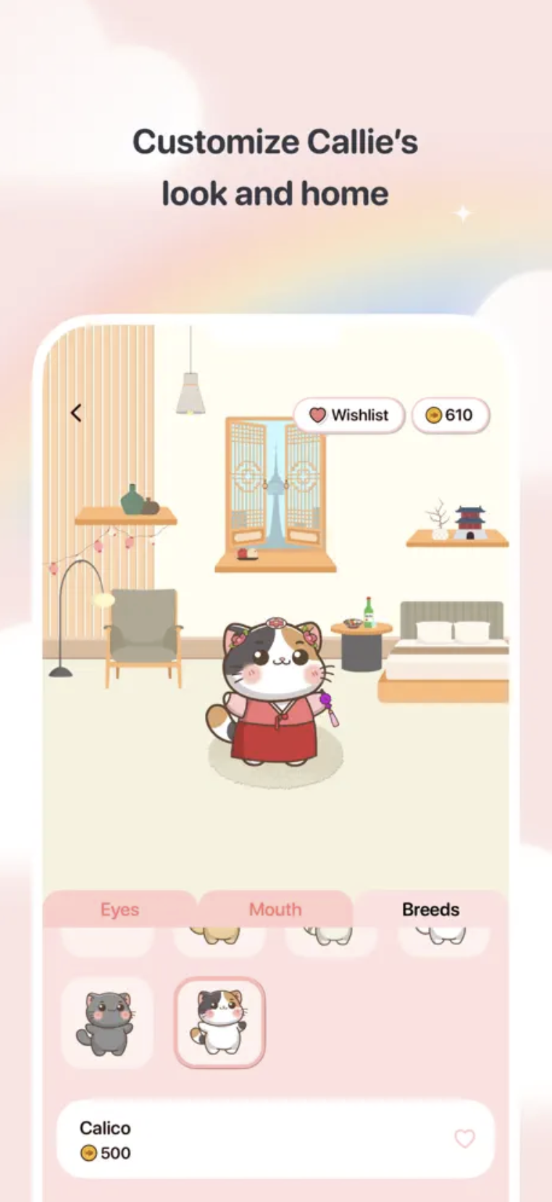
Callie
A food self care AI pet that you care for by caring for yourself (eat).
Features:
Feed Callie by logging meals; talk to Callie
Micro-journaling
Gamification of healthy routines
BlooME’s uniqueness:
Emotional connection with human beings who share the real-world context
Implications: reassurance, companion, and gamification may encourage users to care for themselves

Slide 13
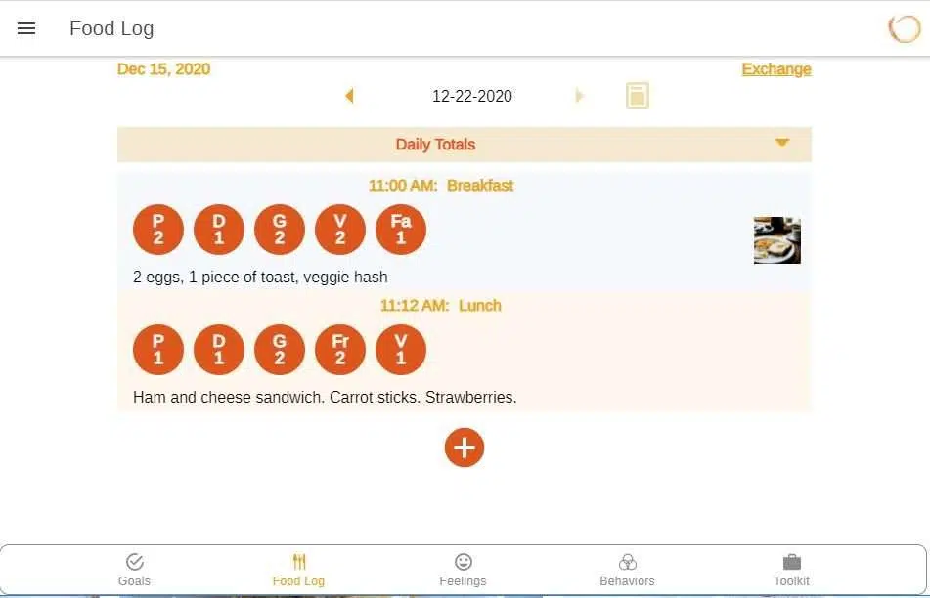
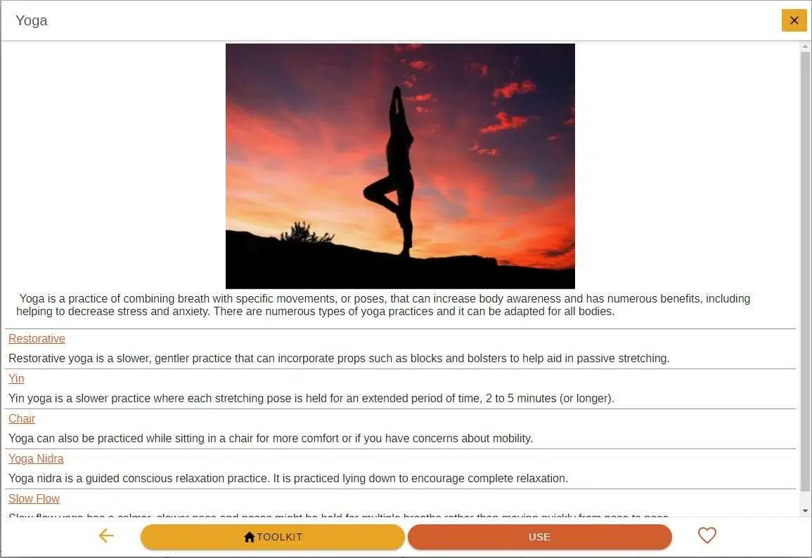
With Me When
Clinician-designed platform for 24/7 inspiration, education, and skills.
Features:
Food/Feelings/Behavior log
Skills toolkit & mindfulness exercises
Goals setting
BlooME’s uniqueness:
Community as the companion; built through user’s active participation
Implications: recovery is a long journey; proper guidance from experienced/professional people can help the process

Slide 14
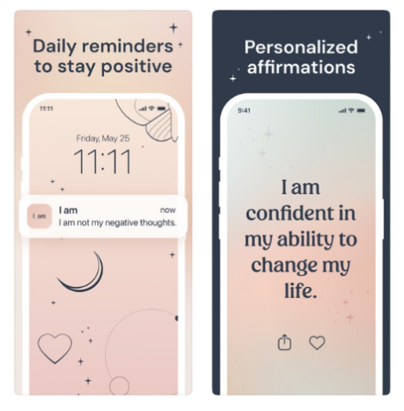
I am
Daily affirmation notifications to build self love and manifest desires.
Features:
Large library of daily affirmation cards
Schedule multiple reminders
Customize themes and widgets
BlooME’s uniqueness:
Specialized in Eating Disorders to provide more direct support
Implications: positive affirmation is backed by evidence and real users; customizable service gives users a sense of autonomy

Slide 15
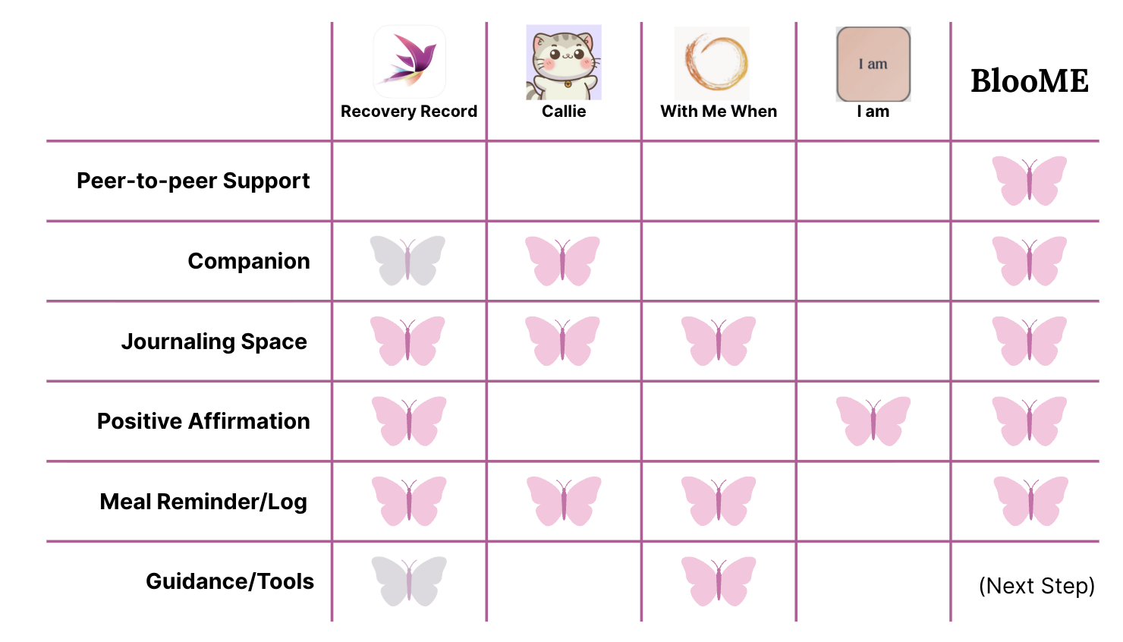

Slide 16

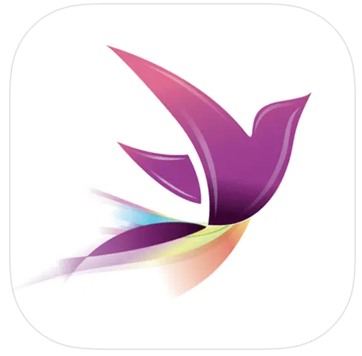
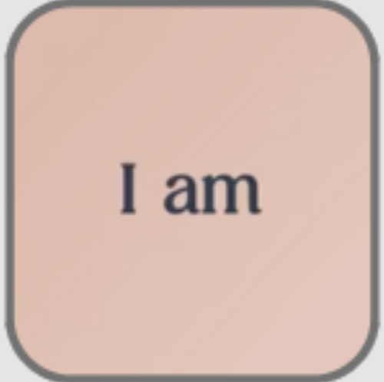

COMMUNITY
BlooME
ENGAGING
CLINICAL
INDIVIDUAL

Slide 17
Values in Design

Slide 18
Stakeholder Analysis
Direct Stakeholder: Users of App
Indirect Stakeholder: Family & Friends
Young adults (15–25) experiencing distress around food and body image- using the app for support, psychoeducation, and daily coping — particularly because traditional treatment feels inaccessible, stigmatizing, or “too clinical.”
Loved ones of individuals struggling with food or body image concerns- indirect beneficiaries who may see improvements in their loved one’s well being or use app-informed language to better support them.

Slide 19
Stakeholder Analysis
Indirect Stakeholder: Healthcare Professionals
Indirect Stakeholder:
Eating Disorder
Advocacy Orgs
Institutions and policymakers who may view it as a scalable, early-intervention model that reduces burden on clinical systems.
Eating disorder awareness and body image advocacy groups, who may be partners for awareness campaigns, outreach, or resource integration.

Slide 20
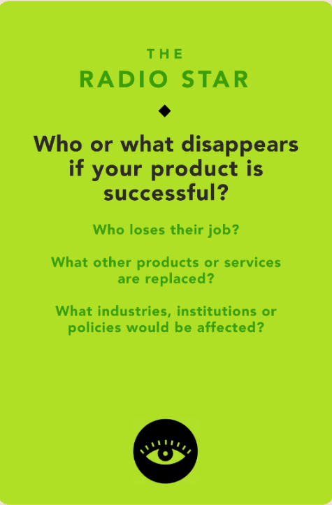
Tarot Card:
Scale and Disruption
Who might lose market share / jobs
Diet industry & weight-loss apps (fad programs, restrictive trackers, “detox” plans): demand declines as users move toward body-peace and nourishment.
Some ‘accountability’ tools built on weighing/calorie counting may contract.
What does not disappear (but changes)
Therapists & ED clinicians: roles remain essential; demand shifts from crisis/residential toward earlier, stepped-care, skills-focused work.
Recovery coaches & peer supporters: augmented—not replaced—by scalable, anonymous support that can triage and refer.

Slide 21
Tarot Card:
Scale and Disruption
Industries / institutions affected
Healthcare & insurers: incentives move toward prevention/early intervention; potential reimbursement for digital adjuncts.
Universities & schools: integrate low-stigma prevention tools; counseling centers see altered caseload mix.
Platforms & policy: higher bar for “health” app claims, data privacy, safety moderation; reduced tolerance for harmful diet advertising
Ethical guardrails:
Position as complement, not substitute for care; build warm referral pathways to clinicians/crisis lines.

Slide 22
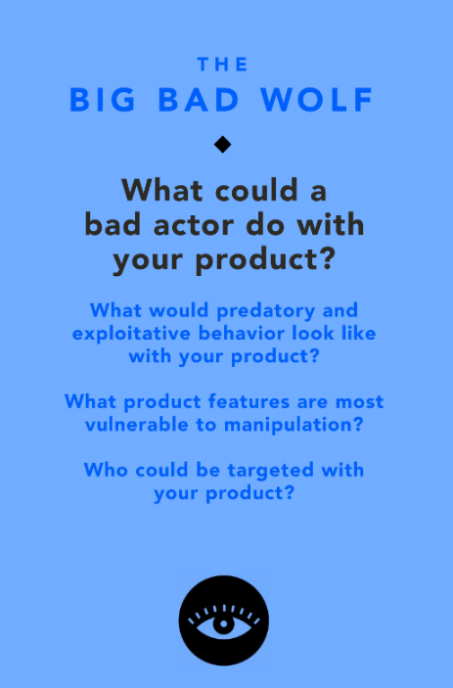
Tarot Card: Usage
Predatory or exploitative risks
If misused, the app’s personalization and emotional data could be weaponized. A bad actor could:
Exploit users’ vulnerabilities around body image or self-worth to push products, diets, or “quick-fix” content.
Use anonymized data to micro-target ads that prey on insecurity or eating behaviors.
Impersonate peers in the anonymous connection feature to spread harmful or triggering messages.
Features most vulnerable to manipulation
Peer connection / sharing features: vulnerable to trolling, misinformation, or glorification of disordered behaviors.
Data collection / content curation: if mishandled, could compromise privacy or expose emotional states to third parties.

Slide 23
Tarot Card: Usage
Who could be targeted
Adolescents and young adults already experiencing low self-esteem or eating distress.
Ethical guardrails:
Build strict moderation and AI bias detection to prevent triggering or pro-diet content.
Keep the app ad-free; no partnerships with brands profiting from appearance anxiety.
Enforce ethical data policies—no third-party sharing, no personalized ads, no “progress” metrics tied to weight or restriction.

Slide 24
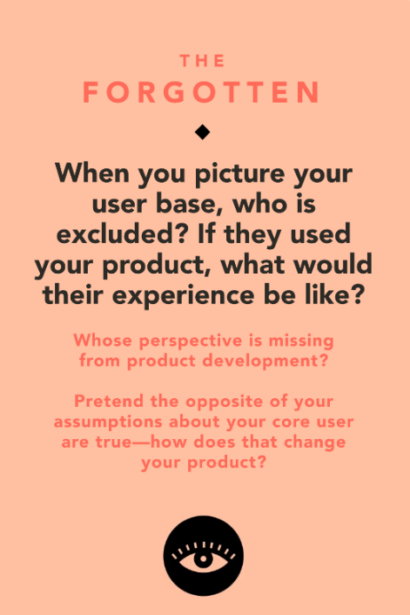
Tarot Card:
Equity and Access
Who might be excluded
Older adults or those less digitally literate, who may struggle with app-based interfaces or prefer in-person community.
Users in low-connectivity or low-income settings without consistent smartphone/internet access.
Individuals from non-Western cultures, where language and cultural conceptions of body/food differ significantly from the app’s defaults.
What their experience might be like
If they use the app as it currently stands, they may feel:
Alienated by language or imagery that assumes a young, Western, educated audience.
Disconnected from examples that don’t reflect their lived experience or cultural context.
Frustrated by tech barriers or lack of integration with offline resources and community supports.

Slide 25
Tarot Card:
Equity and Access
If we flipped our assumptions
If we assumed users were not young, digitally fluent, or Western, we’d need to:
Localize content linguistically and culturally (perhaps by developing versions of the app in different languages and cultures).
Build offline and low-bandwidth functionality (SMS-based modules, downloadable lessons).
Include diverse body representations and cultural food examples.
Redefine “recovery” to account for different norms and values around food, family, and care.

Slide 26
Tasks

Slide 27
Simple Task Brainstorming
Receiving Personalized Tips/Stories
Feeling Less Alone During Hard Times
Task: The user wants to receive a a short, personalized note or story from others experiencing similar struggles. Helping them feel seen, supported, and less alone in their eating journey.
Why Simple: Accessible to all users at any stage of their journey, involves little to no cognitive or emotional load, and can be done repeatedly and casually. The task is introductory and universal, users will do this often.
Task: The user wants to find immediate reassurance and emotional support whenever they are feeling any anxiety or uncertainty around food.
Why Simple: This task doesn’t require any reflection, decision-making, or contribution from the user. It meets a more common emotional need quickly. Making it a frequent and easy starting point for engagement for all users.

Slide 28
Moderate Task Brainstorming
Discovering Stories/Tips that Resonate
Keeping Meaningful Stories
Task: The user wants to find stories or tops from other people that they feel personally resonates with their own situation.
Why Moderate: This task requires for active engagement and light reflection from the users to identify what contents matters to them the most. This is a little more involved than simply receiving a note, but still approachable for most users.
Task: The user wants to keep any of the stories and tips that feel personally significant to them, so they can return to them later.
Why Moderate: Since the user has to decide what matters to them, this task involves more selective judgement and personalization. This task is not emotionally intense, but requires more intention than passive engagement, which makes it still appropriate for most users to use who return regularly.
Notes:
Finding tips from others and adding them to the user’s own garden (didnt include the users own garden part because it felt like it was telling the user what to do).

Slide 29
Complex Task Brainstorming
Expressing Personal Experiences
Sharing Tips/Stories to Support Others
Task: The user wants to express their own personal experiences, feelings, or reflections relating to their eating journey.
Why Complex: This task needs a more deep self-reflection, trust, and emotional effort. Meaning that it is not something users will do every time they use the app, but instead, when they feel more safe or ready to open up. This makes it less frequent and more suited for users who are comfortable with the platform already.
Task: The user wants to contribute their own stories to the community so that others can feel supported and inspired throughout their own journey.
Why Complex: This task involves sharing personal experiences with a larger community, which required high vulnerability, cognitive effort, as well as intentionality. Not all users will feel ready or willing to do this, so this task will be done by more engaged users who feel comfortable opening up to others.

Slide 30
Finalized Tasks!
Simple
Moderate
Complex
Discovering Stories/Tips that Resonate and Adding to Personal Journal
Posting Tips/Stories onto BlooME to Support Others
Receiving Personalized Tips/Stories
Time Stamp:
0:24-0:31
Time Stamp:
0:43-0:52
Time Stamp:
0:57-1:07

Slide 31
Storyboard

Slide 32
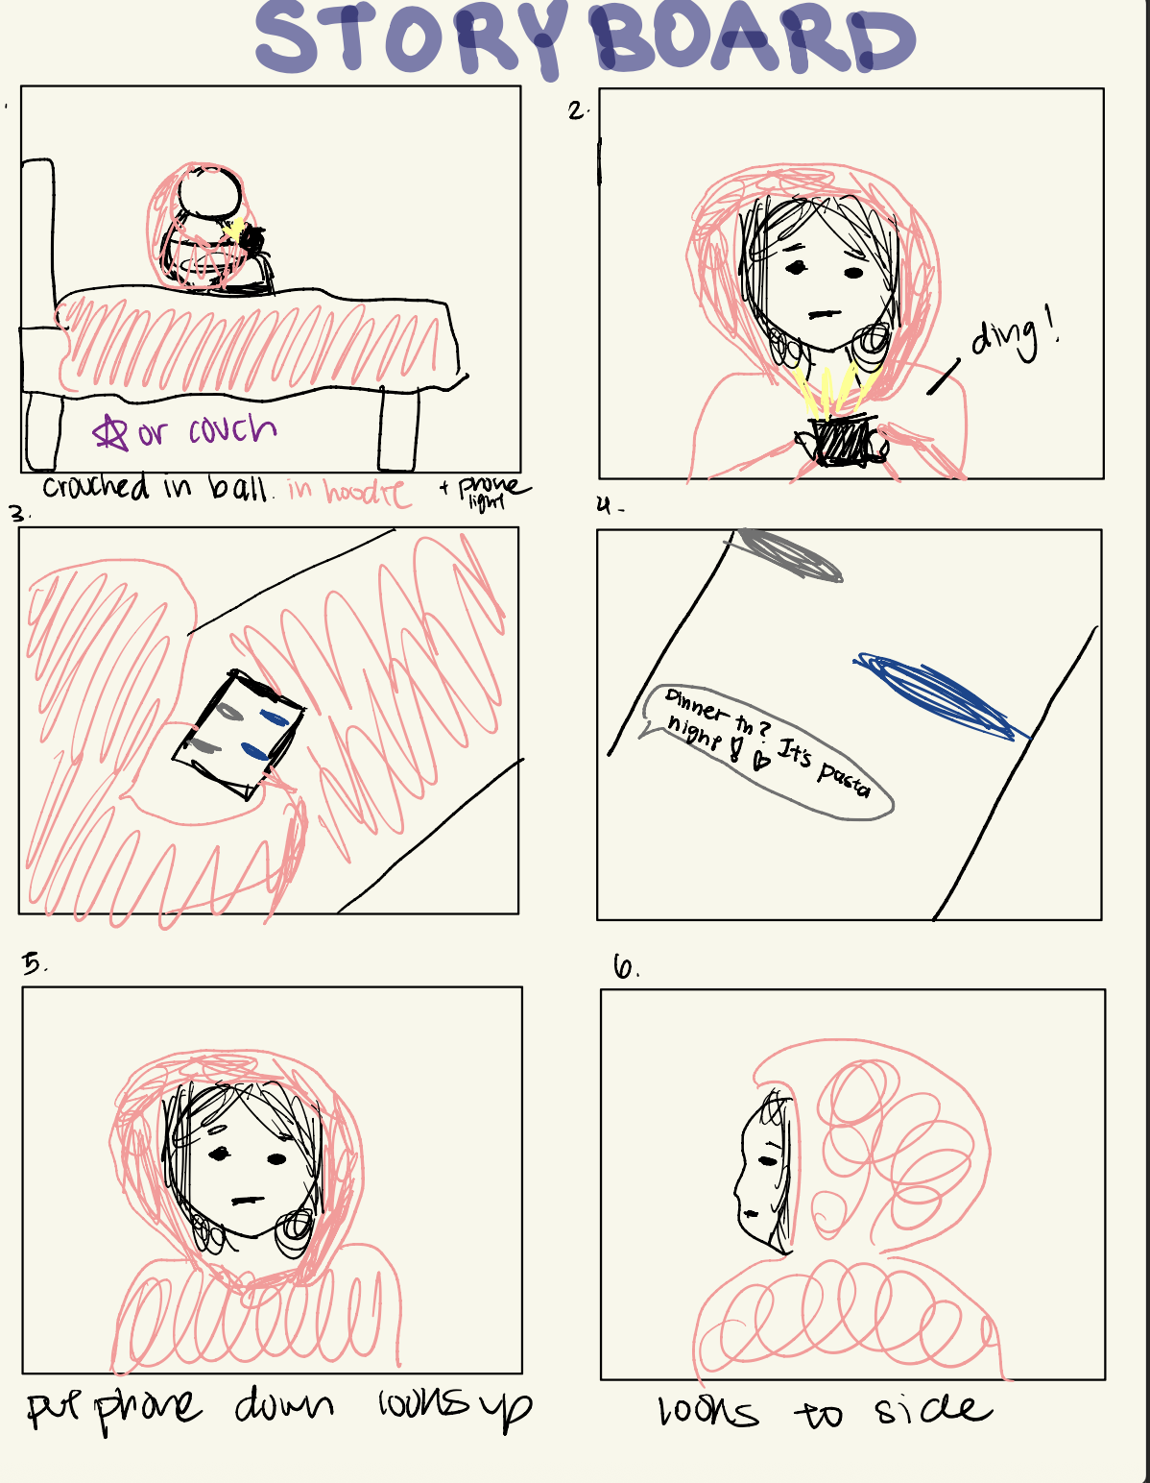
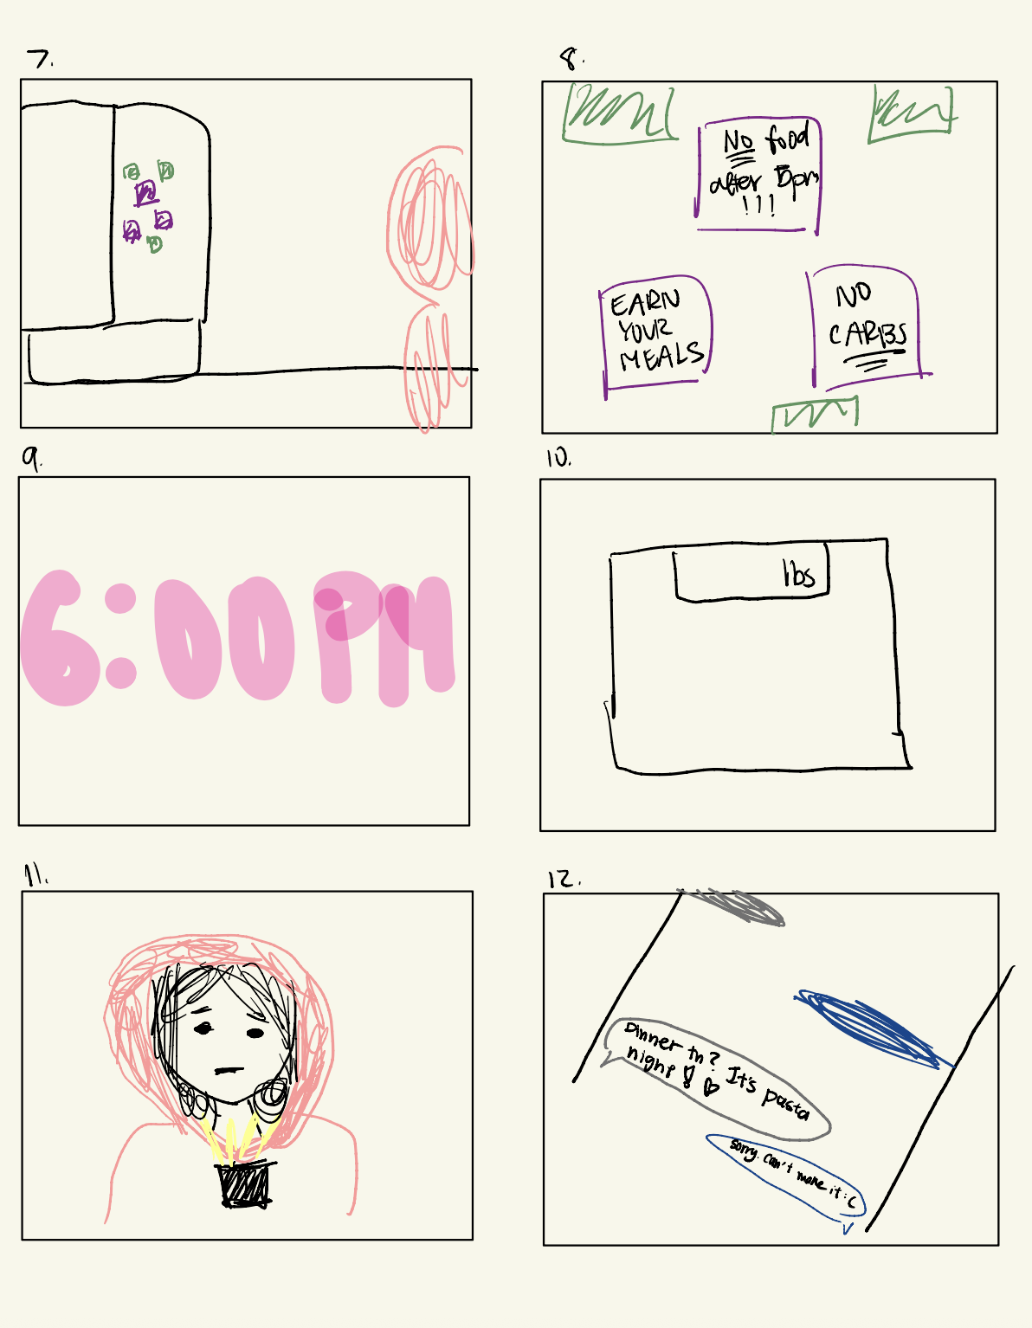
Setting the context: MC is lonely and feels guilty about eating, but also not connecting with friends.

Slide 33
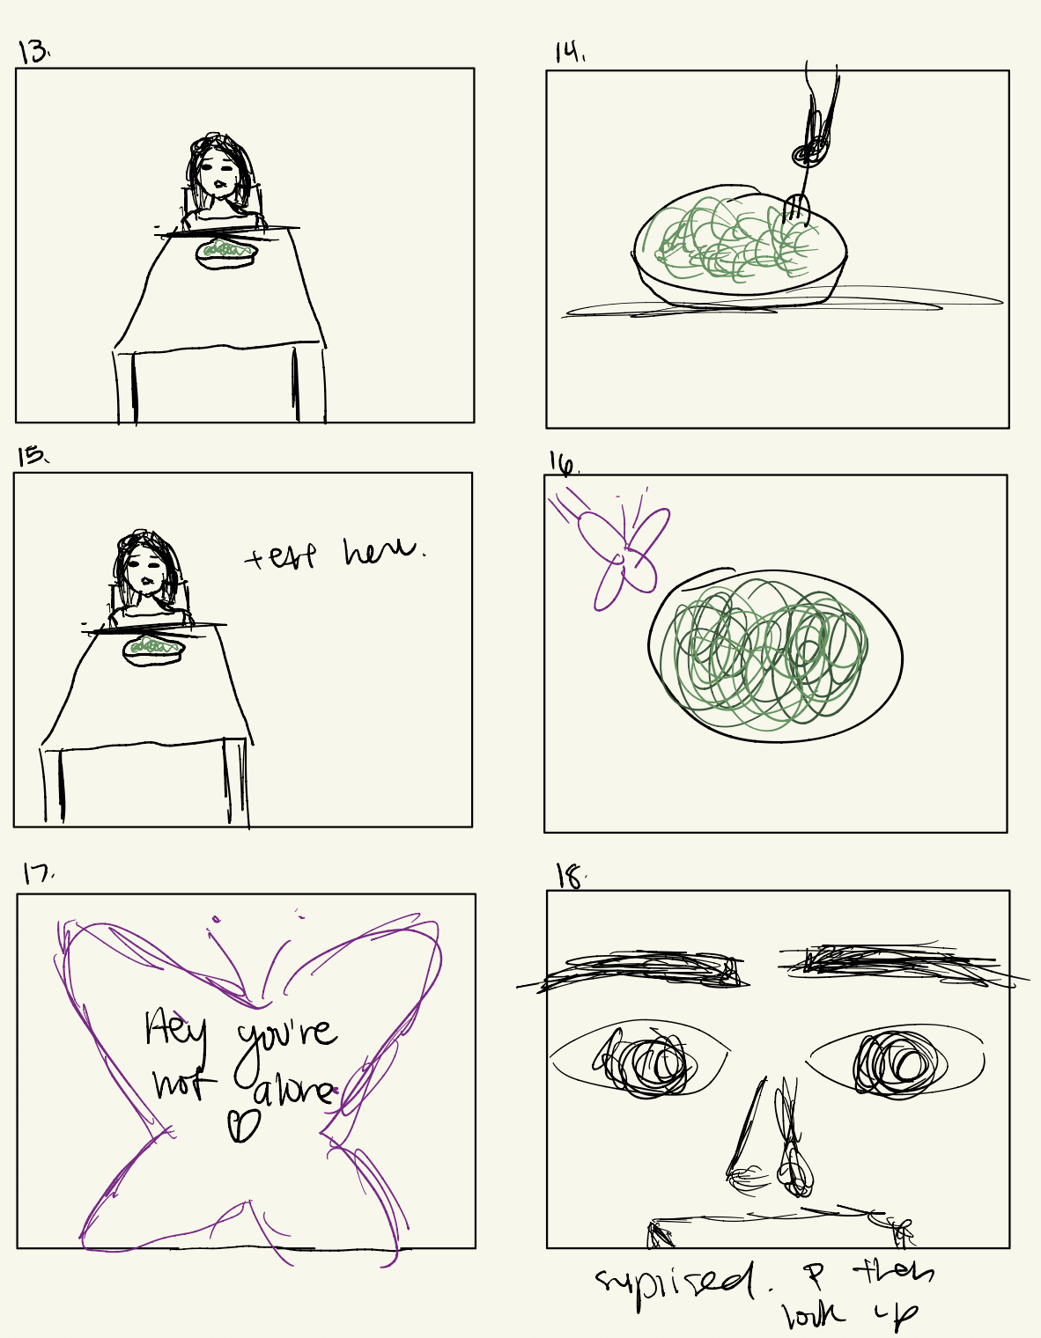
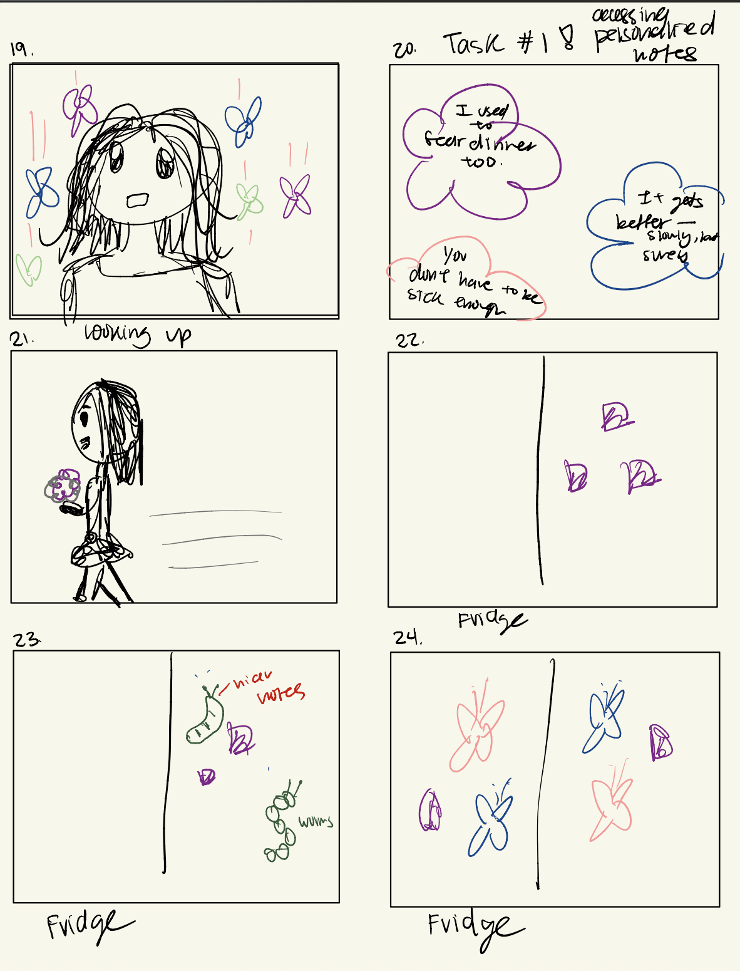
< Emotional shift: we see something has shown her empathy and is reaching out
Task #1: > accessing personalized notes.

Slide 34
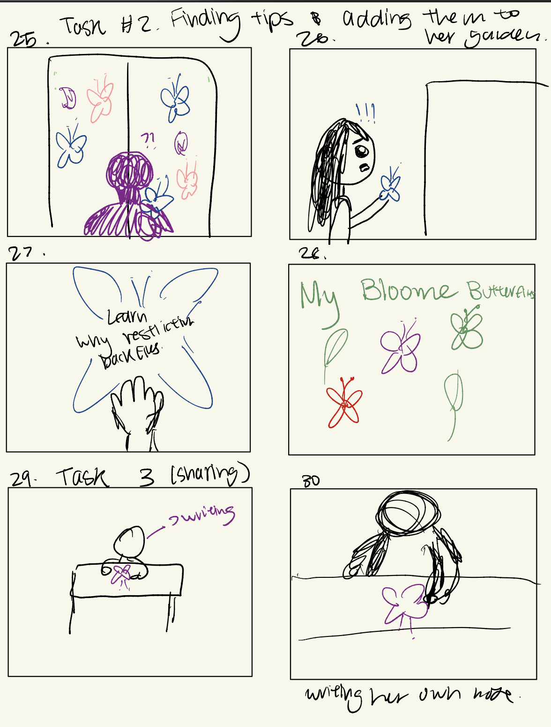
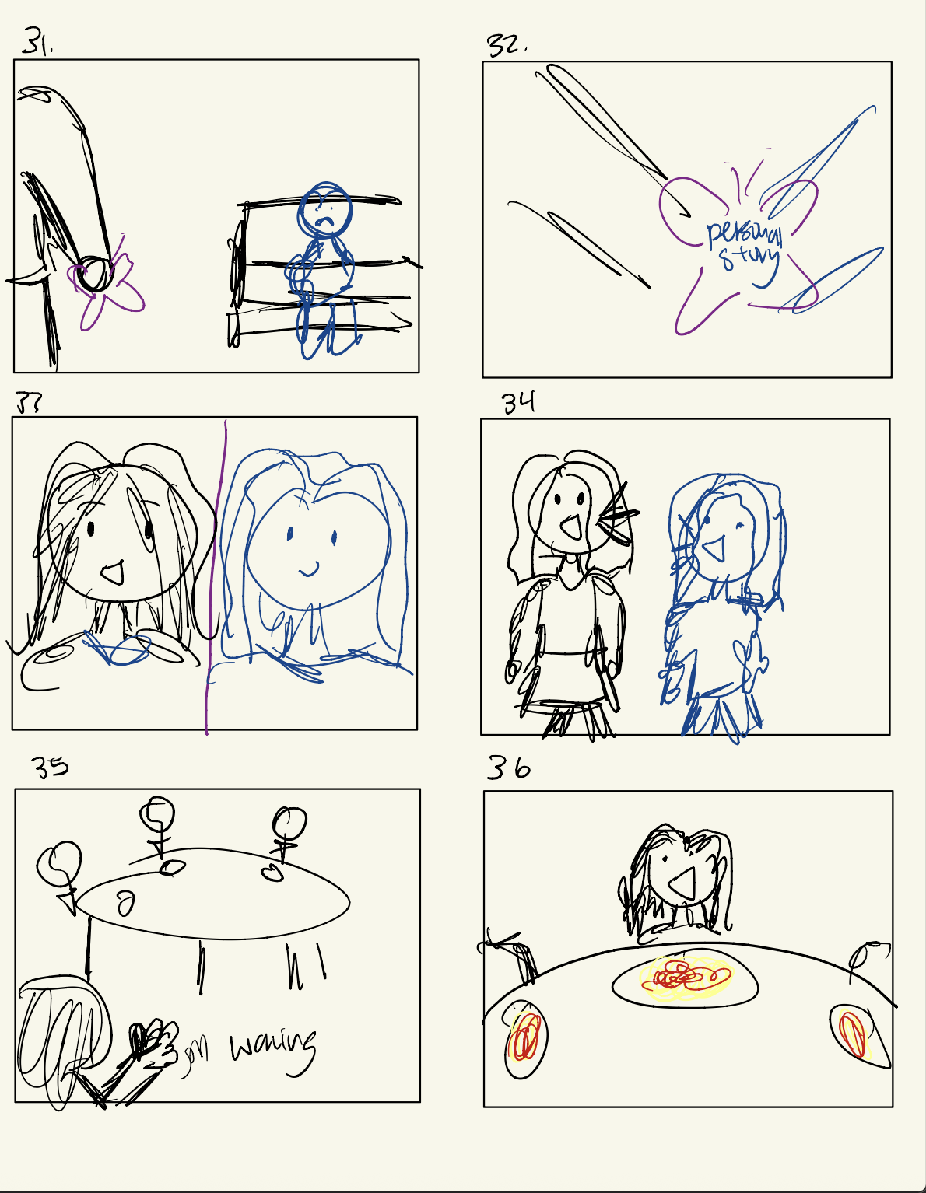
< Task #2: Storing notes and tips into a personal BlooME Butterfly Diary
Task #3 >
Writing and sharing their own notes to the platform and creating community.

Slide 35
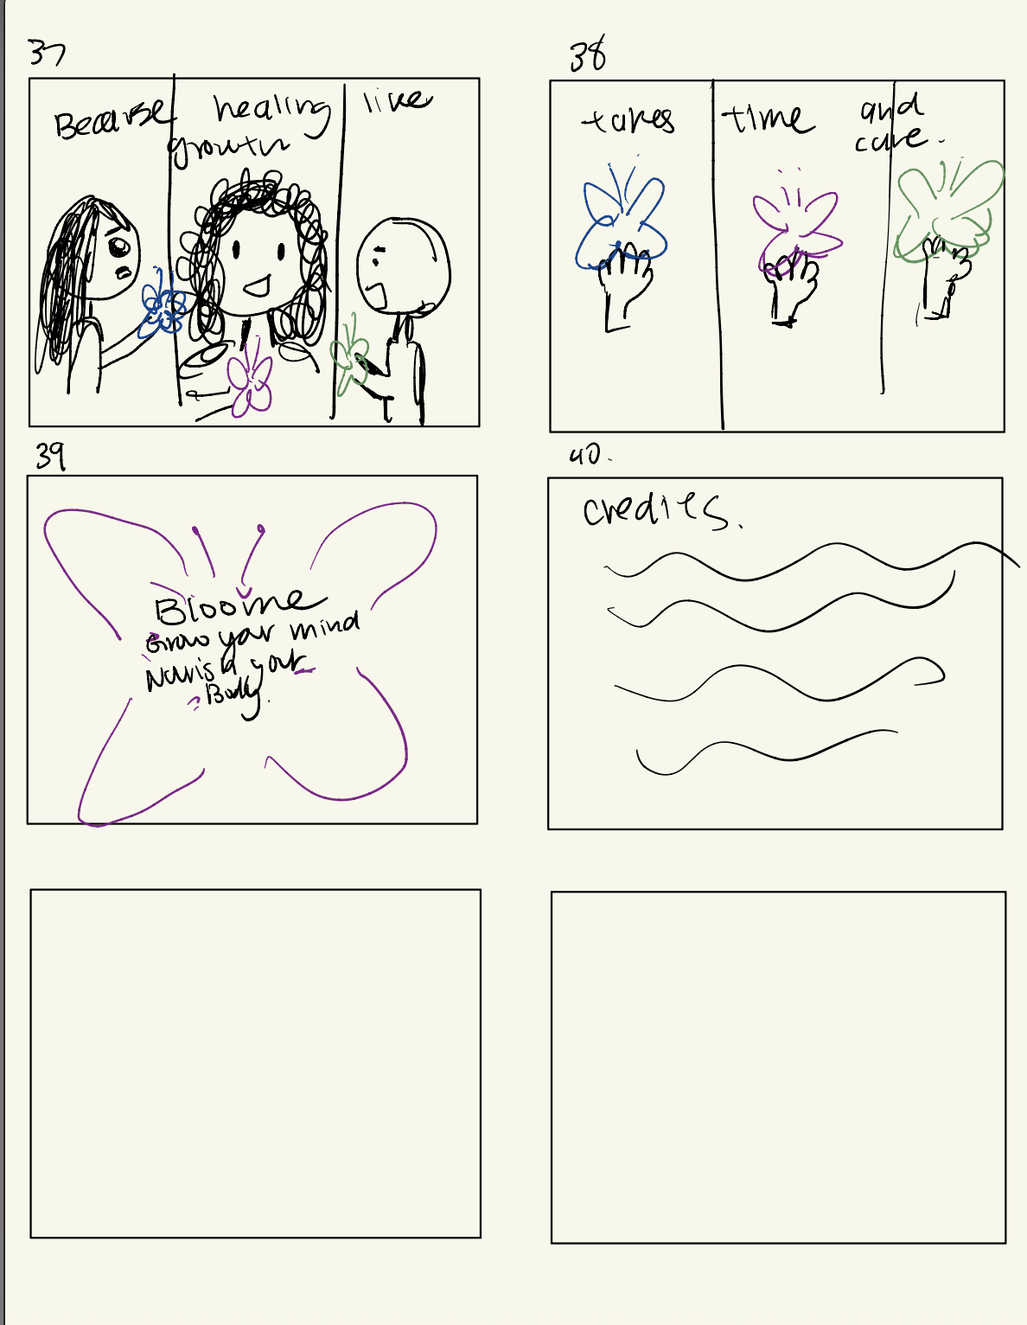
Resolution: comfort within community by recognizing their experiences.
Mood Change: lonely to feeling hope.

Slide 36

Concept Video !!!
https://youtu.be/TD30D-hQMCs

