Slide 1

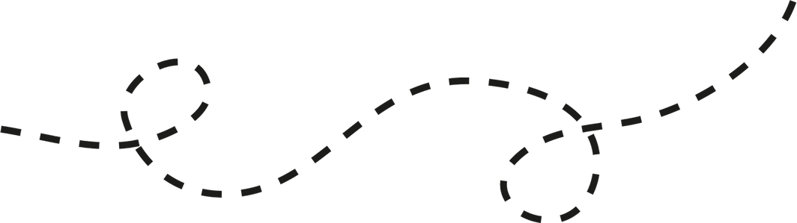

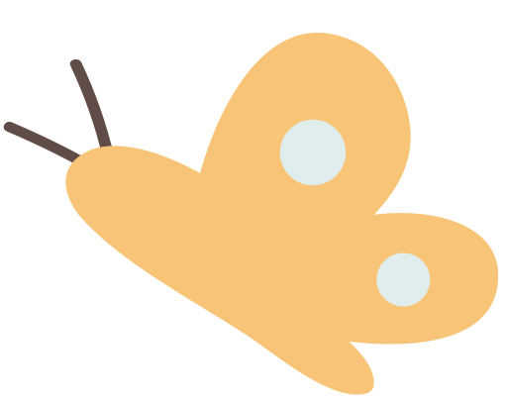
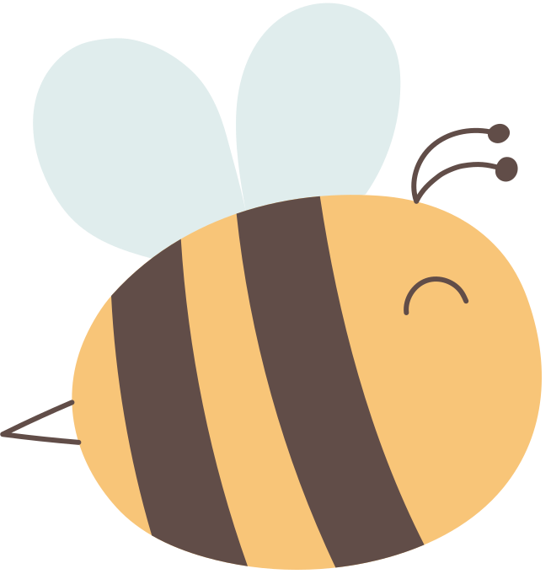
BlooME
Grow your mind
Nourish your body

Slide 2



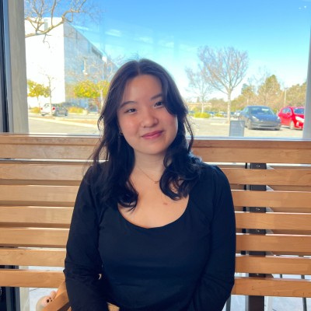
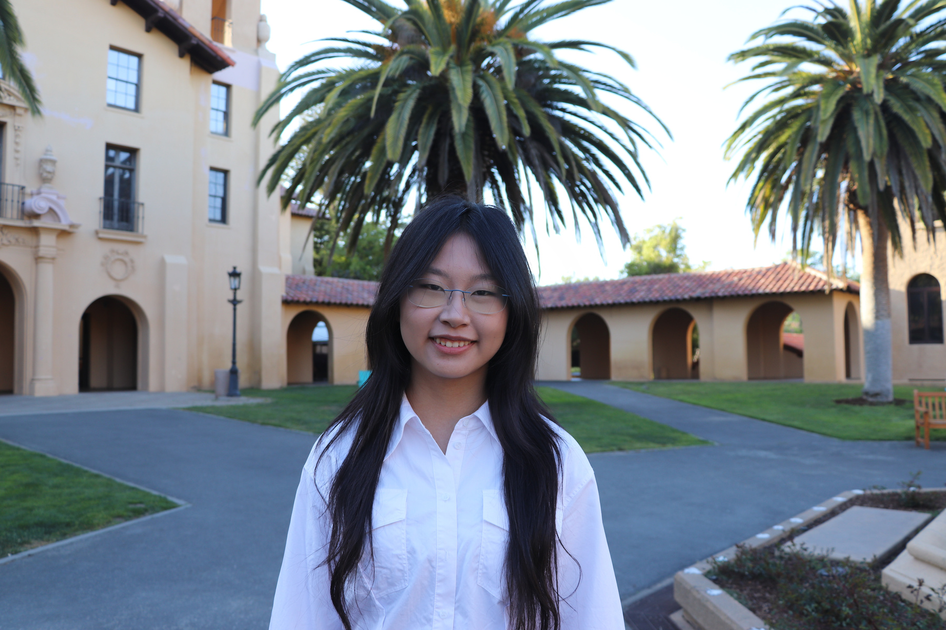

MEET JJYC
Jasmine X.
Yujen L.
Jade C.
Clare L.
Psychology & CS ‘27
Symbolic Systems ‘27
Symbolic Systems ‘27
Design ‘28

Slide 3
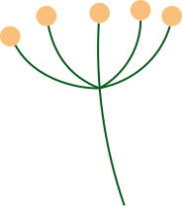

Problem
People struggling with food often keep their pain to themselves. They hesitate to reach out to friends, family, or professionals because they feel a persisting anxiety in being a burden to others, and continue to live with their guilt around eating.

Slide 4


Solution
BlooMe is a peer-to-peer story-sharing app that pairs community warmth with daily structure. It also offers journaling prompts, a personal “butterfly sanctuary” to store encouraging messages, and meal reminders with affirmations to guide recovery routines.

Slide 5
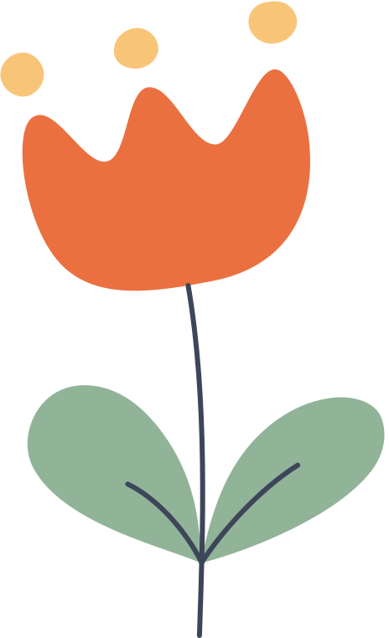

Value Proposition
  Growth: Healing is a journey of continuous inner expansion and blooming.
  Compassion: Approaches healing with gentleness, care, and understanding.
  Community: Fosters connection and shared support in the recovery journey.

Slide 6



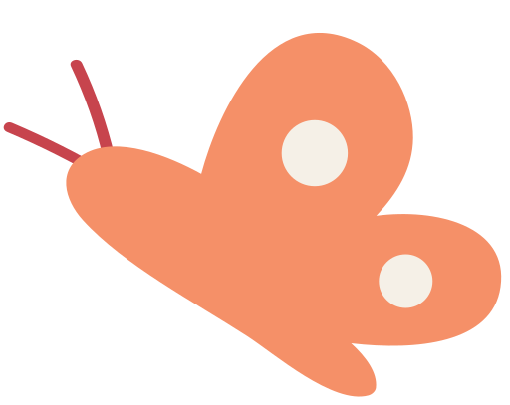
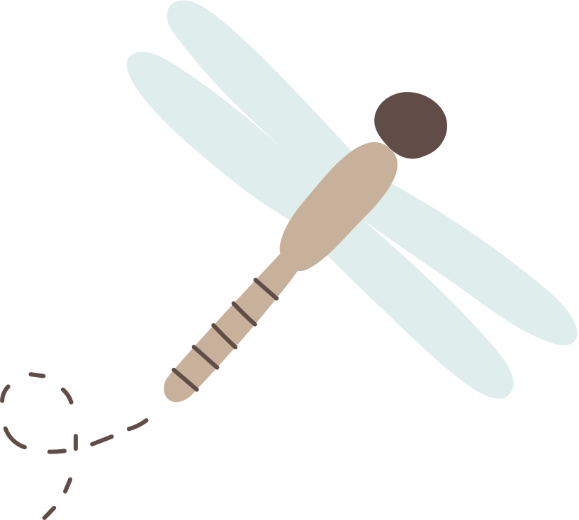
Outline of the Talk
1 Sketching Exploration
3 Low-fi
Prototype
5 Testing
Result
2 Selected
Interface
4 Testing
Methodology
6 Discussion

Slide 7

Sketching Exploration

Slide 8
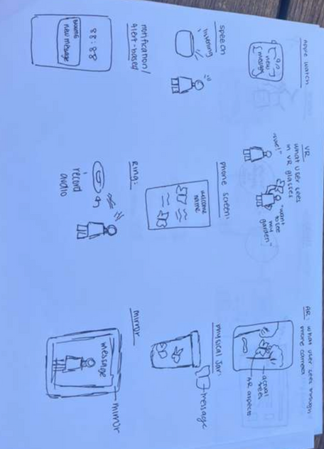
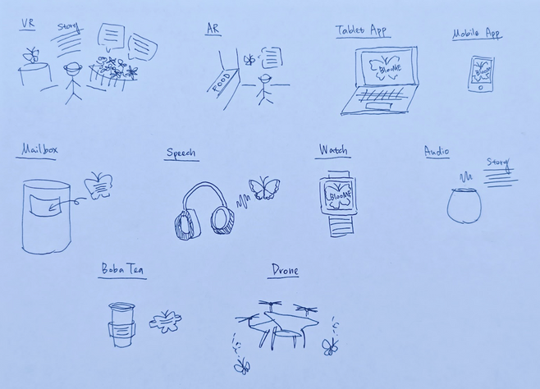
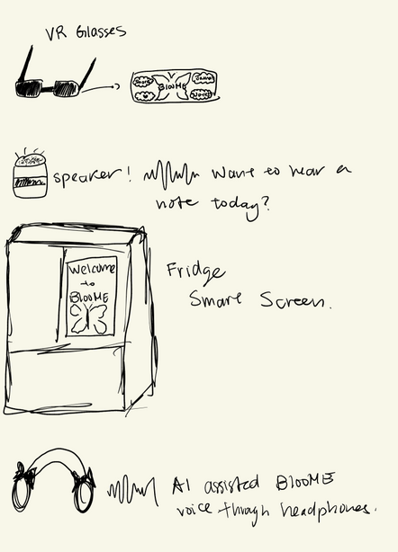
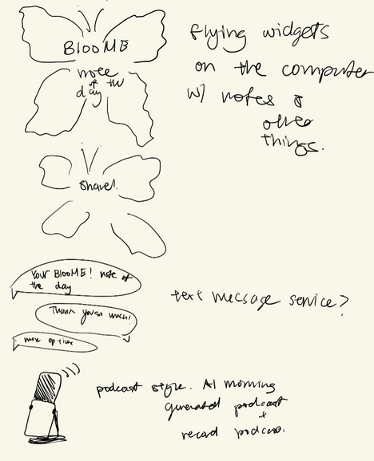
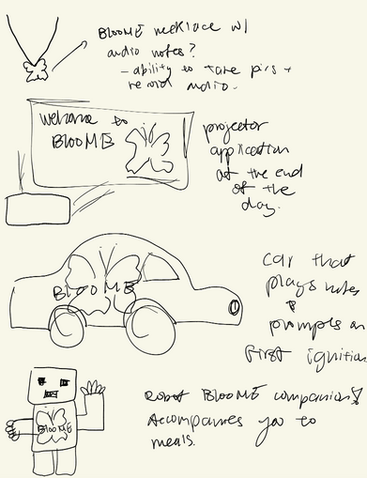
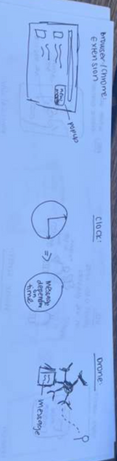

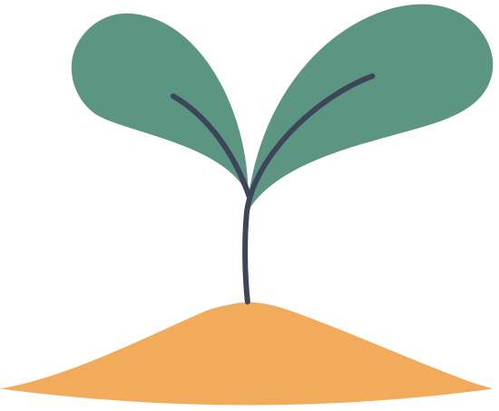

Solution Ideas

Slide 9
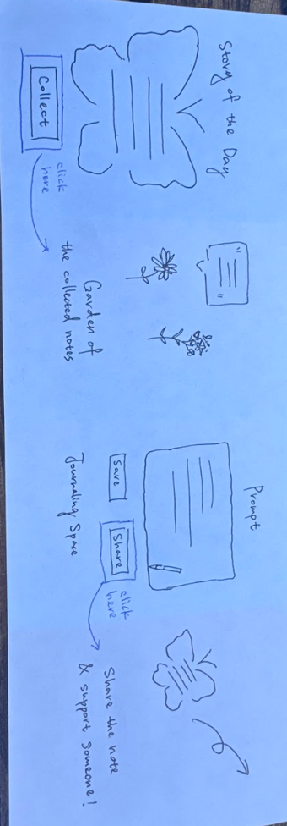
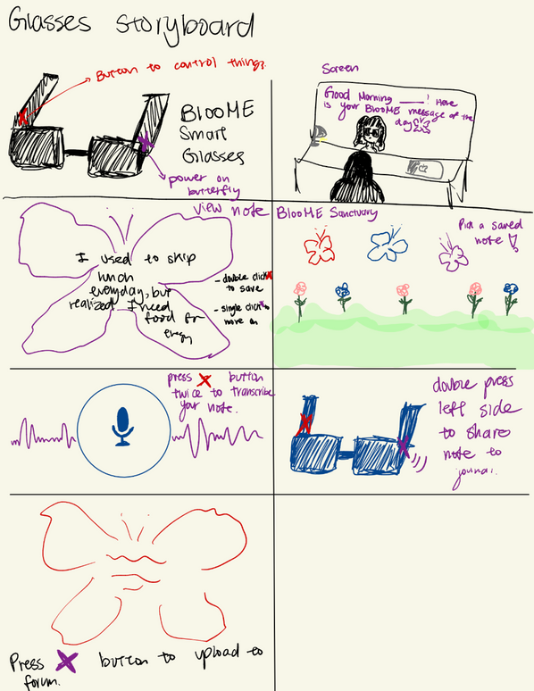
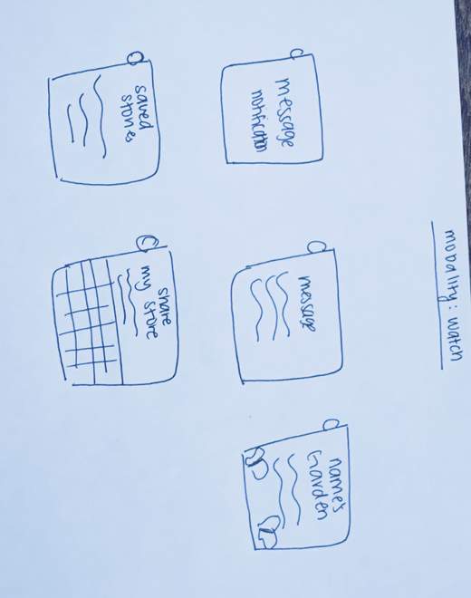
Concept Sketches
Watch
Phone
Glasses

Slide 10
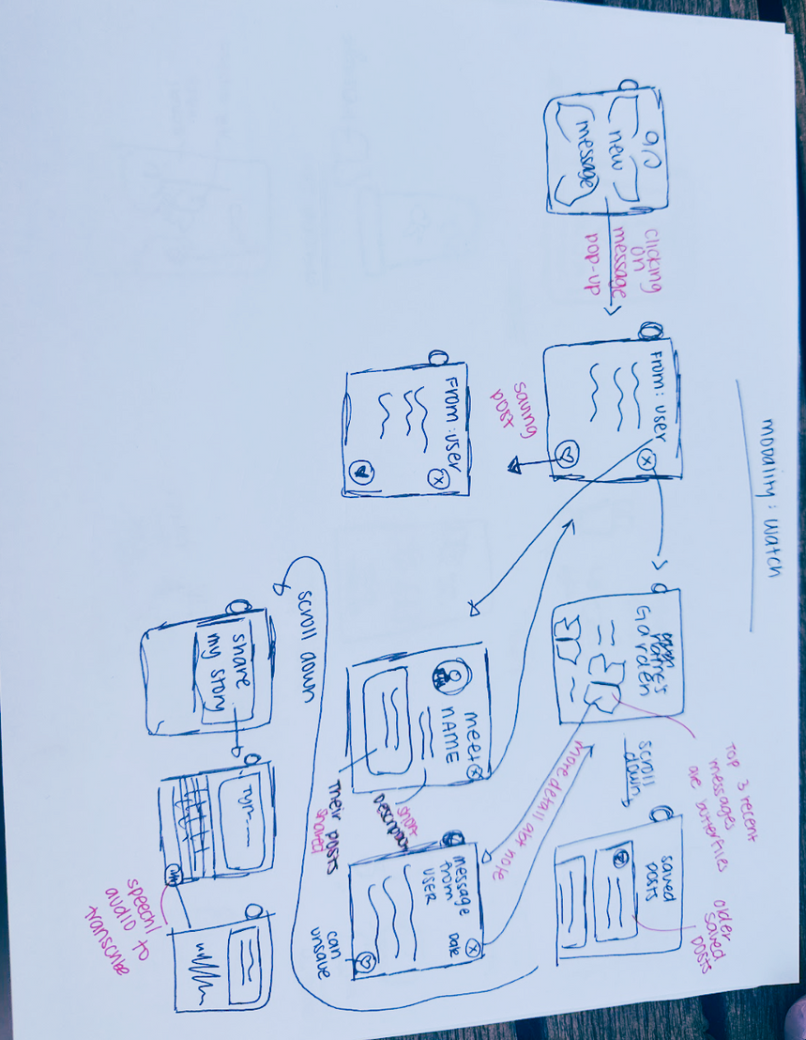
Realization 1: Watch App

Slide 11
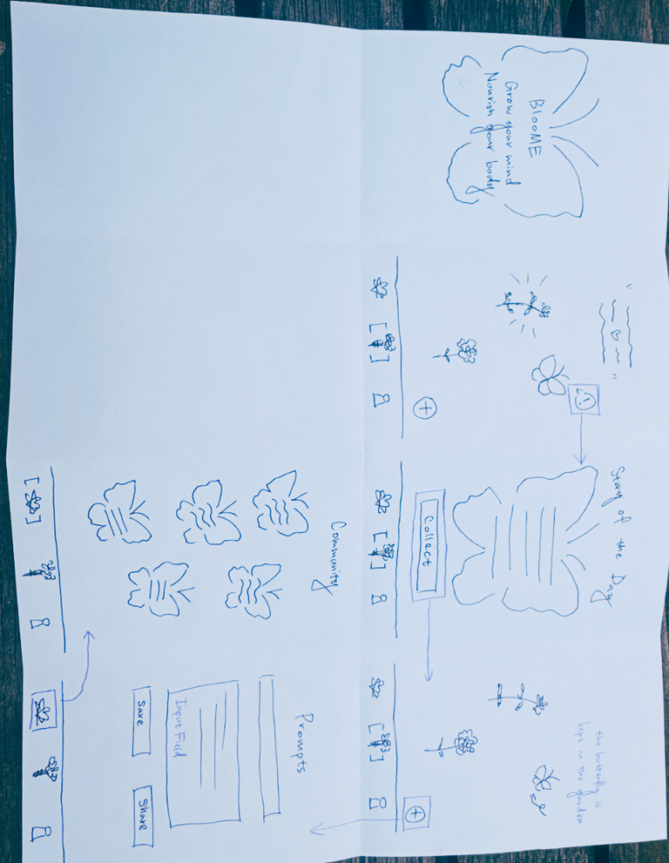
Realization 2: Mobile App

Slide 12
Selected Interface

Slide 13


Selected: Mobile App
Pros
Cons
Widely Adopted (91% > 21%)
Richer Design Space
Compatible Across Devices
Notification Easily Missed
Phone Use Habit Dependent
Distractive

Slide 14
Selected: Mobile App
Pros
Cons
Widely Adopted (91% > 21%)
Richer Design Space
Compatible Across Devices
Notification Easily Missed
Phone Use Habit Dependent
Distractive
We prefer to build an immersive reflective experience with greater accessibility rather than just surface-level interaction.

Slide 15
Low-fi Prototype

Slide 16
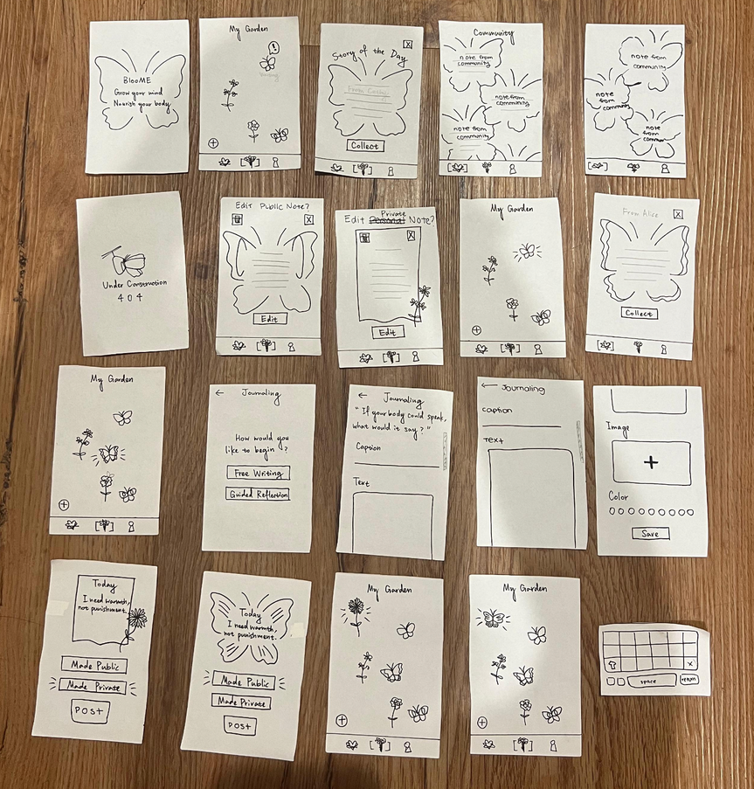
Construction
  Paper-based
  Scrollable
  Explorable

Slide 17
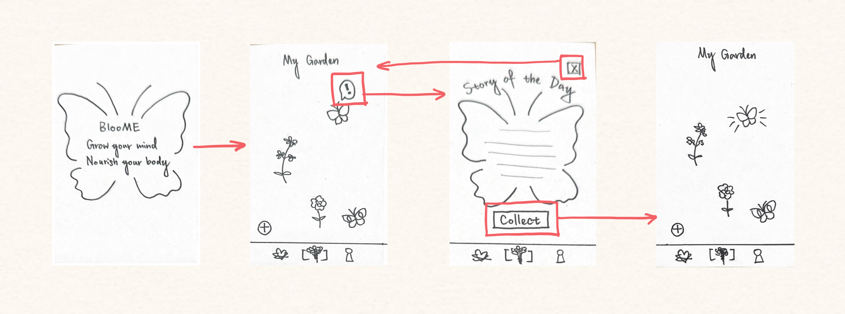
Easy Task
Collect Story of the Day

Slide 18
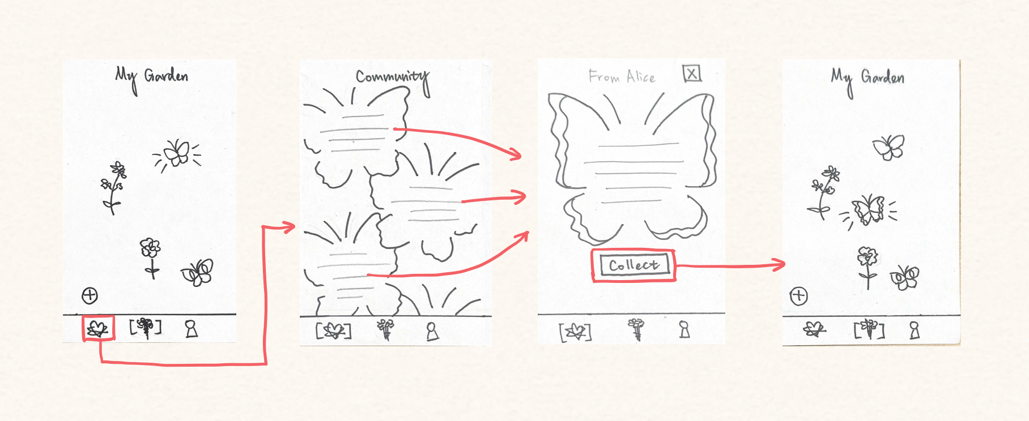
Moderate Task
Collect a story from Community

Slide 19
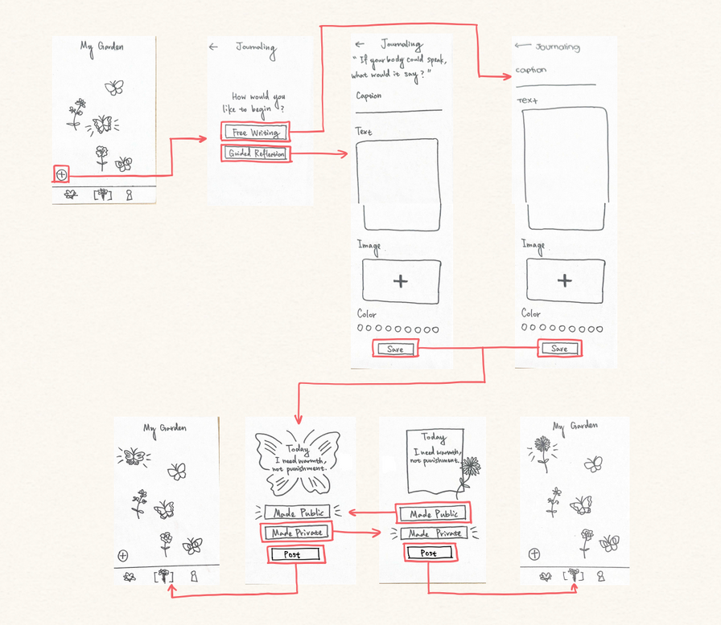
Hard Task
Post your own story

Slide 20
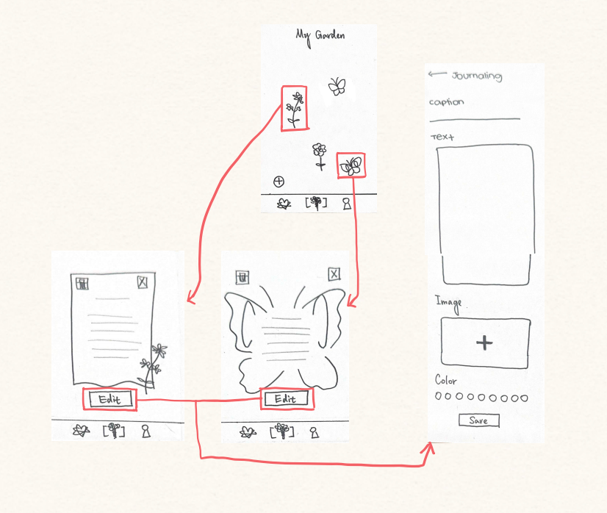
Exploration
Check and edit your own post

Slide 21
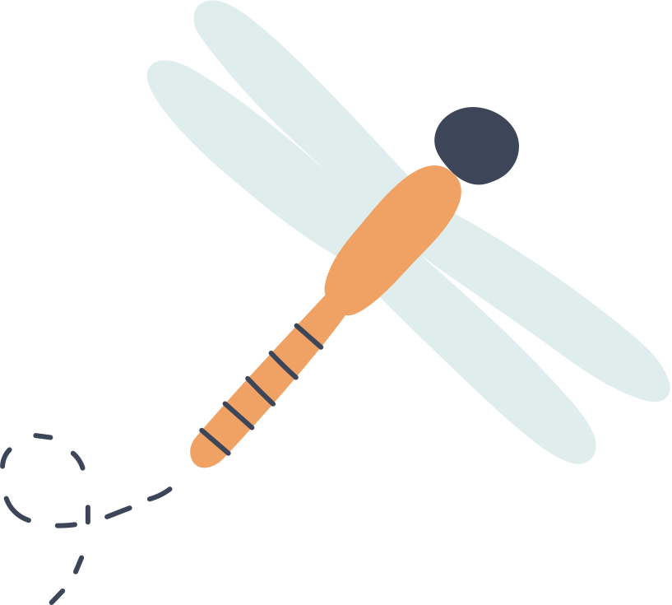
Testing
Methodology

Slide 22
Environments & Roles
Locations
Blue Bottle, Verve, Starbucks, Tongsui, Bar Zola
Roles
Notetaker: Yujen, Clare, Jasmine
Facilitator: Yujen, Jade, Jasmine, Clare
Computer: Jade, Clare
No Compensation given.

Slide 23

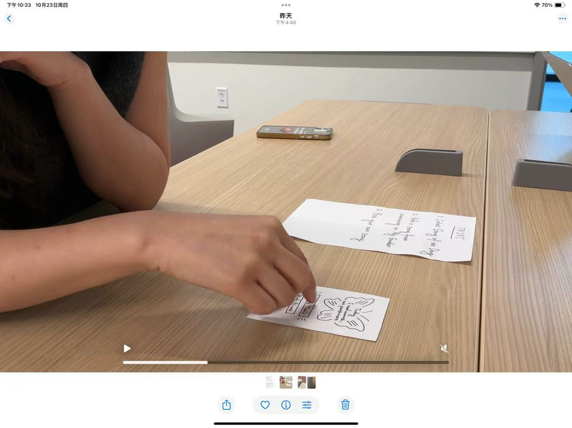
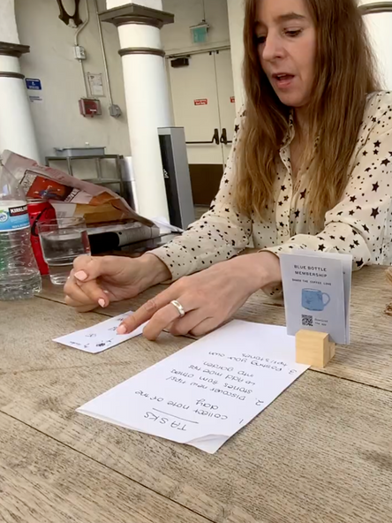
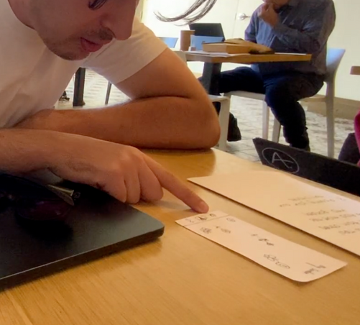
Participants
Pamela
Californian Woman
Early 40s
CEO & Counselor
Larry
Australian Man
Early 30s
Rainey
Asian Woman
Mid 20s

Slide 24
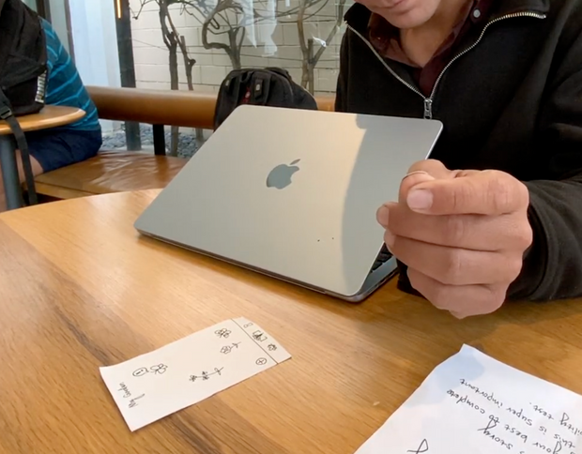
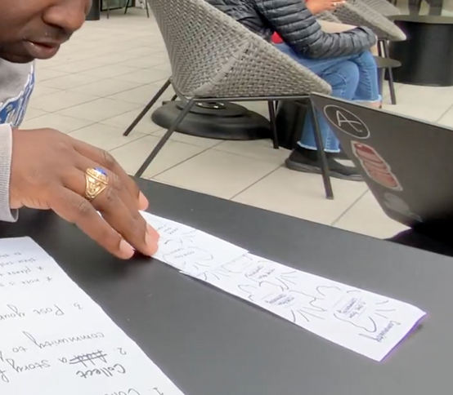
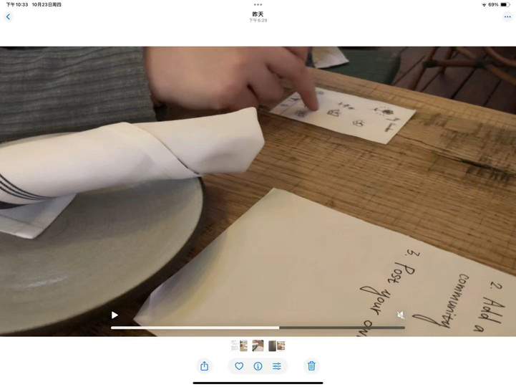
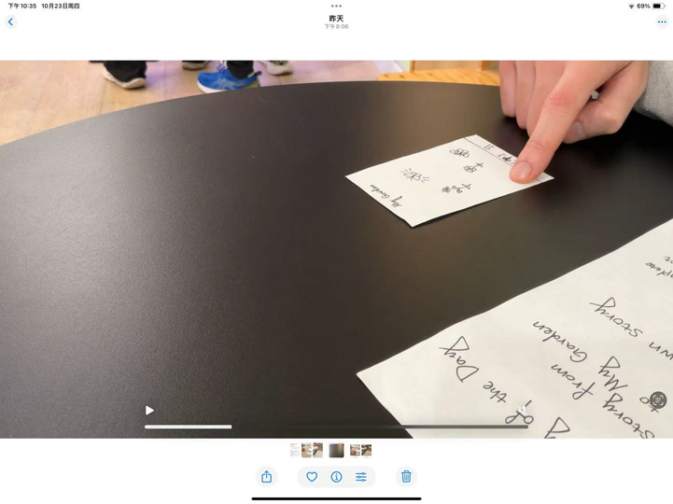
Participants
Paris
Asian Women
Late 20s
Brandon
Californian Man
Mid 20s
Chai
Man
Works in Tech
Early 40s
Cory
Californian Man
Early 30s

Slide 25
Procedure
  Introduce the context of the problem space and our testing purpose
  Ask them to complete the tasks at their best and speak aloud their thinking process
  Show them the task instructions and our prototype
  Record the testing process for data analysis
  Ask for qualitative feedback

Slide 26
Usability Goals
Easy to use?
Intuitive to use?
fun to use?

Slide 27

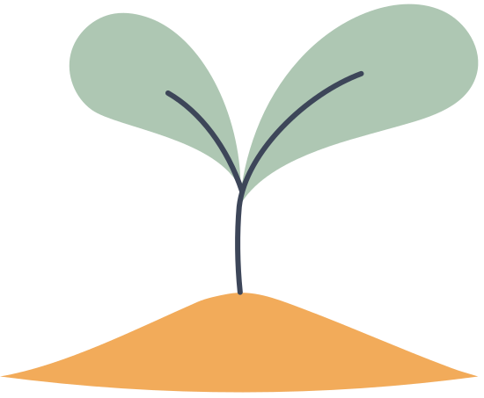
Usability Goals
Efficiency
Enjoyment
Effectiveness
Time spent on each task
Qualitative
feedback
# of misclick

Slide 28
Testing Result

Slide 29
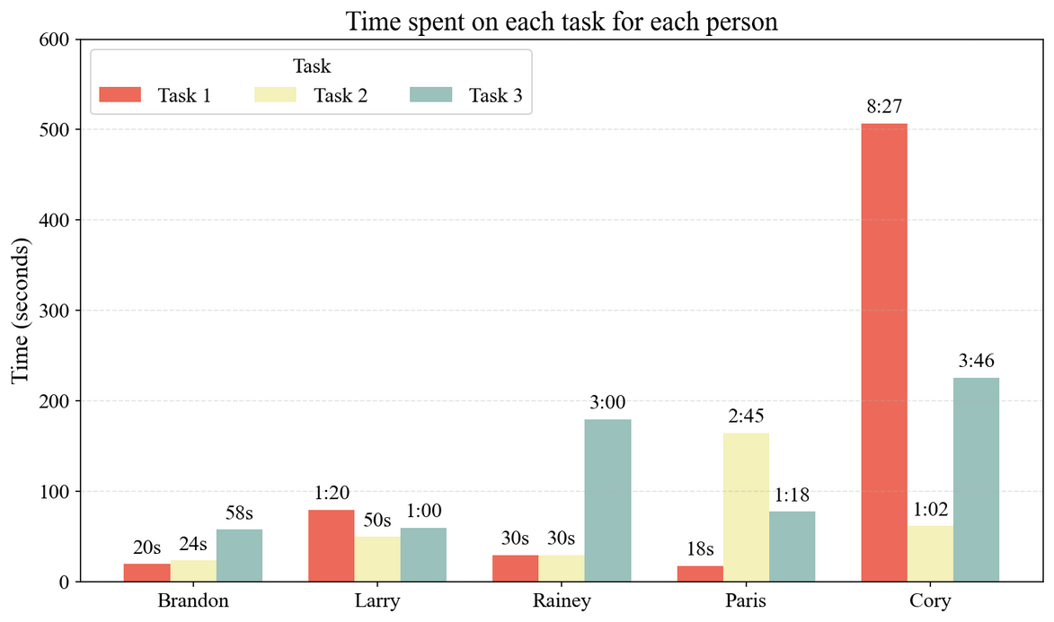

Bottom-line Data

Slide 30
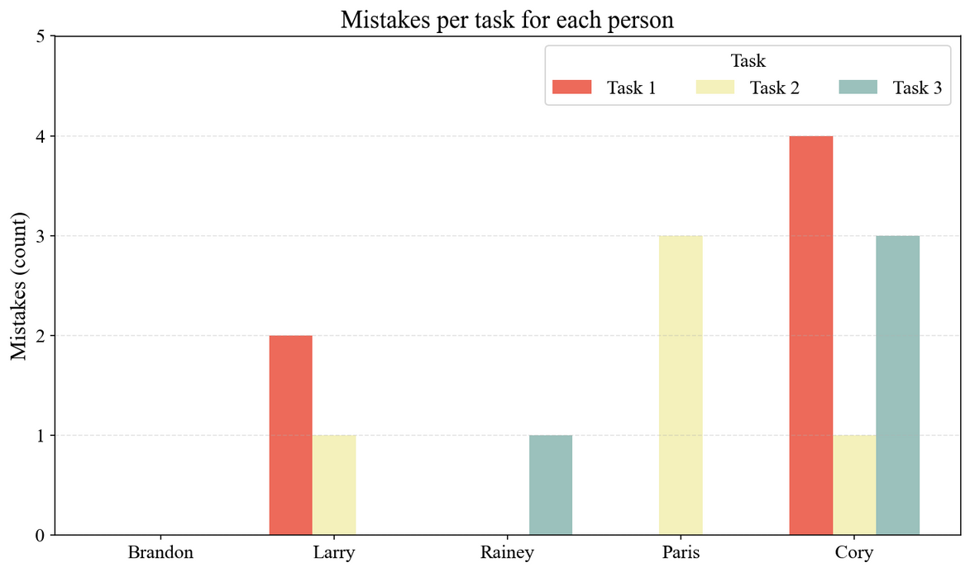
Bottom-line Data

Slide 31


Usability Goals
Efficiency
Time spent on each task

Slide 32

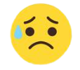

Usability Goals
Efficiency
Effectiveness
Time spent on each task
# of misclick

Slide 33


Usability Goals
Efficiency
Enjoyment
Effectiveness
Time spent on each task
Qualitative
feedback
# of misclick

Slide 34

Process Data
  Half of the people started with the exclamation mark butterfly (task 1), while the other half started with exploring.
  Task 2 & Task 3 generally went smoothly.
  For those who chose to explore other icons, Task 1 led to the most confusion.

Slide 35
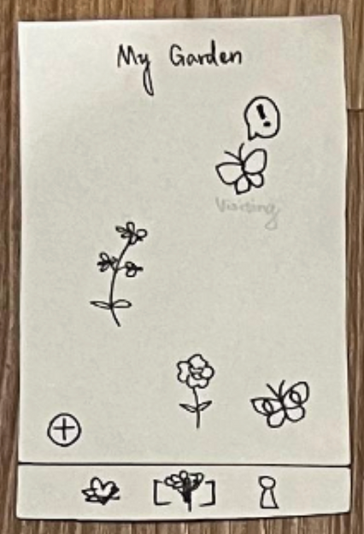


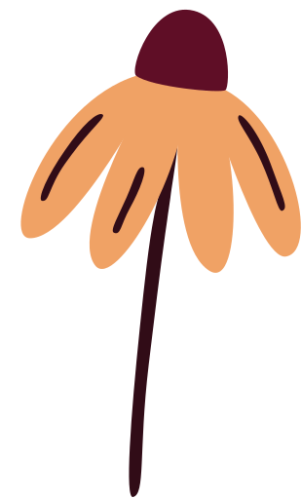
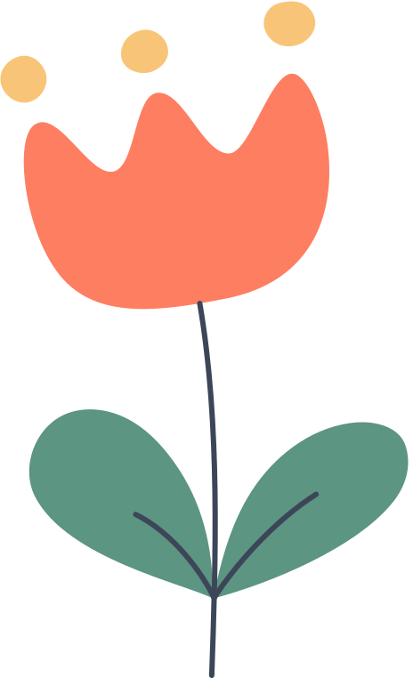
Task 1 Reflection
Collect Story of the Day
Severity 3
  Without guidance, people need to figure out the meaning of all butterflies/flowers themselves.

Slide 36
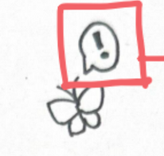
Task 1 Reflection
Collect Story of the Day
Severity 2
  The arrangement of flowers/butterflies needs to be more organized for searching
  Need to separate saved butterflies from other people from my public butterflies
Severity 1
  The attractiveness of the notification (exclamation mark) depends on the person.

Slide 37
Task 2 Reflection
Collect a story from Community
Severity 1
  Dragging butterflies from the community to the garden feels intuitive.
Severity 0
  Simplicity is good for people struggling.

Slide 38
Task 3 Reflection
Check and edit your own post
Severity 3
  “People struggling need more guidance and warm sentences along their journey.”
Severity 2
  Should have the date and time of the post.
Severity 0
  “Technology is only a tool, and you need the heart and humanity.”

Slide 39
Surprise & Summary
Disparities in how people perceive the attractiveness of icons & interpret the metaphoric icons (flowers & butterflies) → Need for tutorial in onboarding.

Slide 40
Surprise & Summary
Common icons (add/exclamation mark) are more intuitive for people to understand because they are familiar with them.

Slide 41
Surprise & Summary
Accessibility should be considered (people who are not good at using apps or with visual impairments).

Slide 42
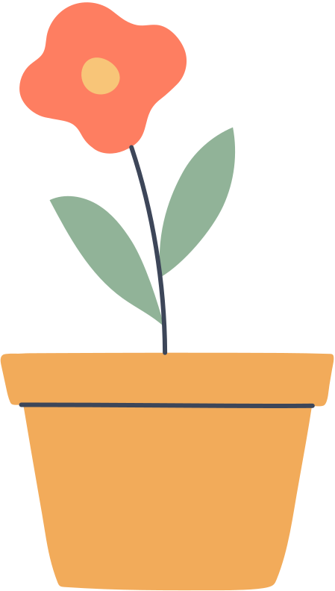
Discussion

Slide 43

Implications
  Design layout & arrangement of the main page will be reconsidered
  Data storage to ensure longevity & engagement.
  Guidance from the tutorial & daily structure to support people.
  Making the app more accessible; Being aware of different needs.

Slide 44
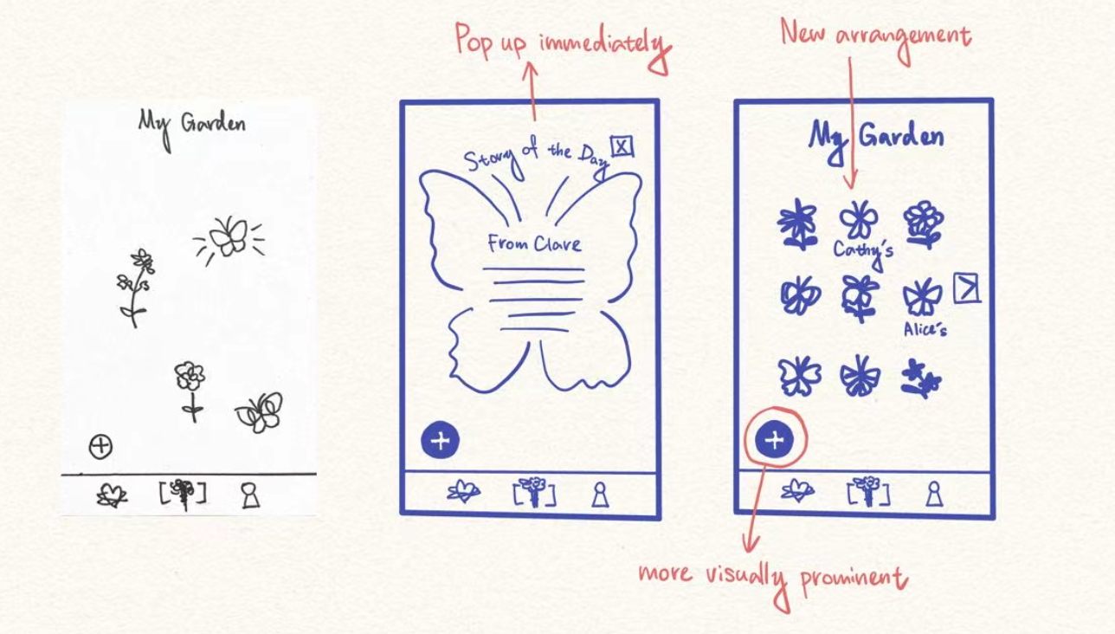
Future Change

Slide 45
Limitations
  Did not simulate the entire onboarding and could not reveal how people go through the garden creation
  The Account icon was not implemented, but it did attract people.
  The drawing may lead people to interpret icons in other ways.

Slide 46
Q & A

Slide 47
Appendix

Slide 48
Mobile App
Pros
Cons
  More functionality that we are able to add.
  Many people know how to use mobile apps (it is intuitive in our day and age).
  More high-fidelity features and space for aesthetics.
  Bigger screen, can adapt to tablets, computers, and phones. More variety and accessibility
  Notifications can be easily missed for people who aren’t constantly on their phones.
  Dependent on screen engagement and how often the user is on the phone
  Users often open apps while multitasking, so emotional or reflective experiences can be broken by external noise or distractions.
  Ergonomics: people don’t have the best posture when using phones, and eye health could decrease.

Slide 49
Watch App
Pros
Cons
  More mobile, wearable and light
  Can access at any time easily
  Easier to get attention and notify because it is on wrist
  Can emphasize use of audio and voice
  Small screen for user and designer space.
  Difficult to type
  Not accessible to all generations and socioeconomic brackets
  Less compatible if needed to share with other applications that don't have watch features (less interactive features)

Slide 50
Other Documents
All Testing Log

